Slide 1
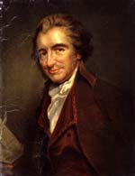
Thomas Paine: Architect of Cooperative Individualism
Written by Edward J. Dodson, M.L.A.
Notes:
This is a presentation on the Life and Legacy of Thomas Paine, the 18th Century’s Most Remarkable Champion of Liberty

Slide 2
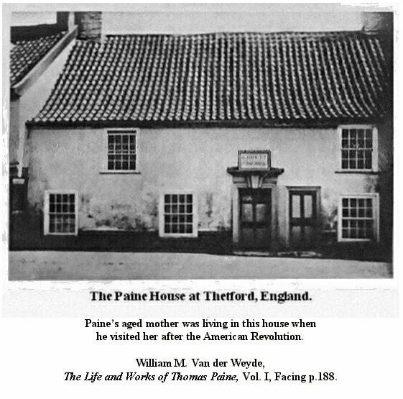
Notes:
He was born, “Thomas Pain” in Thetford, England, in 1737.

Slide 3
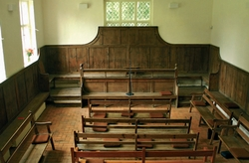
Notes:
His father was a member of the Society of Friends and a staymaker by profession. His mother was a member of the Church of England, which caused his father to be expelled from the Quakers because of his marriage outside his religious sect.

Slide 4
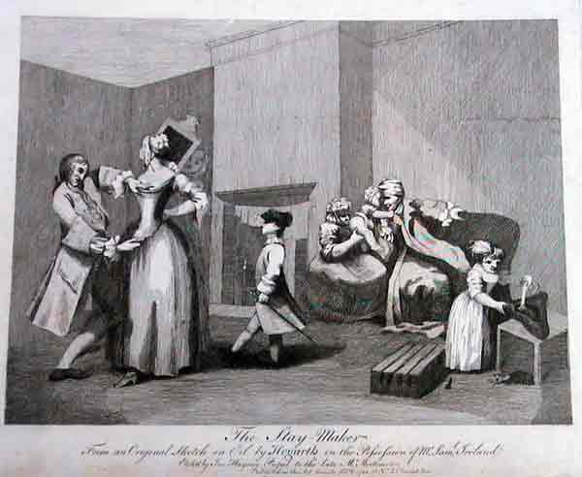
Notes:
Thomas was removed from school at age 12 to apprentice as a staymaker. Paine later wrote of his earlier education:

Slide 5
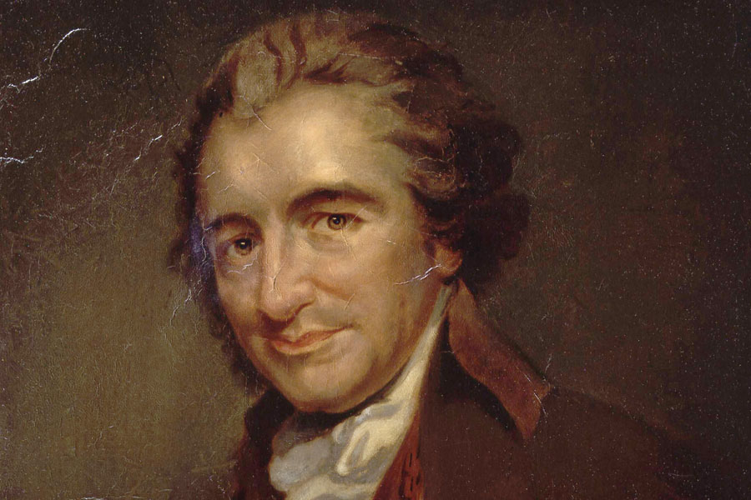
“My father being of the Quaker profession, it was my good fortune to have an exceeding good moral education, and a tolerable stock of useful learning.”
Notes:
“My father being of the Quaker profession, it was my good fortune to have an exceeding good moral education, and a tolerable stock of useful learning. …”

Slide 6
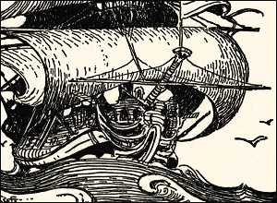
Notes:
In 1756, Thomas left home to join the crew of a privateer, the King of Prussia, serving until August, 1757.

Slide 7
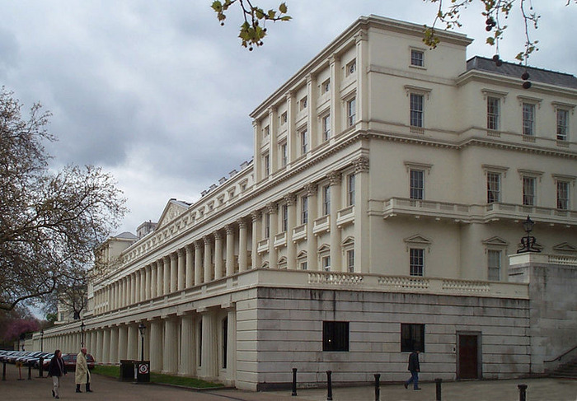
Notes:
In 1757 he arrived in London. With money earned from his share of King of Prussia’s booty, Paine pursued his interest in natural science, attending the Royal Society lectures and befriending other amateur scientists. As his funds depleted he moved to Sandwich and opened his own staymaking shop.

Slide 8
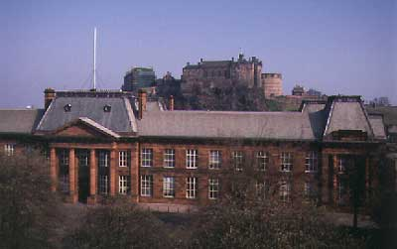
Notes:
Two years later, in 1759, he married Mary Lambert, who died the following year during premature birth of their child. Thomas then entered school to study mathematics, improve his knowledge of the English language and later to study for a position in the excise service – a collector of internal customs duties.

Slide 9

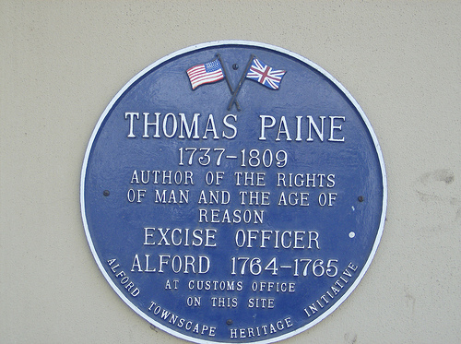
Notes:
In 1764 he was appointed an excise collector in the town of Alford, Lincolnshire. Sometime later he was accused of not inspecting goods before assigning the amount of tax due and dismissed.

Slide 10
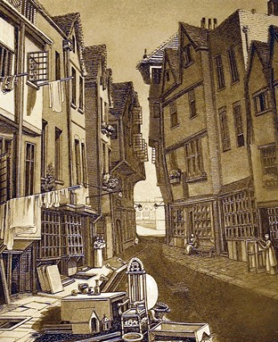
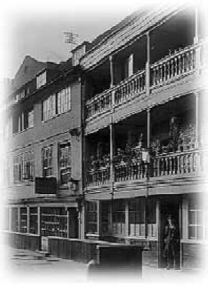
Notes:
He eventually moved to London in 1766, where he took a position as an English instructor at a small academy. However, he left after a short while, as teaching did not agree with him.

Slide 11
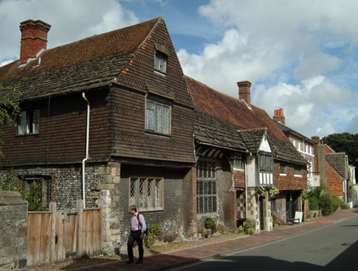
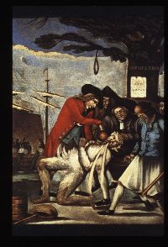
Lewes
Notes:
In 1768 he returned to the work as an excise collector, this time in the town of Lewes. Here, he joined an informal debating club.

Slide 12
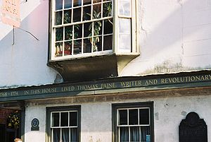
Notes:
In 1769, Paine’s landlord, owner of a tobacco shop, died. Paine stepped in to help the family run the shop. Then, for reasons of propriety, he married his dead benefactor’s eldest daughter, Elizabeth, a marriage he later said was never consummated.

Slide 13
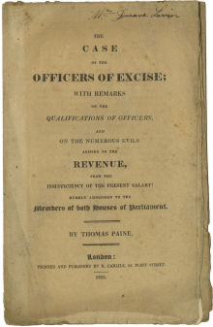
Notes:
His employment as an excise officer was difficult and paid little. In an effort to get the attention of the Members of Parliament, in 1772 Paine was asked by his fellow officers to put their case in writing. He wrote his first political pamphlet, The Case of the Officers of Excise.

Slide 14
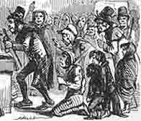
Notes:
The pamphlet talks about “general want” among the English people caused by increasing prices and the desperation that poverty imposes on people:

Slide 15
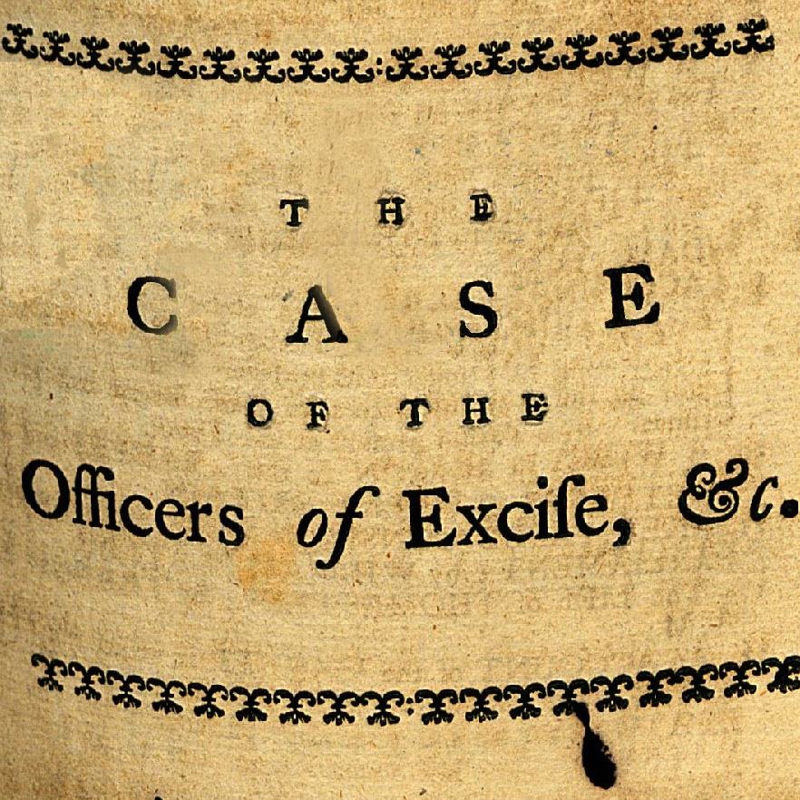
Notes:
For his trouble, Paine was eventually dismissed from his position, charged with being absent without permission to distribute pamphlets. Also, the tobacco shop soon failed and was sold at auction. He separated from his wife with 35 pounds as a financial settlement.

Slide 16
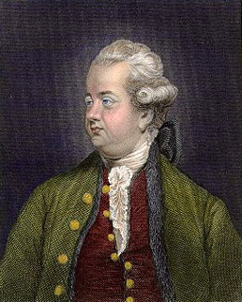
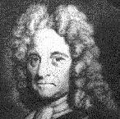
Edward Gibbon
John Bevis
Notes:
Paine now wandered, searching for some meaning to his life. In 1772 he befriended the mathematician George L. Scott, who had been tutor to George III. And, through Scott, he was brought into a circle of intellectuals that included Edward Gibbon, astronomer John Bevis and …

Slide 17
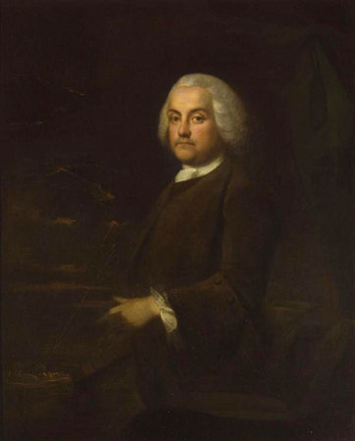
Benjamin Franklin
Notes:
… Benjamin Franklin. It is his association with Franklin that will change his life forever.

Slide 18
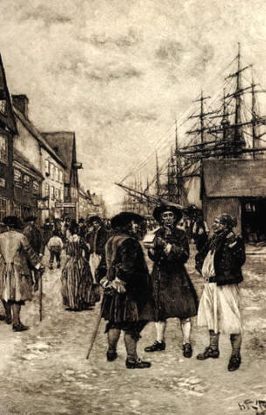
Notes:
Franklin convinced Paine that his talents would find ready employment in North America. So, in 1774, Paine departed from England. He traveled as a first-class passenger and with a letter of introduction from Benjamin Franklin. This raises speculation on my part whether Paine was, in fact, enlisted by Franklin to convey messages to leading colonials that Franklin could not without risk of arrest by British authorities.

Slide 19
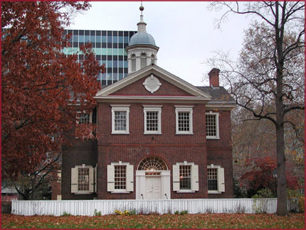
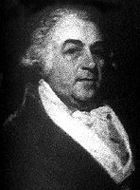
Richard Bache
Notes:
Paine became quite ill on the ship and was bedridden for almost two months after arriving in New York. In the Fall, he finally made his way to Philadelphia, where he immediately called upon Franklin’s son-in-law, Richard Bache.

Slide 20
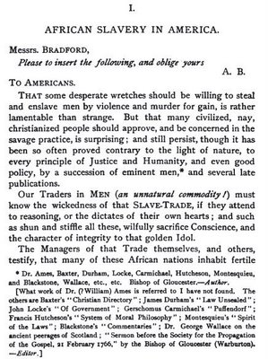
Notes:
One of his first essays, written in 1774 and published early in 1775 in the Pennsylvania Journal and the Weekly Advertiser, attacked the institution of slavery. He pointed to the moral conflict of the American position:

Slide 21
“That some desperate wretches should be willing to steal and enslave men by violence and murder for gain, is rather lamentable than strange. ...”
Notes:
“That some desperate wretches should be willing to steal and enslave men by violence and murder for gain, is rather lamentable than strange. ...”

Slide 22
“But that many civilized, nay, Christianized people should approve, and be concerned in the savage practice, is surprising; and still persist, though it has been so often proved contrary to the light of nature, to every principle of Justice and Humanity.”
Notes:
“But that many civilized, nay, Christianized people should approve, and be concerned in the savage practice, is surprising; and still persist, though it has been so often proved contrary to the light of nature, to every principle of Justice and Humanity.”

Slide 23
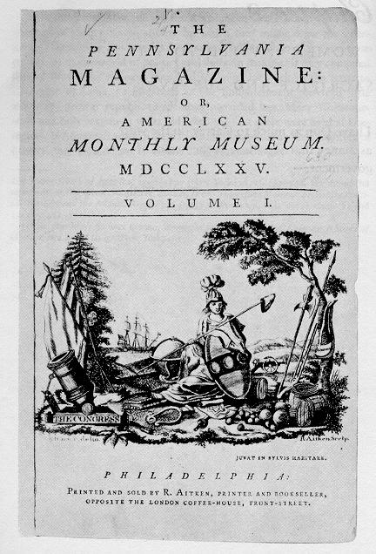
Notes:
As an indication of Franklin’s influence and Paine’s abilities, he soon secured the position of editor of the Pennsylvania Magazine. As was common for this era, he wrote under several pseudonyms.

Slide 24
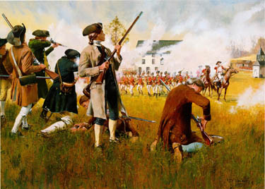
Notes:
Paine was now in the thick of events erupting around him. British forces in Boston anticipating violence, sought to deny the militia ammunition stored at Concord. The result was the skirmish between the so-called Minute Men and British troops at Lexington.

Slide 25
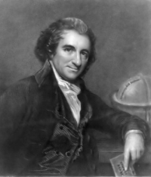
Notes:
In July, in an essay in the Pennsylvania Magazine, Paine referred to the conflict as a defensive war rather than as a revolution or rebellion.

Slide 26
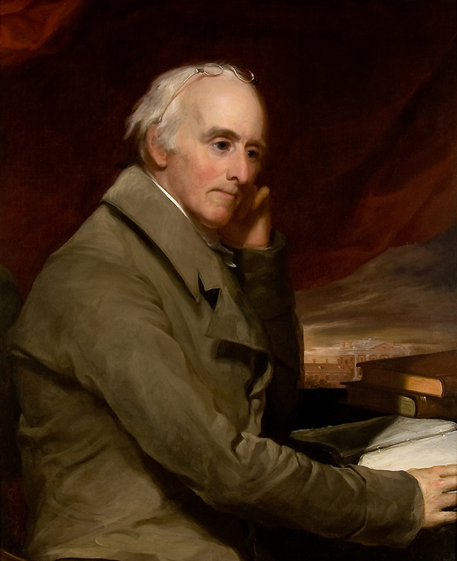
Benjamin Rush
Notes:
With the conflict on the battlefield going poorly, Benjamin Rush approached Paine to work on a pamphlet that would explain to the colonials what was at stake in the conflict.

Slide 27
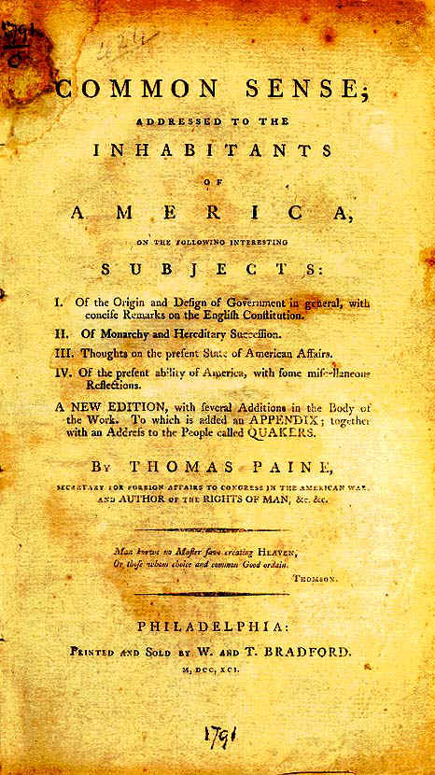
Notes:
The result, late in 1775, was Common Sense, published anonymously, of course, because it was a treasonous document in British eyes. Paine wrote that the purpose of the pamphlet was to:

Slide 28
“… rescue man from tyranny and false principles of government, and enable him to be free.”
Notes:
“rescue man from tyranny and false principles of government, and enable him to be free.”

Slide 29
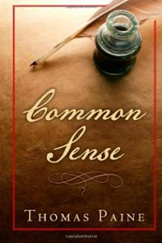
Notes:
He attacked hereditary rule and monarchy and called for a representative system of government, a republic with a unicameral legislature, frequent elections and a written constitution”

Slide 30
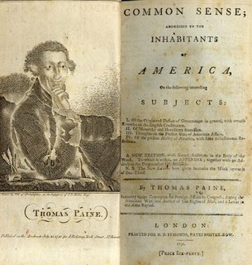
Notes:
An estimated 120,000 copies of Common Sense were sold in just a few months, some 500,000 in the first year. Eventually, the pamphlet was produced in twenty-five editions that first year. Paine donated his royalties from Common Sense to help fund the Continental army.

Slide 31
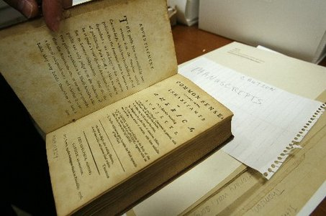
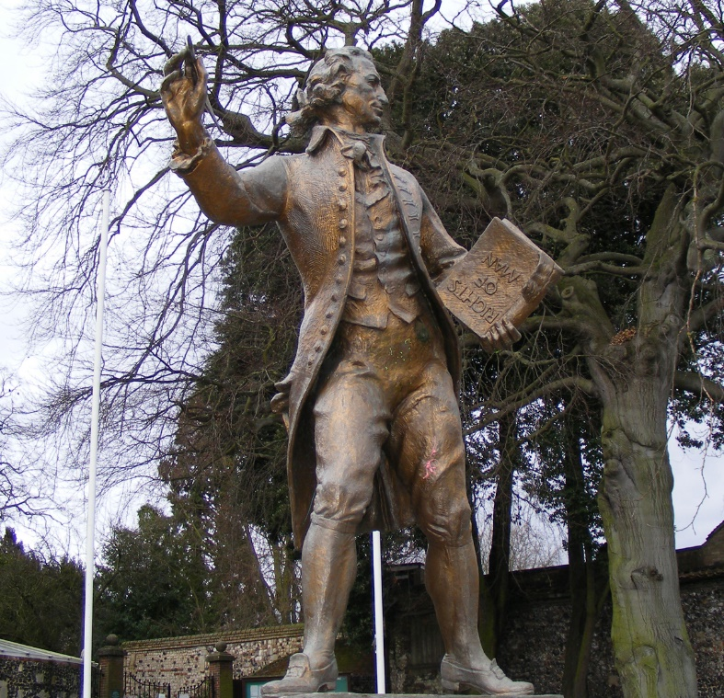
Notes:
Common Sense quickly made its way across the Atlantic, where English radicals made sure their countrymen got to read Paine’s courageous pamphlet. British authorities responded by confiscation of the pamphlet and prosecution of any publisher who dared reprint it.

Slide 32
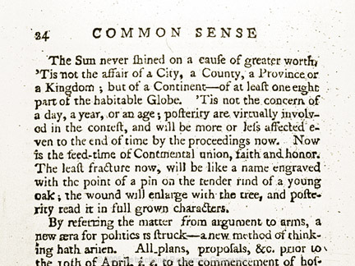
Notes:
What adds to the power of Paine’s arguments for independence was something very new and different. He declared that monarchy and aristocracy must be brought to an end.

Slide 33
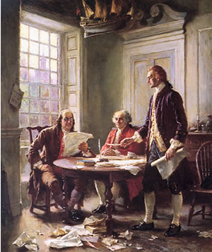
Notes:
Paine was one of the earliest to call for independence. His words helped bring others to the same conclusion. The Declaration of Independence was signed on the 4th of July, 1776.

Slide 34
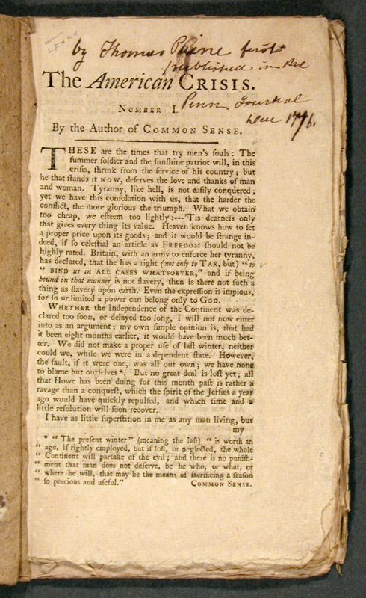
Notes:
Paine’s role now became that of a war correspondent, while serving as aide-de-camp to General Nathanael Greene. In December, Paine issued his first “crisis” paper, in which he delivered his famous challenge:

Slide 35
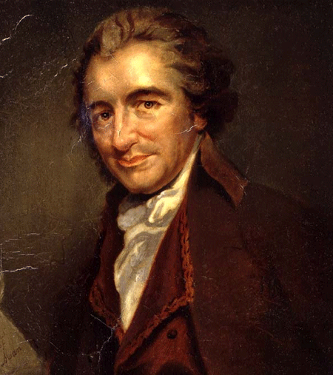
“These are the times that try men’s souls. The summer soldier and the sunshine patriot will in this crisis shrink from the service of his country; but he that stands it now, deserves the love and thanks of man and woman. Tyranny, like hell, is not easily conquered; yet we have this consolation with us, that the harder the conflict, the more glorious the triumph. ...”
Notes:
“These are the times that try men’s souls. The summer soldier and the sunshine patriot will in this crisis shrink from the service of his country; but he that stands it now, deserves the love and thanks of man and woman. Tyranny, like hell, is not easily conquered; yet we have this consolation with us, that the harder the conflict, the more glorious the triumph. …”

Slide 36
“…What we obtain too cheap, we esteem too lightly; ‘tis dearness only that gives everything its value. Heaven knows how to put a proper price upon its goods; and it would be strange, indeed, if so celestial an article as freedom should not be highly rated.”
Notes:
“... What we obtain too cheap, we esteem too lightly; ‘tis dearness only that gives everything its value. Heaven knows how to put a proper price upon its goods; and it would be strange, indeed, if so celestial an article as freedom should not be highly rated.”

Slide 37
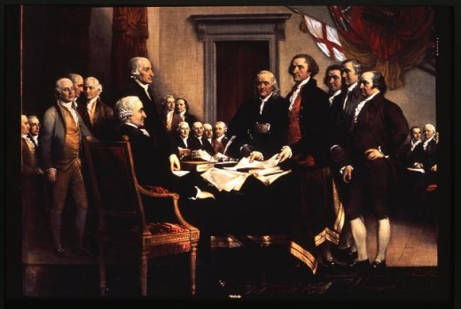
Notes:
In April, Paine was appointed secretary to the Committee for Foreign Affairs. He now decided he would record the history of the struggle for independence.

Slide 38
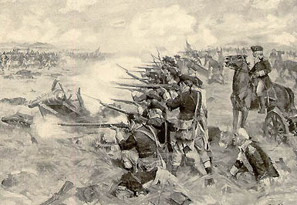
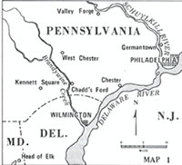
Notes:
Paine’s urgings took on an added importance as the year 1777 brought yet another defeat of Washington’s forces at the Battle of Brandywine, after which British forces occupied Philadelphia and the Congress was forced to flee. In his fourth crisis paper, Paine told his countrymen:

Slide 39
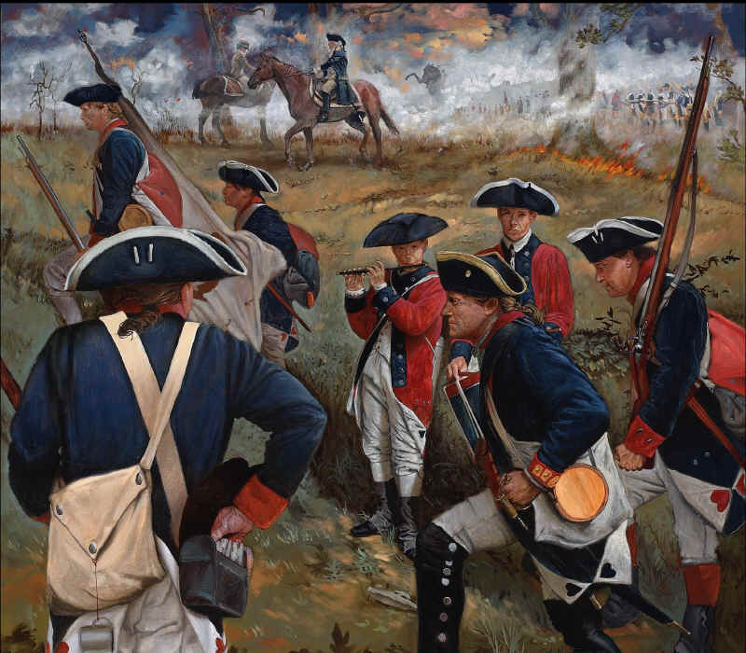
“The nearer any disease approaches to a crisis, the nearer it is to a cure.”
Notes:
“The nearer any disease approaches to a crisis, the nearer it is to a cure.”

Slide 40
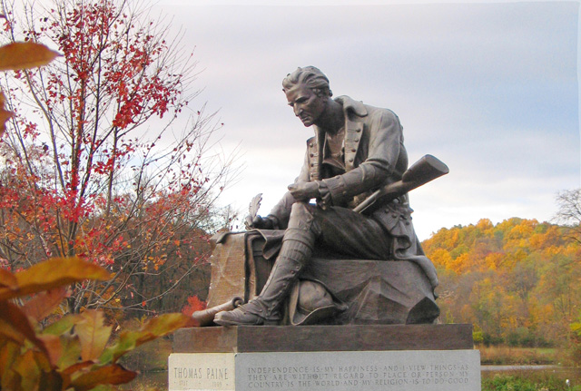
Notes:
Paine’s 1778 Crisis paper was addressed to the people of England, challenging the English claim to having created the highest order political system. He observed that Britain’s political system:

Slide 41
“… instead of civilizing, has tended to brutalize mankind.”
Notes:
“…instead of civilizing, has tended to brutalize mankind.”

Slide 42
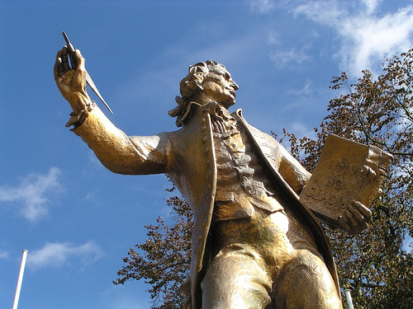
Notes:
He also disclosed his own sense of now becoming a world citizen. He writes:

Slide 43
“My attachment is to all the world, and not any particular part…”
Notes:
“My attachment is to all the world, and not any particular part...”

Slide 44

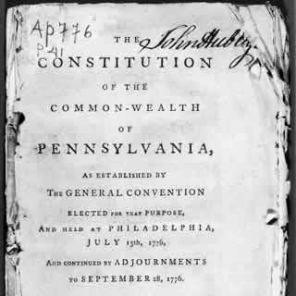
Notes:
Also, in 1778, Paine wrote a series of essays promoting a new constitution for Pennsylvania. Some years later, he reflected on the form of government that evolved:

Slide 45
“At the commencement of the revolution, it was supposed that what is called the executive part of a government was the only dangerous part; but we now see that quite as much mischief, if not more, may be done, and as much arbitrary conduct acted, by a legislature.”
Notes:
“At the commencement of the revolution, it was supposed that what is called the executive part of a government was the only dangerous part; but we now see that quite as much mischief, if not more, may be done, and as much arbitrary conduct acted, by a legislature.”

Slide 46
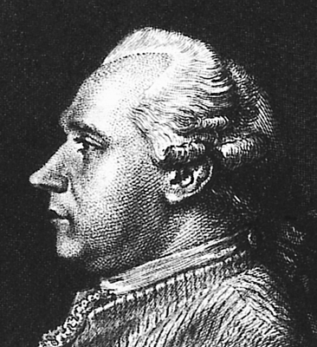
Silas Deane
Notes:
In the same year, Paine inserted himself in the middle of the “Silas Deane affair.” Deane had been recalled from France to explain huge debts incurred in the name of the Congress. Paine, having access to government documents, let Deane’s opponents know that goods Deane claimed were purchased were actually gifts provided by the French government.

Slide 47
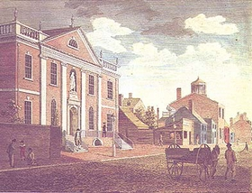
Notes:
For disclosing this secret information, Paine was forced to resign from his position as secretary to the committee. He was then hired by Owen Biddle to work as a clerk in Biddle’s Philadelphia business.

Slide 48
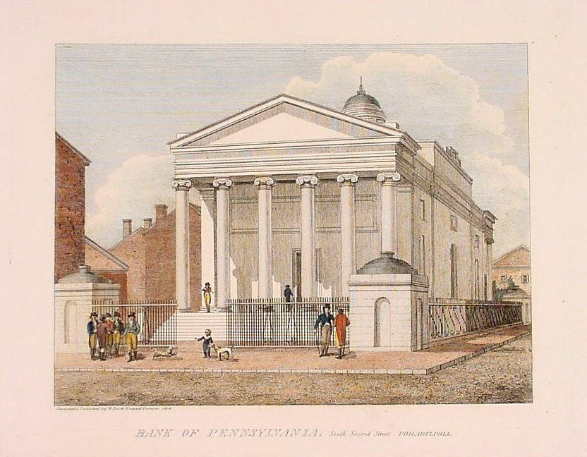
Notes:
Desperate for finances, a group of Patriots formed the Bank of Pennsylvania. The capital of the bank was to be used for loans made to the government for the war effort. Paine was one of the first to subscribe as a shareholder.

Slide 49
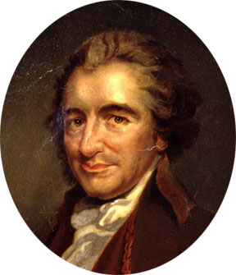
Notes:
Years earlier Paine wrote that a national debt bound the people together and was important for the war effort. What history reveals, however, is that few governments have paid for wars by taxing those who possess the most wealth – and, therefore, have the most to lose should a war be lost.

Slide 50
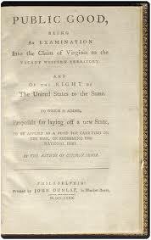
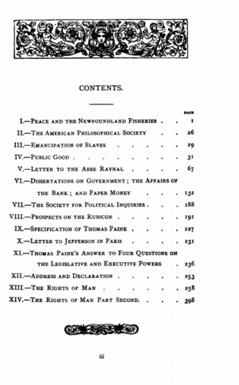
Notes:
In 1780, Paine turned his attention to the future. He provided his thoughts on how the frontier lands ought to be treated in the pamphlet, Public Good.

Slide 51

Notes:
He argued that all western lands – what was then the Northwest Territory – belonged to all the states collectively. Sale of these lands would, he stated, be an important source of income for the Congress.

Slide 52

Notes:
In recognition of some of the unresolved difficulties of governing the new nation, Paine also called for a convention to consider amendments to the Articles of Confederation.

Slide 53

Notes:
For Paine, the principles for creation of the just society are universal. He also believed they come to us from a Conscious Creator. Yet, destructively, we demonstrate our free will by consistently rejecting those principles in the promotion of narrow self-interest.

Slide 54

Notes:
Of interest is Paine’s use of initial capitals when writing ‘United States’. Were the states still sovereign and voluntarily joined together in confederation? Or, was state sovereignty relinquished in the creation of one nation -- the United States? Somewhat hopefully, perhaps naively, he observed:

Slide 55


“The times that tried men’s souls are over – and the greatest and completest revolution the world ever knew, gloriously and happily accomplished.”
Notes:
“The times that tried men’s souls are over – and the greatest and completest revolution the world ever knew, gloriously and happily accomplished.”

Slide 56

Notes:
After prolonged negotiations, the Treaty of Paris was signed in November of 1783, officially ending the war. Paine took the opportunity to pen A Supernumerary Crisis, calling for a strengthening of the union between the states. On a personal level, he petitioned the Congress for a pension for his war-time services. A committee recommended Paine be offered the position of official historian.

Slide 57

Notes:
In June of 1783 the New York legislature awarded Paine a farm in New Rochelle – a property confiscated from a departed Tory. He also acquired a small residence in Bordentown, New Jersey, where he spent the winter of 1783-84.

Slide 58

Notes:
Madison and Washington did their best to have the Virginia legislature award land to Paine but a decision was several times postponed. In 1785, Pennsylvania awarded him five hundred pounds, with the prospect of a higher award later on. Also in 1785, he was awarded $3,000 by the U.S. Congress for his services during the war. Paine biographer, David Freeman Hawke, observes that:

Slide 59


“… from a nation unaccustomed to honoring literary gentlemen with cash rewards Paine had received more than almost any writer would ever receive from a national or state government in American history.”
Notes:
“[f]rom a nation unaccustomed to honoring literary gentlemen with cash rewards Paine had received more than almost any writer would ever receive from a national or state government in American history.”

Slide 60


Notes:
In 1785, in response to an escalating fight over the granting of a charter to the Bank of North America, he prepared a new pamphlet, Dissertation on Government; the Affairs of the Bank; and Paper Money.

Slide 61
Notes:
In this pamphlet, he attacked paper money issued by government and the requirement that citizens must accept this money in lieu of coinage. He did, however, express his support of paper money issued by private banks on the grounds that these notes could be accepted or rejected by individuals as they choose. The pamphlet was distributed to members of the Pennsylvania Assembly in February.

Slide 62

Notes:
Paine’s attentions now turned to engineering and his own design of a single-span iron bridge. Funding could not be raised for the project, so Paine decided he should return to Europe.

Slide 63
Iron Bridge over the River Wear - 1796
Notes:
A decade later, an iron bridge incorporating his experimental arch design was constructed at Sunderland, over the River Wear.

Slide 64



Lafayette
Notes:
By 1787, Thomas Jefferson had arrived in France to represent the United States. Paine and Lafayette frequently joined Jefferson in long discussions on every imaginable subject, including whether individuals possess natural rights.

Slide 65


Notes:
Paine argued that natural rights are those the individual can fully exercise without the aid of government; that men come together to form a civil society not to impose restraints on these rights but to protect them. Separate from these natural rights are civil rights that emerge out of any social compact, those “of personal protection, of acquiring and possessing property.” In other writings, Paine came to address the distinction between property in land and property in goods we produce.

Slide 66


Notes:
In 1789, unrest in France erupted into violence. The Bastille was taken in Paris, a People’s Army formed with Lafayette at its head. Food shortages resulted in a march on Versailles, where the royal stores were emptied.

Slide 67


Notes:
Paine wrote to Edmund Burke optimistically about the French Revolution; however, Burke saw nothing but the destruction of time-tested institutions and relationships in the wind. He decided to go on the offensive, producing Reflections on the Revolution in France, published in November of 1790.

Slide 68

Notes:
Paine’s response to Burke was completed in February 1791, and a few hundred copies were printed and sold. British authorities threatened the publisher, and all unsold copies were recalled. Paine found another publisher and wrote a new preface to a second edition.

Slide 69

Notes:
In May, Paine journeyed to France to visit Lafayette. While there, he began work on another book covering the nature of monarchy. This became the second part of a new edition of Rights of Man, published in February of 1792. In Britain, mere possession of the book was sufficient to bring charges of sedition and treason. Paine asks why people form societies, then answers the question himself:

Slide 70

“Man did not enter into society to become worse than he was before, nor to have fewer rights than he had before, but to have those rights better secured. His natural rights are the foundation of his civil rights.”
Notes:
“Man did not enter into society to become worse than he was before, nor to have fewer rights than he had before, but to have those rights better secured. His natural rights are the foundation of his civil rights.”

Slide 71

Notes:
In April of 1792, British authorities ordered Paine’s arrest on charges of treason; his publisher was indicted for sedition. Paine quietly left London and made his way to the coast and a ship to France.

Slide 72

Notes:
Even before his arrival on the Continent, Paine was made an honorary French citizen and chosen a delegate to the National Convention. In September of 1792 he arrived in Calais, then made his way to Paris and the National Convention where he served with Condorcet on the committee charged with drafting the new French constitution.

Slide 73

Palais du Luxembourg
Notes:
In October of 1793, Paine was denounced and declared an enemy of France. At the end of December he was arrested and imprisoned at Luxembourg palace.

Slide 74

Notes:
By a great accident of good fortune, Paine escaped execution. The story told is that the door to his room was opened outward when marked for him to be taken away and executed. That evening, when the door was closed, the mark did not appear on the outside and his room is passed by. For unknown reasons, the executioner did not return.

Slide 75

James Monroe
Notes:
Paine’s fortunes improved after James Monroe replaced Gouverneur Morris as the U.S. minister to France. Paine was released from prison on the 4th of November and moved in with the Monroes to recover his health.

Slide 76


Notes:
Paine’s next major writing resurrected principles he (and Benjamin Franklin) shared with the great French school of political economists, the Physiocrats. Agrarian Justice appeared in 1796, written in response to a sermon by the bishop of Llandaff attempting to give divine sanction to the existing maldistribution of wealth. He notes that poverty is absent among the indigenous tribes of North America and is …

Slide 77

“… a thing created by that which is called civilized life.”
Notes:
“a thing created by that which is called civilized life.”

Slide 78

Notes:
Paine also recognized clearly the principle that the earth is the birthright of all persons, equally; and, he was sufficiently perceptive to recognize the practical problems of preserving this birthright. He writes:

Slide 79

“[A]s it is impossible to separate the improvement made by cultivation from the earth itself, upon which that improvement is made, the idea of landed property arose from that inseparable connection; ...”
Notes:
“[A]s it is impossible to separate the improvement made by cultivation from the earth itself, upon which that improvement is made, the idea of landed property arose from that inseparable connection; ...”

Slide 80

“but it is nevertheless true that it is the value of the improvement only, and not the earth itself, that is individual property.”
Notes:
“but it is nevertheless true that it is the value of the improvement only, and not the earth itself, that is individual property.”

Slide 81

Notes:
As to means of achieving equal access to the earth, Paine accepted the solution advanced by the Physiocrats. He declares:

Slide 82

“Every proprietor … of cultivated land owes to the community a ground rent … for the land which he holds. …”
Notes:
“Every proprietor … of cultivated land owes to the community a ground rent … for the land which he holds. …”

Slide 83

Notes:
From this point on for the rest of his days, Paine devoted his writing energy to the subject of religion. His final major work, The Age of Reason, was published in three parts in 1794, 1795, and 1807.

Slide 84


Notes:
He called upon people to use their powers of reason rather than revelation. He challenged the existence of miracles and the idea that the Bible was written by divinely inspired spokespersons for a conscious creator. The first part of The Age of Reason was an unrelenting attack on the Old Testament. Paine declared:

Slide 85
“Whenever we read the obscene stories, the voluptuous debaucheries, the cruel and torturous executions, the unrelenting vindictiveness, with which more than half the Bible is filled, it would be more consistent that we called it the word of a demon than the Word of God.”
Notes:
“Whenever we read the obscene stories, the voluptuous debaucheries, the cruel and torturous executions, the unrelenting vindictiveness, with which more than half the Bible is filled, it would be more consistent that we called it the word of a demon than the Word of God.”

Slide 86

Notes:
In 1802, a tentative peace was negotiated between Britain and France, providing an opportunity for Paine to sail for the United States. Jefferson made the arrangements on his behalf. Paine arrived in Baltimore at the end of October, to a rather hostile reception but was warmly received at the Capitol by President Jefferson.

Slide 87

Notes:
Early in 1803, republicans in New York City held a banquet in his honor. Late in the Fall, he moved to his farm in New Rochelle but ended up staying in the village. After just a few months, he was drawn back to New York City.

Slide 88

Notes:
Faced with deteriorating finances, Paine sold part of his New Rochelle property for $4,000 in 1804. His writing continued almost without pause, including a condemnation of missionaries who proselytized Indians. Commenting on Connecticut’s Blue Laws, he wrote that they:

Slide 89

“… make a labor of rest, for they oblige a person to sit still from sunrise to sunset on a Sabbath-day, which is hard work.”
Notes:
“make a labor of rest, for they oblige a person to sit still from sunrise to sunset on a Sabbath-day, which is hard work.”

Slide 90

Notes:
Paine wrote to Jefferson, urging him to settle Louisiana “with free Negroes” who would work for a few years on the plantations, then be granted a tract of land of their own.

Slide 91

Notes:
In June he produced a pamphlet titled, Constitutions, Governments, and Charters. He also reflected on the meaning of the American Revolution, writing:

Slide 92
“The independence of America would have added but little to her own happiness, and been of no benefit to the world, if her government had been formed on the corrupt models of the old world. It was the opportunity of beginning the world anew, as it were; and of bringing forward a new system of government in which the rights of all men should be preserved that gave value to independence.”
Notes:
“The independence of America would have added but little to her own happiness, and been of no benefit to the world, if her government had been formed on the corrupt models of the old world. It was the opportunity of beginning the world anew, as it were; and of bringing forward a new system of government in which the rights of all men should be preserved that gave value to independence.”

Slide 93

Notes:
In the Spring of 1808 he was forced to sell his property in Bordentown, New Jersey. He received $800 for the house and seven acres of land.

Slide 94

Notes:
Now quite feeble, Paine moved into rooms in the village of Greenwich. He lingered on until the 8th of June, 1809, and his body was then buried on his land in New Rochelle.

Slide 95

William Cobbett
Notes:
In 1819 an English “Painite” named William Cobbett removed his remains and took them to England, where they eventually disappeared. School children began to sing this song:

Slide 96

“Poor Tom Paine! There he lies:
Nobody laughs and nobody cries.
Where he has gone and how he fares
Nobody knows and nobody cares.”
Notes:
Poor Tom Paine! There he lies: Nobody laughs and nobody cries. Where he has gone and how fares, Nobody knows and nobody cares.

Slide 97
The End

