Slide 1
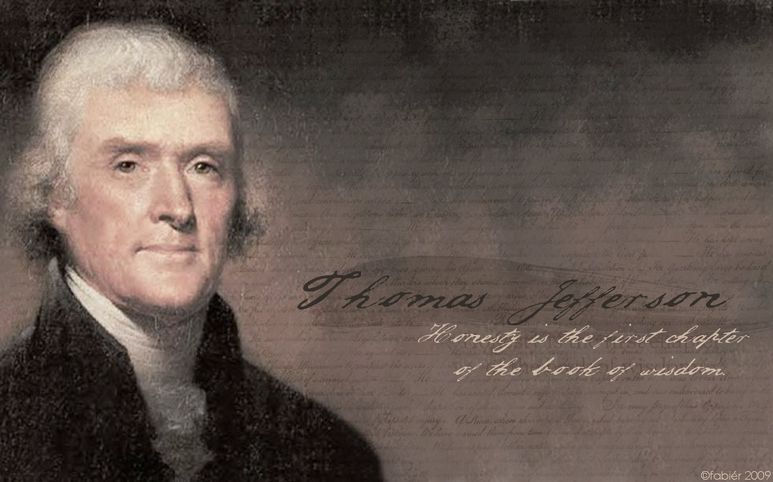
Thomas Jefferson’s Evolving Perspectives on Property and Privilege

Slide 2
Written by:
Edward J. Dodson, M.L.A.
Notes:
Thomas Jefferson’s principles came to him over time, out of his readings of the great minds of past generations, his correspondence with leading contemporary thinkers and his own moral sense of right and wrong. As his activities and reputation expanded, so did interest in what he had to say on the important moral and philosophical issues relating to property and privilege.

Slide 3
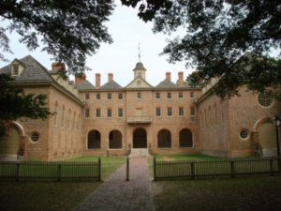
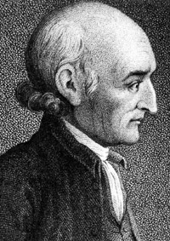
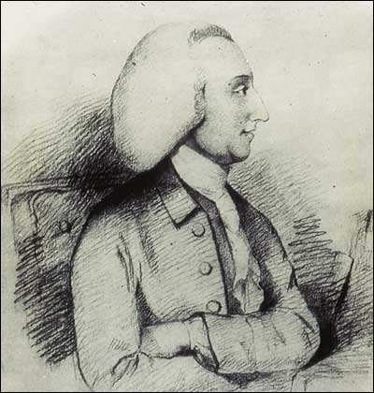
George Wythe
William Small
Notes:
In 1760, at the age of 17, Jefferson left home to attend William and Mary College at Williamsburg, the colonial capital. Here, Jefferson came under the influence of two professors of extraordinary intellect:, George Wythe, the foremost legal mind in Virginia; and William Small, the professor of mathematics and moral philosophy.

Slide 4
George Wythe
Notes:
After graduating in 1762, Jefferson spent the next five years studying the law under George Wythe.

Slide 5
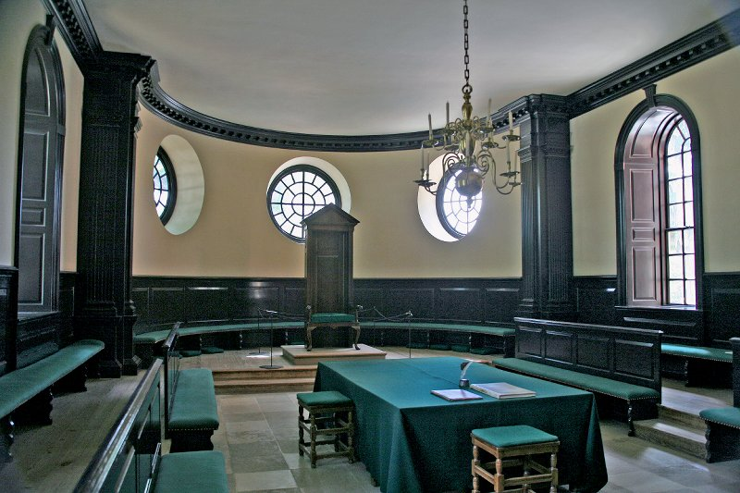
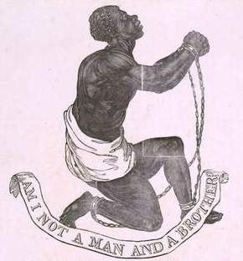
Notes:
He was elected to the House of Burgesses in 1769, where his first action was submission of an unsuccessful bill allowing owners of slaves to grant persons held in bondage freedom. He later wrote:

Slide 6
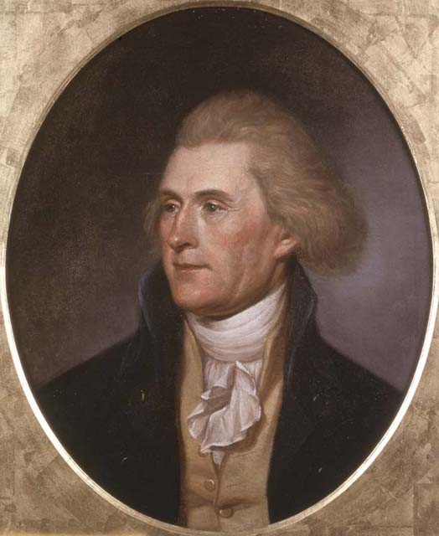
“I made one effort in that body for the permission of the emancipation of slaves, which was rejected; and indeed, during the regal government, nothing liberal could expect success.”
Notes:
“I made one effort in that body for the permission of the emancipation of slaves, which was rejected; and indeed, during the regal government, nothing liberal could expect success.”

Slide 7
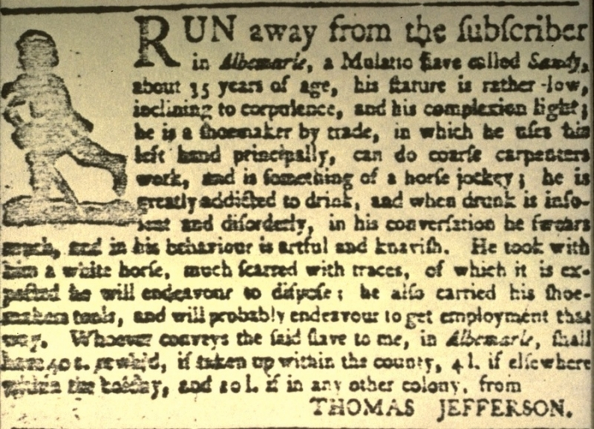
Notes:
Five years later, he denounced slavery as “an infamous practice.” Yet, he continued to hold hundreds of people of color in bondage as his property – prohibited by law, economic necessity and his own narrow view of their potential to live in an environment of self-governance from extending to them the liberty he enjoyed.

Slide 8
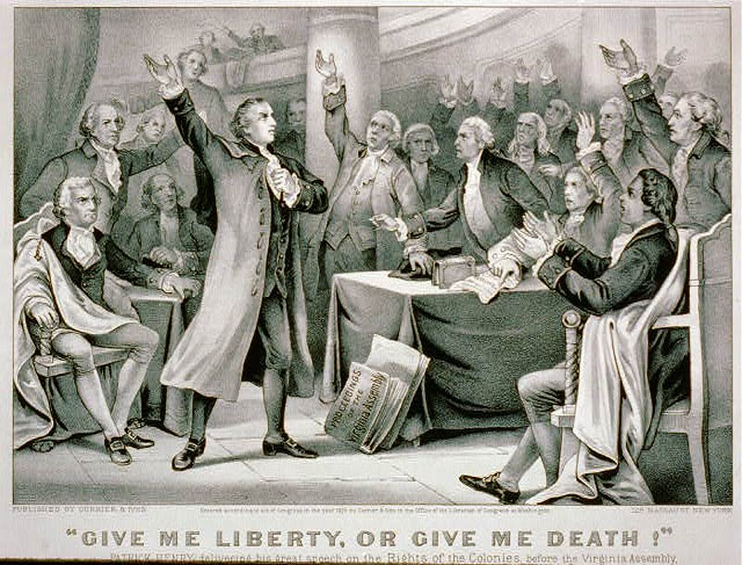
Notes:
As colonial resistance to British authority increased during the early 1770s, Jefferson joined with other, generally young, Virginia citizens such as Patrick Henry to protest the “Intolerable Acts” and other measures indicative of escalating “British tyranny” over the colonials.

Slide 9

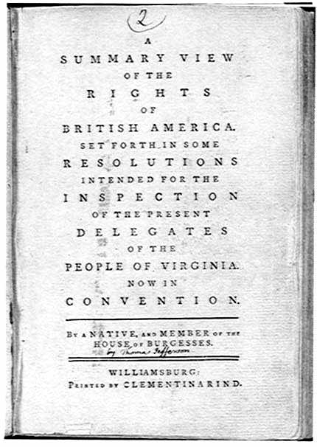
Notes:
He soon authored a set of resolutions under the title “A Summary View of the Rights of British America.” Deemed too radical, the Virginia convention rejected them, but the document was printed and widely circulated.

Slide 10
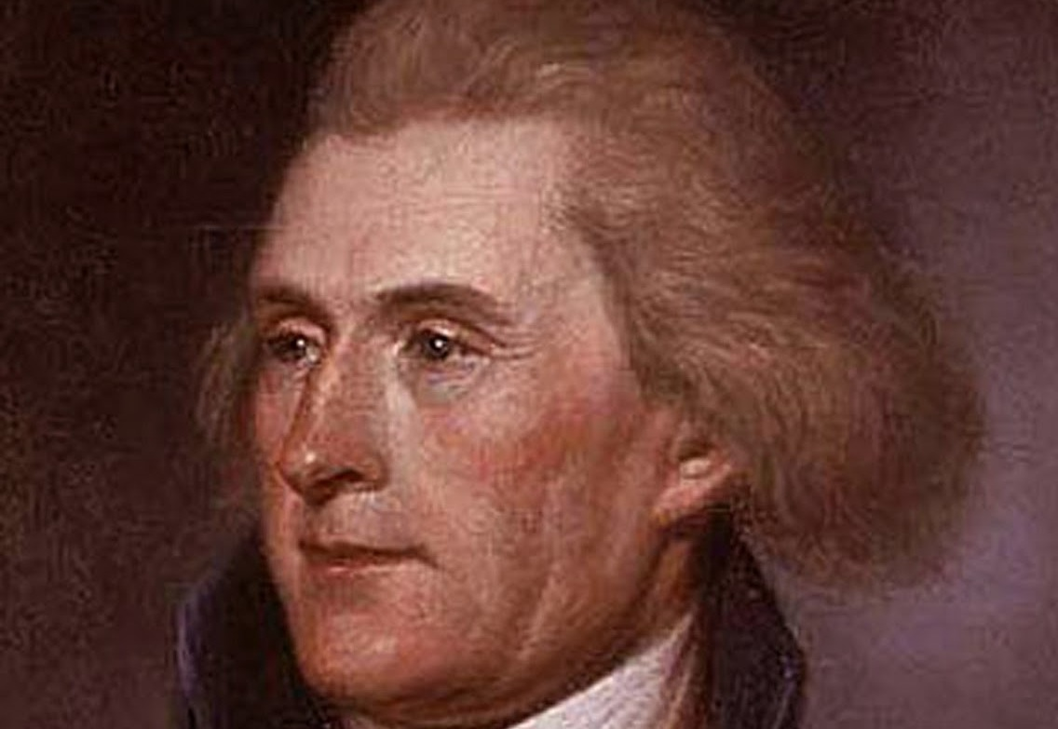
Notes:
Among the rights claimed by the colonials was the right to enter into commerce with whomsoever they pleased. Jefferson declared:

Slide 11
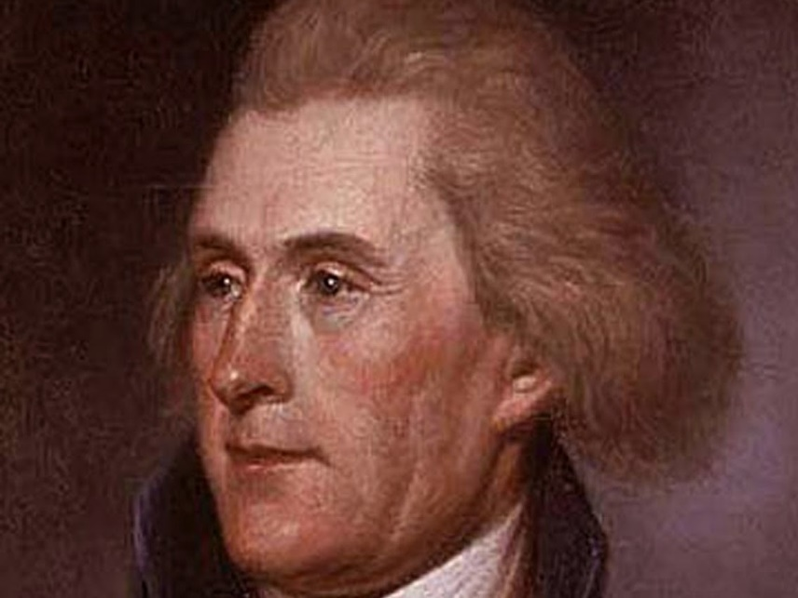
“That the exercise of a free trade with all parts of the world, possessed by the American colonists, as of natural right, and which no law of their own had taken away or abridged, was next the object of unjust encroachment.”
Notes:
“That the exercise of a free trade with all parts of the world, possessed by the American colonists, as of natural right, and which no law of their own had taken away or abridged, was next the object of unjust encroachment.”

Slide 12
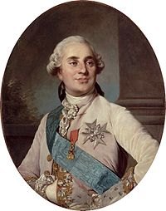
Charles Gravier, comte de Vergennes
Notes:
To Jefferson, the liberty to engage in commerce with others was fundamental. Some years later, in 1785, he wrote to the Count de Vergennes that ..

Slide 13

“the monopoly of the purchase of tobacco in France discourages both the French and American merchant from bringing it [to France]. It is contrary to the spirit of trade, and to the dispositions of merchants, to carry a commodity to any market where but one person is allowed to buy it, and where, of course, that person fixes its price.”
Notes:
“the monopoly of the purchase of tobacco in France discourages both the French and American merchant from bringing it [to France]. It is contrary to the spirit of trade, and to the dispositions of merchants, to carry a commodity to any market where but one person is allowed to buy it, and where, of course, that person fixes its price.”

Slide 14
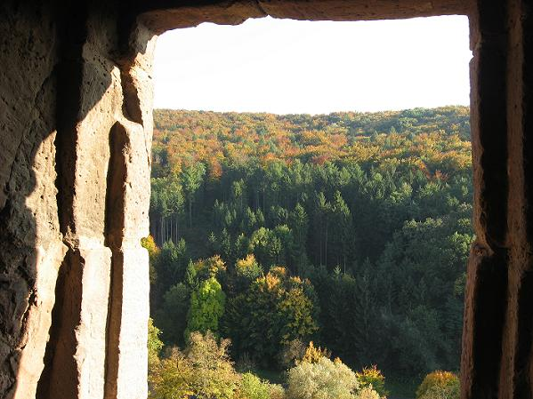
Notes:
Another of Jefferson’s legal acts was to protest the application of British laws regarding land ownership. He states the case as follows:

Slide 15
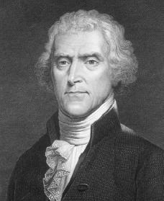
“Our Saxon ancestors held their lands, as they did their personal property, in absolute dominion, disencumbered with any superior, answering nearly to the nature of those possessions which the feudalists term allodial. …Our ancestors, however, who migrated hither, were farmers, not lawyers. …”
Notes:
“Our Saxon ancestors held their lands, as they did their personal property, in absolute dominion, disencumbered with any superior, answering nearly to the nature of those possessions which the feudalists term allodial. …Our ancestors, however, who migrated hither, were farmers, not lawyers. …”
Allodial ownership to Jefferson meant control of land without feudal obligations to the monarch.

Slide 16
“The fictitious principle that all lands belong originally to the king, they were early persuaded to believe real; and accordingly took grants of their own lands from the crown. And while the crown continued to grant for small sums, and on reasonable rents; there was no inducement to arrest the error, and lay it open to public view.”
Notes:
“The fictitious principle that all lands belong originally to the king, they were early persuaded to believe real; and accordingly took grants of their own lands from the crown. And while the crown continued to grant for small sums, and on reasonable rents; there was no inducement to arrest the error, and lay it open to public view.”

Slide 17

Notes:
The fundamental issue Jefferson raised was whether, as claimed, Britain’s laws applied only to colonial landowners.

Slide 18
“In the … spirit of equal and impartial legislation is to be viewed the act of Parliament … by which American lands are made subject to the demands of British creditors, while their own lands were still continued unanswerable for their debts; from which, one of these conclusions must necessarily follow, either that justice is not the same thing in America as in Britain, or else, that the British Parliament pay less regard to it here than there.”
Notes:
“In the … spirit of equal and impartial legislation is to be viewed the act of Parliament … by which American lands are made subject to the demands of British creditors, while their own lands were still continued unanswerable for their debts; from which, one of these conclusions must necessarily follow, either that justice is not the same thing in America as in Britain, or else, that the British Parliament pay less regard to it here than there.”

Slide 19
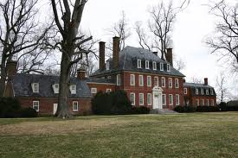
Notes:
The two forms of privilege entrenched in British law that Jefferson opposed were primogentiure and entails. Primogeniture (Latin for first born) required that all of a man’s wealth be passed to his eldest son upon his death. Entails stipulated that this requirement applied to the land in perpetuity. Over time this practice ensured the slow accumulation of great wealth by a few the families who had lived in Virginia the longest. These families formed what was a called a ‘Patrician Order” by Jefferson. His own wealth would eventually be lost because of a combination of excessive personal spending, poor management of his farming estates and numerous family problems.

Slide 20
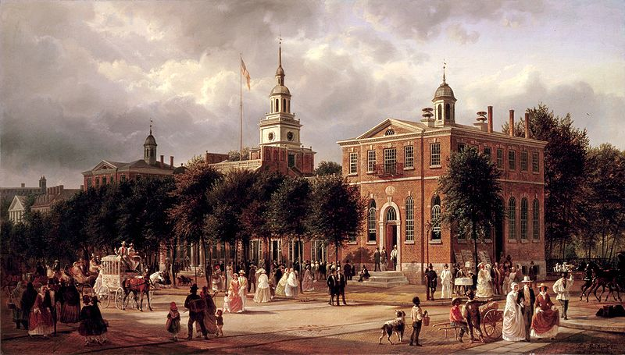
Notes:
His reputation established in Virginia, Jefferson was selected as a delegate to the Second Continental Congress, arriving in Philadelphia in June of 1775.

Slide 21
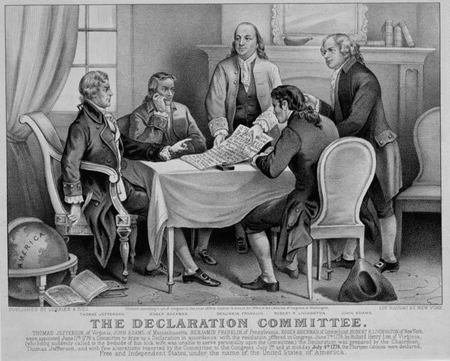
Notes:
The following year, he joined with Benjamin Franklin, John Adams and others to draft a formal declaration of independence.

Slide 22
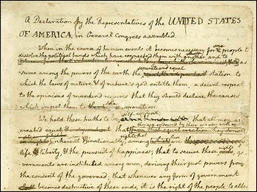
Notes:
Jefferson’s original draft underwent considerable editing after consultation with Franklin and Adams. This final language came from their collaborative effort. This was certainly a radical and liberal expression of the rights of individuals:

Slide 23
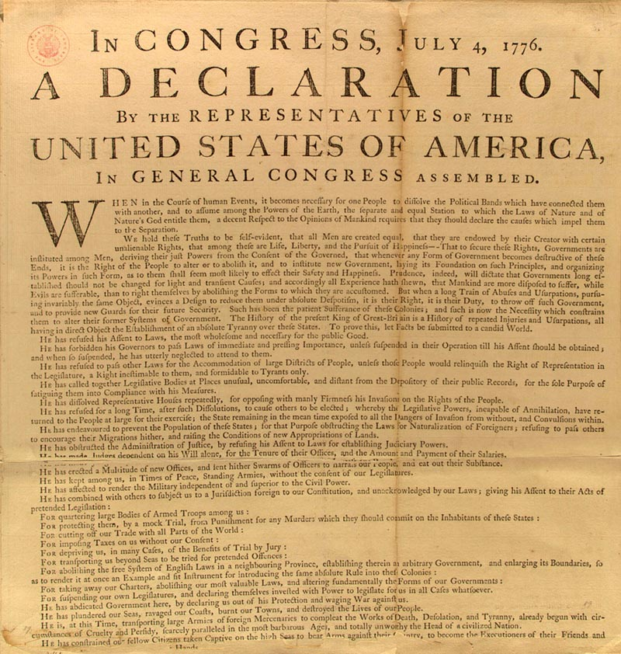
“We hold these truths to be self-evident, that all men are created equal, that they are endowed by their Creator with certain unalienable Rights, that among these are Life, Liberty and the pursuit of Happiness. …”
Notes:
“We hold these truths to be self-evident, that all men are created equal, that they are endowed by their Creator with certain unalienable Rights, that among these are Life, Liberty and the pursuit of Happiness. …”

Slide 24
“That to secure these rights, Governments are instituted among Men, deriving their just powers from the consent of the governed, …”
Notes:
“That to secure these rights, Governments are instituted among Men, deriving their just powers from the consent of the governed, …”

Slide 25
“That whenever any Form of Government becomes destructive of these ends, it is the Right of the People to alter or to abolish it, and to institute new Government, laying its foundation on such principles and organizing its powers in such form, as to them shall seem most likely to effect their Safety and Happiness.”
Notes:
“That whenever any Form of Government becomes destructive of these ends, it is the Right of the People to alter or to abolish it, and to institute new Government, laying its foundation on such principles and organizing its powers in such form, as to them shall seem most likely to effect their Safety and Happiness.”

Slide 26
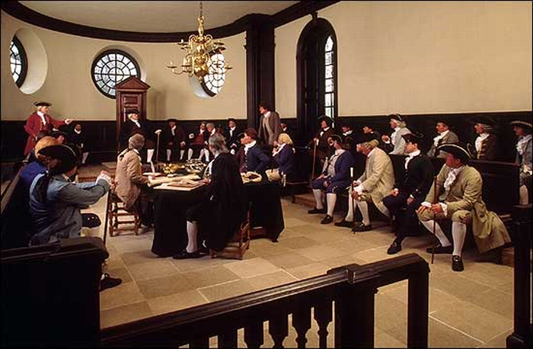
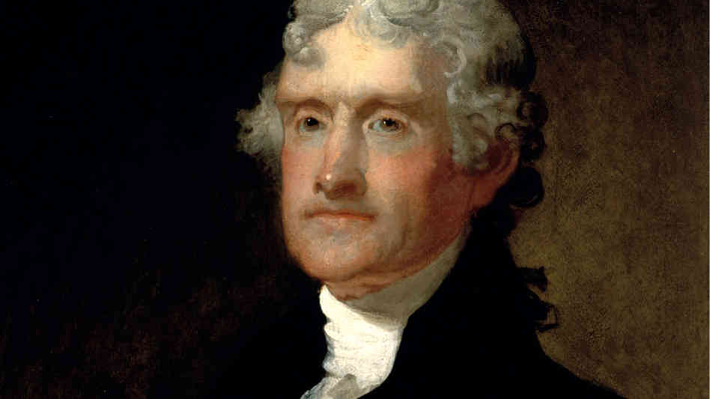
Notes:
At the next session of the Virginia legislature, Jefferson drafted laws, approved by the legislature, abolishing the Old World privileges of primogeniture and entails. In a letter to John Adams written in 1813 Jefferson recalled his feelings:

Slide 27

“These laws, drawn by myself, laid the axe to the root of Pseudoaristocracy.”
Notes:
“These laws, drawn by myself, laid the axe to the root of Pseudoaristocracy.”

Slide 28
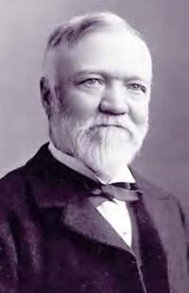
James Truslow Adams
Notes:
An important philosophical position argued over during Jefferson’s life concerned the existence of natural rights. James Truslow Adams, a Jefferson biographer, concludes that:

Slide 29
“one of the not least interesting features of Jefferson’s theory as to the distinction between natural and civil rights was that it ruled economics out of the field of natural law” and “property … could be maintained only by the help of society, and it was therefore … a civil right only.”
Notes:
“one of the not least interesting features of Jefferson’s theory as to the distinction between natural and civil rights was that it ruled economics out of the field of natural law” and “property … could be maintained only by the help of society, and it was therefore … a civil right only.”

Slide 30
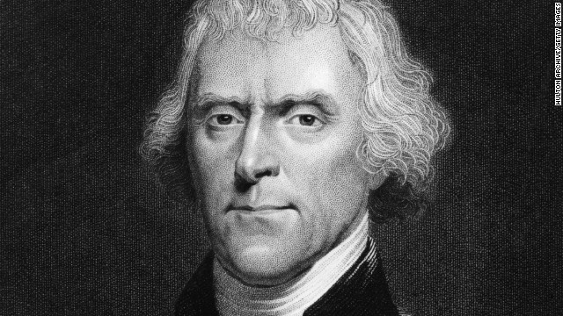
Notes:
This seems to account for the use of the phrase in the Declaration of Independence “pursuit of happiness” rather than the “pursuit of property.” In his 1775 Declaration on Taking Up Arms, Jefferson observed:

Slide 31

“The political institutions of America, its various soils and climates, opened a certain resource to the unfortunate and to the enterprising of every country and insured to them the acquisition and free possession of property.”
Notes:
"The political institutions of America, its various soils and climates, opened a certain resource to the unfortunate and to the enterprising of every country and insured to them the acquisition and free possession of property."

Slide 32
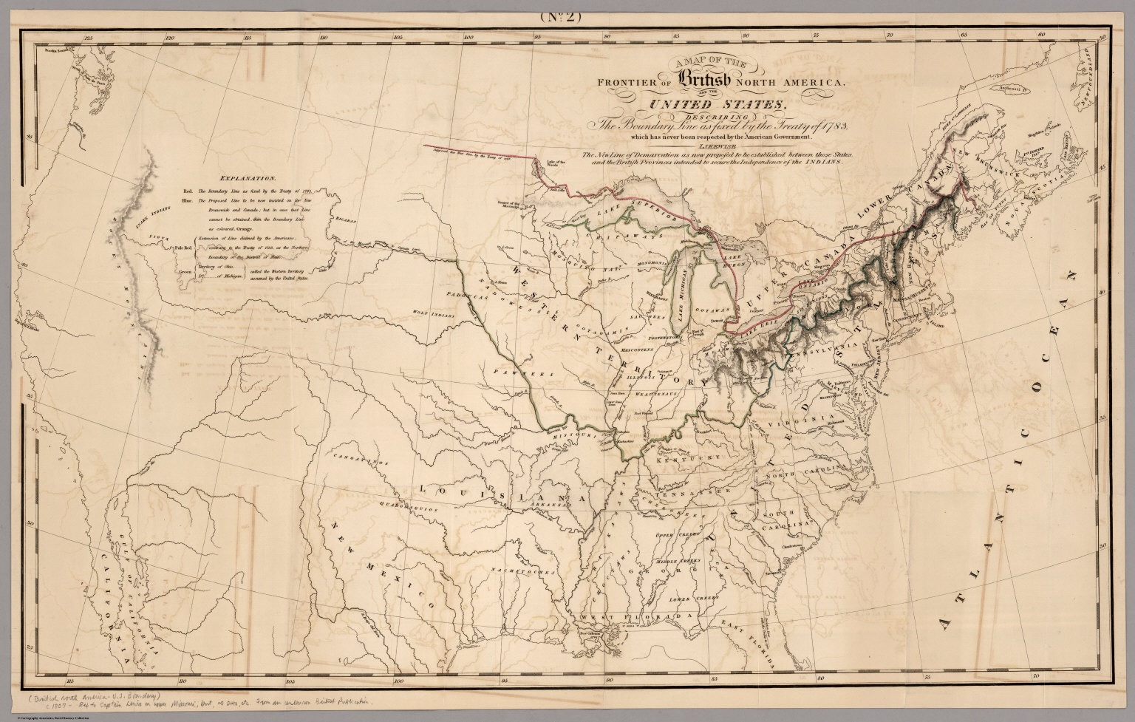
Notes:
On the question of how long the free access to the means of self-sufficiency would last Jefferson expressed only optimism because of the enormity of the North American continent.

Slide 33
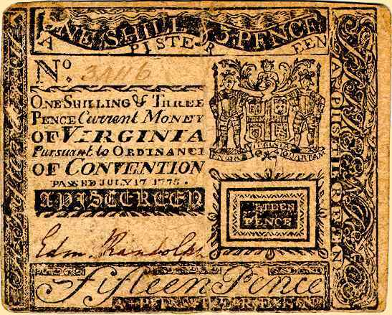
Notes:
As the war for independence continued, a great concern for the colonial subjects of Britain now in rebellion was how to pay for the expenses of the new military. Depreciation of American paper currency cost Jefferson a good deal of the value of his personal assets during the war. This only hardened his opposition to paper currency and fractional reserve banking.

Slide 34
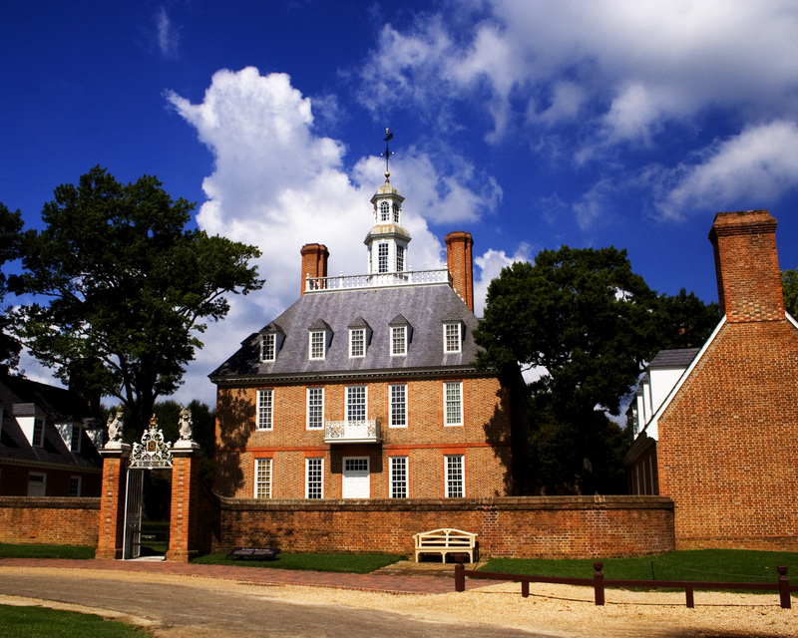
Notes:
Elected Governor of Virginia in June of 1779, succeeding Patrick Henry, Jefferson found the Virginia treasury nearly empty. The state was short of everything needed to support the war effort. And, the Continental currency had become nearly worthless, in part because the British were flooding the countryside with counterfeit currency.

Slide 35
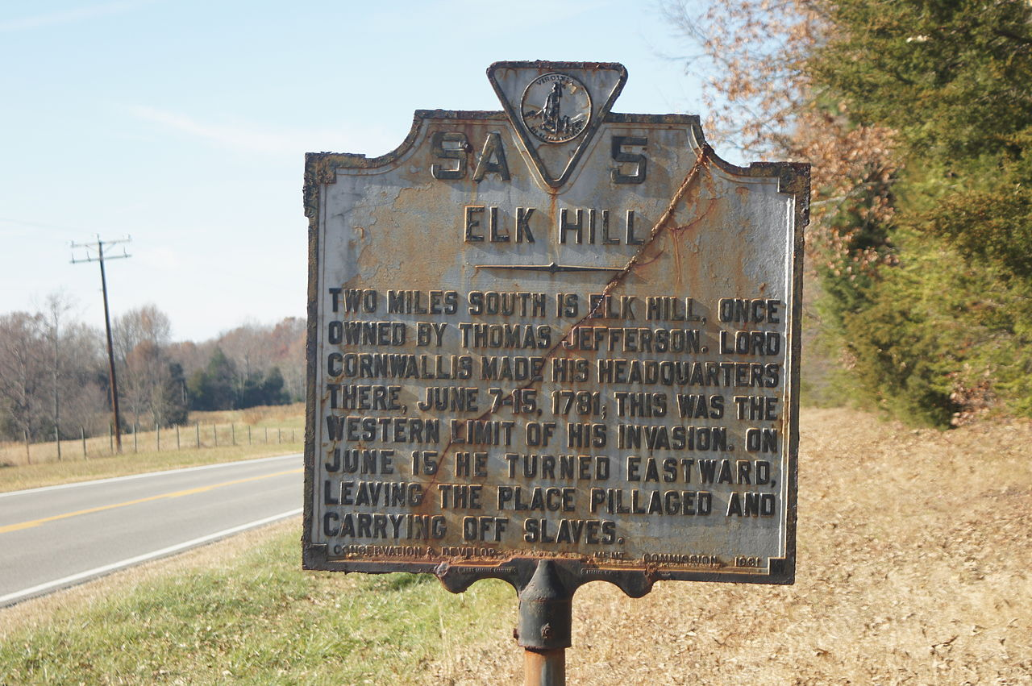
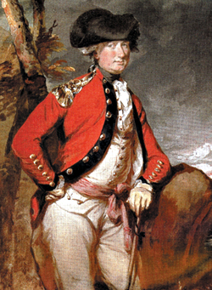
Notes:
To raise funds, Jefferson hoped to sell state lands and raise taxes; however, a poor tobacco crop made these measures impractical. Land values were falling, and many Virginians were hard-pressed to find the money to meet basic needs. On a personal level, Jefferson’s cattle and other stock were taken and his property at Elk Hill destroyed by Lord Cornwallis in 1781.

Slide 36
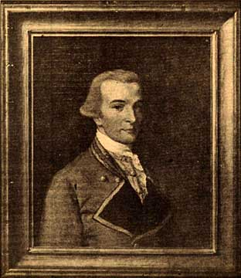
Governor Jefferson
Governor’s Mansion, Williamsburg
Notes:
The following year Jefferson stepped down as Governor and returned to Monticello, where, along with trying to reorganize his farm, he commenced writing his Notes on Virginia in response to a request for information by a French official.

Slide 37
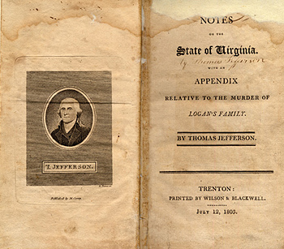
Notes:
As he looked upon the unique circumstance of the American experience, Jefferson recognized change would be inevitable. He hoped that a commitment to principle would create a future very different from what the peoples of the Old World endured. As he wrote:

Slide 38
“The political economists of Europe have established it as a principle, that every State should endeavour to manufacture for itself; and this principle, like many others, we transfer to America, without calculating the difference of circumstance which should often produce a difference of result. In Europe the lands are either cultivated, or locked up against the cultivator. …”
Notes:
“The political economists of Europe have established it as a principle, that every State should endeavour to manufacture for itself; and this principle, like many others, we transfer to America, without calculating the difference of circumstance which should often produce a difference of result. In Europe the lands are either cultivated, or locked up against the cultivator. …”

Slide 39
“Manufacture must therefore be resorted to, of necessity, not of choice, to support the surplus of their people. But we have an immensity of land courting the industry of the husbandman. Is it best then that all our citizens should be employed in its improvement, or that one half should be called off from that to exercise manufactures and handicrafts for the other? …”
Notes:
“Manufacture must therefore be resorted to, of necessity, not of choice, to support the surplus of their people. But we have an immensity of land courting the industry of the husbandman. Is it best then that all our citizens should be employed in its improvement, or that one half should be called off from that to exercise manufactures and handicrafts for the other? ...”

Slide 40
“Those who labour in the earth are the chosen people of God, if ever he had a chosen people.”
Notes:
“Those who labour in the earth are the chosen people of God, if ever he had a chosen people.”

Slide 41
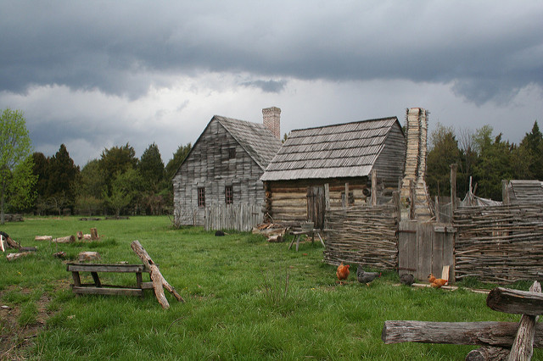
Notes:
A nation of self-supporting freeholders, of propertied citizens, would keep government within its just limits. As he argued:

Slide 42
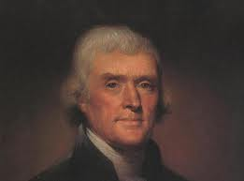
“The mobs of great cities add just so much to the support of pure government, as sores do to the strength of the human body.”
Notes:
“The mobs of great cities add just so much to the support of pure government, as sores do to the strength of the human body.”

Slide 43
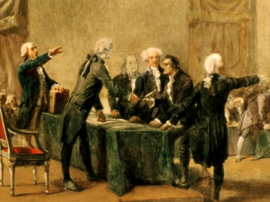
Notes:
Once again, Jefferson was chosen to represent Virginians at the Continental Congress. He chaired a committee to establish a new currency and coinage for the nation. The problem was, as he knew:

Slide 44
“the people are as yet not recovered from the depredations of the war.”
Notes:
“the people are as yet not recovered from the depredations of the war.”

Slide 45
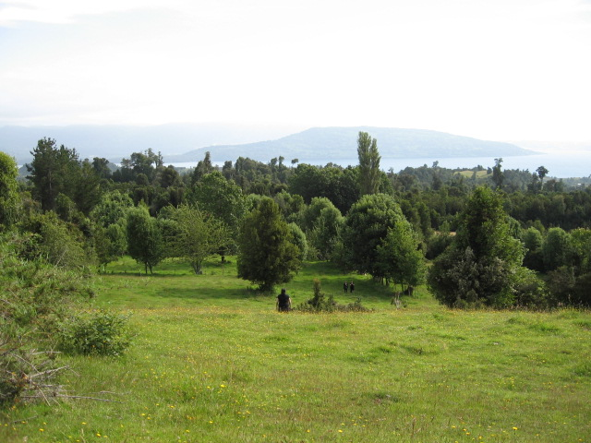
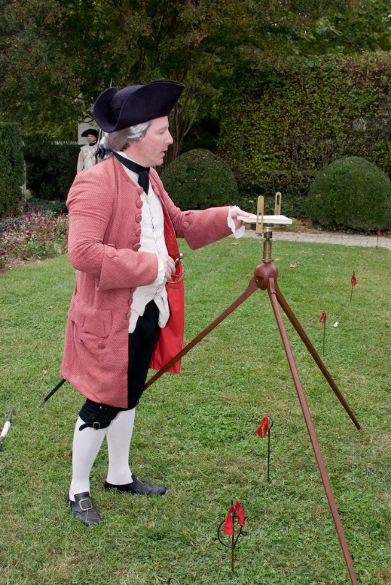
Notes:
These “Americans” were in difficult financial circumstances. They had little ability to absorb new taxes, or even the interest to service the Federal and state debts. The one means of raising revenue quickly was the sale of public lands.

Slide 46
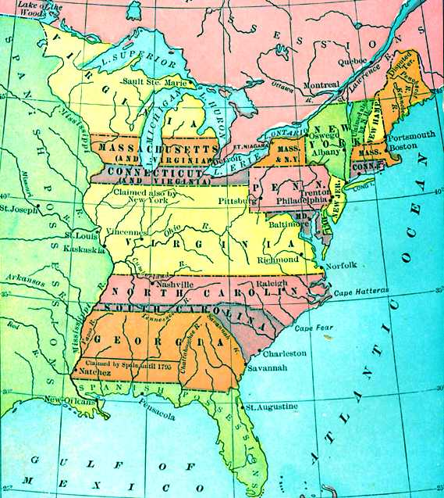
Notes:
At the same time, the states were called upon to relinquish their claims to the frontier and beyond. The Virginia delegates approved the agreement on the 1st of March, 1784.

Slide 47
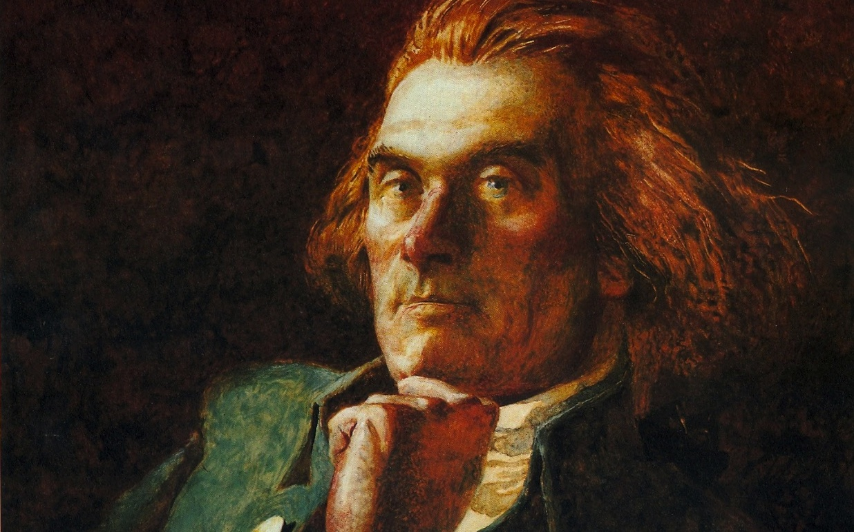
Notes:
All things considered, Jefferson was optimistic about the future of the new nation. In 1786, he conveyed this optimism in a letter:

Slide 48
“The Confederation is a wonderfully perfect instrument, considering the circumstances under which it was formed.”
Notes:
“The Confederation is a wonderfully perfect instrument, considering the circumstances under which it was formed.”

Slide 49
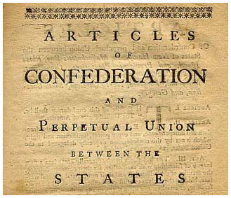
Notes:
Yet, Jefferson identified three areas in need of alteration: First, rules for admission of new states to the Union; second, the apportionment of the cost of the Federal government based on population rather than the value of landed property (because of the difficulty in coming up with a proper valuation); and, third, prohibiting the states from entering into treaties with foreign nations.

Slide 50
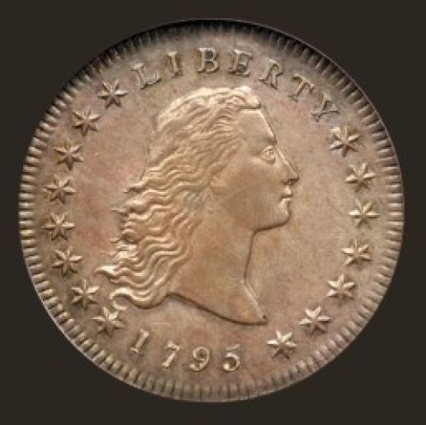
Notes:
The dollar (the name taken from the Spanish gold coins that circulated throughout the New World) became the new standard. Coinage of gold and silver content was approved, although there was precious little of either metal available. The first silver dollar coins were minted in 1795.

Slide 51
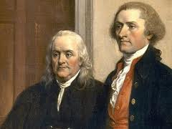
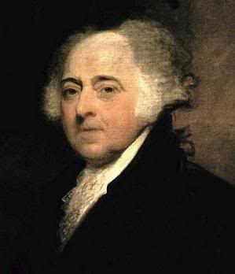
Notes:
In 1784, Jefferson was appointed by the Congress to the post of Minister to France, where he joined Benjamin Franklin and John Adams in negotiating treaties of commerce. He spent the next five years there. As for how this time in the company of many of Europe’s leading lights, James Truslow Adams concludes that:

Slide 52
“He came back without a single major idea which he had not taken with him when he sailed from Boston.”
Notes:
“He came back without a single major idea which he had not taken with him when he sailed from Boston.”

Slide 53
Notes:
Adams was not quite accurate in his assessment. Jefferson’s understanding of political economy had evolved. In 1790, he wrote to Thomas Randolph that:

Slide 54
“in political economy, I think Smith’s Wealth of Nations the best book extant. …
Notes:
“in political economy, I think Smith’s Wealth of Nations the best book extant.” However, he added that

Slide 55
“There are some excellent books of theory written by Turgot and the economists of France.”
Notes:
“There are some excellent books of theory written by Turgot and the economists of France.”

Slide 56
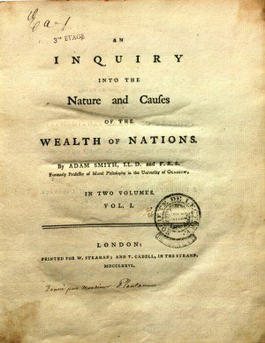
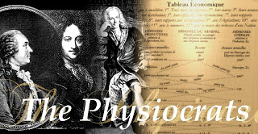
Notes:
These were the Physiocrats, whose writings were major influences on the thinking of both Benjamin Franklin and Thomas Paine. Adam Smith had, in fact, dedicated The Wealth of Nations to his Physiocratic colleagues, from whom he had learned much.

Slide 57
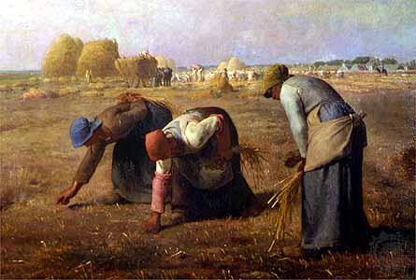
Notes:
Jefferson’s life in America did not prepare him for what he saw in France. As he wrote to a family friend in 1785:

Slide 58
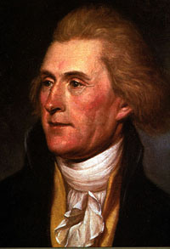
“Of twenty millions of people supposed to be in France, I am of opinion there are nineteen millions more wretched, more accursed in every circumstance of human existence than the most conspicuously wretched individual of the whole United States.”
Notes:
“Of twenty millions of people supposed to be in France, I am of opinion there are nineteen millions more wretched, more accursed in every circumstance of human existence than the most conspicuously wretched individual of the whole United States.”

Slide 59
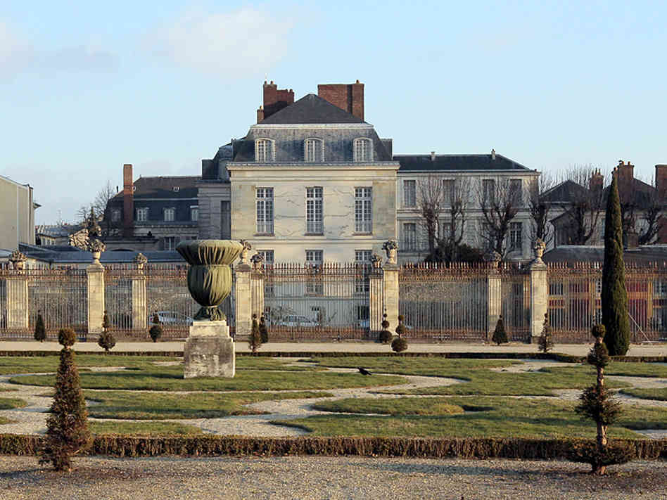
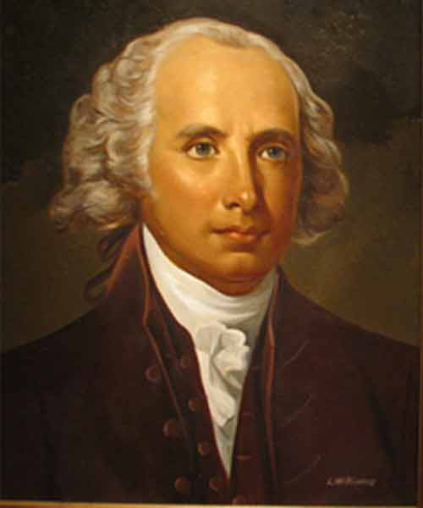
James Madison
Notes:
By spending time in France, Jefferson quickly recognized the uniquely positive circumstances enjoyed by the general population in the United States. In 1785, he wrote to James Madison regarding France:

Slide 60
“The property of this country is absolutely concentrated in a very few hands.”
Notes:
“The property of this country is absolutely concentrated in a very few hands.”

Slide 61

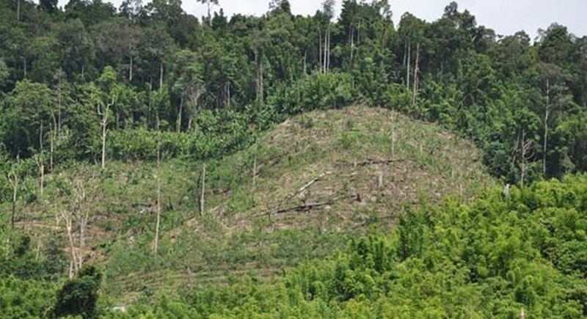

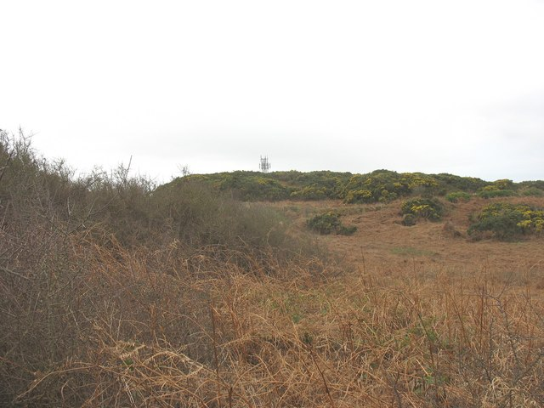
Notes:
He knew that “an equal division of property” was an impracticable solution to the problem of landlessness. Even for agriculture, fertility, rainfall, topography and other factors give land widely varying productive values. Jefferson’s answer was simple:

Slide 62
“exempt all from taxation below a certain point, and to tax the higher portions or property in geometrical progression as they rise.”
Notes:
“exempt all from taxation below a certain point, and to tax the higher portions or property in geometrical progression as they rise.”

Slide 63

Notes:
Jefferson firmly believed that access to land was key to a prosperous future in the United States. Throughout his entire adult life, his financial fortunes would be directly tied to what the land would produce. Only the broad ownership of land would control the rents charged by landowners. Public land might also be made available under lease to those who could not afford the price of purchase:

Slide 64
“that every man who cannot find employment, but who can find uncultivated land, shall be at liberty to cultivate it, paying a moderate rent.”
Notes:
“that every man who cannot find employment, but who can find uncultivated land, shall be at liberty to cultivate it, paying a moderate rent.”

Slide 65

Notes:
Just what the balance ought to be between public and private ownership of the land Jefferson did not comment upon.

Slide 66

Notes:
With the peace treaty finalized with Britain, Jefferson sensed that a large number of Americans were eager to move inland from the coastal regions, because the land along the coast was either held by the new nation’s old families or no longer fertile after generations of farming. To John Jay, he wrote in 1785:

Slide 67
“We have now lands enough to employ an infinite number of people in their cultivation. Cultivators of the earth are the most valuable citizens. …As long … as they can find employment in this line, I would not convert them into mariners, artisans, or anything else.”
Notes:
“We have now lands enough to employ an infinite number of people in their cultivation. Cultivators of the earth are the most valuable citizens. …As long … as they can find employment in this line, I would not convert them into mariners, artisans, or anything else.”

Slide 68
James Madison
Notes:
To James Madison two years later, he warned:

Slide 69
“…our governments will remain virtuous for many centuries; as long as they are chiefly agricultural; and this will be as long as there shall be vacant lands in any part of America. When they get piled upon one another in large cities, as in Europe, they will become corrupt as in Europe.”
Notes:
“…our governments will remain virtuous for many centuries; as long as they are chiefly agricultural; and this will be as long as there shall be vacant lands in any part of America. When they get piled upon one another in large cities, as in Europe, they will become corrupt as in Europe.”

Slide 70


Notes:
British merchants sought from Adams and Jefferson a commitment to honor debts Americans still owed from before the war. The United States also owed a huge amount to the French government. There were (as yet) no gold or silver mines in the new United States, which meant that these debts could only be repaid with revenue from exports and the sale of public lands.

Slide 71

Notes:
European investors were, if nothing else, very interested in the opportunity to profit by speculation in U.S. land. Responding to a Dutch businessman’s inquiry, Jefferson advised:

Slide 72
“With respect to the sale of our lands, that cannot begin till a considerable portion shall have been surveyed … before we shall be able to judge of the efficacy of our land office to sink our national debt.”
Notes:
“With respect to the sale of our lands, that cannot begin till a considerable portion shall have been surveyed … before we shall be able to judge of the efficacy of our land office to sink our national debt.”

Slide 73

Notes:
The orderly settlement of the land by yeoman farmers was undermined by the financial needs of government, as well as those who saw speculation in western lands as a means of wealth accumulation.

Slide 74


Notes:
The new federal constitution simply ignored the complicated issue of how the public domain would be preserved and managed. Jefferson, who always feared the centralization of political power, communicated his thoughts on the new constitution to John Adams:

Slide 75
“Indeed, I think all the good of this new constitution might have been couched in three or four new articles, to be added to the good, old and venerable fabric, which should have been preserved even as a religious relique…”
Notes:
“Indeed, I think all the good of this new constitution might have been couched in three or four new articles, to be added to the good, old and venerable fabric, which should have been preserved even as a religious relique…”

Slide 76
Notes:
To James Madison, Jefferson expressed his most serious displeasure at the omission of a bill of rights and the failure to impose restrictions on monopolies.

Slide 77


Notes:
No sooner had Jefferson returned from France than George Washington nominated him to become Secretary of State. James Madison brought him up-to-date on all that had occurred during the Constitutional Convention and the growing split between the Federalists and those who defended the sovereignty of the states. Madison, Hamilton and John Jay did their best to put all of the issues before the new nation’s leading civic leaders. Jefferson’s differences with Hamilton were fundamental.

Slide 78

Alexander Hamilton
Notes:
In September of 1792, Jefferson wrote to President Washington expressing his deep concern over the measures taken by Alexander Hamilton as Secretary of the Treasury:

Slide 79
“His system flowed from principles adverse to liberty, and was calculated to undermine and demolish the Republic by creating an influence of his department over the members of the Legislature.”
Notes:
“His system flowed from principles adverse to liberty, and was calculated to undermine and demolish the Republic by creating an influence of his department over the members of the Legislature.”

Slide 80

Notes:
As Jefferson had years before predicted, once independence was achieved factions arose, and both class and special interests began to dominate public policy.

Slide 81

Notes:
In 1793, Jefferson provided his opinion on the question of whether the united States had the right to renounce their treaties with France. Note, here, that the reference to the United States is in the plural rather than as a single nation. This distinction is in the original statement. Jefferson took the opportunity to express his view that a society is formed by the voluntary association of individuals:

Slide 82

“The moral duties which exist between individual and individual in a state of nature, accompany them into a state of society, and the aggregate of the duties of all the individuals composing the society constitutes the duties of that society towards any other.”
Notes:
“The moral duties which exist between individual and individual in a state of nature, accompany them into a state of society, and the aggregate of the duties of all the individuals composing the society constitutes the duties of that society towards any other.”

Slide 83

Notes:
Civil rights, including the right to vote for one’s representatives, Jefferson saw as a privilege to be earned. To John Adams he admitted as much:

Slide 84
“I agree with you that there is a natural aristocracy among men. The grounds of this are virtue and talents” and “that that form of government is the best, which provides the most effectually for a pure selection of these natural aristoi into the offices of government.”
Notes:
“I agree with you that there is a natural aristocracy among men. The grounds of this are virtue and talents” and “that that form of government is the best, which provides the most effectually for a pure selection of these natural aristoi into the offices of government.”

Slide 85

Notes:
Disenchanted with the direction being taken by the federal government, Jefferson resigned his cabinet position and returned to Monticello. In 1795, he wrote to a French correspondent, reflecting on the times in which they lived, seemingly content in retirement from public affairs:

Slide 86
“We have chanced to live in an age which will probably be distinguished in history, for its experiments in government on a larger scale than has yet taken place. But we shall not live to see the result.”
Notes:
“We have chanced to live in an age which will probably be distinguished in history, for its experiments in government on a larger scale than has yet taken place. But we shall not live to see the result.”

Slide 87

Notes:
From his perspective, the nation’s landowners -- “the whole landed interest” – were stalwarts of republican principles, arraigned against the unprincipled, the:

Slide 88
“speculators and holders in the banks and public funds.”
Notes:
“speculators and holders in the banks and public funds.”

Slide 89

Alexander Hamilton
Notes:
The voters chose John Adams over Jefferson to succeed George Washington. Both men feared the intrigues of Alexander Hamilton, who maneuvered to be appointed de facto commander of the army.

Slide 90

Edmund Randolph
Notes:
In the meantime, Jefferson raised the issue of whether the states retained the authority to nullify federal law. His thinking is revealed clearly in a letter to Edmund Randolph dated August 18, 1799:

Slide 91

“Before the revolution there existed no such nation as the United States; they then first associated as a nation. But they did not … proceed to adopt a whole system of laws ready made to their hand. ...”
Notes:
“Before the revolution there existed no such nation as the United States; they then first associated as a nation. But they did not … proceed to adopt a whole system of laws ready made to their hand. ...”

Slide 92

“As their association as a nation was only for special purposes, to wit, for the management of their concerns with one another and with foreign nations, and the States composing the association chose to give it powers for those purposes and no others, they could not adopt any general system, because it would have embraced objects on which this association had no right to form or declare a will.”
Notes:
“As their association as a nation was only for special purposes, to wit, for the management of their concerns with one another and with foreign nations, and the States composing the association chose to give it powers for those purposes and no others, they could not adopt any general system, because it would have embraced objects on which this association had no right to form or declare a will.”

Slide 93


Notes:
Jefferson’s perspectives found form in the Kentucky resolves. Madison followed with a somewhat milder document for Virginia. On entering the Presidency in 1801, Jefferson made clear to all his commitment to individual rights:

Slide 94
“If there be any among us who wish to dissolve this union, or to change its republican form, let them stand undisturbed, as monuments of the safety with which error of opinion may be tolerated where reason is left free to combat it.”
Notes:
“If there be any among us who wish to dissolve this union, or to change its republican form, let them stand undisturbed, as monuments of the safety with which error of opinion may be tolerated where reason is left free to combat it.”

Slide 95

Albert Gallatin
Notes:
Leading the nation at this crucial moment demanded much of Jefferson. American merchant ships were boarded and taken by both the British and French navies. The financial stability of the Union remained at risk. Jefferson charged Albert Gallatin, the new Secretary of the Treasury, with bringing …

Slide 96
“things back to that simple and intelligible system on which they should have been organized at first.”
Notes:
“things back to that simple and intelligible system on which they should have been organized at first.”

Slide 97

Notes:
Yet, in 1803 Jefferson had to somehow find $15 million to pay Napoleon Bonaparte for the Louisiana territory – a purchase doubling the territory of the United States and requiring Jefferson to exercise authority beyond that extended to the Executive under the Constitution.

Slide 98

Jean Baptiste Say
Notes:
One thing the Presidency had not changed was Jefferson’s faith in an agrarian economy. Writing to the French political economist, Jean Baptiste Say in 1804, he spoke of:

Slide 99
“the immense extent of uncultivated and fertile lands” which “enables every one who will labor, to marry young, and to raise a family of any size.”
Notes:
“the immense extent of uncultivated and fertile lands” which “enables every one who will labor, to marry young, and to raise a family of any size.”

Slide 100

Notes:
In his mind, the great difference of life for North Americans of European heritage remained the opportunity for almost all to acquire landed property. Jefferson and his fellow republicans were committed to turning back the clock.

Slide 101


Notes:
As historian Drew McCoy wrote in his study of the period:

Slide 102
“Within the Jeffersonian framework of assumptions and beliefs, three essential conditions were necessary to create and sustain such a republican political economy: a national government free from any taint of corruption, an unobstructed access to an ample supply of open land, and a relatively liberal international commercial order that would offer adequate foreign markets for America’s flourishing agricultural surplus.”
Notes:
“Within the Jeffersonian framework of assumptions and beliefs, three essential conditions were necessary to create and sustain such a republican political economy: a national government free from any taint of corruption, an unobstructed access to an ample supply of open land, and a relatively liberal international commercial order that would offer adequate foreign markets for America’s flourishing agricultural surplus.”

Slide 103

Notes:
This third provision collapsed under the weight of Jefferson’s embargo against British and French commerce. Unemployment skyrocketed and the nation fell into a deep economic depression. Many merchants ignored the embargo and resorted to smuggling. Despite the decline in his own financial fortunes that resulted, Jefferson responded angrily:

Slide 104
“While honest men were religiously observing it, the unprincipled along our sea-coast and our frontiers [have been] fraudulently evading it.”
Notes:
“While honest men were religiously observing it, the unprincipled along our sea-coast and our frontiers [have been] fraudulently evading it.”

Slide 105

Notes:
After completion of his second term in the Presidency, Jefferson returned to Monticello burdened by heavy personal debts. Yet, he continued to accumulate things and to entertain graciously, at great cost. To raise needed cash, he eventually sold his own library to the Congress to replace what was burned by the British during the War of 1812.

Slide 106

Notes:
The loss of American shipping and seamen to the British nearly destroyed the new nation’s export-dependent economy. Jefferson anticipated that the war would be long and arduous. He believed:

Slide 107
“the object of England … is to claim the ocean as her domain, and to exact transit duties from every vessel traversing it.”
Notes:
“the object of England … is to claim the ocean as her domain, and to exact transit duties from every vessel traversing it.”

Slide 108


Notes:
Americans responded by becoming producers. To a Scottish correspondent, Jefferson expressed his changed views regarding the nation’s means of securing the future:

Slide 109

“I have not formerly been an advocate for great manufactories. I doubted whether our labor, employed in agriculture, and aided by the spontaneous energies of the earth, would not procure us more than we could make ourselves of other necessaries. But other considerations entering into the question, have settled my doubts.”
Notes:
“I have not formerly been an advocate for great manufactories. I doubted whether our labor, employed in agriculture, and aided by the spontaneous energies of the earth, would not procure us more than we could make ourselves of other necessaries. But other considerations entering into the question, have settled my doubts.”

Slide 110

Notes:
The nation was embarking on a new basis for self-sufficiency, one that would bring about a dramatic increase in the production of wealth, but would be accompanied by a dramatic increase in the role of government to establish new and specific rules to guarantee property rights. Laws and regulations would be needed to secure, he wrote:

Slide 111
“natural and even an hereditary right to inventors.”
Notes:
“natural and even an hereditary right to inventors.”

Slide 112


Notes:
As for one’s legitimate claim to property in land, Jefferson asserts:

Slide 113
“that no individual has, of natural right, a separate property in an acre of land.” Rather, land “is the property for the moment of him who occupies it, but when he relinquishes the occupation, the property goes with it.”
Notes:
“that no individual has, of natural right, a separate property in an acre of land.” Rather, land “is the property for the moment of him who occupies it, but when he relinquishes the occupation, the property goes with it.”
What Jefferson believes is that a person should be permitted to own only so much land as is put to productive use. However, as with much that Jefferson proclaimed, there are important contradictions between his ideals and his own actions. Jefferson held slaves to work his land. He also collected ground rents from tenant farmers.

Slide 114

Notes:
On the matter of intellectual property, of property in ideas, Jefferson argues:

Slide 115


“That ideas should freely spread from one to another over the globe, for the moral and mutual instruction of man, and improvement of his condition, seems to have been peculiarly and benevolently designed by nature.”
Notes:
“That ideas should freely spread from one to another over the globe, for the moral and mutual instruction of man, and improvement of his condition, seems to have been peculiarly and benevolently designed by nature.”

Slide 116

Notes:
Retired from national and world affairs, Jefferson had time to think even more deeply about the distinction between that which nature provides and that which we produce. He compared the social organization common to the tribes of First Americans and that created on the European model. In 1812, he wrote:

Slide 117

"A right of property in moveable things is admitted before the establishment of government. A separate property in lands, not till after that establishment. The right to moveables is acknowledged by all the hordes of Indians surrounding us. Yet by no one of them has a separate property in lands been yielded to individuals. …”
Notes:
"A right of property in moveable things is admitted before the establishment of government. A separate property in lands, not till after that establishment. The right to moveables is acknowledged by all the hordes of Indians surrounding us. Yet by no one of them has a separate property in lands been yielded to individuals. …”

Slide 118
"He who plants a field keeps possession till he has gathered the produce, after which one has as good a right as another to occupy it. Government must be established and laws provided, before lands can be separately appropriated, and their owner protected in his possession. ...”
Notes:
“He who plants a field keeps possession till he has gathered the produce, after which one has as good a right as another to occupy it. Government must be established and laws provided, before lands can be separately appropriated, and their owner protected in his possession. ..."

Slide 119
"Till then, the property is in the body of the nation, and they, or their chief as trustee, must grant them to individuals, and determine the conditions of the grant.”
Notes:
“Till then, the property is in the body of the nation, and they, or their chief as trustee, must grant them to individuals, and determine the conditions of the grant."

Slide 120

Notes:
His physical health was seriously in decline by 1818, but his mind remained sharp. Responding to a letter from Dr. Benjamin Waterhouse, he asked whether any individual really discovers anything on their own:

Slide 121
“The fact is, that one new idea leads to another, that to a third, and so on through a course of time until some one, with whom no one of these ideas was original, combines all together, and produces what is justly called a new invention.”
Notes:
“The fact is, that one new idea leads to another, that to a third, and so on through a course of time until some one, with whom no one of these ideas was original, combines all together, and produces what is justly called a new invention.”

Slide 122
Notes:
Toward the end of his life, in 1824, he left what is perhaps his most profound thought, asking:

Slide 123
“Can one generation bind another, and all others in succession forever?” To which he answered: “I think not. The Creator has made the earth for the living, not the dead. Rights and powers can only belong to persons, not to things, not to mere matter, unendowed with will. …”
Notes:
“Can one generation bind another, and all others in succession forever?” To which he answered: “I think not. The Creator has made the earth for the living, not the dead. Rights and powers can only belong to persons, not to things, not to mere matter, unendowed with will. …”

Slide 124
“A generation may bind itself as long as its majority continues in life; when that has disappeared, another majority is in place, holds all the rights and powers their predecessors once held, and may change their laws and institutions to suit themselves. Nothing then is unchangeable but the inherent and unalienable rights of man.”
Notes:
“A generation may bind itself as long as its majority continues in life; when that has disappeared, another majority is in place, holds all the rights and powers their predecessors once held, and may change their laws and institutions to suit themselves. Nothing then is unchangeable but the inherent and unalienable rights of man.”

Slide 125

The End
Notes:
In his final years, his one great project was the design of Virginia’s first great public institution of higher learning.

Slide 126

The End
Notes:
Upon his death, on the 4th of July in 1826, his family was faced with demands for the repayment of debts that could not be met. Monticello itself quickly fell into disrepair and was sold in 1831 to a local apothecary. In 1836, it was bought by Uriah Levy, a real estate speculator who was the first Jewish American to serve an entire career as a commissioned Navy officer; he and his nephew, Jefferson Monroe Levy, are largely responsible for its restoration and preservation. The Thomas Jefferson Foundation, a nonprofit organization, purchased the property in 1923.

Slide 127
The End
Notes:
It is not really possible to conclude the story of Thomas Jefferson. Historians and other scholars continue to discuss and debate his contributions and abilities. His words continue to inspire, even as the details of his personal life reveal his flawed moral sense and controversial treatment of persons of color.

