Slide 1
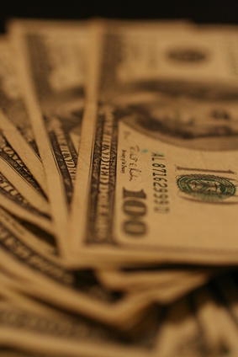

BUILDING MOMENTUM TO A GLOBAL ECONOMIC COLLAPSE The Untold Story of the Inevitable Consequences of Centuries of Entrenched Privilege
EPISODE 1

Slide 2
Money Market Funds Started the Dominoes Falling; Reagan did the Rest

Slide 3
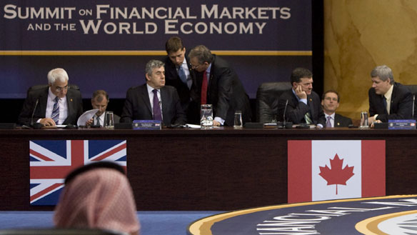
Written by
Edward J. Dodson, M.L.A.

Slide 4
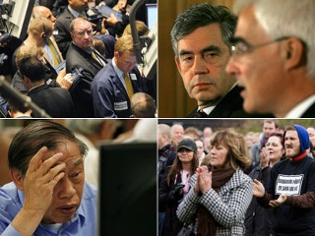
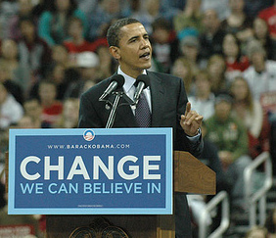
Notes:
The world’s political leaders desperately tried to convey to us that they had taken the steps required to prevent collapse of the global financial and economic systems. Decades of deregulation and “trickle down” economic policies, to some degree, ended under Barack Obama in response to evidence of widespread fraud and violations of law.

Slide 5

Notes:
What should concern all of us is that the measures adopted did not address the fundamental causes of this and every previous economic crisis.

Slide 6


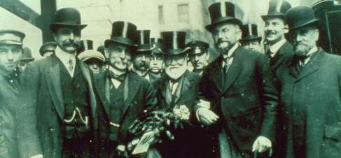
Notes:
My analysis of economic history reveals that the root cause is entrenched privilege -- secured and protected by laws and public policies adopted over a period of centuries. The politically-powerful few have as a consequence benefited unconscionably at the expense of the general population in every society.

Slide 7
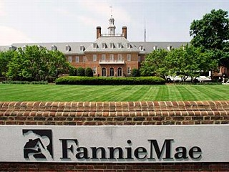
Notes:
I spent most of my working years in the banking and financial services industry, the last twenty years as a market analyst and business manager in the Housing & Community Development group at Fannie Mae.

Slide 8
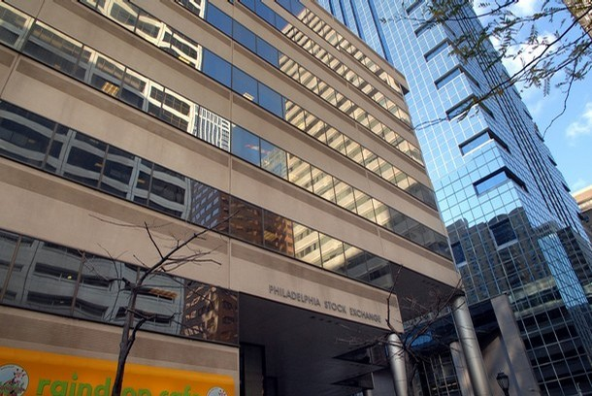
Notes:
The office I worked from was located here in Philadelphia, in the building that then housed the Philadelphia Stock Exchange.

Slide 9
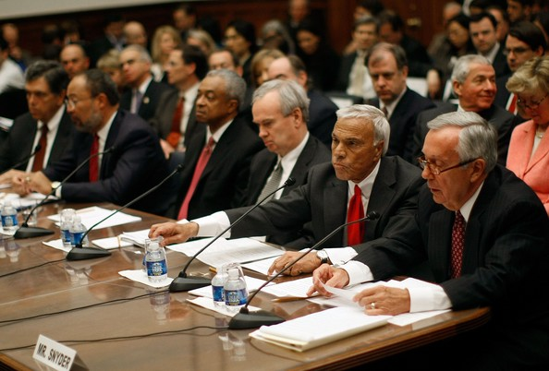
Notes:
I retired in 2005 just before Wall Street, the credit rating agencies, the insurance giants and the world’s largest banking entities began to flood the global markets with mortgage-backed securities collateralized to a significant extent by so-called “subprime” mortgage loans.

Slide 10
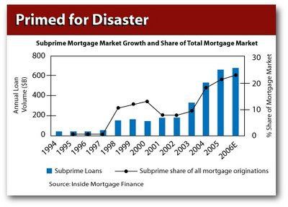
Notes:
This was business the traditional secondary mortgage market players – Fannie Mae, Freddie Mac and Ginnie Mae – largely rejected because of the known increased risk of borrower default. The way these loans were marketed and the questionable creditworthiness of many of the borrowers should have alerted regulators that a financial disaster was building. Those of us working in the trenches of the business were very aware that a disaster was on the horizon.

Slide 11

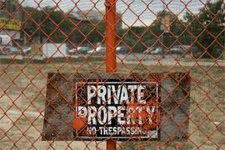
Notes:
Yet, what is not generally acknowledged is that this last period of high risk investment behavior was a consequence and not the cause of the economic crisis. The stage for this last collapse was set in laws relating to property and taxation enacted centuries ago. Importantly, none of these systemic conditions has been corrected.

Slide 12
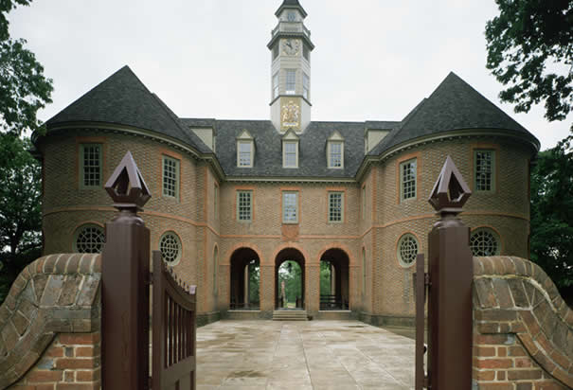
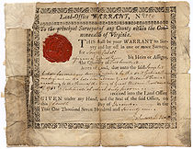
Land Office Warrants
KEY TO LANDED PRIVILEGE
Notes:
In this series, I will trace the origins of the recent financial and economic meltdown, looking back in history to the sources of privilege that have virtually guaranteed the boom-to-bust nature of the economic system that prevails in the United States and other social democracies.

Slide 13

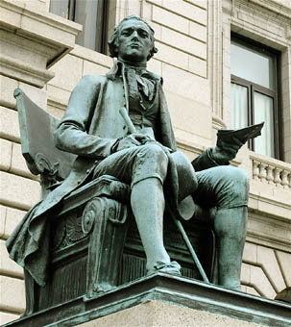
“A national debt, if it is not excessive, will be to us a national blessing.” Alexander Hamilton
Notes:
The ideas that formed the U.S. economic system, embraced by men such as Alexander Hamilton, are alive and well today. Hamilton believed, “A national debt, if it is not excessive, will be to us a national blessing.” Whether Hamilton would consider the current debt incurred by the United States and most other governments today excessive is an interesting question, indeed.

Slide 14
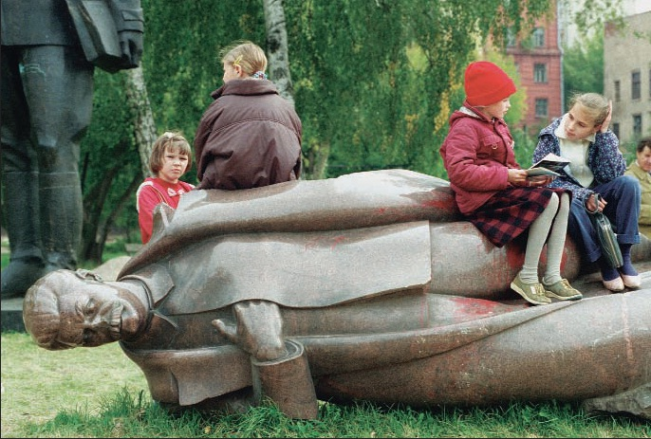
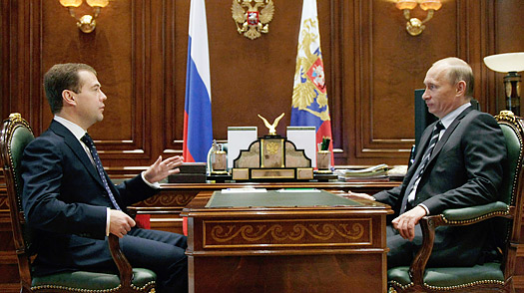
Notes:
As we begin this journey, I want to first comment on the disastrous experience of the Soviet style command economy, where bureaucracy and corruption guaranteed an economic collapse and an end to state-socialism in Russia. There are also lessons to be learned by briefly examining the path taken by the leaders of post-communist Russia.

Slide 15
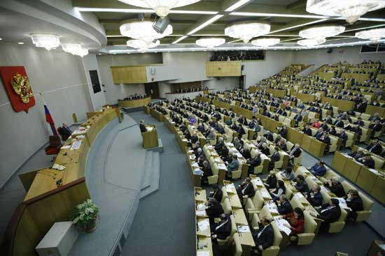
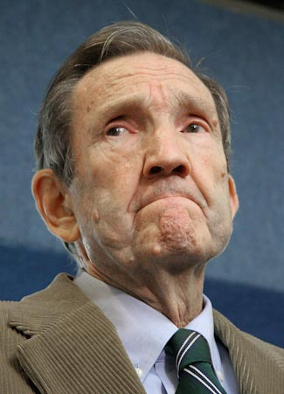
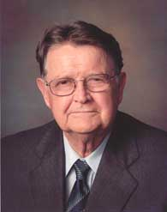
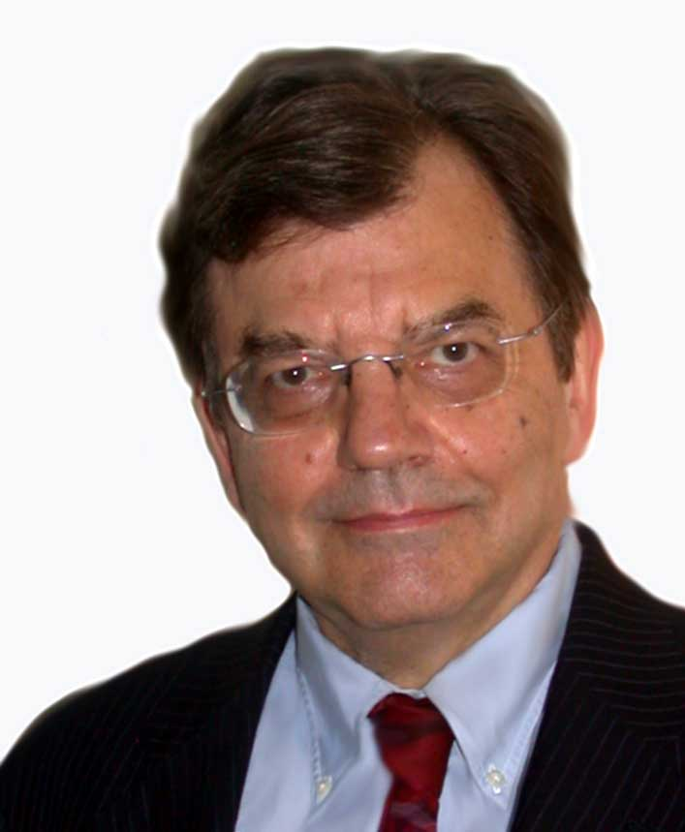
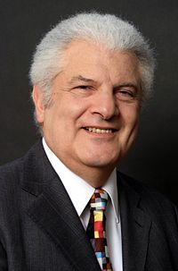
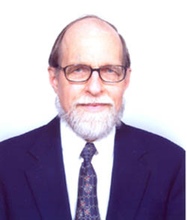
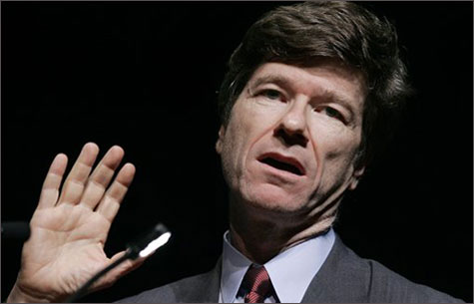
Ramsey Clark (former U.S. Attorney General)
Mason Gaffney (economist)
Michael Hudson (economist)
Fred Harrison (economist)
Nicolaus Tideman (economist)
Jeffrey Sachs
Notes:
Back in the mid-1990s, I was a member of this team of Western advisers who traveled to Russia to do what we could to counter the advice being given to the Russians by advisers such as Jeffrey Sachs. We sought to help the Russian people develop a market-oriented economy that might avert the boom-to-bust experiences of Western market-oriented economies .

Slide 16
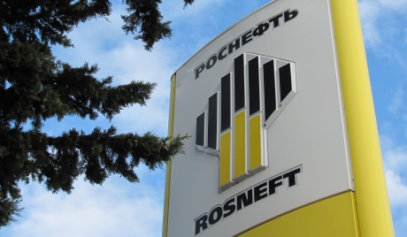
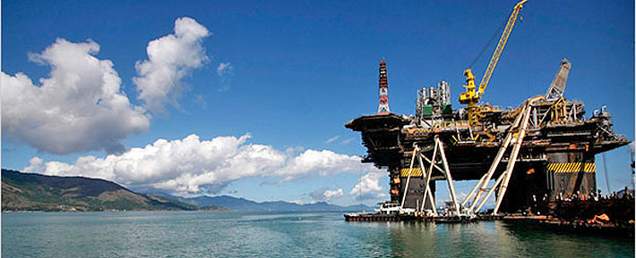



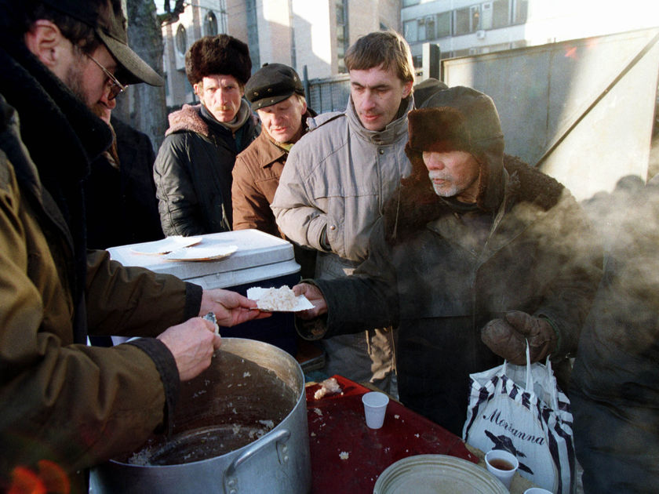
Notes:
Several members of the team made numerous trips back to Russia, meeting with officials and offering sound economic advice, to no avail. The Russian leaders rushed ahead with privatization, influenced by those who were in a position to benefit most while removing the thin safety net that socialism had provided for the general population.

Slide 17
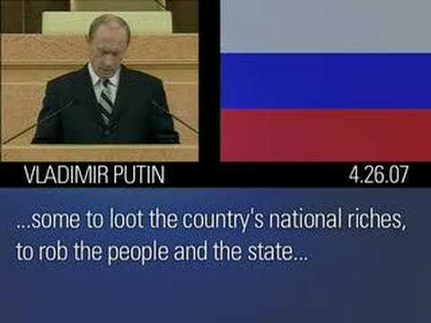
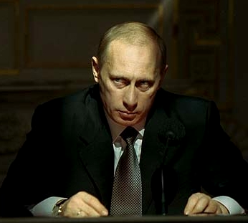
Notes:
Soviet-style privilege was replaced with Western-style privilege, resulting in a frenzied period of speculation and political intrigue that left the majority of Russians out in the cold.

Slide 18
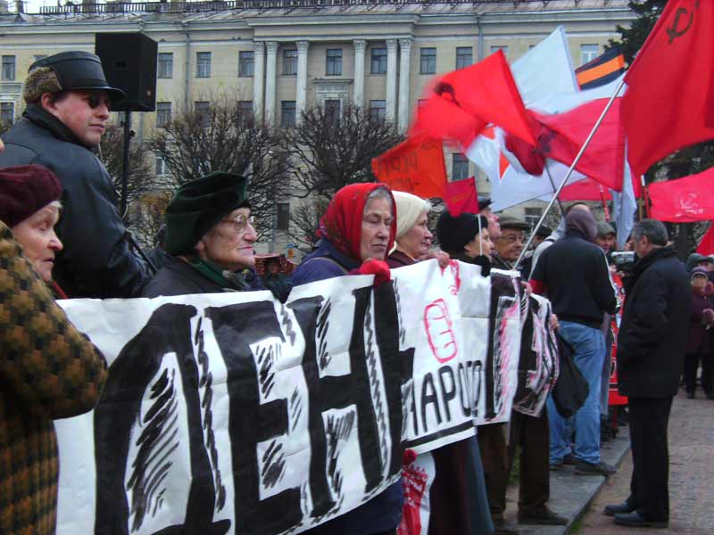
Notes:
Making the trip to Russia at that time seemed like an opportunity to change the course of history. My own professional work and academic studies turned me into an activist. I came to understand that our own society desperately needed changes in our laws relating to property and taxation. Perhaps, just perhaps, our explanation of what caused the periodic crashes of Western economies would help prevent the Russians from making the same mistakes.

Slide 19
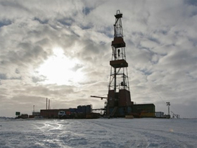
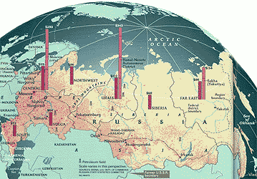
Notes:
But, the Russian leaders had already started the giant give-away of the nation’s common heritage – its land and natural resources.

Slide 20
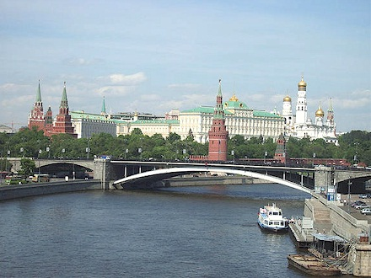
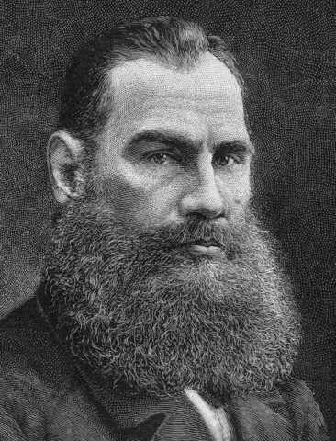
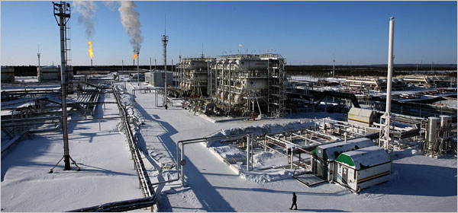
Count Leo Tolstoy
Notes:
Our thought was that if the Russians could be persuaded to allocate government-owned land by competitive bidding and by leaseholds rather than outright sales, the Russian government would secure a stable source of revenue to rebuild its infrastructure and pay for social welfare programs. Ironically, this very proposal had been made to the Russian Czar by Count Tolstoy as the solution to Russia’s social unrest in at the turn of the 20th century.

Slide 21
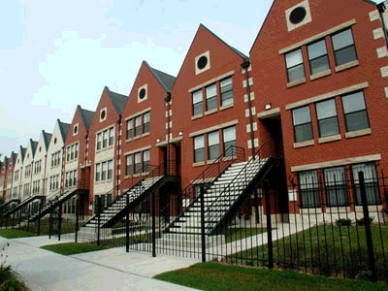
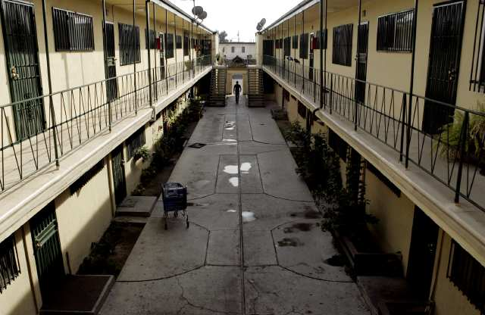

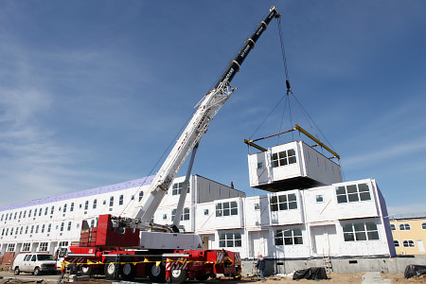
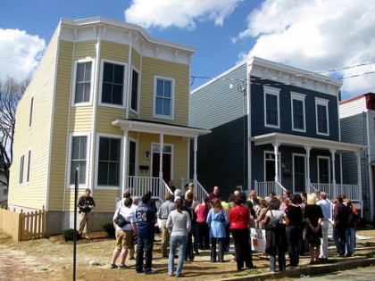
Notes:
Our mission to Moscow, and all that followed, failed to bring about the changes we argued for. Back at work here in the United States, my responsibilities were to work with public and private groups to come up with affordable housing and community revitalization initiatives. We sincerely believed that greater opportunity for homeownership would improve the lives of minorities and lower-income families..

Slide 22
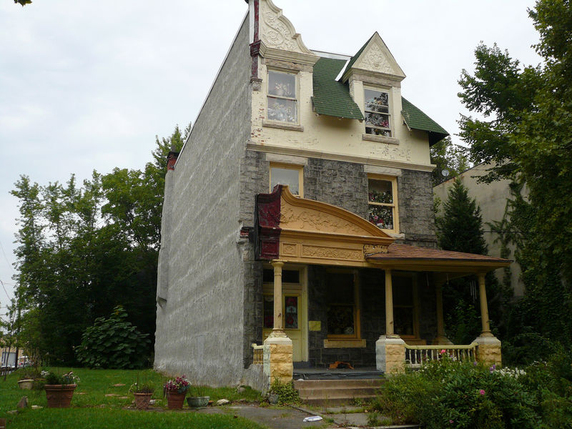
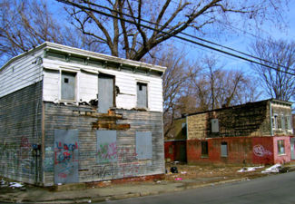
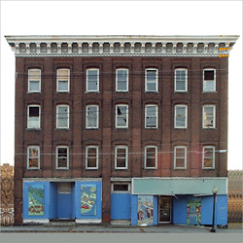
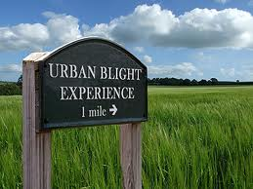
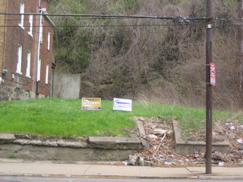
Notes:
Cities and towns often had land to offer to developers, but the land was in parts of their cities where household incomes were extremely low, where public amenities were few, schools poorly rated and the incidence of crime and gang presence high.

Slide 23

Notes:
The construction of new housing units would not by itself create vibrant and healthy communities. Distressed communities needed businesses creating employment opportunities for residents. Public services needed to be improved and revenue found to pay for these services.

Slide 24
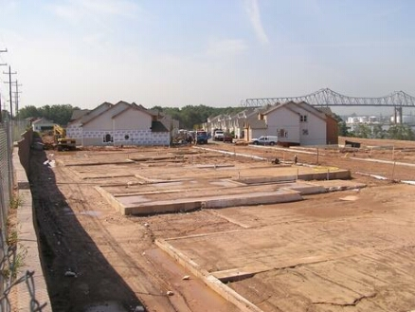
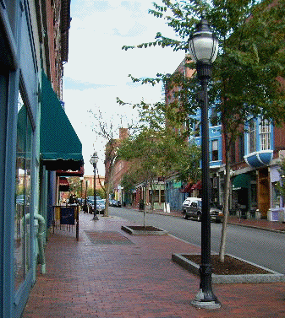

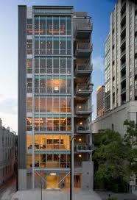
Notes:
Where people wanted to live, land costs were already high and beginning to skyrocket. To create at least some housing options affordable to moderate-income households, municipal governments provided construction subsidies or adopted “inclusionary zoning” that set aside a certain percentage of new housing units based on household income.

Slide 25
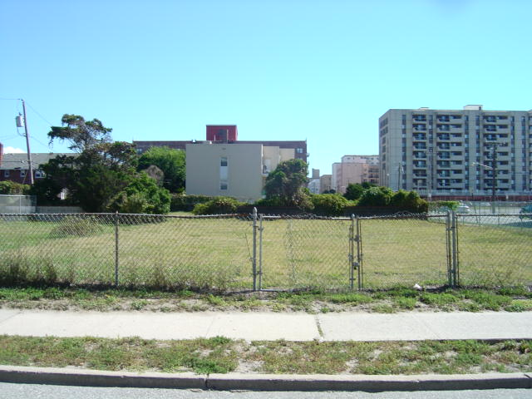
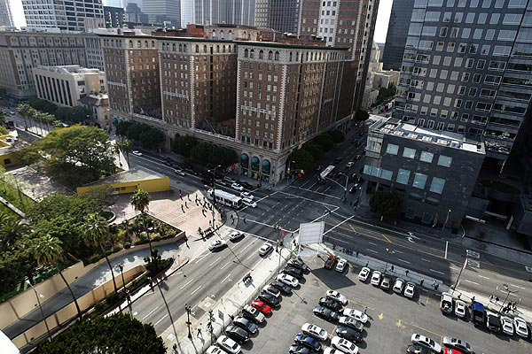
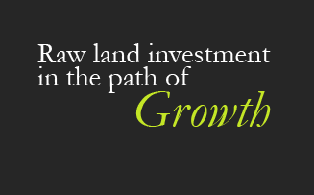
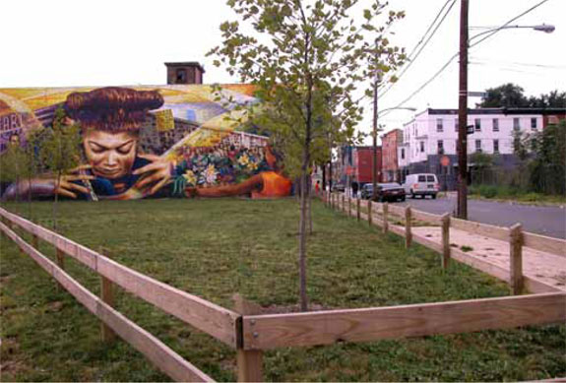
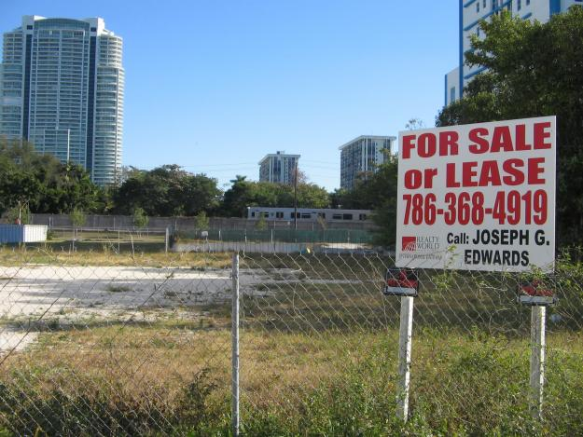

Notes:
Always, public agencies and community development groups faced competition for land from speculators.

Slide 26



Notes:
You have heard investigative reporters say that if you want to solve many types of crimes “follow the money.” Money and, more specifically, credit is an accelerant the financial system adds to an already burning fire of speculative investment behavior.

Slide 27





Notes:
Individuals need access to credit to purchase goods that would otherwise require saving over years or decades. We know something is terribly wrong when hundreds of millions of people are relying on credit, extending payments out over many years, to meet basic needs. As this chart reveals, this was certainly the case as the nation spiraled toward a financial meltdown at the end of 2007.

Slide 28



Notes:
Businesses also needs access to credit to cover production costs until sales revenues are collected. Yet, thousands of businesses became so highly leveraged they failed when sales volumes or market prices fell below expectations.

Slide 29




Notes:
The repeated meltdowns of our financial system hides the fact that deeper forces are at work. Bank failures are a symptom rather than a cause of the global economic crisis. In the next episode I will explain the role of the new money market funds and Reaganomics.

Slide 30
END OF EPISODE 1
Notes:
In the next episode, “Money Market Funds and Reaganomics” I will begin to explain the mystery of just what those forces are that brought us to the brink!

