Slide 1
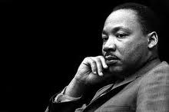
The Political Economy
of
Martin Luther King, Jr.

Slide 2
Written by
Edward J. Dodson, M.L.A.
Notes:
We know Martin Luther King, Jr. as the leader in the non-violent approach to gaining full civil liberties and equality of opportunity for people of color in the United States. Less appreciated is his broader concern to end the very existence of poverty.

Slide 3
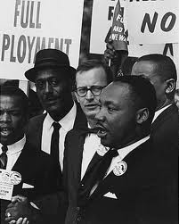
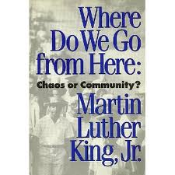
Notes:
In King’s 1967 book, Where Do We Go From Here: Chaos or Community?, he was looking ahead to the day when racial discrimination was no longer tolerated. He knew this would not bring an end to poverty. More had to be done. Deep changes in the nation’s economic system were called for, he was convinced.

Slide 4
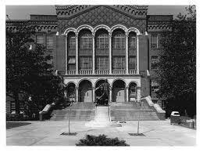
Booker T. Washington High School, Atlanta, Georgia
Notes:
King was born in Atlanta, Georgia in 1929, attending the Booker T. Washington High School until 1944.

Slide 5
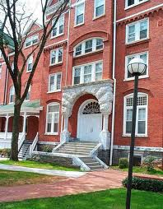
Morehouse College, Atlanta, Georgia
Notes:
Although he had not formally graduated from his high school, he was admitted to Morehouse College.

Slide 6
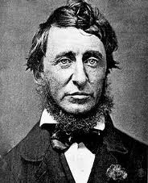
Henry David Thoreau
Notes:
At Morehouse, King was introduced to the writings of Henry David Thoreau, which had a lasting influence on the direction of his activism. He later wrote:

Slide 7
“During my student days I read Henry David Thoreau's essay ‘On Civil Disobedience’ for the first time. Here, in this courageous New Englander's refusal to pay his taxes and his choice of jail rather than support a war that would spread slavery's territory into Mexico, I made my first contact with the theory of nonviolent resistance.”
Notes:
“During my student days I read Henry David Thoreau's essay "On Civil Disobedience" for the first time. Here, in this courageous New Englander's refusal to pay his taxes and his choice of jail rather than support a war that would spread slavery's territory into Mexico, I made my first contact with the theory of nonviolent resistance.”

Slide 8
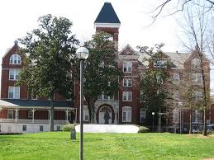
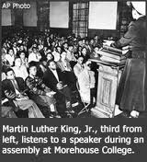
Morehouse College, Atlanta, Georgia
Notes:
He graduated from Morehouse College in 1948 and entered the Crozer Theological Seminary in Pennsylvania.

Slide 9
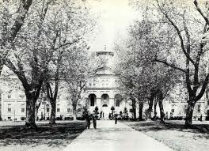
Crozer Theological Seminary Chester, Pennsylvania
Notes:
Now, while a student at Crozer, King began to broaden his study of what might be called ‘the great ideas’. He recalled:

Slide 10
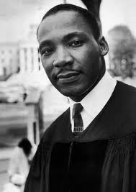
“I turned to a serious study of the social and ethical theories of the great philosophers, from Plato and Aristotle down to Rousseau, Hobbes, Bentham, Mill, and Locke. All of these masters stimulated my thinking -- such as it was -- and, while finding things to question in each of them, I nevertheless learned a great deal from their study.”
Notes:
“I turned to a serious study of the social and ethical theories of the great philosophers, from Plato and Aristotle down to Rousseau, Hobbes, Bentham, Mill, and Locke. All of these masters stimulated my thinking -- such as it was -- and, while finding things to question in each of them, I nevertheless learned a great deal from their study.”

Slide 11
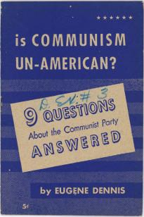
Notes:
King then decided to examine the rationale behind the communist ideology.

Slide 12

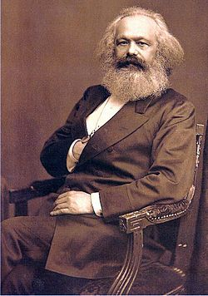
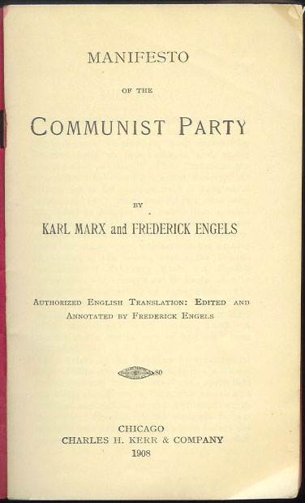
Karl Marx
Notes:
He read Das Kapital by Karl Marx as well as the Communist Manifesto .

Slide 13
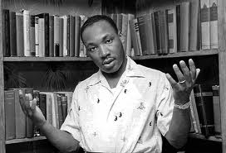
Notes:
As a devout Christian, King rejected the communist interpretation of history. Thus, although King thought Marxist ideology to be without principle, and even evil in its fundamental nature, he acknowledged why others might embrace it as a path to escape from long-standing oppressions. He wrote:

Slide 14
“With all of its false assumptions and evil methods, communism grew as a protest against the hardships of the underprivileged. Communism in theory emphasized a classless society, and a concern for social justice, though the world knows from sad experience that in practice it created new classes and a new lexicon of injustice. ...”
Notes:
“With all of its false assumptions and evil methods, communism grew as a protest against the hardships of the underprivileged. Communism in theory emphasized a classless society, and a concern for social justice, though the world knows from sad experience that in practice it created new classes and a new lexicon of injustice. ...”

Slide 15
“The Christian ought always to be challenged by any protest against unfair treatment of the poor.”
Notes:
“The Christian ought always to be challenged by any protest against unfair treatment of the poor.”

Slide 16
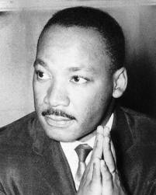
Notes:
Importantly, he came to the conclusion that capitalism as practiced was inherently unjust and in need to specific reforms.

Slide 17
“My reading of Marx also convinced me that truth is found neither in Marxism nor in traditional capitalism. Each represents a partial truth. Historically capitalism failed to see the truth in collective enterprise and Marxism failed to see the truth in individual enterprise. ...”
Notes:
“My reading of Marx also convinced me that truth is found neither in Marxism nor in traditional capitalism. Each represents a partial truth. Historically capitalism failed to see the truth in collective enterprise and Marxism failed to see the truth in individual enterprise. ...”

Slide 18
“Nineteenth-century capitalism failed to see that life is social and Marxism failed and still fails to see that life is individual and personal.”
Notes:
“Nineteenth-century capitalism failed to see that life is social and Marxism failed and still fails to see that life is individual and personal.”

Slide 19
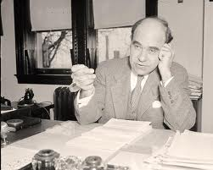
Mordecai Johnson
Notes:
In Philadelphia, he then heard a sermon by Dr. Mordecai Johnson, president of Howard University, who spoke of his recent trip to India and the teachings of Mahatma Gandhi.

Slide 20
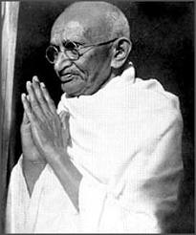
Mahatma Gandhi
Notes:
King immersed himself into a study of Gandhi's life and works. He came to embrace Gandhi’s strategy of non-violent resistance as the answer to the unfair treatment people of color received in the United States. The question then arises: to what extent was King also influenced by Gandhi’s views on reforms and how to end poverty?

Slide 21
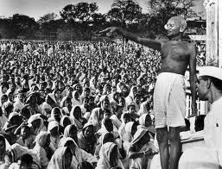
Notes:
Gandhi was a dedicated agrarian and championed the cause of the landless peasants. He supported the outright confiscation of land from India’s large landowners, to be distributed free of charge to the poor. It was his view that only those who actually worked the land should be permitted to own it. He declared:

Slide 22
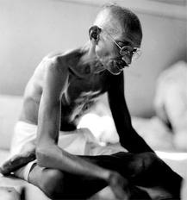
“Land and all properties is his who will work it.”
Notes:
“Land and all properties is his who will work it.”

Slide 23
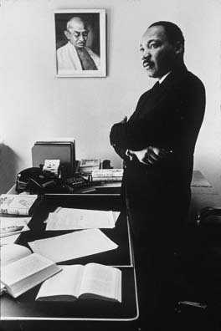
Notes:
Years later, King was able to make the journey to India to visit Gandhi’s place of birth. In a radio address made just before returning to the United States, he said:

Slide 24
"Since being in India, I am more convinced than ever before that the method of nonviolent resistance is the most potent weapon available to oppressed people in their struggle for justice and human dignity. ..."
Notes:
"Since being in India, I am more convinced than ever before that the method of nonviolent resistance is the most potent weapon available to oppressed people in their struggle for justice and human dignity. ..."

Slide 25
"In a real sense, Mahatma Gandhi embodied in his life certain universal principles that are inherent in the moral structure of the universe, and these principles are as inescapable as the law of gravitation."
Notes:
"In a real sense, Mahatma Gandhi embodied in his life certain universal principles that are inherent in the moral structure of the universe, and these principles are as inescapable as the law of gravitation."

Slide 26
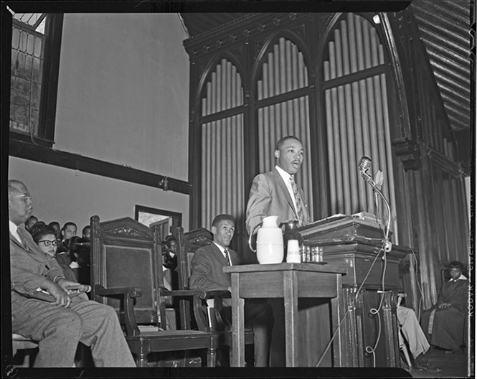
Notes:
In a November 1956 sermon, King presented an imaginary letter from the apostle Paul to American Christians, which stated:

Slide 27
"Oh America, how often have you taken necessities from the masses to give luxuries to the classes... God never intended for one group of people to live in superfluous inordinate wealth, while others live in abject deadening poverty."
Notes:
"Oh America, how often have you taken necessities from the masses to give luxuries to the classes... God never intended for one group of people to live in superfluous inordinate wealth, while others live in abject deadening poverty."

Slide 28
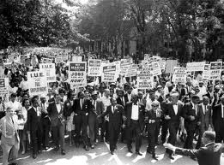

Notes:
Speaking in 1963, King talked about the poverty that crossed the color line:

Slide 29
“To this day the white poor also suffer deprivation and the humiliation of poverty if not of color. ..."
Notes:
“To this day the white poor also suffer deprivation and the humiliation of poverty if not of color. ...”

Slide 30
“It corrupts their lives, frustrates their opportunities and withers their education. In one sense it is more evil for them, because it has confused so many by prejudice that they have supported their own oppressors."
Notes:
“It corrupts their lives, frustrates their opportunities and withers their education. In one sense it is more evil for them, because it has confused so many by prejudice that they have supported their own oppressors.”

Slide 31

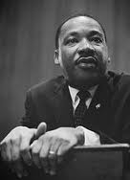
Notes:
King asked some of the same moral questions raised by others regarding the treatment of nature as private property:

Slide 32
"You see, my friends, you begin to ask the question, 'Who owns the oil?' You begin to ask the question, 'Who owns the iron ore?' You begin to ask the question, 'Why is it that people have to pay water bills in a world that is two-thirds water?”
Notes:
"You see, my friends, you begin to ask the question, 'Who owns the oil?' You begin to ask the question, 'Who owns the iron ore?' You begin to ask the question, 'Why is it that people have to pay water bills in a world that is two-thirds water?”

Slide 33
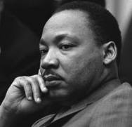
Notes:
Despite the history of how people of color were subjected to centuries of unjust law, King looked to government to secure economic rights. He described capitalism, as it existed, as a system:

Slide 34
“permitting necessities to be taken from the many to give luxuries to the few.”
Notes:
"permitting necessities to be taken from the many to give luxuries to the few.”

Slide 35
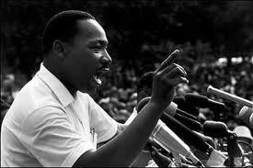
Notes:
The reforms he sought were directed toward achieving what political economists described as a just distribution of wealth. Government needed to be pressured to secure and protect economic as well as political rights. As King put it in a 1965 Speech to the Negro American Labor Council:

Slide 36
“The good and just society is neither the thesis of capitalism nor the antithesis of communism, but a socially conscious democracy which reconciles the truths of individualism and collectivism. ..."
Notes:
“The good and just society is neither the thesis of capitalism nor the antithesis of communism, but a socially conscious democracy which reconciles the truths of individualism and collectivism. ..."

Slide 37
“Call it democracy, or call it democratic socialism, but there must be a better distribution of wealth within this country for all God's children."
Notes:
“Call it democracy, or call it democratic socialism, but there must be a better distribution of wealth within this country for all God's children."

Slide 38
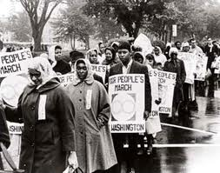
Notes:
King observed that in the world of 1963, people of color were the last hired and the first to be let go, all the more so because of improvements in the efficiency of industrial machinery:

Slide 39
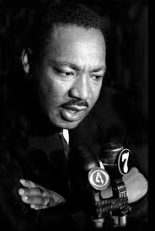
“The nation will also have to find the answer to full employment, including a more imaginative approach than has yet been conceived for neutralizing the perils of automation. ...”
Notes:
“The nation will also have to find the answer to full employment, including a more imaginative approach than has yet been conceived for neutralizing the perils of automation. ...”

Slide 40
“Today, as the skilled and semiskilled Negro attempts to mount the ladder of economic security, he finds himself in competition with the white working man at the very time when automation is scrapping forty thousand jobs a week. ...”
Notes:
“Today, as the skilled and semiskilled Negro attempts to mount the ladder of economic security, he finds himself in competition with the white working man at the very time when automation is scrapping forty thousand jobs a week. ...”

Slide 41
“Though this is perhaps the inevitable product of social and economic upheaval, it is an intolerable situation, and Negroes will not long permit themselves to be pitted against white workers for an ever-decreasing supply of jobs.”
Notes:
“Though this is perhaps the inevitable product of social and economic upheaval, it is an intolerable situation, and Negroes will not long permit themselves to be pitted against white workers for an ever-decreasing supply of jobs.”

Slide 42
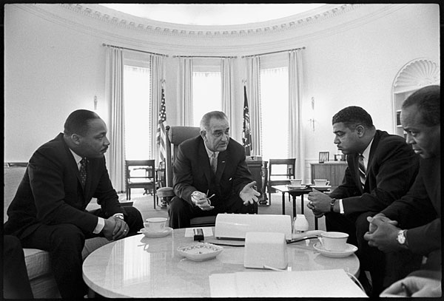
Notes:
King’s vision of a world in which all persons felt part of society rested on a realization of full employment. To that end, he sent a telegram to President Lyndon Johnson:

Slide 43
“I propose specifically the creation of a national agency that shall provide a job to every person who needs work, young and old, white and Negro. …I propose a job for everyone, not a promise to see if jobs can be found. …”
Notes:
“I propose specifically the creation of a national agency that shall provide a job to every person who needs work, young and old, white and Negro. ...I propose a job for everyone, not a promise to see if jobs can be found. ..."

Slide 44
“There cannot be social peace when a people have awakened to their rights and dignity and to the wretchedness of their lives simultaneously. If our government cannot create jobs, it cannot govern. It cannot have white affluence amid black poverty and have racial harmony.”
Notes:
“There cannot be social peace when a people have awakened to their rights and dignity and to the wretchedness of their lives simultaneously. If our government cannot create jobs, it cannot govern. It cannot have white affluence amid black poverty and have racial harmony."

Slide 45
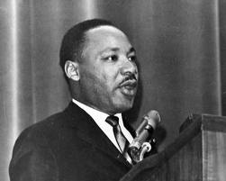
Notes:
King understood that without the opportunity to earn a decent living, the social conflicts would only escalate into political turmoil and violence, threatening the very life of the Democracy that was, potentially, the promise of the United States as a society. Because the private sector had failed to deliver a full employment economy, King called upon the federal government to fill the void:

Slide 46
“We must develop a federal program of public works, retraining, and jobs for all -- so that none, white or black, will have cause to feel threatened. At the present time, thousands of jobs a week are disappearing in the wake of automation and other production efficiency techniques.”
Notes:
“We must develop a federal program of public works, retraining, and jobs for all -- so that none, white or black, will have cause to feel threatened. At the present time, thousands of jobs a week are disappearing in the wake of automation and other production efficiency techniques.”

Slide 47
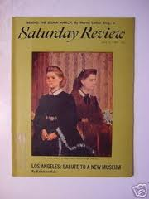
April 3, 1965
Notes:
In an article he wrote appearing in the April 3rd issue of Saturday Review during 1965, King acknowledged that racial and economic problems in the Northern states were far more serious than he had thought. King biographer David L. Lewis writes:

Slide 48
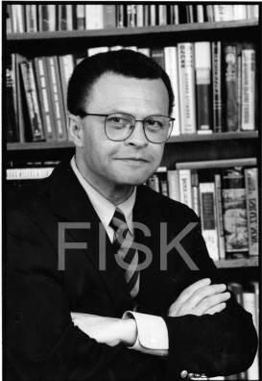
“The illusion of freedom in the North had masked its hideous economic conditions – matriarchal families whose morality was vitiated by perpetual dependence upon welfare programs, levels of unemployment that had actually risen in the decade since Montgomery, and agglutinations of the impoverished in substandard housing that had few equivalents even in the South.”
David L. Lewis
Notes:
“The illusion of freedom in the North had masked its hideous economic conditions – matriarchal families whose morality was vitiated by perpetual dependence upon welfare programs, levels of unemployment that had actually risen in the decade since Montgomery, and agglutinations of the impoverished in substandard housing that had few equivalents even in the South.”

Slide 49
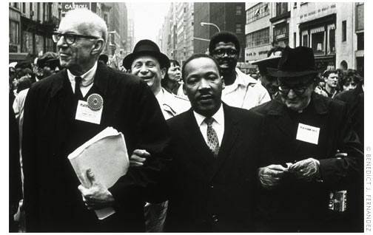
Notes:
Late in 1965, King arrived in Chicago to add strength to a coalition formed to take on Mayor Richard Daley and Chicago’s very real racial and economic segregation. High on King’s list of priorities was the terrible condition of rental housing units available to Chicago’s people of color and poor whites.

Slide 50
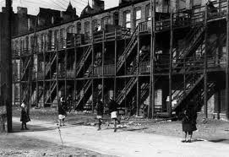
Notes:
King could feel gratified, to some degree, when in August of 1966, Chicago’s officials announced that $500 million would be invested in twenty-two depressed areas of the city over the next two years. Moreover, after prolonged negotiations with Mayor Daley, an agreement was reached that promised an end to housing discrimination.

Slide 51
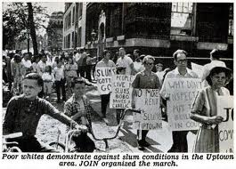
Notes:
The lessons learned from the Chicago campaign were significant, King wrote:

Slide 52
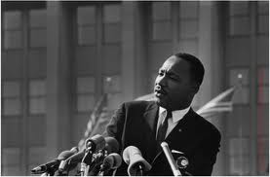
“For years I labored with the idea of reforming the existing institutions of the society, a little change here, a little change there. Now I feel quite differently. I think you’ve got to have a reconstruction of the entire society, a revolution of values.”
Notes:
“For years I labored with the idea of reforming the existing institutions of the society, a little change here, a little change there. Now I feel quite differently. I think you’ve got to have a reconstruction of the entire society, a revolution of values.”

Slide 53
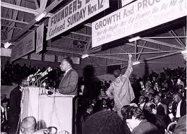
Strike support rally for sanitation workers -- 1968
Notes:
Under circumstances of widespread discrimination in the labor markets that faced people of color, they had little hope of better pay and working conditions. According to King, unionization was one of the few responses available to them:

Slide 54
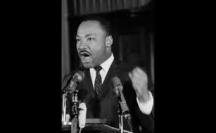
“Where Negroes are confined to the lowest paying jobs, they must get together to organize a union in order to have the kind of power that could enter into collective bargaining with their employers.”
Notes:
“Where Negroes are confined to the lowest paying jobs, they must get together to organize a union in order to have the kind of power that could enter into collective bargaining with their employers.”

Slide 55
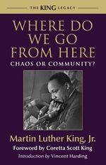
Notes:
King’s final book is also his statement of positions on raising the living standards of the poor among his fellow citizens:

Slide 56
"We must create full employment or we must create incomes. People must be made consumers by one method or the other. …We realize that dislocations in the market operation of our economy and the prevalence of discrimination thrust people into idleness and bind them in constant or frequent unemployment against their will. …"
Notes:
"We must create full employment or we must create incomes. People must be made consumers by one method or the other. …We realize that dislocations in the market operation of our economy and the prevalence of discrimination thrust people into idleness and bind them in constant or frequent unemployment against their will."

Slide 57
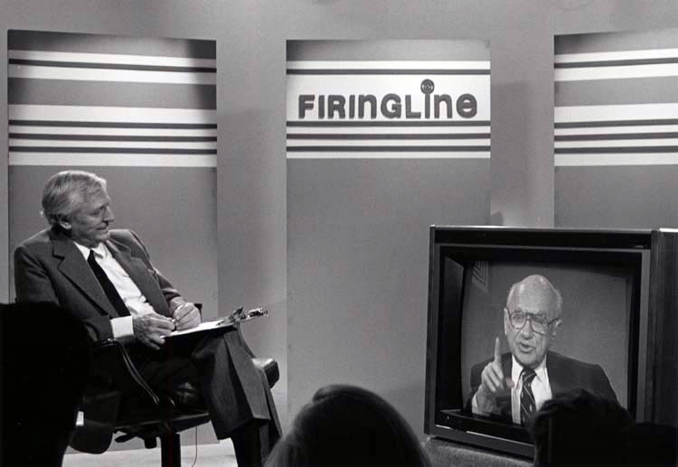
Notes:
What King understood is that the existing system never achieved full employment. Even without bigotry and prejudice there would always be a large number of people left outside the mainstream. Faced with the same observation, the economist Milton Friedman argued for a negative income tax as a means of enabling people to obtain necessary goods with the minimum involvement of social engineering and government bureaucracy. In 1968, Friedman answered William F. Buckley, Jr. on the merits of this proposal as follows:

Slide 58
“The proposal for a negative income tax is a proposal to help poor people by giving them money which is what they need, rather than as is now by requiring them to come before a governmental official, detail all their assets and liabilities and be told ‘you can spend x dollars on rent, y dollars on food, etc.’ and then be given a handout.”
Notes:
“The proposal for a negative income tax is a proposal to help poor people by giving them money which is what they need, rather than as is now by requiring them to come before a governmental official, detail all their assets and liabilities and be told ‘you can spend x dollars on rent, y dollars on food, etc.’ and then be given a handout.” King continued in his own analysis:

Slide 59
“Economic expansion alone cannot do the job of improving the employment situation of Negroes. It provides the base for improvement but other things must be constructed upon it, especially if the tragic situation of youth is to be solved. In a booming economy Negro youth are afflicted with unemployment as though in an economic crisis. They are the explosive outsiders of the American expansion. …”
Notes:
“Economic expansion alone cannot do the job of improving the employment situation of Negroes. It provides the base for improvement but other things must be constructed upon it, especially if the tragic situation of youth is to be solved. In a booming economy Negro youth are afflicted with unemployment as though in an economic crisis. They are the explosive outsiders of the American expansion.”

Slide 60
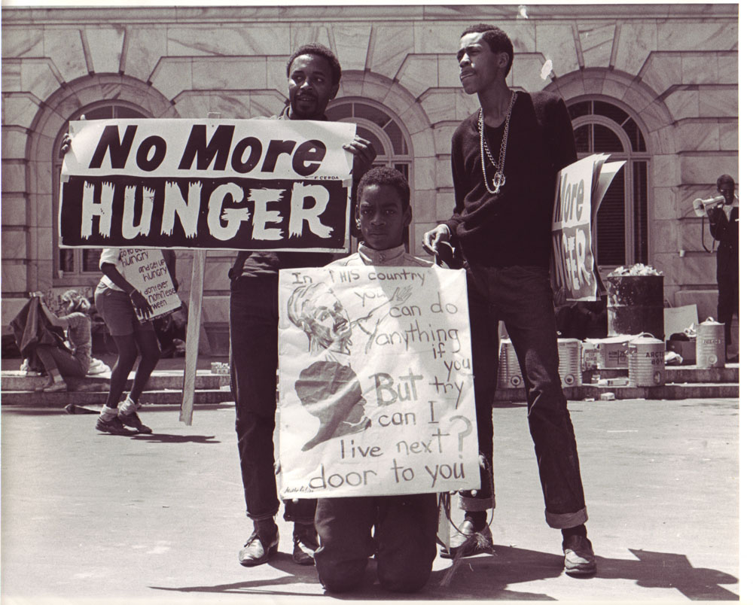
Notes:
Ever since families left the land for work in the cities, we have experienced high rates of youth unemployment. As King observes, the problems have always been far more acute in the sections of our cities with predominately poor households. And, of course, in many cities the number of African-Americans living in sections with few employers has always been the great. Adults found their way into low wage jobs but the unskilled youth were simply left out altogether.

Slide 61
“Depressed living standards for Negroes are not simply the consequence of neglect. Nor can they be explained by the myth of the Negro's innate incapacities, or by more sophisticated rationalization of his acquired infirmities (family disorganization, poor education, etc.). They are a structural part of the economic system in the United States. Certain industries are based on a supply of low-paid, under-skilled and immobile nonwhite labor.”
Notes:
“Depressed living standards for Negroes are not simply the consequence of neglect. Nor can they be explained by the myth of the Negro's innate incapacities, or by more sophisticated rationalization of his acquired infirmities (family disorganization, poor education, etc.). They are a structural part of the economic system in the United States. Certain industries are based on a supply of low-paid, under-skilled and immobile nonwhite labor.”

Slide 62
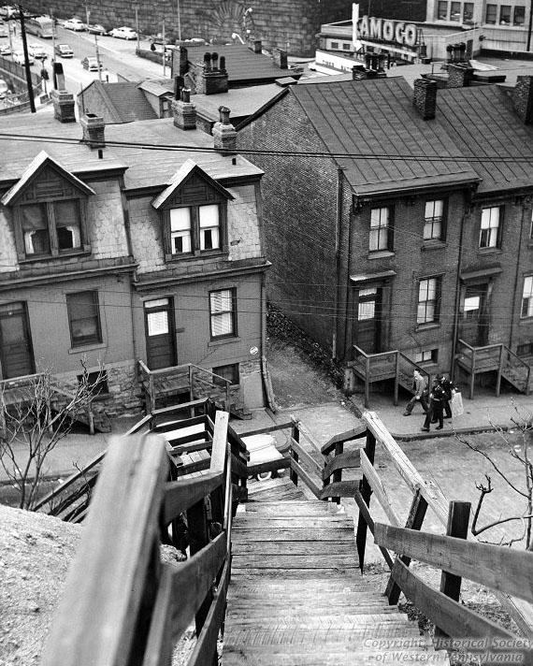
Notes:
The challenge was to identify the structural flaws in the nation’s economic system and press for changes in law. As the followers of Henry George knew, the answer was to be found by looking at who owns the land. For the poor living in American cities, few owned any land – or even a house.

Slide 63
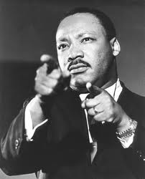
Notes:
In his famous April 1967 speech at Riverside Church in New York City, King made a damning indictment of a budgetary imbalance that continues to this day:

Slide 64
"A nation that continues year after year to spend more money on military defense than on programs of social uplift is approaching spiritual death."
Notes:
"A nation that continues year after year to spend more money on military defense than on programs of social uplift is approaching spiritual death."

Slide 65
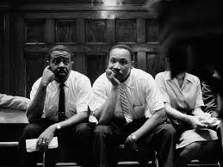
Notes:
Toward the end of his final book, King adds:

Slide 66
“I am now convinced that the simplest approach will prove to be the most effective -- the solution to poverty is to abolish it directly by a now widely discussed measure: the guaranteed income.”
Notes:
“I am now convinced that the simplest approach will prove to be the most effective -- the solution to poverty is to abolish it directly by a now widely discussed measure: the guaranteed income.”

Slide 67
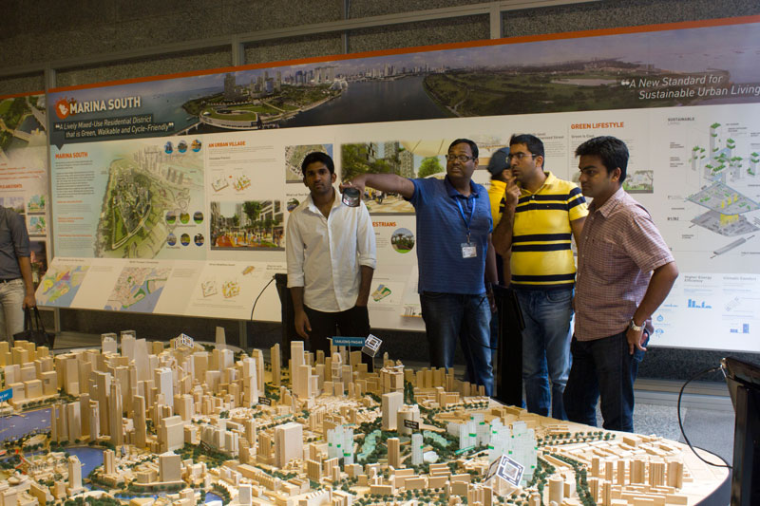
Notes:
The problem with this measure is similar to the problem of the negative income tax proposed by Milton Friedman. King can be forgiven for failing to see the outcome. Friedman, the economist, should have thought the issue through more thoroughly. Increase household incomes broadly without increasing the supply of housing and most of the increase in disposable income will end up in the pockets of landlords. At minimum, government would need to construct millions of new housing units priced to be affordable to lower-income households.

Slide 68
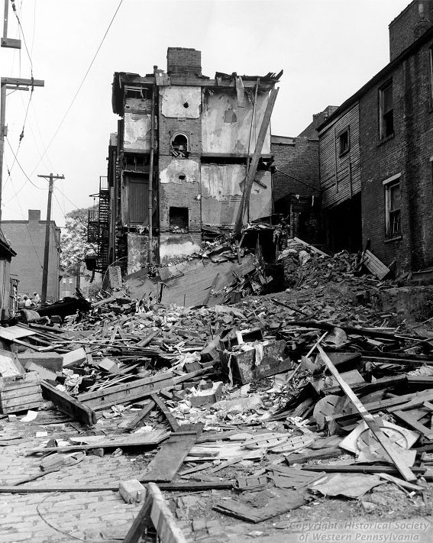
Notes:
By the time King wrote his final book, a large portion of the residential properties in U.S. cities was crumbling from age and neglect.

Slide 69
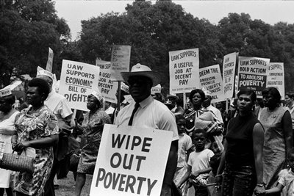
Notes:
Martin Luther King Jr. was working hard to get people to Washington, DC. in 1968. The Southern Christian Leadership Conference initiated the Poor People's Campaign, and King stood with them.

Slide 70
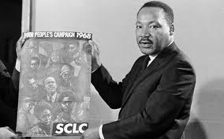
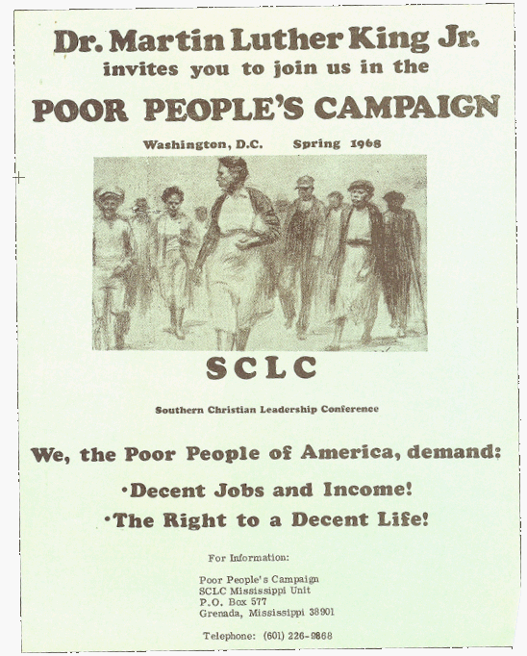
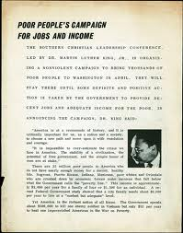
Notes:
As King prepared to join the Poor People’s Campaign march on Washington, he added his voice to those calling for an economic bill of rights. He called for guaranteed employment for all willing and able to work, a living income for those not able to work, an end to discrimination in the access to decent, affordable housing, and the integration of the nation’s schools.

Slide 71
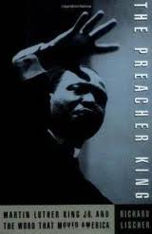

Richard Lischer
Notes:
In Richard Lischer’s 1995 biography, The Preacher King, Lischer concludes:

Slide 72
“Martin Luther King was the last of the great liberals in America to identify the purposes of social reform with those of Christianity. …He routinely cast the struggle for civil rights in terms of light and darkness, good and evil, and the two kingdoms.”
Notes:
“Martin Luther King was the last of the great liberals in America to identify the purposes of social reform with those of Christianity. …He routinely cast the struggle for civil rights in terms of light and darkness, good and evil, and the two kingdoms.”

Slide 73

Notes:
In an article in Look published just after he was murdered, Dr. King wrote:

Slide 74
"We call our demonstration a campaign for jobs and income because we feel that the economic question is the most crucial that black people, and poor people generally, are confronting. …"
Notes:
"We call our demonstration a campaign for jobs and income because we feel that the economic question is the most crucial that black people, and poor people generally, are confronting. …"

Slide 75
“There is a literal depression in the Negro community. When you have mass unemployment in the Negro community, it's called a social problem; when you have mass unemployment in the white community, it's called a depression. ...”
Notes:
“There is a literal depression in the Negro community. When you have mass unemployment in the Negro community, it's called a social problem; when you have mass unemployment in the white community, it's called a depression. ..."

Slide 76
“The fact is, there is a major depression in the Negro community. The unemployment rate is extremely high, and among Negro youth, it goes up as high as forty percent in some cities.”
Notes:
“The fact is, there is a major depression in the Negro community. The unemployment rate is extremely high, and among Negro youth, it goes up as high as forty percent in some cities."

Slide 77


Notes:
To summarize what I believe I learned in this examination of King’s positions on how to deal with poverty, he believed that government is there to ensure that all citizens have access to what Mortimer Adler called the goods of a decent human existence. In his experience, the system almost everyone chooses to call capitalism fails to deliver the goods. Therefore, the system had to changed and government had to intervene on behalf of those at the margin.

Slide 78
Notes:
King embraced democracy, but a social democracy distinct from the Social Darwinism defended by some who stand right of center.

Slide 79

Notes:
Unfortunatley, like most of his contemporaries who cared deeply about ending poverty, Martin Luther King, Jr. apparently did not fully grasp the extent to which privilege dictates economic outcomes in our country. Or, perhaps more accurately, he had not yet recognized some of the most powerful forms of entrenched privilege that plague our society.

Slide 80

Notes:
To be sure, his struggles helped to lessen privilege based on race or the color of one’s skin. Every day we observe how other forms of privilege continue to threaten our very democracy and stand in the way of a society built on equality of opportunity. As have many before and since, Martin Luther King, Jr. gave his life in an effort to help change the course of history.

Slide 81

The End
Notes:
THE END

