Slide 1

The State of the United States
ECONOMY and SOCIETY
Part 16

Slide 2
Sports: From Almost the Cradle to the Grave
Notes:
Engaging in athletics and competing in sporting events is an increasingly organized form of activity all across the United States, with huge effects on the nation’s economy. Preparing oneself to participate at a high performance level requires years of preparation. Millions of people – from the very young to seniors -- are actively engaged as participants, trainers, coaches, team managers, league organizers, medical professionals, marketers, vendors, groundskeeper, and so on and so on.

Slide 3
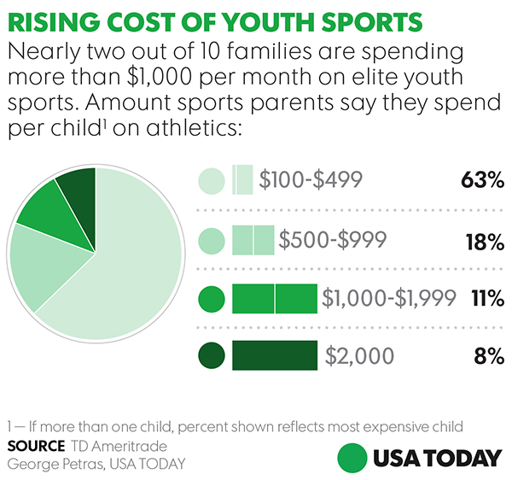
Notes:
3
A 2017 survey by TD Ameritrade of parents between age 30 and 60 who have at least $25,000 in investable assets, found that one in five U.S. households spends over $1,000 per month on youth sports, per child.

Slide 4
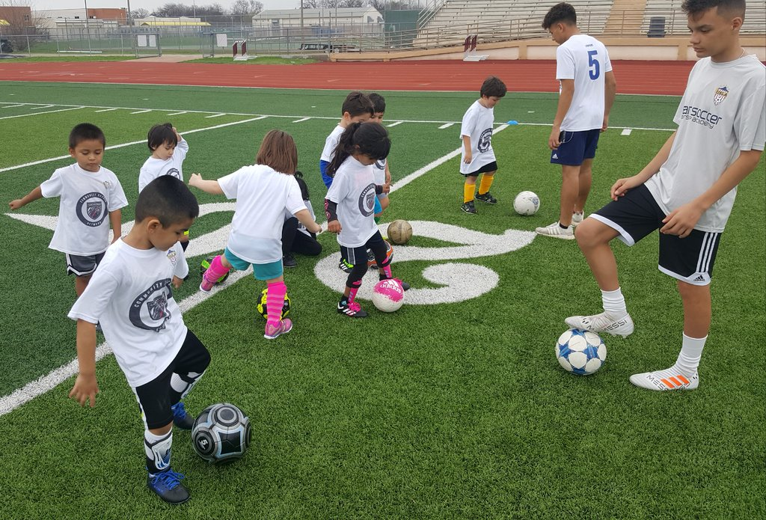
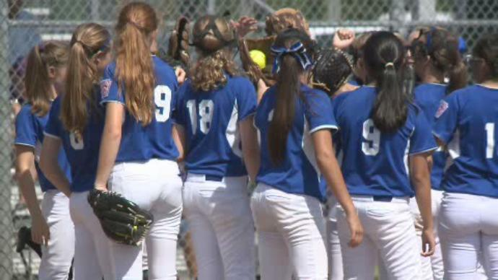
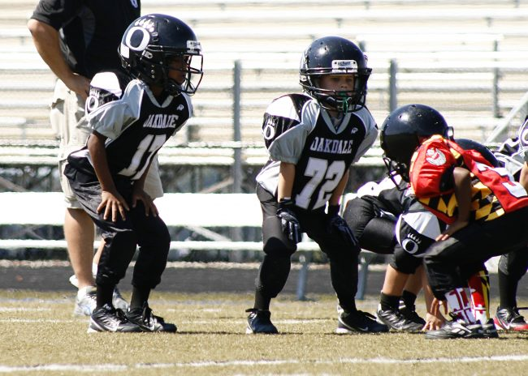
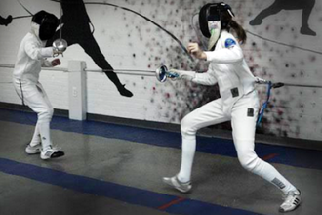
Notes:
4
Spending by households on youth sports tournaments, including the significant travel costs incurred, reached roughly $10.5 billion in 2016, a 26 percent increase just from 2012. [Source: National Association of Sports Commissions, Cincinnati, Ohio]

Slide 5

“The cost for parents is steep. At the high end, families can spend more than 10% of their income on registration fees, travel, camps and equipment.”
Notes:
5
“The cost for parents is steep. At the high end, families can spend more than 10% of their income on registration fees, travel, camps and equipment.” [Source: Sean Gregory. “How Kids’ Sports Became a $15 Billion Industry,” Time, 24 August, 2017]

Slide 6
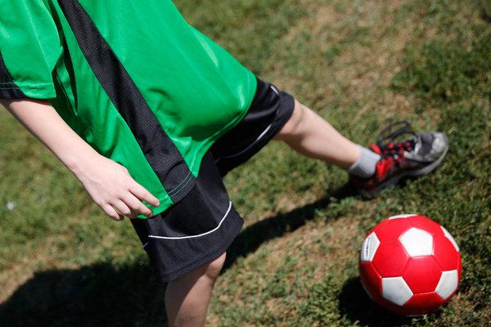
Notes:
6
However, as an increasing number of the nation’s youth have gravitated to electronic diversions, the sport that has experienced the steepest decline in participation has been youth soccer, except among the nation’s urban schools, according to a 2018 story in The New York Times:

Slide 7
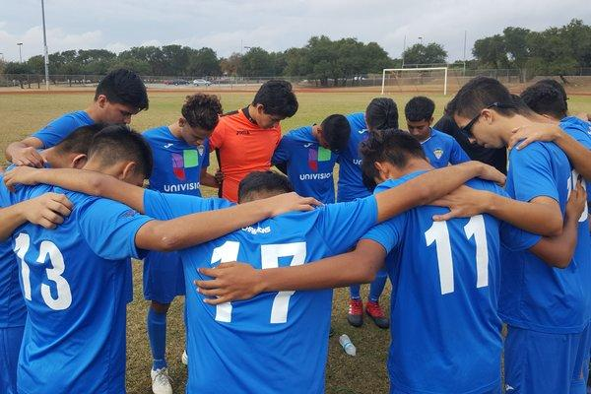
“Over the past three years, the percentage of 6- to 12-year-olds playing soccer regularly has dropped nearly 14 percent, to 2.3 million players, according to a study by the Sports & Fitness Industry Association, which has analyzed youth athletic trends for 40 years. The number of children who touched a soccer ball even once during the year, in organized play or otherwise, also has fallen significantly.”
Notes:
7
“Over the past three years, the percentage of 6- to 12-year-olds playing soccer regularly has dropped nearly 14 percent, to 2.3 million players, according to a study by the Sports & Fitness Industry Association, which has analyzed youth athletic trends for 40 years. The number of children who touched a soccer ball even once during the year, in organized play or otherwise, also has fallen significantly.”

Slide 8
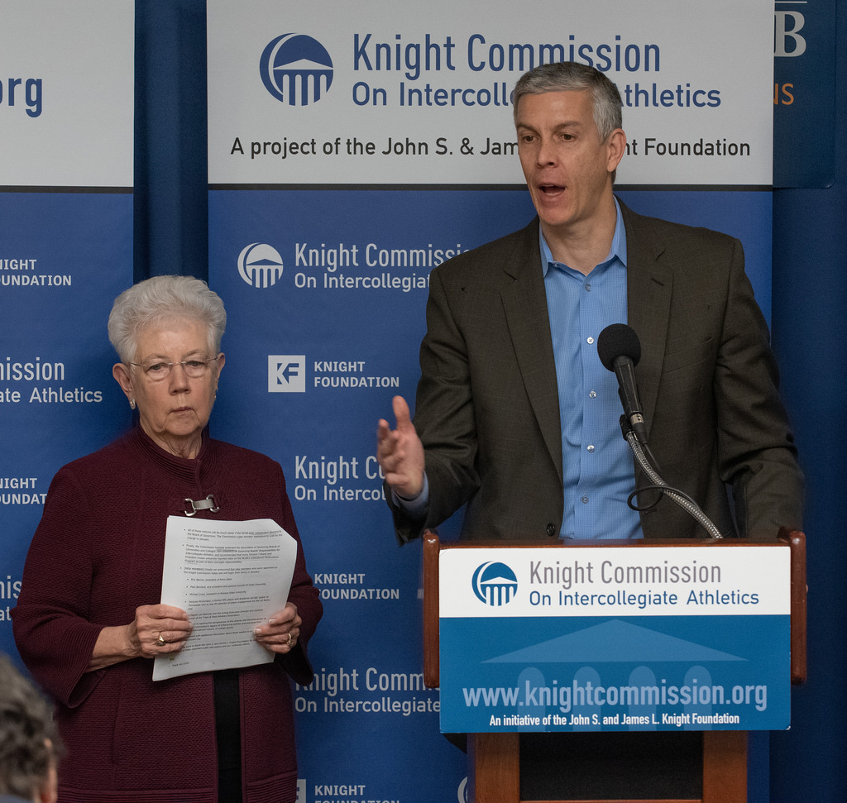
Notes:
8
A 2018 study by the Knight Commission on intercollegiate Athletics states that annual spending on sports by public non-profit universities in the largest conferences now exceeds $100,000 per student athlete (which is around 8-12 times the amount spent on academics per full time student). More than twenty universities spend more than $200,000 per football player. Part of the cost is paid by fees charged to all students.

Slide 9
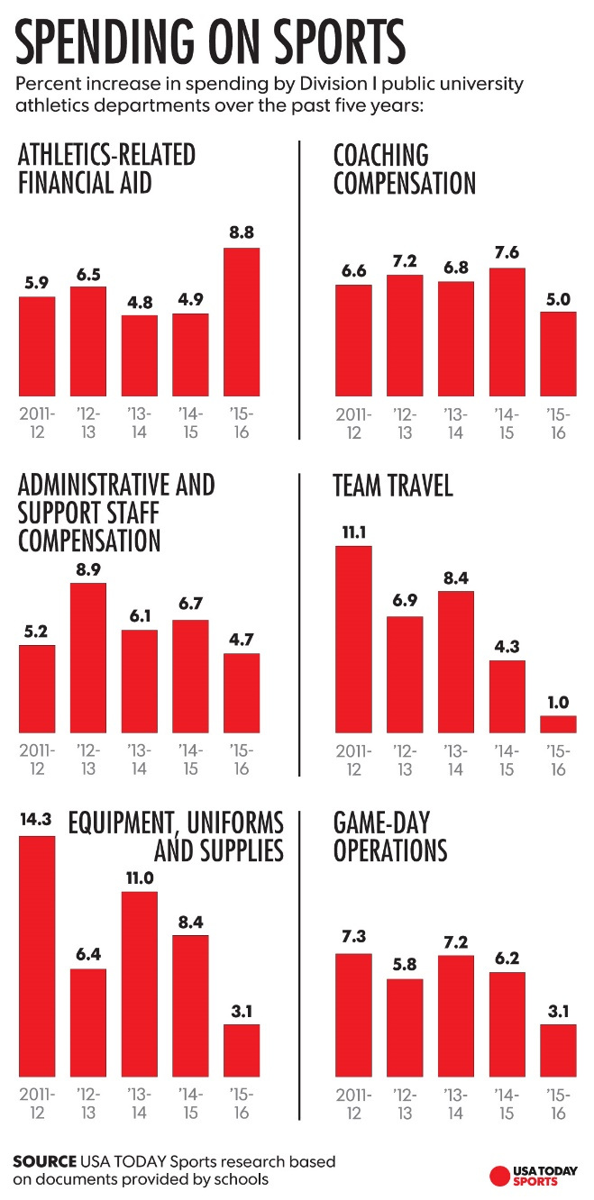
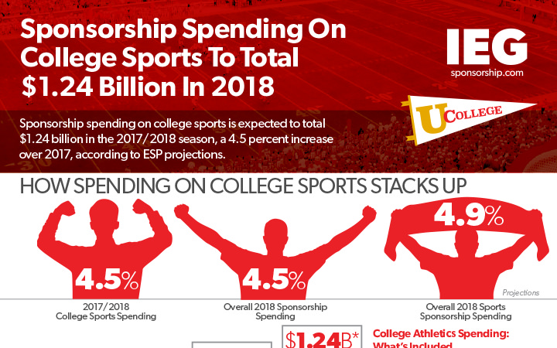
Notes:
9
Schools compete with huge salaries and program expansion plans to attract winning coaches. Millions of dollars are borrowed to finance the construction of new athletic buildings, stadiums, state-of-the-art technologies, travel costs, recruiting, scholarships for student athletes and growing staffs. State Farm Insurance, Google and Nissan are major sponsors of the NCAA and most individual conferences.

Slide 10
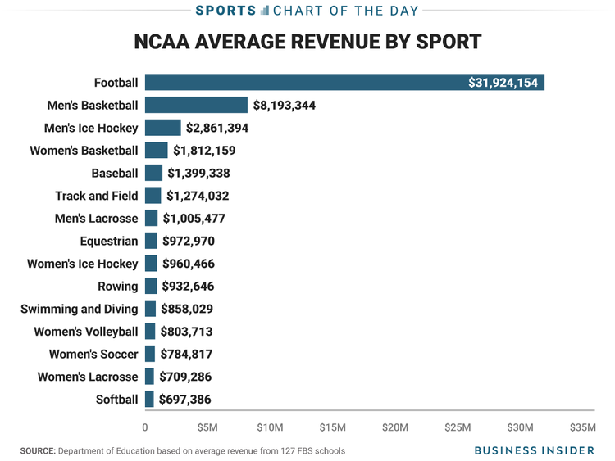
Notes:
10
What this chart does not reveal is that most athletic programs at public universities neither break even or enjoy a net positive operating income. A 2017 report in Bloomberg put the economics into its proper perspective:

Slide 11
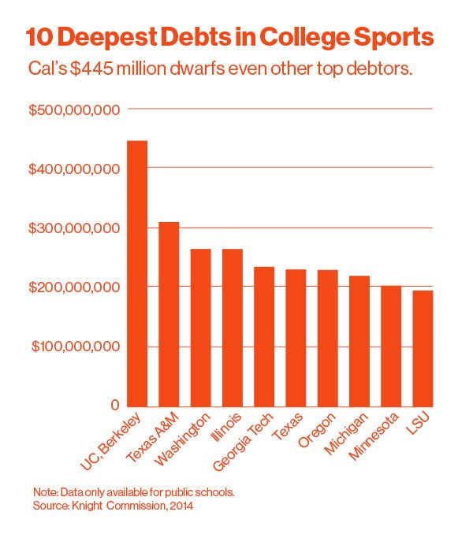
“[A]ccording to public records, athletic departments at at least 13 schools in the country have long-term debt obligations of more than $150 million as of 2014 – money usually borrowed to build ever-nicer facilities for the football team. …For some schools, millions in TV money can support a high level of debt service.”
Notes:
11
“[A]ccording to public records, athletic departments at at least 13 schools in the country have long-term debt obligations of more than $150 million as of 2014 – money usually borrowed to build ever-nicer facilities for the football team. …For some schools, millions in TV money can support a high level of debt service.” [Source: Eben Novy-Williams. “College Football’s Top Teams Are Built on Crippling Debt,” Bloomberg; 4 January, 2017]

Slide 12

Notes:
12
The major television networks pay the various conferences tens or hundreds of millions of dollars for the rights to broadcast football, basketball, and other intercollegeate sports. Digital live streaming may be a game-changer.

Slide 13
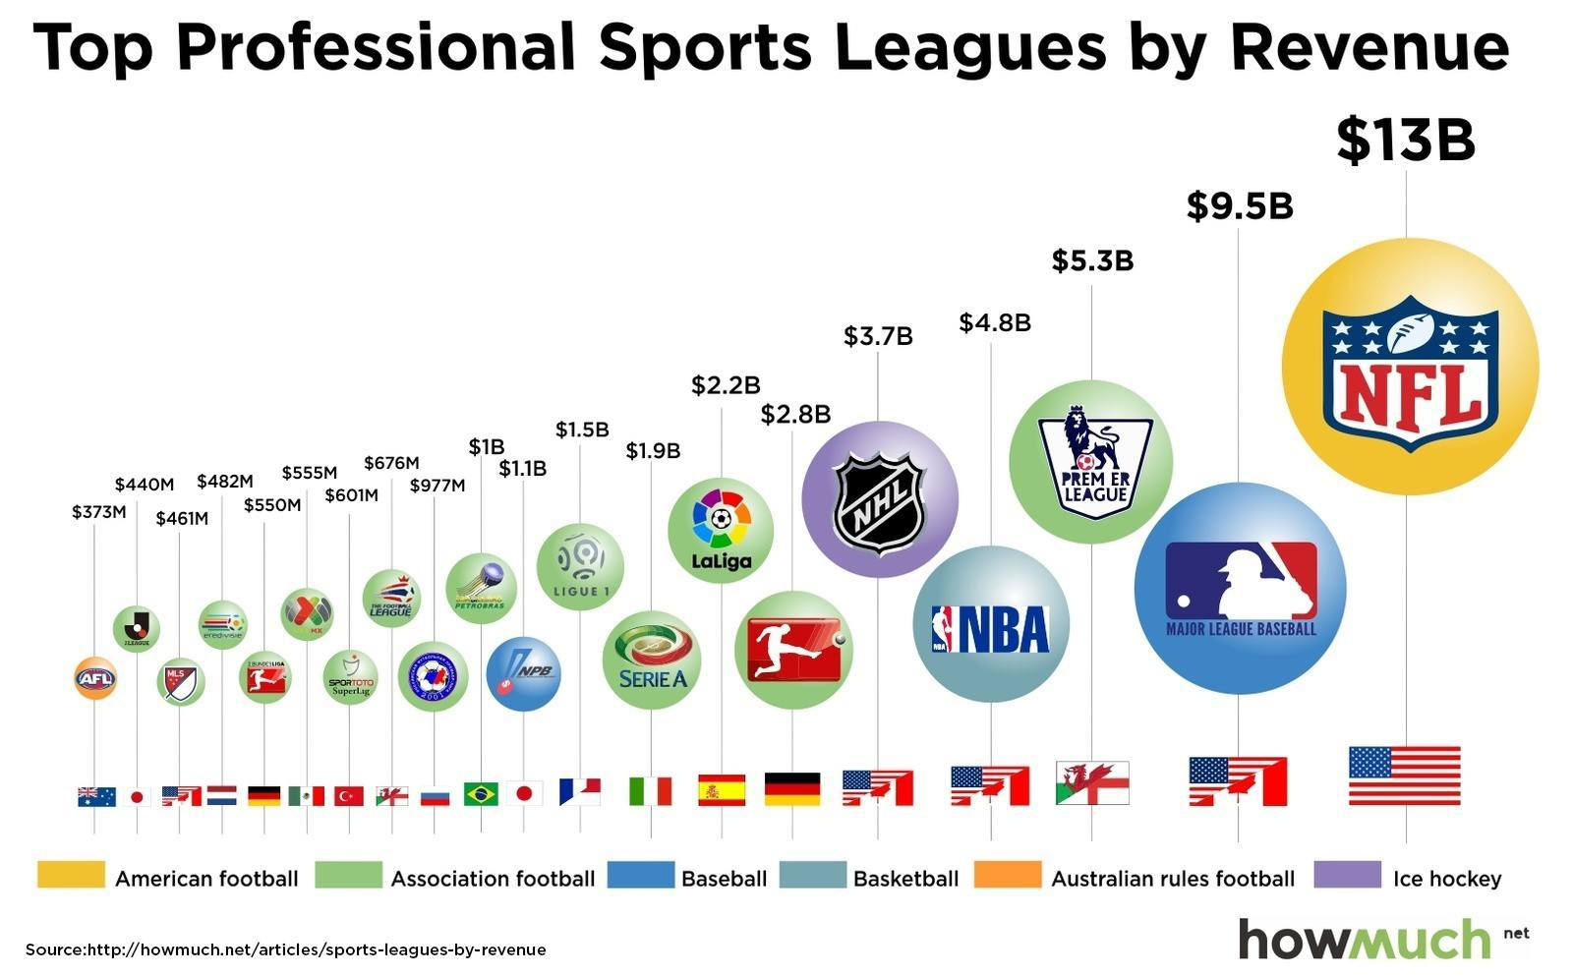
Notes:
13
Americans and the people of many other countries exhibit an almost unquenchable appetite for the activities and competitions engaged in by professional (that is, paid) athletes.

Slide 14
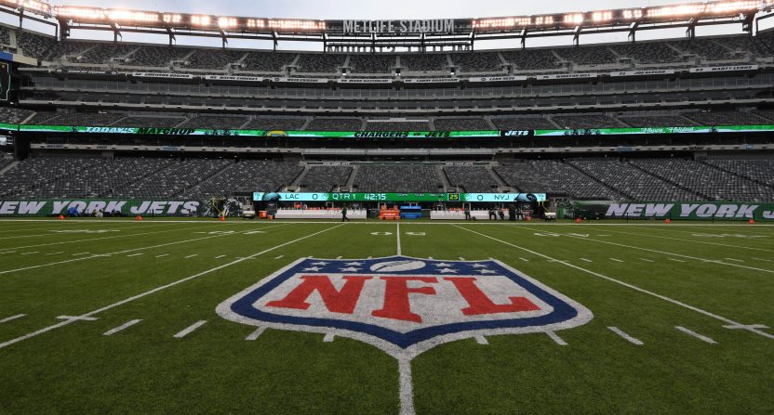
Notes:
14
By a significant margin, the National Football League generates the largest annual revenue of all professional sports leagues. The league consists of 32 teams, each paying players, coaches and all other personnel around $190 million in 2018. The leagues total annual payroll is, therefore, around $6 billion.

Slide 15
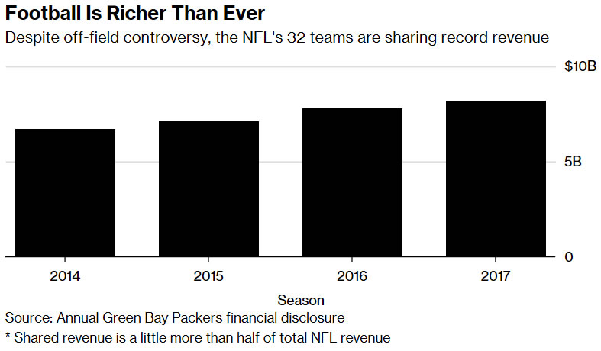
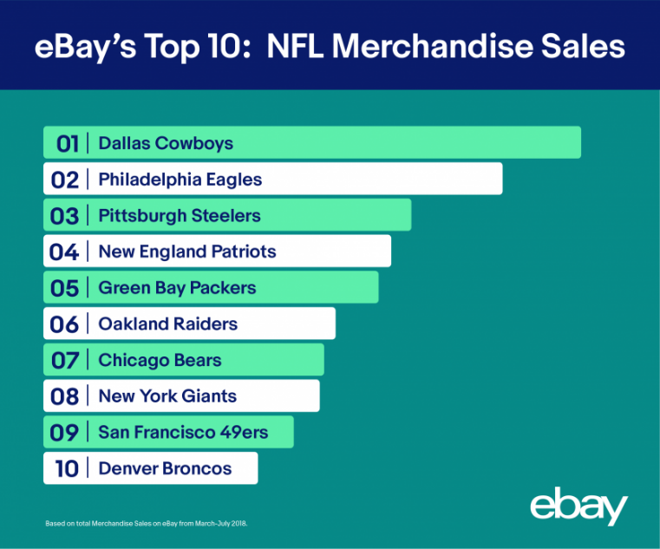
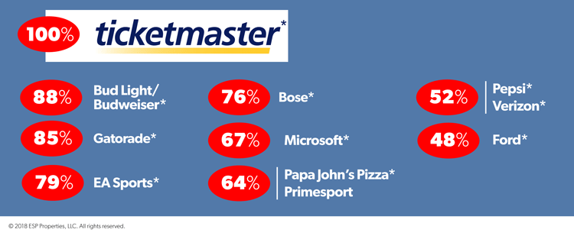
Notes:
15
Covering these expenses and generating a profit requires a huge infrastructure and organization. Games require stadiums seating up to 100,000 fans. Stadiums are all surrounded by huge parking areas. Team merchandise is for sale at the stadiums and online. Food and beverage sales generate significant revenue. The league earns $5 billion a year for broadcasting rights.

Slide 16

Notes:
16
And, then, there is this. An estimated $150 billion is wagered illegally on sports every year in the United States, some $95 billion of which is wagered on NFL and college football games.

Slide 17

Notes:
17
Nearly 60 million Americans participate in fantasy football leagues, spending an estimated $7.2 billion during the 2017 NFL season. One consideration for employers is that participants spend time while at work to perform the research required to put the best team of players in their lineup each week.

Slide 18
End of Part 16

