Slide 1

The State of the United States
ECONOMY and SOCIETY
Part 15

Slide 2

Notes:
We have many challenges facing us as a people. There is our system of law, which is not serving very consistently the hope of justice for all citizens. There is our system of taxation, which strongly benefits those who own land, control natural resources or enjoy government-granted subsidies and privileges over those who actually produce goods and provide services. There is the deep problem of poverty, and the problem of long-term unemployment for many people. There is the problem of how to protect our environment from further degradation, the loss of species of plants and animals. And, there is the problem of our reliance on fossil fuels and nuclear power to provide the energy to provide the power needed by our modern mode of living.

Slide 3

Notes:
3
Our homes, our places of work, where we shop or engage in almost any activity are linked together by a complex infrastructure network. That network requires continuous maintenance and periodic replacement. Maintenance and replacement requires public revenue. The subject and issues involved deserve a far more detailed analysis than I am able to present here, but what follows provides some examples of how our best, most innovative thinkers are responding to these challenges.

Slide 4
Notes:
4
We constantly hear about the problem of increasing carbon-dioxide in the atmosphere. Here is at least one response that has potential:

Slide 5
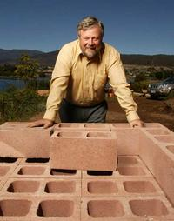
Notes:
5
The potential exists to capture carbon dioxide emissions in a new and unique manner: in the production of an eco-friendly type of concrete. The process is the invention of Australian John Harrison. The cement is a composite of magnesite, recycled industrial wastes, and ordinary cement. As it sets and hardens, it absorbs carbon dioxide from the atmosphere and converts it to carbonate. To date, however, the cement industry has refused to change its methods. Harrison expresses what he sees as the sense of urgency:

Slide 6
“I really do not think we have much time left with the atmosphere we have. It is time all the great thinkers of the world, combined with government funding, solved the problem in a manner similar to the way the atomic bomb was created.”
Notes:
6
“I really do not think we have much time left with the atmosphere we have. It is time all the great thinkers of the world, combined with government funding, solved the problem in a manner similar to the way the atomic bomb was created.” [Quoted in: Meir Rinde. “Concrete Solutions: Making eco-friendly cement is easy; the hard part comes later,”Distillations, Fall 2017]

Slide 7
Notes:
7
Remarkable, it is thought possible to generate nuclear energy without the risk of a disaster should a nuclear reactor melt down and release radioactive poisons.

Slide 8
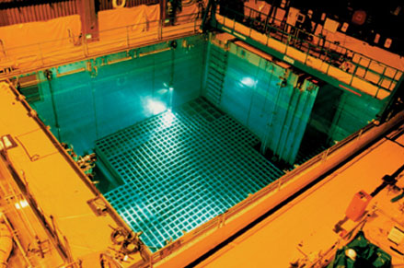
Notes:
8
Because no permanent repository for spent fuel exists in the United States, reactor owners have kept spent fuel at the reactor sites. As the amount of spent fuel has increased, the Nuclear Regulatory Commission has authorized many power plant owners to increase the amount in their storage pools to as much as five times what they were designed to hold. As a result, virtually all U.S. spent fuel pools have been “re-racked” to hold spent fuel assemblies at densities that approach those in reactor cores. In order to prevent the spent fuel from going critical, the spent fuel assemblies are placed in metal boxes whose walls contain neutron-absorbing boron.

Slide 9
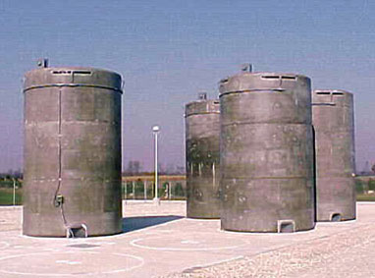
Notes:
9
The risks from spent fuel in storage pools can be reduced by moving some of it to dry casks. Typical dry casks are made of steel and concrete, with the concrete providing radiation shielding, and are stored at U.S. reactors outdoors on concrete pads. To become cool enough to be placed in the dry casks currently licensed and used in the United States, the spent fuel must first spend five years in a spent fuel pool. By then it is cool enough that further cooling can be accomplished by natural convection — air flow driven by the decay heat of the spent fuel itself.

Slide 10
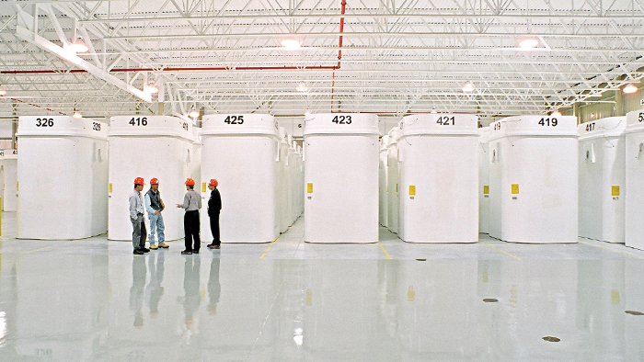
Notes:
10
Dry storage containers are made of reinforced high-density concrete about 510 millimetres (20 inches) thick and are lined inside and outside with 12.7-millimetre-thick (half-inch) steel plate. The thickness of concrete provides an effective barrier against radiation. The dry storage containers have a minimum design life of 50 years.

Slide 11
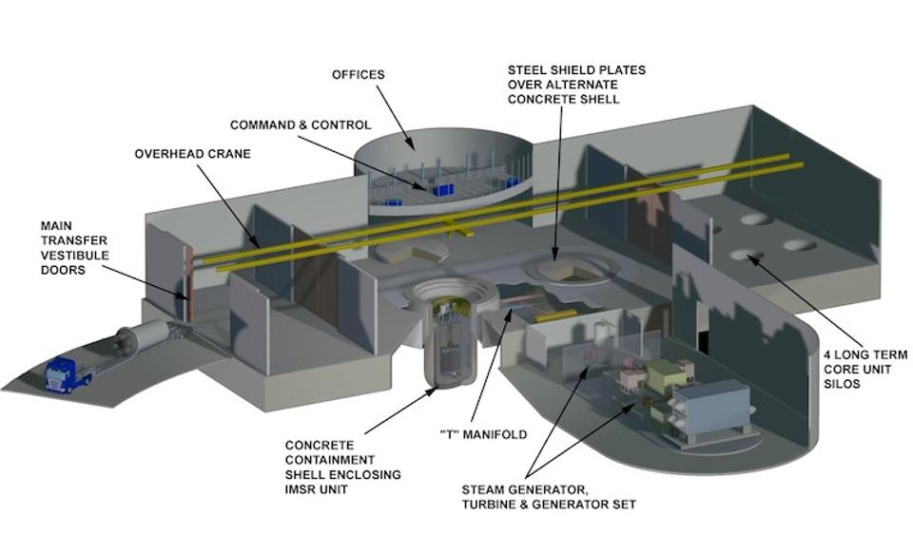
Notes:
Where nuclear energy is concerned, the next innovation is one that is coming from the early days of research into how to produce nuclear energy. A real solution is on the horizon: the development of what is called an Integral Molten Salt Reactor.

Slide 12
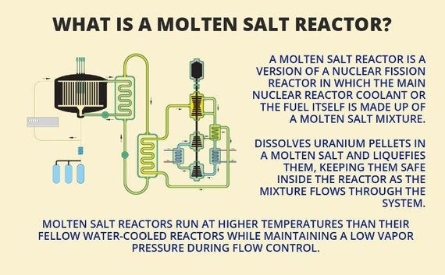
Notes:
This type of reactor was developed sixty years ago at the Oak Ridge National Laboratory but shelved because of short-sighted thinking on the part of other scientists, military priorities and energy officials. Remarkably, the process creates much less waste and few long-lived radioactive elements. Moreover:

Slide 13
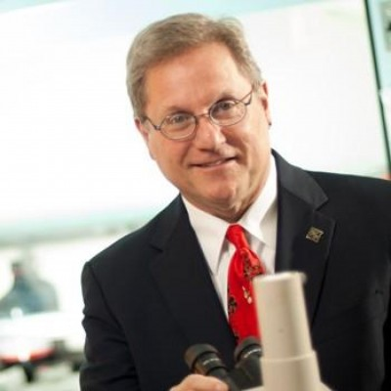
“The IMSR’s fundamental advantage lies in its most novel feature – the fuel is a liquid. At first glance, that might seem odd. But molten salt, with the uranium dissolved in it, can operate at low-pressure and absent are chemical or mechanical driving forces which can cause so many problems with traditional solid fuel reactors.”
Notes:
“The IMSR’s fundamental advantage lies in its most novel feature – the fuel is a liquid. At first glance, that might seem odd. But molten salt, with the uranium dissolved in it, can operate at low-pressure and absent are chemical or mechanical driving forces which can cause so many problems with traditional solid fuel reactors.” [Source: James Conca. “Nuclear Power Turns To Salt,” Forbes Magazine, 7 January, 2015]

Slide 14
Notes:
14
What is being done to remove some of the plastic waste from our oceans, lakes and rivers?

Slide 15
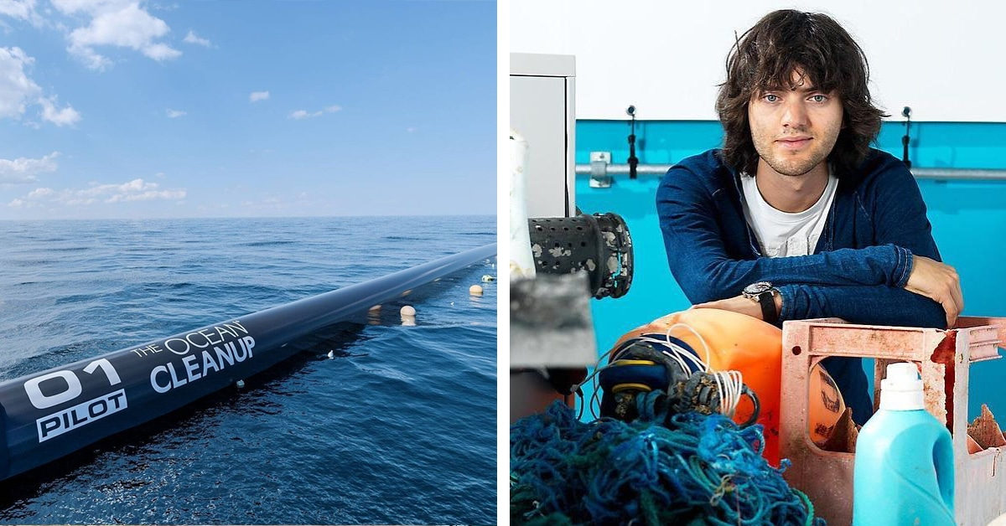
Notes:
15
Dutch inventor Boyan Slat developed a means of filtering and gathering plastic waste from the oceans. Testing has begun in the Great Pacific Garbage Patch. Although problems occurred with the system retaining captured plastic, the team of engineers are optimistic the issues can be resolved so that the system can be deployed in the Pacific Ocean.

Slide 16
Notes:
16
Is it feasible and environmentally sound to replace fossil fuels with plant-based bio-fuels?

Slide 17
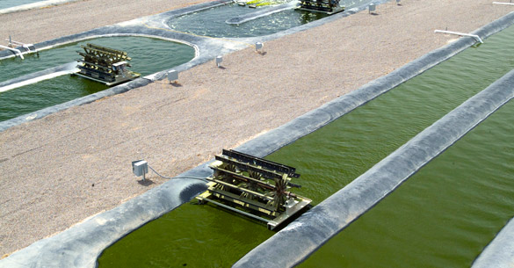
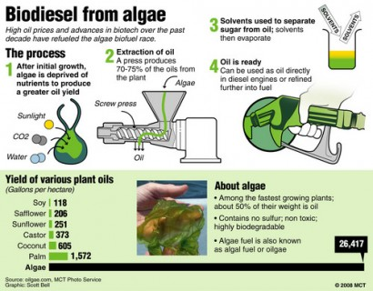
Notes:
17
An important fuel source for the future will be oil extracted from algae and used as a biofuel. Oil yields from mico-algae are much greater than from other crops, such as corn or sunflowers. Algae can be grown easily in ponds and swamps, not competing with foodcrops for land.

Slide 18
Notes:
18
We see windmills constructed in many parts of the country and the world. They are huge and complex machines. Are there any alternatives?

Slide 19
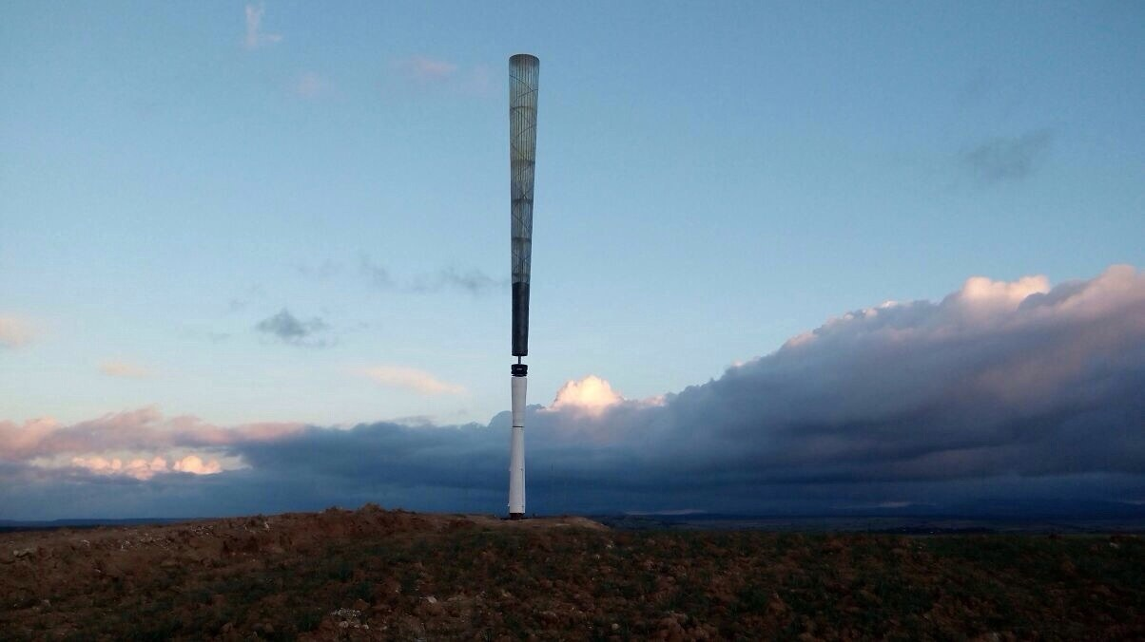
Notes:
19
Energy from wind is now being generated by a bladeless technology that uses “vorticity,” an aerodynamic effect that produces a pattern of spinning vortices. The cone is made from a composite of fiberglass and carbon fiber, which allows the mast to vibrate as much as possible. There are no gears, bolts, or mechanically moving parts. The cone captures 40 percent of the wind’s power when the wind is blowing 26 miles per hour.

Slide 20
Notes:
20
Our homes and many buildings now use solar panels to generate electricity. Solar farms exist in places were the sun shines almost every day. What’s next?

Slide 21
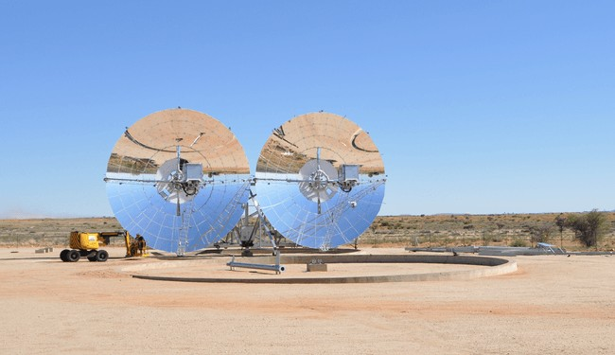
Notes:
21
These are mirrored dishes are the newest innovation in solar energy. The dish captures 34 percent of the sun’s energy, compared to 23 percent for most solar generators. To generate the same amount of electricity burning coal, 81 metric tons of CO2 would be released into the atmosphere.

Slide 22
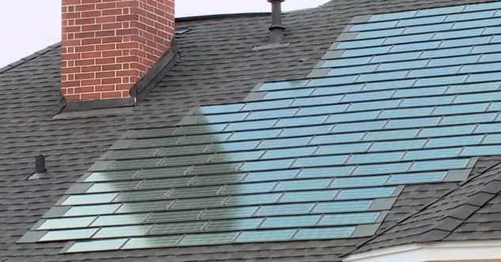
Notes:
22
Tesla is now manufacturing solar panel shingles for homes. Tesla’s major innovation is to make the active solar shingles look the same as all other non-active roof tiles. The cost is around $21 per square foot, which is very competitive to standard roofing shingles. The total cost for a 2,500 square foot home would be around $50,000.

Slide 23
Notes:
23
Lithium batteries are now providing the power for everything from laptop computers to automobiles. However, lithium batteries are relatively easily damaged and can catch on fire. Is there a solution?

Slide 24
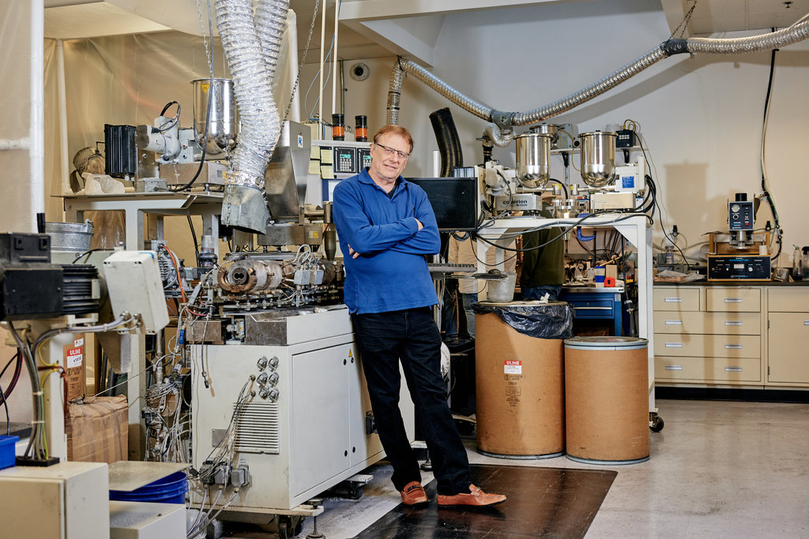
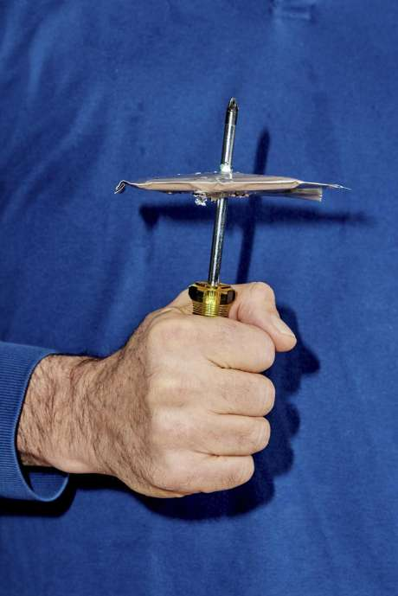
Notes:
24
Mike Zimmerman, owner of Ionic Materials, has invented a lithium-ion battery that will not catch fire. His battery is a solid lithium polymer metal battery that solves the problem of preventing battery electrodes from contacting each other directly, starting a fire.

Slide 25
Notes:
25
We send billions of plastic bags to land fills every year. Some states have prohibited the use of plastic bags by retail stores. What innovation solutions are on the horizon?

Slide 26

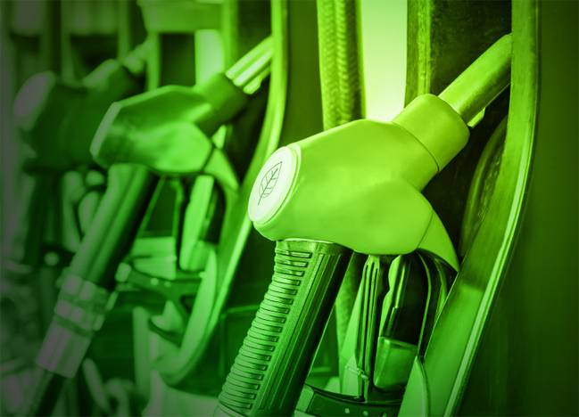
Notes:
26
Researchers at the University of Illinois have found away to make diesel fuel and other petroleum products from used plastic grocery bags. A company in India is now mixing plastic from landfills with asphalt to form a compound that can be used in road construction. Nearly 1,000 miles have been constructed to date with this material, which wears better and lasts longer than traditional asphalt.

Slide 27

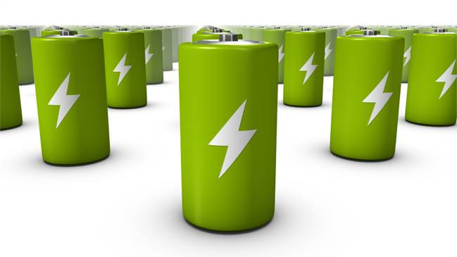
Notes:
27
A researcher at Renssaleaer Polytechnic University has developed a process for granulating plastic bags and mix the granules with concrete. Scientists at the University of Adelaide have figured out how to turn plastic bags into a material hundreds of time stronger and six times lighter than steel. This material is now being used in electronics, wind turbines and other devices.

Slide 28
Notes:
28
Another innovation gaining traction is using the movement of water to generate electricity.

Slide 29
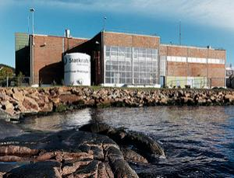
Notes:
29
Electricity is now being produced by osmosis, the passage of water from membranes, generating a pressure difference that can be harnessed to generate power. The first power plant using this system began operation in 2009 in Norway. It was estimated by the Norwegian minister for petroleum and energy that plants using osmosis could supply as much as 10 percent of the world’s electricity needs.

Slide 30
Notes:
30
It is estimated that over 300 million golf balls are lost or discarded in the United States, every year. Many of them end up in lakes, rivers, streams and the oceans. A golf ball will decompose naturally in somewhere between 100 and 1,000 years. Some communities and environmental activists are beginning to do something about the problem.

Slide 31
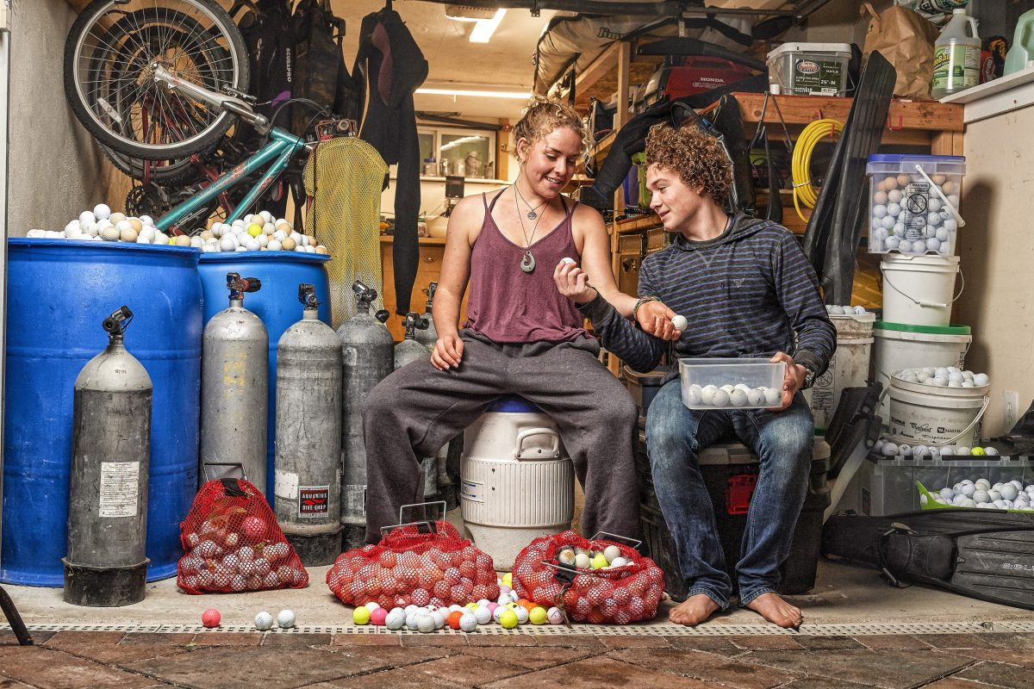
Notes:
31
The problem worldwide is huge. A sonar search of Loch Ness in Scotland in 2009 found over 100,000 golf balls. Golf balls contain zinc and other heavy metals that could potentially escape into the surrounding water. Recovered balls are being sold online for half the cost of new ones.

Slide 32
Notes:
32
Water power already produces an enormous amount of energy, turning turbines at the base of huge dams. A lesser known engineering innovation also produces electrical energy by pumping water uphill to a reservoir, then releasing it to flow back thru turbines at the base of a lower level lake.

Slide 33
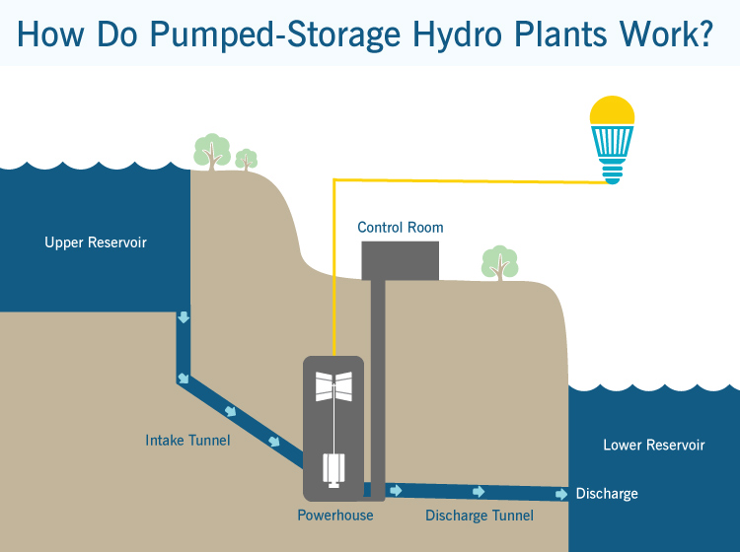
Notes:
33
This technique is called “off-river pumped hydro energy storage.” When there is excess electricity, water is pumped through a pipe or tunnel, to the upper reservoir. The energy is later recovered by letting the water flow back down again, through a turbine that converts it back into electricity.

Slide 34
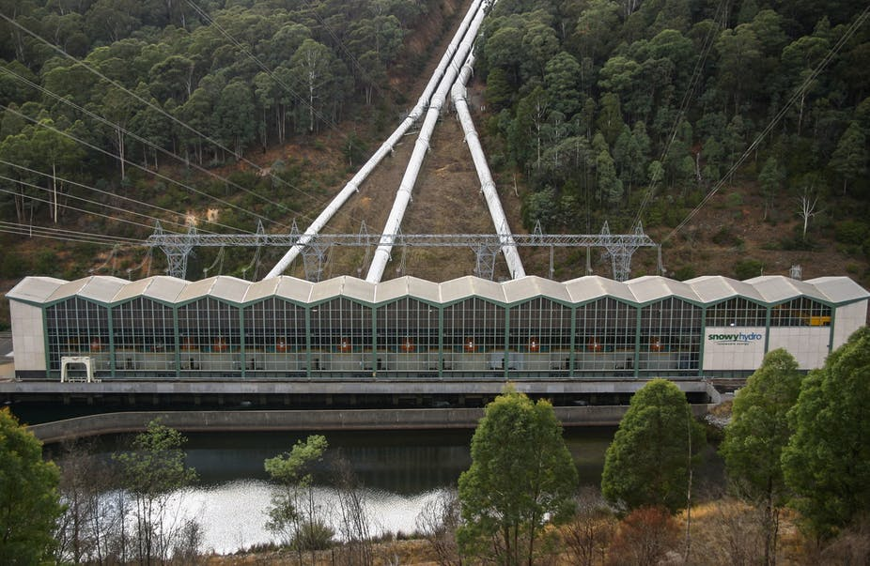
Notes:
34
Efficiencies of 90% in each direction are possible. Pumped hydro is by far the most widely used form of energy storage, representing 99% of the total. Used in conjunction with solar farms, the total cost is calculated to be much lower than using batteries for storage of electricity.

Slide 35
Notes:
35
A company based in Japan called Eco Marine Power, founded by a former Australian naval officer named Greg Atkinson, is creating rigid solar panel sails for us on large-sea-faring vessels. The objective is to harness wind and solar energy, dramatically cutting back on fuel consumption and lower a vessel’s emissions by up to 10 percent.

Slide 36
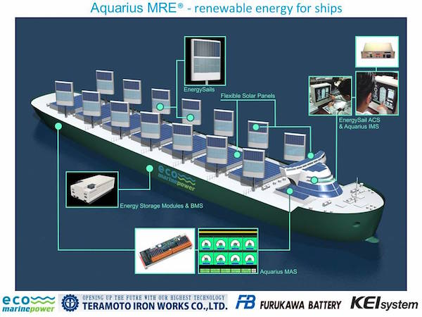
Notes:
36

Slide 37
Notes:
37
And, finally (for now), the next generation of alternatively-powered vehicles continues to evolve.

Slide 38
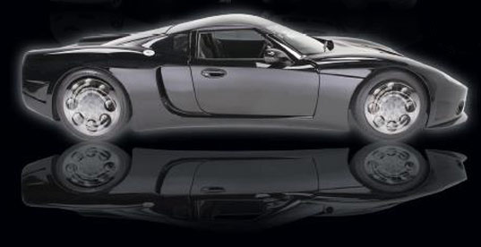
Notes:
38
Sometimes called PHEV (pneumatic-hybrid electric vehicle), these cars are most typically powered by a compressed air engine combined with an electric motor. The engines are similar to steam engines as they use the expansion of externally supplied pressurized gas to perform work against a piston.

Slide 39
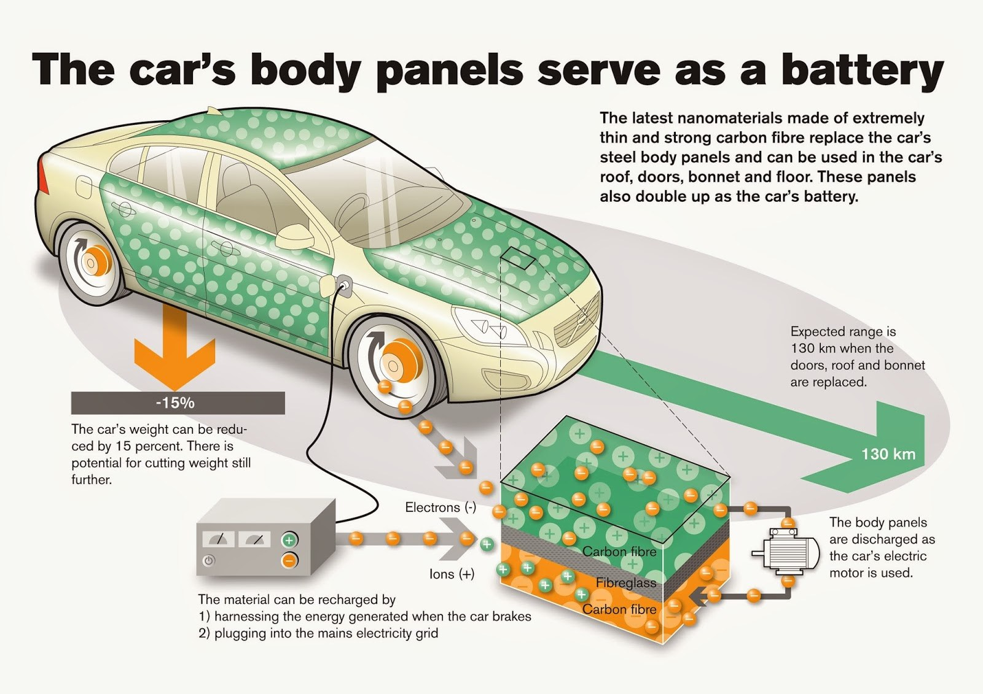
Notes:
39
Researchers have developed lightweight “supercapacitors” that can be combined with regular batteries to dramatically boost the power of an electric car. The supercapacitors – a “sandwich” of electrolyte between two all-carbon electrodes – were made into a thin and extremely strong film with a high power density. The film could be embedded in a car’s body panels, roof, doors, bonnet and floor – storing enough energy to turbocharge an electric car’s battery in just a few minutes.

Slide 40
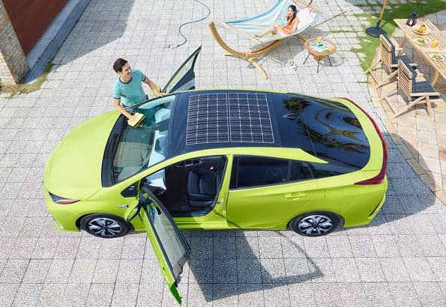
Notes:
40
Prius has introduced in Japan a model with a solar panel built into the roof. The solar panel charges the battery but does not power the car directly. The efficiency is still pretty low, but innovation continues.

Slide 41
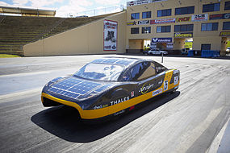
Notes:
41
Students in Australia have designed and built a solar powered sports car that could be the first step to solar powered vehicles.

Slide 42

Notes:
42
Covering all of the activities in which people are involved that affect the U.S. economy would require many more segments to this analysis. I finish, then, with a modest effort to examine the impact generated by our passions for athletics and sports.

Slide 43
End Part 15

