Slide 1
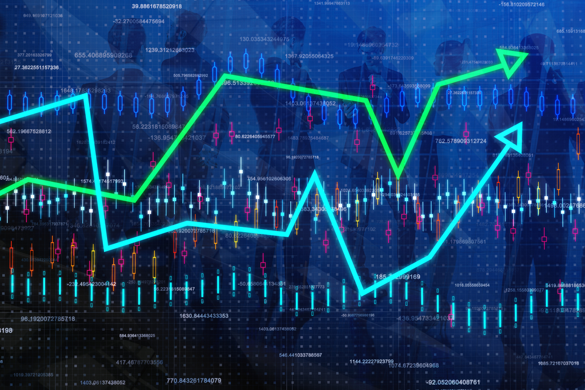
The State of the United States
ECONOMY and SOCIETY
Part 14

Slide 2
Cracks in the Constitution
Notes:
The statistics compiled in this report on the state of the U.S. economy and society reveal we are a long way from providing to all what the philosopher Mortimer J. Adler described as “the goods required for a decent human existence.” The reasons for this are many, and clear insights into those reasons require an objective analysis of the history of our system of law. Long years of study have brought me to certain conclusions and to advocate the need for specific systemic changes.

Slide 3
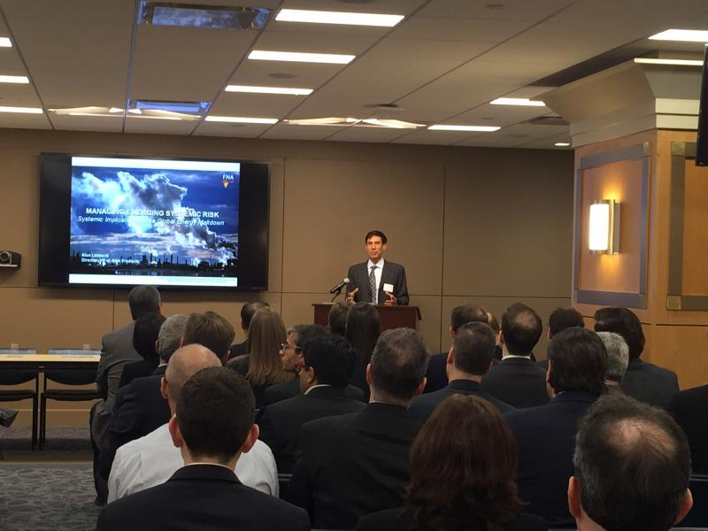

SYSTEMIC CHANGE AGENDA
Notes:
Importantly, what is required is a campaign of public education that reaches beyond ideological bias and politically-expedient rhetoric. We are a society markedly divided over what how we ought to be organized. The arguments are ancient. We continue to debate and argue over the proper balance between human rights and property rights without even a consensus of the definition of rights in either case.

Slide 4
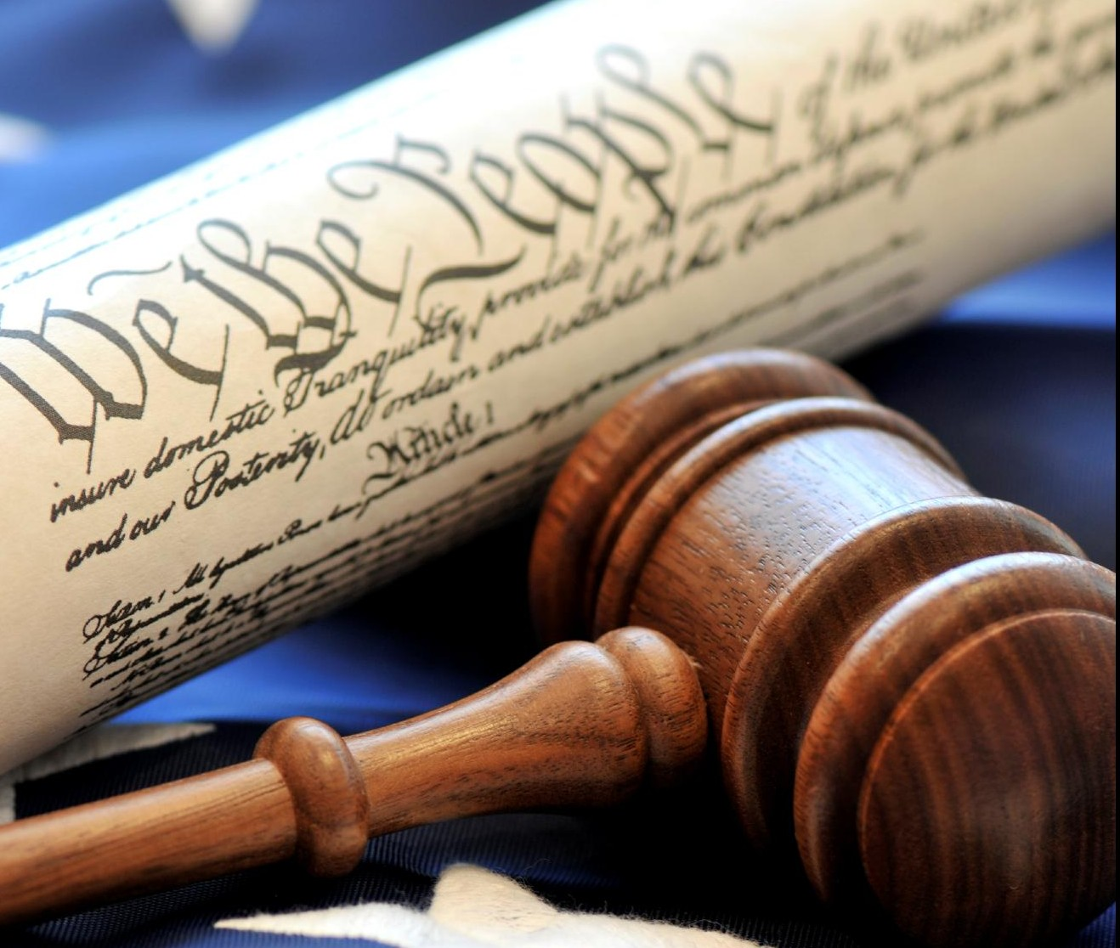
Notes:
Moral philosophers have always sought answers to questions involving fundamental truth. High on this list of concerns is the moral basis for law.

Slide 5
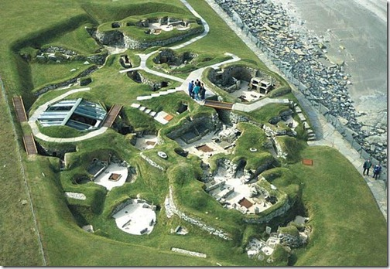
Notes:
5
Once our ancestors began to settle in one place, they needed to come up with rules for allocating access to land and to the resources required by all to live. Justice required that these rules be derived from the principle of voluntary association. With the passing of time, what emerged instead were hierarchical societies within which privilege destroyed justice.

Slide 6
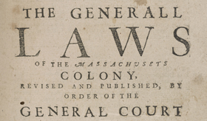
Notes:
That system of hierarchical privilege was introduced in North America by a privileged European aristocracy who secured from their monarchs huge grants of land. The origins of property law in the United States and the means by which government raises revenue are traced to the period of British colonial rule. The war of independence from Britain did little to alter these arrangements.

Slide 7
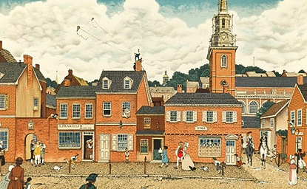
Notes:
7
A low initial population with access to a huge, resource-rich continent to settle mitigated the negative effects of deeply-entrenched privilege associated with property law.

Slide 8
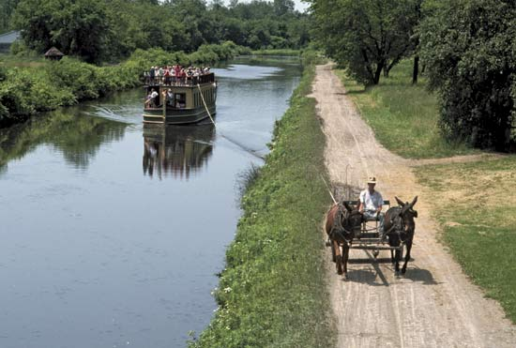
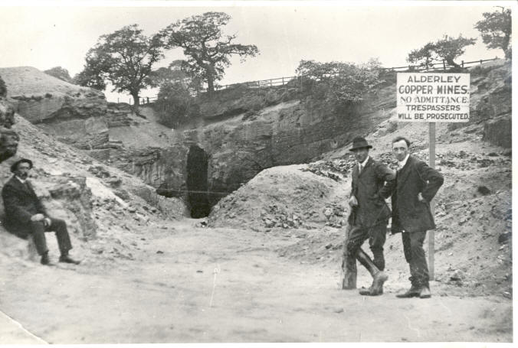
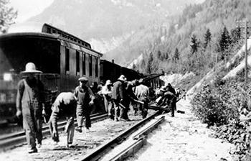
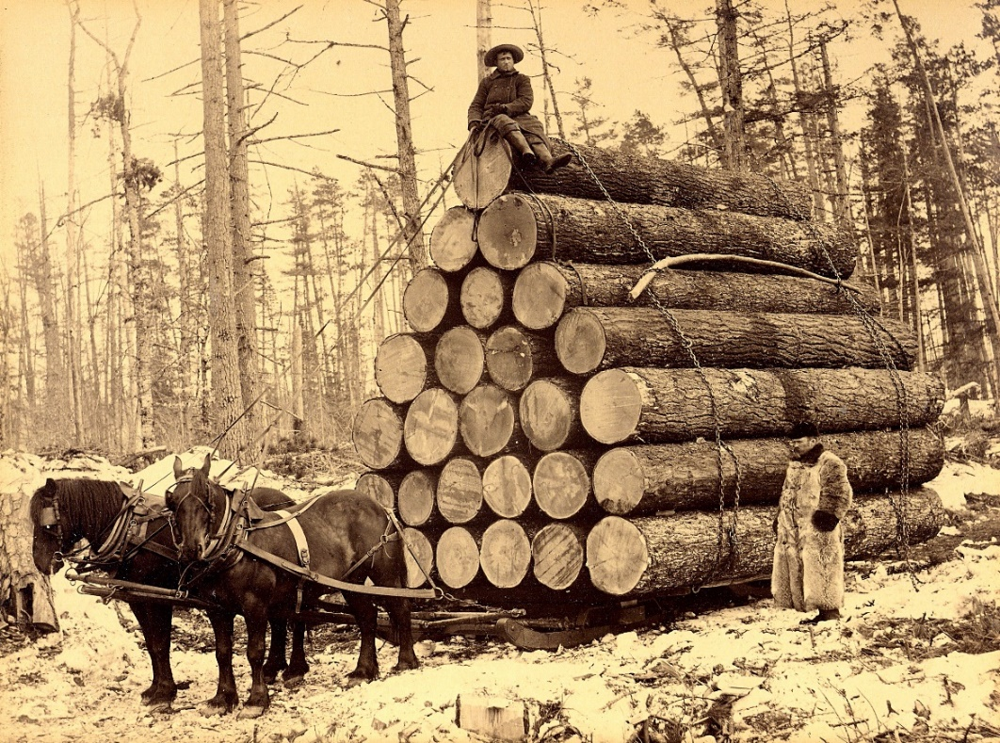
Notes:
Soon, however, much of the public domain was essentially given away to canal builders, railroads, mining and timber interests, and companies organized purely to speculate in land. Minimal charges, If any, were imposed by government in return for granting control over land and natural resources to private interests.

Slide 9
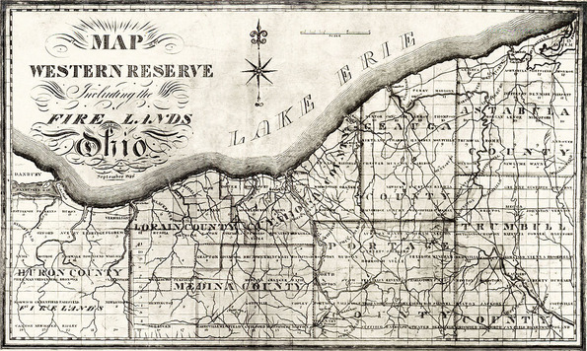
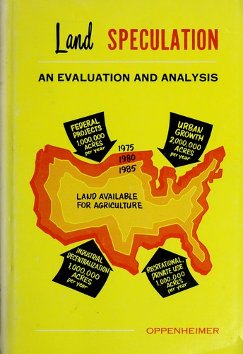
Notes:
The result of over two centuries under this system of property law and taxation is a great vulnerability to speculation driven cycles of boom and bust.

Slide 10

Nature is NOT a Capital Good
Notes:
10
At the beginning of this presentation, I expressed my frustration with the current state of economic theory, which continues to treat nature as a form of capital good rather than the source of capital goods. The consequences of this one disregard for truth have been devastating.

Slide 11
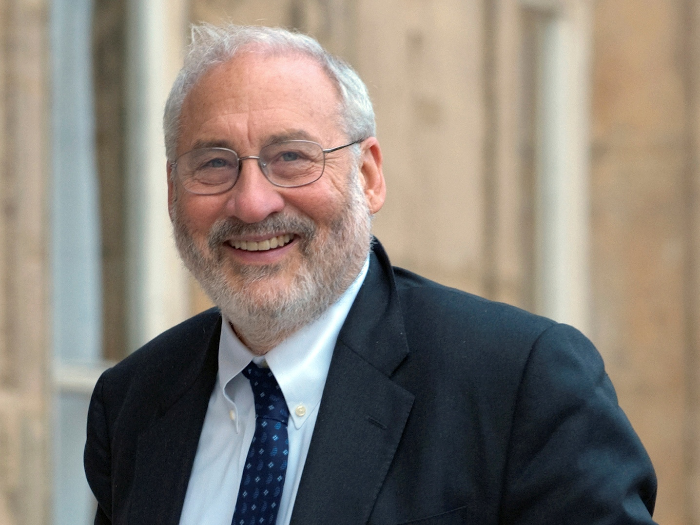
Notes:
11
A few economists have begun to rethink what they were taught during their formal education. One is former World Bank economist, Joseph Stiglitz. Interviewed in 2012, he urged dramatic changes in how government raises its revenue:

Slide 12

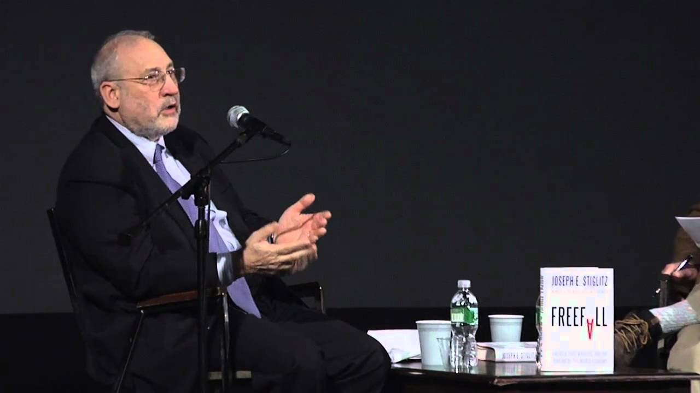
“We have to have a more progressive tax structure. And what is interesting to realize is that our tax structure not only is unfair, but actually distorts our economy. It lowers growth and increases inequality. If you tax speculation at less than half the rate you tax people who work for a living, what you do is you encourage speculation. …”
Notes:
We have to have a more progressive tax structure. And what is interesting to realize is that our tax structure not only is unfair, but actually distorts our economy. It lowers growth and increases inequality. If you tax speculation at less than half the rate you tax people who work for a living, what you do is you encourage speculation. ...”

Slide 13
“You weaken the economy. Speculative activities are activities associated with high levels of inequality. And that way you increase inequality. We tax in a sense a lot of the rent-seeking activities at a lower rate because they get under the rubric of the capital gains tax.”
Notes:
“You weaken the economy. Speculative activities are activities associated with high levels of inequality. And that way you increase inequality. We tax in a sense a lot of the rent-seeking activities at a lower rate because they get under the rubric of the capital gains tax.”

Slide 14
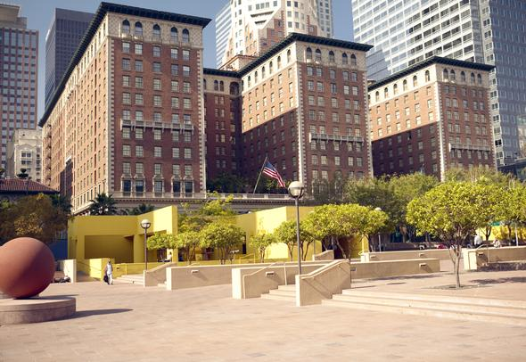
Notes:
What he does not explain here is the fact that real capital goods – buildings, machinery, technologies – are never sold for more than their initial purchase price. They depreciate over time, even when regular inputs of labor and new capital goods are made. Land is the asset that does not, under most conditions, depreciate.

Slide 15
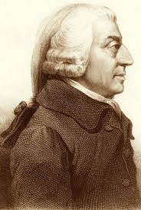
Notes:
There are huge implications for our economy and society arising from the policy proposals made by Joseph Stiglitz and other economists – going back to Adam Smith -- who held similar views. As Smith wrote:

Slide 16
“Ground-rents and the ordinary rent of land are, perhaps the species of revenue which can best bear to have a peculiar tax imposed upon them. …Nothing can be more reasonable than that a fund which owes its existence to the good government of the state should be taxed peculiarly.”
Notes:
16
“Ground-rents and the ordinary rent of land are, perhaps the species of revenue which can best bear to have a peculiar tax imposed upon them. …Nothing can be more reasonable than that a fund which owes its existence to the good government of the state should be taxed peculiarly.”

Slide 17
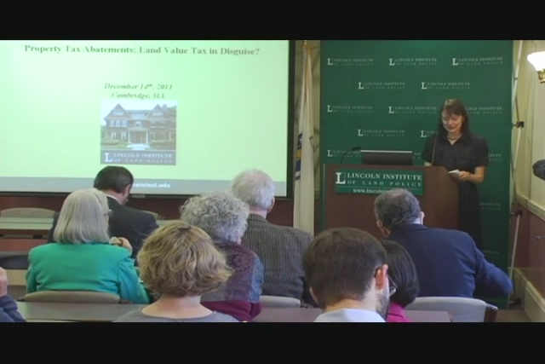

The Taxation of Land’s Rental Values
Exempt Property Improvements
Notes:
Where real estate is concerned, a high annual tax on the potential annual rental value of land is called for. Buildings and other property improvements, the taxation of which imposes significant deadweight losses on the economy, need to be exempted from the tax base.

Slide 18
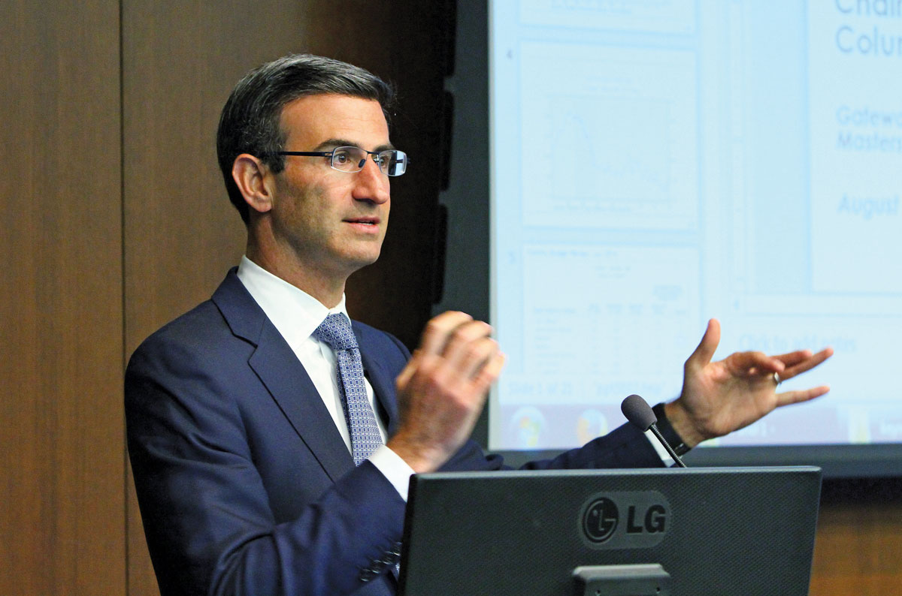
Notes:
Interestingly, Citigroup’s chairman of financial strategy, Peter R. Orszag – hardly a member of the Progressive community – in 2017 wrote in his Bloomberg View column in support of the reforms called for by Joseph Stiglitz, adding this challenge:

Slide 19
“So here is a bold idea for a national candidate: Propose a national land value tax. It would highlight the fact that, except for land and housing, capital ratios have not risen here. ...
Notes:
“So here is a bold idea for a national candidate: Propose a national land value tax. It would highlight the fact that, except for land and housing, capital ratios have not risen here. ... “

Slide 20
It would also be economically efficient and reduce wealth inequality. The revenue could be used to reduce other taxes, or to help close the actuarial deficits in our entitlement programs, or some combination thereof.”
Notes:
“It would also be economically efficient and reduce wealth inequality. The revenue could be used to reduce other taxes, or to help close the actuarial deficits in our entitlement programs, or some combination thereof.”

Slide 21
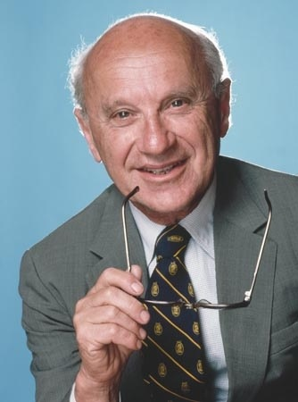
Milton Friedman
Notes:
21
Decades earlier, a similar endorsement came from Milton Friedman, who observed that this change in tax law was hardly a new insight:

Slide 22
“In my opinion, the least bad tax is the property tax on the unimproved value of land, the Henry George argument of many, many years ago.”
Notes:
22
“In my opinion, the least bad tax is the property tax on the unimproved value of land, the Henry George argument of many, many years ago.”

Slide 23

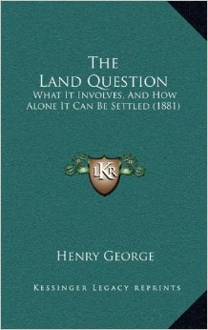
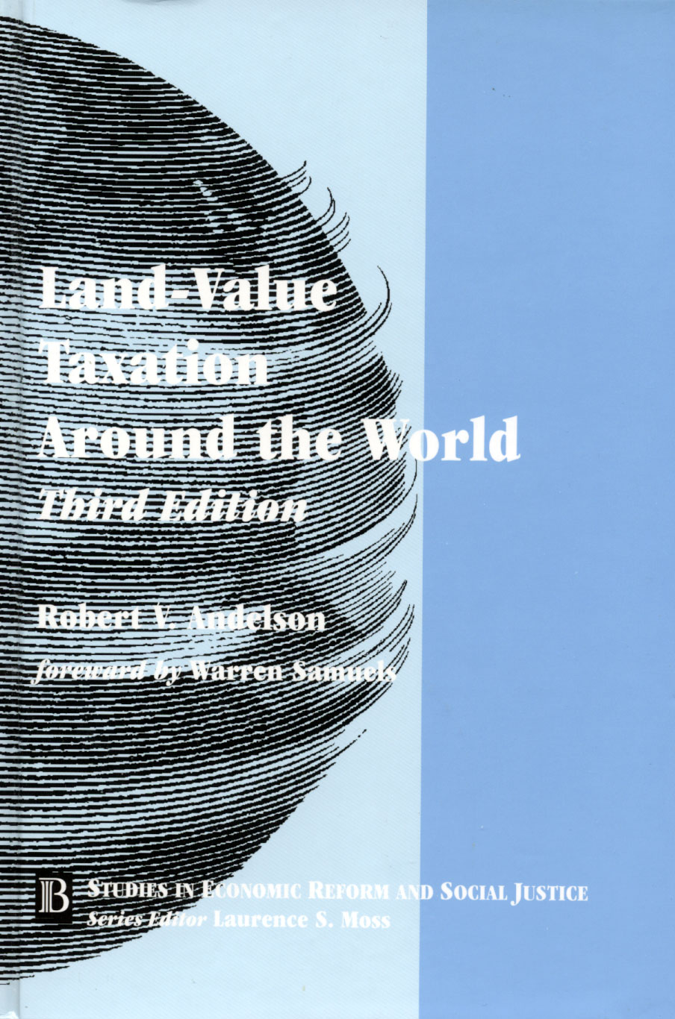
Notes:
In fact, this is a policy issue that has been continuously and extensively studied and debated since the time Adam Smith wrote The Wealth of Nations.

Slide 24

Notes:
What we know is that the measures taken since 2008 have provided no clear path to sustainable, noninflationary economic growth and have likely only pushed into the near future another, even more serious economic and financial crisis. None of the systemic flaws in the nation’s system of law and taxation have been addressed.

Slide 25
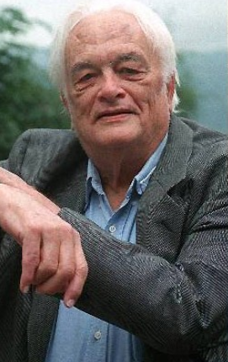
William Vickrey
Notes:
25
Nobel Prize winning economist William Vickrey is also among those who had called for the move to land values as the source of public revenue:

Slide 26
“The property tax is, economically speaking, a combination of one of the worst taxes — the part that is assessed on real estate improvements... and one of the best taxes — the tax on land or site value.”
Notes:
“The property tax is, economically speaking, a combination of one of the worst taxes — the part that is assessed on real estate improvements... and one of the best taxes — the tax on land or site value.”

Slide 27
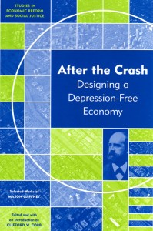
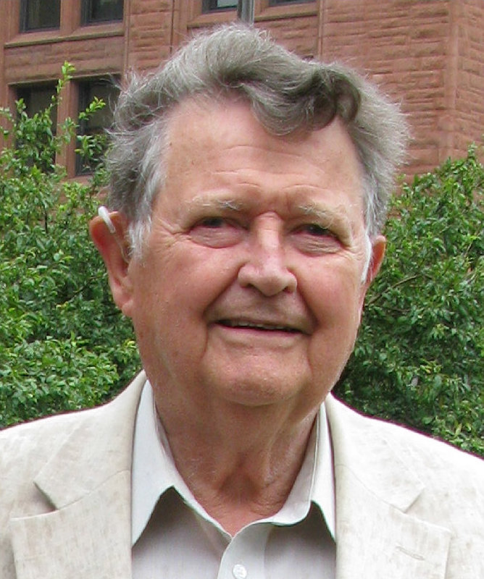
Notes:
An even more penetrating analysis comes from Mason Gaffney, emeritus professor at the University of California. Few economists have a better understanding of how land markets operate in an economy than does Professor Gaffney. In “After the Crash,” he writes:

Slide 28

“A rise in land prices cannot simply flatten out at a high plateau because the increment has become part of the expected return that buyers are paying for, and lenders are relying on. So prices that cannot rise further have to drop: there is no equilibrium level at the inflated prices of the boom. …”
Notes:
“A rise in land prices cannot simply flatten out at a high plateau because the increment has become part of the expected return that buyers are paying for, and lenders are relying on. So prices that cannot rise further have to drop: there is no equilibrium level at the inflated prices of the boom.”

Slide 29
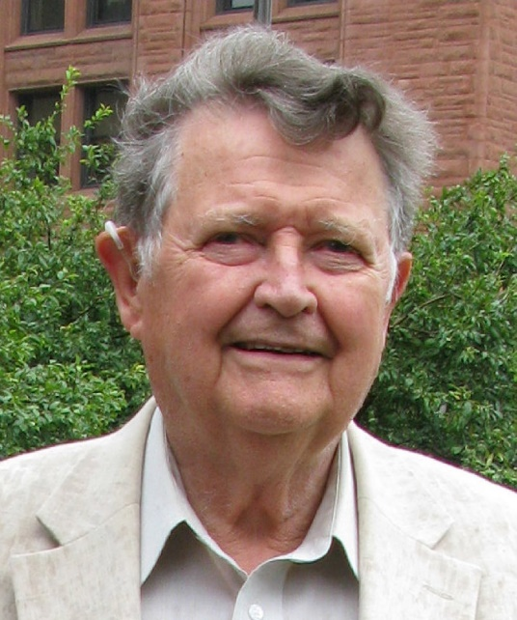
“Cleaning up the mess left from the last few manic years will cost sweat and tears and some fortunes, whoever undertakes it. Lower rents and land prices will finally let us recover, but the process of getting from here to there entails a fall from illusion to reality, from high to low, that will agonize many. ...”
Notes:
“Cleaning up the mess left from the last few manic years will cost sweat and tears and some fortunes, whoever undertakes it. Lower rents and land prices will finally let us recover, but the process of getting from here to there entails a fall from illusion to reality, from high to low, that will agonize many. ...”

Slide 30

“New administrations will prolong the agony by trying to defer it. They will bail out a few of the victims and many of the culprits by raising the national debt and inflating the currency to validate bad debts and sustain land values.”
Notes:
“New administrations will prolong the agony by trying to defer it. They will bail out a few of the victims and many of the culprits by raising the national debt and inflating the currency to validate bad debts and sustain land values.”

Slide 31


ELITE
Notes:
Despite the evidence, despite the devastating impact of people’s lives of repeated economic crashes, those who have held the nation’s fate in their hands have done almost nothing to address the systemic problems identified here.

Slide 32
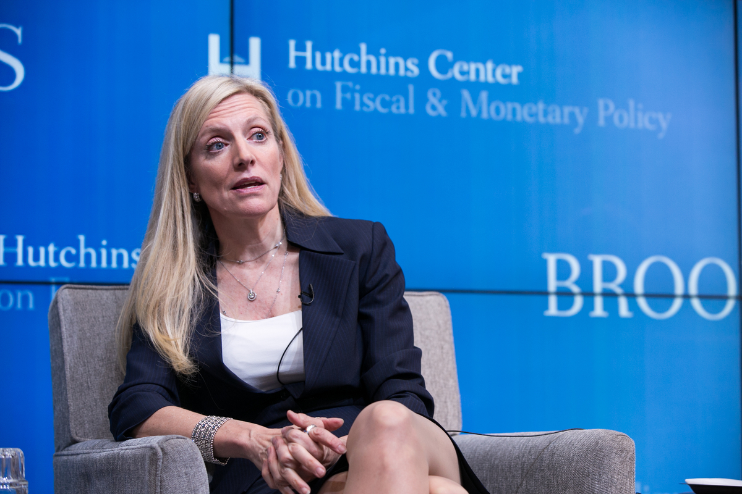
Notes:
In a speech delivered on December 3, 2014, at The Brookings Institution, Federal Reserve Governor Lael Brainard described the steps her institution was putting in place to ensure there would be no repeat of the 2008 financial crisis:

Slide 33
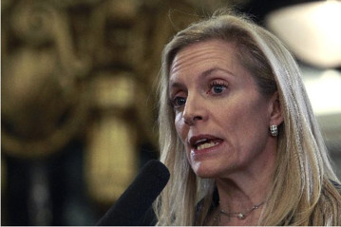
“First, the Federal Reserve is well along in promulgating an important system of new, through-the-cycle safeguards that together should deliver much greater structural resilience and make excessive risk-taking costly for the large, complex institutions that pose the greatest risks to the financial system. …”
Notes:
“First, the Federal Reserve is well along in promulgating an important system of new, through-the-cycle safeguards that together should deliver much greater structural resilience and make excessive risk-taking costly for the large, complex institutions that pose the greatest risks to the financial system. …”

Slide 34
“Second, the Federal Reserve is assessing the kinds of broad time-varying regulatory tools that might further buttress resilience during periods in which risks associated with rapid credit expansion are building. …”
Notes:
“Second, the Federal Reserve is assessing the kinds of broad time-varying regulatory tools that might further buttress resilience during periods in which risks associated with rapid credit expansion are building. …”

Slide 35
“Third, the Federal Reserve is exploring tools that can be varied over the cycle to target specific activities, recognizing that we will have limited authorities relative to some foreign financial regulators in operating on the borrowing side and outside the regulatory perimeter of the banking system.”
Notes:
“Third, the Federal Reserve is exploring tools that can be varied over the cycle to target specific activities, recognizing that we will have limited authorities relative to some foreign financial regulators in operating on the borrowing side and outside the regulatory perimeter of the banking system.”

Slide 36

Notes:
Even with the best of intentions, the tools available to the Federal Reserve system have never proven to be effective. We are still very exposed to the instability of the global derivatives market. Early in 2015, attorney and business analyst Michael Snyder commented on the origins of the huge losses associated with the skyrocketed derivatives market:

Slide 37
“Basically, derivatives are financial instruments whose value depends upon or is derived from the price of something else. A derivative has no underlying value of its own. It is essentially a side bet. Originally, derivatives were mostly used to hedge risk and to offset the possibility of taking losses. …”
Notes:
“Basically, derivatives are financial instruments whose value depends upon or is derived from the price of something else. A derivative has no underlying value of its own. It is essentially a side bet. Originally, derivatives were mostly used to hedge risk and to offset the possibility of taking losses. …”

Slide 38
“But today it has gone way, way beyond that. Today the world financial system has become a gigantic casino where insanely large bets are made on anything and everything that you can possibly imagine. The derivatives market is almost entirely unregulated and in recent years it has ballooned to such enormous proportions that it is almost hard to believe.”
Notes:
“But today it has gone way, way beyond that. Today the world financial system has become a gigantic casino where insanely large bets are made on anything and everything that you can possibly imagine. The derivatives market is almost entirely unregulated and in recent years it has ballooned to such enormous proportions that it is almost hard to believe.”

Slide 39
“Today, the worldwide derivatives market is approximately 20 times the size of the entire global economy. Because derivatives are so unregulated, nobody knows for certain exactly what the total value of all the derivatives worldwide is, but low estimates put it around 600 trillion dollars and high estimates put it at around 1.5 quadrillion dollars.”
Notes:
“Today, the worldwide derivatives market is approximately 20 times the size of the entire global economy. Because derivatives are so unregulated, nobody knows for certain exactly what the total value of all the derivatives worldwide is, but low estimates put it around 600 trillion dollars and high estimates put it at around 1.5 quadrillion dollars.”

Slide 40
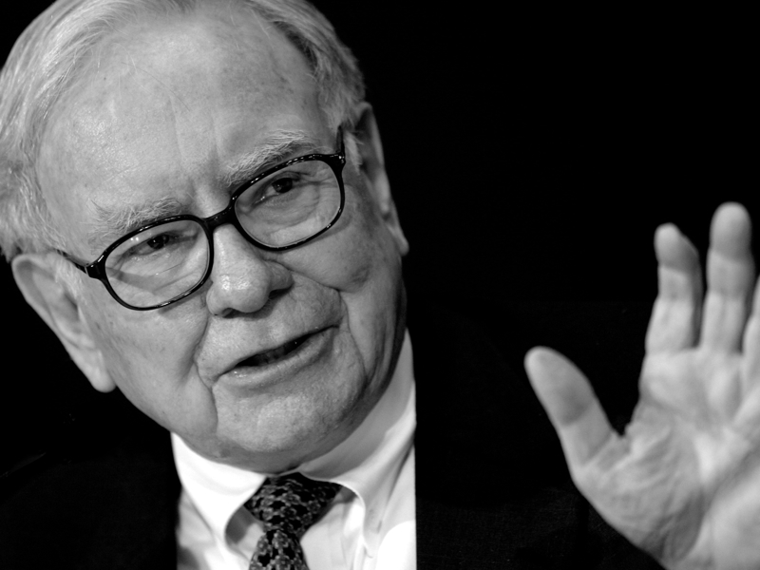
Notes:
In 2017, investor Warren Buffet, told Forbes Magazine that he will no longer enter into any long term derivatives contracts with anyone. He expressed fear of a financial meltdown because of the outstanding derivatives contracts:

Slide 41

“Someday, it won’t matter how large the level of assets on J.P. Morgan’s balance sheet. There is no risk control system that is effective if the numbers get big enough. I don’t believe the reserves they set up against loss in their derivatives.”
Notes:
“Someday, it won’t matter how large the level of assets on J.P. Morgan’s balance sheet. There is no risk control system that is effective if the numbers get big enough. I don’t believe the reserves they set up against loss in their derivatives.”

Slide 42

Notes:
We need to keep watch to learn whether government has learned from experience what is required to tame what is mistakenly called “the business cycle.” As discussed above, however, the conventional fiscal and monetary tools relied upon to this point are at best tools of mitigation. Improperly applied, the impact is to restart the credit-fueled, speculation-driven land markets that drive our boom-to-bust economic cycles. The real solution must come from a change in how government raises its revenue.

Slide 43
End Part 14

