Slide 1

The State of the United States
ECONOMY and SOCIETY
Part 13

Slide 2
Crisis With The Environment?
Notes:
One of the great responsibilities of government is to provide the public goods and services needed to ensure a high quality of life. We are totally dependent on what nature provides to sustain ourselves and our communities. There is deep debate and disagreement over the extent to which we have abrogated our responsibilities as stewards of our natural environment.

Slide 3

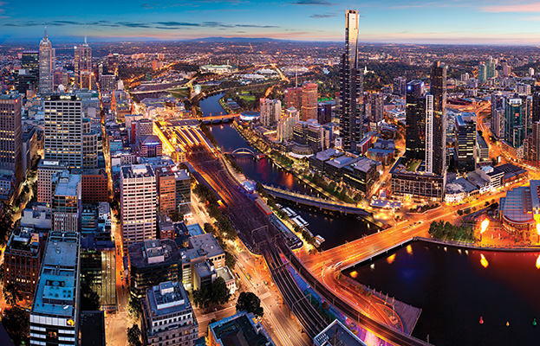
Notes:
3
Our homes, our places of work, where we shop or engage in almost any activity are linked together by a complex infrastructure network. That network requires continuous maintenance and periodic replacement. Maintenance and replacement requires public revenue. The subject and issues involved deserve a far more detailed analysis than I am able to present here, but what follows provides some insight into the state of our environmental systems and physical infrastructure.

Slide 4
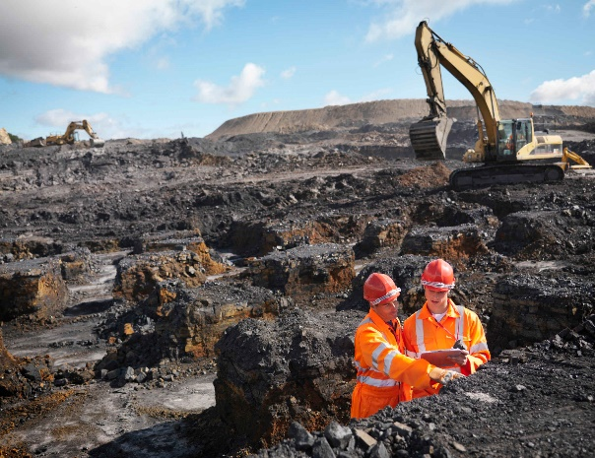
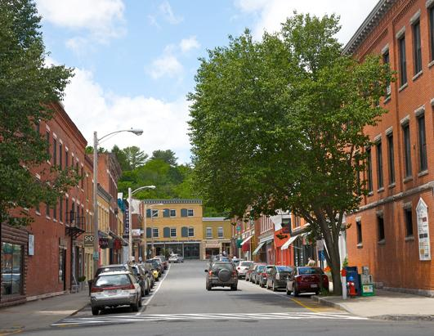

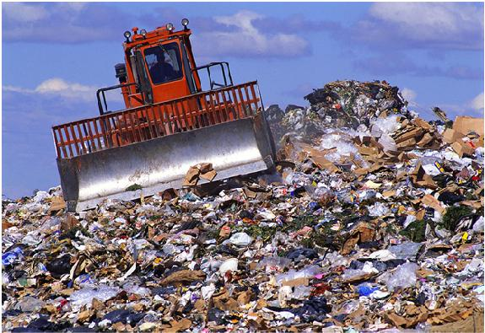
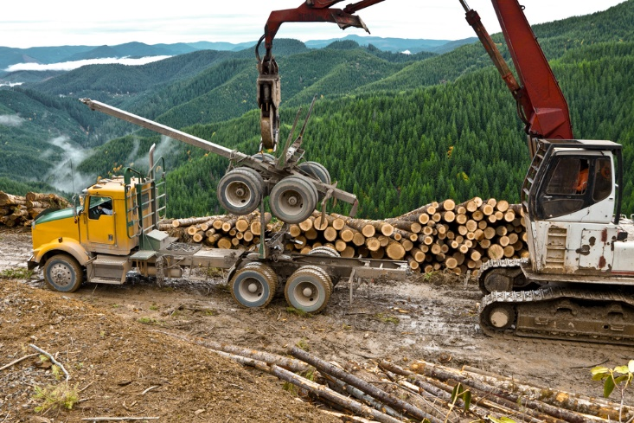
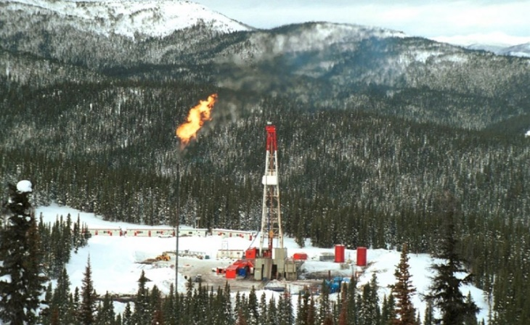
Notes:
First, let’s examine how we treat the land on which we live, work and play, where our food is grown and our mineral, timber and other natural resources are extracted. And, then, where and how we dispose of the huge amount of waste we produce each and every day.

Slide 5

Notes:
This map indicates the percentage of land in each state classified as farmland, totaling just under 41 percent of the total area.

Slide 6
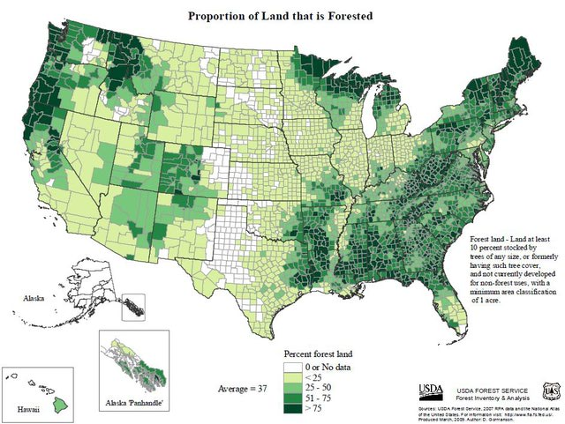
Notes:
Forests cover roughly one-third of the country, about the same as was the case in 1912.

Slide 7
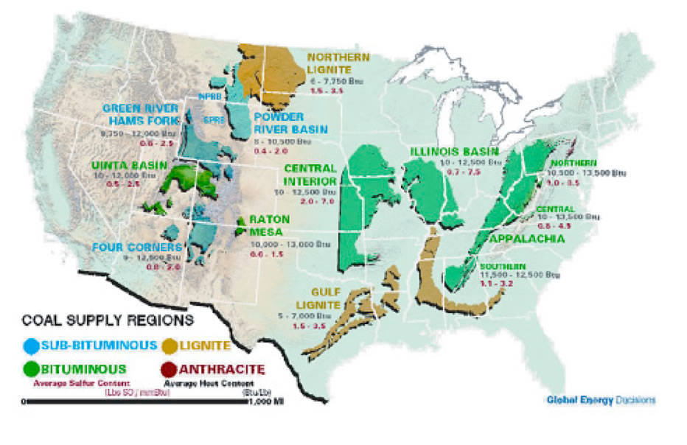
Notes:
Government analysts estimate there are 18.7 billion tons of coal recoverable from existing producing mines, with an estimated total recoverable reserve of 257.6 billion tons .[Source: Annual Coal Report 2012, U.S. Energy Information Administration, December 2013. Table 14, p.21]

Slide 8
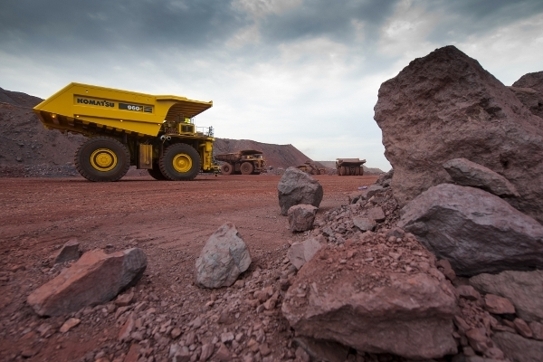
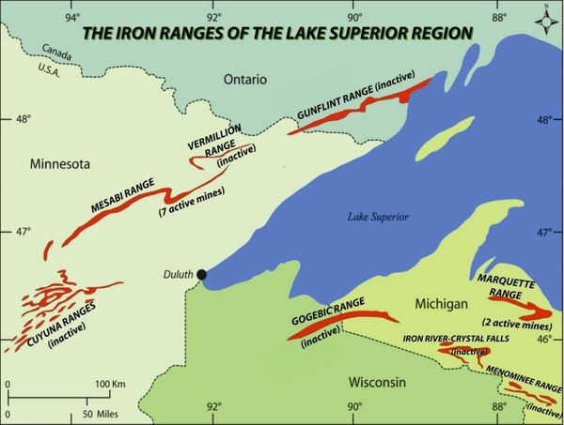
Notes:
Iron mining in the United States produced 42.5 million metric tones of iron ore in 2015, worth $3.8 billion, but has declined by 7.3% over the past five years to a level of $3 billion revenue in 2018. Some 90 percent of the remaining U.S. iron ore is found in the region around Lake Superior.

Slide 9
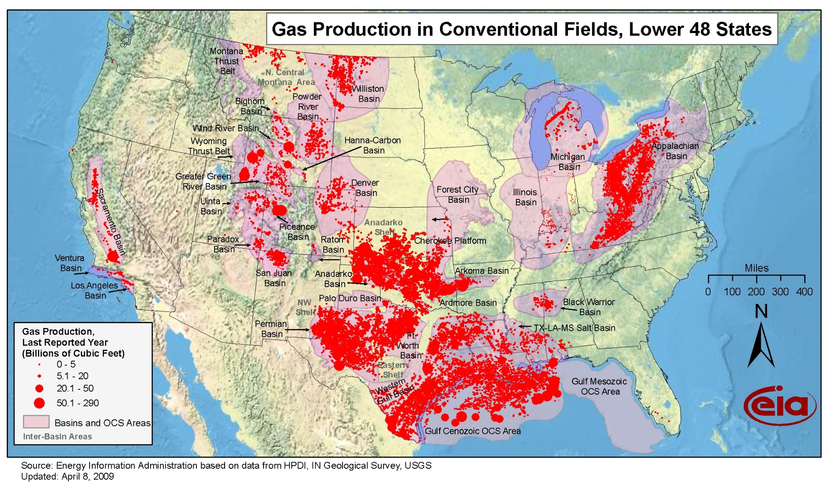
Notes:
The U.S. Energy Information Administration estimates that as of January 1, 2014, there were about 2,474 trillion cubic feet of recoverable resources of dry natural gas. At the rate of consumption in 2014, this is enough natural gas to last about 90 years.

Slide 10
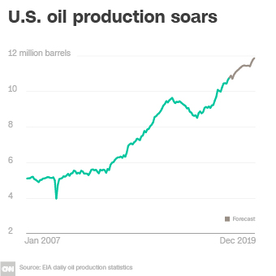
Notes:
The United States oil reserves are greater than those of any other nation except, perhaps, Russia. And, at the end of November 2018, the U.S. Geological Survey published an assessment of yet untapped resources from Western Texas into Southeastern Mexico that could be the largest on the planet. The USGS estimates that over 46 billion barrels of oil, 280 trillion cubic feet of gas, and 20 billion barrels of natural gas liquids are tripped in these low-permeability shale formations.

Slide 11
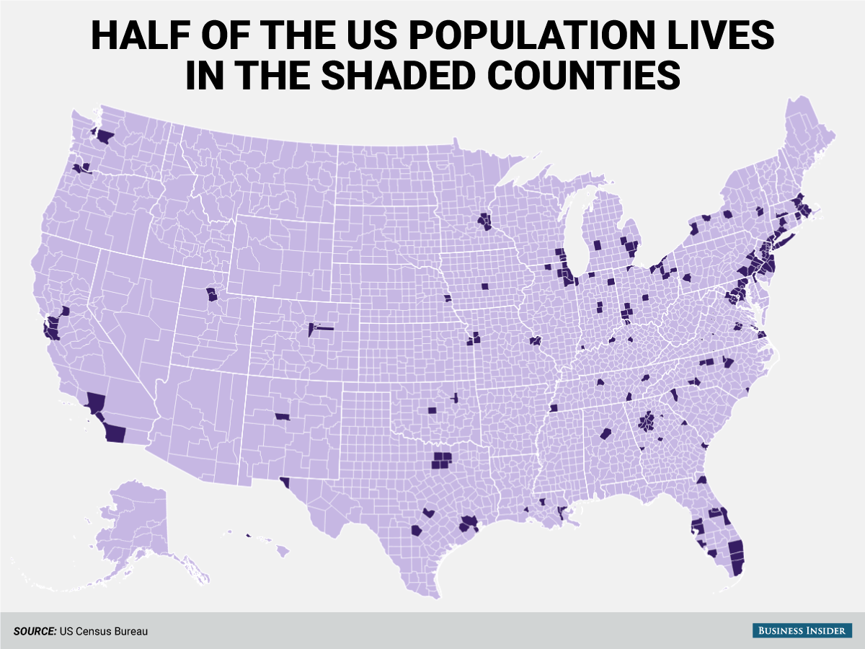
Notes:
We in the United States consume an enormous quantity of all manner of natural resources. From this perspective our footprint on the planet is very heavy. Although we physically occupy only a small part of the total land area, we have not done a very good job of taking care of the places where we live, work and play.

Slide 12
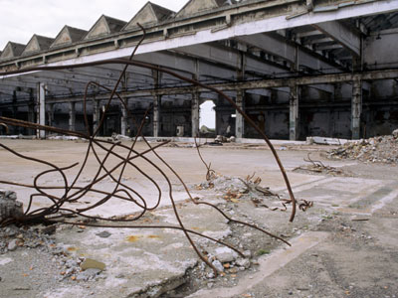
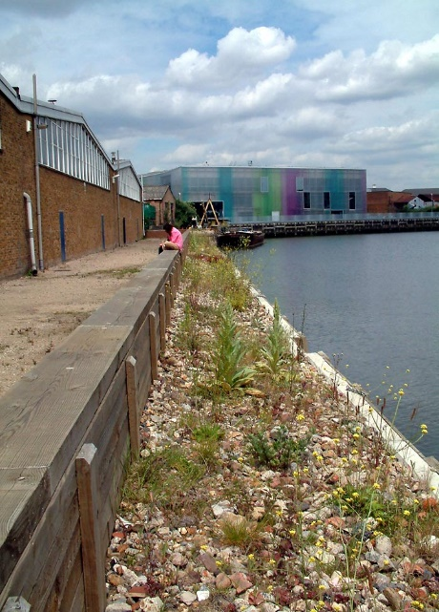
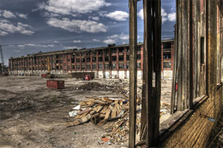
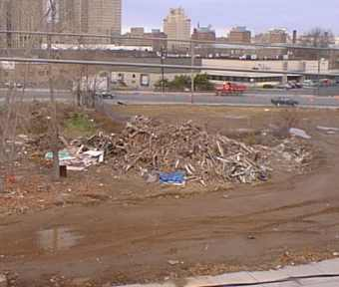
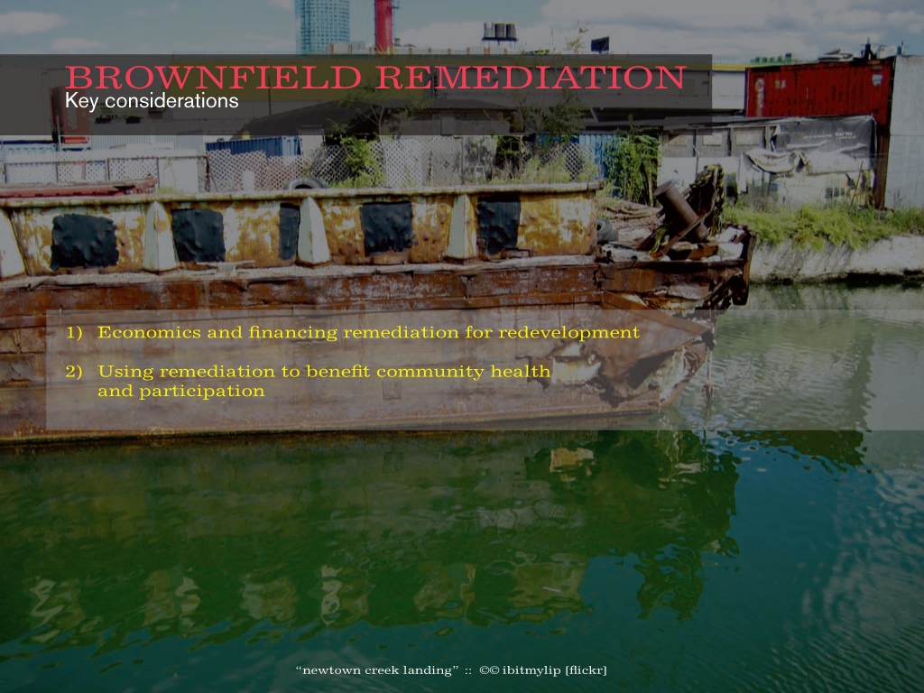
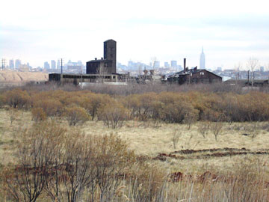
Notes:
There are more than 450,000 brownfield sites in the United States. Since 2013 the Environmental Protection Agency has awarded around 1,000 grants for cleanup of these sites, for a total of almost $190 million. A recent study by the National Bureau of Economic Research indicates that property values in the surrounding neighborhoods rise when brownfield sites are remediated. Of course, the Environmental Protection Agency is now under the direction of an individual with very different views about the role of this agency.

Slide 13
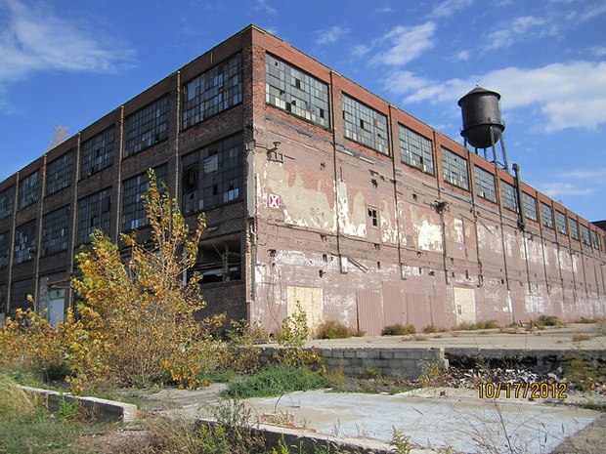
VACANT AND ABANDONED
Notes:
13
What we find in almost every town, city and other community in the United States is a large number of vacant industrial and other buildings, often surrounded by land contaminated by buried chemicals.

Slide 14
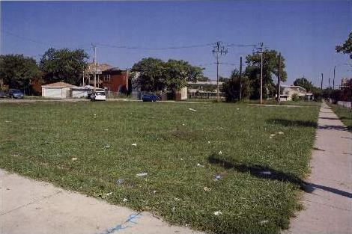
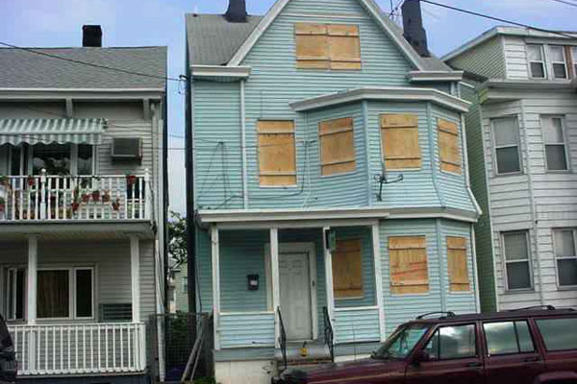
Notes:
14
Nationally, an average 16.7% of large US cities’ land area is considered vacant, with approximately 4% of city addresses unoccupied. Regional variations exist in both the amount and kind of vacant land, suggesting that any ameliorative actions should be designed to fit specific conditions. Cities also reported that most vacant parcels are small, odd shaped, and disconnected, making them difficult to redevelop.

Slide 15

Notes:
And, of course, it is no secret that much of our physical infrastructure needs to be replaced.

Slide 16
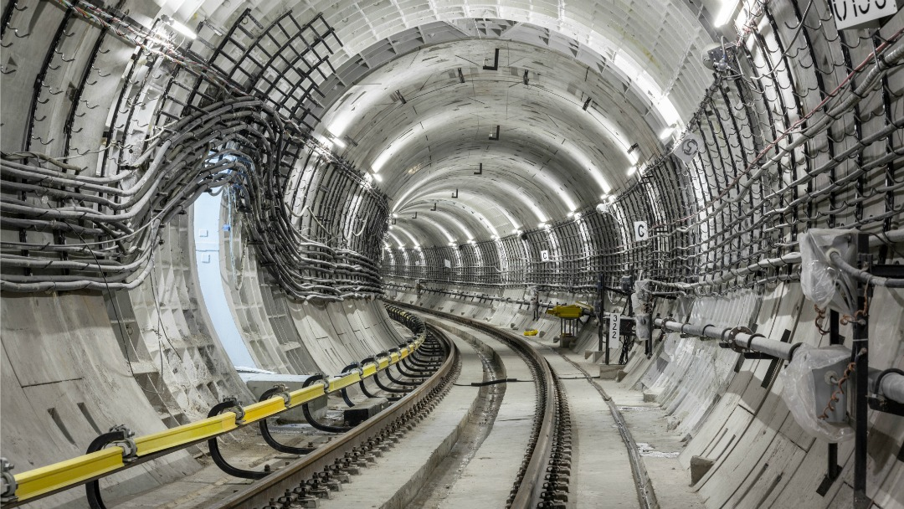
Notes:
While we wait for government to allocate the revenue required to maintain and rebuild the nation’s infrastructure, the situation becomes more dangerous and desperate.

Slide 17
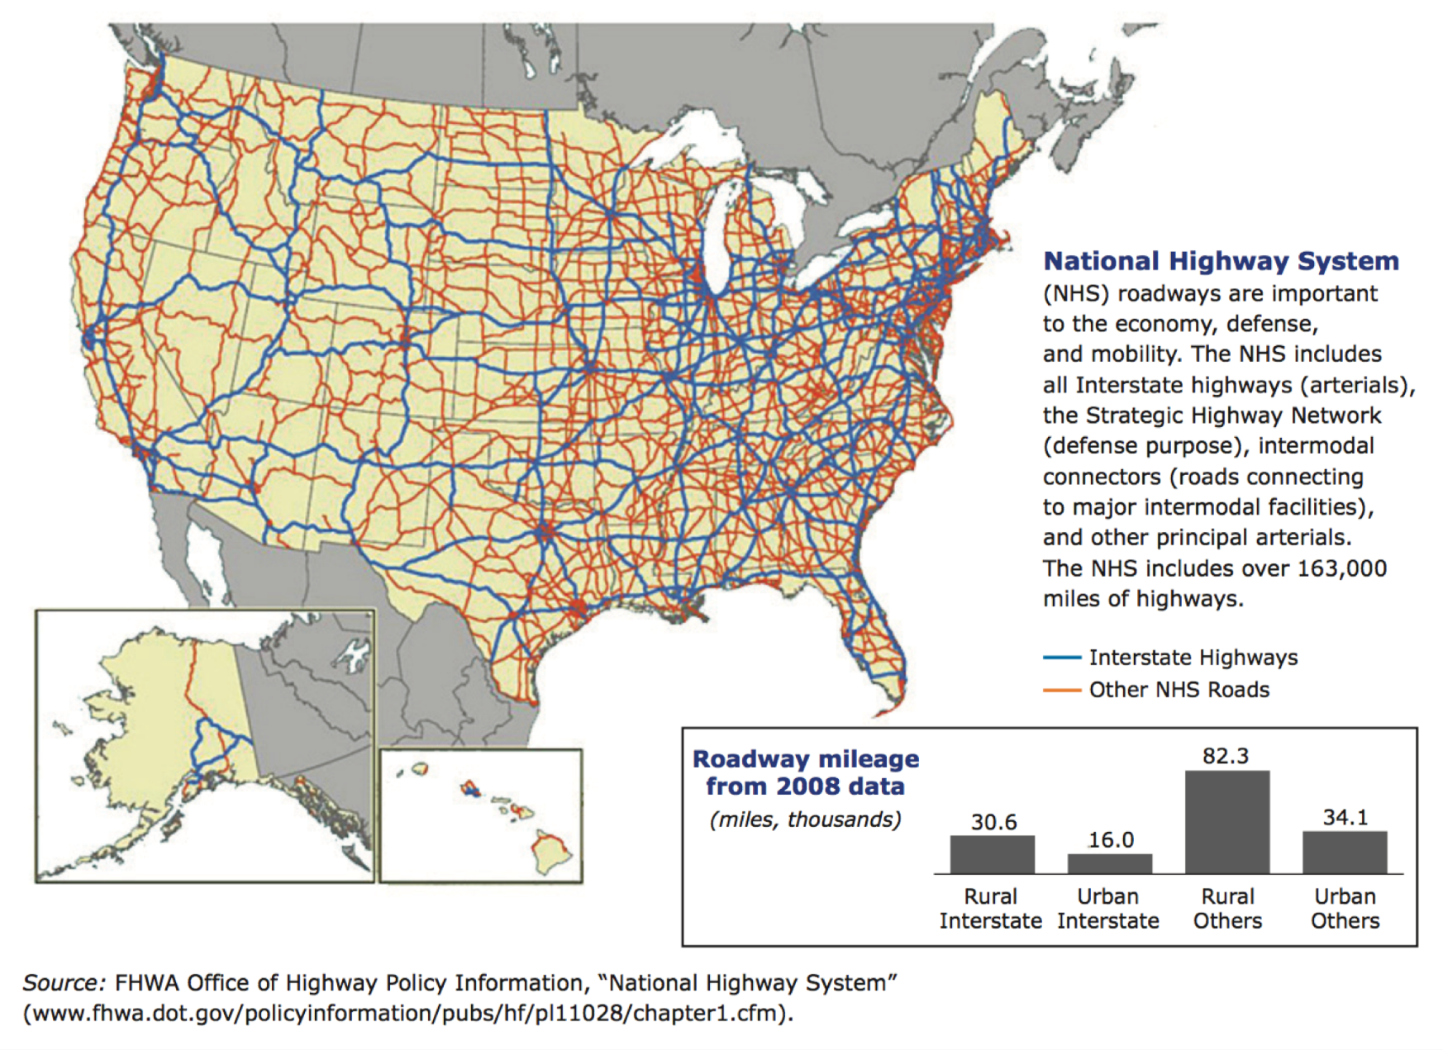
Notes:
The National Highway System is essentially the lifeblood of the nation’s commerce and public mobility. Although constituting only about 4 percent of the nation’s roads, it carries more than 40 percent of all highway traffic, 75 percent of heavy truck traffic, and 90 percent of all tourist traffic. More than 90 percent of all U.S. residents live within five miles of this network.

Slide 18
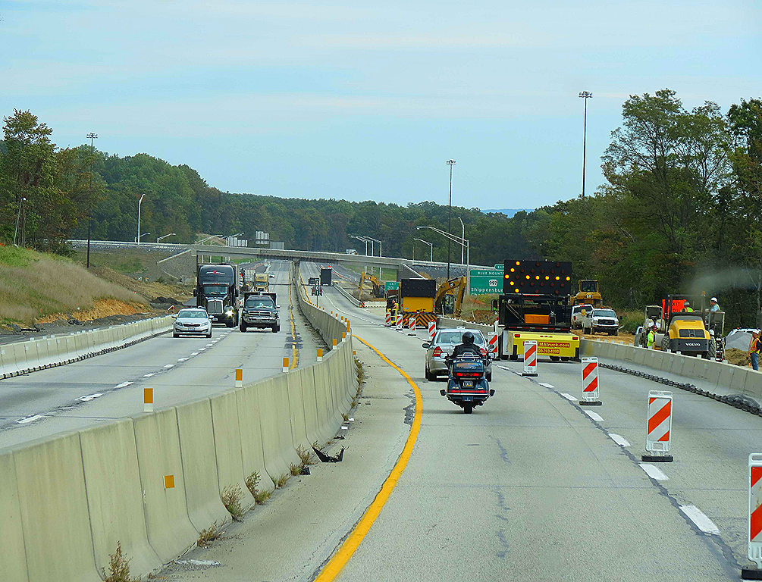
Notes:
Roughly 4.3 million miles of roads and highways criss-cross the United States. A 2013 Department of Transportation report stated that of the more than $200 billion spent on U.S. highways in 2010, about half was used for capital investments and a quarter for routine maintenance and traffic services. As American University Radio journalist Martin DiCaro reported in 2014:

Slide 19
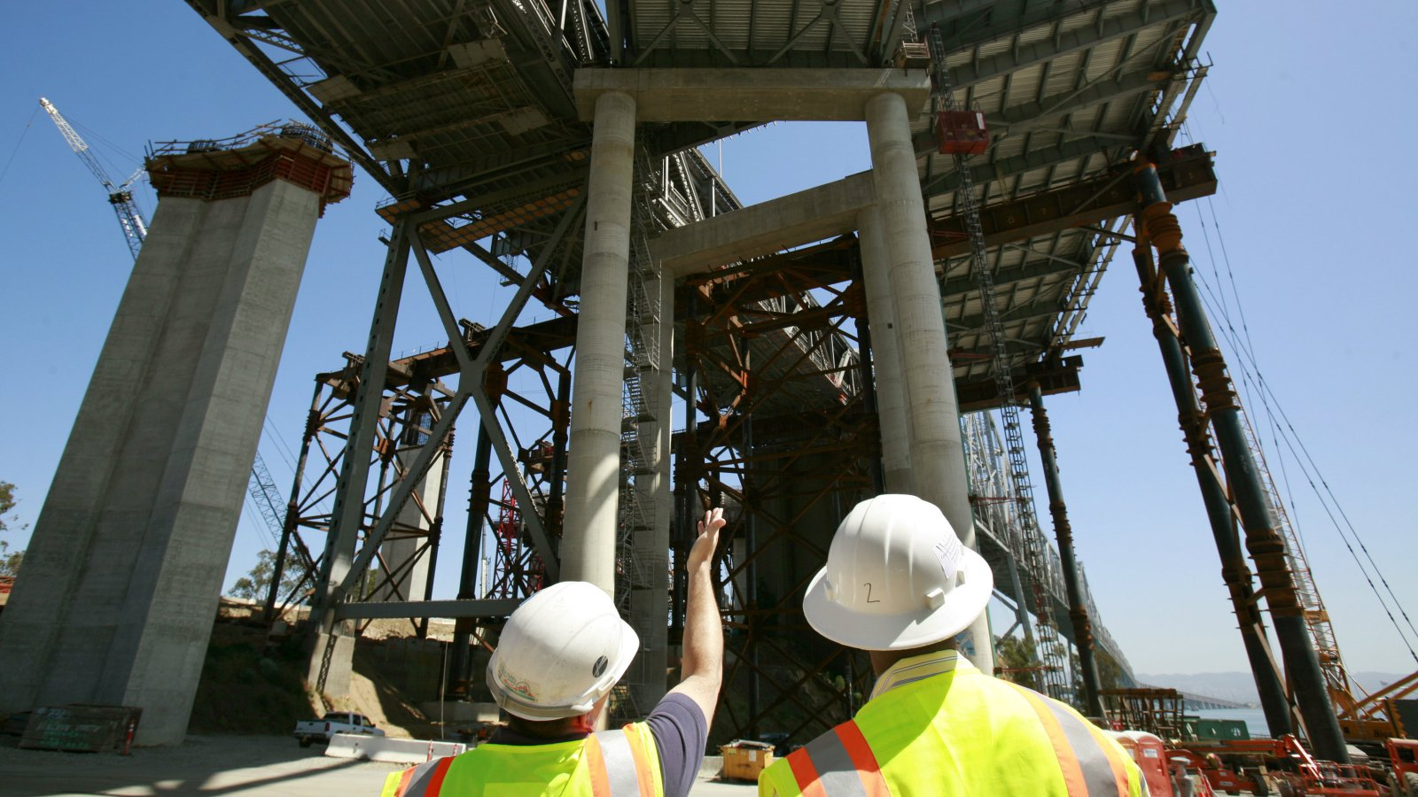
Notes:
A 2017 policy brief issued by the Conference Board’s Committee for Economic Development reported that in 2014 various levels of government spent $165 billion to build, operate and maintain highways. One quarter of this amount was provided by the federal government. The U.S. Department of Transportation estimates it will cost about $189 billion to clear the backlog of necessary system improvement projects. Just to maintain highway and bridge conditions will cost between $65 and $87 billion. Actual system improvements would add another $146 billion annually. [Source: Committee for Economic Development of the Conference Board. “Fixing America’s Roads & Bridges: The Path Forward,” 29 May, 2017]

Slide 20
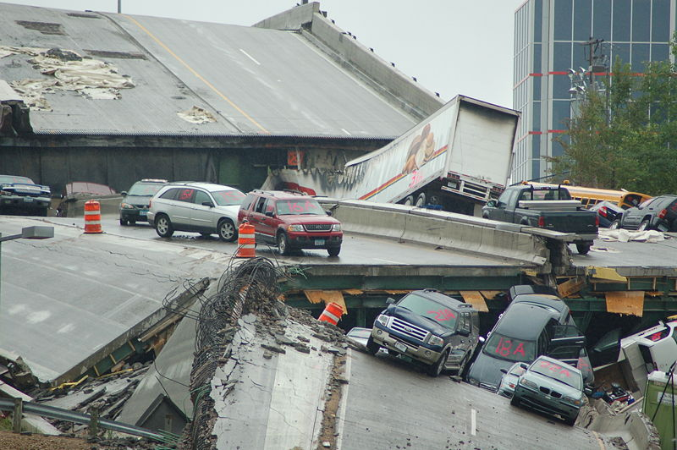
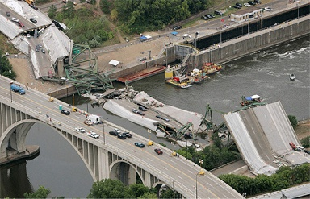
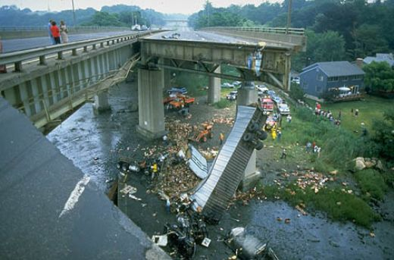
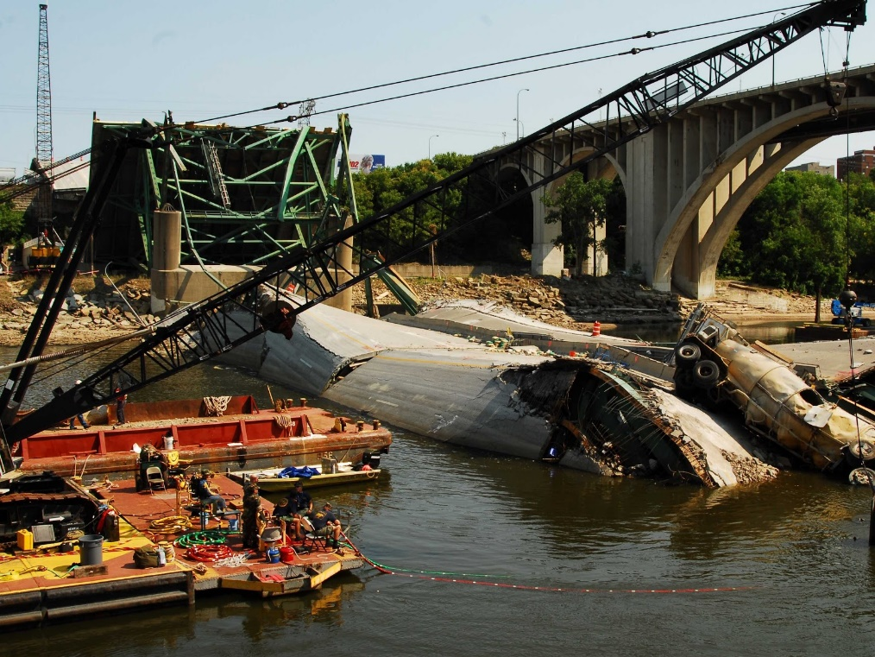
Notes:
20
Bridges are susceptible to damage and deterioration from a variety of causes. In 1968 a U.S. Navy training aircraft crashed into the eastern side of the Oakland Bay Bridge causing considerable damage. Then, in 1989 a 6.9 magnitude earthquake caused a 50 foot section of the upper deck to collapse on the lower deck. The bridge had to be closed for over a month. The photograph in the upper left is of the 2007 collapse of a major bridge in Minnesota.

Slide 21

Notes:
21
The pattern of spending on the nation’s roadways prompted this conclusion by Leighton Walter Kille, managing editor of the online news organization created to give academics a greater voice in public affairs:

Slide 22
“Given the failing grades that existing U.S. roads received from the American Society of Civil Engineers, the implication is that road expansion continues even as maintenance is shortchanged.”
Notes:
22
“Given the failing grades that existing U.S. roads received from the American Society of Civil Engineers, the implication is that road expansion continues even as maintenance is shortchanged.” [Source: Leighton Walter Kille. “U.S. DOT: Status of America’s highways, bridges and transit.” Journalist’s Resource. March 31, 2014]

Slide 23

Notes:
23
Martin DiCaro, the transportation reporter at radio station WAMU took a close look at our transportation problems in 2014, concluding:

Slide 24
“The number of miles people drive every year has stayed the same. But when you look at 2009 to 2011, across the entire country we spent $60 billion on adding capacity and congestion didn’t get fixed. …When you look at the repair problem, motorists spend, according to the American Social of Civil Engineers, about $67 billion a year on car repairs caused by roads in poor condition.”
Notes:
24
“The number of miles people drive every year has stayed the same. But when you look at 2009 to 2011, across the entire country we spent $60 billion on adding capacity and congestion didn’t get fixed. …When you look at the repair problem, motorists spend, according to the American Social of Civil Engineers, about $67 billion a year on car repairs caused by roads in poor condition.” [Source: Martin DiCaro. “States Spend Too Much On New Roads, Neglecting Maintenance, Report Says,” WAMU 88.5, American University Radio, 18 March, 2014]

Slide 25
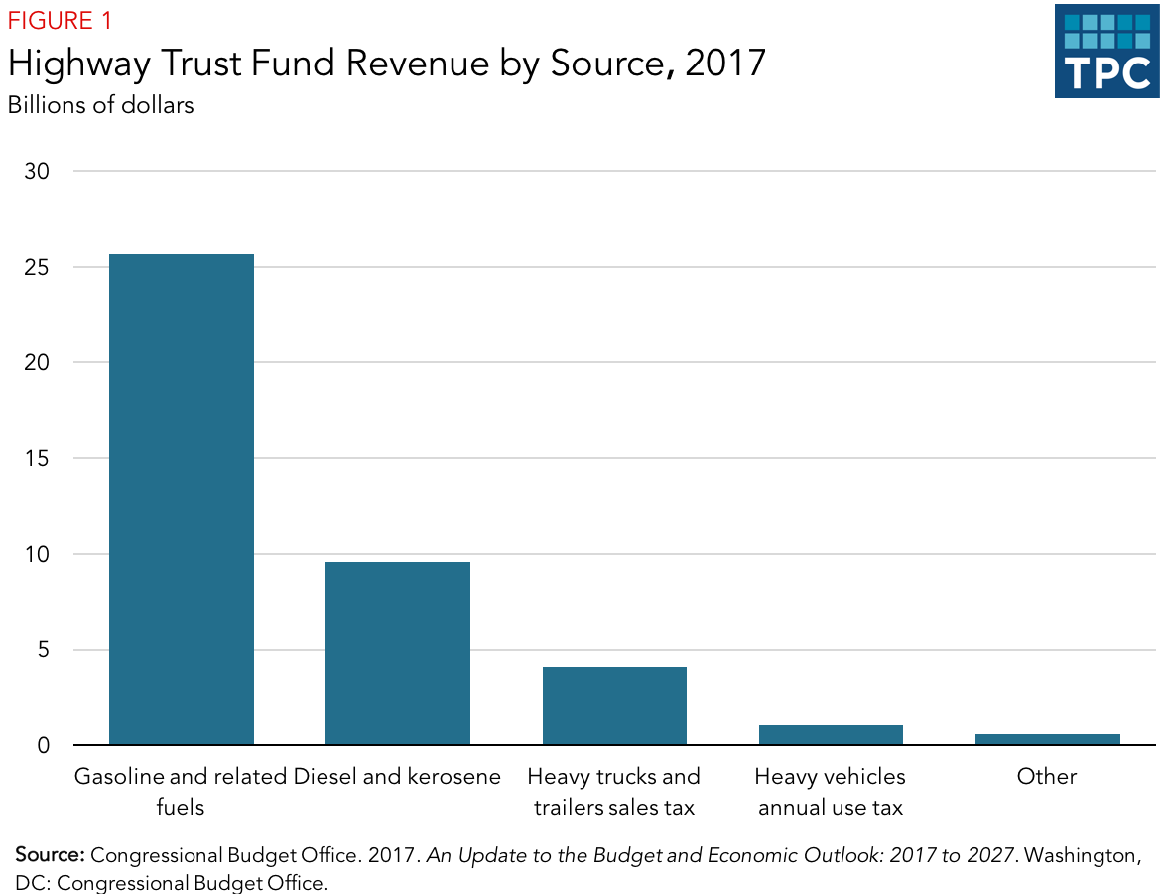
Notes:
In 2017, combined private and public investment for transportation projects of all kinds cost nearly $250 billion. Roughly $90 billion of this total was for highway and street construction. As this graph reveals, the U.S. Highway Trust Fund provided only $40.9 billion of the needed revenue, raising the important public policy issue of whether the tax on gasoline and other fuels ought to be significantly increased. This is certainly more practical than trying to convert more major highways into toll roads. In either case, however, the effect on lower income workers dependent on an automobile for transportation would affect them disproportionately.

Slide 26
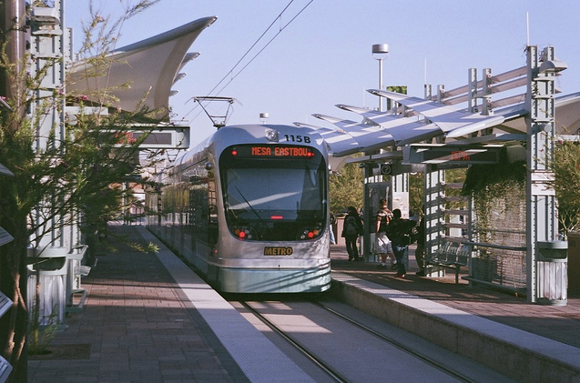
Notes:
The age distribution of U.S. rail vehicles shows great disparities. Many are 10 or fewer years old, while more than 2,000 have been in service for 35 years or more. This is in part a reflection of their initial expense and intended lifespan, but also a consequence of longstanding underinvestment in large urban transit systems — the majority of the longest-serving vehicles are for commuter-rail systems.

Slide 27
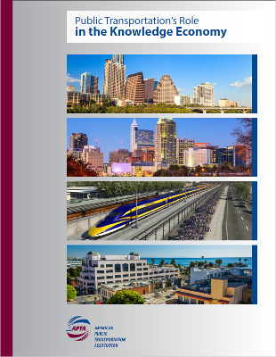
Notes:
27
A 2016 study commissioned by the American Public Transportation Association finds a direct relationship between the quality of public transportation and the expansion of businesses that employ knowledge workers. As stated by APTA chair Valarie McCall:

Slide 28

“Public transportation is the catalyst that attracts knowledge workers who show a preference to be connected with multiple transportation options to high-growth business centers. It allows these Innovation Districts to create dense business infrastructure that preserves key community benefits while mitigating congestion issues and providing businesses greater access to labor.”
Notes:
28
“Public transportation is the catalyst that attracts knowledge workers who show a preference to be connected with multiple transportation options to high-growth business centers. It allows these Innovation Districts to create dense business infrastructure that preserves key community benefits while mitigating congestion issues and providing businesses greater access to labor.” [Source: American Public Transportation Association “Transit News” March 8, 2016]

Slide 29
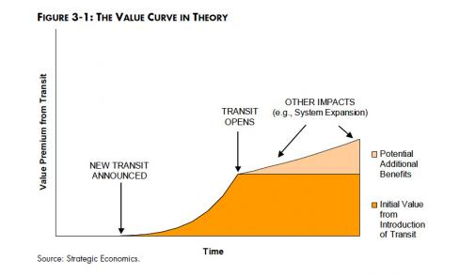
Notes:
29
The planning community has in recent years awakened to the significant – often enormous – increase in land values caused by the extension of public transit systems into new areas and by the improvement of existing transit hubs. This has stimulated discussion of whether and how to capture these increased land values to offset the cost of the public transit investments.

Slide 30

Notes:
30
Rick Rybeck, a city planner and Director of the firm Just Economics, based in Washington, DC, supports restructuring the conventional property tax in order to efficiently capture the increases in land value associated with public infrastructure investments:

Slide 31

“Surprisingly, the higher tax on land helps keep land prices more affordable. (It reduces the profit from land speculation, thereby reducing the speculative demand for land.) Returning infrastructure-created land values to the public helps make infrastructure financially self-sustaining (at least to a greater degree than today) and thereby reduces the need for other taxes and subsidies. It also creates some fairness in infrastructure funding because landowners who benefit from infrastructure end up paying in proportion to the benefits that they receive.”
Notes:
31
“Surprisingly, the higher tax on land helps keep land prices more affordable. (It reduces the profit from land speculation, thereby reducing the speculative demand for land.) Returning infrastructure-created land values to the public helps make infrastructure financially self-sustaining (at least to a greater degree than today) and thereby reduces the need for other taxes and subsidies. It also creates some fairness in infrastructure funding because landowners who benefit from infrastructure end up paying in proportion to the benefits that they receive.” [Source: Rick Rybeck. “Funding Infrastructure to Rebuild Equitable, Green Prosperity.” Revitalization News, Issue #7, July 15, 2015]

Slide 32
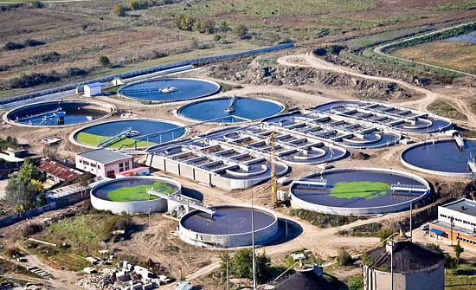
Notes:
32
Additionally, extremely important parts of our nation’s infrastructure are the systems we rely upon to deliver clean, drinkable water to our residences, businesses and other locations where we congregate. Many of us have concerns over whether our tap water is safe to drink.

Slide 33

Notes:
33
For much of the history of the country, our rivers, lakes and streams have been used for the dumping of toxic chemicals as well as human and animal wastes. Nature does its best to rid the toxins over time, but is overwhelmed by our continued abuse of this essential natural resource.

Slide 34
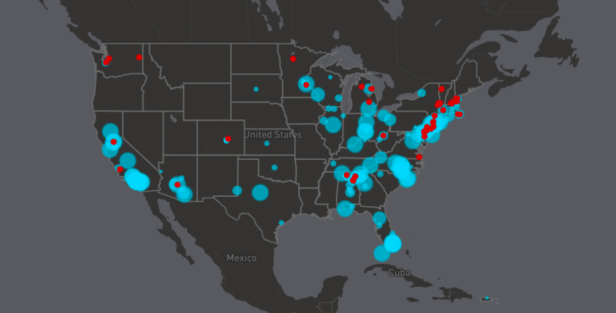
Notes:
34
This map was developed from research by Northeastern University in 2017. It shows the regions of the United States with the highest levels of toxic chemical pollution found in tap water systems serving 15 million people in 27 states. The conclusion of the researchers is that EPA chemical testing is seriously inadequate to monitor the problem. In June, the university hosted a major conference to bring together scientists, regulators, activists and others to address the social, scientific, political, economic and environmental health issues related to their findings. [Source: Greg St. Martin. “Study: Toxic Chemicals Found in Drinking Water of 15M Americans,” News@Northeastern, 14 June, 2017]

Slide 35
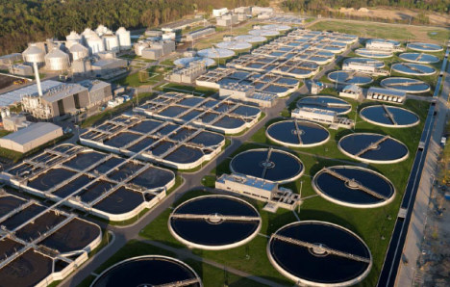
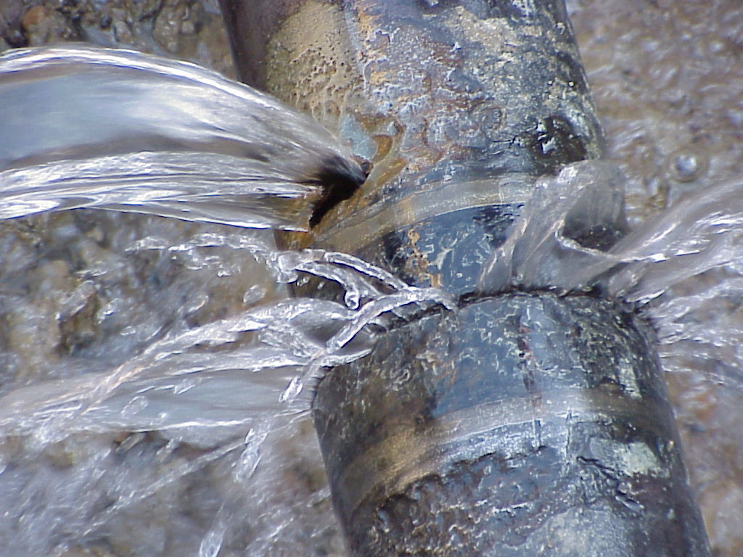
Notes:
35
Thus, in order to bring safe drinking water into our communities, a huge investment in waste treatment has been required. Broken, rusted and leaking pipes characterize another infrastructure crisis that is estimated to cost $1 trillion over the next 25 years. [Source: American Water Works Association report: “Buried No Longer: Confronting America’s Water Infrastructure Challenge”]

Slide 36
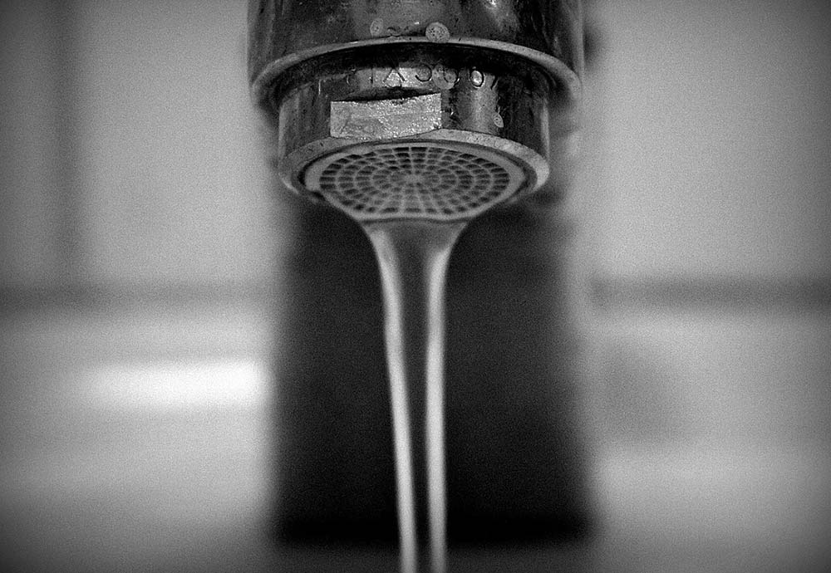
Notes:
We are learning that the lead-contamination of the water supply in Flint, Michigan is closer to a norm than an exception. Data released by the Environmental Protection Agency reveals that only nine states report safe levels of lead in their water supply.

Slide 37
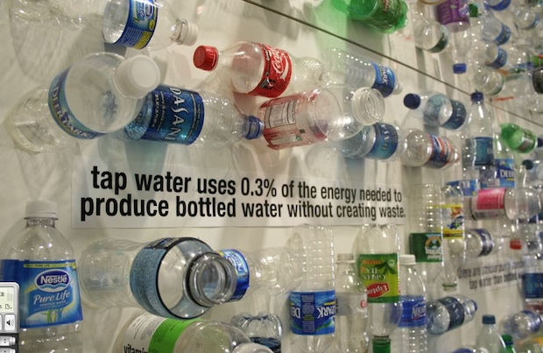
Notes:
37
Concern over the quality of tap water continues to serve as a primary reason for the consumption of bottled water, despite the huge quantity of plastic waste that must be recycled or disposed of. The irony is that nearly half of all bottled water is sourced from the municipal water supply, then purified. Some 12.8 billion gallons of bottled water was consumed in 2016., 13.7 billion in 2017, and $18.5 billion by mid-2018.

Slide 38
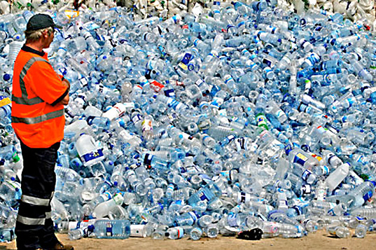
Notes:
38
Studies of bottled water quality carried out in Europe found chemicals in the water leached from the plastic bottles, from the lids and from contamination of the wells from which the water is drawn.

Slide 39
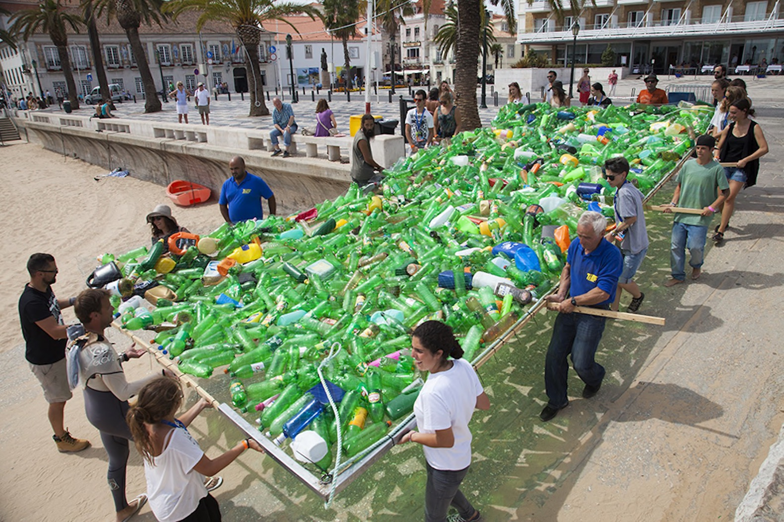
Notes:
39
Plastics were invented in the late 19th century but did not become widely used until the 1950s. Now we have some 9.2 billion tons of plastics, of which 7 billion tons have become waste. Over 6.3 billion tons have never been recycled and end up in landfills, rivers, lakes, streams and the oceans.

Slide 40
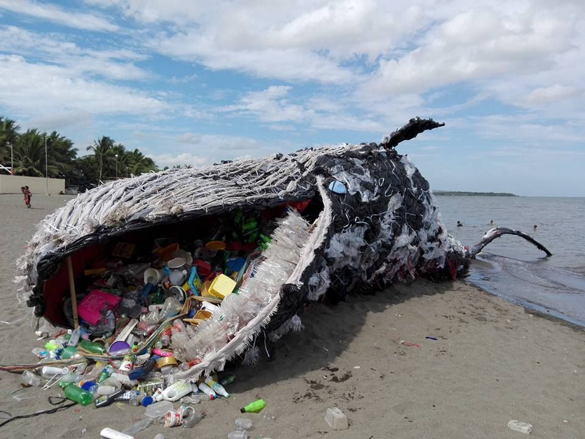
Notes:
40
Millions of marine animals are killed by plastics every year. Marine species of all sizes, from zooplankton to whales, consume microplastics.

Slide 41

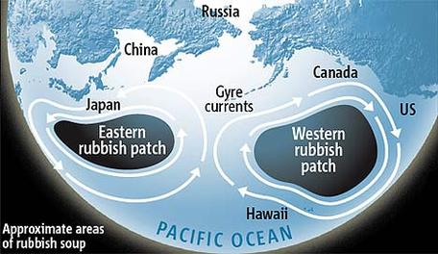
Notes:
41
Ocean currents pull small plastic particles from Asia all the way to Hawaii’s Big Island. Ramani Narayan, a chemical engineering professor at Michigan State University puts the scale of the problem in its proper context:

Slide 42
“Let’s say you recycle 100 percent in all of North America and Europe. You still would not make a dent on the plastics released into the oceans. If you want to do something about this, you have to go there, to these countries, and deal with the mismanaged waste.”
Notes:
42
Let’s say you recycle 100 percent in all of North America and Europe. You still would not make a dent on the plastics released into the oceans. If you want to do something about this, you have to go there, to these countries, and deal with the mismanaged waste.”

Slide 43
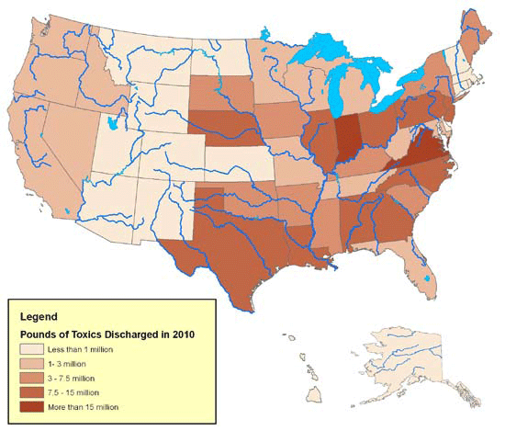
Notes:
43
A report issued by Environment America Research and Policy Center finds that industry discharged 226 million pounds of toxic chemicals into America's rivers and streams in 2010. There are no laws or regulations prohibiting such discharges. The pollution included dead-zone-producing nitrates from food processors, mercury and other heavy metals from steel plants, and toxic chemicals from various kinds of refineries. Within the overall waste, the researchers identified 1.5 million pounds of carcinogens, 626,000 pounds of chemicals linked to developmental disorders and 354,000 pounds of those associated with reproductive problems.

Slide 44
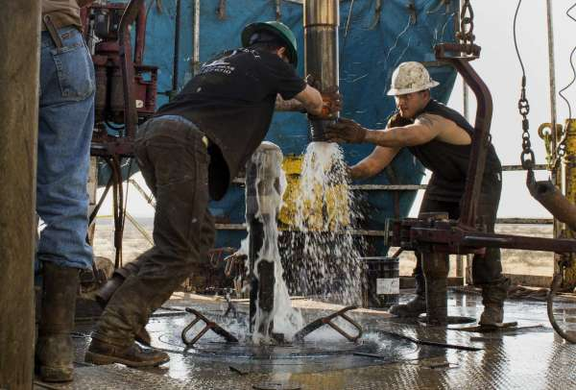
Notes:
44
And, now, the current administration at the EPA is considering granting permission to oil drillers working in the Permian Basin of Texas to discharge wastewater directly into rivers and streams. This wastewater contains huge amounts of salt, heavy metals and other chemicals. At least the EPA is conducting public hearings to determine whether the wastewater can be economically treated before being pumped into the water supply without contaminating drinking war supplies or killing off local wildlife. This is a story that deserves ongoing coverage.

Slide 45
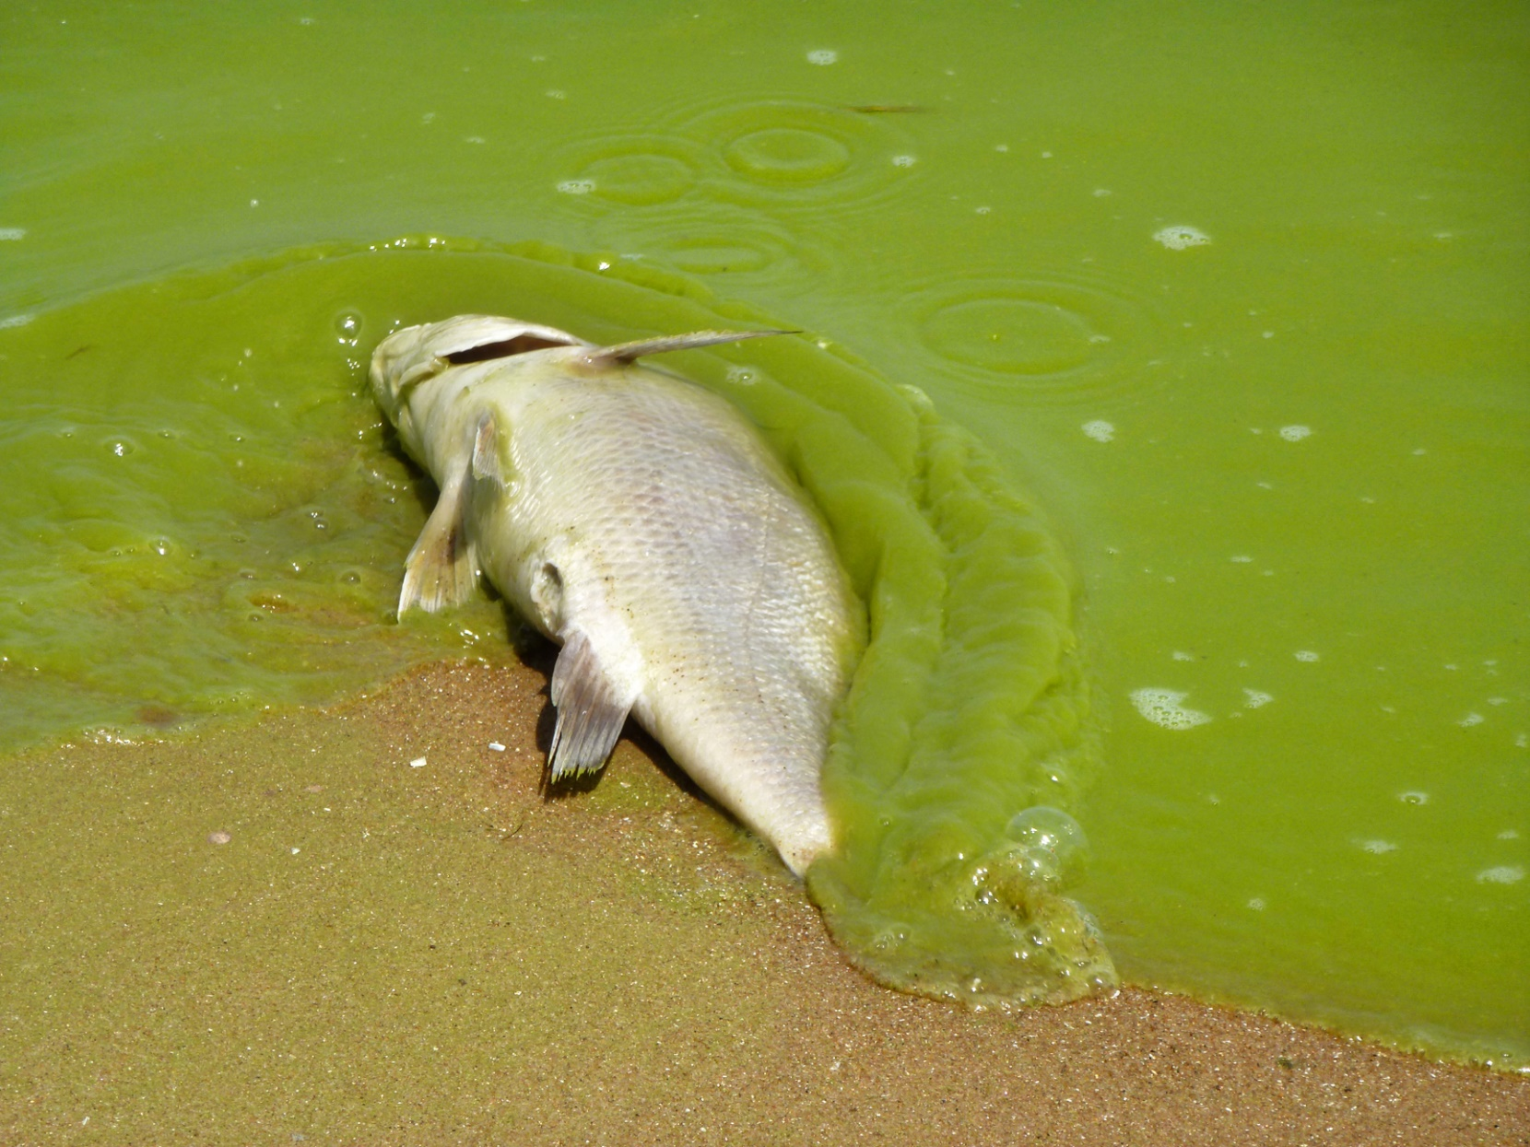
Notes:
45
Already, increasing temperatures are warming our lake waters, resulting in the growth of microorganisms into toxic algae blooms that kill fish and the food fish require. In 2014, a massive algae bloom blanketed Lake Erie, invading the water supply of Toledo, Ohio. A 2018 study by the Environmental Working Group found that just since 2010 there have been over 300 algae blooms recorded in lakes, rivers and bays in 48 states. In 2017 alone there were 169 blooms recorded in 40 states. The primary cause: chemical runoff from farms.

Slide 46
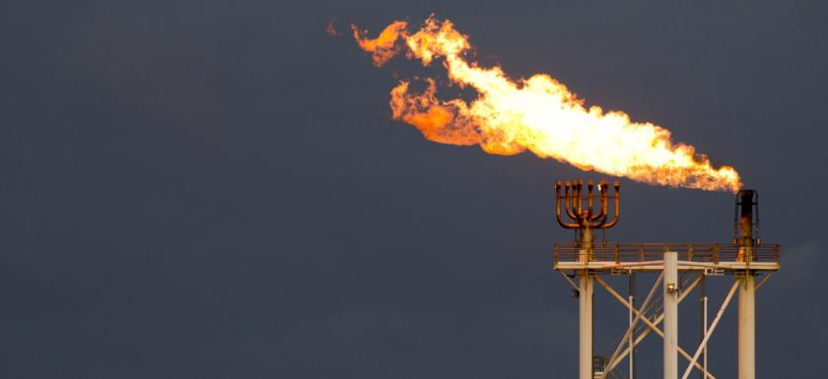

Notes:
The production and use of natural gas in the U.S. is at an all-time record level, growing every year since 2010. There are real monetary savings over oil or most sources of electrical energy. There are perceived environmental advantages over the burning of oil or coal. However, the Union of Concerned Scientists puts these advantages in a balanced context:

Slide 47
“Natural gas emits 50 to 60 percent less carbon dioxide (CO2) when combusted in a new, efficient natural gas power plant compared with emissions from a typical new coal plant. Considering only tailpipe emissions, natural gas also emits 15 to 20 percent less heat-trapping gases than gasoline when burned in today’s typical vehicle. Emissions from smokestacks and tailpipes, however, do not tell the full story. …”
Notes:
Natural gas emits 50 to 60 percent less carbon dioxide (CO2) when combusted in a new, efficient natural gas power plant compared with emissions from a typical new coal plant. Considering only tailpipe emissions, natural gas also emits 15 to 20 percent less heat-trapping gases than gasoline when burned in today’s typical vehicle. Emissions from smokestacks and tailpipes, however, do not tell the full story.

Slide 48
“The drilling and extraction of natural gas from wells and its transportation in pipelines results in the leakage of methane, primary component of natural gas that is 34 times stronger than CO2 at trapping heat over a 100-year period and 86 times stronger over 20 years. Preliminary studies and field measurements show that these so-called “fugitive” methane emissions range from 1 to 9 percent of total life cycle emissions. Whether natural gas has lower life cycle greenhouse gas emissions than coal and oil depends on the assumed leakage rate, the global warming potential of methane over different time frames, the energy conversion efficiency, and other factors.”
Notes:
“The drilling and extraction of natural gas from wells and its transportation in pipelines results in the leakage of methane, primary component of natural gas that is 34 times stronger than CO2 at trapping heat over a 100-year period and 86 times stronger over 20 years. Preliminary studies and field measurements show that these so-called “fugitive” methane emissions range from 1 to 9 percent of total life cycle emissions. Whether natural gas has lower life cycle greenhouse gas emissions than coal and oil depends on the assumed leakage rate, the global warming potential of methane over different time frames, the energy conversion efficiency, and other factors.” [Source: Union of Concerned Scientists. “Environmental Impacts of Natural Gas”]

Slide 49
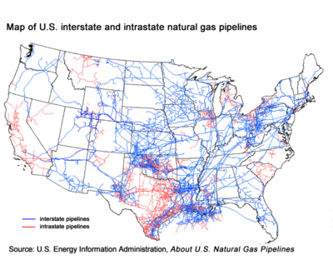
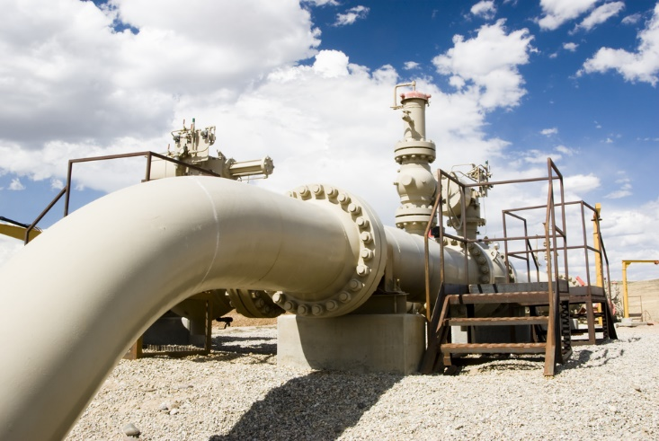
Notes:
The pipelines through which natural gas is distributed need to be replaced in many parts of the country. A 2013 report released by the U.S. Senate found that “Gas distribution companies in 2011 reported releasing 69 billion cubic feet of natural gas to the atmosphere, almost enough to meet the state of Maine’s gas need for a year.”

Slide 50

Notes:
50
This graph shows the distribution of the age of the pipelines. One analyst, Chris Dalby of the energy company ENI succinctly describes the scale of the problem:

Slide 51
“An issue that has overcome much of the goodwill toward fixing energy infrastructure in the sheer scale of the problem. Given the interconnection of pipes, pipelines and transmission lines across state lines, under lakes and rivers, and through deserts, tracking where the most serious issues lie is arduous at best.”
Notes:
51
“An issue that has overcome much of the goodwill toward fixing energy infrastructure in the sheer scale of the problem. Given the interconnection of pipes, pipelines and transmission lines across state lines, under lakes and rivers, and through deserts, tracking where the most serious issues lie is arduous at best.” [Source: Chris Dalby. “America’s aging energy infrastructure,” eni.com]

Slide 52

Notes:
The annual State of the Air report by the American Lung Association found that although levels of year-round particle pollution and ozone are improving, more than half of all Americans live in counties where they are exposed to unhealthful levels of these pollutants. Los Angeles remains the metropolitan area with the worst ozone pollution, as it has for all but one of the 16 reports.

Slide 53

Notes:
53
A major source of air pollutants is the power plants that generate the electricity we rely on. A report by the Clean Air Task Force found that about 7,500 deaths each year are attributable to fine particle pollution from U.S. power plants.

Slide 54



Notes:
54
The Union of Concerned Scientists points to coal powered plants as the top source of carbon dioxide emissions, which they argue is the primary cause of global warming. This chart, produced by the U.S. Energy Information Administration, shows a modest reduction in total carbon dioxide emissions since 2008, primarily attributed to the reduction in the use of coal by U.S. power plants.

Slide 55

Notes:
55
The situation is serious, but there are many people working on solutions.

Slide 56

Notes:
56
The potential exists to capture carbon dioxide emissions in a new and unique manner: in the production of an eco-friendly type of concrete. The process is the invention of Australian John Harrison. The cement is a composite of magnesite, recycled industrial wages, and ordinary cement. As it sets and hardens, it absorbs carbon dioxide from the atmosphere and converts it to carbonate. To date, however, the cement industry has refused to change its methods. Harrison expresses what he sees as the sense of urgency:

Slide 57
“I really do not think we have much time left with the atmosphere we have. It is time all the great thinkers of the world, combined with government funding, solved the problem in a manner similar to the way the atomic bomb was created.”
Notes:
57
“I really do not think we have much time left with the atmosphere we have. It is time all the great thinkers of the world, combined with government funding, solved the problem in a manner similar to the way the atomic bomb was created.” [Quoted in: Meir Rinde. “Concrete Solutions: Making eco-friendly cement is easy; the hard part comes later,”Distillations, Fall 2017]

Slide 58

Notes:
58
Serious concerns also continue to exist over the risks associated with the production of energy by nuclear fission.

Slide 59

Notes:
59
Because no permanent repository for spent fuel exists in the United States, reactor owners have kept spent fuel at the reactor sites. As the amount of spent fuel has increased, the Nuclear Regulatory Commission has authorized many power plant owners to increase the amount in their storage pools to as much as five times what they were designed to hold. As a result, virtually all U.S. spent fuel pools have been “re-racked” to hold spent fuel assemblies at densities that approach those in reactor cores. In order to prevent the spent fuel from going critical, the spent fuel assemblies are placed in metal boxes whose walls contain neutron-absorbing boron.

Slide 60

Notes:
60
The risks from spent fuel in storage pools can be reduced by moving some of it to dry casks. Typical dry casks are made of steel and concrete, with the concrete providing radiation shielding , and are stored at U.S. reactors outdoors on concrete pads. To become cool enough to be placed in the dry casks currently licensed and used in the United States, the spent fuel must first spend five years in a spent fuel pool. By then it is cool enough that further cooling can be accomplished by natural convection — air flow driven by the decay heat of the spent fuel itself.

Slide 61

Notes:
61
Dry storage containers are made of reinforced high-density concrete about 510 millimetres (20 inches) thick and are lined inside and outside with 12.7-millimetre-thick (half-inch) steel plate. The thickness of concrete provides an effective barrier against radiation. The dry storage containers have a minimum design life of 50 years.

Slide 62
Notes:
62
Where nuclear energy is concerned, the next innovation is one that is coming from the early days of research into how to produce nuclear energy.

Slide 63

Notes:
A real solution is on the horizon: the development of what is called an Integral Molten Salt Reactor.

Slide 64

Notes:
This type of reactor was developed sixty years ago at the Oak Ridge National Laboratory but shelved because of short-sighted thinking on the part of other scientists, military priorities and energy officials. Remarkably, the process creates much less waste and few long-lived radioactive elements. Moreover:

Slide 65

“The IMSR’s fundamental advantage lies in its most novel feature – the fuel is a liquid. At first glance, that might seem odd. But molten salt, with the uranium dissolved in it, can operate at low-pressure and absent are chemical or mechanical driving forces which can cause so many problems with traditional solid fuel reactors.”
Notes:
“The IMSR’s fundamental advantage lies in its most novel feature – the fuel is a liquid. At first glance, that might seem odd. But molten salt, with the uranium dissolved in it, can operate at low-pressure and absent are chemical or mechanical driving forces which can cause so many problems with traditional solid fuel reactors.” [Source: James Conca. “Nuclear Power Turns To Salt,” Forbes Magazine, 7 January, 2015]

Slide 66

Notes:
66
At the core of our challenges as a society are what the author Ferdinand Lundberg described as cracks in the constitution. We’ll look at these issues in the next part of this update.

Slide 67
End Part 13

