Slide 1

The State of the United States
ECONOMY and SOCIETY
Part 12

Slide 2
The Crisis of Law
Notes:
We are said to be a nation ruled by law, rather than by the directives of individuals holding positions of authority. For differing reasons, many of us argue that our system of laws violates fundamental human rights or the laws are inconsistently enforced. The erosion of respect for the law and for those charged with enforcement of law has exposed serious cracks in The American System.

Slide 3
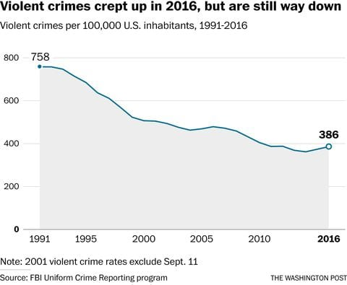
Notes:
Violent crimes against us as individuals are the type of crimes that make the evening news. Families are often devastated by these acts, and as a society there is no disagreement that penalties need to be strong. FBI data released in September of 2018 indicated that violent crime fell in 2017 and again in 2018. It is noteworthy that about 73% murders are committed with guns, a proportion that has been increasing yearly.

Slide 4
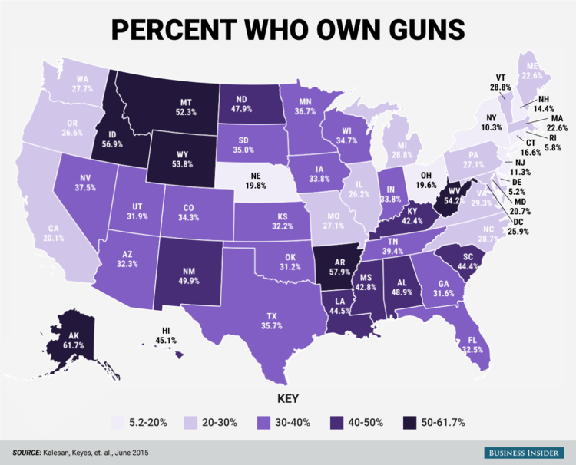
Notes:
Proponents of gun ownership or of gun control can argue over the impact guns have on violent crimes. What economists know is that the sale of guns, other weapons and ammunition has become an important part of the security-focused economy. Guns are good for GDP growth, not so good for building social cohesion.

Slide 5
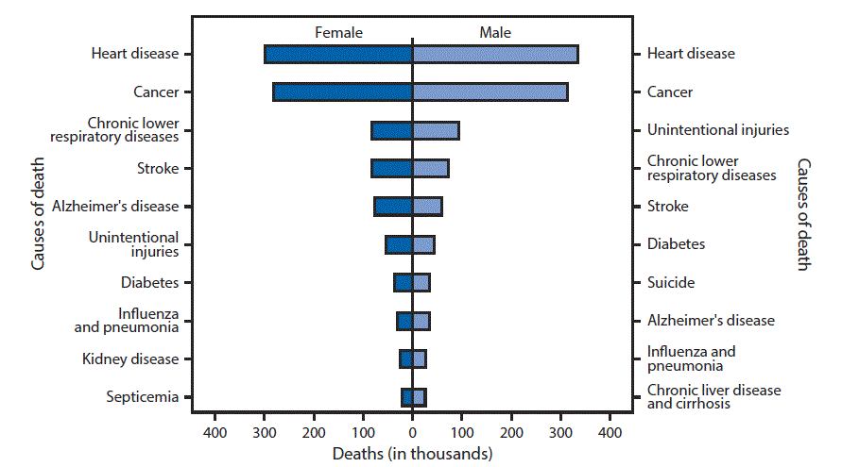
Notes:
Three of every 100,000 Americans are killed by guns each year. Around 16,000 people require medical attention annually from gun-related injuries. Every year around 21,000 people (one-half of the total) commit suicide using a firearm. [Source: National Center for Health Statistics]

Slide 6
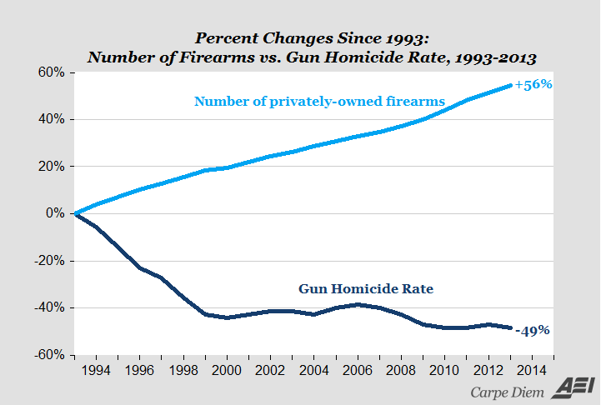
Notes:
This chart seems to confirm what gun ownership proponents suggest, that the expanded private ownership of firearms results in a significant reduction in the use of firearms resulting in a homicide. However, before one reaches that conclusion more detail is needed. For example, surveys of Texans indicate that 44 percent of gun owners own two to five guns. One in five Texan gun owners own more than five guns. What other factors might contribute to the decline in gun homicides? Aging of the population is one to consider.

Slide 7
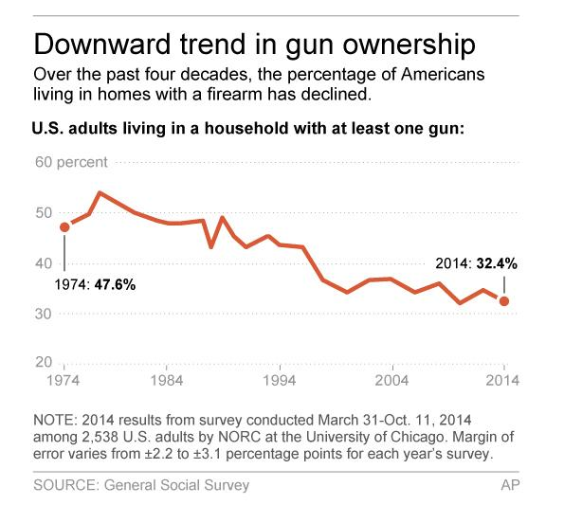
Notes:
This University of Chicago survey concluded that gun ownership is actually declining. In 2016, a CBS News poll found that 36 percent of adults either personally owned a firearm or live with someone who does. That same year a survey released by the PEW Research Center indicated gun ownership by households was at 44 percent. An important question is whether people respond accurately when surveyed. One estimate puts the number of firearms owned by Americans at between 250-280 million. Law enforcement officials estimate that nearly 90 percent of all juveniles in correctional facilities owned a gun at some point, all of which would have been illegal weapons.

Slide 8

Notes:
What is likely to be seen as highly controversial is a recent analysis of crime and race by Edwin S. Rubenstein of the New Century Foundation. Among the findings revealed by analysis of police reports, as well as victim and witness surveys are following:

Slide 9
“There are dramatic race differences in crime rates. Asians have the lowest rates, followed by whites, and then Hispanics. Blacks have notably high crime rates. This pattern holds true for virtually all crime categories and for virtually all age groups. …”
Notes:
“There are dramatic race differences in crime rates. Asians have the lowest rates, followed by whites, and then Hispanics. Blacks have notably high crime rates. This pattern holds true for virtually all crime categories and for virtually all age groups.”

Slide 10
“In 2015, a black person was 2.45 times more likely than a white person to be shot and killed by the police. A Hispanic person was 1.21 times more likely. These figures are well within what would be expected given race differences in crime rates and likelihood to resist arrest. …”
Notes:
“In 2015, a black person was 2.45 times more likely than a white person to be shot and killed by the police. A Hispanic person was 1.21 times more likely. These figures are well within what would be expected given race differences in crime rates and likelihood to resist arrest.”

Slide 11
“In 2013, of the approximately 660,000 crimes of interracial violence that involved blacks and whites, blacks were the perpetrators 85 percent of the time. This meant a black person was 27 times more likely to attack a white person than vice versa. A Hispanic was eight times more likely to attack a white person than vice versa.”
Notes:
“In 2013, of the approximately 660,000 crimes of interracial violence that involved blacks and whites, blacks were the perpetrators 85 percent of the time. This meant a black person was 27 times more likely to attack a white person than vice versa. A Hispanic was eight times more likely to attack a white person than vice versa.”

Slide 12
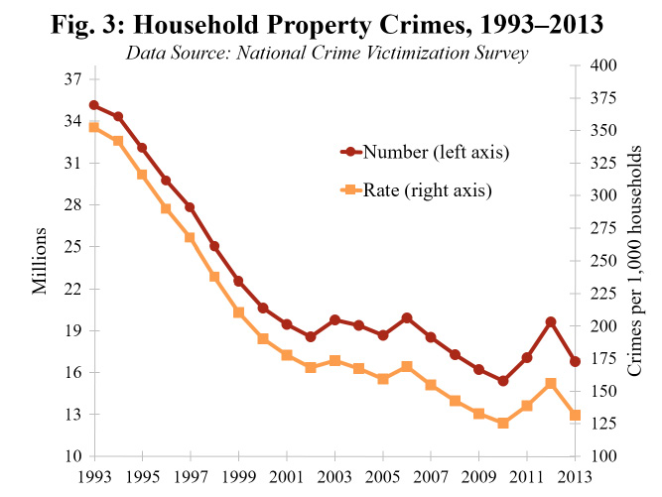
Notes:
Property crimes such as burglary and motor vehicle theft also appear to be in long-term decline, falling from an estimated 35.1 million cases in 1993 to 16.8 million in 2013. An analysis of 2017 crime statistics by the New York University Law School confirmed that the downward trend was continuing.

Slide 13
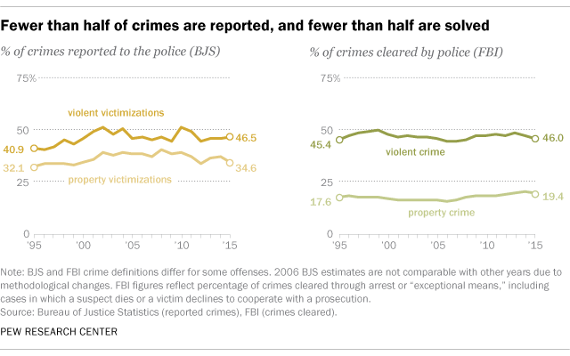
Notes:
There is also the fact that many crimes are not reported to the police. Only one-third of property crimes are reported, most do not result in the arrest, charging and prosecution of a suspect.

Slide 14
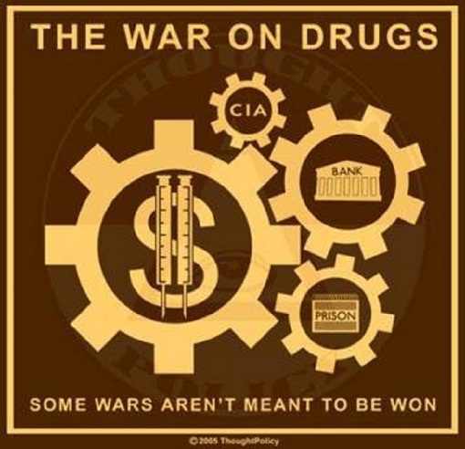
Notes:
The use and abuse of addictive chemical substances ruins many lives. We have spent billions of dollars and incarcerated millions of people for producing, distributing and consuming these chemicals. These measures have accomplished little.

Slide 15


Notes:
Nor have education efforts been effective. On the one-hand there are millions of existing and potential users of drugs who succumb to their use. And, on the supply side there are the enormous profits to be made by people who control the supply and distribution. A 1999 investigation by the PBS program FRONTLINE concluded:

Slide 16
“Globalization hit organized crime over the last decade and now is integral to its most profitable business -- the international narcotics traffic. Once a regional problem involving a customer base of a few million, and barely a billion dollars in sales, the illegal drug industry is now a worldwide enterprise with tens of millions of hard core consumers spending hundreds of billions on opiates, cocaine and amphetamines and marijuana, as well as other drugs.”
Notes:
“Globalization hit organized crime over the last decade and now is integral to its most profitable business -- the international narcotics traffic. Once a regional problem involving a customer base of a few million, and barely a billion dollars in sales, the illegal drug industry is now a worldwide enterprise with tens of millions of hard core consumers spending hundreds of billions on opiates, cocaine and amphetamines and marijuana, as well as other drugs.” Fast forward to 2017 and the problems of addiction affect every community and almost every family.

Slide 17
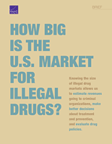
Notes:
A 2014 report generated by the Rand Corporation for the U.S. White House Office of National Drug Control Policy adds:

Slide 18
“Drug users in the United States spend on the order of $100 billion annually on all four drugs (in 2010 dollars). This figure has been stable over the decade, but there have been important shifts in the drugs being purchased.”
Notes:
“Drug users in the United States spend on the order of $100 billion annually on all four drugs (in 2010 dollars). This figure has been stable over the decade, but there have been important shifts in the drugs being purchased.”

Slide 19
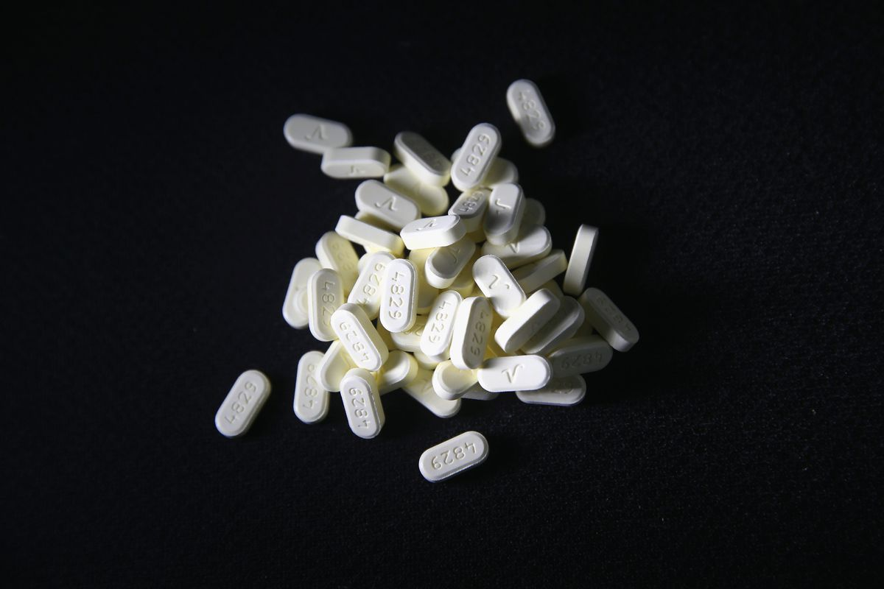
Notes:
The Centers for Disease Control and Prevention reports that opiods (including prescription opioids, heroin, and fentanyl) killed more than 42,000 people in 2016 out of a total 63,600 deaths caused by drug overdose. Some 40 percent of all overdose deaths involved a prescription opioid.

Slide 20
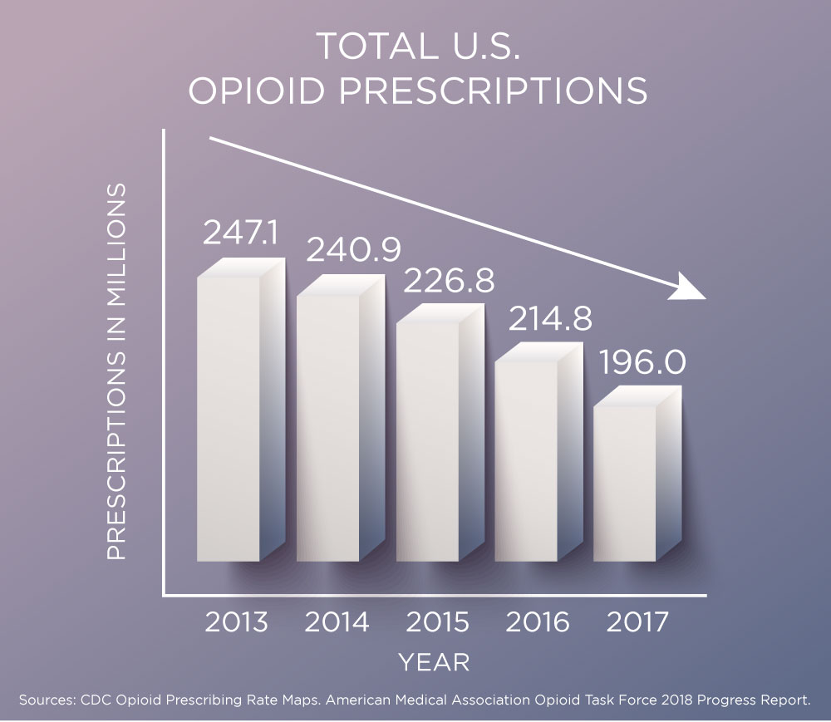
Notes:
After far too long, physicians have finally awakened to the addictions they fostered by prescribing opioids to deal with patient pain. The rate of deaths involving opioids increased from 2.9 per 100,000 in 1999 to 10.4 in 2015. From 2015-2016, deaths from fentanyl and other synthetic opiates more than doubled; deaths from heroin increased nearly 20%; and deaths from other opioids such as hydrocodone and oxycodone increased 14%. Additionally, a March 2018 CDC report showed a 30% increase in emergency department opioid overdose visits from July-September 2016 vs July-September 2017, which suggests that the death trend will also continue to rise.

Slide 21
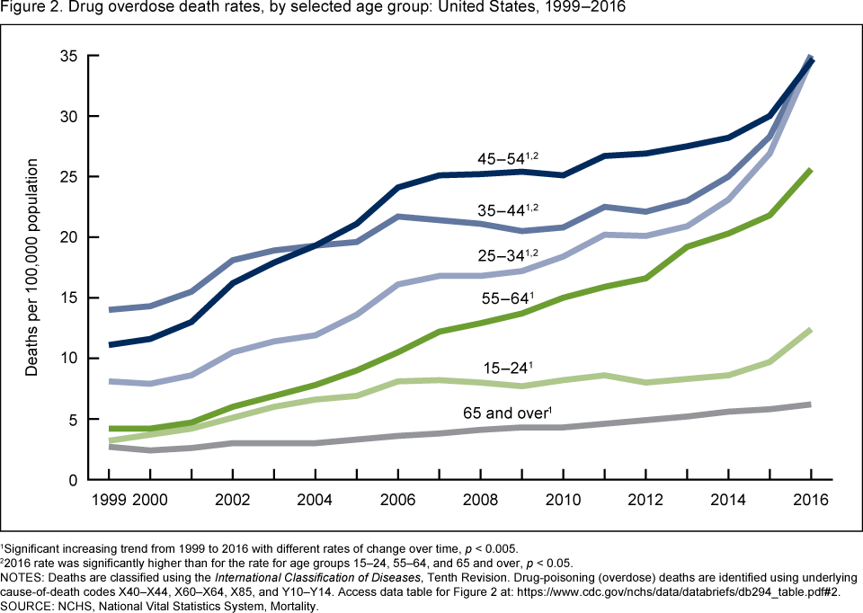
Notes:
In combination, all drug overdoses are now the leading cause of death among Americans under age 50.

Slide 22
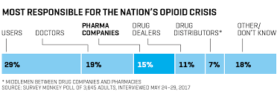
Notes:
The issue for us as a society is how to respond to the widespread use of life-destroying drugs. While we have allowed the large pharmacuedical companies to manufacture strong, addicting opioids and allowed medical practitioners to prescribe them to patients with almost no oversight, we have convicted and incarcerated an estimated 2.3 million people for possession and/or distribution of narcotics and other illegal substances. This graph shows the results of an opinion survey conducted in May of 2017.

Slide 23
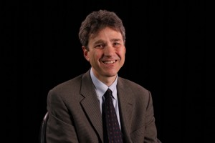
Notes:
The nation’s new Attorney General, Jeff Sessions, remained convinced that the criminal justice system and long prison sentences are the appropriate societal response. One former federal prosecutor, David Sklansky, responded:

Slide 24
“It can’t be emphasized enough that the direction they’re pointing is 180 degrees wrong. Mandatory minimums have had a terrible effect on the American criminal justice system, and we need to retreat further from their use, not return to the patterns of usage a decade ago.”
Notes:
“It can’t be emphasized enough that the direction they’re pointing is 180 degrees wrong. Mandatory minimums have had a terrible effect on the American criminal justice system, and we need to retreat further from their use, not return to the patterns of usage a decade ago.” [Quoted in: John Schuppe. “Attorney General Sessions Charts Course Back to Long Drug Sentences,” NBC News, 13 May, 2017]

Slide 25

Notes:
Another category of crime that is seemingly uncontrollable is identify theft.

Slide 26

Notes:
A study by Javelin Strategy & Research found that in 2016 over $16 billion was stolen from 15.4 million U.S. consumers. Between 2012-2016 identify thieves stole over $107 billion. Another 16.7 million persons were victimized in 2017, losing $16.8 billion. Fraudulently opened new credit cards accounted for losses of $5.1 billion.

Slide 27
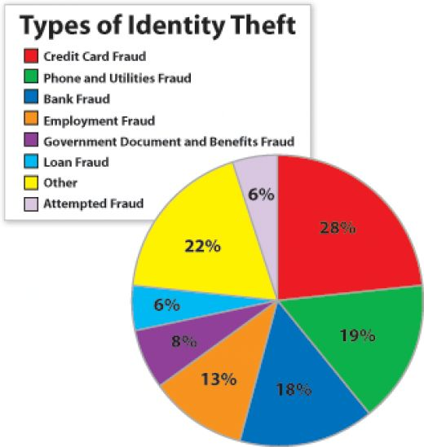
Notes:
More and more, we are victimized by various forms of identify theft and internet-based crime.

Slide 28
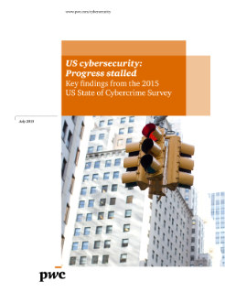
Notes:
This 2015 survey by PwC (Price Waterhouse Coopers) of 500 U.S. executives, security experts and others reported heightened concerns over cybersecurity and the potential for cyber attacks.

Slide 29
“Globally, a record 1 billion data records were compromised in 2014. …As motives and means continue to evolve, so do the methods of attack. Distributed denial of service attacks are becoming increasingly potent and are one of the most frequent types of cybersecurity incidents.”
Notes:
“Globally, a record 1 billion data records were compromised in 2014. …As motives and means continue to evolve, so do the methods of attack. Distributed denial of service attacks are becoming increasingly potent and are one of the most frequent types of cybersecurity incidents.”

Slide 30
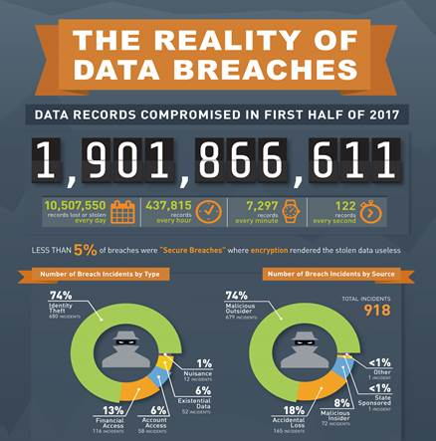
Notes:
Gemalto, a major leader in digital security, found 918 data breaches, compromising 1.9 billion data records around the world occurred during the first six months of 2017. This represented a 164 percent increase from 2016. In May, a ransomware virus affected 200,000 victims in 150 countries. And, then, there was the Equifax revelation that information on 143 million Ameicans was compromised in 2017.

Slide 31
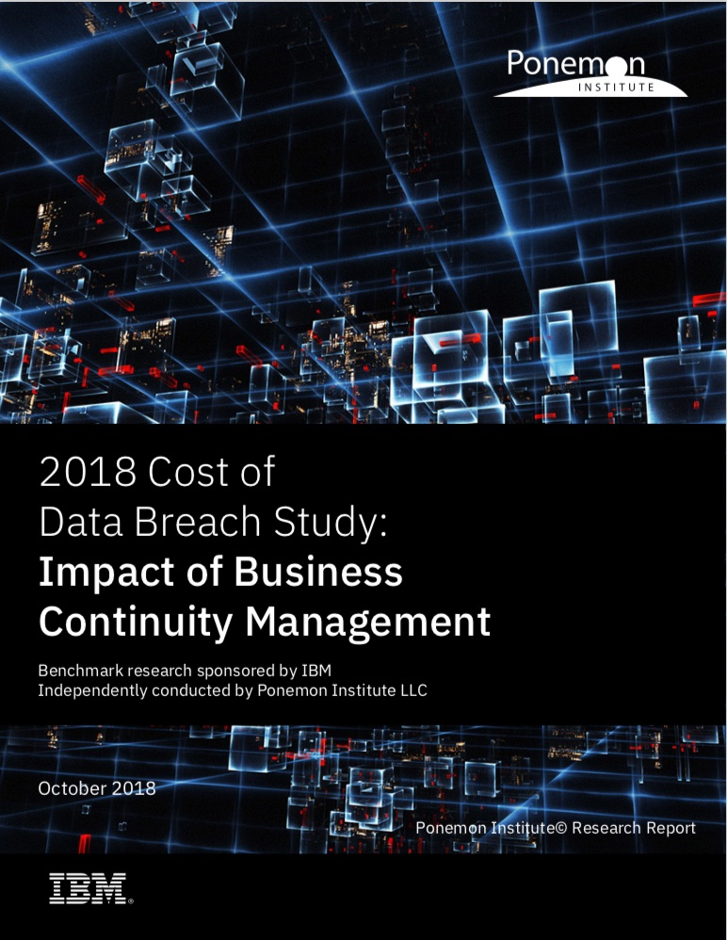
Notes:
A 2018 Cost of a Data Breach study by Ponemon Institute found that the global average cost of a data breach is up 6.4 percent over 2017, to $3.86 million. The average cost for each lost or stolen record containing sensitive and confidential information also increased by 4.8 percent year over year to $148.

Slide 32

Notes:
Experts in cyber crime forecast that the damage will cost $6 trillion annually by 2021, doubling the cost incurred in 2015. In response, spending on cybersecurity rose to $86.4 billion in 2017, $114 billion in 2018. Statista reports the U.S. spent $66 billion on cybersecurity in 2018, up from $54.8 billion in 2016.

Slide 33
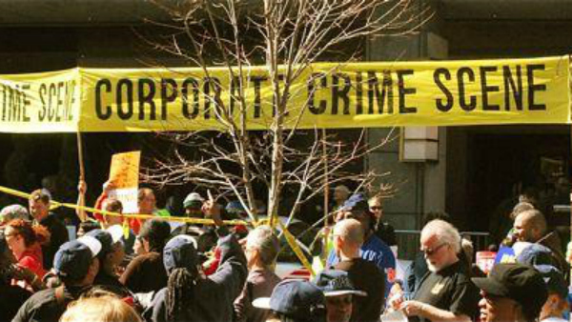
Notes:
Decisions are regularly made by top executives of corporations and other businesses to circumvent or directly violate existing laws and regulations in their quest for profits and personal financial gain. In this sense, the actions of some business leaders result in public harm as or more devastating than the activities of what we think of as organized criminal enterprises.

Slide 34

Notes:
34
The organization Havoscscope.com gathers the statistics on a long list of illegal, or black market, commerce. Here is a list of the dollar volume of some of these activities:

Slide 35
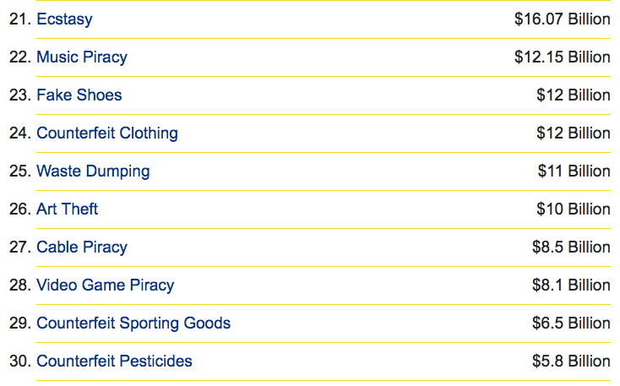
Notes:
35
These figures reveal the extent to which people are engaged in illegal activities, many of which violate fundamental human rights and are environmentally destructive.

Slide 36

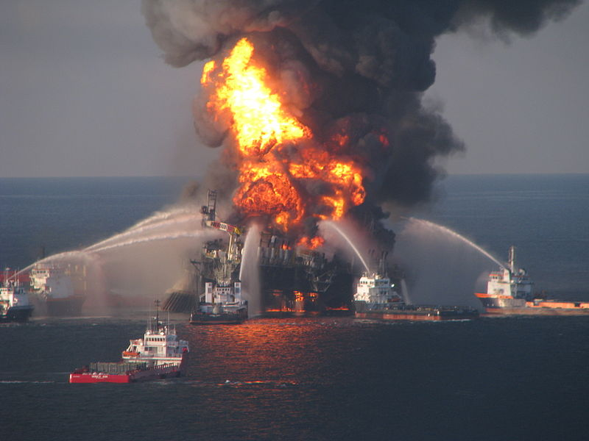
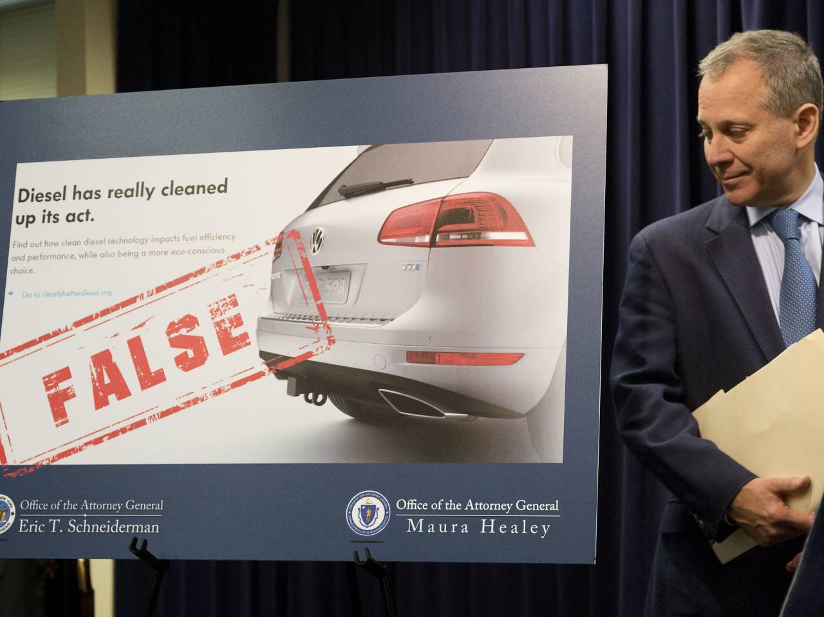
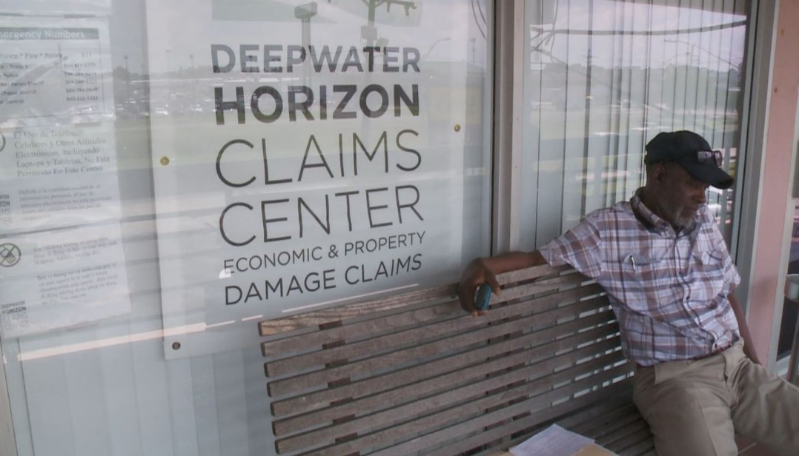
Notes:
36
The list of serious corporate crimes identified and prosecuted continues to grow. British Petroleum paid $20 billion in 2015 to settle civil charges relating to the Deepwater Horizon disaster ($4 billion paid in criminal penalties). Volkswagen was penalized $2.8 billion for purposely building a diesel engine equipped with software to misreport greenhouse gas emissions. U.S. banks were fined $200 billion for their role in the financial crisis.

Slide 37
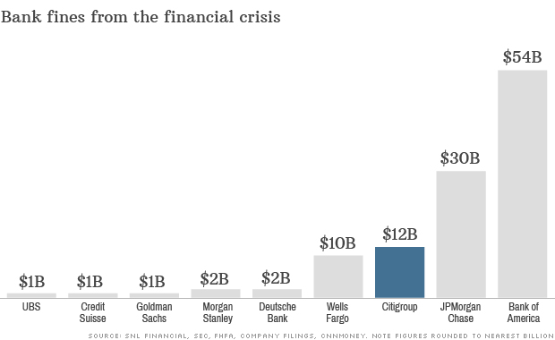
Notes:
37
The world’s financial institutions were found guilty of predatory lending, fraud in the creation and marketing of various asset-backed securities and derivatives. Bank of America got into trouble for the practice of “robo-signing” in connection with foreclosure actions and for predatory practices under the governments Home Affordable Modification Program, as described by journalist David Dayen in 2013:

Slide 38
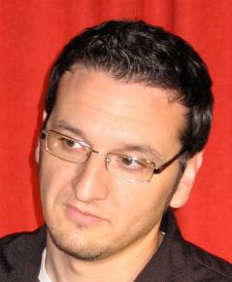
“The government’s Home Affordable Modification Program (HAMP), which gave banks cash incentives to modify loans under certain standards, was supposed to streamline the process and help up to 4 million struggling homeowners. …In reality, Bank of America used it as a tool … to squeeze as much money as possible out of struggling borrowers before eventually foreclosing on them.”
Notes:
38
“The government’s Home Affordable Modification Program (HAMP), which gave banks cash incentives to modify loans under certain standards, was supposed to streamline the process and help up to 4 million struggling homeowners. …In reality, Bank of America used it as a tool … to squeeze as much money as possible out of struggling borrowers before eventually foreclosing on them.” [Source: David Dayen. “Bank of America whistle-blower’s bombshell: ‘We were told to lie’,” SALON.com, 18 June, 2013]

Slide 39
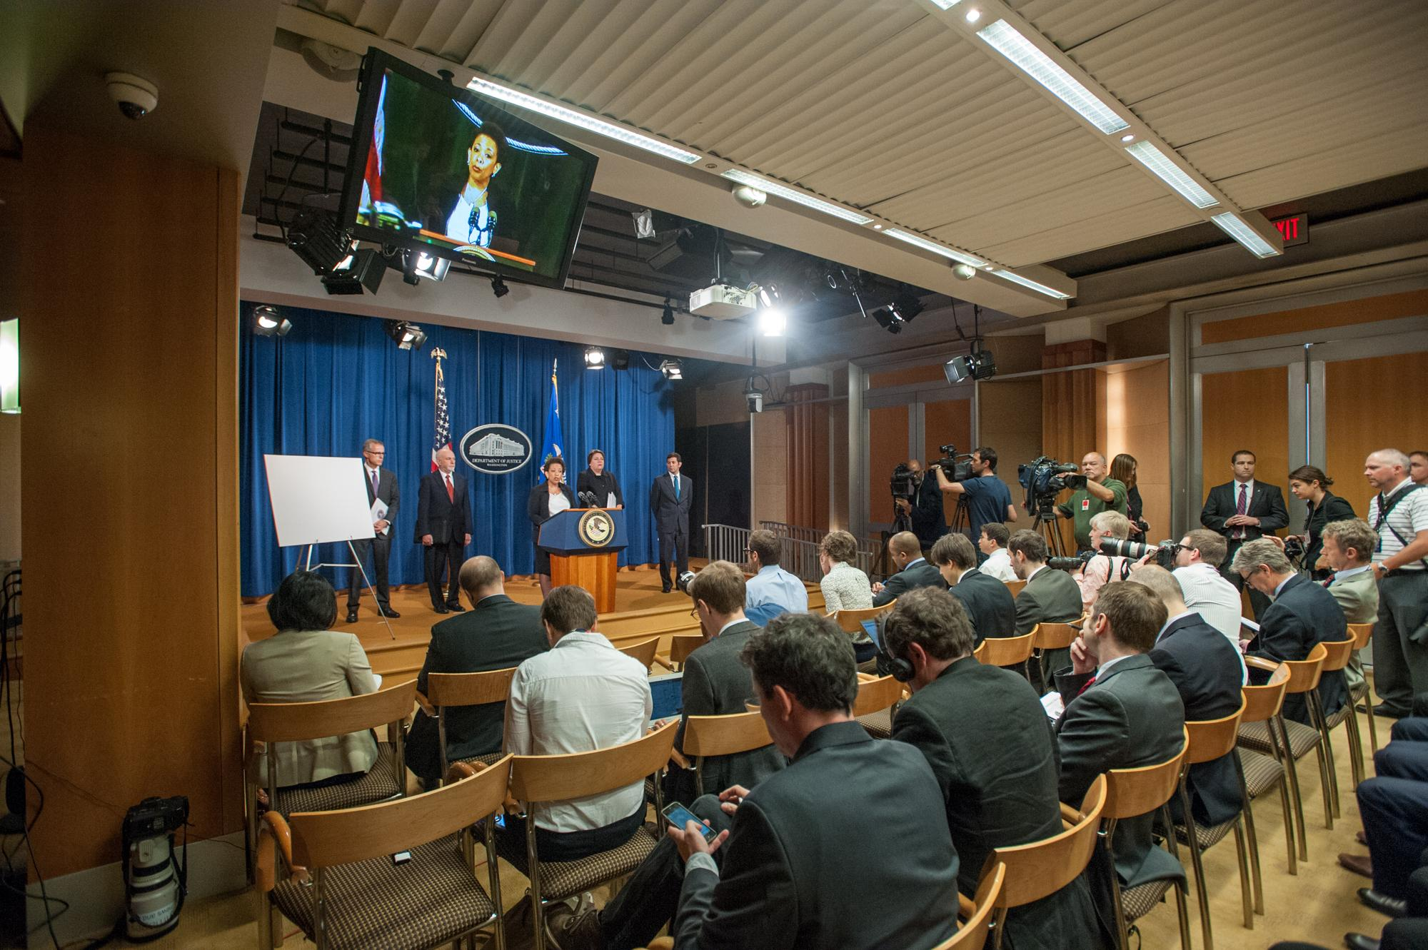
Notes:
39
Bank executives and managers have hardly blinked. Multiple banks implicated in the scheme agreed in 2015 to pay $4.3 billion in fines for their roles in manipulating foreign exchange markets. The banks include HSBC, Citigroup, JPMorgan Chase, Royal Bank of Scotland and UBS.

Slide 40
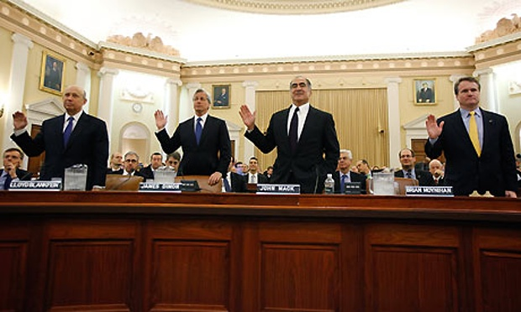
Notes:
40
Fraud as an accepted business practice exacerbated the depth and duration of the latest and all other collapses in our financial markets. And yet, as one law professor commented back in February of 2015 after Standard & Poor’s agreed to pay $1.375 billion to settle civil charges that it inflated ratings on private-label mortgage-backed securities:

Slide 41

“More often than not, when the largest corporations are prosecuted federally, individuals aren’t charged.”
Brandon L. Garrett, University of Virginia Law School
Notes:
41
“More often than not, when the largest corporations are prosecuted federally, individuals aren’t charged.”

Slide 42
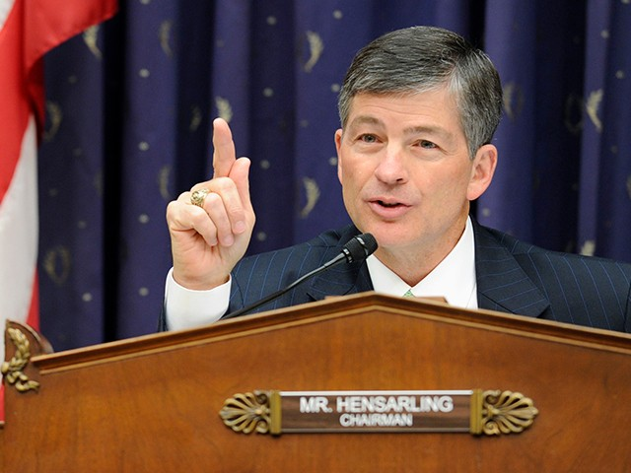
Notes:
Somewhat surprisingly, during 2017 Texas Republican member of the U.S. House of Representatives, Jeb Hensarling, who introduced legislation to scale back portions of the Dodd-Frank bill, came down fairly hard on Wells Fargo & Co. Chief Executive John Stumpf, testifying before the House Financial Services Committee:

Slide 43
“To the American people, this kind of feels like déjà vu all over again. Some institution is found engaging in terrible activities. There is a headline, fine, and yet no one seems to be held accountable.”
Notes:
“To the American people, this kind of feels like déjà vu all over again. Some institution is found engaging in terrible activities. There is a headline, fine, and yet no one seems to be held accountable.”

Slide 44
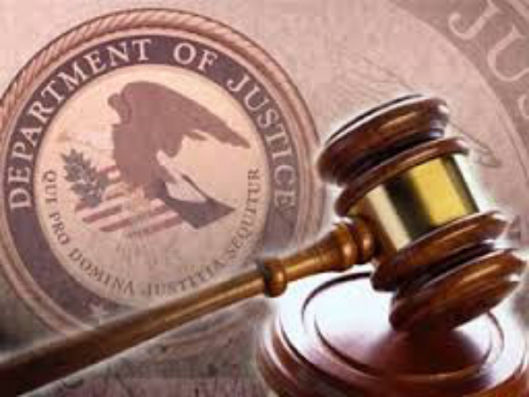

Notes:
In September of 2017, the U.S. Department of Justice announced a revision of its policy on prosecuting white-collar crime. When corporations are the violator, the difficulty is finding the evidence to prosecute individual executives. Statements by the Deputy Attorney General have indicated there will be an intensified focus on individual accountability.

Slide 45

Notes:
One of the major fraud cases of 2018 was that of Elizabeth Holmes, founder of Theranos. Ms. Holmes agreed to pay a $500,000 fine, relinquish 19 million (now worthless) shares of the company and was banned from working for the company for 10 years. In September, Theranos was dissolved. Not yet determined is whether he will spend time in prison.

Slide 46
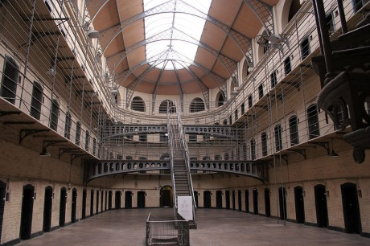
Notes:
This does not mean that our criminal justice system is not overwhelmed with cases or our prisons with convicted inmates.

Slide 47
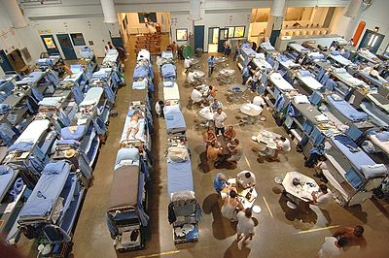
Notes:
One in five persons in prison are there for drug-related offenses. Those imprisoned for these crimes are disproportionately persons of color.

Slide 48
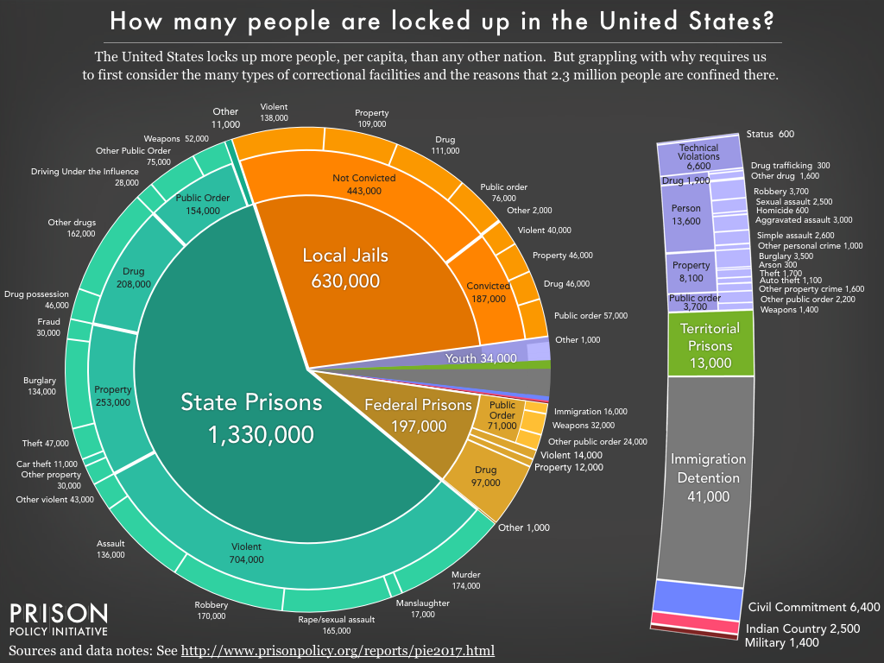
Notes:
According to the US Bureau of Justice Statistics, 2.3 million people are held in 1,719 state prisons, 102 federal prisons, 901 juvenile correctional facilities, 3,163 local jails, and 76 Indian Country jails as well as in military prisons, immigration detention facilities, civil commitment centers, and prisons in the U.S. territories. One in five are incarcerated for a drug offense. [Source: Peter Wagner and Bernadette Rabuy. “Mass Incarceration: The Whole Pie 2017,” Prison Policy Initiative, 14 March, 2017]

Slide 49
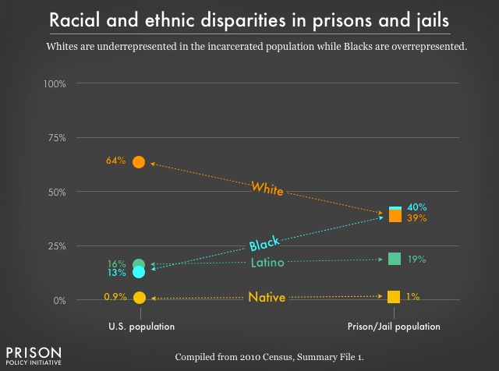
Notes:
No one should be surprised that Blacks are overrepresented in our prisons and Whites are underrepresented. The debate continues over the causes. Is it law enforcement prejudice? Is it growing up in disadvantaged communities? Is it drug dependency? Is it lack of access to high quality education? Is it the breakdown of the traditional family structure? Most likely, the causes are all of the above, and more.

Slide 50
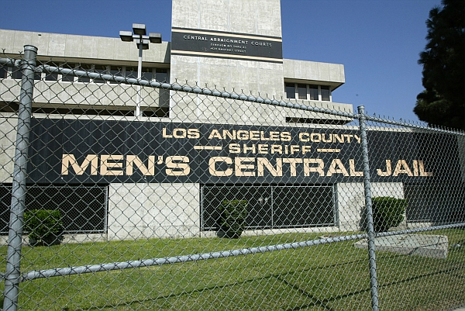
Notes:
The largest prison in the United States is the Los Angeles County Jail, with an annual budget of more than $700 million and an inmate population of between 17,000 and 20,000.

Slide 51
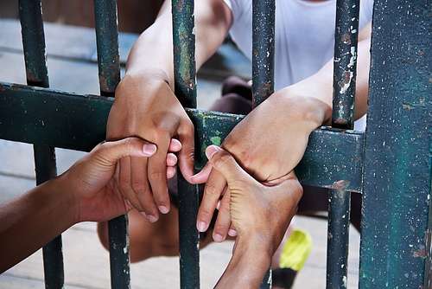
Notes:
A 2016 study by Washington University in St. Louis put the cost of incarceration in the United States at over $1 trillion. This figure includes not merely the amount spent on incarceration but the costs of incarcerated persons, families, children and communities. The study found that for every dollar in corrections costs, incarceration generates an additional $10 in social costs.

Slide 52

Notes:
52
Perhaps the greatest challenge we face is one we cannot deal with without strong international cooperation; the crisis with the environment. This we will examine next.

Slide 53
End of Part 12

