Slide 1

The State of the United States
ECONOMY and SOCIETY
Part 10

Slide 2
Death by Debt Strangulation?
Notes:
Throughout most of history commerce has depended on the use of credit, particularly when large quantities of goods are involved. Kings, Feudal Lords and governments have throughout history borrowed to engage in wars of territorial conquest or to defend territories already held. The stability of our economy today is dependent on the continuous access to affordable credit by business, government and individuals. The question is, are we approaching death by debt strangulation?

Slide 3

Notes:
A few comments on the role money, credit and debt have played in human history might be useful.

Slide 4

Notes:
The Crusades turned the Mediterranean into a vast trading area dependent on the use of gold and silver coinage and credit, bringing about the end of Feudalism and its self-contained economies. As peasant farmers were charged money rents and taxes instead of a large portion of crops harvested, land also became a commodity to be bought, sold and mortgaged. Debt became a constant feature of expanding commercial and civic relationships. For centuries, the banking families of the Mediterranean states provided the credit to fuel economic expansion and wars over territory and natural resources.

Slide 5
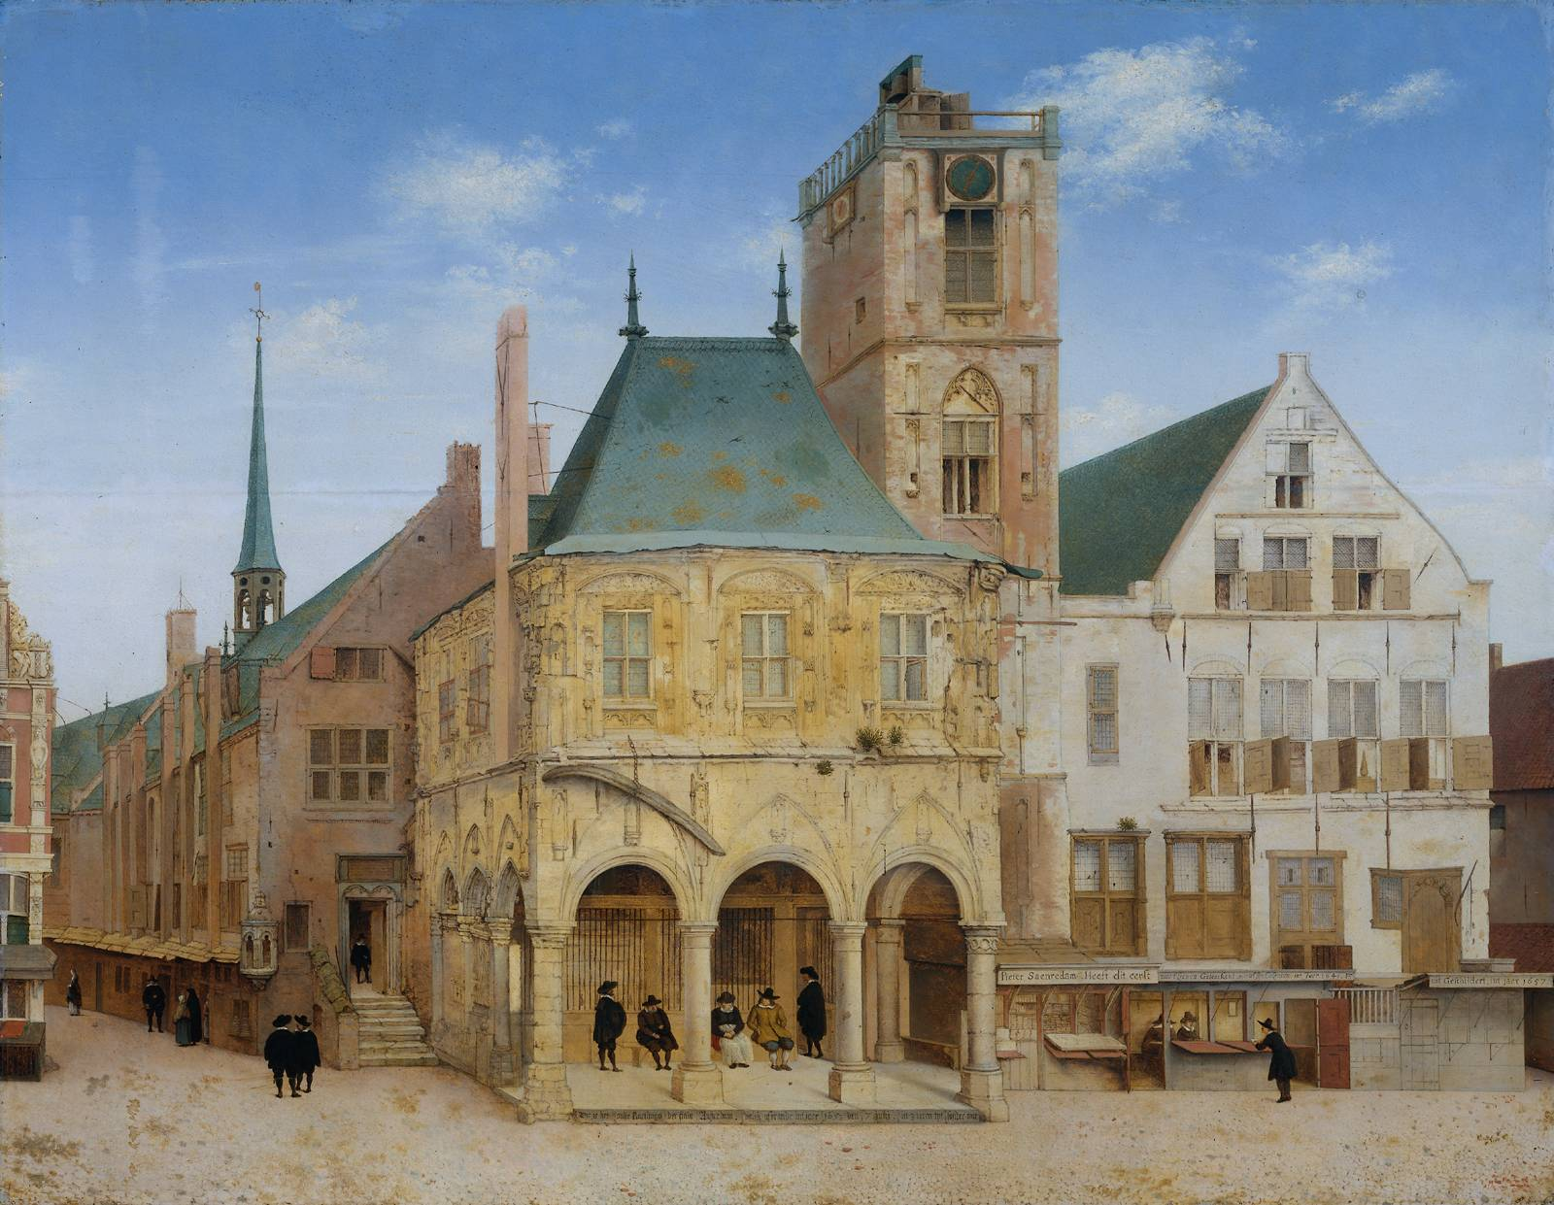
Notes:
The next great leap forward in the world’s global economic structure was the establishment of the Bank of Amsterdam as a deposit bank, its “receipt money” circulating throughout Europe and beyond. The Bank held the coinage of its depositors, as full reserves for the paper receipts issued. For a time, this model of full reserve banking stimulated a remarkable expansion of commerce between merchants in different countries.

Slide 6

Notes:
Today’s global economy functions mainly on the use of digital monetary transfers. Central bank notes are issued independent of any reserves of gold or silver coins or bullion. The paper currency we hold or the balances we own in banks are essentially promises to pay nothing in particular. The exchange value of currency changes from day to day.

Slide 7
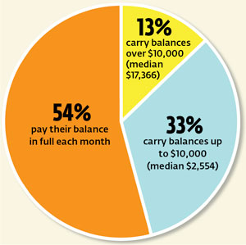
Notes:
Only a small portion of our population possesses sufficient financial assets to do without credit to make major purchases, although the use of credit cards in lieu of cash is a common practice even for those who pay off the balance each month. More than half of credit card holders do so.

Slide 8

Notes:
Whether for business-to-business exchanges or business-to-consumer commerce, risk must be properly assessed and priced, or things do go quite wrong.

Slide 9
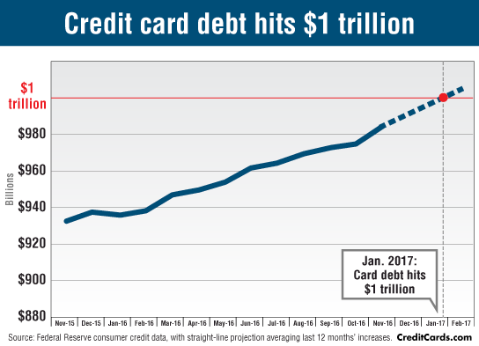
Notes:
Credit card debt is thought to be the No. 1 reason individuals cannot put money aside as savings. Total outstanding revolving debt, which is chiefly made up of credit card balances reached $1.3 trillion In December of 2018. Total outstanding consumer debt has now hit $3.9 trillion.

Slide 10

Notes:
A study of consumer credit card debt released in December 2018 by Elite Personal Finance based on data from the U.S. Census Bureau, the Federal Reserve and other sources, found that the medina household credit card debt is $2,300, although the average debt is much higher, at $5,700. During 2018 banks received $104 billion in interest and fees from their credit card holders.

Slide 11

Notes:
The creditworthiness of these cardholders, as measured by their credit score, is the highest it has ever been, at 704. At the same time, credit card balances and delinquencies are on the rise. Transunion forecasts that delinquency rates on credit cards will increase slightly during 2019, to just above 2%. Of course, this is dependent in large part on employment stability.

Slide 12

Notes:
A growing concern is the aggregate credit card balances carried month to month, which pat $420 billion in late 2018. The average U.S. household with credit card debt carries nearly $7,000 in revolving balances, subject to high rates of interest that make difficult paying off what is owed. Card holders have an aggregate $23 billion in overdue credit-card debt. About 1 in 11 persons who have credit card debt say they do not think they will ever be completely free of credit card debt.

Slide 13


Notes:
Only one in six of the 21% of Americans who say they have been delinquent on a credit card debt say that the reason for the delinquency is that they overspent on nonessential items. The most common reason people cited for being delinquent (35%): they forgot. A full third said they had to pay for essential items and 32% said they had to pay for an unexpected emergency.

Slide 14

Notes:
14
For most U.S. households, the highest level of debt incurred is mortgage debt taken on as a result of the purchase of a residential property.

Slide 15

Notes:
15
Only a small portion of households have savings sufficient to pay cash for a residential property. Those who do have sufficient cash or other financial assets tend to be longer-term property owners who have benefited by loan amortization and by appreciation of the value of land under a home. The amount of equity may be sufficient upon sale to permit a cash purchase of another property..

Slide 16


$10.8 trillion
Notes:
16
The Federal Reserve Bank of St. Louis reports that mortgage debt on one-to-four unit properties reached $10.8 trillion during the third quarter of 2018, an increase of about $400 million over the previous year. As property prices continue to increase, property buyers are incurring increasing levels of mortgage debt. The economics are straightforward. Historically low mortgage interest rates enabled buyers to qualify for higher levels of borrowing, and this was capitalized by market forces into higher asking prices for property.

Slide 17
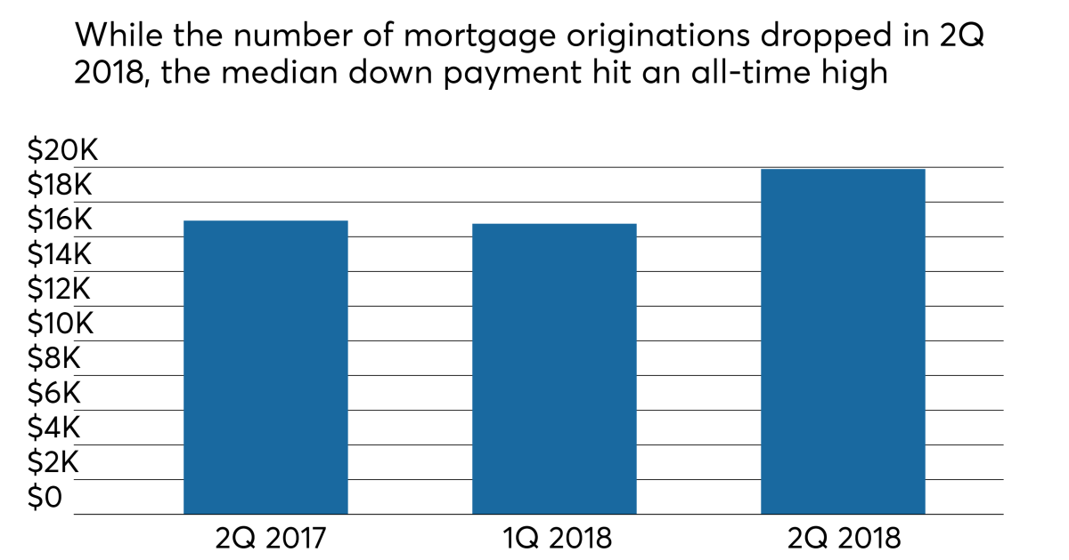
Notes:
17
What this chart indicates is that the amount of cash savings required to obtain the maximum conforming loan amount is increasing. To obtain a 95% mortgage loan on a property sold at the national median price for a new home ($302,400), the buyer needs to make a down payment of $15,120, as well as have the cash to cover all closing costs.

Slide 18
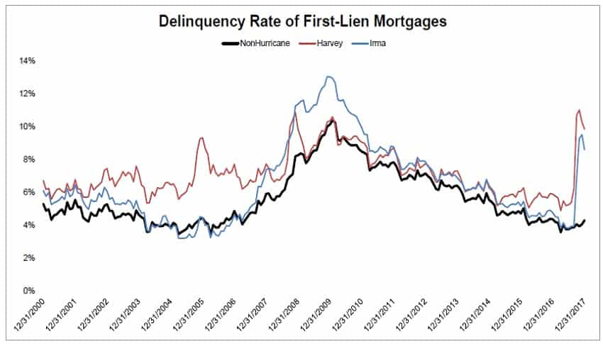
Notes:
18
More stringent creditworthiness standards required to qualify for a mortgage loan, combined with the gradual increase in wages for many workers has contributed to a low rate of delinquencies. Seriously delinquent loans (i.e., those that are over three months behind in payment or are in the foreclosure process) are not at 2.1%. This chart also graphs the hurricane-related delinquencies.

Slide 19
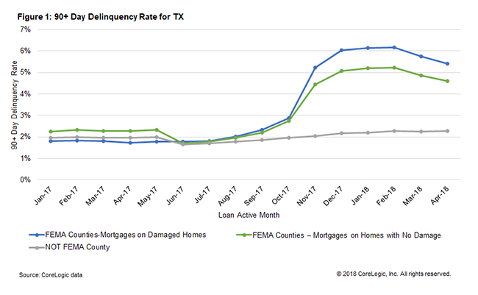
Notes:
19
CoreLogic’s September 2018 Economic Outlook isolated the delinquency rates in Texas following Hurricane Harvey. Their analysis showed that the average FEMA disaster assistance grant was only $4,000, while average damage claims amounted to $110,000. Their analysis also considered the damage caused by the 5,000 plus wildfires that have burned across California. In an effort to mitigate the potential for widespread foreclosures, Fannie Mae, Freddie Mac and FHA each came forward with disaster relief programs. Property owners, even if they are able to obtain the funds to rebuild face declining property values because of the risk of future weather-related disasters. They are among some 5.4 million owners experiencing negative equity.

Slide 20

Notes:
20
Roughly one in four property owners who are still paying down on a mortgage loan have at least a 50 percent equity position in the property. They are the beneficiaries of a combination of loan amortization and rising land values. One in three property owners own their property free and clear of any mortgage debt.

Slide 21
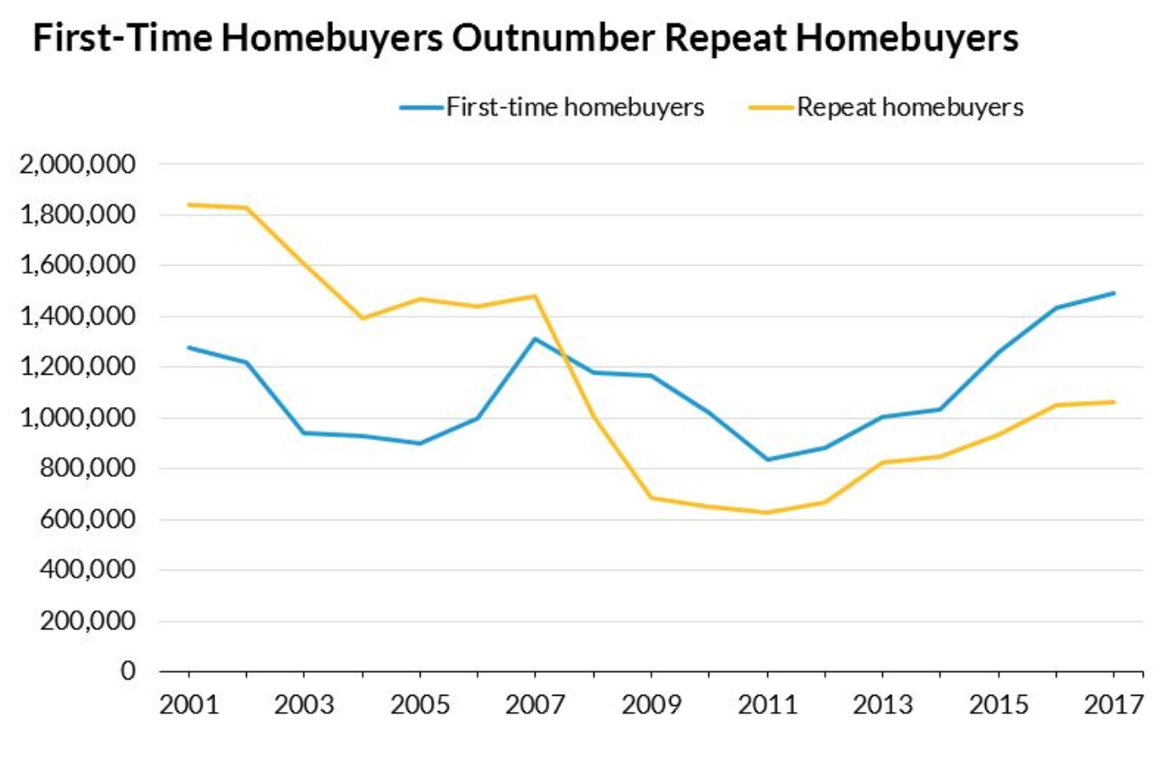
Notes:
21
An analysis of the residential property market by the National Association of Realtors indicates that buyers aged 36 and under have constituted more than one-third of all purchases for at least the last four years. Two-thirds of these transactions have been to first-time homebuyers. Nearly one-half of these households are also servicing a median student loan balance of $25,000.

Slide 22
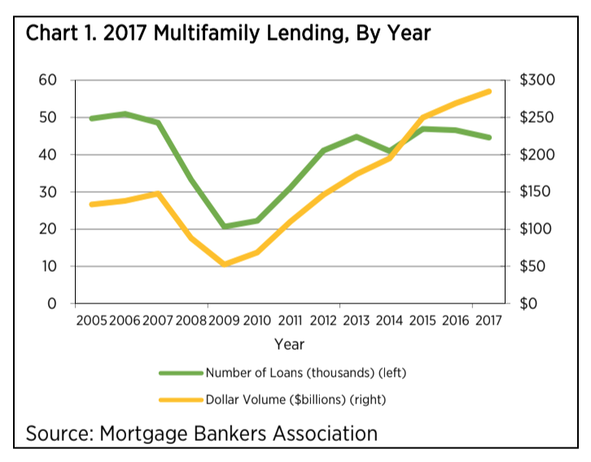
Notes:
22
Another major part of the nation’s credit markets involves multi-family properties. Strong market conditions fueled a 6% increase in multifamily lending in 2017, generating $285 billion in new mortgages for apartment buildings with five or more units. While the number of loans originated remains relatively steady, the chart shows the loan amounts are rising as the total loan volume continues to rise. [Source: Kelsey Ramirez. “Multifamily lending hits all-new high in 2017,” Housingwire, 25 October, 2018]

Slide 23
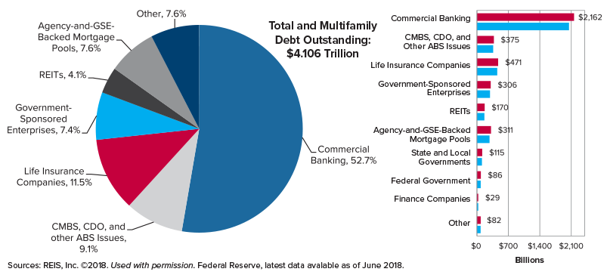
Notes:
23
This chart shows the size of the combined credit markets for commercial real estate and multi-family properties.

Slide 24

Notes:
The value of commercial real estate is generally determined by capitalizing the current and immediate future income stream generated by use of the property. Based on this, a lender must determine what level of financing is warranted. A commonly applied 90% debt service coverage ratio requirement means that the property itself must generate income sufficient to cover 90% of any mortgage loan debt. The remaining 10% might then come from other sources of revenue.

Slide 25
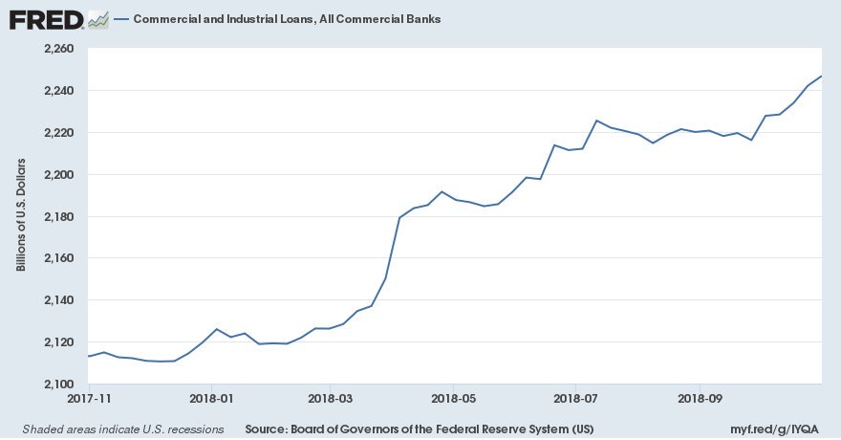
Notes:
25
The Federal Reserve Bank of St. Louis reported in November of 2018 that the volume of commercial and industrial loans on the books of the nation’s banks had grown to $2.25 trillion.

Slide 26

Notes:
26
Examining the history of the nation’s credit markets over the previous five decades, Wolf Richter wrote in Business Insider in mid-2017 that a key indicator of the health of the economy – the volume of commercial and industrial loans – was not expanding and this might be signaling a downturn on the horizon. They wrote:

Slide 27
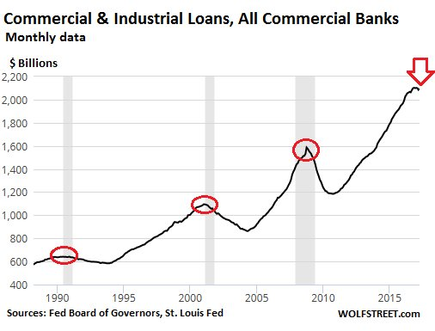
“Over the past five decades, each time commercial and industrial loan balances at US banks shrank or stalled as companies cut back or as banks tightened their lending standards in reaction to the economy they found themselves in, a recession was either already in progress or would start soon. There has been no exception since the 1960s.”
Notes:
27
“Over the past five decades, each time commercial and industrial loan balances at US banks shrank or stalled as companies cut back or as banks tightened their lending standards in reaction to the economy they found themselves in, a recession was either already in progress or would start soon. There has been no exception since the 1960s.”

Slide 28

Notes:
We are an automobile-dependent nation, and that will not change any time soon. U.S. auto sales totaled 17.274 million vehicles in 2018, with trucks and SUVs once again accounting for two-thirds of the market. The number of new vehicles sold fell by 2 percent from 2017, with strong competition from dealers specializing in the sale of quality preowned vehicles.

Slide 29
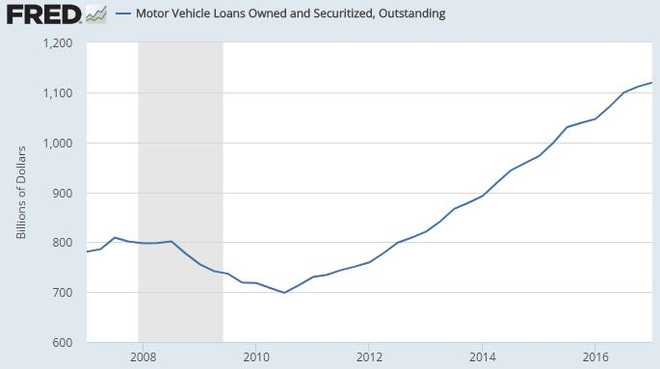
Notes:
As of September of 2018, Americans owed $1.14 trillion in outstanding automobile loan debt. Banks and other lenders are expressing concern that the average amount financed is rising about 3.1% a year in dollar amounts. Moreover, the average new car loan originated by a finance company is nearly $30,000, an increase of more than $5,000 from 10 years earlier.

Slide 30
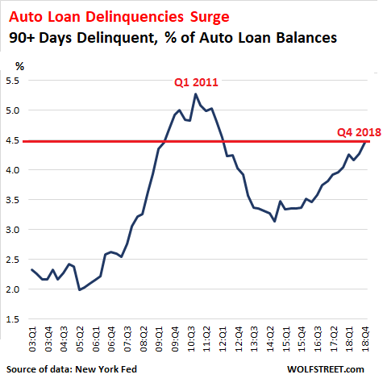
Notes:
Around 2.3% of all automobile loans, or 7 million, are 90 days or more delinquent. The share of subprime borrowers to have fallen well behind on car payments during the last three months of 2018 is the highest since 2010.

Slide 31

Notes:
31
The number of loans made to persons with credit scores below 620 increased by 150% over the last six years. Between 1.7 and 1.8 million vehicles were repossessed in 2017. For borrowers who had no choice but to obtain financing from a subprime lender, the loan balance is not forgiven upon repossession of the vehicle. Lenders frequently file a lawsuit to garnish payments from the person’s wages.

Slide 32
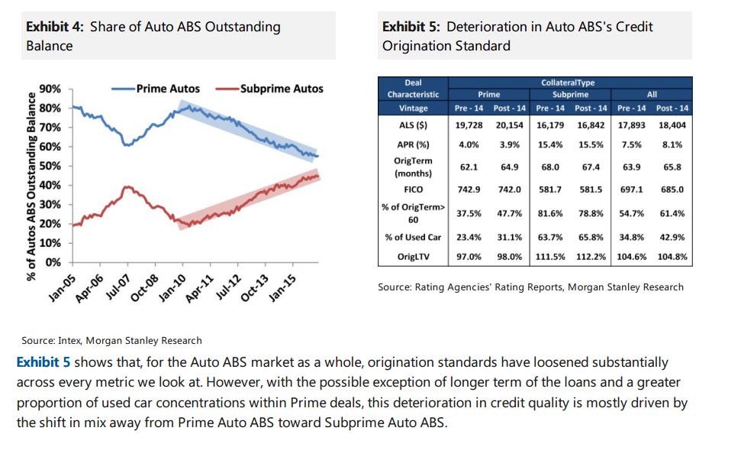
Notes:
32
There is yet one additional part of the credit market that involves automobiles. A study released in May of 2016 by the Consumer Financial Protection Bureau reported that individuals who put their cars up as collateral for short-term emergency loans are being charged with interest rates as high as 300 percent. One out of every five of these loans results in the borrower’s automobile being repossessed.

Slide 33

Notes:
33
Total student loan debt is now over $1.56 trillion, owed by some 44.7 million persons, with an average debt of $29,800 those students who graduated in 2018. Student loans have seen almost 157 percent in cumulative growth over the last 11 years.

Slide 34
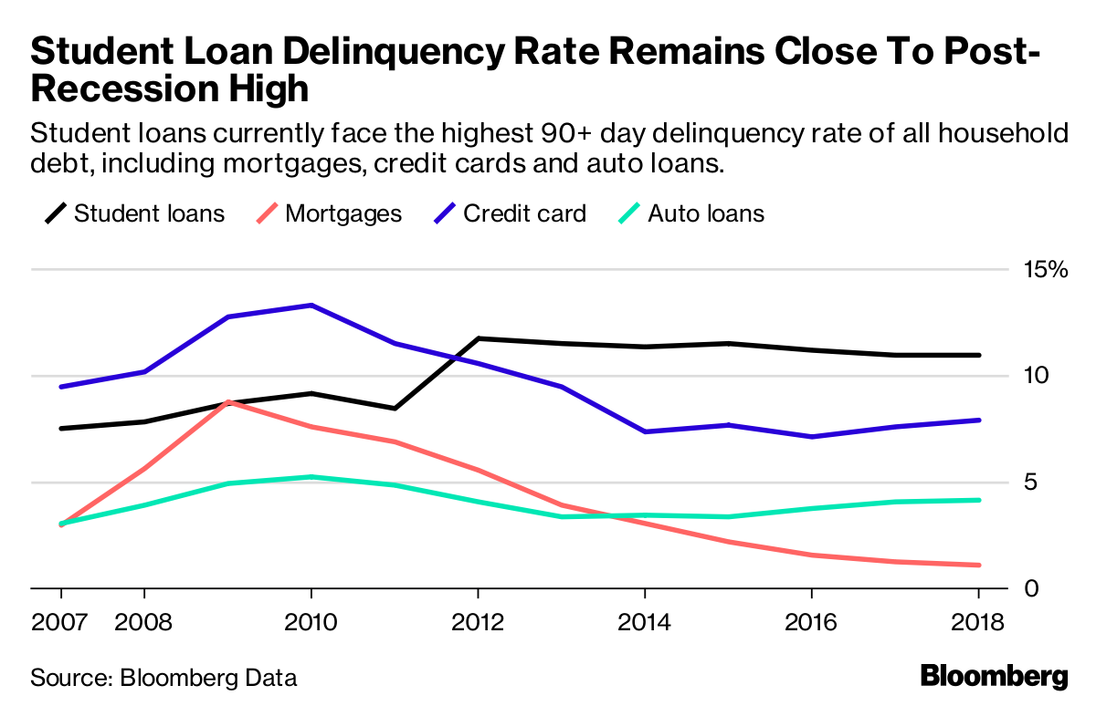
Notes:
Student loan debt currently has the highest 90+ day delinquency rate of all household debt. More than 1 in 10 borrowers is at least 90 days delinquent, according to Bloomberg Global Data.. Student loan delinquency rates remain within a percentage point of their all-time high in 2012.

Slide 35
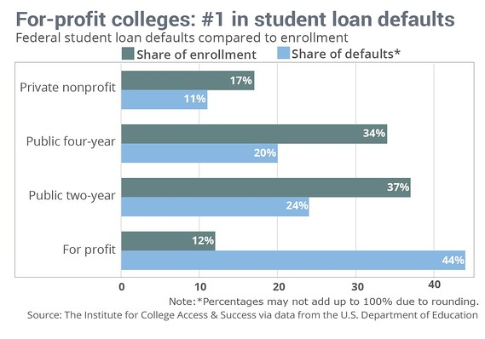
Notes:
This chart is based on 2013 data. A Brookings Institution report released in January of 2018 showed that over half (some 52%) of students who attended a for-profit college in 2003 defaulted on their student loans after 12 years. The rate of default is four times greater than for students who attended community colleges.

Slide 36
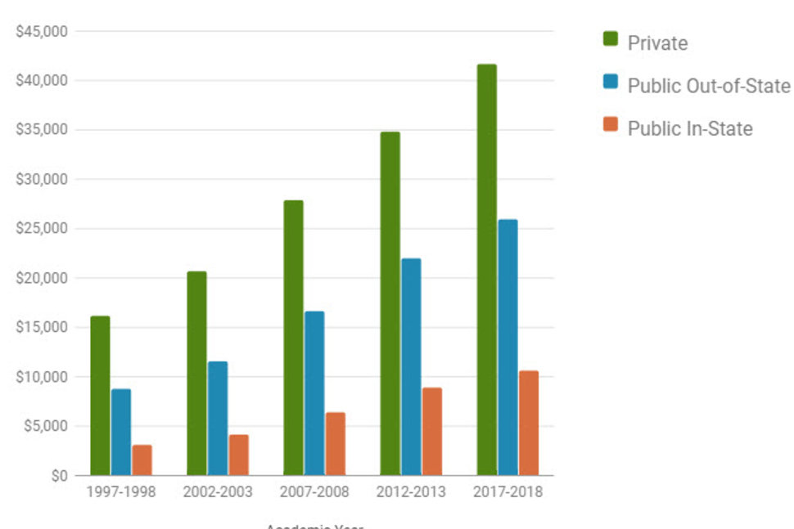
Notes:
36
This chart, compiled by US News & World Report, shows that the annual tuition to an in-state public college for the 2017-2018 academic year averaged over $10,000. The tuition cost to attend a private college is nearly $43,000. An additional $10,000 to $11,500 is spent on housing and meals. And, as has been widely reported, many students do not have enough money left over for food.

Slide 37

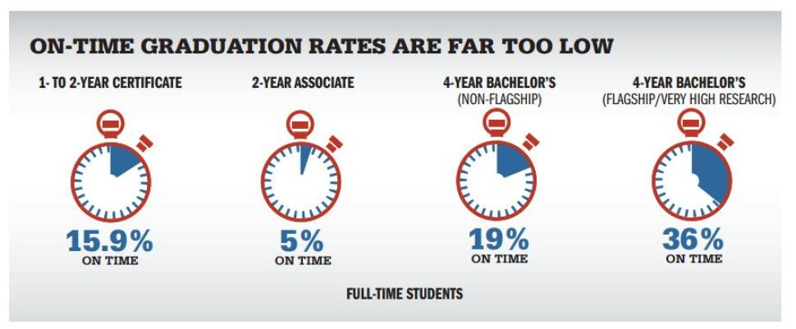
Notes:
A study by the nonprofit Complete College America released at the end of 2014 reported that only one in five full-time students earns a bachelor’s degree in four years. Nationwide, only 50 of more than 580 public four-year institutions graduate a majority of students on time. At community colleges the percentage who earn an associate degree within two years is just 5 percent. Among those who enter college, 1.7 million students begin taking remediation courses; of this group, only one in 10 students ever graduates.

Slide 38
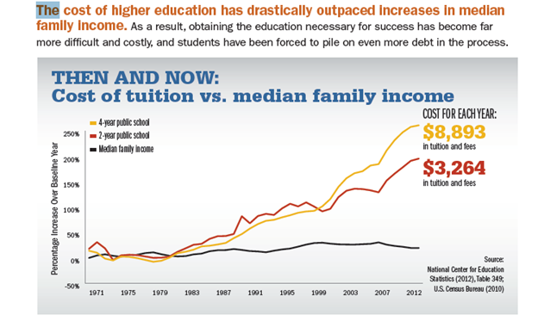
Notes:
There are corollary cost contributors, primarily, students taking longer than the presumed amount of time specifically, 4 years to complete an undergraduate degree. Students, take unnecessary, non-degree-related classes because students want a break from the academic rigor of their majors. Also, fully 60% of students transfer from one college to another and lose credits toward graduation. Students frequently need a class that is either full or otherwise unavailable. That may leave them short of credit hours sufficient for scholarship and grant requirements. Therefore, students take classes they do not need simply to generate a credit-hour load for financial aid purposes. Finally, all of those are directly related to students entering college without a clear direction as to purposes and outcomes.

Slide 39
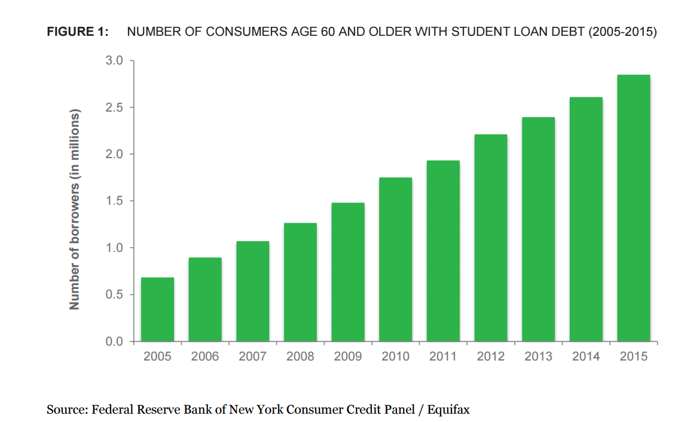
Notes:
39
A 2017 report issued by the Consumer Financial Protection Bureau that the number of people age 60 and over with outstanding student loan debt quadrupled from 2005 to 2015, increasing from about 700,000 to 2.8 million. This group increased during this period from 2.7% to 6.4% of the total number of student loan borrowers.

Slide 40




Notes:
40
A large number of older adults have returned to school to obtain new skills or add to their existing credentials. Others have co-signed for loans made to their college-age children. The Federal Reserve Bank study released in 2015 indicated that borrowers over the age of 60 have the highest rate of delinquency. Nearly 40 percent of federal student loan borrowers over age 65 are in default. About 67,300 borrowers over age 60 had their benefits garnished below the poverty line in 2015, according to the General Accounting Office.

Slide 41

Notes:
41
A Lending Tree study of users aged 65-70 across the U.S. found that the average median non-mortgage debt is $20,643. What kind of debt? It's mostly auto loans (37.9%) and credit card balances (35.9%), with some student (13.2%) and personal loans (12.9%) in the mix. Thus, more than 1 in 8 dollars of debt was for student loans, which was even more than the balance owed for personal loans!

Slide 42

Notes:
42
Rising property values translate into an estimated $6.3 trillion in equity homeowners 62 and older could utilize to obtain additional income under the Federal government’s Home Equity Conversion Mortgage or HECM program.

Slide 43
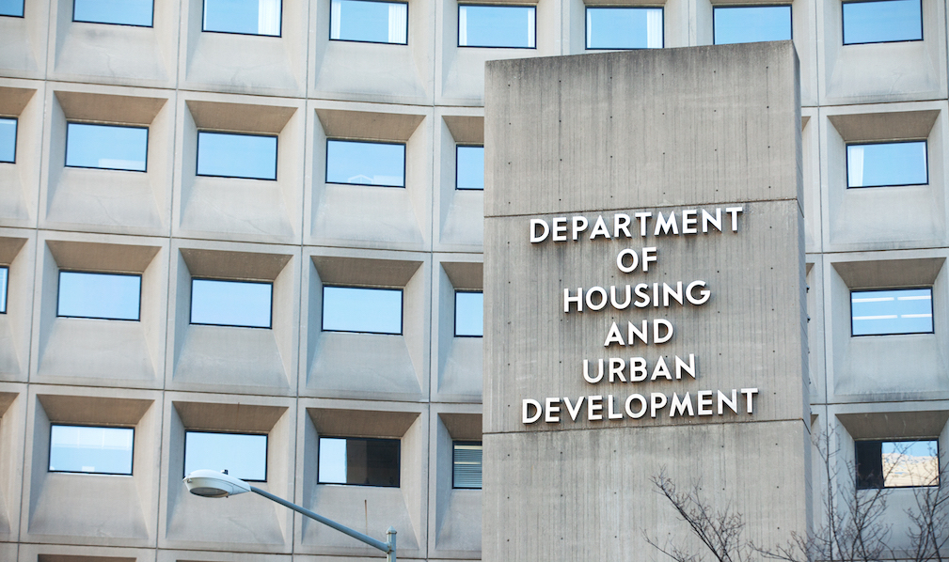
Notes:
43
Analysis in 2016 of the viability of the HECM program by the U.S. Department of Housing and Urban Development indicated the costs of administration made the program economically unviable as structured. Changes were announced taking effect in October of 2017 to lower the amount that can be borrowed to 58 percent of homeowner’s equity.

Slide 44
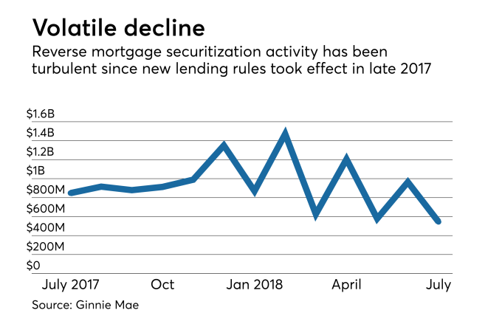
Notes:
44
Program changes reduced the attractiveness of the HECM program, resulting in a lower number of applications during the program’s 2017-2018 fiscal year that began in October and ended September 30th.

Slide 45
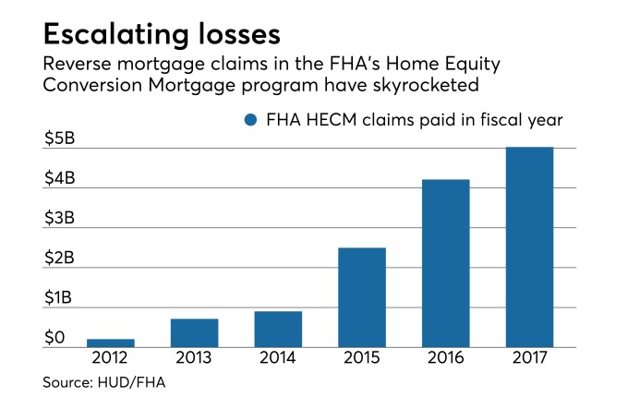
Notes:
45
The Annual Report to Congress released in November 2018 by the Federal Housing Administration highlighted several programs with the program, including inflated property appraisals and ineligible occupancy by non-borrowers. As of September 2017, nearly 90,000 reverse mortgage loans were at least 12 months behind in payment of taxes and insurance and were expected to end in involuntary termination. Worst of all, loses absorbed by FHA have absorbed about a third of the taxpayer-guaranteed insurance reserves.

Slide 46

Notes:
46
The Mortgage Bankers Association, the National Association of Realtors and other groups support a review to look at removing the HECM program from the FHA Mutual Mortgage Insurance Fund. At an October 2017 congressional hearing, Housing and Urban Development Secretary Ben Carson agreed that separating the two mortgage programs would be a "worthy pursuit.“ [Source: Brian Collins, “Calls intensify to separate reverse mortgages from FHA fund,” National Mortgage News, 22 November, 2017] As of today, the issue is still only under discussion.

Slide 47

PUBLIC
Notes:
Local and State governments have five means of raising revenue: taxation, fees for services, fines and other penalties, leasing or selling of public lands and other assets to private concerns, and the issuance of bonds. The Federal government has these, plus, with the cooperation of the Federal Reserve System, the sale of government securities in exchange for newly-created monetary balances.

Slide 48

Notes:
The longer-term ramifications of continuously funding public debt in this manner are of great concern to some, of almost no concern to others.

Slide 49

Notes:
The national debt has now surpassed the $22 trillion mark and continues to climb. Economists engage in endless debate over the debt’s threat to the U.S. economy.

Slide 50
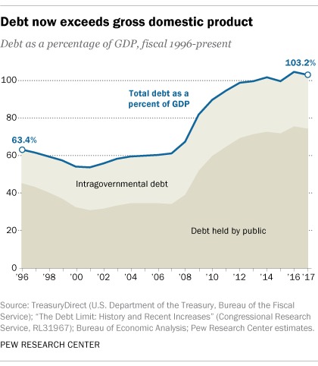
Notes:
Debt as a share of GDP rose steeply during and after the 2008 financial crisis. Since 2013 it has equaled or exceeded GDP. At the end of 2018, debt had risen to 104.1% of GDP.

Slide 51

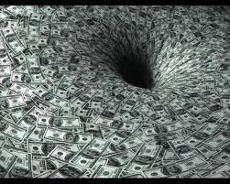
Notes:
Since the early 1980s, the federal government has borrowed and spent, somehow expecting that a lowering of marginal tax rates on high income individuals, on business profits and on gains from the sale of financial and other assets would generate enough revenue to balance the federal budget and eventually pay down at least some of the national debt. This has not been the case. There is no plan to stabilize let alone gradually pay down the debt.

Slide 52

$20 trillion
Notes:
A real concern almost no one is talking about is whether the Federal government will be able to raise sufficient revenue from taxation to pay the interest, that is, to service the debt, even if interest rates do not increase.

Slide 53
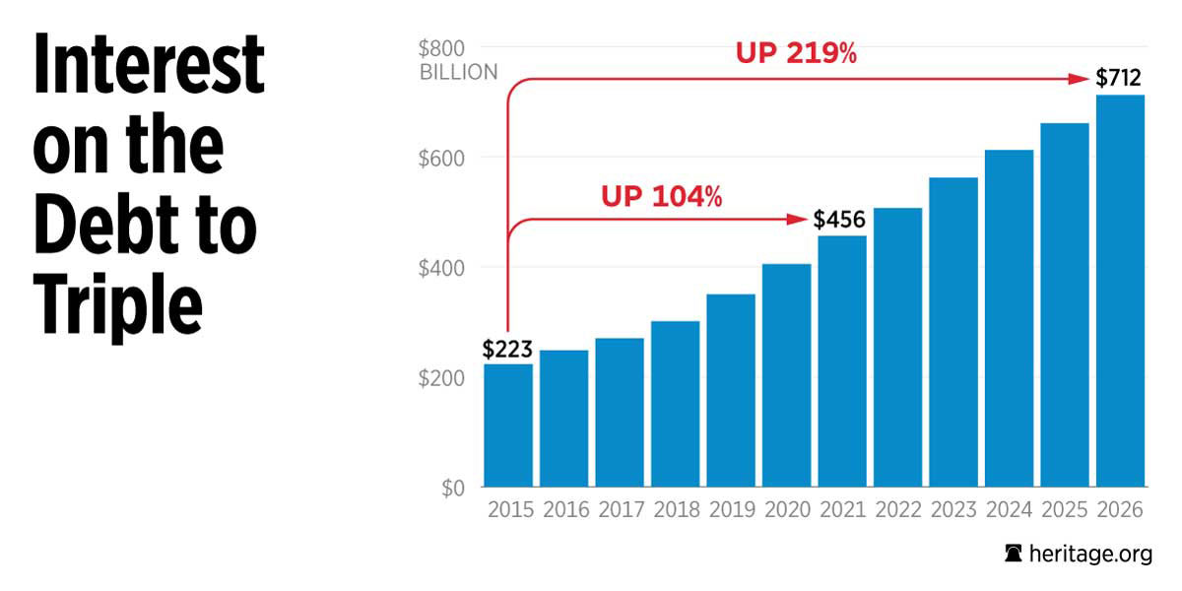
$20 trillion
Notes:
If the interest costs on government debt do continue to increase in an effort to halt inflation, the debate over tax increases will have to be renewed, perhaps after a change in parties with a majority in the U.S. Congress and in the Office of the President. It is likely that a political solution will impose new taxes on consumption rather than shifting the burden of taxation to unearned rents as some of us argue is the necessary approach.

Slide 54
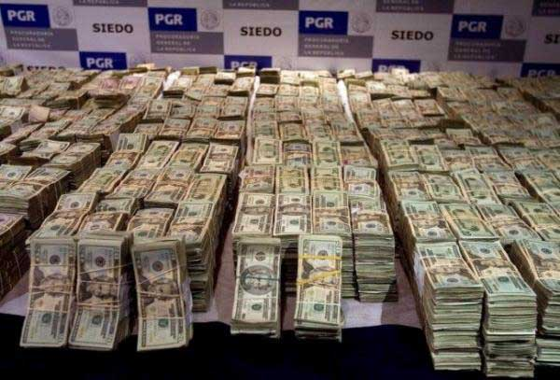
Notes:
An analysis by the Congressional Budget Office forecasts that over the next decade more than 14% of all revenue the government is projected to collect will be sucked up by interest payments. This will be higher than total Medicaid spending, will be equal to half of Social Security benefits paid out, and nearly equal to total defense spending.

Slide 55

$20 trillion
Notes:
A 2016 analysis of the U.S. economy by the International Monetary Fund urged U.S. lawmakers to take steps to generate a revenue surplus and gradually bring down the federal debt. The IMF economists wrote:

Slide 56
“Near-term fiscal and monetary policies have been well-calibrated to the prevailing economic circumstances but demographic trends and rising interest rates will lead to larger fiscal imbalances over the medium-term. This will cause the federal debt to begin rising in 2019 and exceed 80 percent of GDP by 2022. Regrettably, the U.S. continues to lack a detailed medium-term fiscal consolidation plan to prevent this renewed rise in the public debt.”
Notes:
“Near-term fiscal and monetary policies have been well-calibrated to the prevailing economic circumstances but demographic trends and rising interest rates will lead to larger fiscal imbalances over the medium-term. This will cause the federal debt to begin rising in 2019 and exceed 80 percent of GDP by 2022. Regrettably, the U.S. continues to lack a detailed medium-term fiscal consolidation plan to prevent this renewed rise in the public debt.” [Source: 2016 Article IV Consultation with the United States of America: Concluding Statement of the IMF Mission; June 22, 2016] Of course, the IMF analysis turned out to be too conservative, as the level of debt is now well above GDP.

Slide 57

FULLY AMORTIZING
Notes:
The United States is in need of a real program of comprehensive tax reform, once and for all finally beginning to collect unearned rents from the many natural assets generating rent. As for the federal government debt, one part of the solution would be to adopt fully amortizing bonds as the means of refunding maturing debt. These bonds would pay to bondholders both interest and principal so that when the bond matures the principal is fully repaid.

Slide 58

Notes:
Another worrying segment of the economy is the health care costs we are incurring. We will next look at the state of the nation’s health care system.

Slide 59
End Part 10

