Slide 1

The State of the United States
ECONOMY and SOCIETY
Part 8

Slide 2
Land Prices as a Driver of Economic Cycles
Notes:
In order to live, work and play, we all need access to land, even that form of land – or natural asset – we call water. We also live, work and play on and under our rivers, streams, lakes and oceans. Every location on the planet (and within the borders of the United States) has some potential annual rental value – from almost zero to around $530 per acre for irrigated land $30 per square foot per year in the financial district of a major city.

Slide 3


Notes:
3
One of the few efforts by the U.S. government to calculate the value of the land in the United States was completed in 2015 by William Larson at the Bureau of Economic Analysis. The report states:

Slide 4
“Estimates suggest that this 1.89 billion acres of land are collectively worth approximately $23 trillion in 2009 (current prices), with 24% of the land area and $1.8 trillion of the value held by the federal government.”
Notes:
4
Estimates suggest that this 1.89 billion acres of land are collectively worth approximately $23 trillion in 2009 (current prices), with 24% of the land area and $1.8 trillion of the value held by the federal government. [Source: William Larson. “New Estimates of Value of Land of the United States,” Bureau of Economic Analysis, 3 April 2015]

Slide 5


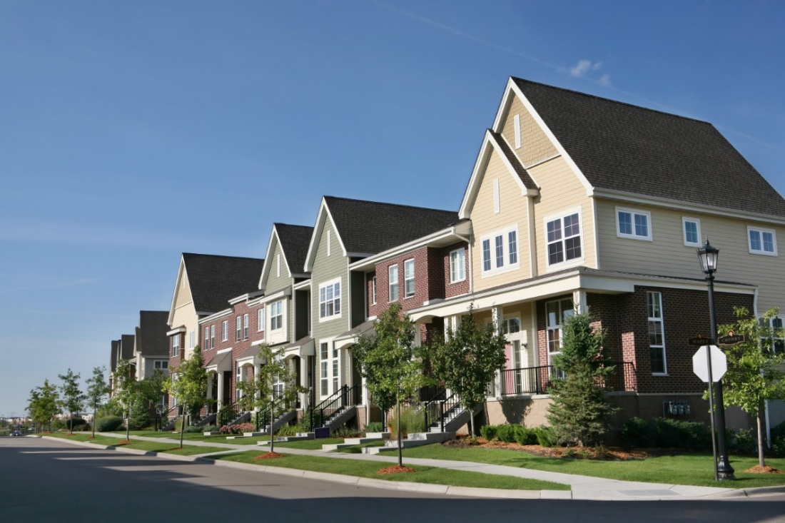
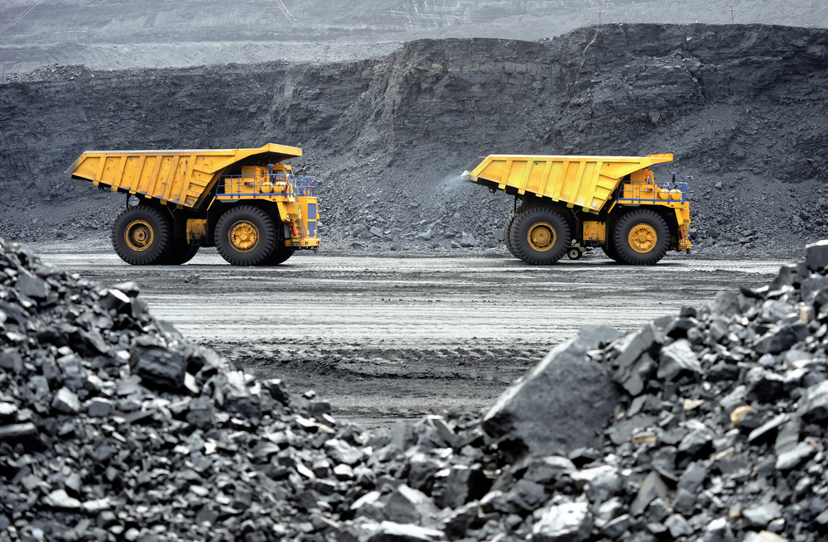
Notes:
5
Land in the cities is valued by the square foot, in the suburbs by portions of an acre, and in rural areas primarily based on the existence of exploitable natural resources or fertility and annual rainfall necessary for agricultural production.

Slide 6
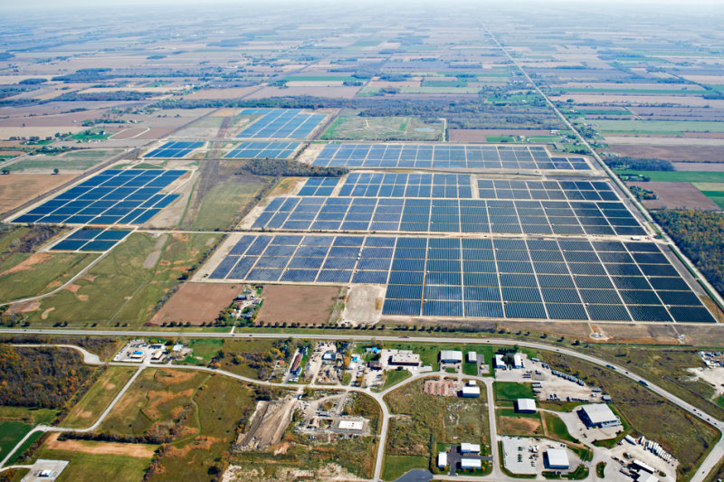

Notes:
6
However, changing technologies have dramatically increased the value of land where the sun or wind provides a reliable source of electrical energy. Once marginal agricultural land today yields significant rental income from companies that install wind or solar farms, or drill for oil or gas. Private owners of once very marginally-productive land are becoming quite wealthy by leasing land to companies that construct these facilities and take on all of the associated risks.

Slide 7
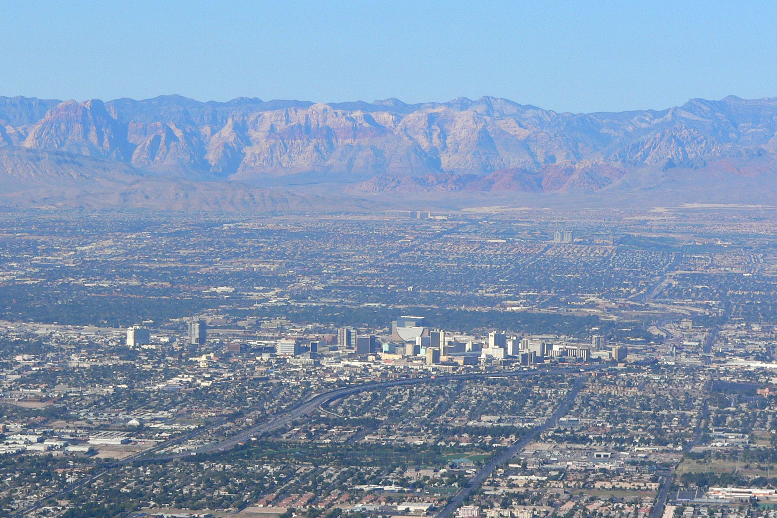
Notes:
7
Changes in permissable uses also dramatically influence land values. Legalized gambling (and a guaranteed supply of water from Lake Meade) turned Las Vegas from a sleepy desert town into a growing metropolitan region.

Slide 8
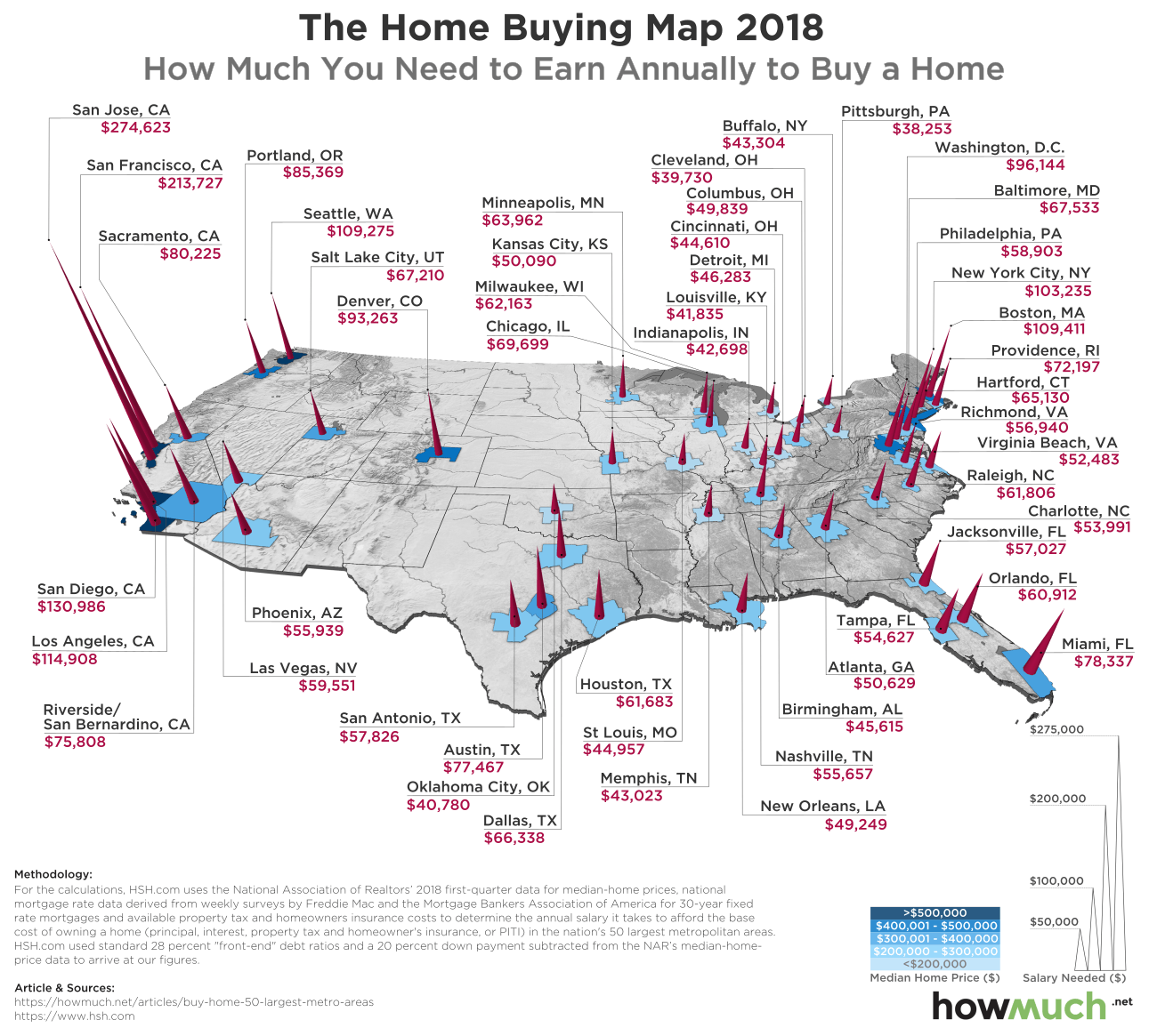
Notes:
Prudent underwriting standards relied upon by mortgage lenders restricts the level of debt approved that can be serviced by no more than about 30 percent of a property buyers monthly household income. Based roughly on this guideline, this map indicates the level of annual household income that today is required to be approved to purchase a median-priced residential property.

Slide 9
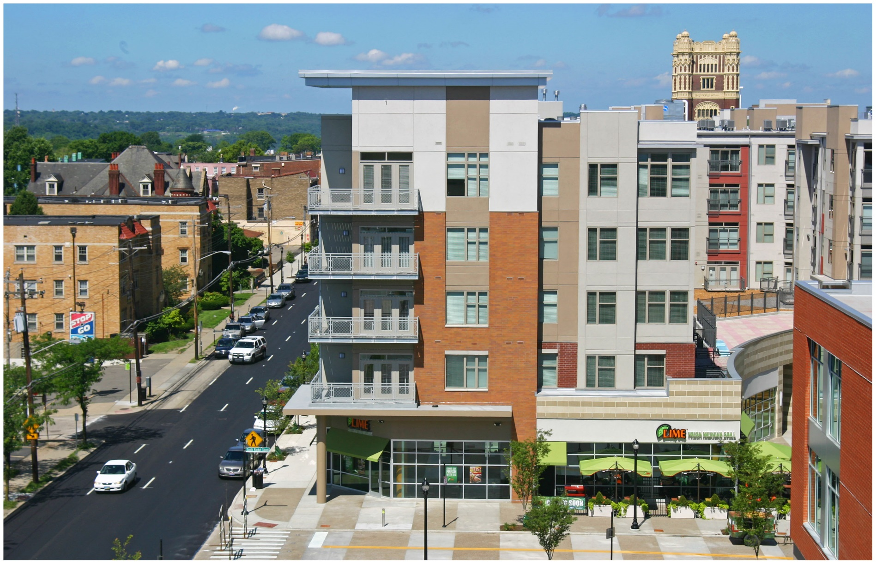
Notes:
People living in regions, cities and even neighborhoods with growing populations face high and ever-rising housing costs because demand almost always outpaces supply. At the heart of the supply problem is the failure of land to be brought to the market at prices that make development affordable except for higher income households.

Slide 10
Median value of a residential property:
$255,600
Median land-to-total value ratio (est.):
40%
Median value of the land beneath a residence:
$ 102,240
Multiplied by the number of properties owned:
86 million
Total estimated value of residentially-owned and developed land:
$8.79 TRILLION
Notes:
10
As previously discussed, equity in the value of the land beneath one’s residential property comprises a major portion of household net worth. Out of the 120 million U.S. households, 76.8 million own the homes in which they live. Some 9.2 million also own a second home (down from 12.6 million in 2008). [Source: “People living in households that own a second home in the U.S. 2017,” Statista.com] Thus, a rough estimate of the value of residential land owned by these households (which does not include investor-owned property or vacant residential lots) is shown in this slide.

Slide 11
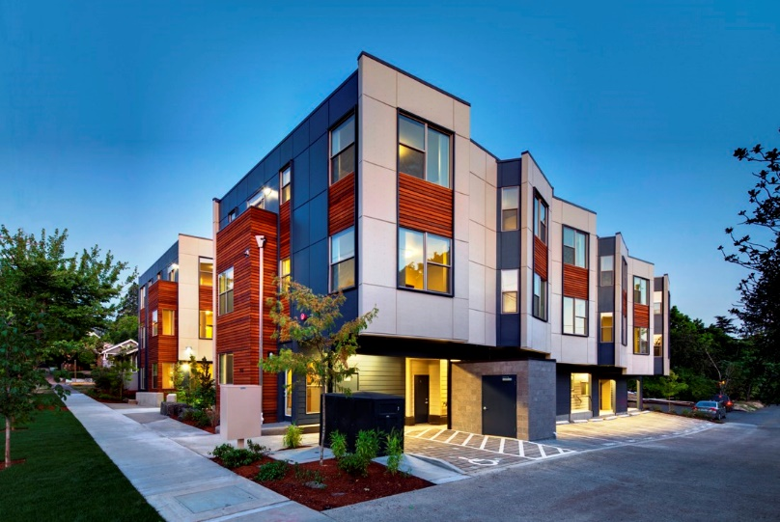
Notes:
There are many households that choose to live in a rented apartment or house. Their reasons are varied, but the chief reasons are job mobility, the lack of savings to make a down payment on a property, or insufficient household income. Few renters have the financial net worth close to the median for those who own a residential property.

Slide 12
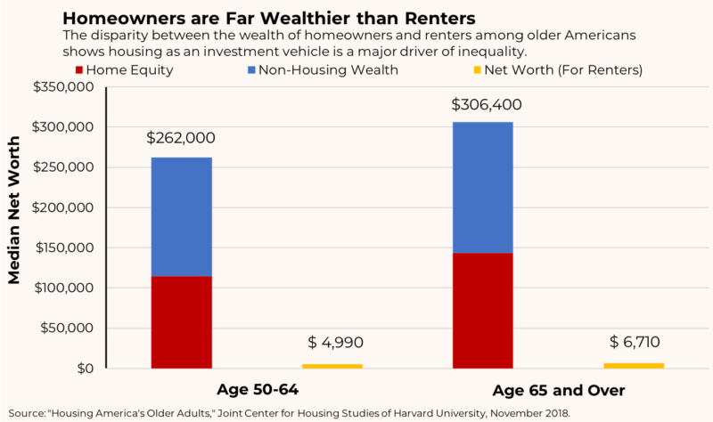
Notes:
This simple graph tells a remarkable story about the financial benefits of becoming an owner of a residential property during one’s working years. What is categorized here as “home equity” is really two types of equity. First is the equity one has in the depreciated value of whatever housing unit is owned. Second is the equity in the almost continuously rising value of the underlying parcel of land.

Slide 13
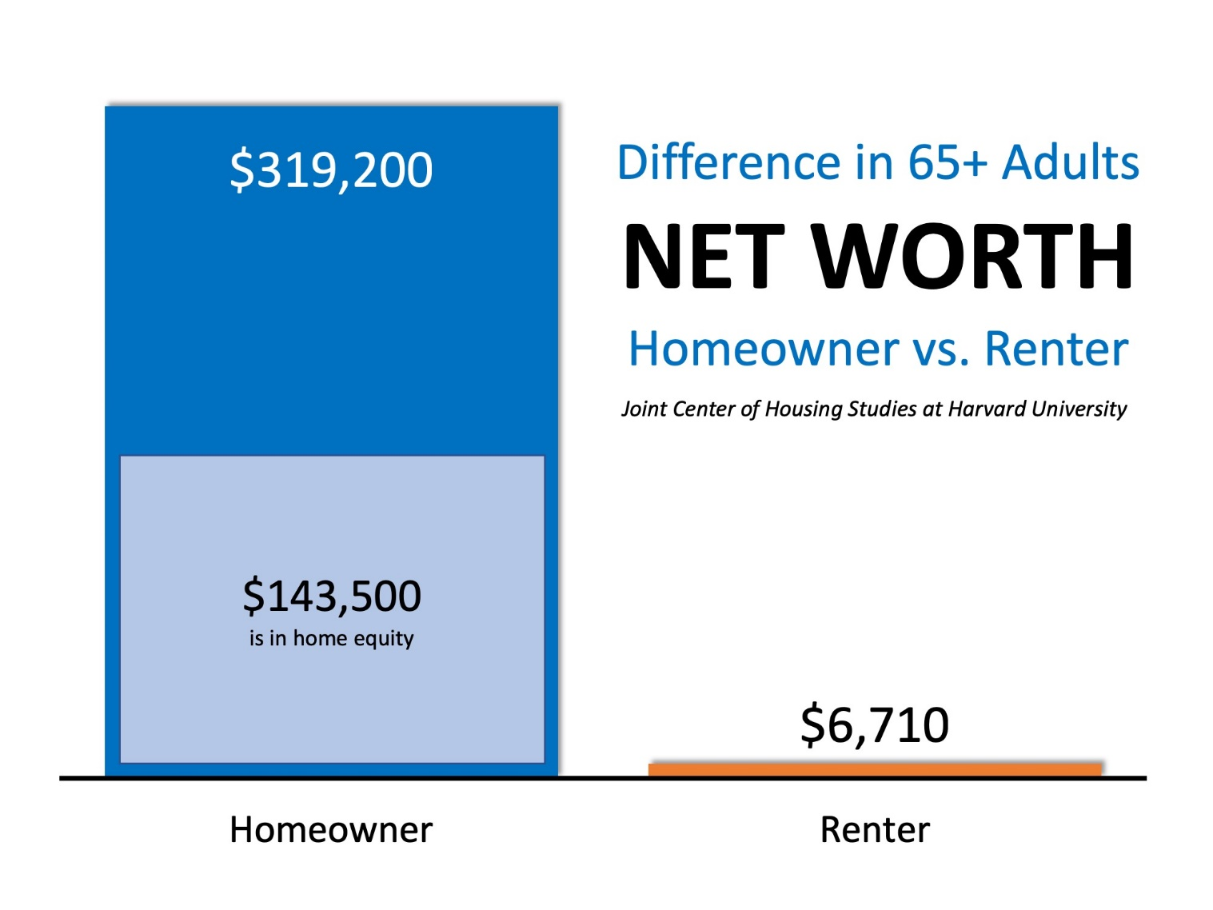
Notes:
A recent study by the Joint Center for Housing Studies at Harvard University looked at homeowners and renters over the age of 65. For this group, the advantage of property owners was even higher, at 47.5 times greater.

Slide 14
Does Renting Ever Make Sense
If One Can Afford to Own?
Notes:
As shown, owning a residential property eventually repays the owner for much of the cost of ownership incurred over the years of ownership and occupancy. However, property markets are susceptible to periodic downturns leaving some owners with mortgage indebtedness higher than the property could be sold for if needed. When a region experiences a loss of employment opportunities and rising unemployment, some property owners find themselves trapped: unable to find employment and unable to dispose of their property in order to relocate to where employment opportunities exist. One advantage of renting housing is the ability to relocate far more easily in time of financial need.

Slide 15
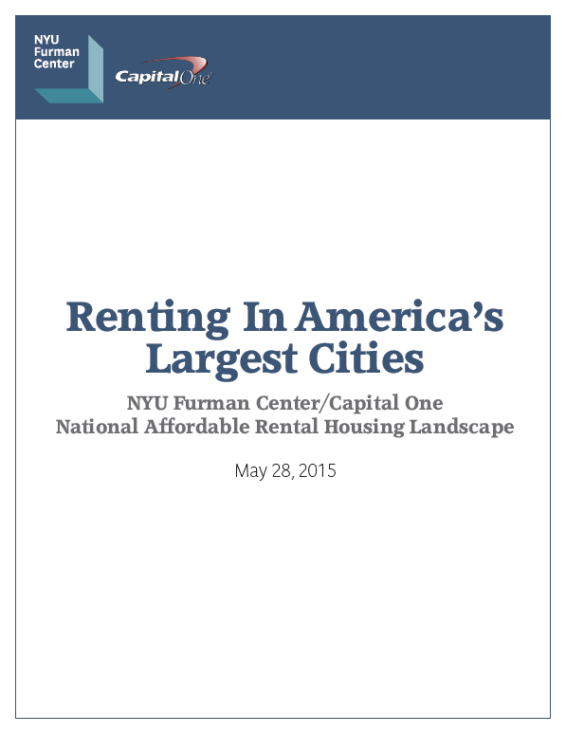
Notes:
This 2015 report by NYU’s Putman Center indicated that nine of the 11 largest U.S. cities had experienced falling vacancy rates and rising rents. Low-income renters could afford no more than 11 percent of recently available units even in the most affordable cities. However, in some cities supply has increased while demand has fallen.

Slide 16
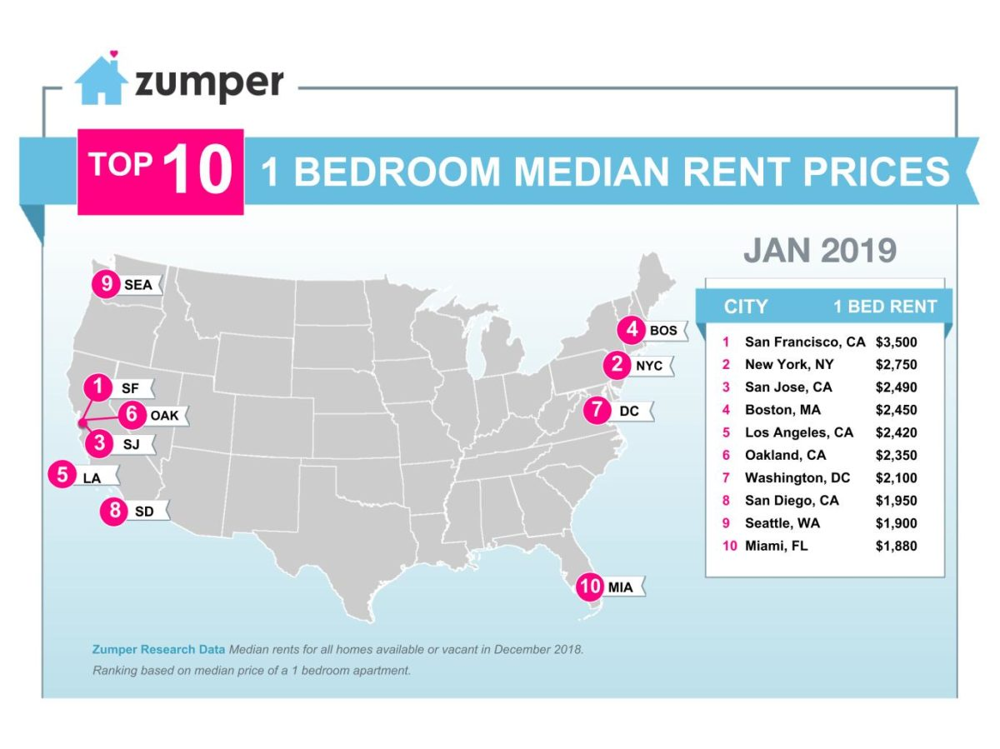
Notes:
Overall, 37% of households nationwide are renters in the U.S. as of 2016 versus 33% back in 2006 and 34% in 2000. Memphis, Tenn., experienced the most pronounced growth in the share of its population that rents, with an 11 percentage-point increase. Other cities whose residents notably shifted from buying to renting include Honolulu, Las Vegas, Mesa, Ariz., and Atlanta. Meanwhile, Miami has the greatest share of renter households of any major city in the country, with nearly 70% of its households renting their homes. New York was next at 68%, followed by Boston (65%), Los Angeles (64%) and Long Beach, Calif. (62%).

Slide 17

Notes:
The City of Chicago is one market where the demographics and economics have improved for renters. Since 2013 Chicago has lost about 22,600 people, while 26,000 multifamily rental units were completed. The result has been a decline of nearly 14 percent in asking rents for a one-bedroom apartment and nearly 16 percent for a two-bedroom unit, although the average 2 bedroom unit will still cost you $2,000 per month (plus utilities).

Slide 18
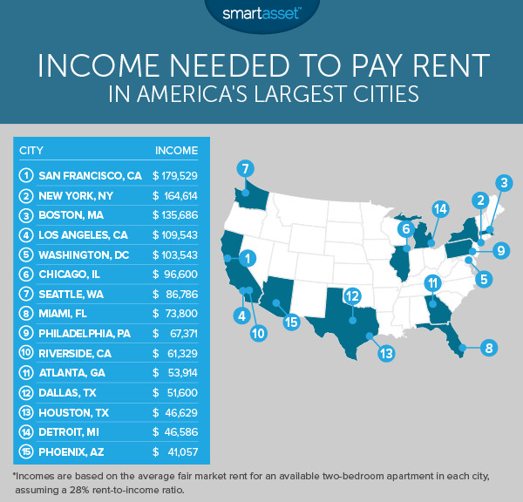
Notes:
San Francisco property owners are learning that potential renters cannot afford to meet the almost continuous increase in asking rents. Rents for a one-bedroom apartment have come down by 7.6 percent since 2015. [Source: Wolf Richter. “Rents are collapsing in some of America’s biggest cities,” Business Insider, 3 September, 2017] A studio apartment in the city costs an average of $2,500 a month.

Slide 19
Commercial Land
Notes:
As our population grows and as people continue to migrate to cities in search of employment, the value of urban land will continue to climb. Market forces result in the construction of multi-story buildings – of skyscrapers – in part to counter the higher and higher per square foot cost of land in and near central business districts. Businesses constantly face decisions about having to downsize or relocate in order to lower the cost of doing business associated with where they operate.

Slide 20

Notes:
20
There is no publicly-available data on the ownership of land in the nation’s major cities and metropolitan regions. However, just fifteen real estate companies own a combined total of more than 1.4 billion square feet of commercial real estate in the U.S. Their buildings occupy the nation’s most valuable parcels of land. The Indianapolis-based firm Simon, a publicly traded REIT is the nation’s largest owner, with 325 properties totaling 241 million square feet. [Source: “Top Retail Space Owners 2017,” SquareFootprint.com]

Slide 21

Notes:
21
Commenting on the ongoing concentration of ownership in the commercial real estate sector, Jeffrey DeMaso, research director at Adviser Investments in New York warns:

Slide 22
“When you own all the landlords, competition among them – in which REITs might improve properties and cut rents to attract the best tenants – starts to look not like a natural part of the free-market system favoring the best property managers, but like a nuisance that easts into owners’ total profits.”
Notes:
22
“When you own all the landlords, competition among them – in which REITs might improve properties and cut rents to attract the best tenants – starts to look not like a natural part of the free-market system favoring the best property managers, but like a nuisance that easts into owners’ total profits.” [Quoted in: Joseph N. DiStefano. “Vanguard Group is America’s new landlord,” The Inquirer/Daily News, 2 June, 2018]

Slide 23
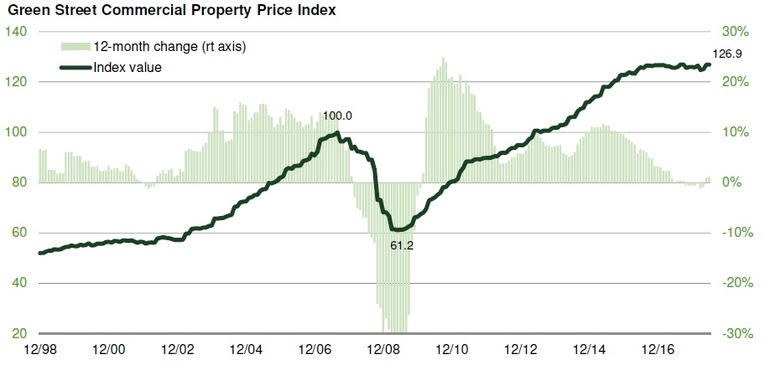
Notes:
23
Green Street Advisors tracks commercial property prices across the United States. The company reported in September of 2018 that commercial property prices should be stable for the next six to twelve months. Investors express concern that further increases in interest rates by the Federal Reserve could trigger a recession, although credit for property acquisitions is still widely available.

Slide 24
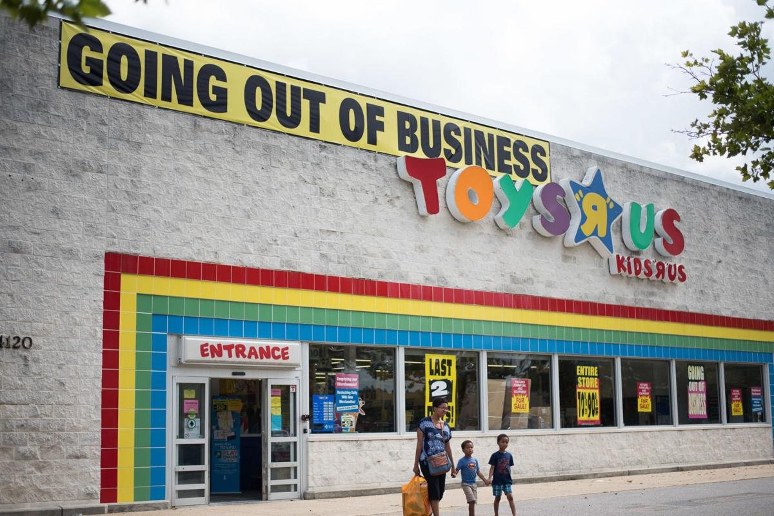
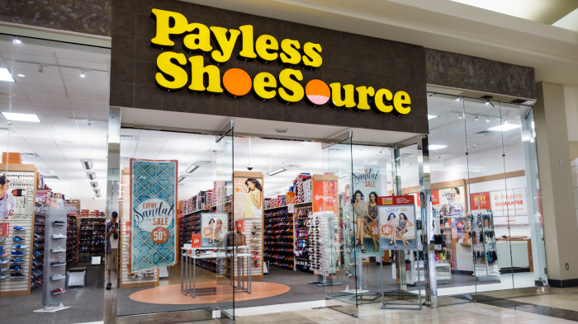
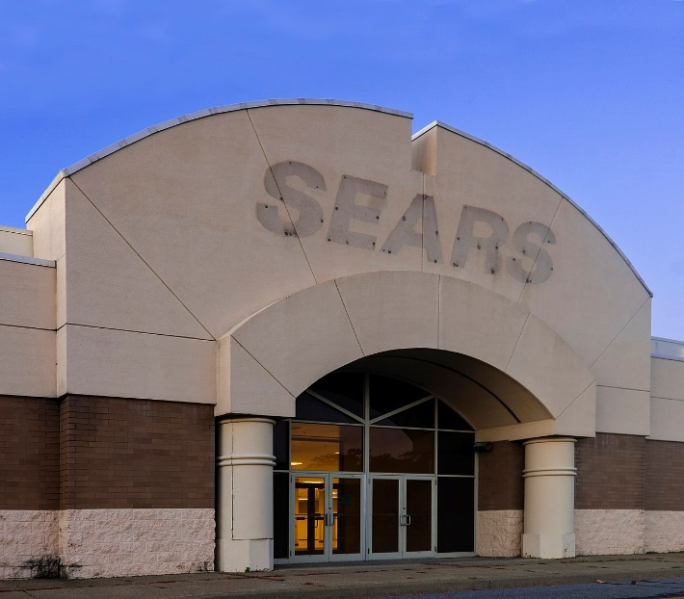
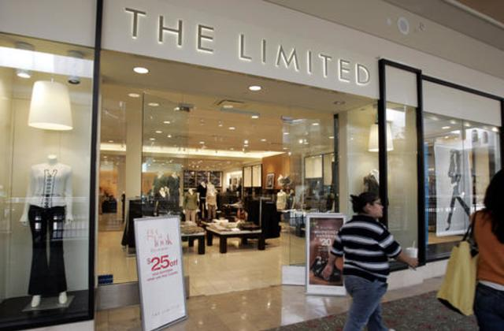
Notes:
24
The sector with the greatest declines in value was retail because of the growing strength of e-commerce. A report issued in November of 2018 by the National Association of Realtors concluded that retail property is under stress, with empty stores, little growth and customers who prefer to shop online.

Slide 25
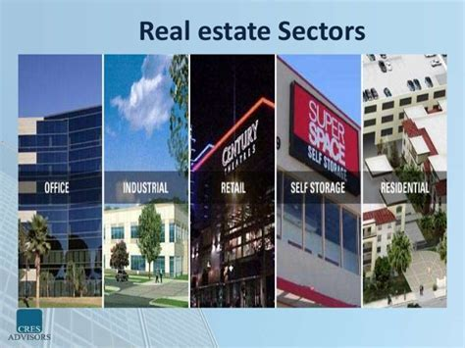

VACANT
LAND
Notes:
25
Following the 2008 crash in property prices, foreign and U.S. corporations began buying urban land and buildings, particularly from owners highly leveraged with mortgage debt. In just one twelve-month period – from mid-2014 to mid-2015 over $1 trillion in property changed hands in the top 100 cities. [Source: Saskia Sassen. “Who owns our cites – and why this urban takeover should concern us all.” The Guardian, 24 November 2015]

Slide 26

Notes:
26
Economists at the Federal Reserve Bank of Philadelphia released a paper in the third quarter of 2018 titled, “Investing in Elm Street; What Happens When Firms Buy Up Houses?” Among their key findings:

Slide 27
“In some cities, investors have bought more than a quarter of the houses sold since the early 2000s, far more than the less than 5 percent purchased by investors prior to the crisis. Meanwhile, the growing proportion of single-family houses being turned into rentals comes amid a steady decline in the nation’s homeownership rate since the mortgage crisis. …”
Notes:
27
“In some cities, investors have bought more than a quarter of the houses sold since the early 2000s, far more than the less than 5 percent purchased by investors prior to the crisis. Meanwhile, the growing proportion of single-family houses being turned into rentals comes amid a steady decline in the nation’s homeownership rate since the mortgage crisis. …”

Slide 28
“Institutional investors … can easily out-compete ordinary families looking to buy a home. …Such ‘crowding out’ may exacerbate wealth inequality by robbing families of their chance to accumulate home equity, a form of wealth-building that historically has been a mainstay of middle-class well-being and financial security. When investor purchases raise local house prices, it benefits older and richer people because they re more likely to own their homes, while younger and poor people get priced out.”
Notes:
28
“Institutional investors … can easily out-compete ordinary families looking to buy a home. …Such ‘crowding out’ may exacerbate wealth inequality by robbing families of their chance to accumulate home equity, a form of wealth-building that historically has been a mainstay of middle-class well-being and financial security. When investor purchases raise local house prices, it benefits older and richer people because they re more likely to own their homes, while younger and poor people get priced out.” [Source: Lauren Lambie-Hanson, Wenli Li and Michael Slonkosky. “Investing in Elm Street: What Happens When Firms Buy Up Houses?” Federal Reserve Bank of Philadelphia Research Department, 2018 Q3]

Slide 29

Notes:
During 2016, Chinese investors were the single largest group of foreign investors in commercial real estate in the United States. Chinese insurance companies were involved in many of the largest transactions. Then, during 2017, Chinese investments feel by 55 percent, to $7.3 billion, as a result of tighter capital controls imposed by the Chinese government (and because of more attractive investment opportunities in other countries).

Slide 30
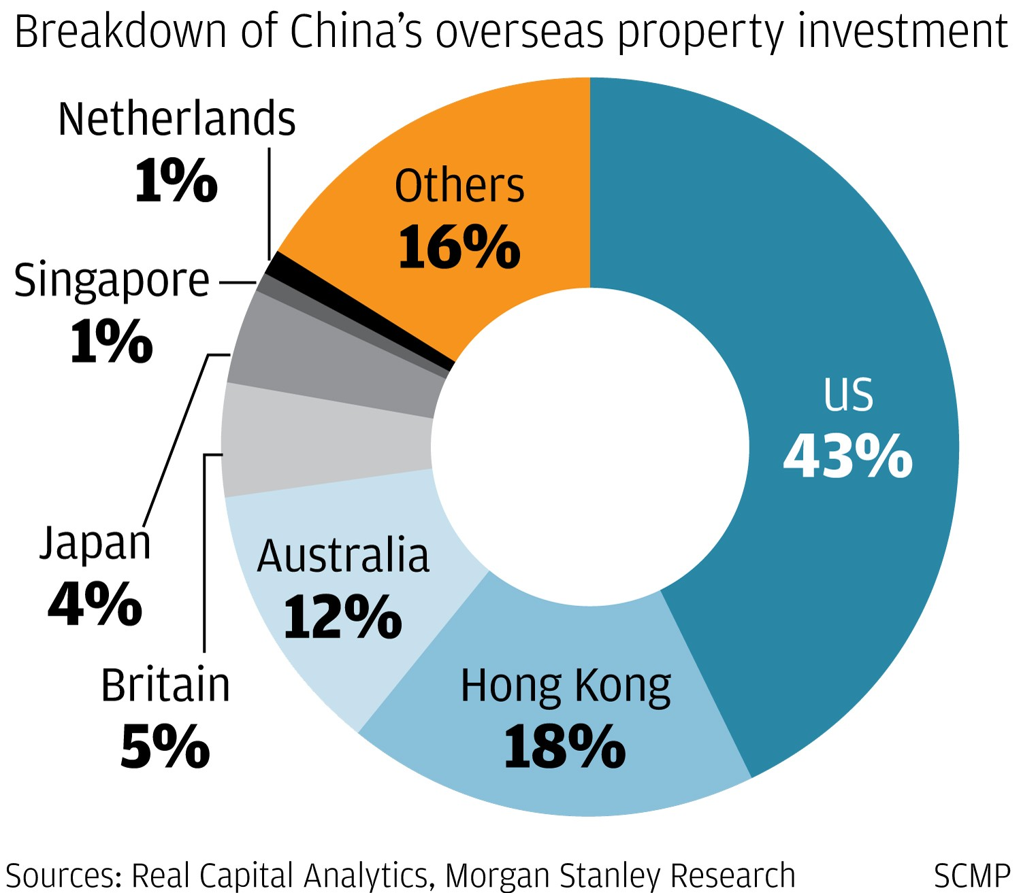
Notes:
30
Thus, while investment by Chinese firms and individuals in U.S. property markets is significant, these investments are fairly concentrated in certain parts of the country. Chinese investors have been the top buyers in both units and dollar volume of residential property for six years, according to the National Association of Realtors. California, Texas, Georgia and Florida attract the largest portion of newer Chinese investors. Mortgage lenders have generally required a 50 percent cash down payment as a condition of providing mortgage financing.

Slide 31
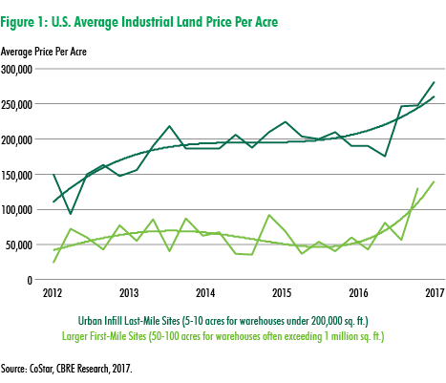
Notes:
31
This chart shows the upward trend in the average price paid for industrial land. Industrial land in northern New Jersey has been selling at prices far above the average, at $1,750,000. The Inland Empire market has also yielded an average price of $980,000. The list of most active markets for industrial land appears on the next slide.

Slide 32
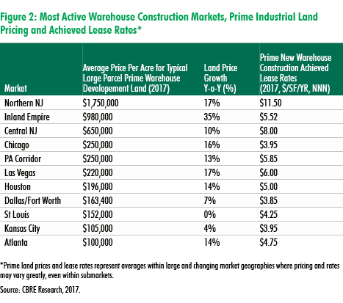
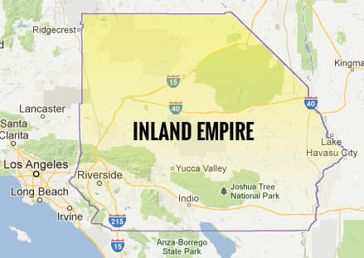
Notes:
32
This chart shows the upward trend in the average price paid for industrial land. Industrial land in northern New Jersey has been selling at prices far above the average, at $1,750,000. The Inland Empire market has also yielded an average price of $980,000.

Slide 33
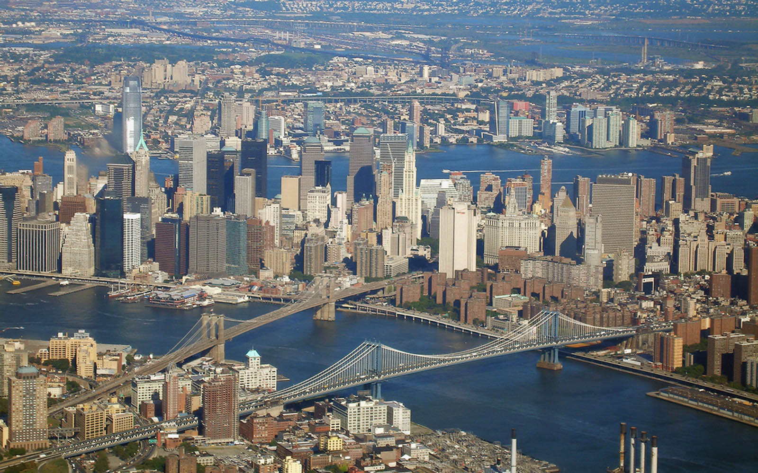
Notes:
33
Economists at Rutgers University, in a paper published in Regional Science and Urban Economics, came up with an estimated 2014 value of all of the developable land in Manhattan (excluding parks, roads and highways). The came to a range of between $1.54 and $1.95 trillion. An April 2018 article by Richard Florida in Citylab described their methodology:

Slide 34
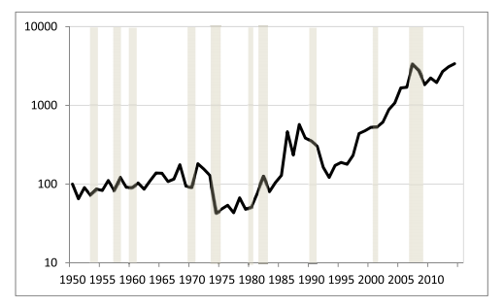
“The researchers arrived at that number by analyzing the prices of vacant parcels of land in Manhattan. This enabled them to avoid the problem of disentangling the land value from the value of the structure that sites on top of it. Using data on all vacant land transactions form 1950 to the first quarter of 2015, they built a land value index that represents the change in Manhattan’s land value over time, adjusted for inflation.”
Notes:
34
“The researchers (Jason Barr, Fred Smith, and Sayali Kulharni) arrived at that number by analyzing the prices of vacant parcels of land in Manhattan. This enabled them to avoid the problem of disentangling the land value from the value of the structure that sites on top of it. Using data on all vacant land transactions form 1950 to the first quarter of 2015, they built a land value index that represents the change in Manhattan’s land value over time, adjusted for inflation.” [From:
Richard Florida. “What’s Manhattan’s Land Worth? Try Canada’s Entire GDP,” Citylab. 24 April, 2018]

Slide 35
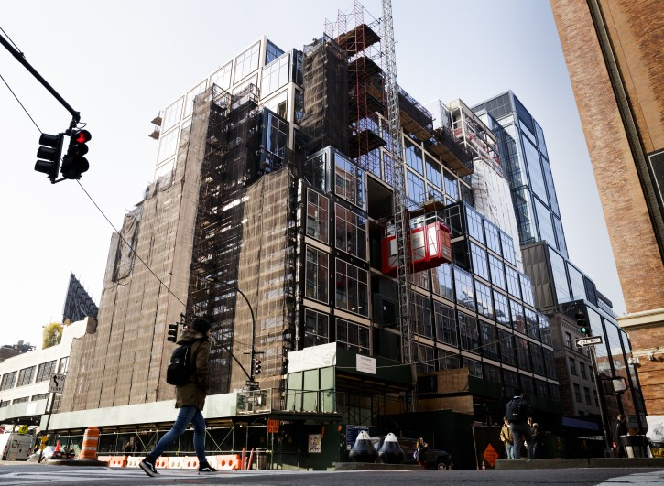
Notes:
35
Land development in Manhattan was down 74 percent in 2016 from 2015, in part because banks became concerned about an oversupply of high-end luxury condominiums. In order to recover the costs of land acquisition, construction and financing, and then achieve an acceptable profit margin a developer has to construct a huge building marketed to tenants, whether commercial, retail or residential. The risk is that the demand for space will materially change between the time ground is acquired and construction undertaken and the property is ready for occupancy. A building lot the size of a typical city block (100,000 square feet) in Manhattan would (at $600 to $800 per square foot) would cost a minimum of $60 million.

Slide 36
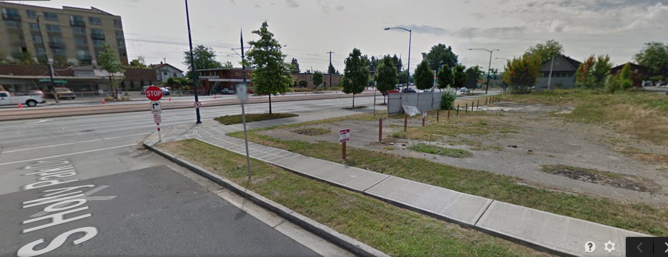
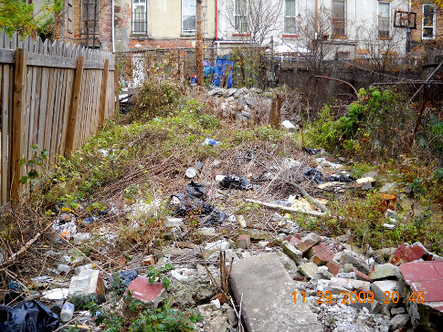
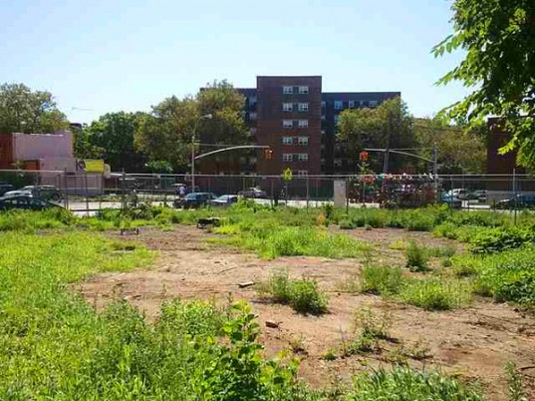
Notes:
36
Even in prosperous and growing cities there is a significant amount of vacant and underutilized land. Aerial photographs of most cities show just how much land could be developed for residential, commercial and other uses, if only public policies provided the right incentives for owners to bring the land they hold to its highest, best use. Assessment practices that fail to adjust values to current market are particularly harmful in parts of cities where demand for land is increasing. The low effective rate of taxation allows owners to hold on to land for years without real concern for the carrying cost of doing so.

Slide 37

Notes:
37
While most of us live in towns and cities, we could not do so if others were not hard at work producing the food we consume. Let’s look at this complex and integrated system of how food is produced and delivered to market.

Slide 38
End Part 8

