Slide 1
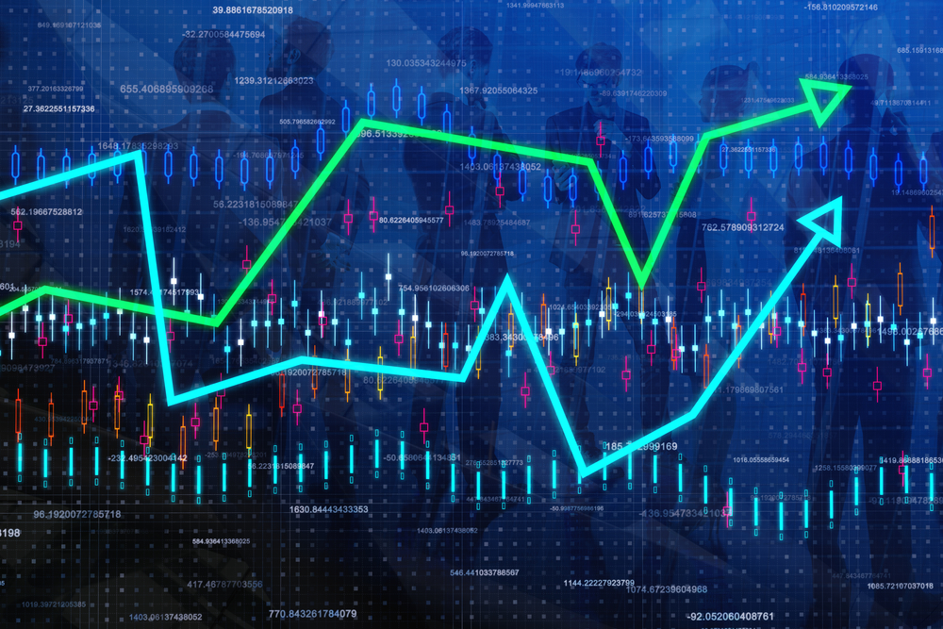
The State of the United States
ECONOMY and SOCIETY
Part 7

Slide 2
Managing Nature
Notes:
Today there is little real understanding of the connection between the private, concentrated control over nature, the distribution of income and wealth and the way we exploit the planet’s natural resources. I came to the conclusion many years ago that these systemic problems must be solved or we will continue to lose the quality of life we have enjoyed. For millions of people around the world, their quality of life is already well below what we would agree is a decent human existence.

Slide 3
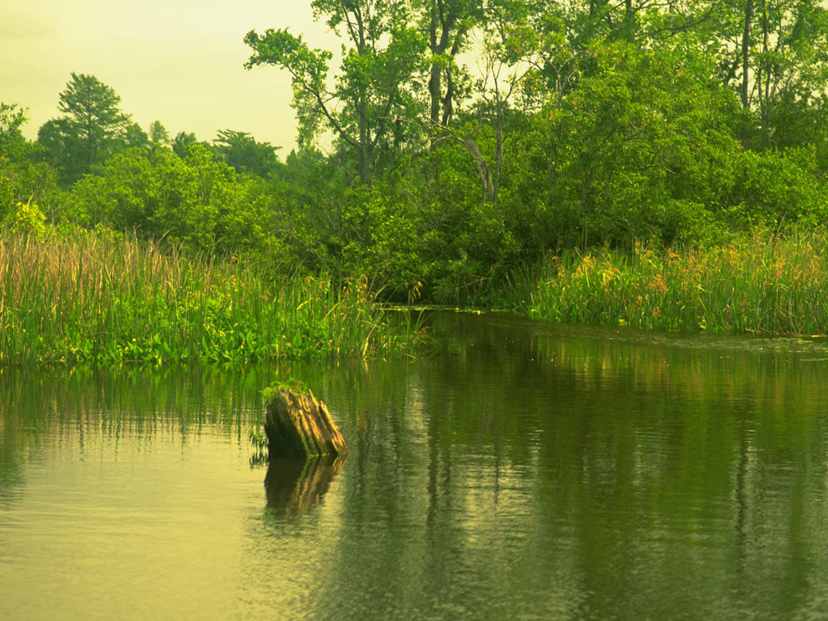
Notes:
Consider that nature is provided to us without any expenditure of labor or use of capital goods. The mere ownership of nature produces nothing. One must exert labor and use capital goods in order to produce goods that meet needs and desires. However, the system of law we have created has made it possible for some to obtain goods others produce without providing anything in exchange.

Slide 4
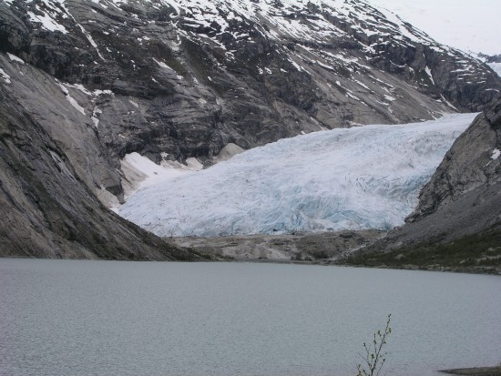
Notes:
Nature is the commons we all depend upon for everything. The control over access to nature has and continues to be a fundamental cause of conflict between people within and between nation-states.

Slide 5
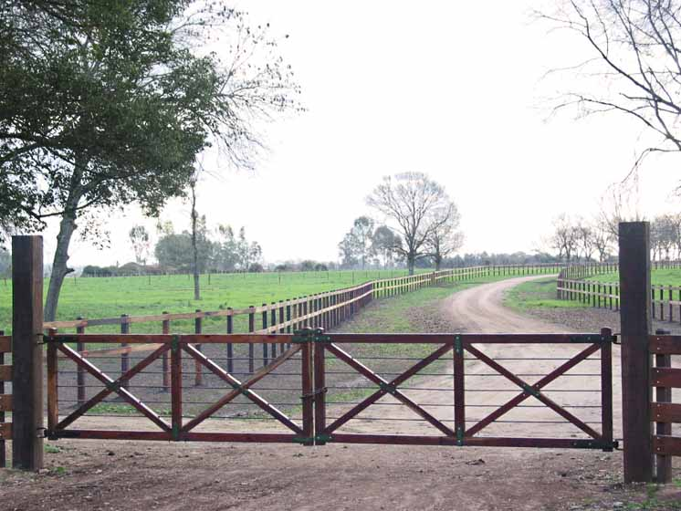
Notes:
Yet, the laws of the United States (and most every society) allow individuals and entities to control huge parts of the planet with nominal – often zero -- compensation to society for what I argue is justly described as a form of privilege, what the philosopher John Locke described as a form of economic license. In the fifth chapter of Locke’s The Second Treatise of Civil Government, he argued:

Slide 6
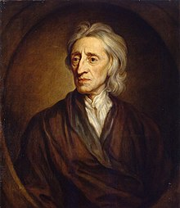
“God, who hath given the world to men in common, hath also given them reason to make use of it to the best advantage of life and convenience. The earth and all that is therein is given to men for the support and comfort of their being. And though all the fruits it naturally produces, and beasts it feeds, belong to mankind in common, as they are produced by the spontaneous hand of Nature, and nobody has originally a private dominion exclusive of the rest of mankind in any of them, as they are thus in their natural state, yet being given for the use of men, there must of necessity be a means to appropriate them some way or other before they can be of any use, or at all beneficial, to any particular men.”
Notes:
“God, who hath given the world to men in common, hath also given them reason to make use of it to the best advantage of life and convenience. The earth and all that is therein is given to men for the support and comfort of their being. And though all the fruits it naturally produces, and beasts it feeds, belong to mankind in common, as they are produced by the spontaneous hand of Nature, and nobody has originally a private dominion exclusive of the rest of mankind in any of them, as they are thus in their natural state, yet being given for the use of men, there must of necessity be a means to appropriate them some way or other before they can be of any use, or at all beneficial, to any particular men.”

Slide 7
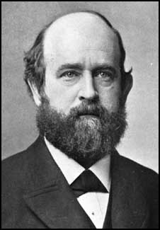
Notes:
Unfortunately, Locke was unable to resolve the conflict between protecting the commons for all to access and the parallel need to allocate control over nature to specific individuals in order to ensure the products of human activity would be secured to those who produced them. It came to the American political economist and author Henry George, writing in the late 1800s, to provide the solution:

Slide 8
“It is perfectly clear that we are all here with equal rights to the use of the universe. We are all here equally entitled to the use of land. How can we secure that equal right? Not by the dividing up of land equally; that in the present stage of civilisation is utterly impossible. Equality could not be secured in that way, nor could it be maintained. The ideal way, the way which wise men, desirous of according to each his equal right, would resort to in a new country, would be to treat the land as the property of the whole, to allow individuals to possess and to use it, paying for the whole a proper rent for any superiority in the piece of land they were using. ...”
Notes:
“It is perfectly clear that we are all here with equal rights to the use of the universe. We are all here equally entitled to the use of land. How can we secure that equal right? Not by the dividing up of land equally; that in the present stage of civilisation is utterly impossible. Equality could not be secured in that way, nor could it be maintained. The ideal way, the way which wise men, desirous of according to each his equal right, would resort to in a new country, would be to treat the land as the property of the whole, to allow individuals to possess and to use it, paying for the whole a proper rent for any superiority in the piece of land they were using. …”

Slide 9
“The ideal plan would allow every man who wished to use land to obtain it, and to possess what he wished to use so long as no one else wished to use it, and if the land be so superior that more than one wanted to use it, a proper payment according to its superiority should be made to the community, and by that community used for the common benefit.”
Notes:
“The ideal plan would allow every man who wished to use land to obtain it, and to possess what he wished to use so long as no one else wished to use it, and if the land be so superior that more than one wanted to use it, a proper payment according to its superiority should be made to the community, and by that community used for the common benefit.” [Source: Henry George. “The Single Tax versus Social Democracy,” a debate with H.M. Hyndman, St. Jame’s Hall, London, 2 July, 1889]

Slide 10
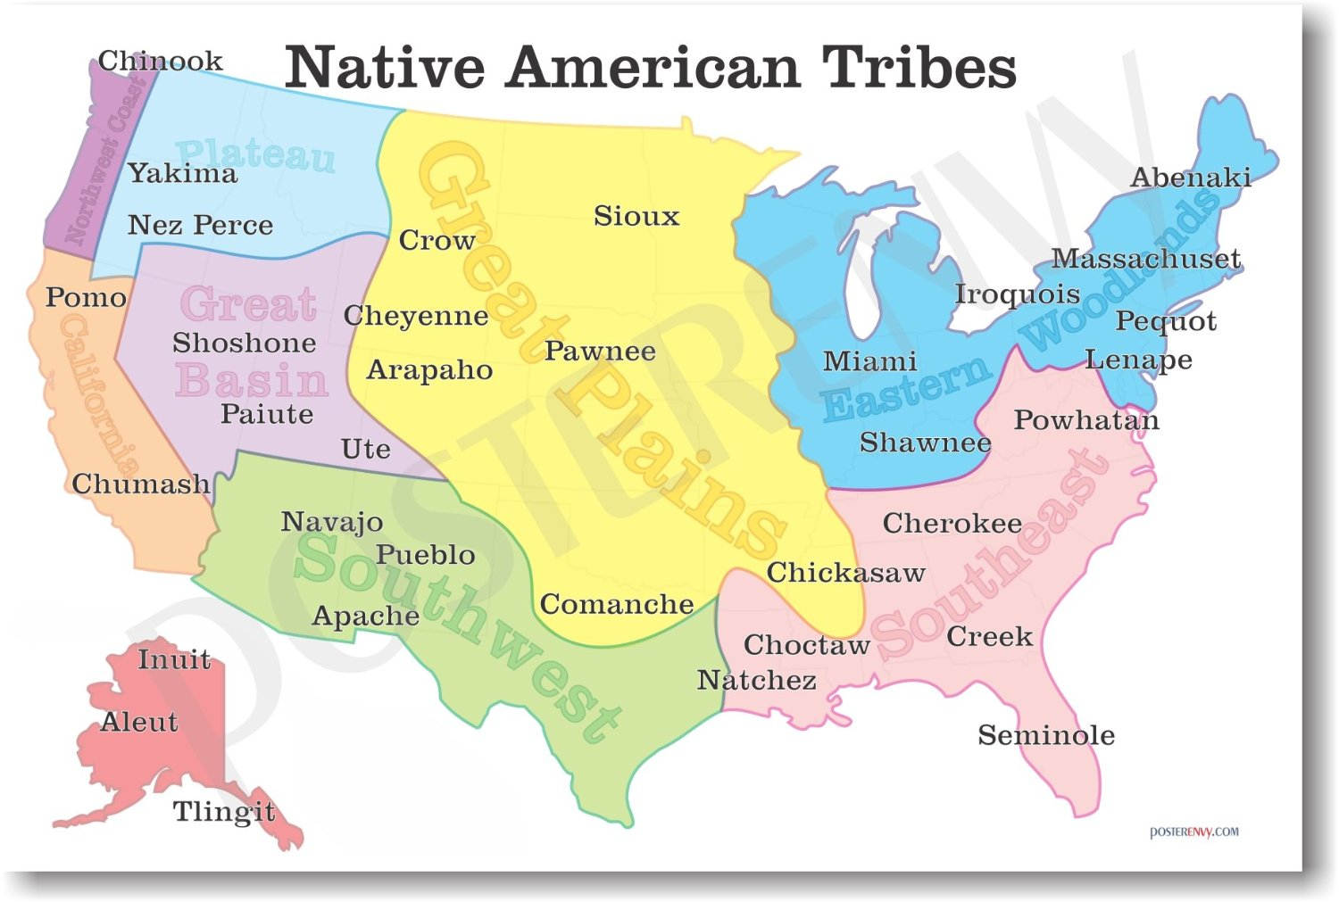
Notes:
10
It is worth recalling that most of the territory that eventually came under the control of the United States of America was once occupied by numerous tribal peoples, even as European powers claimed the same territory as part of their colonial holdings.

Slide 11
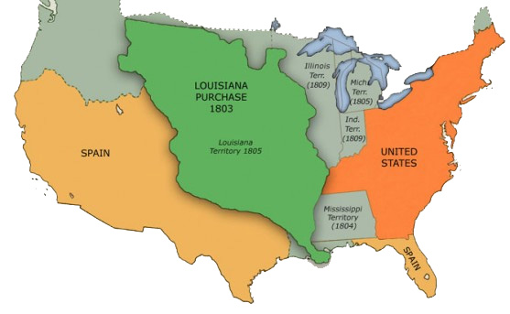
Notes:
11
Whether by purchase or conquest, the original group of independent states huddled along the eastern coast of North America acquired control over this vast territory, out of which a system of private landholdings was introduced and institutionalized.

Slide 12
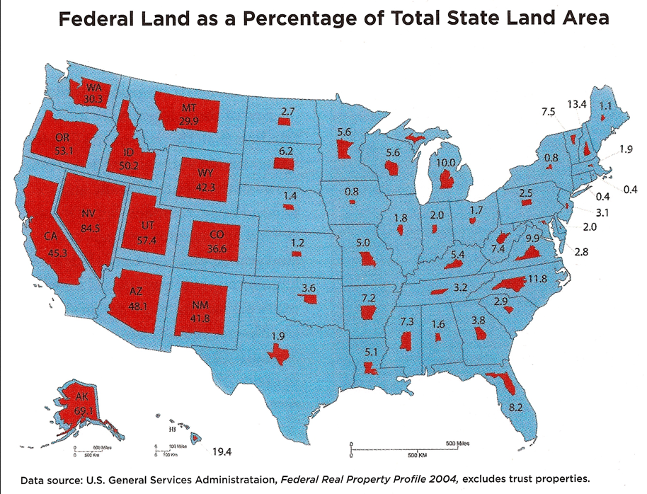
Notes:
12
That some understanding existed that nature should not be owned by individuals is found in the fact that roughly fifty percent of the land area of the United States is retained as our public domain. Government has the responsibility and mandate to wisely administer the public domain on behalf of the entire citizenry.

Slide 13
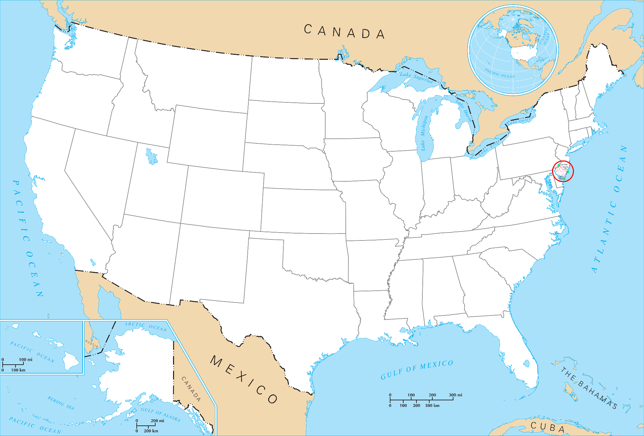
95% of land VALUE is held by 3-5 percent
of the population
Notes:
13
Although statistics on private land ownership are not kept by any U.S. government agency, a good estimate is that 95 percent of land value is held by between 3-5 percent of the population (as well as foreign nationals and corporations). Only a relatively small number of people own more than the parcel of land beneath their residence.

Slide 14
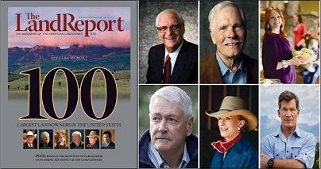
Notes:
The interdependencies of our land and land policies with the broader economy is seldom discussed in the halls of government. What our history reveals, on the other hand, is a continuous scramble for control of the land. This is today reflected in the ongoing accumulation of landed holdings by those at the top.

Slide 15
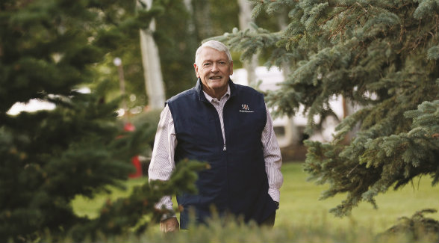
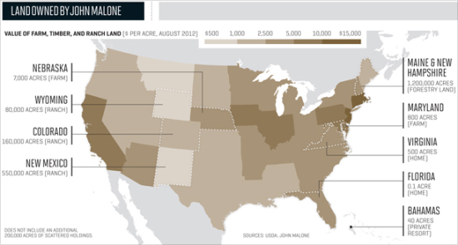
Notes:
15
As of 2017, John Malone, chairman of Liberty Media, continues to be the largest landowner in the United States, controlling 2.2 million acres of land. This is an area about three times the size of Rhode Island.

Slide 16
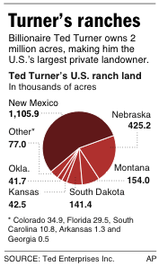
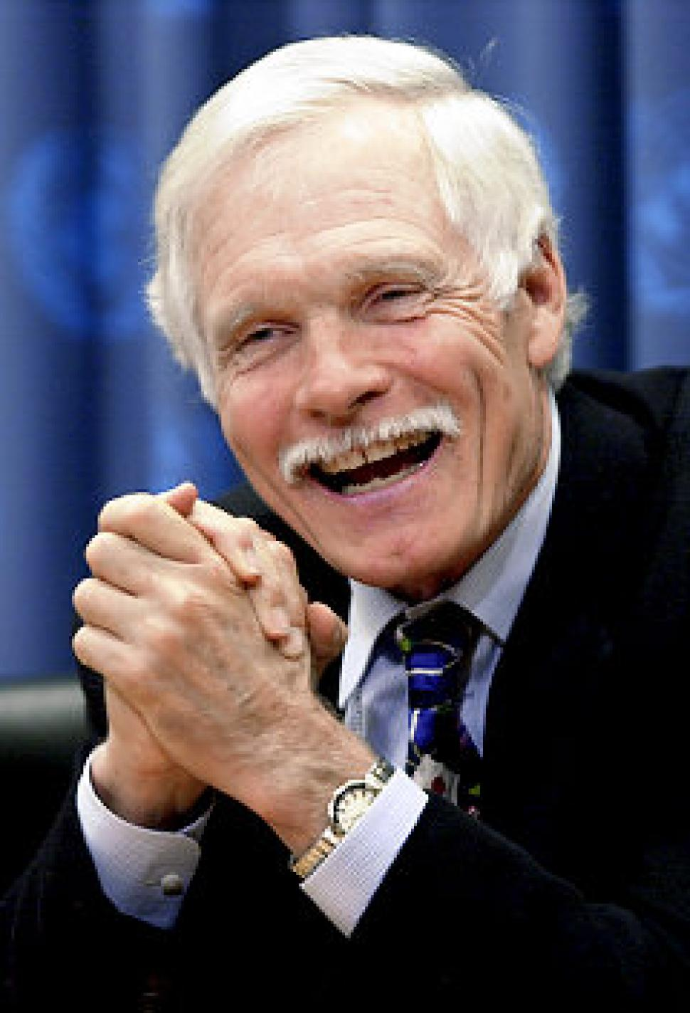
Notes:
16
Billionaire Ted Turner is second on the list, the owner of over 2 million acres of land from Montana to Florida. During 2018 he acquired a large Nebraska ranch, lifting his Nebraska acreage to almost 507,000 acres. Interestingly, with respect to his primary business activity, he made this comment regarding the dangers associated with such a concentration of ownership:

Slide 17
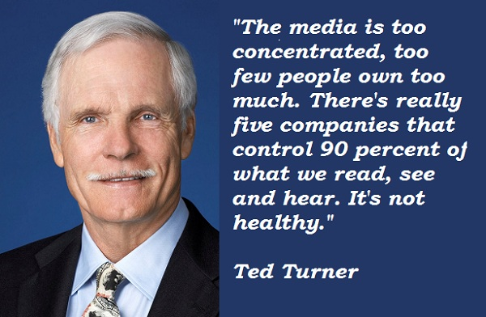
Notes:
17
“The media is too concentrated, too few people own too much. There’s really five companies that control 90 percent of what we read, see and hear. It’s not healthy.”

Slide 18
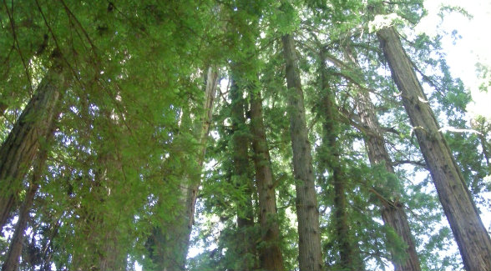
The Emmerson Family: 1.96 million acres
Notes:
18
Malone and Turner are followed by The Emmerson family, owners of one of the nation’s largest lumber producers, Sierra Pacific Industries. The family controls 1.96 million acres of land and generates around 70% of its annual revenue from the sale of lumber.

Slide 19
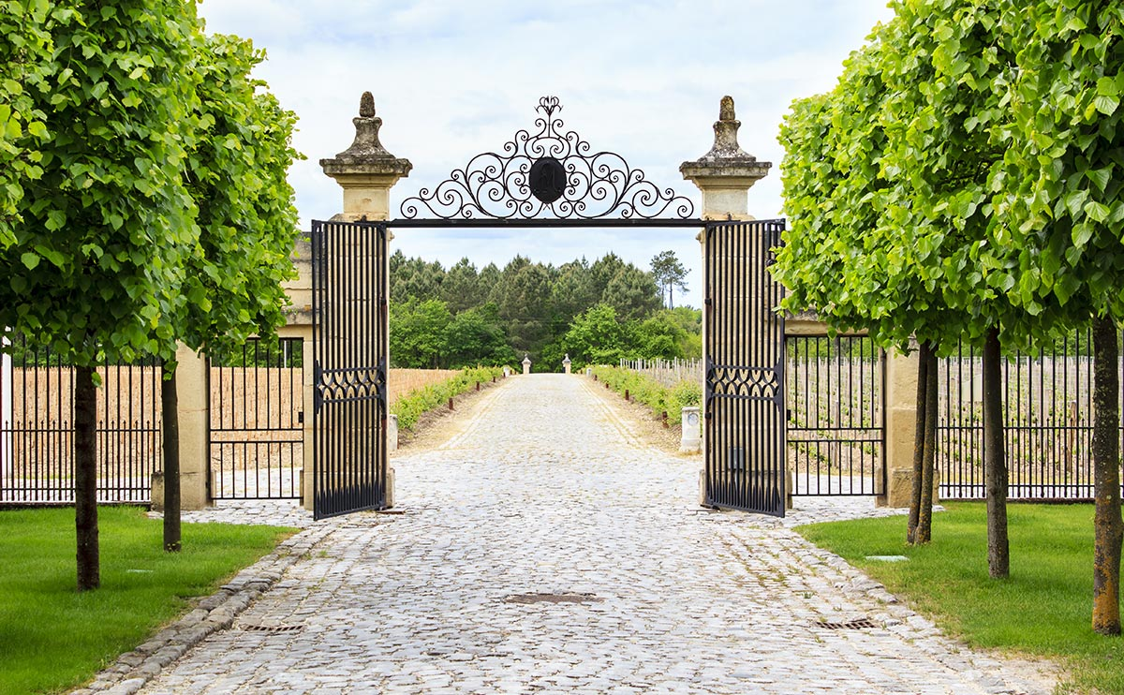
Notes:
19
These owners of huge land holdings will argue that they are, in many cases, better stewards of the land than the government would be, which is arguably the case. At the same time, they effectively remove huge areas from the public domain and enjoy monopolistic control over the natural resources that exist. This raises both a moral issue and an issue of economic efficiency.

Slide 20
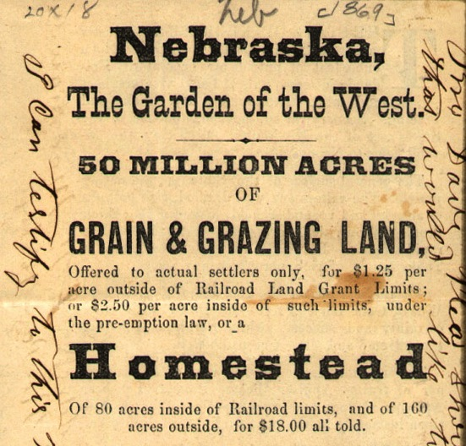
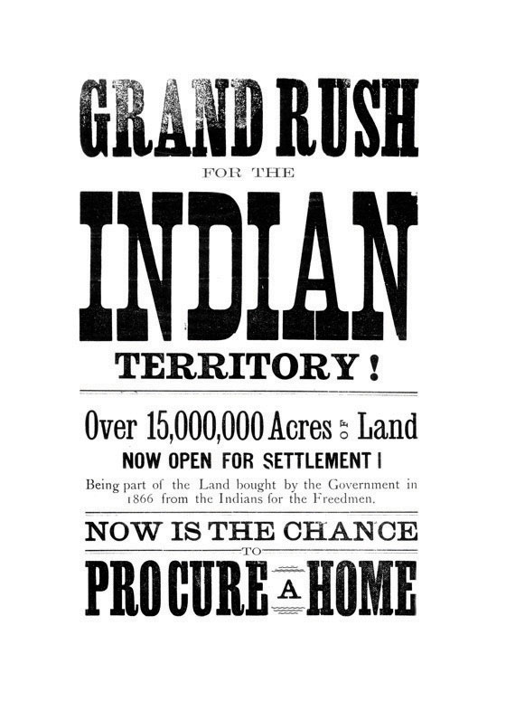
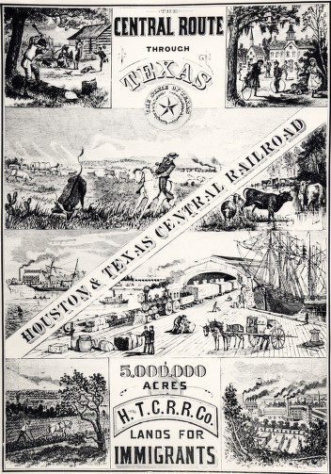
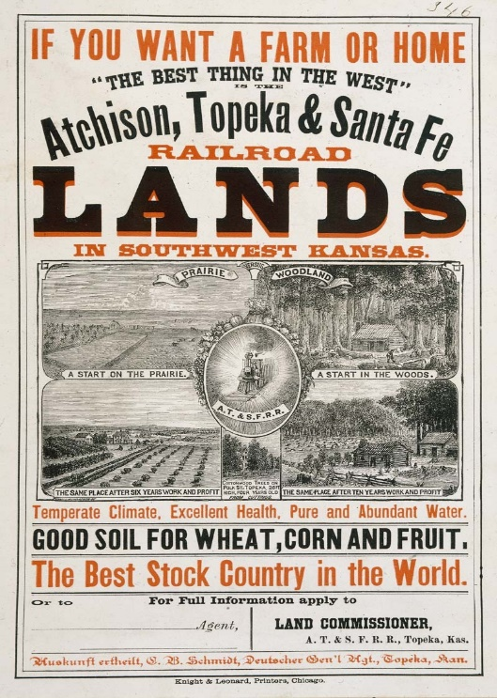
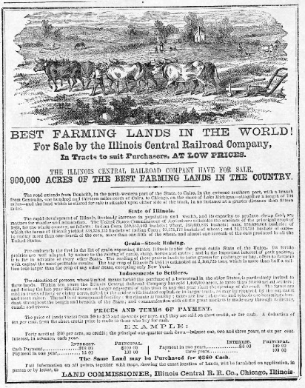
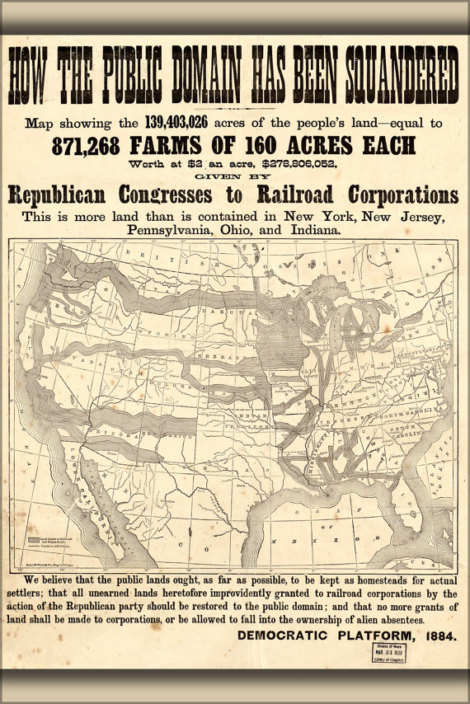
Notes:
Acquiring land, whether for one’s use or for pure speculation, has been from the moment Europeans first stepped foot in North America a primary driver of our economic system. Landed interests have always been economically and politically powerful influences over public policies.

Slide 21
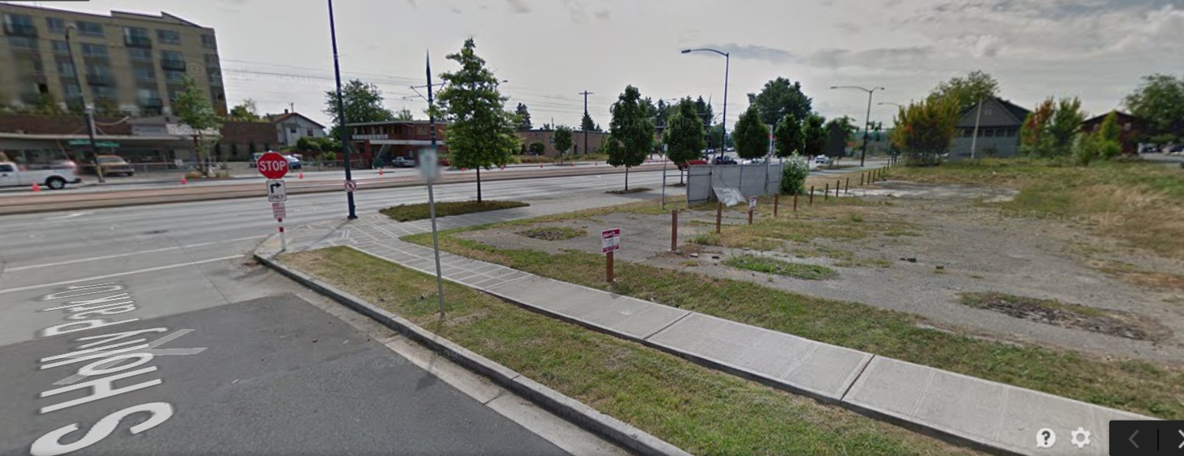
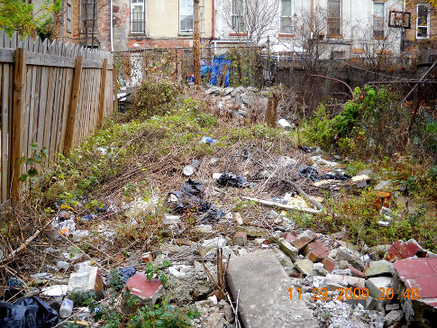
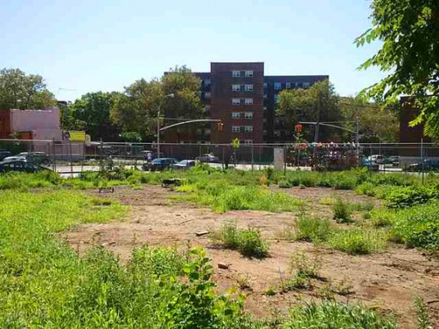
Notes:
21
Even in prosperous and growing cities there is a significant amount of vacant and underutilized land. Aerial photographs of most cities show just how much land could be developed for residential, commercial and other uses, if only public policies provided the right incentives for owners to bring the land they hold to its highest, best use.

Slide 22
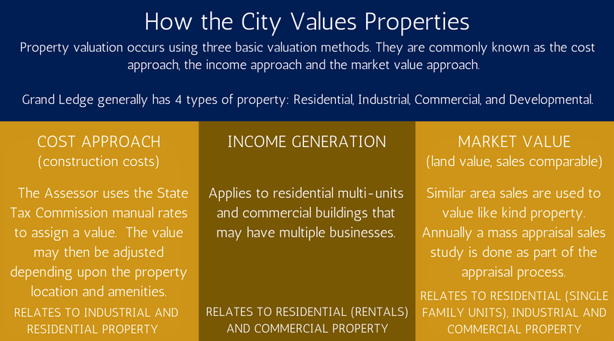
Notes:
22
Assessment practices that fail to adjust values to current market are particularly harmful in parts of cities where demand for land is increasing. The low effective rate of taxation allows owners to hold on to land for years without real concern for the carrying cost of doing so.

Slide 23
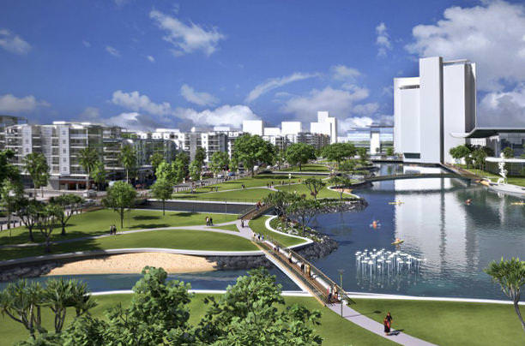
Notes:
23
Cities that adopt “best practices” continue to evolve to provide residents with the infrastructure and amenities to provide for a high quality of life within a relatively high population density.

Slide 24
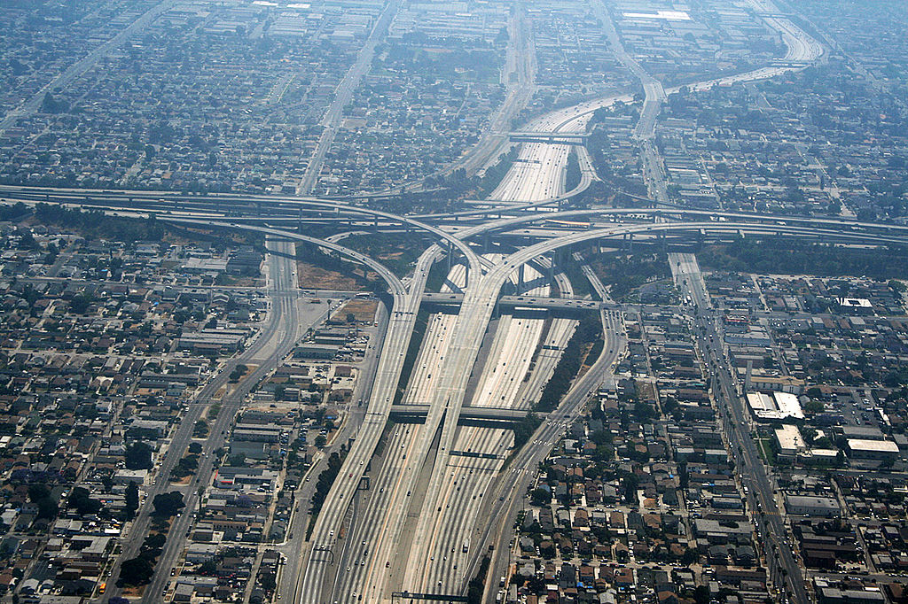
Notes:
24
Other cities have allowed speculators and hoarders of high-value locations to impede sustainable development patterns. Sprawl and dependence on the automobile over public transit systems is the common outcome.

Slide 25
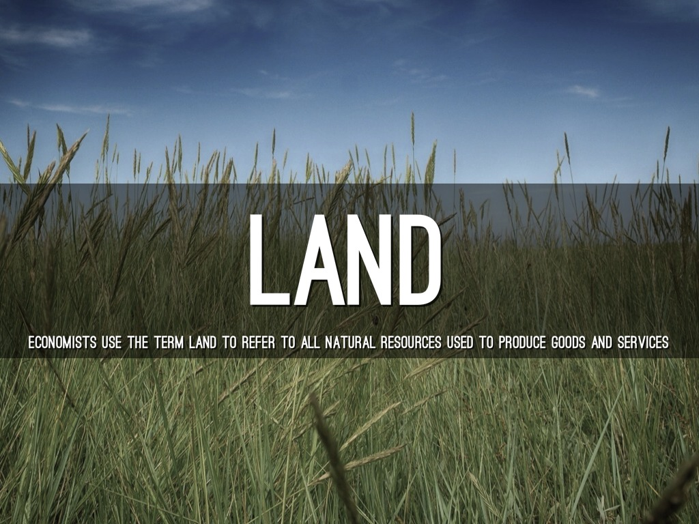
Notes:
25
Whether land is owned by the community and offered to private individuals or entities for lease, or ownership is conveyed by sale and purchase, land markets fundamentally determine the cost of doing business and the cost of acquiring a home. We will next look at the impact of land markets on a society.

Slide 26
End Part 7

