Slide 1

The State of the United States
ECONOMY AND SOCIETY
Part 6

Slide 2
Widening Gaps in Income
Notes:
For a large percentage of working persons, income has stagnated or fallen – in both nominal and real terms – over the last forty years. Wide is the gap between those at top and bottom of the income ladder in the United States.

Slide 3
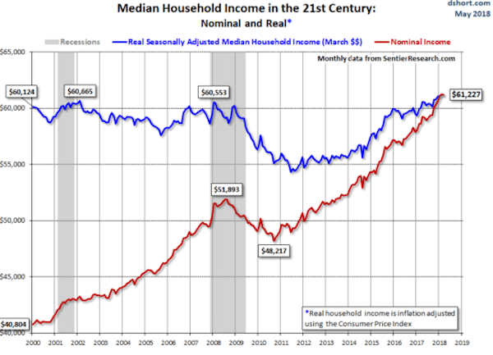
Notes:
The U.S. Census Bureau reports that in January of 2018 median U.S. household income was $61,227. What this chart indicates is that there is very little difference at this time between one’s nominal income and the purchasing power when compared to the base year utilized (2000).

Slide 4
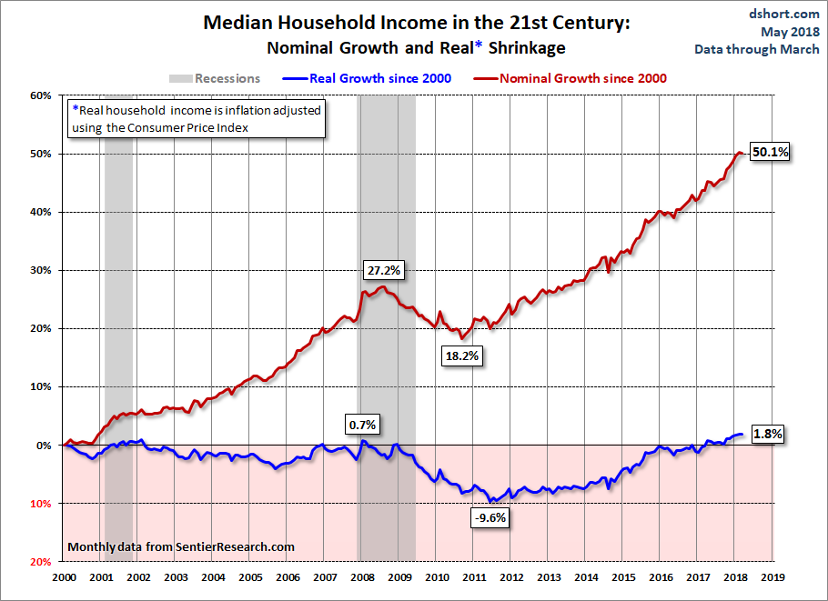
Notes:
This second graph shows the increase in income necessary to maintain one’s purchasing power against the rising costs of living. What the chart does not indicate is the number of persons contributing to household income to maintain a stable purchasing power. A important question to raise is the number of households with one employed adult are able to do so. [Source: Jill Mislinski. “Real Median Household Reintroduction,” Advisor Perspectives, 2 May, 2018]

Slide 5
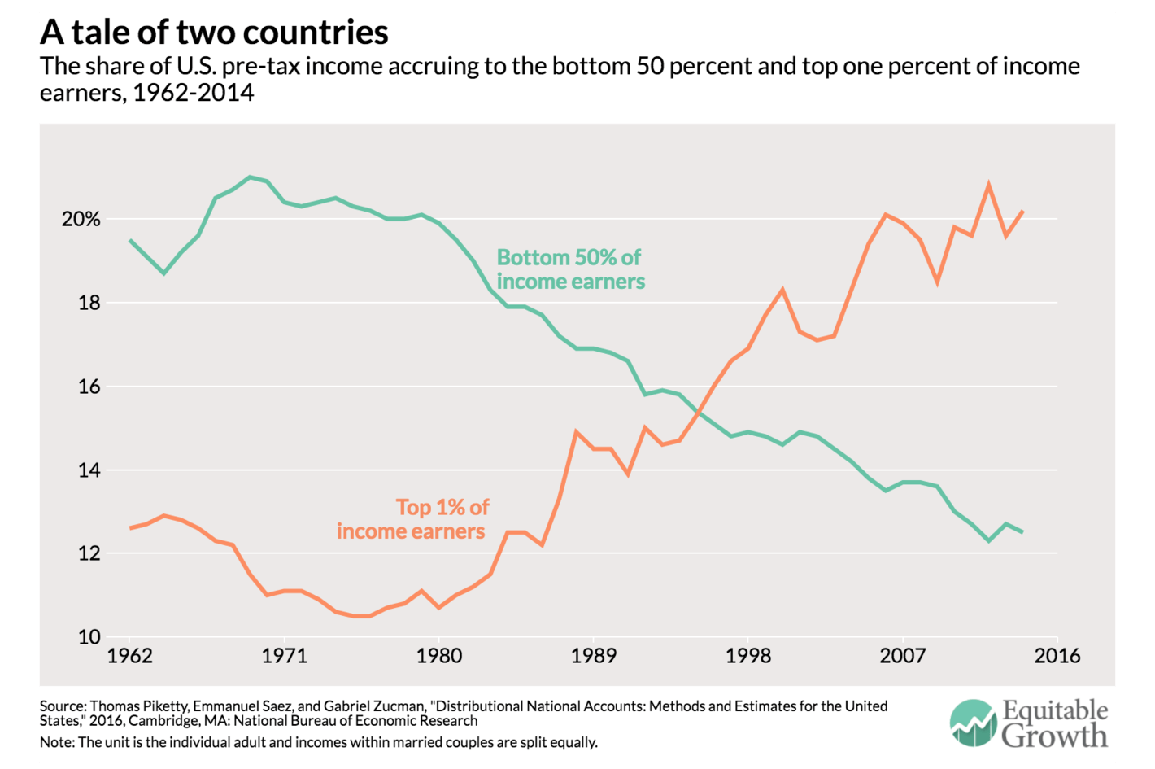
Notes:
This chart shows how the gap between those at the very top and those in the bottom half of income earners has widened dramatically with each passing year since the late 1970s. The situation since 2016 has certainly become even more pronounced.

Slide 6
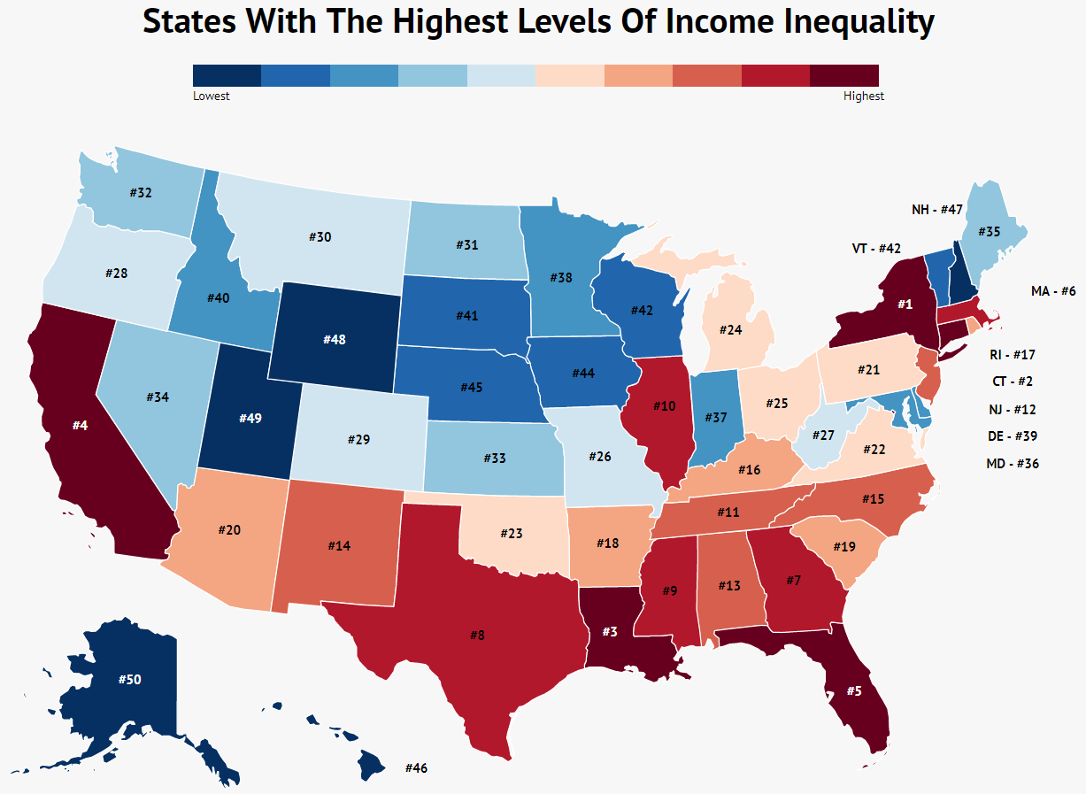
Notes:
Where one lives in the United States makes a significant difference. This map was produced by Zippia using data from the U.S. Census Bureau’s American Community Survey in 2017.

Slide 7

Notes:
An article by Eric Levitz printed in the December 2018 issue of New York Magazine makes a point about just how bad the situation has become:

Slide 8
“In 1980, the average worker on the bottom half of America’s income ladder earned about $16,000 a year (in today’s money). Over the ensuing three-and-a-half decades, the average national income in the United States grew by 61 percent. That rising tide lifted all boats so high that, by 2014, the average worker in the bottom 50 percent took home a whopping … $16,000 a year. Meanwhile, the average denizen of the top one percent went from earning an inflation-adjusted $428,000 in 1980, to taking home $1,304,800 in 2014.”
Notes:
“In 1980, the average worker on the bottom half of America’s income ladder earned about $16,000 a year (in today’s money). Over the ensuing three-and-a-half decades, the average national income in the United States grew by 61 percent. That rising tide lifted all boats so high that, by 2014, the average worker in the bottom 50 percent took home a whopping … $16,000 a year. Meanwhile, the average denizen of the top one percent went from earning an inflation-adjusted $428,000 in 1980, to taking home $1,304,800 in 2014.” [Source: Eric Levitz. “A New Study Shows How Severe U.S. Inequality Is – and How Little We’re Doing About It,” New York Magazine, 8 December, 2016]

Slide 9

Notes:
As is often the case, the devil is in the details. And, when the details are analyzed there is controversy. An opinion article by Leonid Bershidsky printed by Bloomberg in January of 2019 explains:

Slide 10
“Much of the current debate about inherited wealth in a number of Western countries is informed by the notion that most of today’s top incomes are the product of passive returns on financial capital rather than labor. But in a new National Bureau of Economic Research working paper, four U.S. economists stipulate that much of that income actually comes from the returns on the aptitudes, or human capital, of the working rich; these returns are so great because large human capital is exceedingly rare ...”
Notes:
“Much of the current debate about inherited wealth in a number of Western countries is informed by the notion that most of today’s top incomes are the product of passive returns on financial capital rather than labor. But in a new National Bureau of Economic Research working paper, four U.S. economists stipulate that much of that income actually comes from the returns on the aptitudes, or human capital, of the working rich; these returns are so great because large human capital is exceedingly rare ...”

Slide 11
“In their important 2018, “Distributional National Accounts,” Thomas Piketty, Emmanuel Saez and Gabriel Zucman wrote that, in contrast to earlier decades, the increase in income concentration over the past 15 years derives from a boom in the income from equity and bonds at the top. This implies that the top incomes of the 20th century — those of top executives, star performers and professional athletes — grew because the richest received bigger pay for work considered unique. Now the elite grows wealthier simply by virtue of owning assets. The authors say the new state of affairs is manifestly unfair, especially since the assets can be passed by inheritance, creating an idle owner class, somewhat like the old aristocracy, that vacuums up much of societies’ cash.”
Notes:
“In their important 2018, “Distributional National Accounts,” Thomas Piketty, Emmanuel Saez and Gabriel Zucman wrote that, in contrast to earlier decades, the increase in income concentration over the past 15 years derives from a boom in the income from equity and bonds at the top. This implies that the top incomes of the 20th century — those of top executives, star performers and professional athletes — grew because the richest received bigger pay for work considered unique. Now the elite grows wealthier simply by virtue of owning assets. The authors say the new state of affairs is manifestly unfair, especially since the assets can be passed by inheritance, creating an idle owner class, somewhat like the old aristocracy, that vacuums up much of societies’ cash.” [Source: Leonid Bershidsky. “The U.S. Is a Meritocracy. That Doesn’t Mean It’s Fair,” Bloomberg Opinion, 15 January, 2019]

Slide 12
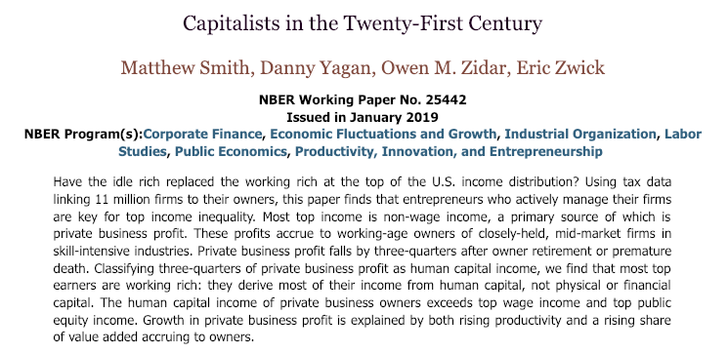
Notes:
Reaching a somewhat different conclusion based on the same data, several other researchers argue that about three-quarters of the pass-through business income the biggest U.S. earners receive is, in effect, payment for work or returns from human capital such as expertise, connections and reputation. [See: Matthew Smith, Danny Yagan, Owen Zidar andEric Zwick. “Capitalists in the Twenty-First Century,” 2019]

Slide 13

Notes:
One of the co-authors of this paper, Eric Zwick, explained the finding published in this paper at a program at the University of Chicago. His lecture is available online at: https://www.youtube.com/watch?v=o0aDJ754eyY. An important take-away from his comments (from my perspective) is a continued problem of not limiting the definition of returns to “capital” as returns to “capital goods.” As do most economists, he refers to “human capital” as a characteristic of effort distinct in “kind” rather than “degree” from that of what be thought of as ordinary labor skills.

Slide 14
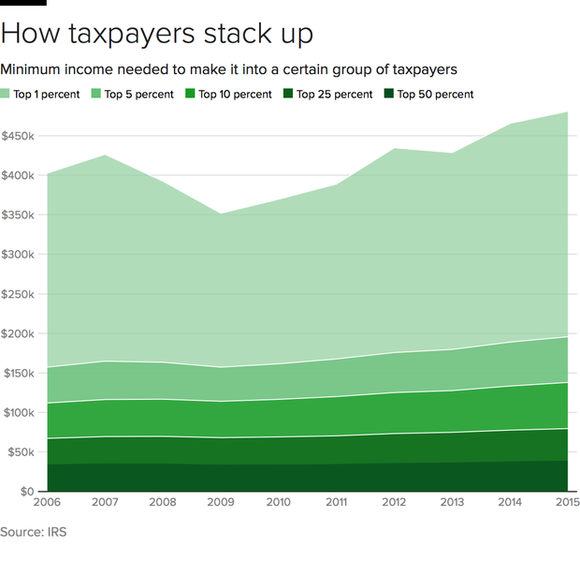
Notes:
A report issued in mid-2018 by the Economic Policy Institute finds that a household needs an annual income of nearly $422,000 to be included in the top 1 percent of U.S. households. In Connecticut, you would need an income of $700,800 to be in the top 1 percent. In New Mexico, you need just $255,500.

Slide 15
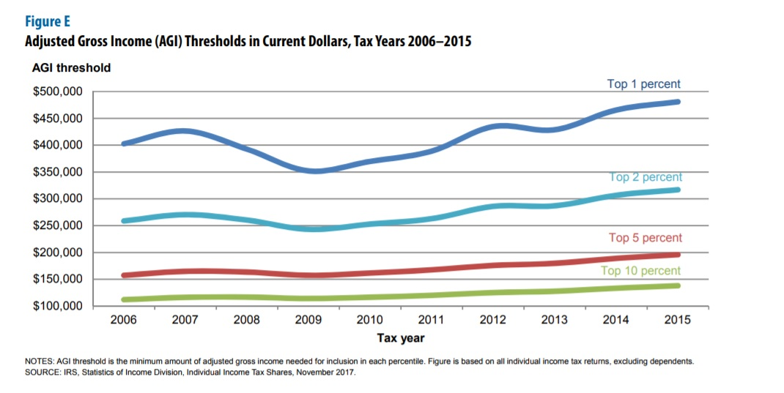
Notes:
Income inequality is worsening and will certainly continue on this path as a consequence of the tax cuts now in effect. The Federal Reserve’s data released in 2017 indicated that the top 1 percent of households received 23.8 percent of total income in 2016, double the percentage in 1992. At the same time, the bottom 90 percent of households now receive just 49.7 percent of income, down from more than 60 percent in 1992.

Slide 16
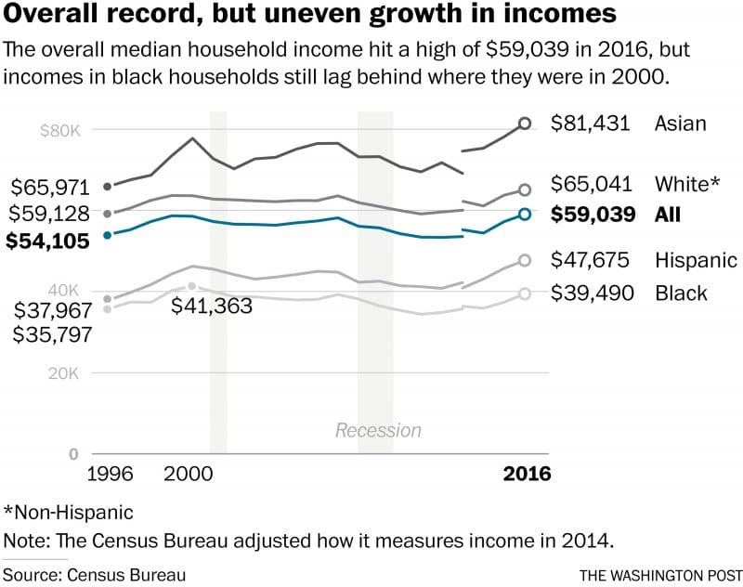
Notes:
Median household income for Whites continues to be significantly higher than for Blacks or Hispanics. The underlying reasons for these ethnic and racial distinctions are complex, of course. Discrimination continues to be a serious obstacle for persons of color. Educational level is often advanced as a major reason. While 47 percent of Whites have completed at least a two-year college degree, the rate for African-Americans is 33 percent, and for Hispanics, just 23 percent. The disparities increase for individuals who complete a bachelor’s or higher degree: 32.8 percent for Whites; 22.5 percent for African-Americans; and 15.5 percent for Hispanics.

Slide 17
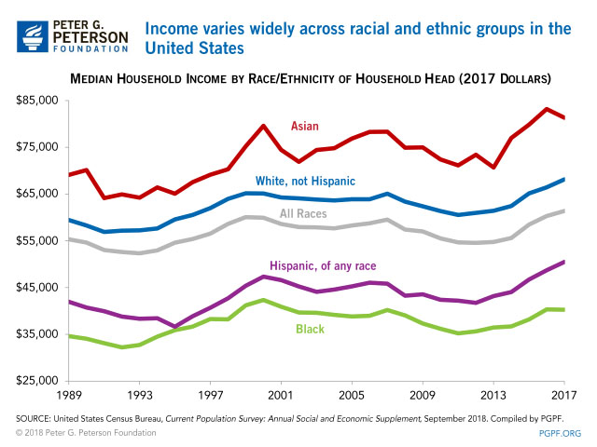
Notes:
Here is a slightly updated chart. Note that levelling off of median income for Blacks and the decline indicated for Asians. This chart was published by the Peter G. Peterson Foundation in September of 2018.

Slide 18
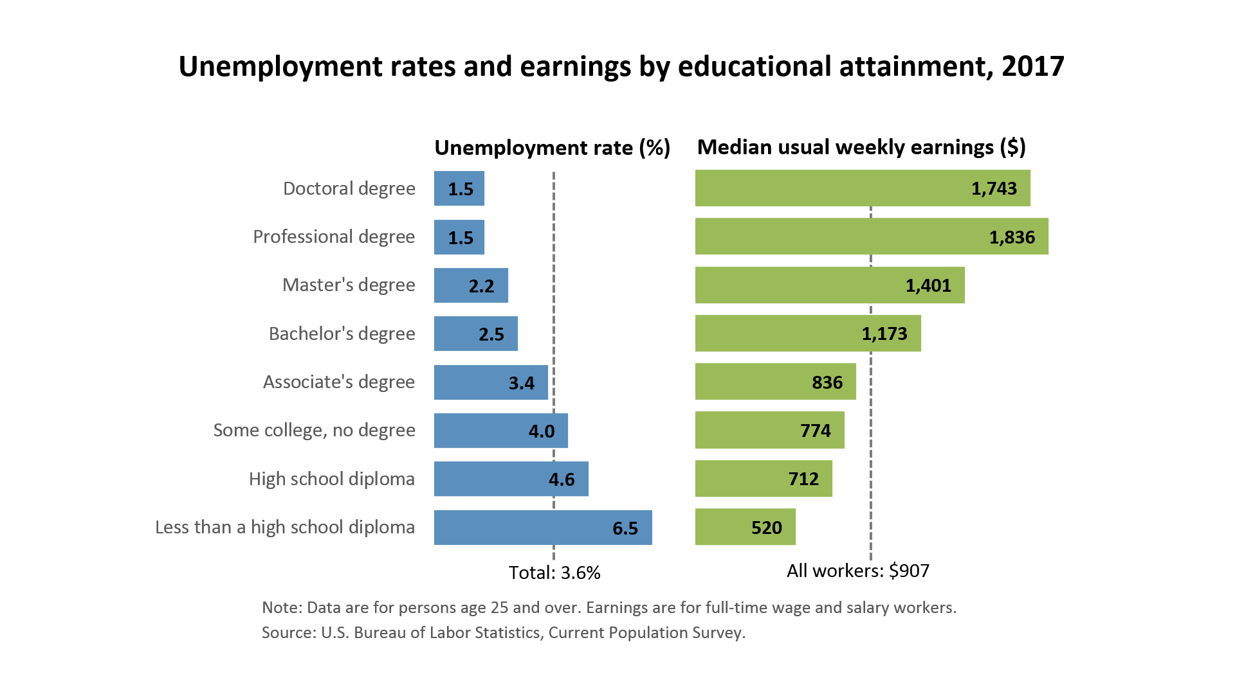
Notes:
Formal education does matter, and in many cases matters quite significantly as a factor determining lifetime earnings. [Source: Bureua of Labor Statistics, Current Population Survey, March 2018]

Slide 19
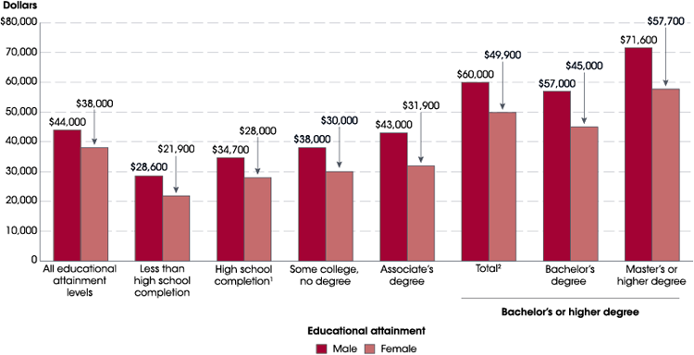
Notes:
And, even where the educational attainment is the same for men and women, men still receive higher annual incomes. [Source: National Center for Education Statistics, updated April 2018]

Slide 20
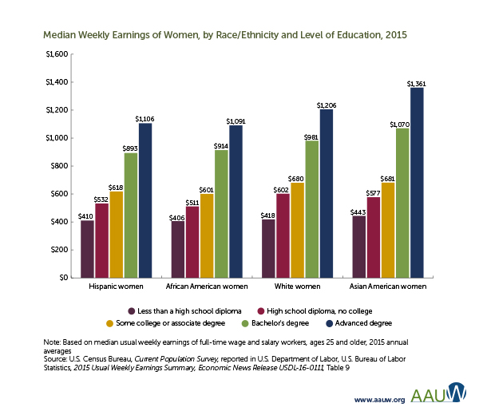
Notes:
Race and ethnicity also play a role in determining the income of women when compared to other women.

Slide 21
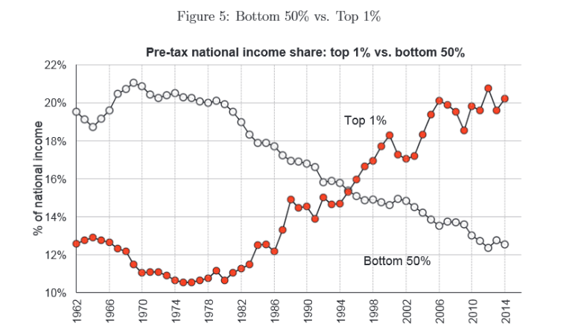

Notes:
The increases in household income creating an expanding middle class in the United States peaked in the late 1970s. The concentration of income at the very top has continued ever since.

Slide 22

Notes:
A paper written by UC Berkeley economics professor Gabriel Zucman, published in February of this year by the National Bureau of Economic Research concludes that income inequality has again reached levels last seen in the years just before the Great Depression and the Great Recession of 2008. Professor Zucman wrote:

Slide 23
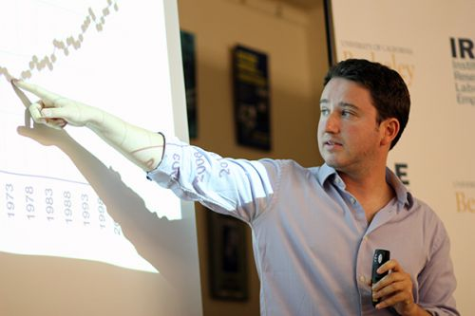
“Wealth inequality has increased dramatically since the 1980s, with a top 1% wealth share around 40% in 2016 vs. 25%-30% in the 1980s. The wealth share owned by the bottom 90% has collapsed in similar proportions.”
Notes:
“Wealth inequality has increased dramatically since the 1980s, with a top 1% wealth share around 40% in 2016 vs. 25%-30% in the 1980s. The wealth share owned by the bottom 90% has collapsed in similar proportions.”

Slide 24
Widening Gaps in Asset Ownership
Notes:
As great is the difference in individual and household income between those at top and those at the bottom, the difference is even more pronounced regarding the assets held by individuals and households.

Slide 25
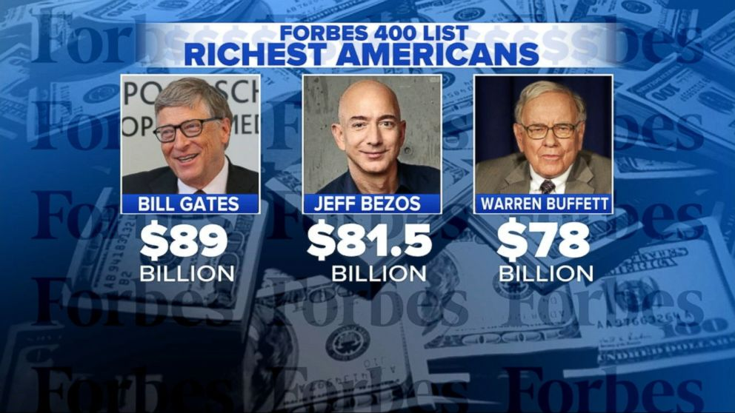
Notes:
Forbes Magazine reported that in 2017 the 400 richest people in the United States were wealthier than ever. The minimum net worth for inclusion in the 400 is was $2 billion, leaving 169 billionaires unable to make the list. Jeff Bezos now heads the list at $120.5 billion.

Slide 26

Notes:
A year later, the asset values held by this list have grown considerably, none higher than that experienced by Amazon.com founder Jeff Bezos, up by $78.5 billion to $160 billion. One must have a minimum net worth of $2.1 billion to qualify for the 2018 list of Forbes 400 Wealthiest Americans.

Slide 27
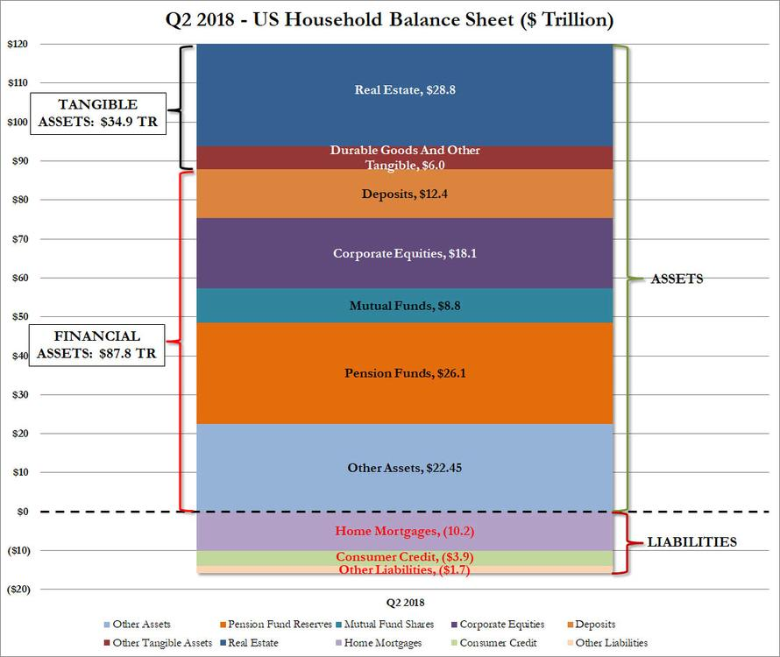
Notes:
The data behind this chart reveals that the aggregate net worth of all U.S. households was over $122.7 trillion as of 30 June, 2018. 2017. Increases in asset value over the last year significantly increased the NOMINAL household asset values shown here. A significant portion of this total is for most households equity in ownership of a residential property. However, the largest portion, concentrated in a much smaller percentage of households, is comprised of financial assets. [Source: Federal Reserve Flow of Funds Report, June 2018]

Slide 28
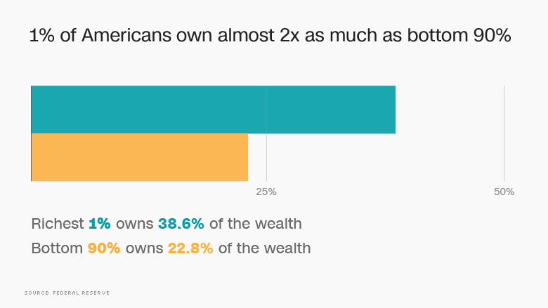
Notes:
In terms of assets owned, the concentration is even more pronounced and concentrated at the very top.

Slide 29
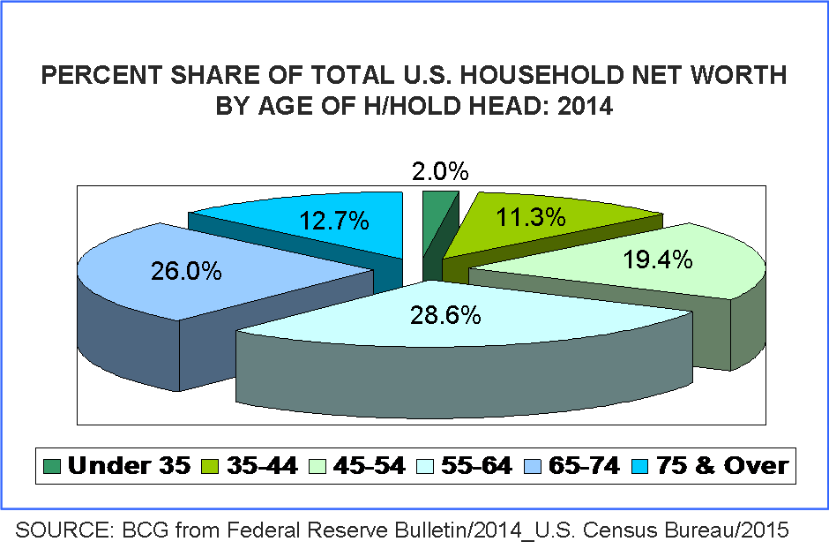
Notes:
As one would expect, there is also a strong correlation between household net worth and age. However, for many in the older age categories, the value of one's residential property accounts for a large portion of overall net worth. This pie chart, based on 2014 data, is the most current data published.

Slide 30
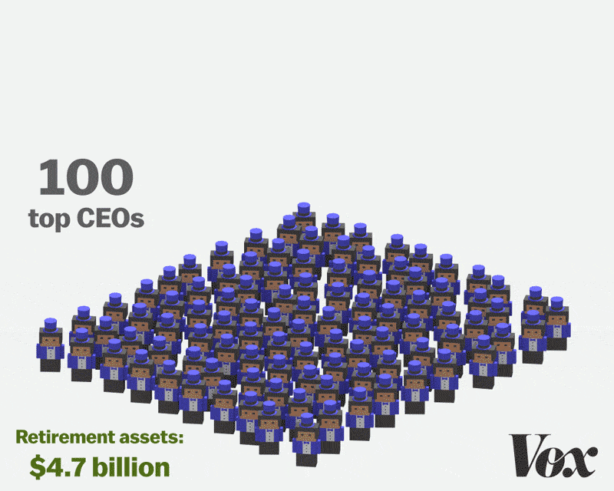
Notes:
A report released at the end of 2016 by the Institute for Policy Studies revealed that the 100 U.S. CEOs with the biggest company retirement funds have $4.7 billion in those accounts. This is roughly equivalent to the retirement savings of the bottom 116 million Americans, or 41 percent of U.S. households and 59 percent of all African-American households.

Slide 31
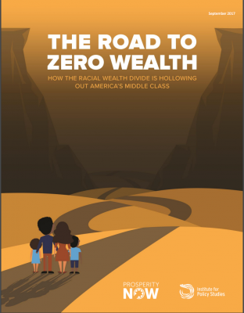
Notes:
A report issued in September of 2017 by the Institute for Policy Studies examined the extent to which wealth concentration is leading to deepening poverty among Black households in the United States. Among the key findings:

Slide 32

The nation’s overall median wealth decreased nearly 20% from 1983 to 2013, from $78,000 to $64,000
White households in the middle income quintile own nearly eight times as much wealth ($86,100) as Black middle-income earners ($11,000) and ten times that of their Latino counterparts ($8,600)
On average, only Black and Latino households with an advanced degree have middle-class wealth or higher, while White households, on average, need only a high school diploma to attain that same level of wealth
Notes:
The nation’s overall median wealth decreased nearly 20% from 1983 to 2013, from $78,000 to $64,000
White households in the middle income quintile own nearly eight times as much wealth ($86,100) as Black middle-income earners ($11,000) and ten times that of their Latino counterparts ($8,600)
On average, only Black and Latino households with an advanced degree have middle-class wealth or higher, while White households, on average, need only a high school diploma to attain that same level of wealth

Slide 33
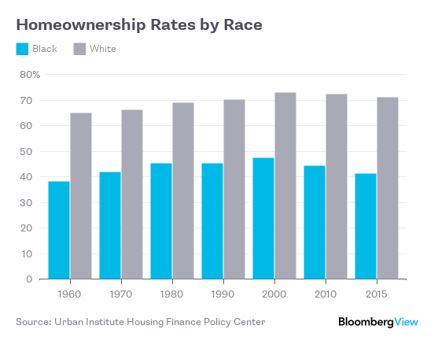

Slide 34

Notes:
An article written in December of 2018 by Edward Wolff, professor of economics at New York University, examined the data on what has occurred since the Great Recession of 2008 to the wealth held by African-American and Hispanic households. His findings include:

Slide 35
“[T]he Great Recession from 2007 to 2010 hit African-American households much harder than whites. Indeed, the mean wealth of black households suffered a 33% decline in real terms. The relative (and absolute) losses suffered by black households from 2007 to 2010 are to a large extent ascribable to the fact that blacks had a higher share of homes in their portfolio than did whites and a much higher debt-net worth ratio (0.55 versus 0.15).”
Notes:
“[T]he Great Recession from 2007 to 2010 hit African-American households much harder than whites. Indeed, the mean wealth of black households suffered a 33% decline in real terms. The relative (and absolute) losses suffered by black households from 2007 to 2010 are to a large extent ascribable to the fact that blacks had a higher share of homes in their portfolio than did whites and a much higher debt-net worth ratio (0.55 versus 0.15).” [Source: Edward Wolff. “The decline of African-American and Hispanic wealth since the Great Recession,” VOX CEPR Policy Portal, 23 December, 2018]

Slide 36
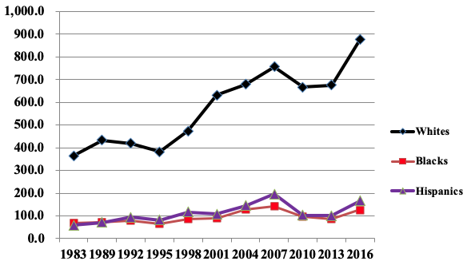
Notes:
This graph provides an easy way to see the disparity in mean wealth by race. And, to repeat what Professor Wolff has indicated, the main reason is that the net worth of Blacks and Hispanics is dependent on the equity in a owner-occupied, residential property.

Slide 37
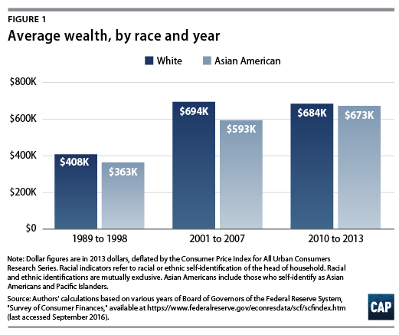
Notes:
For Asian-Americans, the level of net worth depends on a number of factors, especially how many generations ago one’s ethnic group came to the United States and level of education. Another factor is the percentage of an Asian-American group who remain undocumented. Research by the Pew Research Center indicates that the Asian population in the United States has growth 72% since the year 2000.

Slide 38

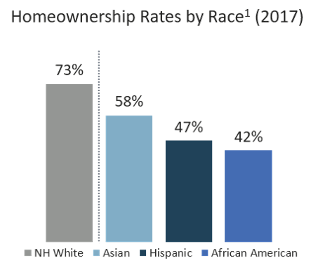
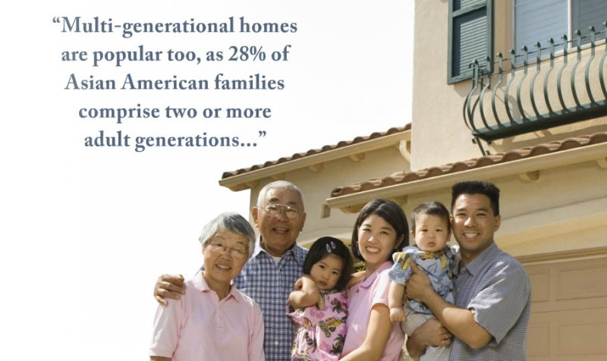
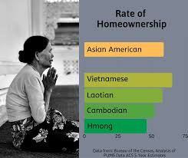
Notes:
Asians have a lower homeownership rate (57%) than the U.S. public overall (63%). All Asian-headed households – except for those headed by a Vietnamese (65%) or Japanese (63%) individual – are less likely to own a home than American households overall. Households headed by some Asian groups have homeownership rates well below the U.S. average. For example, only about quarter of households headed by Nepalese (24%) and a third of Burmese (33%) owned their home in 2015. Nevertheless, homeownership is on the rise among Asian Americans. In 2000, 53% of Asian household heads were homeowners. By 2015, that share had risen to 57%.

Slide 39
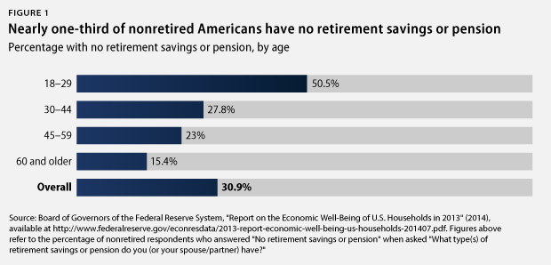
Notes:
For most Americans, the most serious financial problems occur with retirement. Savings and pension data from 2013 indicated that nearly one in three workers had no retirement savings. Far worse, seven out of ten African-Americans and Hispanics had no savings. [Source: Keith Miller. “The Reality of the Retirement Crisis,” Center for American Progress, 26 January, 2015]

Slide 40
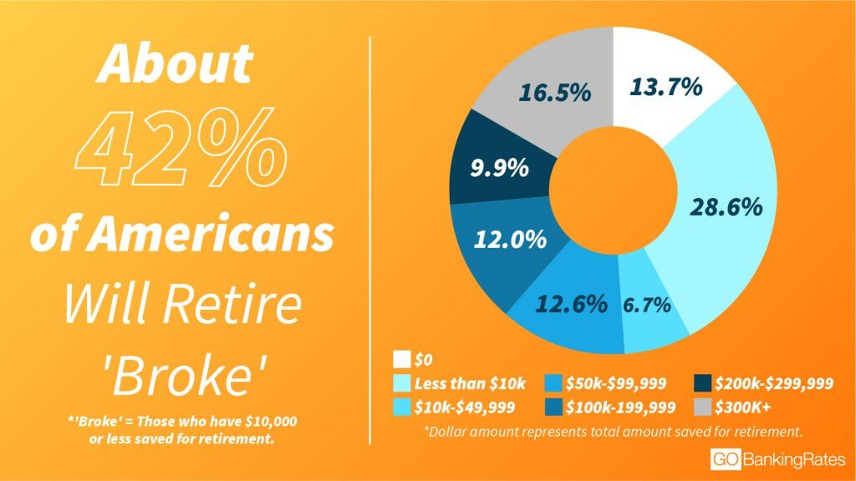
Notes:
A survey taken in January 2019 by GoBankingRates found that 42% of respondents have less than $10,000 saved. This survey reached 3,000 respondents in three age groups: millennials, Generation X, and baby boomers. The Bureau of Labor Statistics adds concern, reporting that on average, adults 65 and over spend almost $46,000 a year. Only when more current data is released by the U.S. Census Bureau will the situation be made clear.

Slide 41

Notes:
Moving on, we will next take a close look at how we own and manage nature.

Slide 42
End Part 6
Notes:
End of Part 6

