Slide 1

The State of the United States
ECONOMY and SOCIETY
Part 5

Slide 2
Property Ownership
The Ownership of Property
Notes:
The ownership of a residential property was almost taken for granted by a majority of White Americans who reached adulthood in the 1950s, their children who entered the workforce in the 1970s, and even their grandchildren who came of age in the 1990s. The crash of the nation’s property markets in 2007-2008 has had long-lasting consequences, unevenly distributed across the United States.

Slide 3

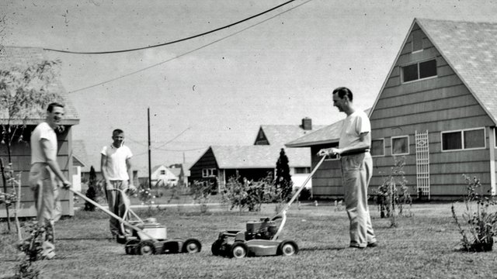
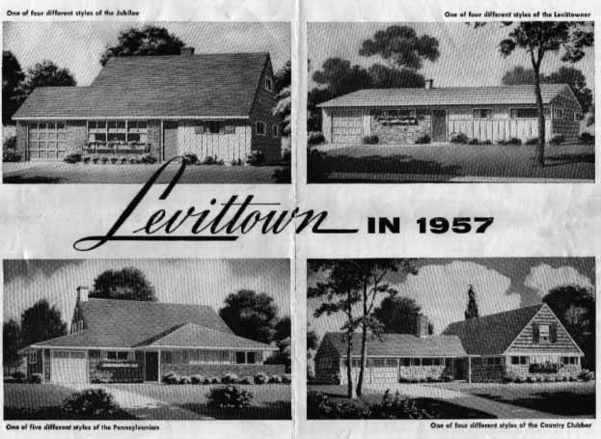
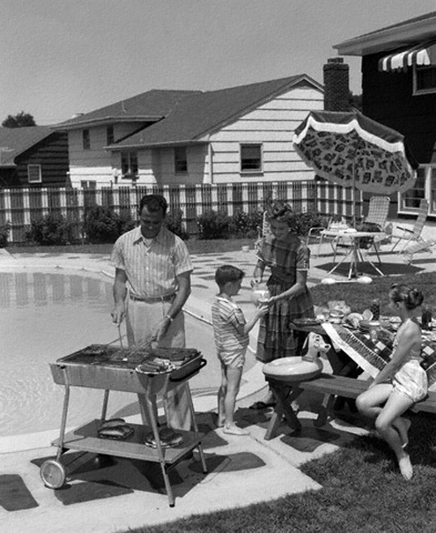
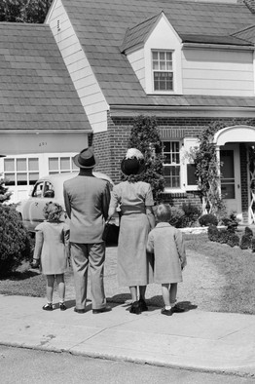
Notes:
Beginning in the1950s, millions of young adults left the nation’s cities to live in new suburban communities characterized by affordable, single-family detached housing on a small parcel of land.

Slide 4
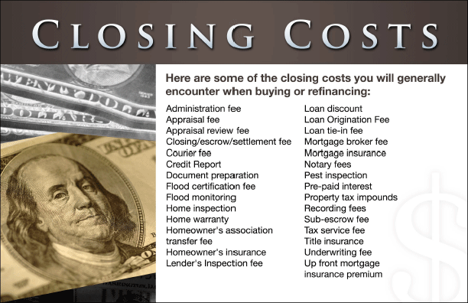
Notes:
From that time on, residential property markets have been a key driver of the U.S. economy. Consider the long list of participants in the “housing” sector, from land owners and building contractors, to the retail sellers of everything required to make a house a home, to landscaping services and companies who service a home’s key systems and equipment.

Slide 5
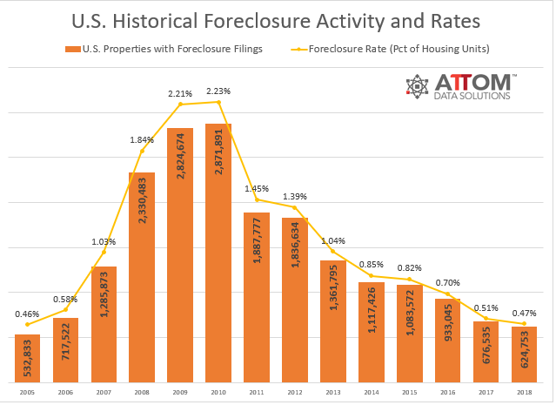
Notes:
5
The darker side of our financial system is evidenced by the millions of households who since 2008 have lost the properties they lived in, sometimes for many years. On the plus side, foreclosures during 2018 dropped to a 13-year low. This still involved nearly 625,000 evictions and subsequent foreclosure sales. The analysis by ATTOM Data Solutions noted that some foreclosures followed natural disasters (most notably in Houston).

Slide 6
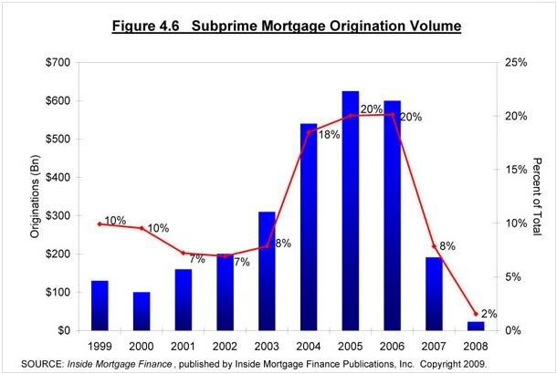
Notes:
6
Predatory lending practices and high-cost subprime mortgage terms victimized millions of property buyers. When a large number of subprime borrowers defaulted, the bank created private label mortgage-backed securities collateralized by the subprime mortgage loans lost their value. This chart indicates the market share of subprime mortgage loans during the period approaching the 2008 crash in the nation’s property markets.

Slide 7
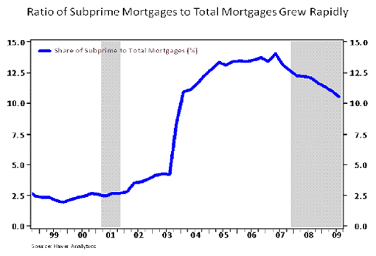
Notes:
7
The large number of subprime foreclosures is closely tied to the rising market share. From 2002 to 2003 the number of subprime loan originations increased by 56 percent. In just one year, total originations then doubled, eventually capturing 14 percent of the market before the delinquency-driven collapse.

Slide 8
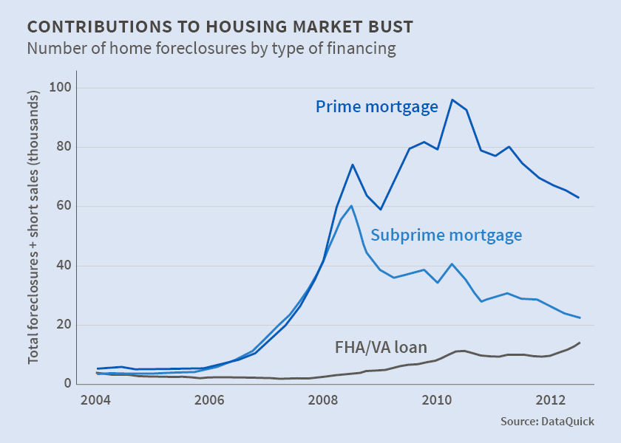
Notes:
8
This chart shows the difference in the number of foreclosures between loans originated using conventional eligibility criteria and underwriting guidelines versus those that were categorized as subprime.

Slide 9
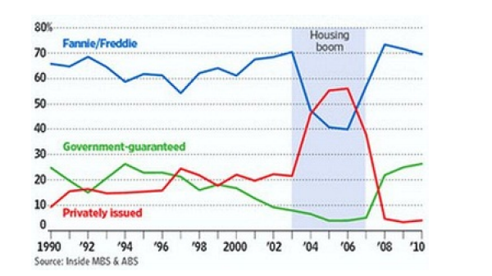
Notes:
9
This chart details the extent to which the private label MBS market share climbed against the conventional securities issued by Fannie Mae and Freddie Mac. When the securities collateralized by subprime mortgage loans lost value because of the high rate of defaults, a chain reaction occurred and investors began to abandon the conventional and government-insured securities markets as well. The recession soon resulted in widespread unemployment and rising delinquencies of conventional and government-insured mortgage loans that, in normal times, would have performed as expected.

Slide 10
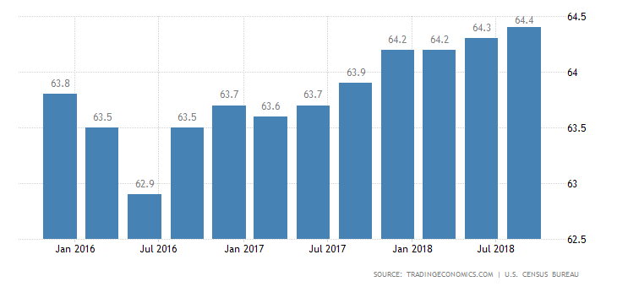
Notes:
10
The result of the recession was a drop in the rate of homeownership to 63.5 percent by 2015, slowly recovering to 64.4 during the third quarter of 2018.

Slide 11
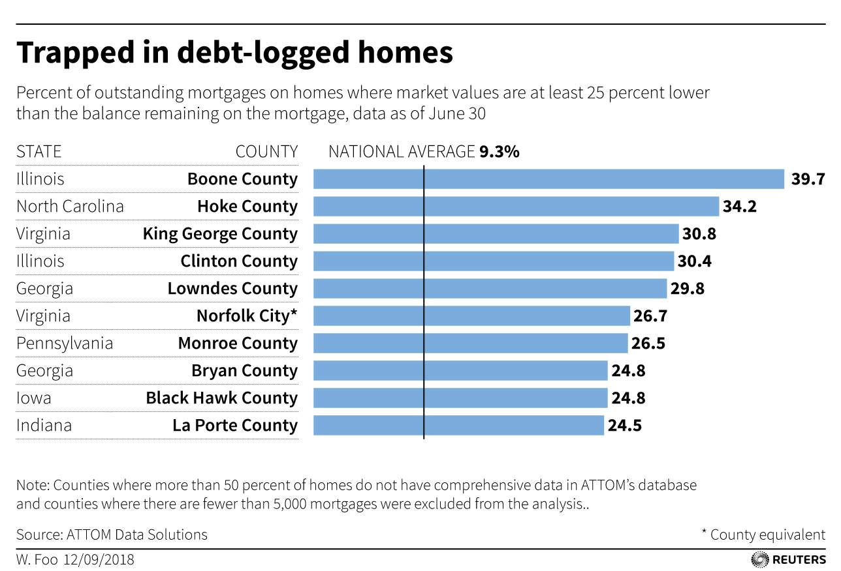
Notes:
11
ATTOM Data Solutions reported in September 2018 that one in ten owners of a residential property with mortgage debt would be unable to sell their property and pay off the loan balance. This chart identifies some of the counties with the highest percentage of declining property values.

Slide 12
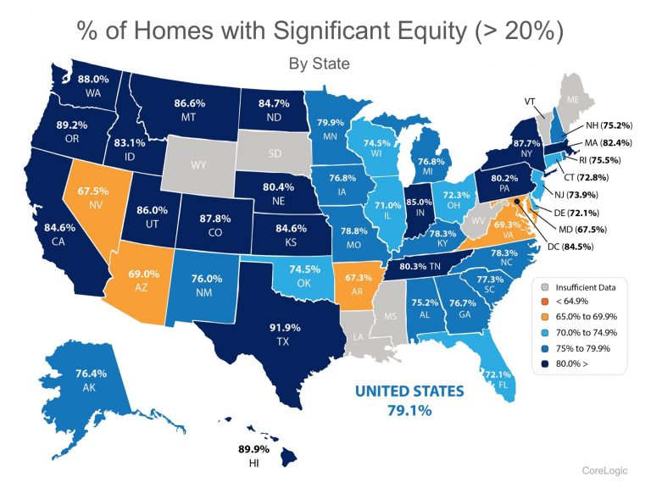
Notes:
12
Conversely, this map, based on data released by CoreLogic, indicates the percent of property owners in each state that enjoy at least a 20 percent equity position in their property.

Slide 13

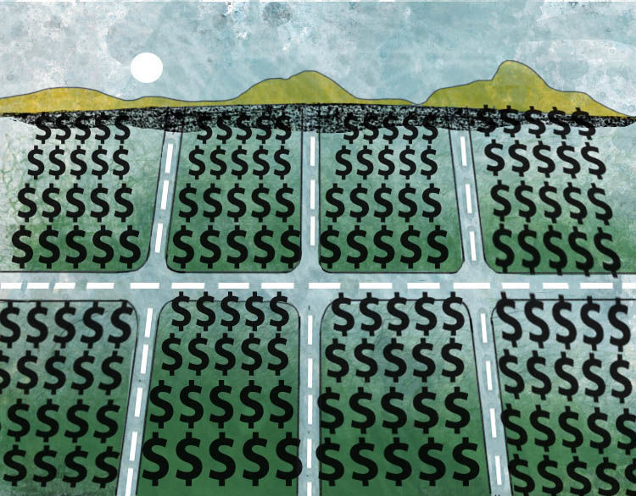
Notes:
13
In January 0f 2018, the real estate tracking firm Zillo estimated the total value of all residential property in the United States at around $31.8 trillion. Values increased by nearly $2 trillion during 2017. In January 2019, Zillo released data indicating an additional increase of $1.9 trillion in 2018, for a total of $33.3 trillion. Analysts hold widely different opinions over whether these prices can be sustained given the Federal Reserve’s interest rate increases and other economic factors, such as stagnant wage levels and rising costs of living.

Slide 14
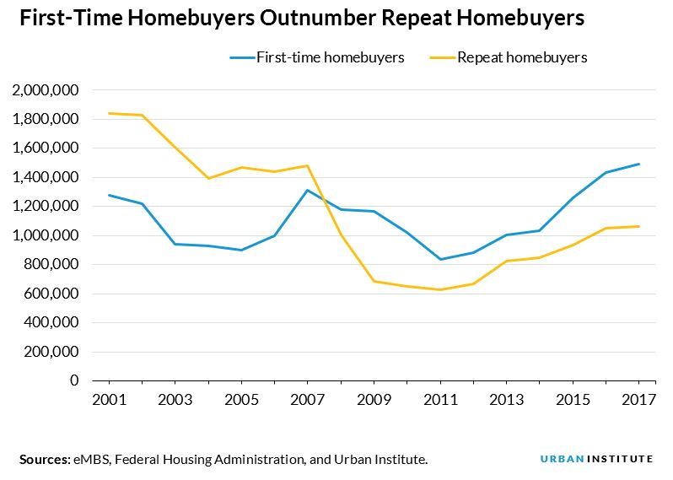
Notes:
14
Despite the continued increase in the cost of a residential property, first-time homebuyers made up over 60 percent of housing sales growth between 2012 and 2017. They purchased 2 million single-family properties in 2016, the most since 2006, accounting for 37 percent of all single-family property sales. [Source: “First-Time Homebuyer Market Report,” Genworth Mortgage Insurance, June 2017] That number increased to 2.1 million in 2017 – 300,000 more than the historical average over the last 25 years. A 2018 analysis by Genworth explains how this has been possible:

Slide 15

“Down payment has always been the biggest hurdle facing potential first-time homebuyers. Low down payment mortgages allows these buyers to afford entry-level homes using a small amount of savings. In the past three years, 79 percent of first-time homebuyers have relied on low down payment mortgage products. We expect that trend to continue with the low down payment mortgage market growing with the first-time homebuyer market.”
Notes:
15
“Down payment has always been the biggest hurdle facing potential first-time homebuyers. Low down payment mortgages allows these buyers to afford entry-level homes using a small amount of savings. In the past three years, 79 percent of first-time homebuyers have relied on low down payment mortgage products. We expect that trend to continue with the low down payment mortgage market growing with the first-time homebuyer market.” [Source: Tian Liu. “Genworth Releases Fourth Report Edition to Track the Entire First-Time Homebuyer Market,” Genworth.com, 22 February, 2018]

Slide 16

Notes:
16
In January of 2018, National Association of Realtors chief economist Lawrence Yun commented on the shortage of affordable housing options in many cities and metropolitan markets across the country:

Slide 17

“Buyers throughout the country continue to be hamstrung by record-low supply levels that are pushing up prices – especially at the lower end of the market.”
Notes:
17
“Buyers throughout the country continue to be hamstrung by record-low supply levels that are pushing up prices – especially at the lower end of the market.”

Slide 18
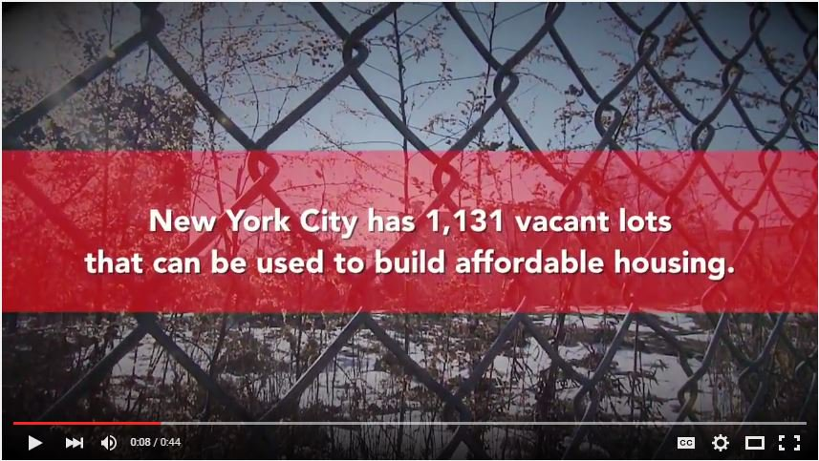
Notes:
18
One of the serious challenges for communities looking to increase the supply of affordable housing is, of course, acquiring land at a price that allows affordable housing units to be constructed. The problem is not universal, however. Many cities have large quantities of land that can be offered to developers at below-market prices in return for a commitment to construct affordable housing.

Slide 19
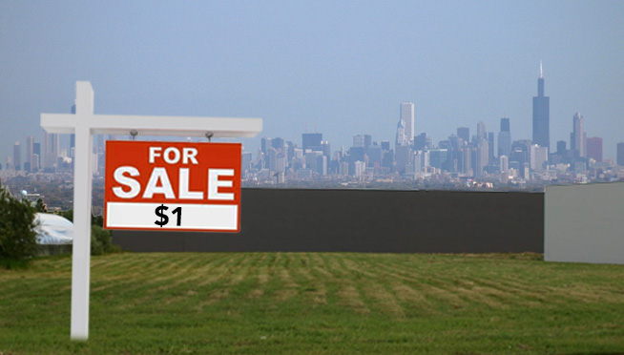
Notes:
19
Since 2014 the City of Chicago has been selling City-owned lots for $1 to “local property owners.” As of October 2018, nearly 2,000 lots had been sold and used for new social spaces, or to grow plants.

Slide 20
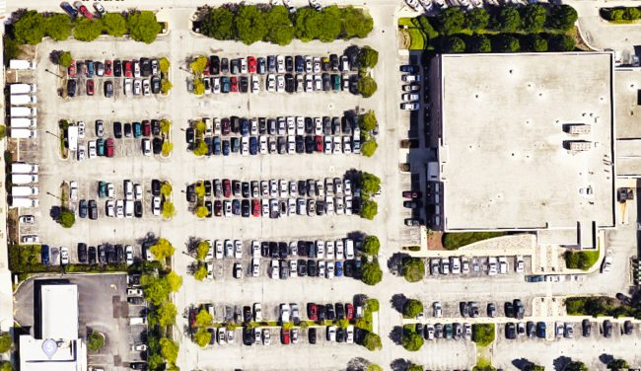
Notes:
20
Cities often decide to raise cash by selling off prime publicly-owned locations. A much better long-term option, I argue, is to offer the land under a leasehold arrangement that allows for increases in the ground rent payments as market circumstances warrant.

Slide 21
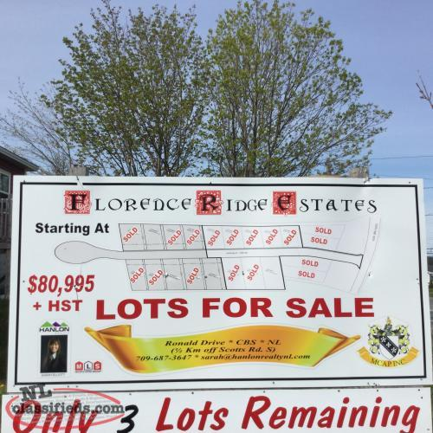
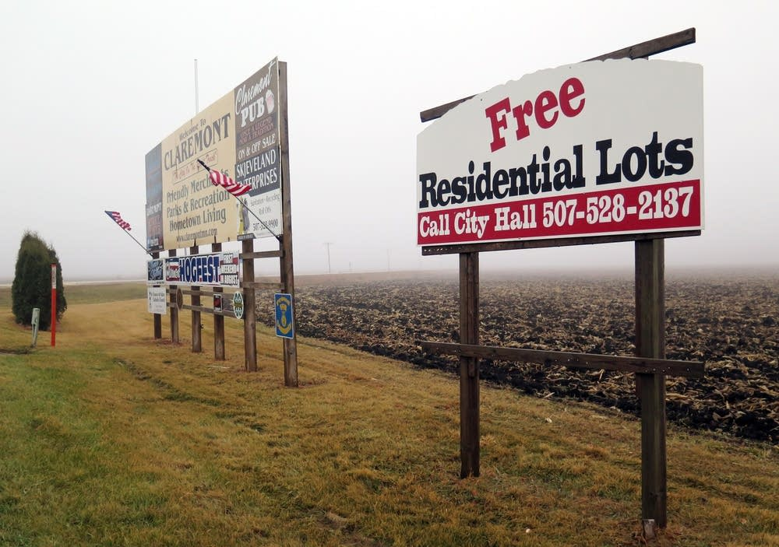
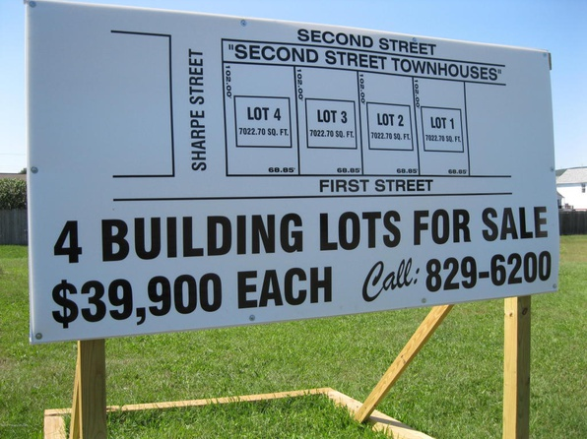
Notes:
21
By mid-2018 the median price of a residential property was back to $280,000 – from a low of $159,000 in West Virginia to a high of $619,000 in Hawaii. While labor and materials costs can differ to some extent location to location, the fundamental reason for the huge difference is the cost of land. Communities desperate to attract new residents and businesses sometimes offer land free to those willing to locate in the community and meet certain minimum eligibility criteria.

Slide 22

Notes:
22
Property prices in some “hot markets” continue to rise at annual double-digit rates. The median property price in San Francisco reached $1,293,000 in December of 2017, a 12.8 percent increase in just one year. Fast forward to January 2019 and that number climbed to $1,378,200.

Slide 23
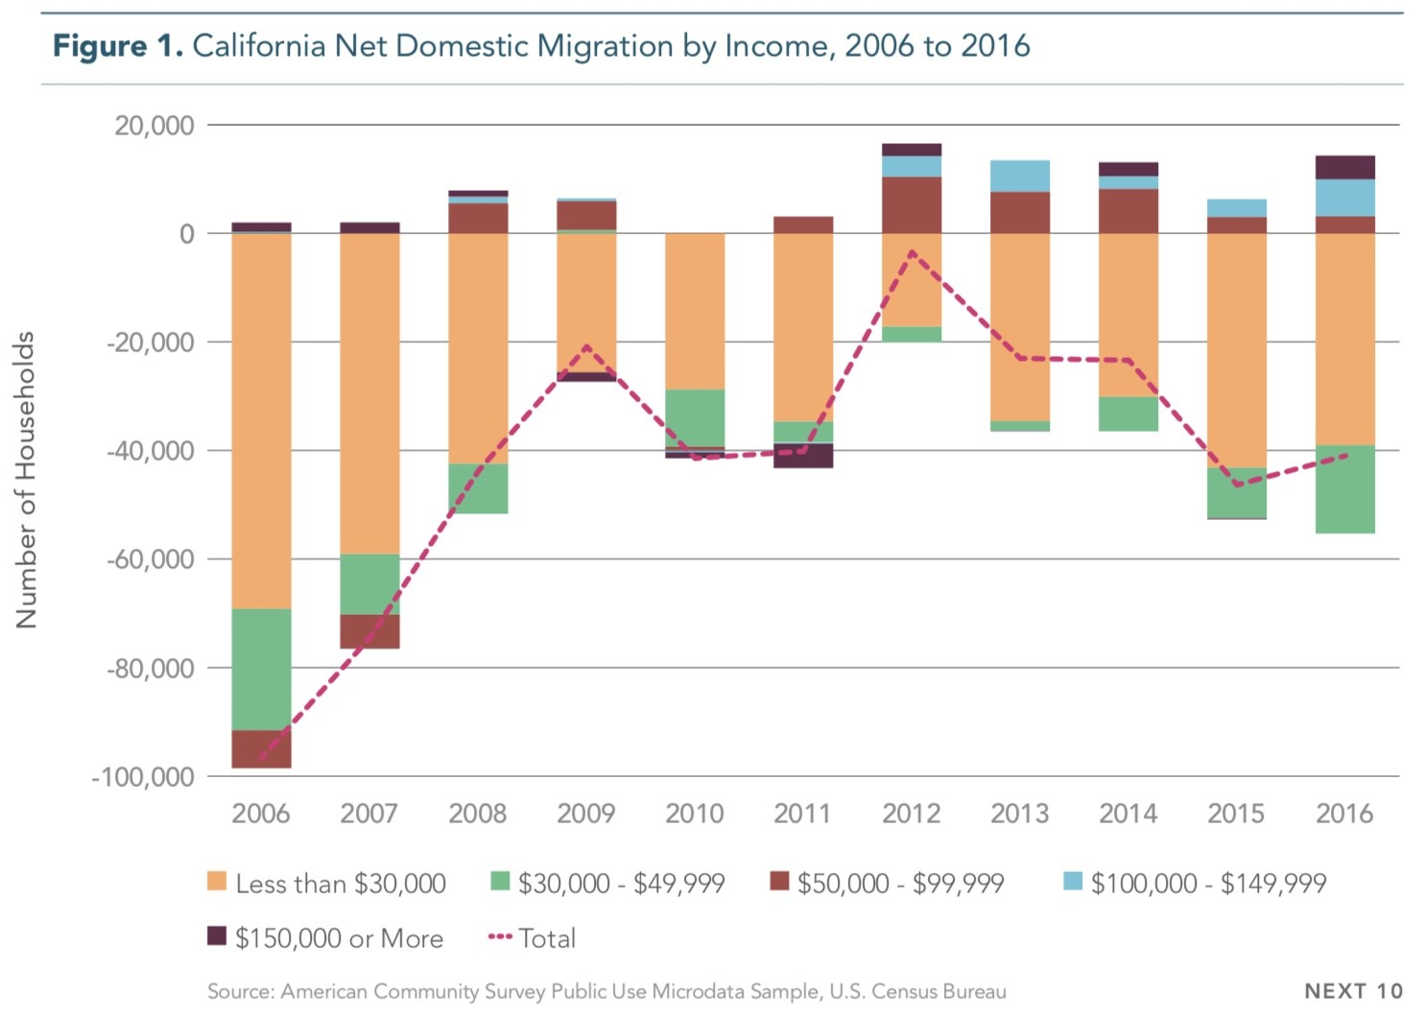
Notes:
23
With median property prices in California double that of many other parts of the country, there has been an exodus of people – and businesses. Between 2006 and 2016, over a million more people moved out of California than moved in. [Source: “Growth Amid Dysfunction: An Analysis of Trends in Housing, Migration, and Employment,” Next 10.org, 3 May, 2018] Around 130,000 people left California for other states during 2017, and another 156,000 left in 2018. [Source: U.S. Census Bureau, December 2018]

Slide 24
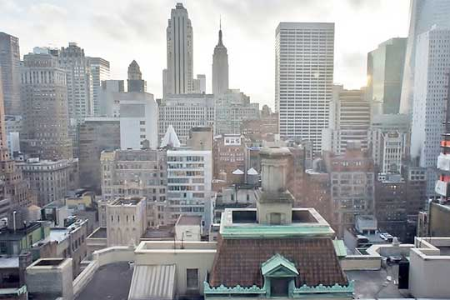
Notes:
And, on the other side of the country, there is the sprawling metropolis of New York City.

Slide 25
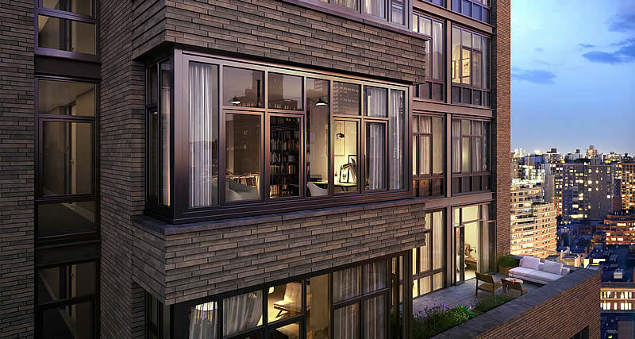
Notes:
During 2017 the average price paid for a condominium or co-op in Manhattan was $2.2 million. Nearly one in five sold for $10 million. However, listings sat for long periods if sellers were unwilling to negotiate a reduction in asking price. It is worth noting that New York City foreclosures in 2017 reached the highest number in eight years, at over 3,300. [Source: Ameena Walker. “In 2017, NYC foreclosures reached its highest level since 2009,” CURBED New York, 9 January, 2018]

Slide 26
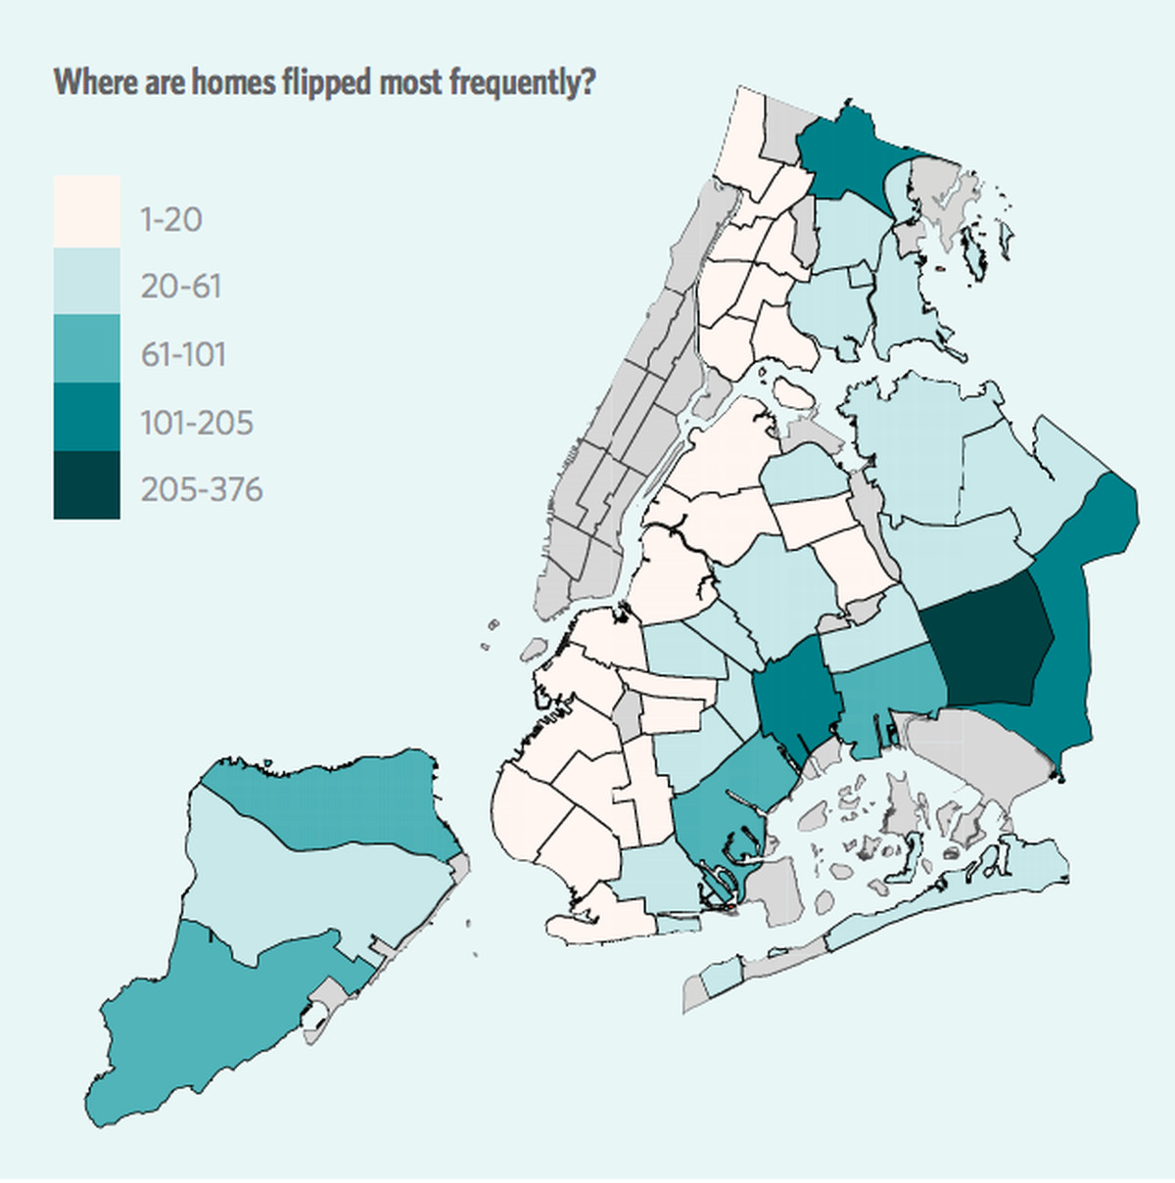
The Bronx
Manhattan
Queens
Brooklyn
Staten Island
Notes:
However, median resale prices fell in parts of Manhattan and Brooklyn since the beginning of 2018, while increasing elsewhere. The buying of properties as speculative investments is said to be contributing to the price climbs in parts of New York City.

Slide 27
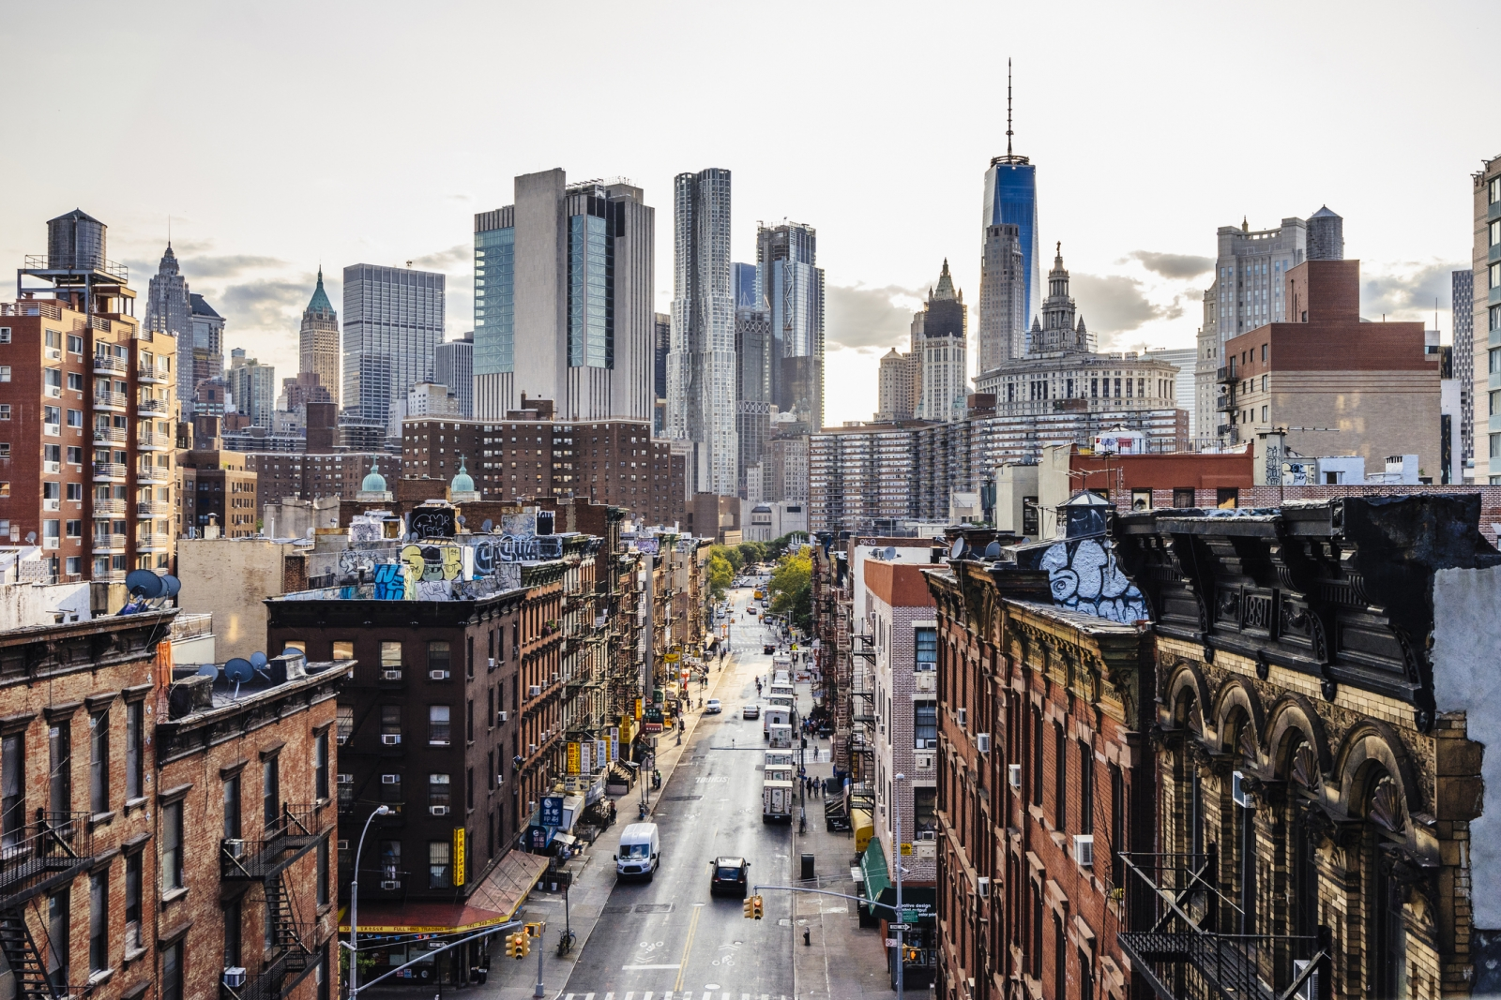
Notes:
As 2019 began, the average listing price for a residential property in Manhattan was $1.39 million. In Brooklyn this was $950,000. Investors are buying into many high-priced new developments across New York City, opting to lease out the units while betting on future price appreciation. At the same time, many hig-priced luxury condominium units are languishing on the market.

Slide 28
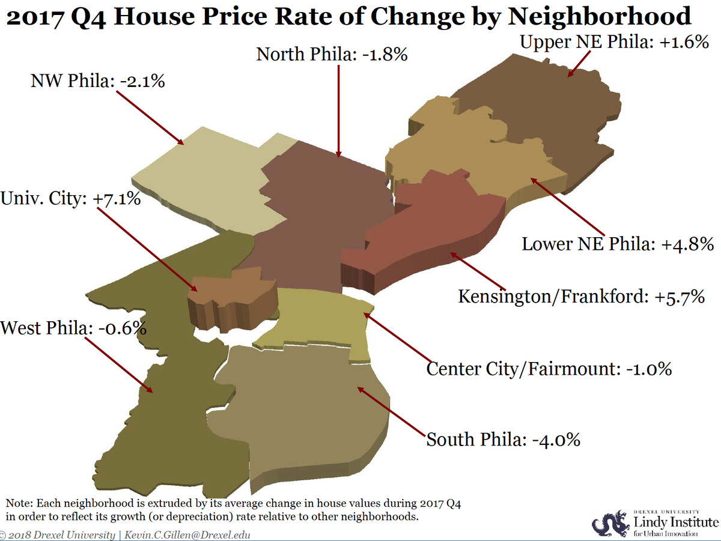
Notes:
By comparison, the median property value in the City of Philadelphia at the end of 2017 was just $144,600, an increase of 9.1 percent over the previous year, rising for $146,700 in April. For the entire metropolitan area the median price increased to $222,900, a 4.1 percent change over the previous year, increasing to $225,300 by April of 2018.

Slide 29

Notes:
The value of Philadelphia's housing stock slowed significantly during 2018, after three years of robust post-recession growth. According to an index of city home values by Drexel economist Kevin Gillen, city home values in both the second and third quarters of this year were unchanged from a year ago, and rose only 4.1 percent in the first quarter of 2018 from the previous year. Year-over-year home value had increased by at least 12 percent from the fourth quarter of 2016 through the fourth quarter of 2017. [Source: Caitlin McCabe. “Philly region’s housing market in 2019: The Slowdown will continue, experts say,” The Inquirer/Daily News, 23 November, 2018]

Slide 30
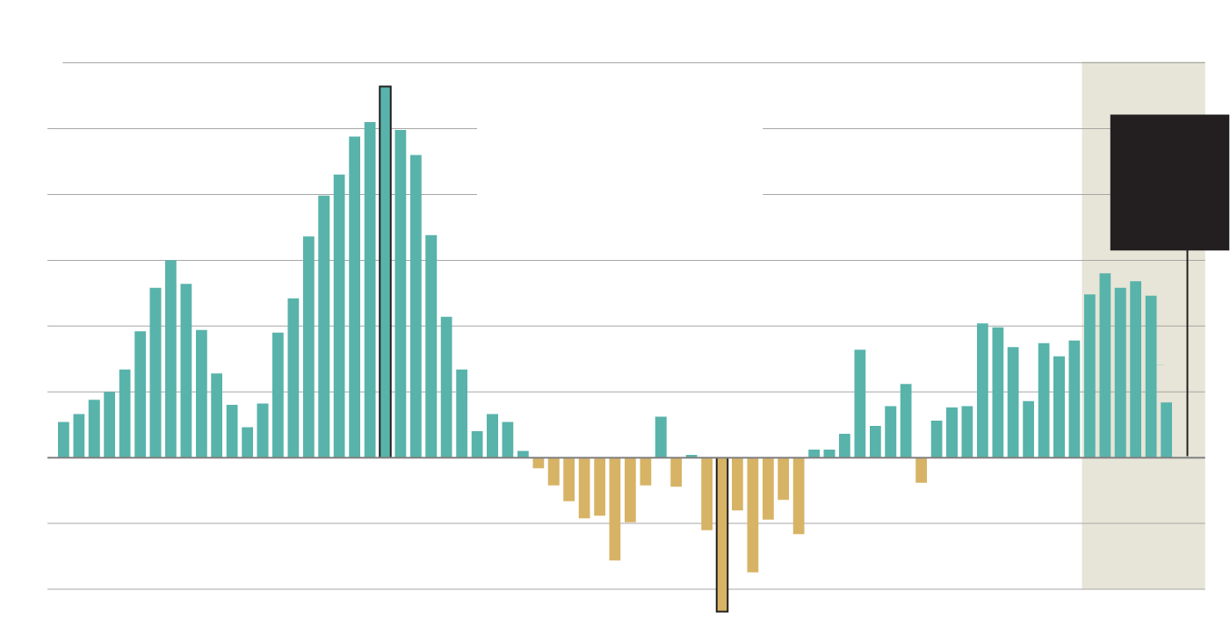
2nd qtr. 2005
+28.2%
Quarterly percentage change in Philadelphia home values from the previous year
2nd and 3rd qtrs. 2018 +0.0%
4th qtr. 2010: -11.7%
Notes:
This chart, prepared by the Philadelphia Inquirer staff from data provided by Kevin Gillen, of Drexel University’s Lindy Institute for Urban Innovation, tracks changing Philadelphia home values from the year 2000 thru the 3rd quarter of 2018.

Slide 31
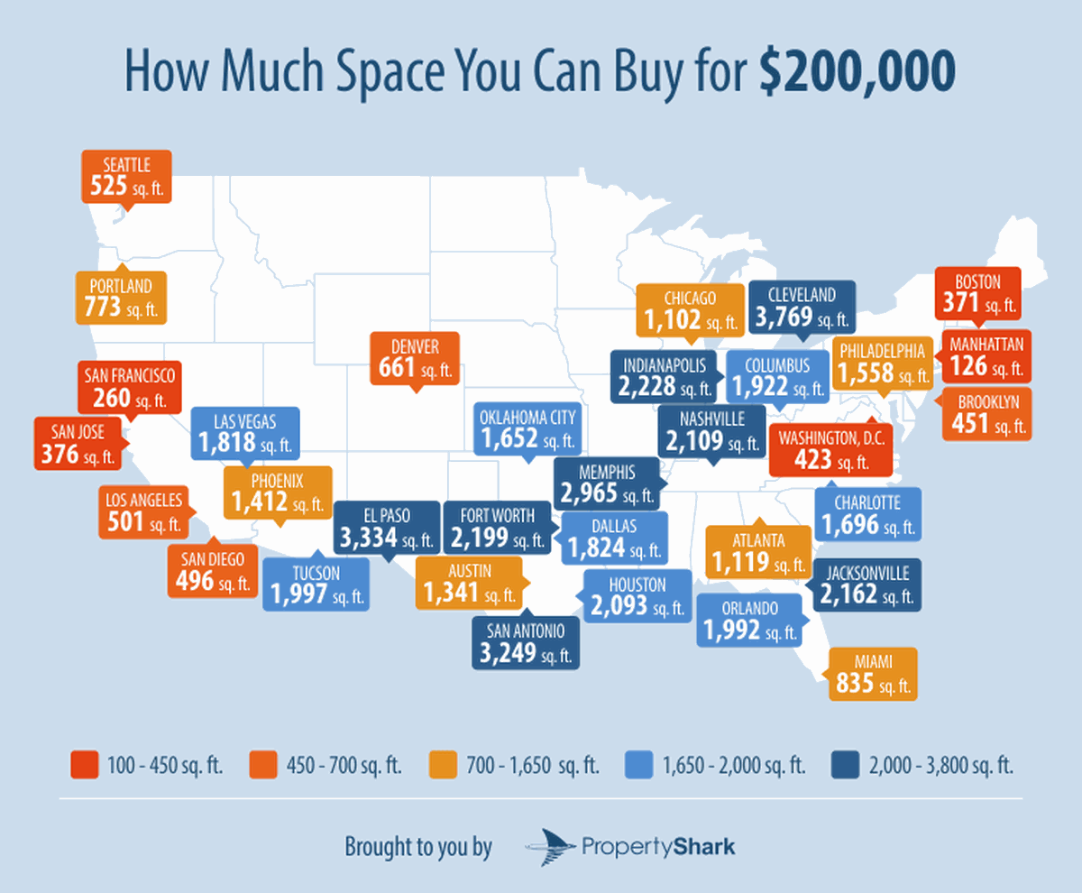
Notes:
This map provides an interesting picture of what you would get paying $200,000 for a property in the different parts of the United States. This amount of money will purchase a good-sized walk-in closet in Manhattan, or a $3,800 square foot home in Cleveland, Ohio. [Source: Ameena Walker. “See what $200K buys in Manhattan compared to other U.S. cities,” Curbed.com, 25 May, 2018]

Slide 32
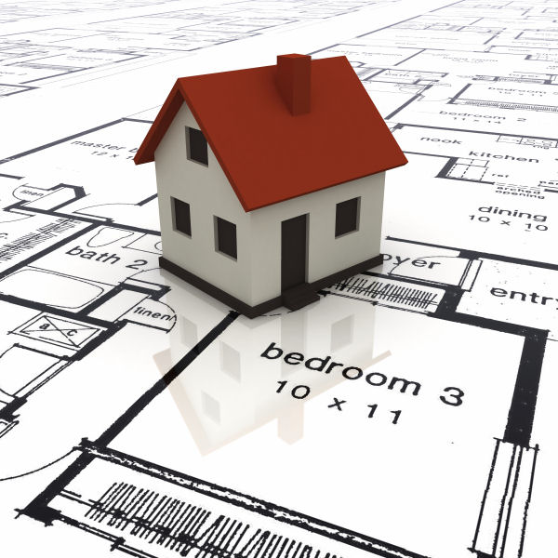
Notes:
As a rule of thumb, builders will not break ground to construct new housing units unless they will be able to sell the finished units for at least four times the acquisition cost of the land. Data published by the National Association of Home Builders indicates that “the cost of the finished lot accounted for 22 percent” of the average property. The average lot size was about one-third of an acre. Of course, using averages where land costs are concerned is only a reliable indicator for a given neighborhood within a larger community. [Source: Federal Reserve Bank of St. Louis, 25 January, 2018]

Slide 33

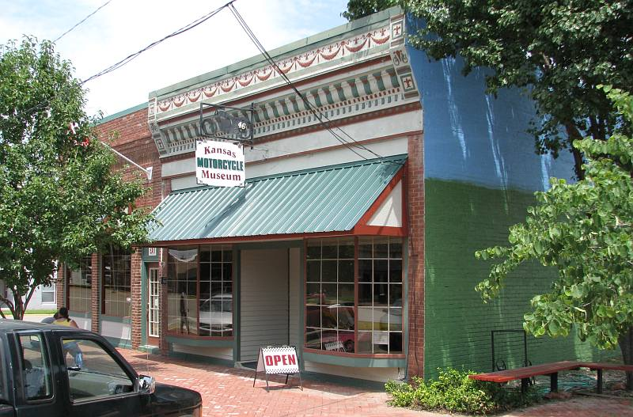

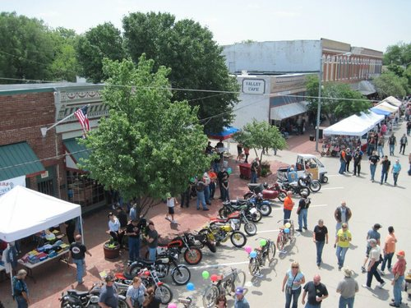
Notes:
If you are willing to move to Marquette, a small town in Kansas, the city will give you a building lot for free.

Slide 34
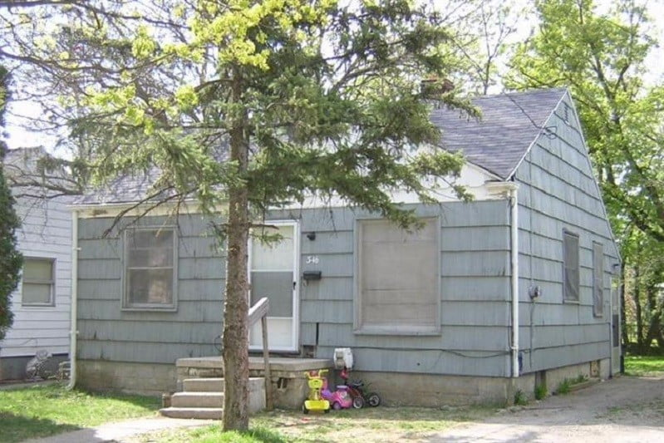
Notes:
Alternatively, you could purchase a foreclosed property in cities like Detroit or Flint in Michigan for a few thousand dollars.

Slide 35
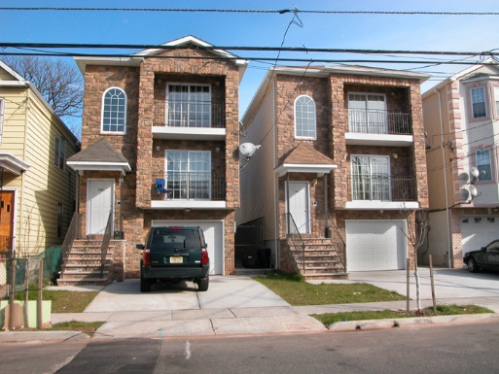
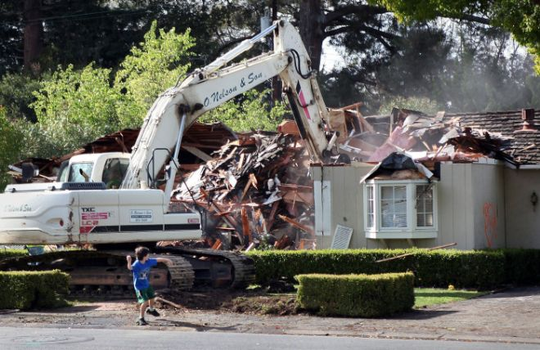
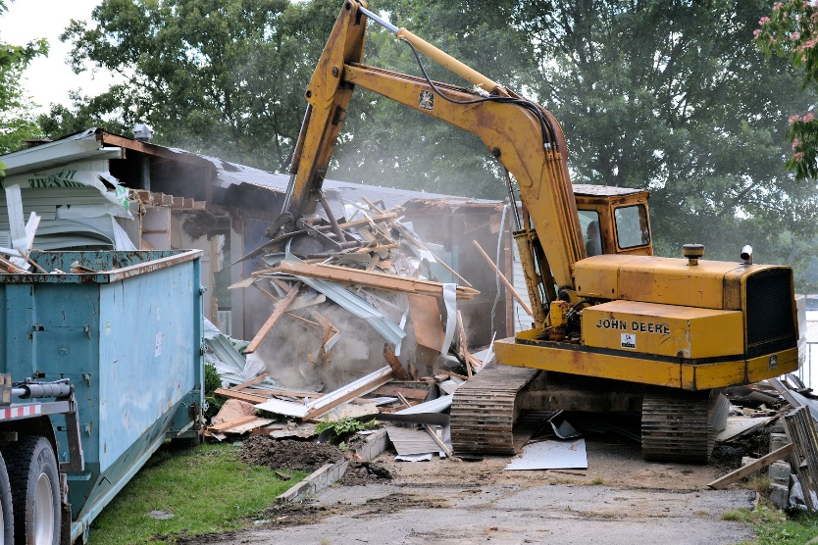
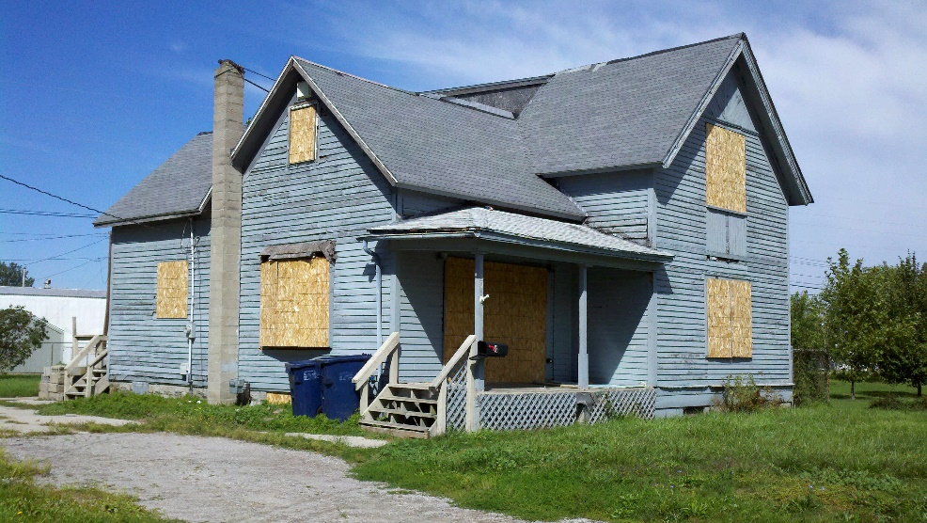
Notes:
As population growth and new household formation has increased the demand for land and housing in many suburban regions, older existing houses are often purchased by developers who tear them down and build much larger homes, or obtain approval to subdivide the lot to construct more than one home.

Slide 36
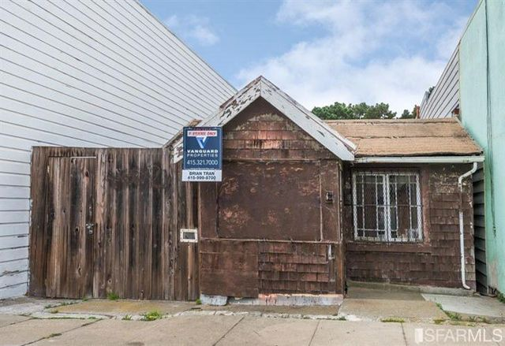
Notes:
36
The value of a house is its replacement cost, less what depreciation the house has experienced. This property in San Francisco was offered for sale at $595,000 earlier in 2016. I have not found out whether the property was sold. It might cost $10,000 to clear the site for new construction, which means the value of the land, if vacant, was $605,000 two years ago. Zillow estimates that property in San Francisco increases in value at a rate of $14 per hour. Thus, just by sitting on this property, investing nothing in the structure or generating income by some business activity, the owner has probably gained (earned?) $245,280 in additional value to the location between 2016 and 2018.

Slide 37

Notes:
Next we will examine the widening gaps in income and wealth.

Slide 38
End of Part 5

