Slide 1

The State of the United States
ECONOMY and SOCIETY
Part 4

Slide 2
Social Welfare Trends
Notes:
For some in our society, the 2008 crash had almost no impact on their quality of life. For others, the result was to destroy an already fragile existence. This presentation will offer some insight into the degree to which the lives of people at the bottom of our socio-economic ladder have improved or not improved.

Slide 3

December 2018
Notes:
The U.S. Department of Housing and Urban Development reported in December of 2018 that on any night during the year some 553,000 people were homeless in the United States. Fully one-third of this number were living in unsheltered locations, meaning they were living outside somewhere. [Source: The 2018 Annual Homeless Assessment Report to Congress, December 2018]

Slide 4
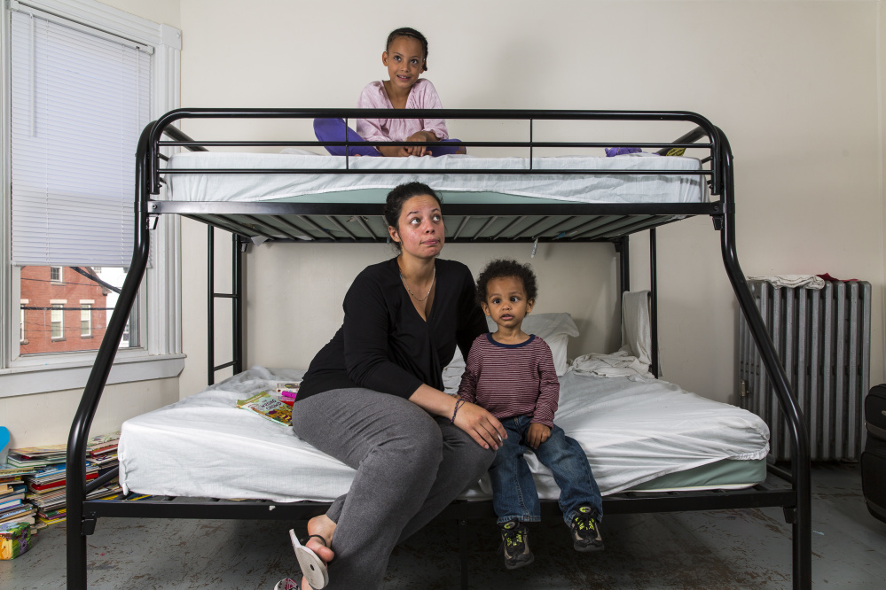
Notes:
The number of people experiencing homelessness in families with children continued to decline, by two percent between 2017 and 2018, and by 23 percent between 2007 and 2018. In 2018, more than 180,000 people in families with children were experiencing homelessness, and most people experiencing homelessness in families with children were staying in sheltered locations (91%). A large part of the decline in family homelessness since 2007 has occurred among people staying in unsheltered locations.

Slide 5
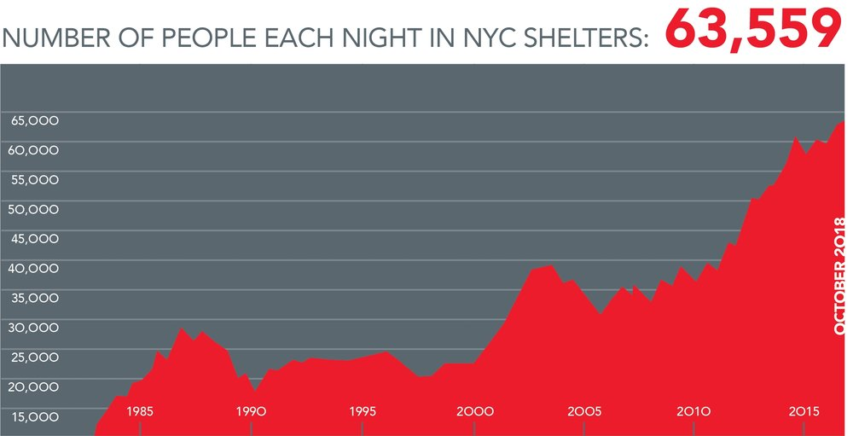
Notes:
Homelessness in New York City, which has reached new all-time records on Mayor de Blasio’s watch, is a direct result of the lack of low-income housing. Between 1996 and 2017, New York City lost more than 1.1 million apartments renting for less than $800 per month, and the city is currently facing a deficit of more than 500,000 apartments needed at that level, given the number of low- income New Yorkers. Today, nearly 64,000 people sleep in shelters every single night, including more than 23,000 children, and last year nearly 130,000 different men, women, and children had to stay in New York City shelters.

Slide 6
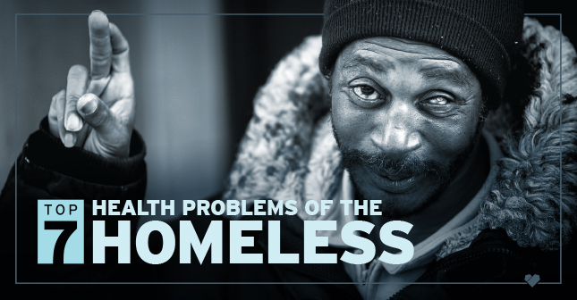
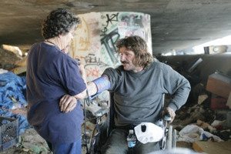
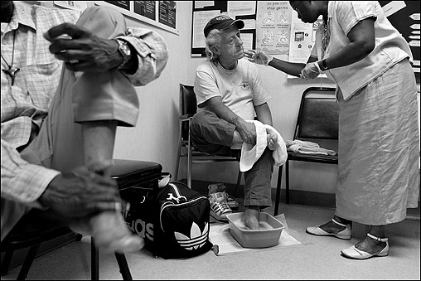
Notes:
A report issued in May, 2018 in the Journal of The American College of Cardiology indicated that heart disease is the major killer of those who are homeless. Over half of the homeless do not have access to a consistent source of health care, so their conditions often go untreated. Smoking is the main source of cardiovascular disease, accounting for about 60 percent of deaths each year. Alcohol and drug abuse are additional causes.

Slide 7
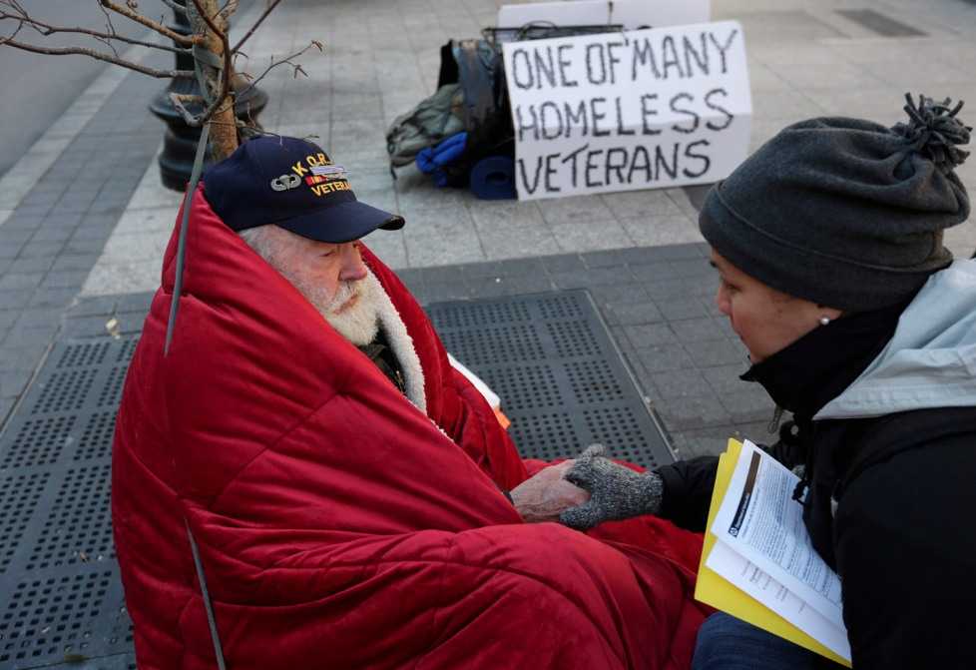
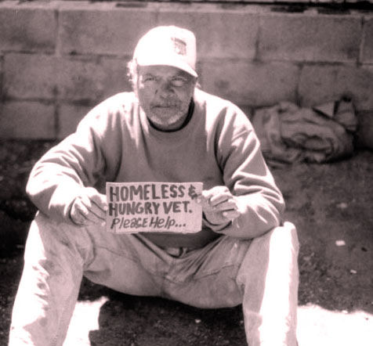
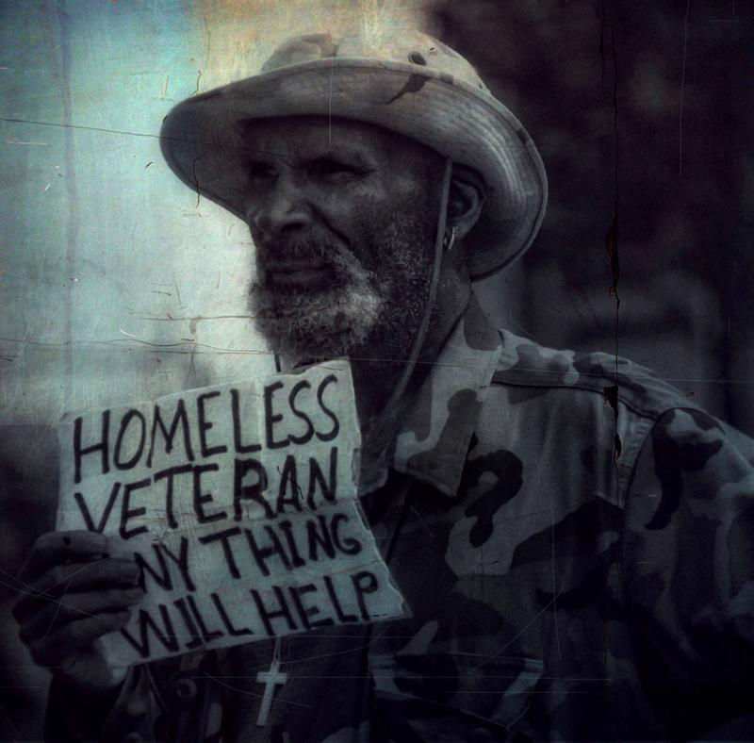
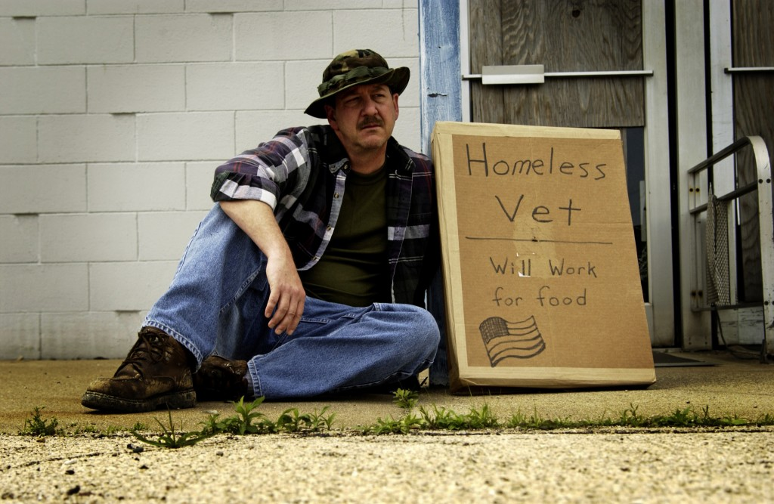
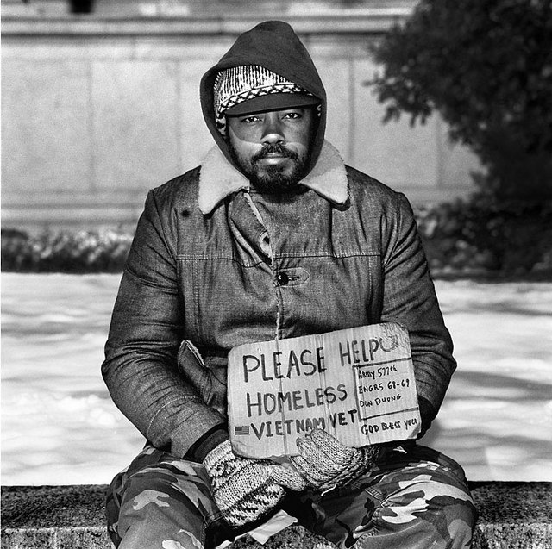
Notes:
Housing and Urban Development officials estimated in November 2018 that there were about 38,000 veterans across the United States without stable housing on any given night. HUD Secretary Ben Carson credited initiatives started under President Obama, particularly connecting housing vouchers with local charities to provide a holistic approach to veterans physical and financial health.

Slide 8
Affordable Rental Housing
Notes:
For some in our society, the 2008 crash had almost no impact on their quality of life. For others, the result was to destroy an already fragile existence. This presentation will offer some insight into the degree to which the lives of people at the bottom of our socio-economic ladder have improved or not improved.

Slide 9
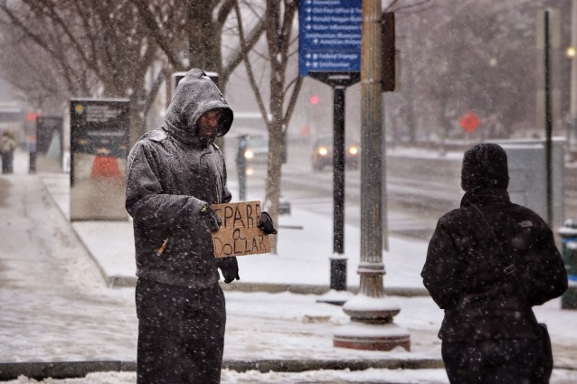
Notes:
The continued decline in the number of publicly-subsidized housing units is exacerbating the problem of homelessness all across the United States. There is currently a shortage of 7.2 million rental homes for extremely low-income renters.

Slide 10

Notes:
10
The 2018 report by the Harvard Joint Center for Housing Studies states that many renters are cost-burdened, meaning they use more than 30 percent of their income to pay for housing and, therefore, have difficulty paying for other necessities.

Slide 11
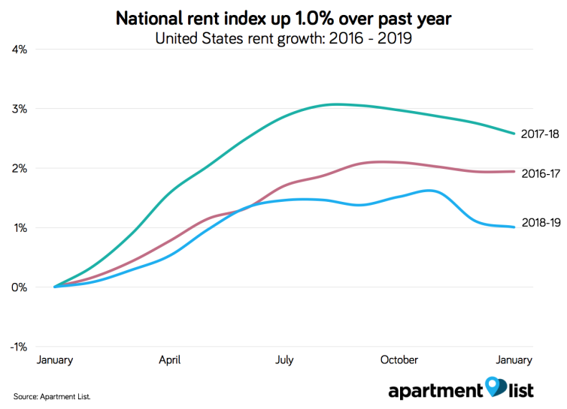
Notes:
11
Analysts at the Mortgage Bankers Association are expecting mortgage interest rates to remain above 5 percent during 2019. An important side-effect will be strong demand for rental housing, resulting in the ability of landlords to increase apartment and housing rents.

Slide 12
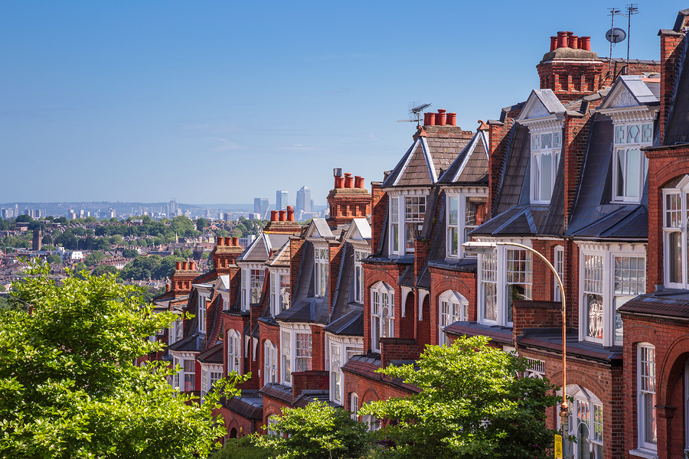
Notes:
12
The economic problem is easily understood. Where employment is strong and household incomes are relatively high (including the income of retirees) land prices are high and tend to keep increasing beyond the ability of individuals to afford asking rents for apartments or to accumulate sufficient savings to make a down payment and cover closing costs to purchase a property. When property markets become severely stressed by rising prices a correction occurs.

Slide 13
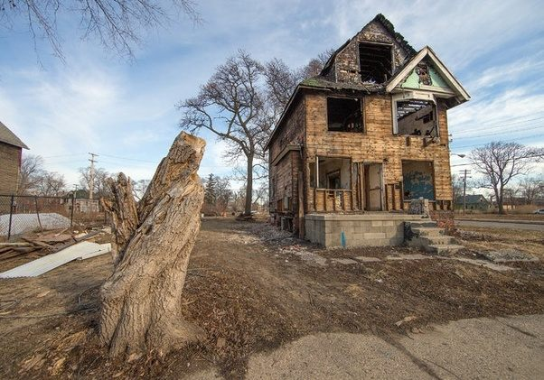
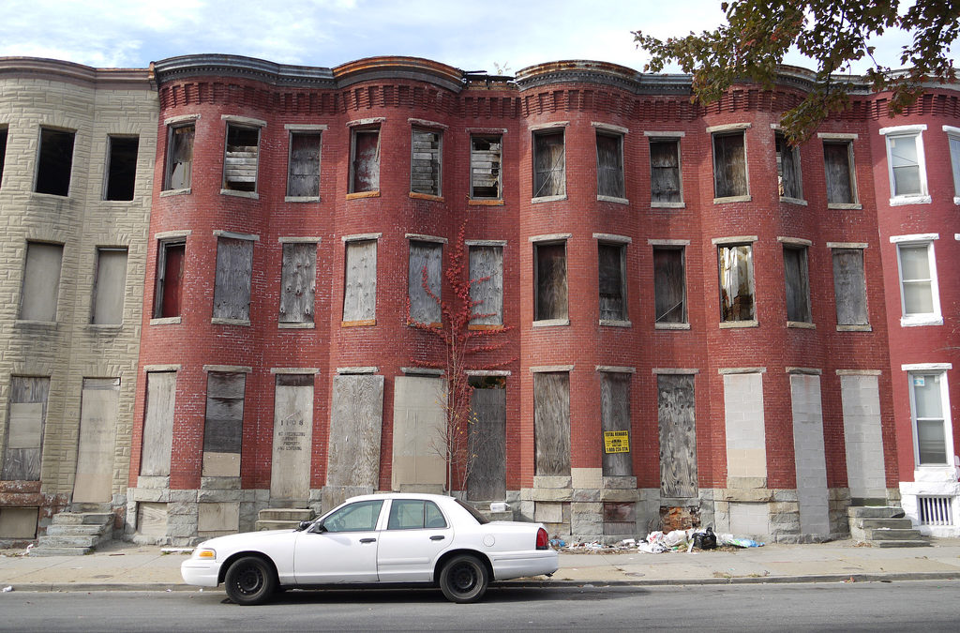
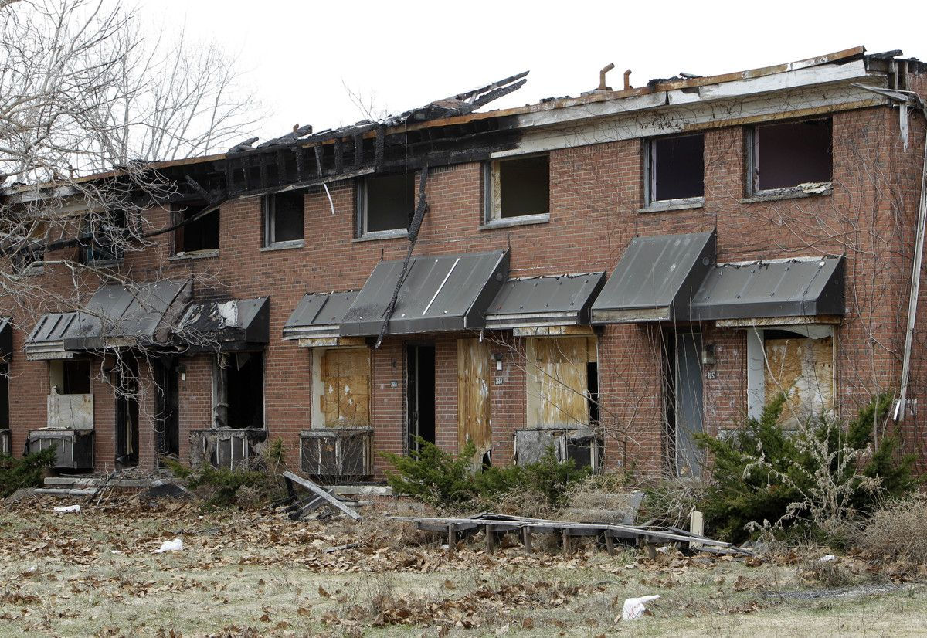
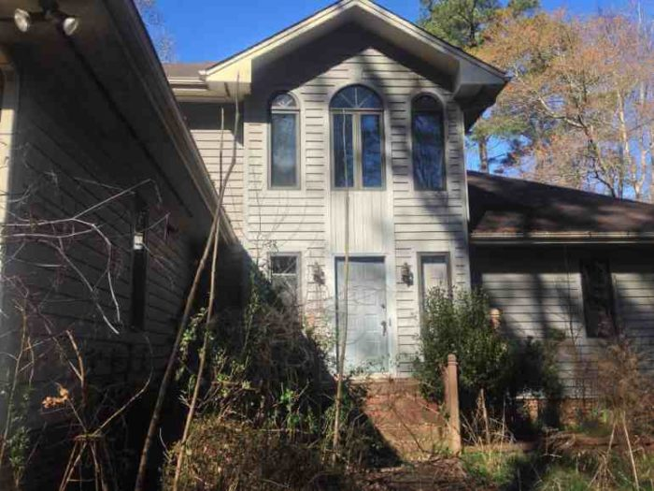
Notes:
13
Where employment is weak and household incomes low, land and property prices are low. In the most distressed neighborhoods, buildings or vacant lots cannot be sold at any price.

Slide 14


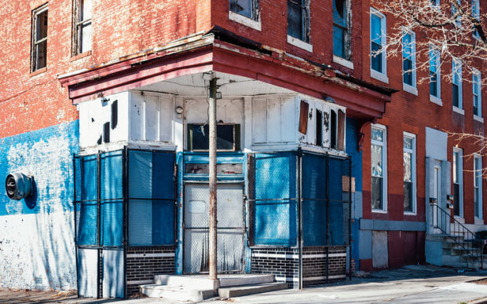
Notes:
14
When potential tenants cannot afford to pay a rent sufficient to cover the costs of ownership, absentee-owners defer maintenance, allow the property to be condemned, and walk away. The result is that all across the United States there are millions of vacant, abandoned properties.

Slide 15
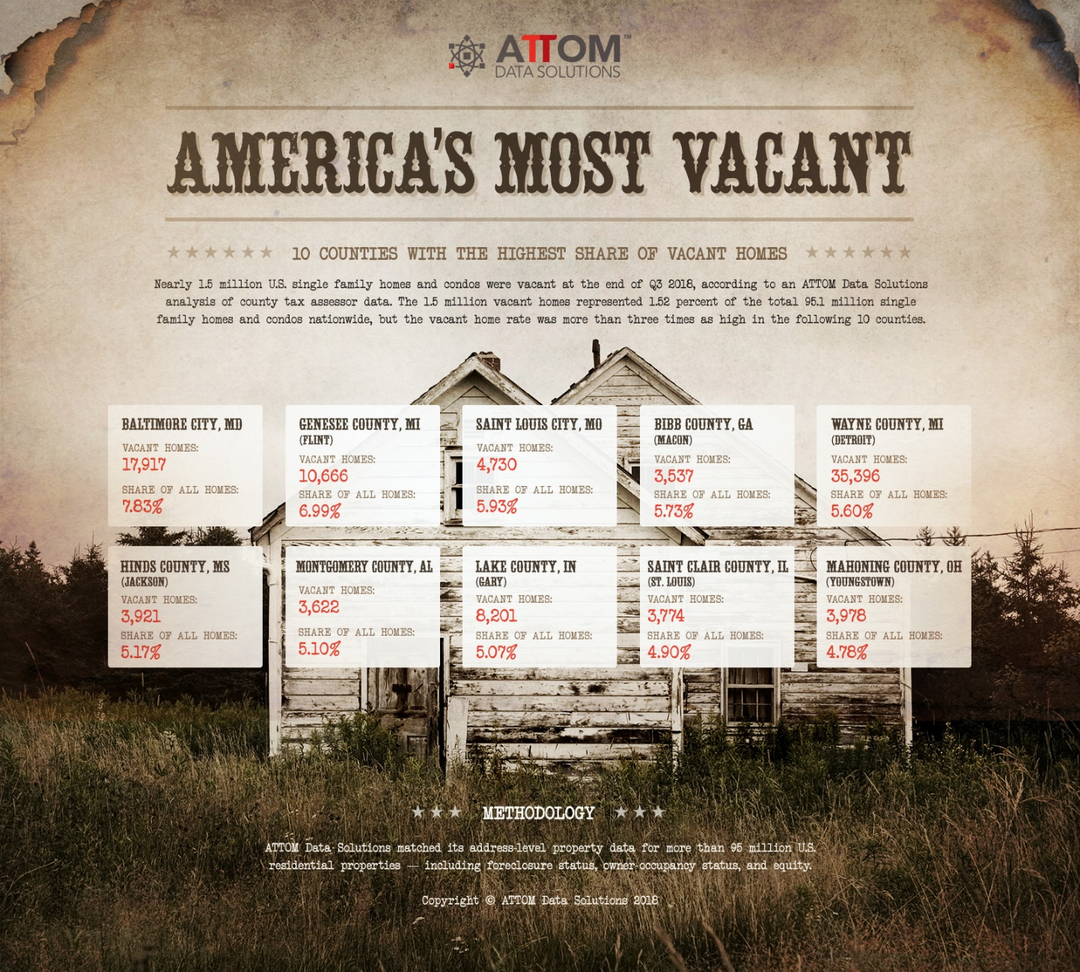
Notes:
15
Data published in October 2018 by ATTOM Data Solutions indicate that nearly 1.5 million single-family homes and condominium units were vacant at the end of the third quarter. This represents 1.52 percent of all housing units nationwide. Cities with the highest vacancy rates included Flint, Michigan, Youngstown, Ohio, and Mobile, Alabama.

Slide 16
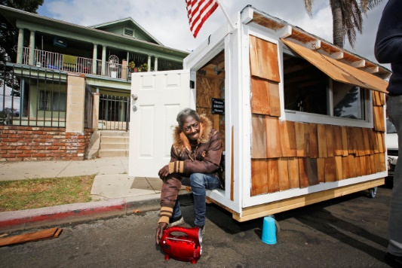
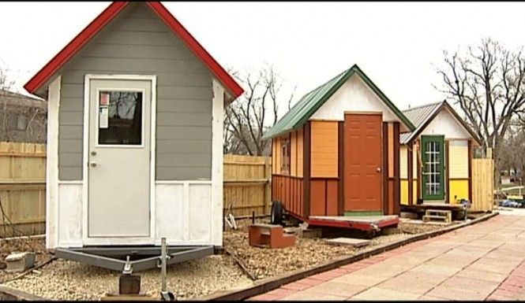
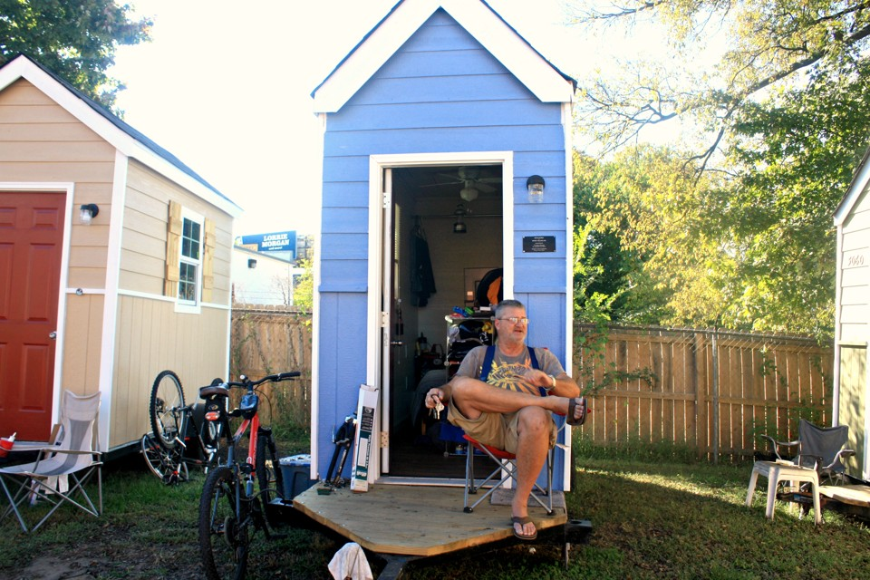
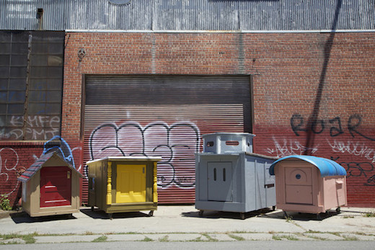
Notes:
16
One response to the problem of affordability has been the development of very small houses to serve as transitional housing for the homeless. Small villages of tiny houses have been constructed in Portland, Seattle, Austin, Madison and elsewhere.

Slide 17
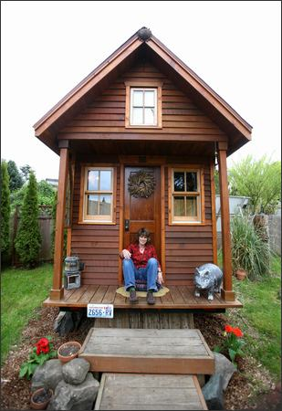
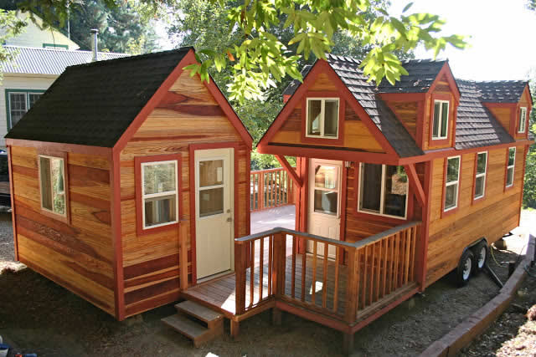


Notes:
17
Many others are choosing to purchase mobile tiny houses for reasons of affordability, reduced environmental impact, and as a lifestyle choice. These homes cost around $40,000 to have constructed. Owners need to obtain the land separately.

Slide 18
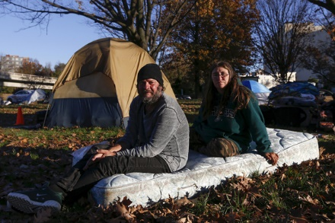
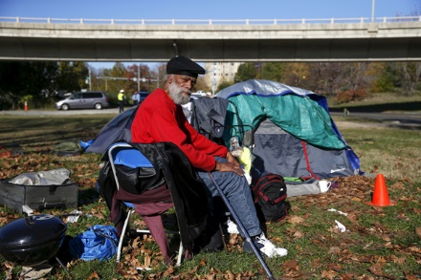
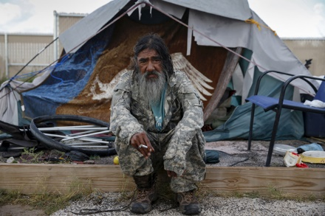
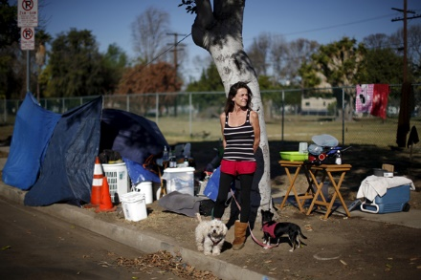
Notes:
The number of people living in tent cities scattered across the nation continues to increase. Late in December The National Law Center on Homelessness & Poverty reported a 1,342 percent increase in what they describe as “homeless encampments” between 2007 and 2017. They identified at least one such encampment in all fifty states and the District of Columbia. The response of city officials to the plight of these people is often to outlaw the encampments without providing a reasonable alternative.

Slide 19
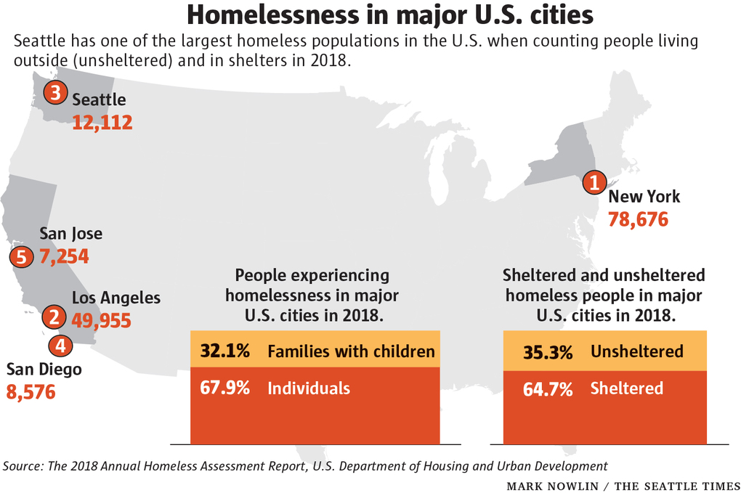
Notes:
The Seattle Times observed in December of 2017 that “As rents soar and access to affordable housing shrinks, the number of people living in states along the West Coast is trending in the wrong direction. …The crisis has prompted several local governments … to declare a civil state of emergency.” Homelessness rose in Seattle and Washington State during 2018 faster than all other states but Massachusetts, New York and Texas.

Slide 20

Food Insecurity
Notes:
A related social issue is the extent to which people are unable to afford adequate food for themselves and their families.

Slide 21

Notes:
The Democratic mayors of San Francisco and Philadelphia were the featured speakers at a discussion on housing and homelessness at the 2019 winter meeting of the U.S. Conference of Mayors held January 24, 2019 in the District of Columbia. They talked about efforts to relieve homelessness in their cities and about their approaches to adjacent issues such as criminal justice reform, drug addiction, and access to health care. They also talked briefly about their cities' responses to a partial shutdown of the federal government, affecting programs like housing vouchers for low-income families.

Slide 22
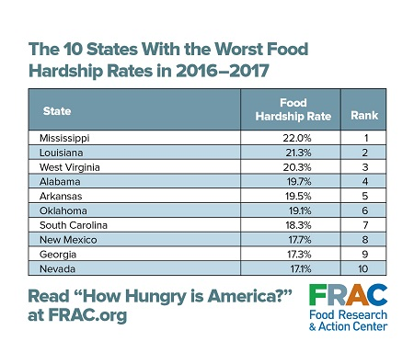
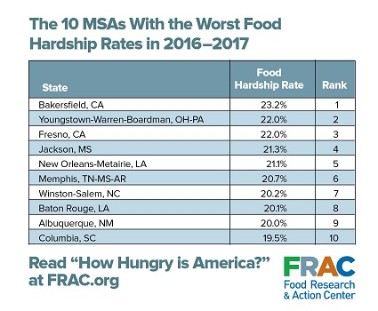
Notes:
22
A report issued in mid-2018 by the U.S. Department of Agriculture stated that 15 million households in the United States access to food is limited by the lack of financial resources. The Food Research & Action Center added that over 18 percent of households with children experience food insecurity. Jim Weill, President of the Food Research & Action Center stated:

Slide 23

“While often hidden behind closed doors, food hardship is a serious national problem that requires a serious national response. Too many people in every region, state, and community have been left behind in the economic recovery from the Great Recession, and are still struggling to put food on the table. …The high rates of food hardship underscore the need for Congress to pass a Farm bill that protects and strengthens SNAP. Otherwise, we will see worse health and hunger for struggling children, seniors, working families, and others across the country.”
Notes:
“While often hidden behind closed doors, food hardship is a serious national problem that requires a serious national response. Too many people in every region, state, and community have been left behind in the economic recovery from the Great Recession, and are still struggling to put food on the table. …The high rates of food hardship underscore the need for Congress to pass a Farm bill that protects and strengthens SNAP. Otherwise, we will see worse health and hunger for struggling children, seniors, working families, and others across the country.” [Source: Emily Pickren. “New Report Finds that More Americans, Particularly Children, are at Risk of Hunger.” Food Research & Action Center, 1 August, 2018]

Slide 24
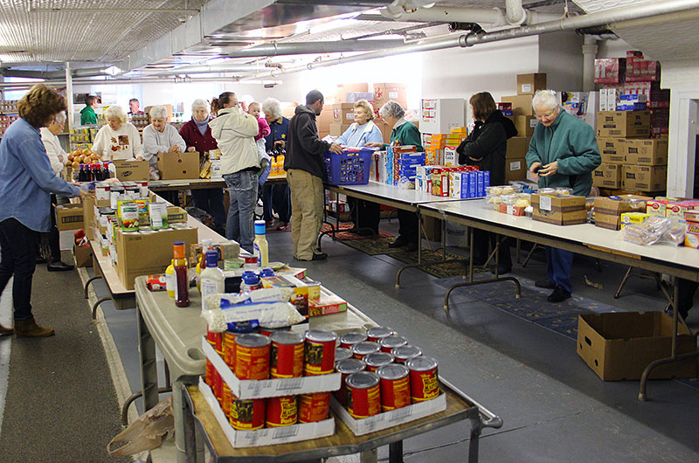
Notes:
24
A recent report issued by the organization Hunger Free America states: “Nationwide, food insecure Americans would need $21.5 billion in additional food purchasing power each year to meet their basic food needs, spending as much on food as do non-hungry Americans.”

Slide 25
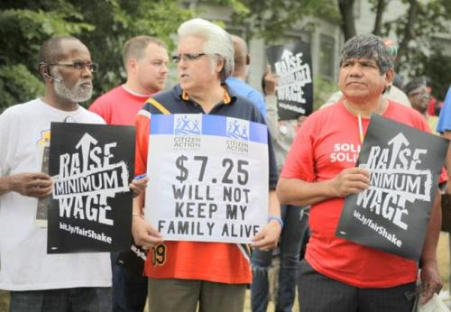
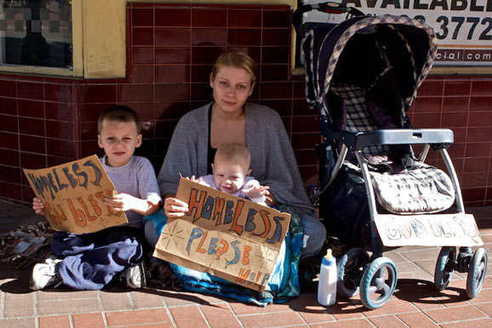
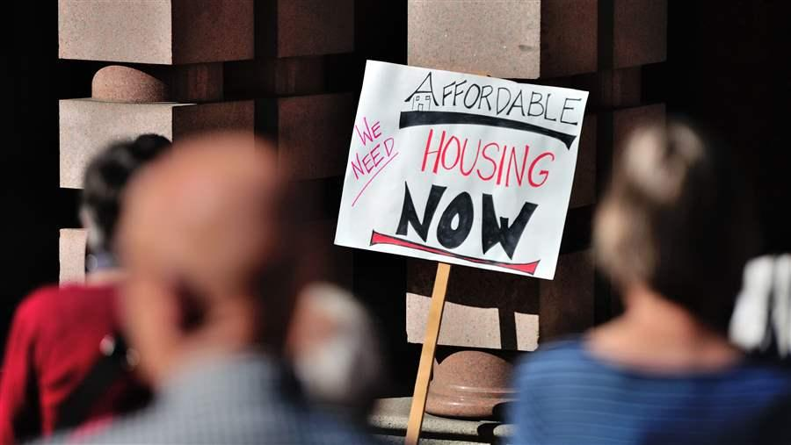
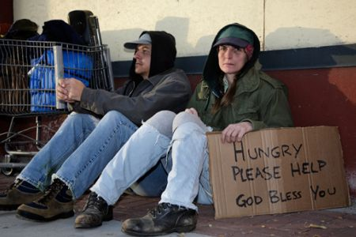
Notes:
25
What causes food insecurity? The survey conducted in 2017 by the U.S. Conference of Mayors identified low wages, high housing costs and poverty.

Slide 26
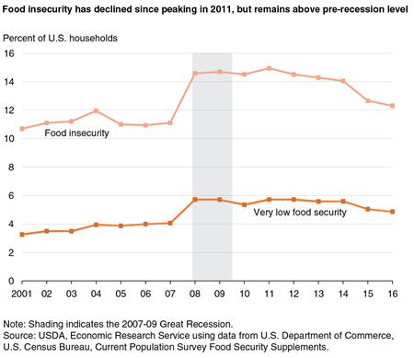
Notes:
26
The most recent detailed statistics on food insecurity published by the U.S. Department of Agriculture are for the year 2016. Reports from other sources suggest the situation has not improved significantly despite the continued reduction in official unemployment.

Slide 27
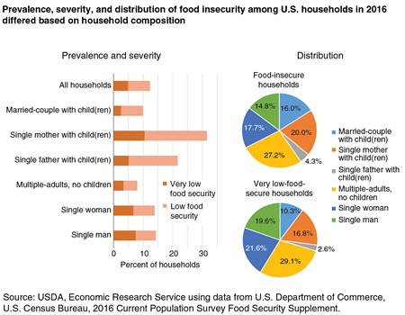
Notes:
Consistent with poverty levels, the households with the most severe food insecurity are single mothers with children.

Slide 28
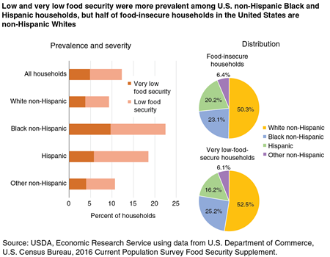
Notes:
And, as one would anticipate, households the members of which are African-American have the highest incidence of food insecurity. The organization FEEDING AMERICA reports that African-American households face hunger at a rate more than twice that of white, non-Hispanic households. The ten counties with the highest food insecurity rates in the nation are at least 60 percent African American. Seven of the ten counties are located in Mississippi.

Slide 29

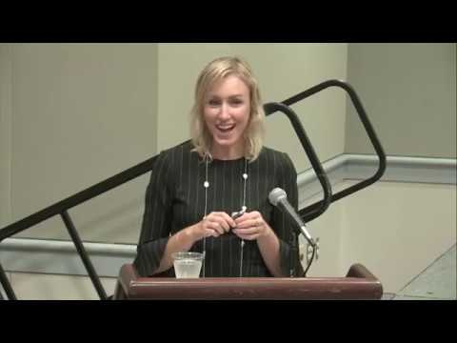
Notes:
In a 2018 CBS Moneywatch segment, Erin McDonald, vice present of Feeding America’s Center for Applied Research in Action observed:

Slide 30
“The overall number for unemployment are lower and there are jobs … but people are making choices around paying for utilities, rent and others costs. Food is a basic need where maybe they are going without or cutting back.”
Notes:
“The overall number for unemployment are lower and there are jobs … but people are making choices around paying for utilities, rent and others costs. Food is a basic need where maybe they are going without or cutting back.”

Slide 31
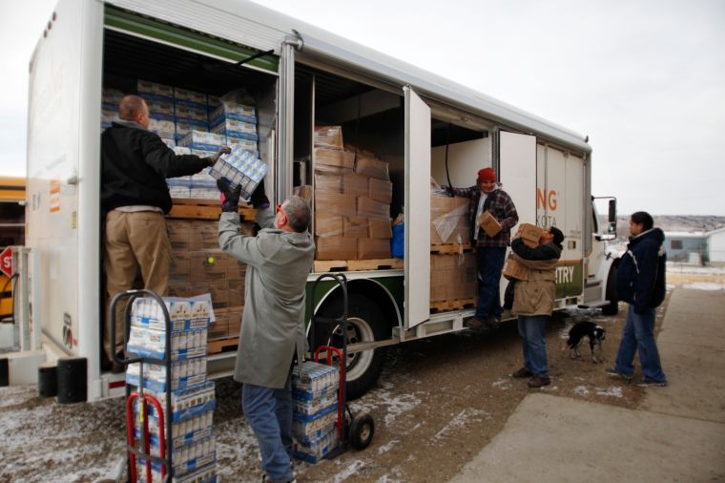
Notes:
Food insecurity is actually greater in rural communities than in our cities. Over half of the counties with the highest rates of food insecurity are in rural areas. Key factors are lower-wage employment opportunities, higher unemployment and underemployment, lower level of education, insufficient affordable child care and an absence of public transportation.

Slide 32
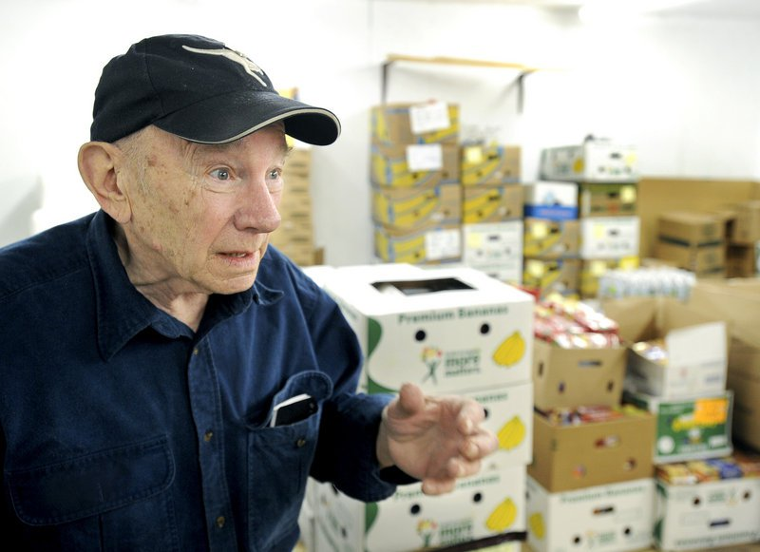
Notes:
Nearly one in every six seniors in the United States faces the threat of hunger and not being properly nourished -- more than 5 million senior citizens age 60 and older. Many are forced to choose between paying for groceries and paying for needed medicines. The organization Feeding America serves more than 46 million people, of which 7 million individuals are age 60 or older and an additional 6 million are age 50-59. AARP reports that seniors face a healthcare bill of more than $130 billion every year due to medical issues stemming from senior hunger.

Slide 33
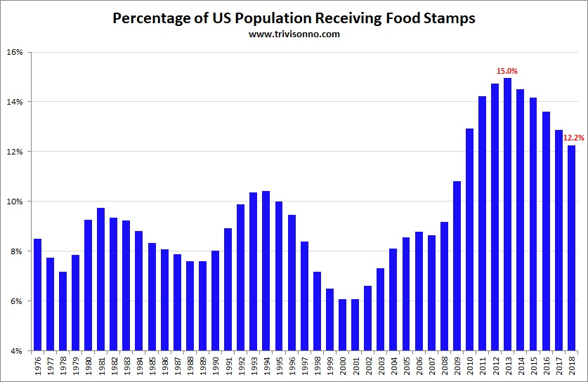
Notes:
Data released by the U.S. Department of Agriculture on the 8th of February, 2019, indicated that 38.5 million people are receiving food stamp assistance. As this chart indicates the number of recipients has been falling annually since the peak in 2013.

Slide 34

Notes:
The 2018 Agriculture and Nutrition Act, defeated in the House of Representatives in May, would have imposed stricter work requirement on those receiving benefits from the Supplemental Nutrition Assistance Program. Debate continues over whether this would benefit or harm low income individuals who, forced to work longer hours at one or more low-wage jobs, would have to absorb child care, transportation, and other expenses.

Slide 35
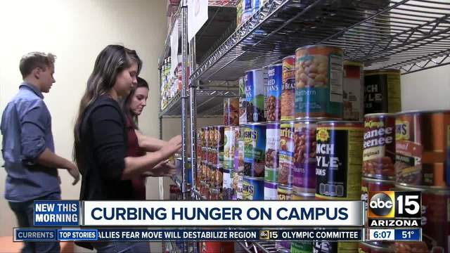
Notes:
Food insecurity is widespread on U.S. college campuses. Current estimates suggest that as many as half of all undergraduates experience food insecurity while pursuing college degrees. Across the country, students from low-income households are enrolling in college at increasing rates - with 39 percent of undergraduates falling at or below 130 percent of the federal poverty line in 2016, according to data from the National Postsecondary Student Aid Study.

Slide 36


Notes:
36
The data on the number of college students who do not have a healthy or regular diet indicates this problem is worsening. In a report written by Christopher Nellum at the American Council on Education, he states:

Slide 37
“The numbers are striking. Feeding America … estimates that nearly half (49.3 percent) of its clients in college must choose between educational expenses (i.e., tuition, books and supplies, rent) and food annually, and that 21 percent did so for a full 12 months.”
Notes:
37
“The numbers are striking. Feeding America … estimates that nearly half (49.3 percent) of its clients in college must choose between educational expenses (i.e., tuition, books and supplies, rent) and food annually, and that 21 percent did so for a full 12 months.”

Slide 38

Notes:
Poverty has always been a serious problem in the United States, particularly among persons of color, the elderly and newly-arrived immigrants. While as a percentage of the total population poverty gradually declined beginning in the late 1940s, the absolute number of people living in poverty continues to increase.

Slide 39
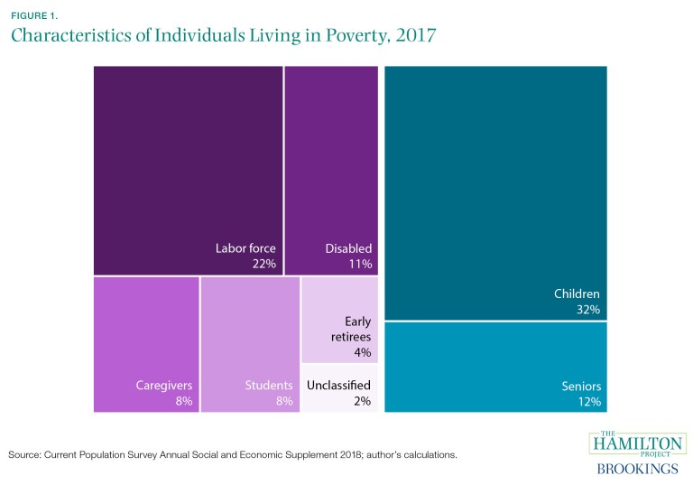
Notes:
The Brookings Institution published this chart detailing the situation in 2017. This chart shows that about one-third of those loving in poverty were children, about an eighth were senior citizens, and more thanhalf were working-age (18- to 64-year-olds) adults.

Slide 40
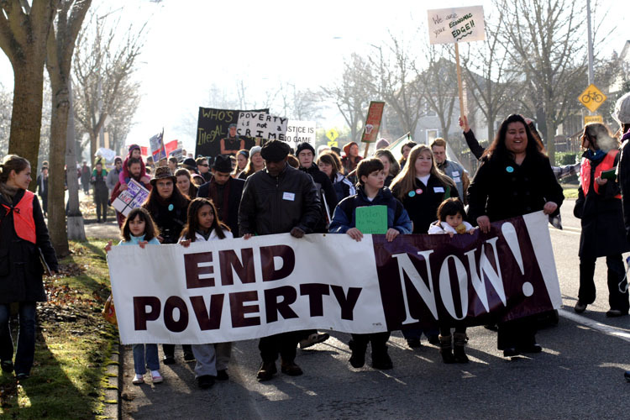
Notes:
A major societal disagreement exists over the extent to which government should intervene on behalf of the poor. There is no consensus on the causes of poverty. Is poverty primarily the result of individual behavior and decisions? Or, is poverty caused by systemic flaws in the socio-political arrangements and institutions?

Slide 41
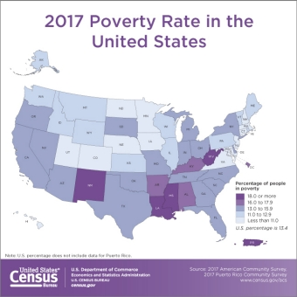
Notes:
This map, released by the U.S. Census Bureau in September 2018, indicates the level of poverty in each state. Note that four states (and Puerto Rico) report a poverty rate of 18 percent or higher.

Slide 42
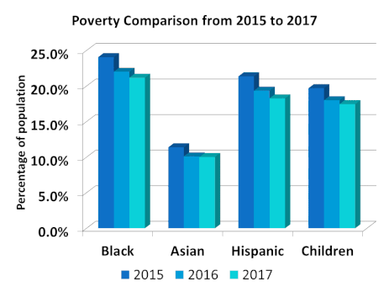
Notes:
It is no great secret that persons of color have had higher rates of poverty going back as far as these statistics were gathered and reported. Significant improvement in the living conditions of minority populations occurred with passage of Civil Rights legislation, but the percentages remain much higher than for Whites. Data released by the U.S. Census Bureau in September 2018 provides the following details:

Slide 43
Adults not working 31%
Single moms 26%
Adults with a disability 25%
Adults without a high school diploma 25%
Black Americans 21%
Foreign born non-citizens 19%
Hispanic Americans 18%
All children 18%
Single dads 12%
Seniors 9%
Married Couples 5%
Adults with college degree or higher 5%
Full time working adults 2%
Notes:
Overall, the U.S. poverty rate dropped to 12.3% of the population in 2017 from 12.7% in 2016.

Slide 44
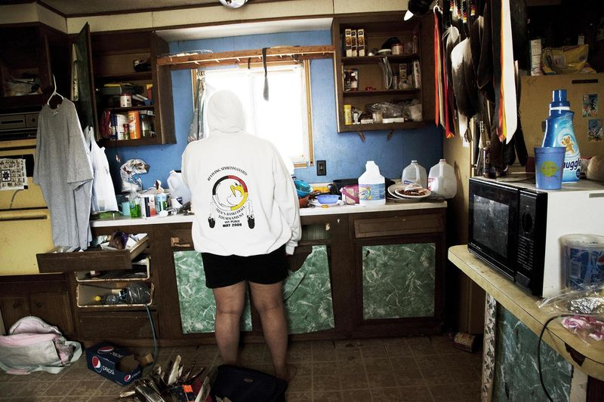
Notes:
Of 27 counties with a majority American Indian or Alaska Native population, about two-thirds had unemployment rates in 2017 above the national level, with nine at 10 percent or higher. Another indicator of the depth of poverty in American Indian communities is a serious shortage of decent housing.

Slide 45

Notes:
Today, 78 percent of people whose heritage is that of a Native American tribal society do not live on a reservation. Most live in urban or suburban communities. This is the result of forced relocation by the United States government during the 1950s. Thus, the causes of poverty within the American Indian population involve factors that are qualitatively different from that of Blacks or immigrant groups, requiring separate analysis outside the scope of this update.

Slide 46

The State of Senior Americans
Notes:
The population of the United States is growing older each year. The median age as of July 2016 was 37.9 years, up from 35.3 years in 2000. There are now 51.4 million people in the United States age 65 and older, which represents 15.3 percent of the nation’s total population. [Source: U.S. Census Bureau]

Slide 47

Notes:
However, reaching age 65 is no longer an automatic time for retirement. The U.S. Bureau of Labor Statistics reports that the percent of individuals age 55 and above in the work force continues to increase and is projected to reach 164 million by the year 2024. People are working later in life for a number of reasons. They are healthier and have a longer life expectancy than previous generations. They are better educated, which increases their likelihood of staying in the labor force. And changes to Social Security benefits and employee retirement plans, along with the need to save more for retirement, create incentives to keep working.

Slide 48

Notes:
U.S. retiree health-care costs are forecasted to increase at an average annual rate of 5.5 percent over the next decade, a rate of increase significantly higher than the anticipated general rate of inflation. [Source: Report by Health View Services, 2017]

Slide 49

Notes:
49
As this graph indicates, people who are White in every age group still comprise over one-half of the senior population.

Slide 50

- Age 65 and older
Notes:
50
This chart shows median household incomes by age bracket. For seniors the median income is around $39,000, half of all senior households above and half below this income level.

Slide 51

Notes:
The main sources of income for people over 65 are Social Security (36 percent), income from working (30 percent), pensions (18 percent) and savings and investments (13 percent). Younger retirees derive more income from working and investments, while over half of older retirees rely heavily or exclusively on Social Security.

Slide 52

Notes:
52
Data compiled in June of 2017 by Business Insider shows the degree to which the net worth of most persons is significantly attached to the ownership of a residential property. And, of course, those who are age 55 and above are most likely to have repaid their mortgage debt or nearly so.

Slide 53






Notes:
As residential property values recovered from the 2008 market collapse, the unrealized housing net worth held by U.S. seniors has climbed to over $6 trillion, tripling since the year 2000. I have not been able to find statistics on how this equity is distributed among senior households. These examples of how we live shed some light on the question. [Source: Jason Oliva, “U.S. Seniors’ Housing Wealth Now a $5.9 Trillion Reverse Mortgage Opportunity,” Reverse Mortgage Daily, 29 September, 2016]

Slide 54

Notes:
Statistics published in February 2019 by ATTOM Data Solutions indicated that during the fourth quarter of 2018 over 14.5 million U.S. properties had equity positions for owners of 50 percent or greater. This represents 25.6 percent of all properties subject to a mortgage lien. Home equity enjoyed by seniors is estimated to be $6.8 trillion. Conversely, more than 5 million properties – some owned by seniors -- have a market value significantly lower than mortgage debt owed.

Slide 55

Notes:
Some seniors continue to lose their property as a result of foreclosure after failing to meet the terms of a reverse mortgage loan. Deferring maintenance, falling behind on property taxes or not carrying homeowners insurance constitute a default of the terms of a reverse mortgage. There continues to be a good deal of imprecision in the reporting of how many seniors lose their homes as a result of a default condition. Industry representatives explain that many HECM foreclosures often occur after the last surviving borrower dies or moves away.

Slide 56


Notes:
56
The poverty rate for people age 65 and older is lower than for any other age group. Two major reasons are the equity in a residential property and benefits under the Social Security system.

Slide 57
Notes:
57
The 2018 Harvard Joint Center for Housing Studies points to a number of interesting trends affecting seniors. One is household income:

Slide 58

“… income growth among older households has been on a steady upward trend. Between 2006 and 2016, the median income for 65-74 year-old households rose 22 percent while that for the 75-and-over age group climbed 15 percent. Indeed, the real incomes of households in these two older age groups were 38 percent and 32 percent higher than those for same-age households in 1988.”
Notes:
58
“… income growth among older households has been on a steady upward trend. Between 2006 and 2016, the median income for 65-74 year-old households rose 22 percent while that for the 75-and-over age group climbed 15 percent. Indeed, the real incomes of households in these two older age groups were 38 percent and 32 percent higher than those for same-age households in 1988.”

Slide 59
Notes:
59
A significant portion of the nation’s seniors have also experienced increases in net worth, from a combination of rising residential property values and rising investment portfolio values. The report states:

Slide 60
“[T]he median wealth of households age 65 and older was $239,100 in 2016, fully 51 percent above the level in 1995. This increase has occurred despite a 19 percentage-point jump in the share of older owners carrying mortgage debt over this period, to 41 percent. In addition, the median amount of mortgage debt among these older owners was $72,000, more than double the inflation-adjusted average of $28,200 in 1995.”
Notes:
60
“[T]he median wealth of households age 65 and older was $239,100 in 2016, fully 51 percent above the level in 1995. This increase has occurred despite a 19 percentage-point jump in the share of older owners carrying mortgage debt over this period, to 41 percent. In addition, the median amount of mortgage debt among these older owners was $72,000, more than double the inflation-adjusted average of $28,200 in 1995.”

Slide 61

Notes:
61
Next, we’ll take a close look at property ownership in the nation.

Slide 62
End of Part 4

