Slide 1

The State of the United States
ECONOMY and SOCIETY
Part 2

Slide 2
What Do We Make In the U.S.A.?
Notes:
There is a widespread belief in this country that we are no longer the world’s leader in manufacturing. To be sure, this sector of the global economy is extremely competitive. Companies based in the United States no longer hold significant advantages in societal infrastructure, in the superiority of workforce skills, in managerial talent or in research and development.

Slide 3
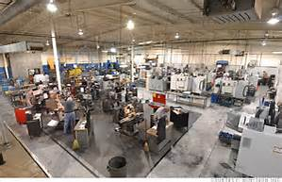
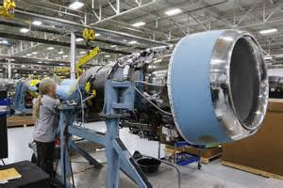
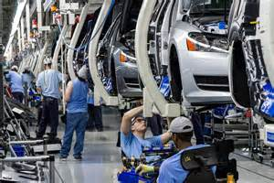
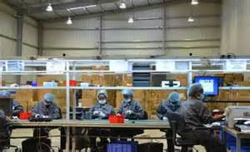
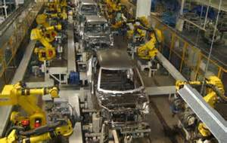
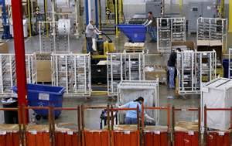
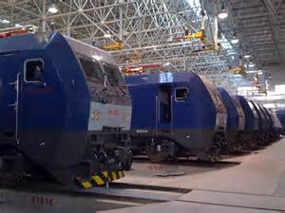
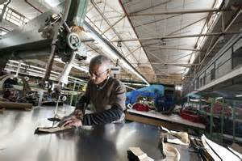
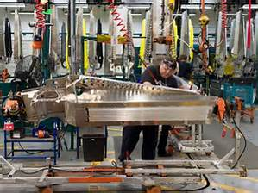
Notes:
3
That said, we still have a vibrant and growing manufacturing sector.

Slide 4
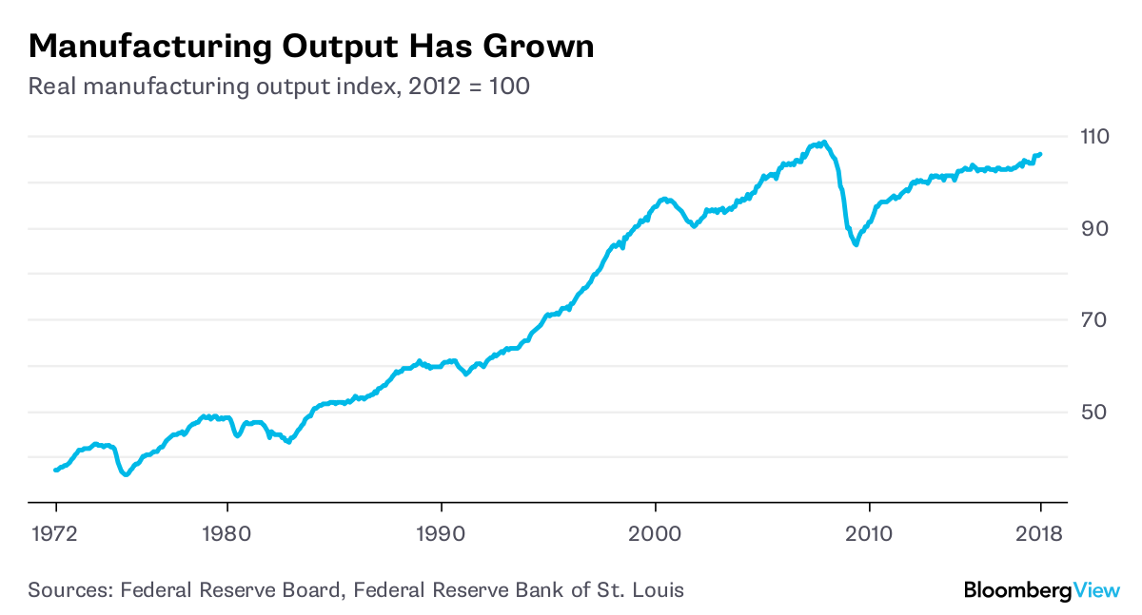
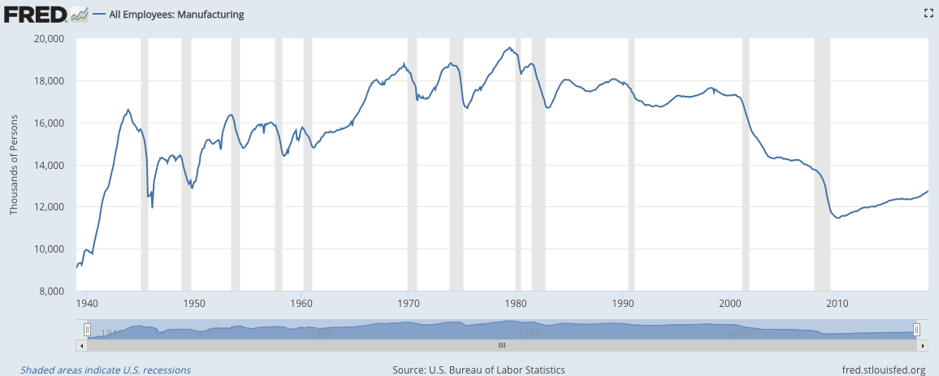
Notes:
4
What is worrying to us as a society is that while manufacturing output has actually doubled over the last three decades, this has been accomplished with fewer and fewer persons employed. Manufacturing employed around 14.66 million persons in 2017, rising slowly each year since the bottom of the last recession, but turning downward again during 2017. Then, between the months of July 2017 and July 2018, the Bureau of Labor Statistics reported a gain of 327,000 jobs in manufacturing.

Slide 5
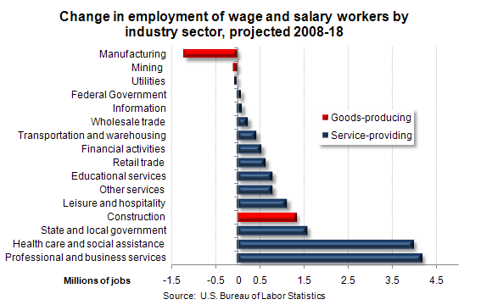
Notes:
5
Over the past 35 years, manufacturers have shed more than seven million jobs while increasing output every year. Even so, manufacturing continues to employ more persons than any other sector of the economy.

Slide 6

Notes:
6
A legitimate public policy concern is what will result from the new restraints on trade imposed on China and other countries. Ann Harrison, at the Wharton School concludes as follows:

Slide 7
“Eighty percent of lost jobs were not replaced by workers in China, but by machines and automation. That is the first problem if you slap on tariffs. What you discover is that American companies are likely to replace the more expensive workers with machines.”
Notes:
7
“Eighty percent of lost jobs were not replaced by workers in China, but by machines and automation. That is the first problem if you slap on tariffs. What you discover is that American companies are likely to replace the more expensive workers with machines.” [Source: Unsigned article, “Can Trump – or Anyone – Bring Back American Manufacturing?” Knowledge @t Wharton, 30 November, 2016]

Slide 8

Peter Minor and Terrie Walmsley, ImpactECON
Notes:
8
An analysis on the Trump Administration’s trade policy by researchers sponsored by Koch Industries concludes the total economic cost by 2030 would reach $2.8 trillion, forcing some 665,000 works to find employment in other sectors of the economy.

Slide 9
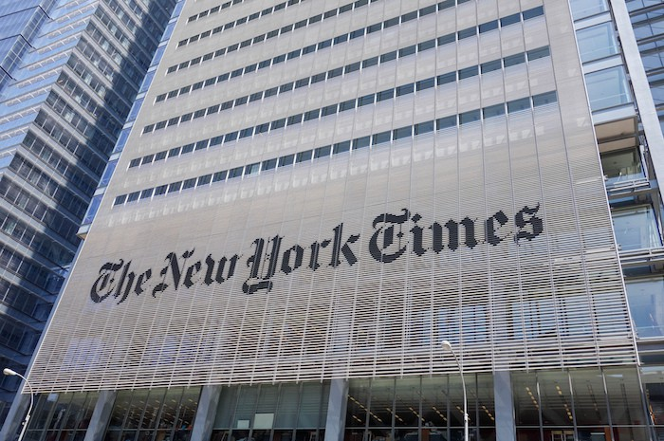
Notes:
9
The Editorial Board of the New York Times had this to say about the administration’s decision to impose tariffs on solar energy cells and panels and on washing machines:

Slide 10

“Tariffs will not be high enough to create new manufacturing jobs because the cost of production in countries like Malaysia and South Korea will remain significantly lower than in the United States. Also, American factories would probably be highly automated and require far fewer workers. Meanwhile, the higher tariffs – and thus higher prices – for solar cells and panels will reduce demand from residential customers, businesses and utilities. …The Solar Energy Industries Association estimates that the tariffs could cost that industry 23,000 jobs.”
Notes:
10
“Tariffs will not be high enough to create new manufacturing jobs because the cost of production in countries like Malaysia and South Korea will remain significantly lower than in the United States. Also, American factories would probably be highly automated and require far fewer workers. Meanwhile, the higher tariffs – and thus higher prices – for solar cells and panels will reduce demand from residential customers, businesses and utilities. …The Solar Energy Industries Association estimates that the tariffs could cost that industry 23,000 jobs.” [Source: “Mr. Trump’s Tariffs Will Not Bring Back Manufacturing Jobs,” The New York Times, 23 January, 2018]

Slide 11
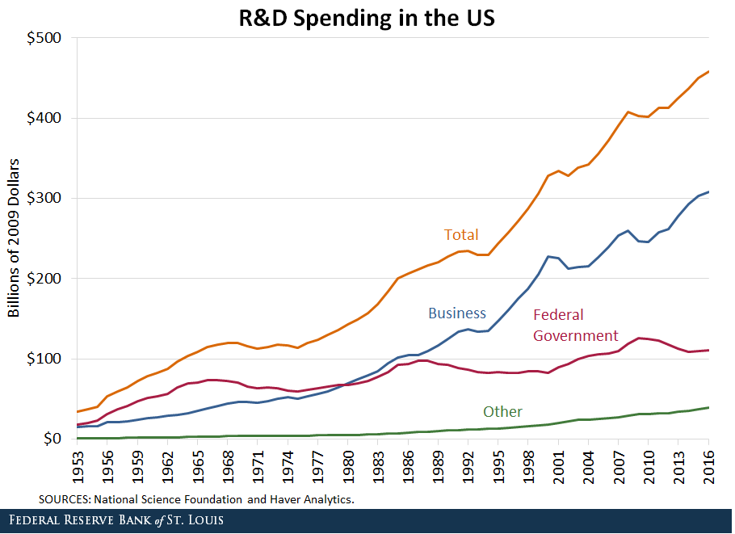
Notes:
11
Overall corporate spending on research and development is showing a steady increase. Spending in 2018 exceeded a half-trillion dollars, with $368 billion by industry, $21 billion by academia and $21 billion by non-profits.

Slide 12
Which Corporations are American?
Notes:
Examine the consolidated financial statements of the largest corporations, and it becomes quite clear that many companies we think of as “American” are really “Multi-national.” A meaningful measurement of just how American specific companies are is the percentage of employees who work full-time out of a location in the United States.

Slide 13

TOTAL
EMPLOYEES
2,300,000
541,900
443,000
420,000
406,000
380,000
375,000
U.S.
EMPLOYEES
1,300,000
n/a
443,000
n/a
349,160
n/a
n/a
RANK
1
2
3
4
5
6
7
COMPANY
Walmart
Amazon
Kroger
Yum! Brands
Home Depot
IBM
McDonald’s
Notes:
13
Not listed here is the largest employer in the country: government, which employs 22.3 million people. Of this total, 2 million full-time civil servants are employed by the federal government.

Slide 14
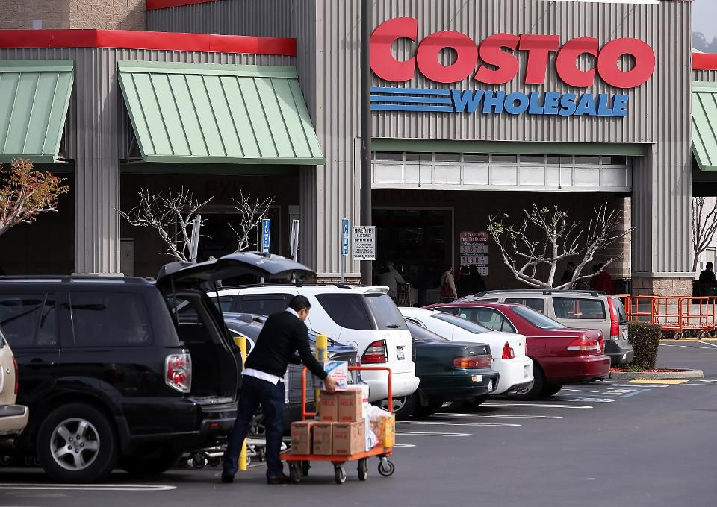
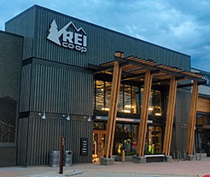
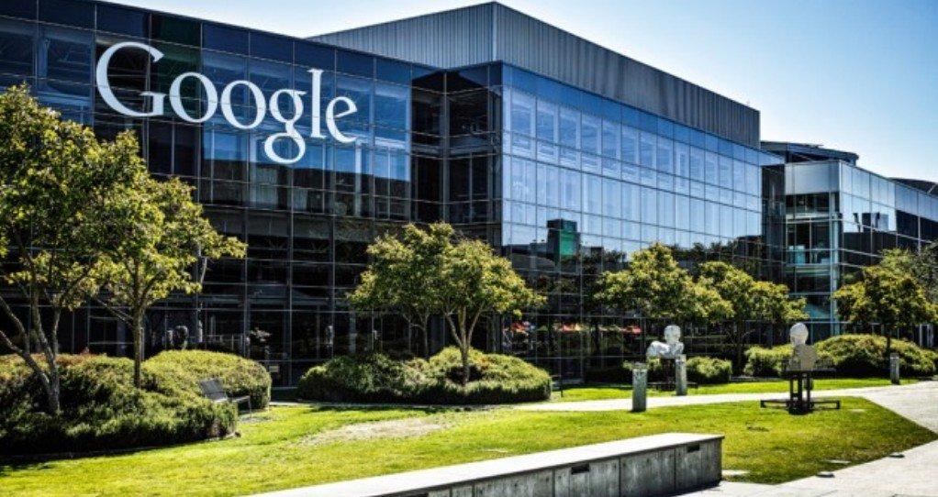
Notes:
14
Forbes Magazine published a survey of 30,000 Americans by Statista in May of 2018 of “America’s Best Employers” with at least 1,000 employees. The list is headed by Michelin, followed by Trader Joe’s, Google, Principal Financial, Costco, NRG Energy, Wegmans Food Markets, Harvard University, and Navy Federal Credit Union.

Slide 15

Notes:
15
An ongoing concern is the number of jobs lost to outsourcing of activities to companies domiciled outside of the United States. However, comprehensive data on overseas outsourcing practices are not easy to obtain because there are no government reporting requirements. An estimated 14 million people are employed by U.S. overseas affiliates.

Slide 16
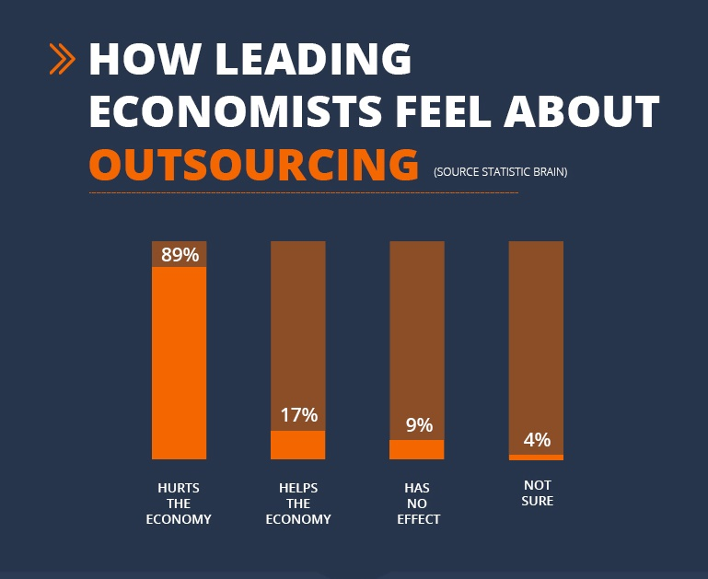
Notes:
16
Data from the U.S. Department of Commerce indicates that during the 2000s the nation’s major employers reduced employment in the United States by 2.9 million persons. At the same time they increased employment overseas by 2.4 million. The level of people employed by U.S. overseas affiliates has remained stable since 2013. The business sectors most affected are technology, call centers, human resources and manufacturing. As this chart indicates, almost nine out of ten economists conclude that outsourcing is harmful to the U.S. economy. [Source: “Activities of U.S. Multinational Enterprises in 2013,” U.S. Bureau of Economic Analysis]

Slide 17
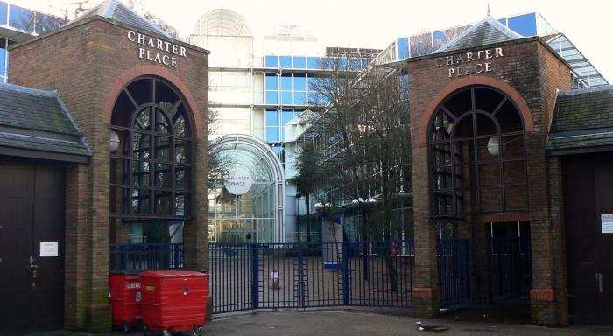
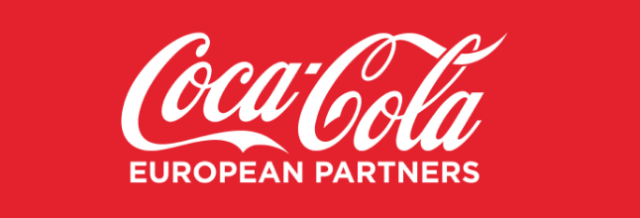
Notes:
17
In 2016 one of the most American of American companies, Coca-Cola, established a new corporate entity called Coca-Cola European Partners, with its headquarters in London. A main reason for their decision, and that of many other companies, has been to shift their tax bases abroad to locations where the taxation of business profits is more favorable. One of the hopes of the administration’s new tax cuts is that the United States will compete in the tax arena on a more level playing field.

Slide 18
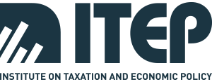
Notes:
18
The Institute on Taxation and Economic Policy issued an analysis in March of 2017 showing that over the eight-year period from 2008 to 2015, the average effective rate of taxation on business profits was just 21.25, far below the previous statutory 35% tax rate. Eighteen corporations out of 258 examined paid no federal business profit tax during this period, and one-fifth of the total paid less than 10 percent.

Slide 19
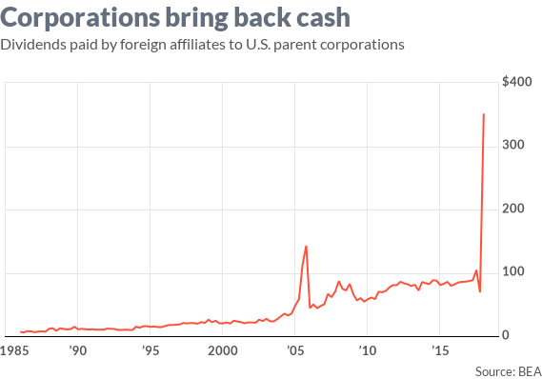
Notes:
19
Thus far, U.S. multinational corporations have brought back over $300 billion in overseas profits and reduced their direct investment overseas by $400 billion. However, a MarketWatch analyst named Rex Nutting observes that “The first fact is trivially true, while the second is misleading – it’s a one-time drop that’s due to the accounting change.” There has yet to be any meaningful investment in new capital goods. [Source: Rex Nutting. “Corporations brought home $350 billion after tax cut, but they haven’t put it to work.” MarketWatch, 3 July, 2018]

Slide 20

Notes:
20
A research economist at the Tax Foundation, Gavin Ekins, examined the implication of the new tax bill and concluded there are provisions that actually encourage companies to invest outside the United States. His findings were summarized in a CNBC report before the bill was approved:

Slide 21

“A company could decide to avoid paying taxes on its above normal, ‘super’ foreign profits if it were instead to invest in a new foreign plant or other tangible asset, which would result in greater tangible depreciable assets. This would provide a bigger base of assets against which profits would be taxed, possibly making the tax hit smaller.”
Notes:
21
“A company could decide to avoid paying taxes on its above normal, ‘super’ foreign profits if it were instead to invest in a new foreign plant or other tangible asset, which would result in greater tangible depreciable assets. This would provide a bigger base of assets against which profits would be taxed, possibly making the tax hit smaller.” [Source: Patti Domm. “Tax bill includes an incentive for US companies to invest in foreign manufacturing,” CNBC Market Insider, 19 December, 2017]

Slide 22
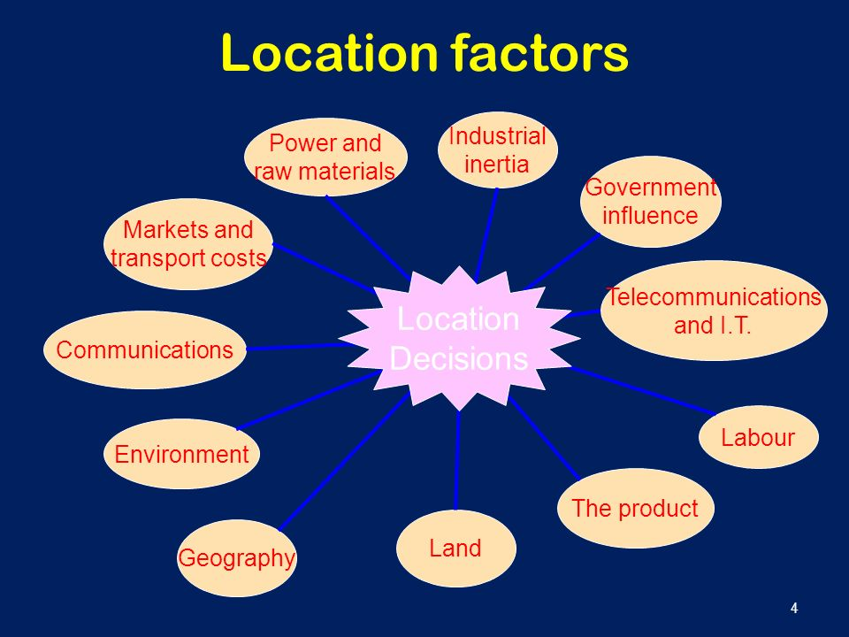
Notes:
22
A 2012 survey by Duke University’s Fuqua School of Business found that labor costs are the main reason corporations send jobs overseas; however, this is misleading when one factors in land acquisition costs or costs of leasing space in buildings owned by others, as well as the costs absorbed in payment of local, state and federal taxes.

Slide 23

Notes:
23
Here in the United States, the State of Delaware is the legal address for over one million entities, including 64 percent of Fortune 500 companies. Why are so many companies domiciled in Delaware? First, it is very easy to incorporate a company in the state. The laws permit companies to shift royalties and similar revenues to holding companies in Delaware, where they are not taxed. Not surprisingly, other states have been lobbying the federal government to intervene. In mid-2018, Delaware’s Secretary of State endorsed changes in law that would go a long way toward combating money laundering and other criminal activities.

Slide 24
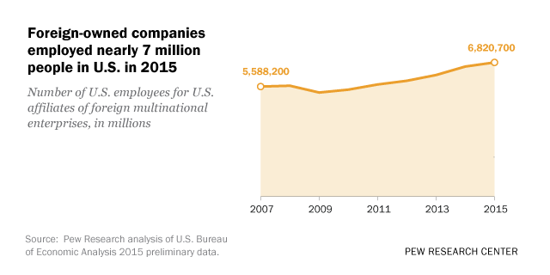
Notes:
24
For many reasons, foreign companies are locating operations in the United States. Forbes Magazine reported in April of 2018 that the number of persons employed in the United States by foreign-owned companies was $5 million. The Organization for International Investment estimates that roughly one-third of these jobs are in manufacturing.

Slide 25
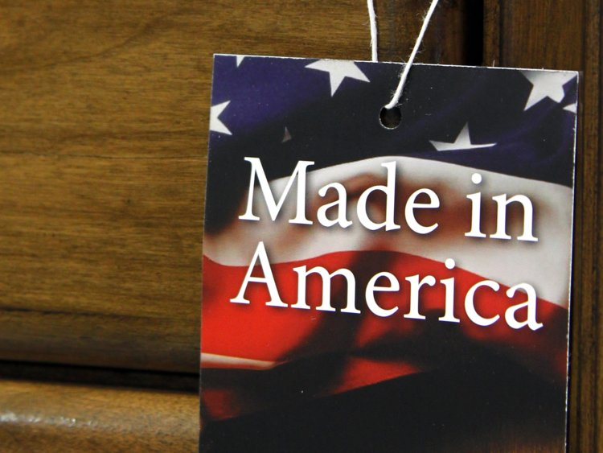
Notes:
25
Another aspect of the global economy is the number of formerly-u.s. companies have are now owned by foreign nationals. In 2008, Anheiser-Busch (maker of Budweiser) was purchased by the Belgian firm, InBev for $52 billion. The Dutch-British firm Unilever acquired Ben & Jerry’s back in 2000 for $326 million. The Canadian firm Restaurant Brands International owns Burger King. The German firm Aldi Nord has owned Trader Joe’s since 1979. A Chinese firm, Haier, paid $5.4 billion in 2016 for General Electric Appliances.

Slide 26
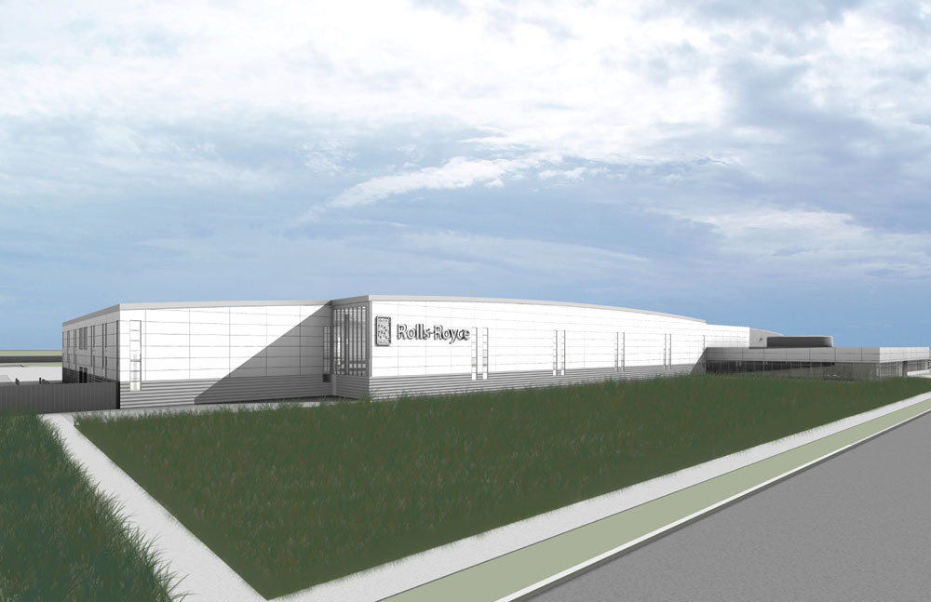
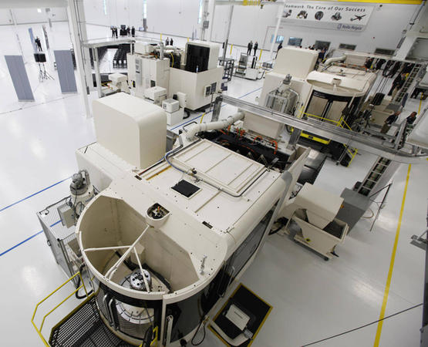
Notes:
26
Foreign companies, like their U.S. counterparts, need locations and facilities. Their investment has had an important effect on real estate prices and sales in certain parts of the United States. A good example of this is the Rolls-Royce factory in Virginia that manufactures jet engine discs, shipping them back across the Atlantic rather than expanding plants in the U.K. A major reason was to be close to one of its major customers – Boeing, which is building aircraft in Charleston, S.C. and in Mobile, Alabama. The Rolls-Royce factory cost $170 million to construct, but as a high-technology manufacturing operation the facility employs just 100 people.

Slide 27
Foreign Ownership of U.S. Real Estate
Notes:
For foreign companies holding huge quantities of U.S. dollars, an important strategy is to use those dollars to acquire property in the United States.

Slide 28
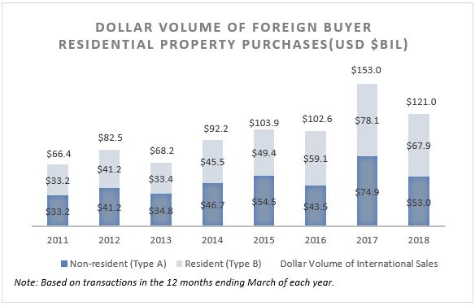
Notes:
Residential properties have always attracted a large number of foreign nationals, as second homes, vacation properties or as revenue-generating investments. International property firms have aggressively begun to acquire large numbers of residential properties made available by the large number of foreclosures since the 2008 financial crisis.

Slide 29
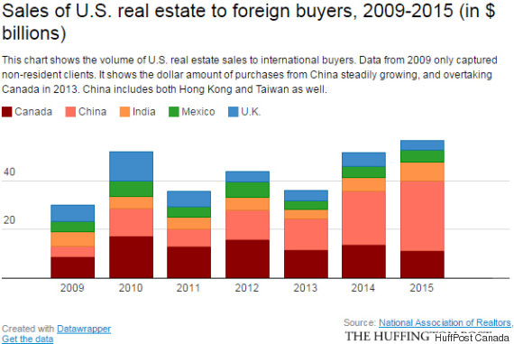
Notes:
29
Between 2009 and 2015 foreign purchases of U.S. real estate totaled around $300 billion. However, one consideration of foreign buyers of a residential property in the United States is the 40 percent inheritance tax on the value of any asset owned by a non-U.S. resident over $60,000 at the time of the owner’s death.

Slide 30
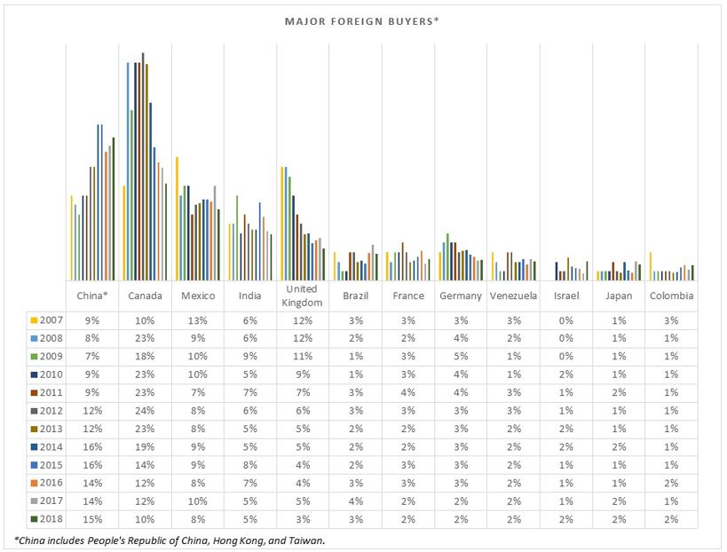
Notes:
30
Chinese buyers remained as the top foreign buyer of U.S. residential property, according to National Association of Realtors report released in mid-2018. Chinese buyers accounted for 15 percent of foreign buyer purchases during the period April 2017-March 2018, which is about the same as the share in the past period. Meanwhile, the shares to total foreign purchases declined for Canada (10 percent), Mexico (eight percent) and the United Kingdom (three percent). The share of Asian Indian foreign buyers was unchanged (five percent).

Slide 31
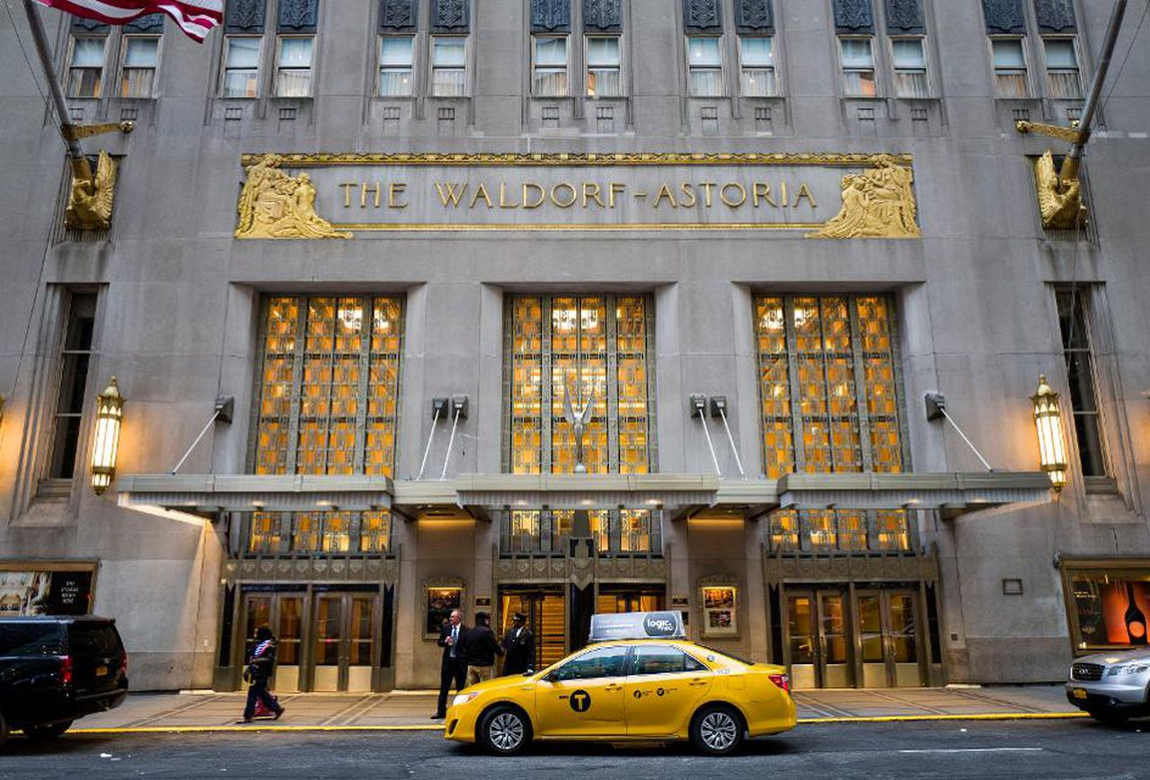
Notes:
31
During 2016, Chinese investors spent $19.2 billion on U.S. commercial real estate, up from $17.3 billion in 2015. Canadian investors were the next largest at $13.1 billion. Nearly half of all Chinese acquisitions were in New York City. [Source: Ellen Sheng. “Chinese Now The Largest Group of Foreign Investors In U.S. Commercial Real Estate,” Forbes. 13 March, 2017]

Slide 32

Notes:
32
An important observation related to economic growth is the fact that the sale of existing real estate generates fee income for a long list of participants but creates no new capital goods, although many buildings are renovated and modernized to improve attractiveness to potential corporate tenants or residential tenants. Sellers of these properties are recording capital gains, but the gains are actually coming from rising land prices, causing a transfer of financial resources between the parties.

Slide 33
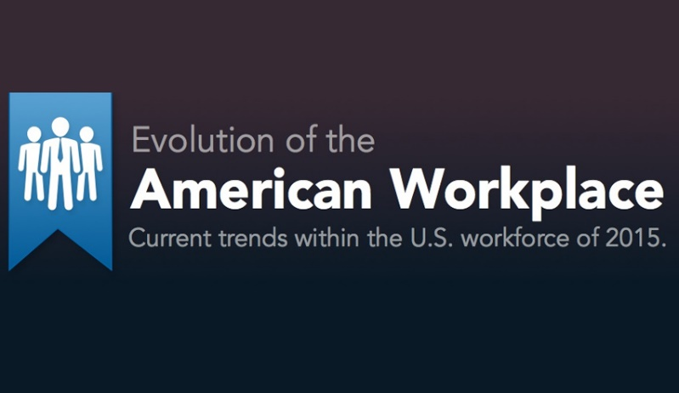

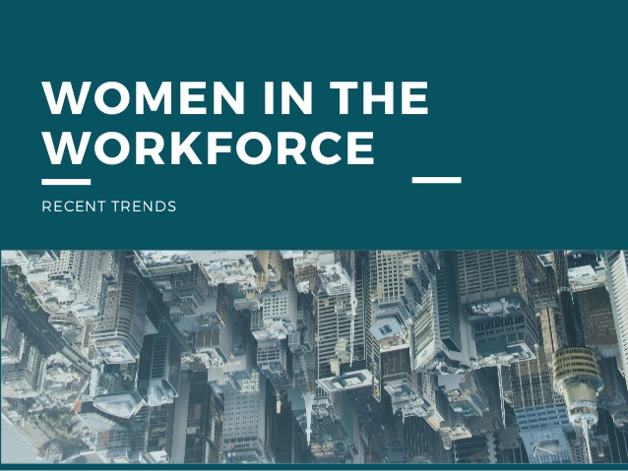

Notes:
33
Next, we will examine the state of our workforce and trends affecting employment across the nation.

Slide 34
End of Part 2

