Slide 1

The State of the United States
ECONOMY AND SOCIETY

Slide 2
Compiled with commentary
by Edward J. Dodson, M.L.A.
February, 2019
Notes:
What follows is an updated analysis of the state of the United States economy and important measurements of the overall strength of our society. Within this presentation I provide what I believe are a number of reasoned recommendations for changes in public policy to address the boom-to-bust character of our economic system and the growing level of income and wealth inequality that threatens our very democracy. Additional proposals for systems change are offered to achieve sustainable use of our natural resources.

Slide 3


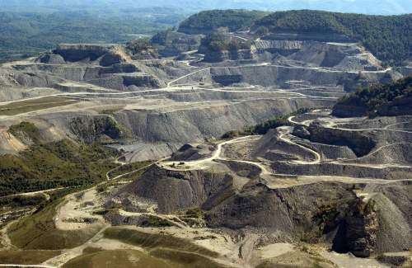
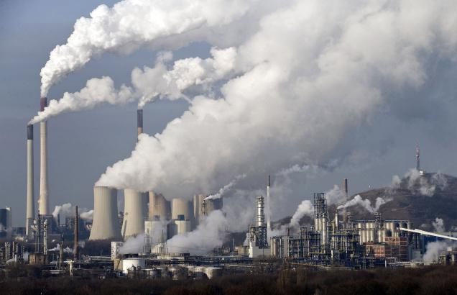
Notes:
More than ever before, we are a society divided over whether and how we can create sufficient employment opportunities for a growing population, at living wages and with measures in place that will not merely reduce but actually eliminate environmental degradation.

Slide 4
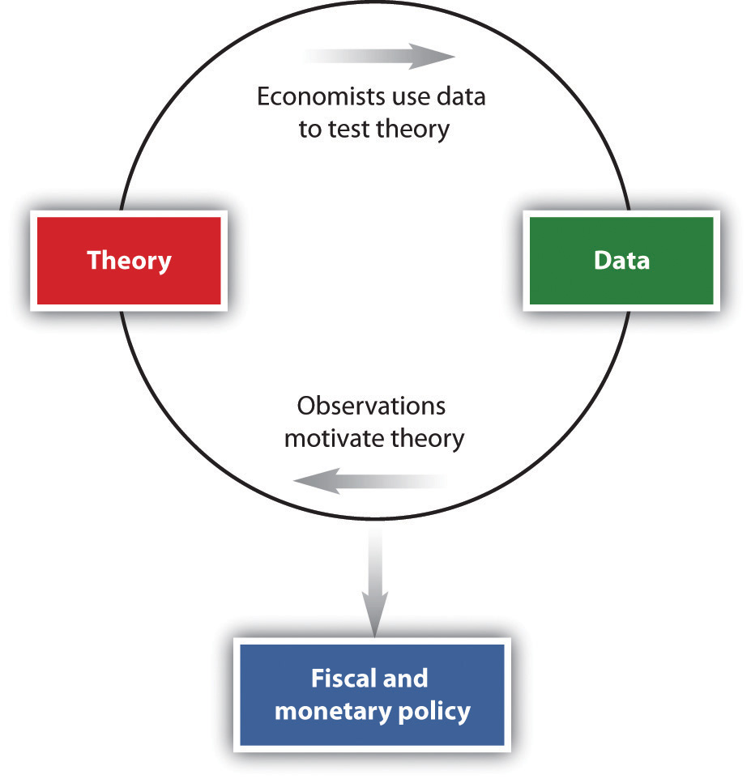
Notes:
When one examines what occurs in the real world, there is strong evidence that economic theory is in need of correction, and that public policies derived from accepted theory must be changed. I will explore these issues further as I proceed.

Slide 5
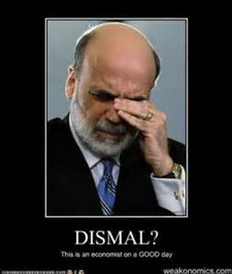
Notes:
It is no secret that the discipline of economics has been the subject of increasing criticism for the failure of most economists to provide meaningful insights into the causes of our boom-to-bust prone economic system. For many reasons, economics has long been referred to as the dismal science or as not a science at all.

Slide 6

Notes:
The list of critics of economics as a discipline and of its value in the real world is long and growing, from within and without the discipline.

Slide 7
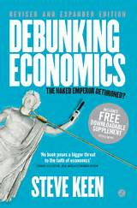

Notes:
One of the most vocal critics today is Professor Steve Keen of Kingston University, London, author of Debunking Economics, in which he writes:

Slide 8
“… If you look at mainstream economics there are three things you will not find in a mainstream economic model – Banks, Debt, and Money. How anybody can think they can analyze capital while leaving out Banks, Debt, and Money is a bit to me like an ornithologist trying to work out how a bird flies whilst ignoring that the bird has wings.”
Notes:
“… If you look at mainstream economics there are three things you will not find in a mainstream economic model – Banks, Debt, and Money. How anybody can think they can analyze capital while leaving out Banks, Debt, and Money is a bit to me like an ornithologist trying to work out how a bird flies whilst ignoring that the bird has wings.”

Slide 9
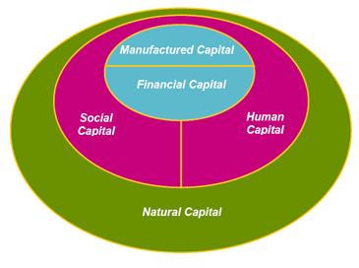
Notes:
An important question I would put to Professor Keen is his definition of “capital.” Economists and their predecessor political economists too often failed to explain what they meant when they wrote about capital. Actual capital goods – buildings, machinery, technologies – have characteristics quite distinct from currency or its digital equivalent, or what is broadly thought of as “financial capital.” The failure to make these distinctions makes scientific analysis impossible.

Slide 10
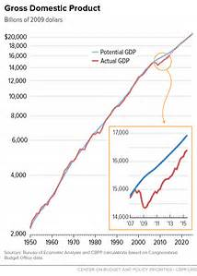
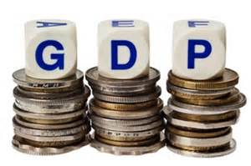
Notes:
Another problem is the interpretation of statistics. Economists and most mainstream analysts consistently point to the measurement labeled Gross Domestic Product to indicate the extent to which our economy is growing. An increase in GDP is automatically considered a positive indicator.

Slide 11
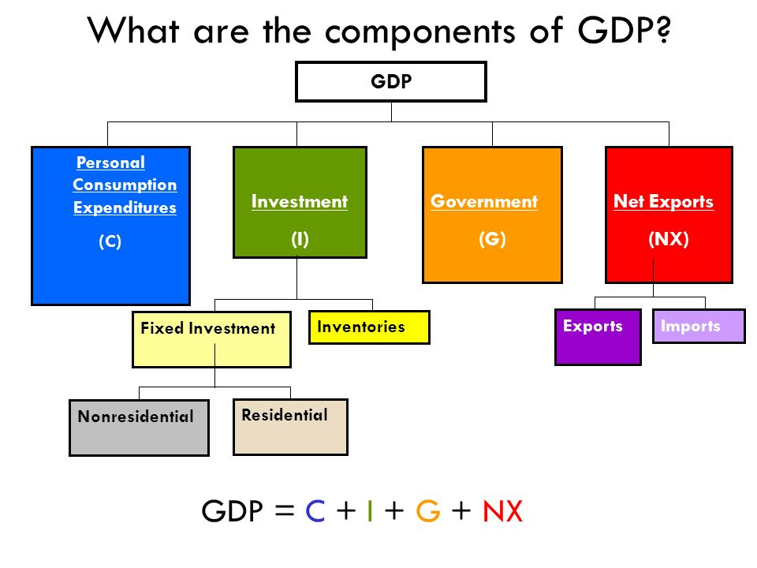

Notes:
In reality, relying on GDP as a measurement of the health of the economy is problematic. GDP includes all spending by government regardless of the source of funding – whether from taxes, borrowing or monetary expansion by the Federal Reserve System. More than this, there is no qualitative judgment regarding what the spending is for.

Slide 12
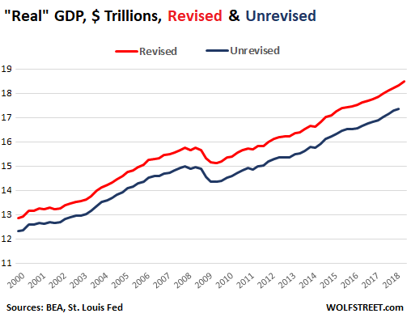
Notes:
A change in the calculation of “real” GDP from using 2009 dollars to using 2012 dollars, an a reduction in the inflation index used for “real” GDP calculation by the Bureau of Economic Analysis resulted in a $952 billion adjustment – from a first quarter initial figure of $17.37 trillion to a revised figure of $18.32 trillion.

Slide 13


Notes:
An important issue for policymakers is the extent to which government borrowing crowds out private sector access to affordable credit. The total debt owed by the U.S. government reached $22 trillion during February of 2019. However, the massive infusion of new money into the U.S. economy by the Federal Reserve – and historically low rates of interest – has more than offset federal borrowing. TransUnion’s forecast of consumer borrowing for 2019

Slide 14


Notes:
TransUnion’s vice president of research and consulting forecasts continued growth in consumer spending and borrowing.

Slide 15
“Consumer demand for both personal loans and auto loans is expected to remain high, and lenders are expected to continue looking to expand their books of business by providing more subprime and near prime borrowers with loans. …Delinquency rates remain at either low or ‘normal’ levels, and lenders have confidence to open up their portfolios to slightly more risk.”
Notes:
“Consumer demand for both personal loans and auto loans is expected to remain high, and lenders are expected to continue looking to expand their books of business by providing more subprime and near prime borrowers with loans. …Delinquency rates remain at either low or ‘normal’ levels, and lenders have confidence to open up their portfolios to slightly more risk.” [Quoted in: “U.S. Consumer Credit Market Poised for More Growth in 2019,” Associated Press, 12 December, 2018]

Slide 16

Notes:
Within the political arena, there continues to be great discussion and debate over stimulating the economy by a massive infusion of spending to repair and rebuild the nation’s infrastructure. This will certainly create employment and profits for businesses. Where will the funding come from? The Trump Administration’s announcement early in 2018 of a $200 billion allocation, to be matched 4-to-1 by state and local government, has not resulted in legislation or funding. In its 2017 report, the American Society of Civil Engineers estimated that the U.S. needs to allocation $4.6 trillion between now and 2025 to keep pace with infrastructure needs.

Slide 17
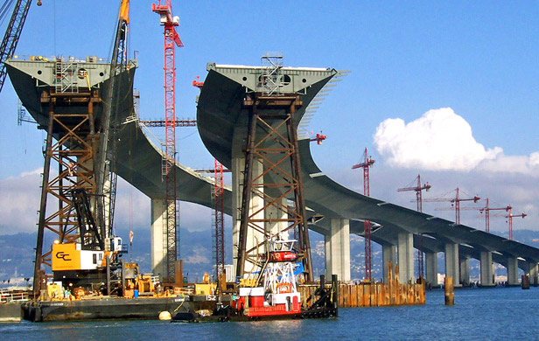
Notes:
Of course, spending on new infrastructure, such as bridges, tunnels, highways, airports or rail lines enable goods and people to move more efficiently from location to location. These investments in public goods yield strong returns to our society. They also generally result in windfall gains to owners of adjacent and nearby locations. The public capture of these gains could significantly lower the amount of debt incurred by infrastructure spending.

Slide 18

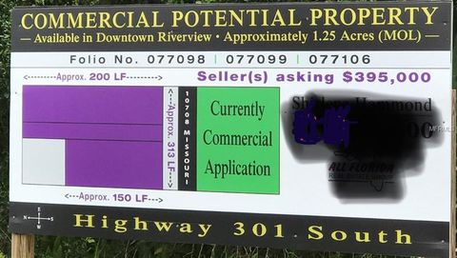
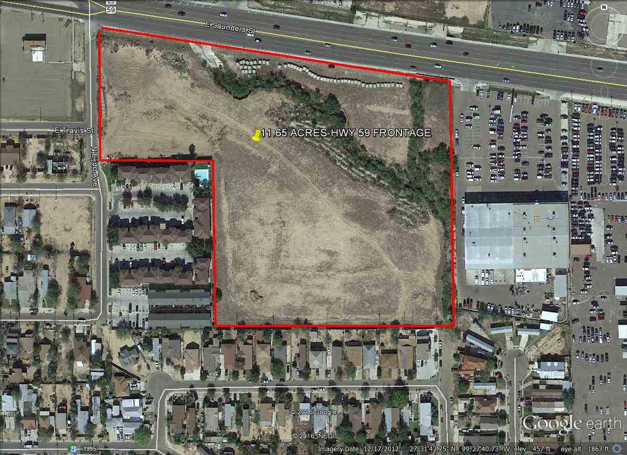
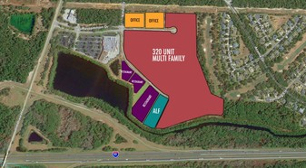
Notes:
Because of the almost universally-low effective rate of taxation on land rent, the not so positive side-effect of infrastructure spending is rising land costs that translate into a rising cost of doing business and a rising cost of cost of living for residents.

Slide 19
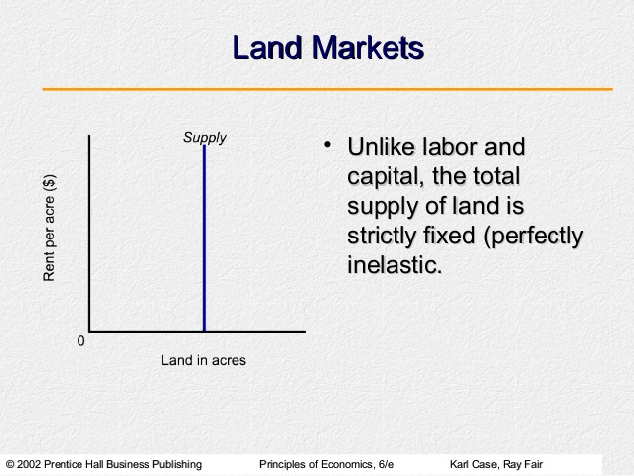
Notes:
It is worth taking a moment to provide an important insight into economic theory. Every parcel or tract of land has some potential annual rental value, that is, what the land would bring to its owner under an annually-adjusted lease payment. After subtracting whatever annual property tax payment is required, the owner experiences a net imputed income stream capitalized by market forces into a potential selling price for the land.

Slide 20
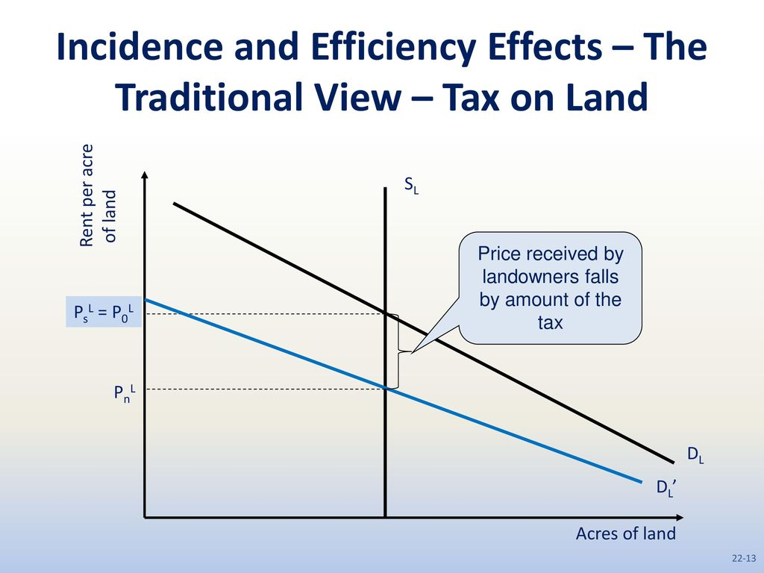
Notes:
The higher the annual tax payment, the lower the imputed income stream to be capitalized. Conversely, the lower the effective rate of taxation the higher will be the land prices (all other things being equal).

Slide 21
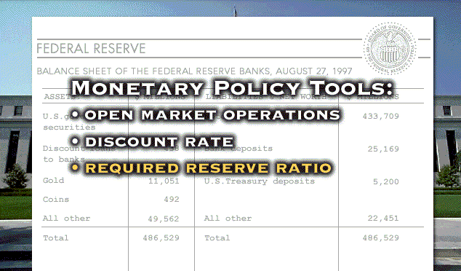
Notes:
A longer-term risk of government borrowing facilitated by adding to the money supply by quantitative easing is the prospect for hyper-inflation. However, the willingness of external trading partners to hold U.S. dollars or invest them in U.S. property markets and corporate shares has supported the exchange value of U.S. currency – at least to this point in time.

Slide 22
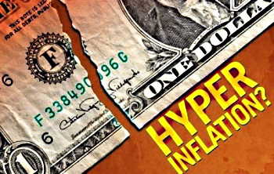
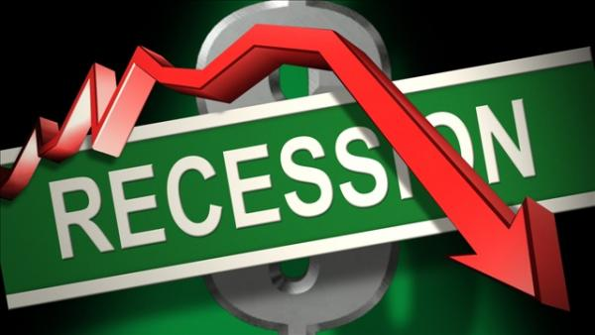
Notes:
Absent systemic reforms, the economic tools available to government and the Federal Reserve to respond to the threat of hyper-inflation are rather limited. The Federal Reserve can raise the rate of interest charged to member banks, which will then find their way through the economy and to yields on new issues of government securities. The risk, of course, is a recessionary downturn.

Slide 23
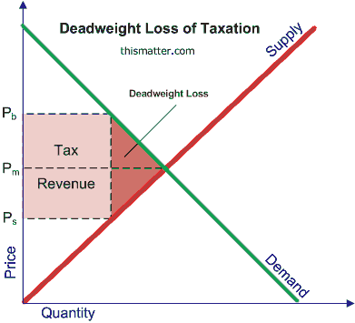
Notes:
How government at all levels raises needed revenue has huge but largely ignored implications for the health of our society. Specific public policies, including taxation policies, create monopolies and quasi-monopolies that impose what are called deadweight losses on asset production and economic output. Counter-productive policies result in a lower value of goods and services produced – and higher prices -- than would have occurred absent these policies.

Slide 24
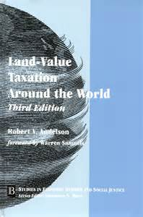
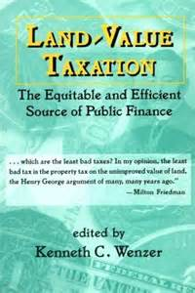
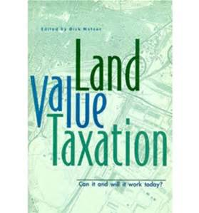
Notes:
I have come to agree with those economists who argue that only the taxation of land value – or, more specifically, the taxation of the potential annual rental value of land (and land-like assets, such as frequencies on the broadcast spectrum) – impose no deadweight loss on economic output.

Slide 25
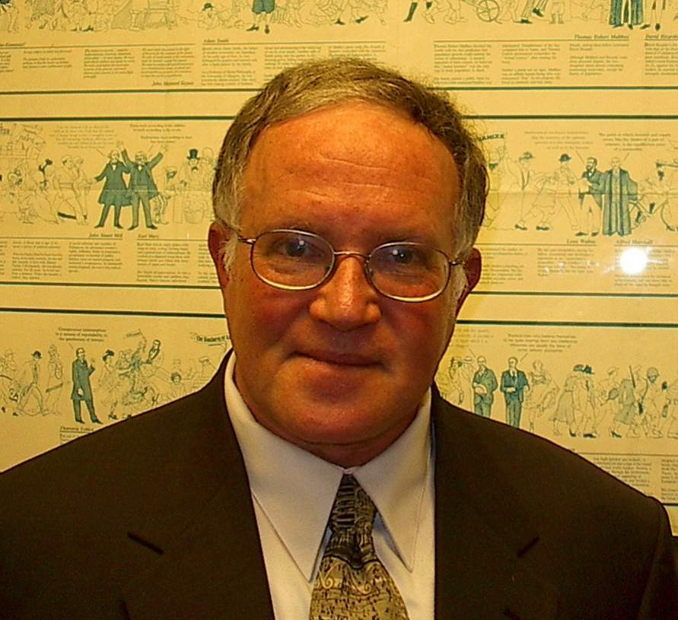
Notes:
Professor Fred Foldvary of San Jose State University explains the consequences of our current public revenue system and what the elimination of deadweight losses would do for the economy and our society:

Slide 26
“The overall excess burden of taxation in the USA has been estimated at about $1.5 trillion dollars, more than 10 percent of total output. So roughly, our standard of living would be ten percent higher if the deadweight loss were eliminated. …”
Notes:
“The overall excess burden of taxation in the USA has been estimated at about $1.5 trillion dollars, more than 10 percent of total output. So roughly, our standard of living would be ten percent higher if the deadweight loss were eliminated. …”

Slide 27
Notes:
He goes on to make the case for the elimination of most other taxes:

Slide 28
“With the elimination of taxes on wages, sales, buildings, and entrepreneurial profits, the economy would take a quantum leap up to dazzling productivity. The demand for labor would surge and wages would jump to now unimaginable levels.”
Notes:
“With the elimination of taxes on wages, sales, buildings, and entrepreneurial profits, the economy would take a quantum leap up to dazzling productivity. The demand for labor would surge and wages would jump to now unimaginable levels.” [Fred Foldvary, “Losses are staggering when taxes induce less productive land use,” The Progress Report, 3 December 2007]

Slide 29
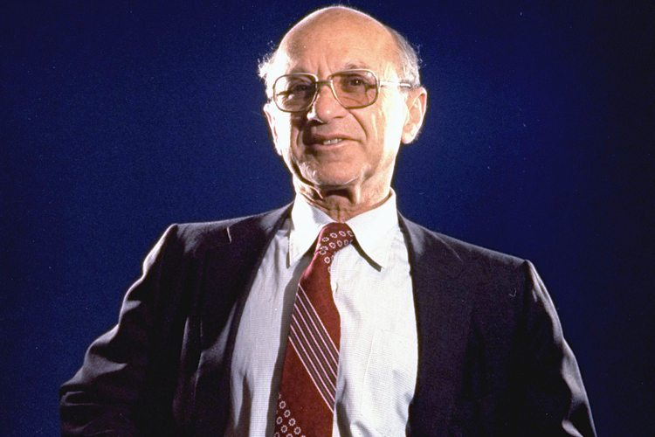
Notes:
Several decades ago another economist, Milton Friedman, advanced this same change in tax policy:

Slide 30
“There’s a sense in which all taxes are antagonistic to free enterprise – and yet we need taxes. …In my opinion the least bad tax is the property tax on the unimproved value of land…”
Notes:
“There’s a sense in which all taxes are antagonistic to free enterprise – and yet we need taxes. …In my opinion the least bad tax is the property tax on the unimproved value of land…” He adds:

Slide 31
“Governments can collect taxes best on things that don’t move. Land is an ideal basis of taxation because you can’t take it away.”
Notes:
“Governments can collect taxes best on things that don’t move. Land is an ideal basis of taxation because you can’t take it away.” [Source: Comment during public debate of the American Education League, reported in Human Events, 18.11.78, p.14]

Slide 32
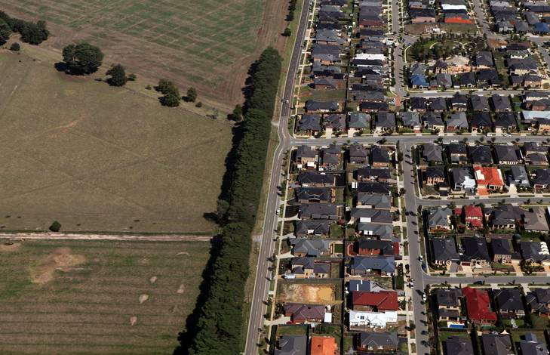
Notes:
32
A low effective annual tax on the potential rental value of locations in our towns and cities, on natural resource-laden land, and other natural assets generates this income stream. The result is intense speculation in land and high land acquisition costs for development of housing, for resource development and other uses – even as huge areas of land in a community remain vacant.

Slide 33
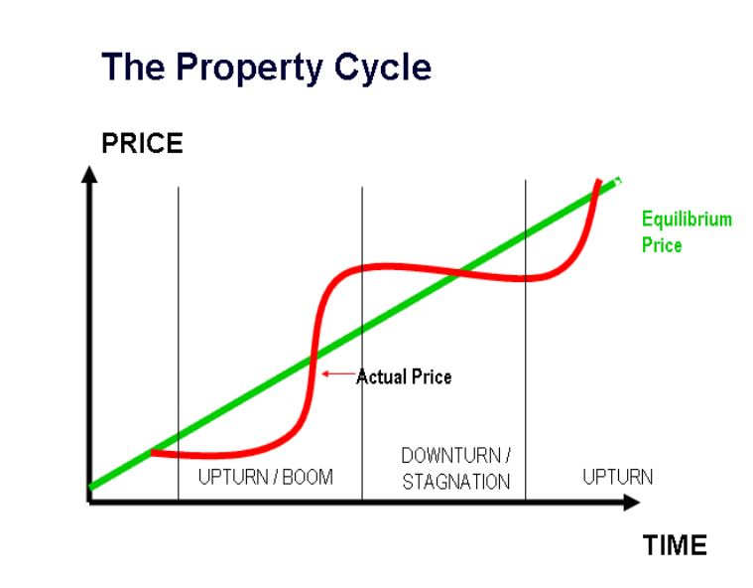
Notes:
33
Access to cheap credit adds fuel to already speculation-driven land markets. Land prices eventually reach a level where businesses can no longer absorb the cost pushed through to office, commercial and retail rents, and a growing number of households can no longer qualify for the mortgage financing to acquire housing.

Slide 34
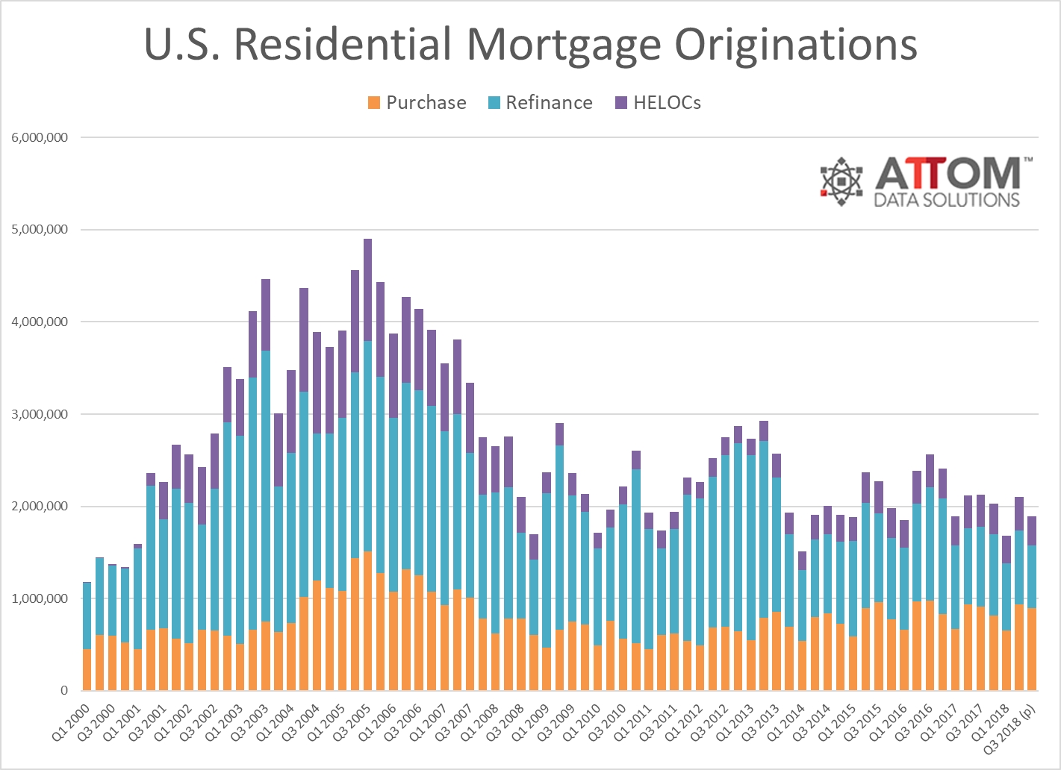
Notes:
34
In order to keep up the level of transactions, mortgage lenders and investors respond by increasing the level of permitted financing, by lowering cash down payment requirements, and by adopting more flexible creditworthiness criteria. The combined effect is to increase the aggregate level of risk in the event of a market correction or economic contraction.

Slide 35
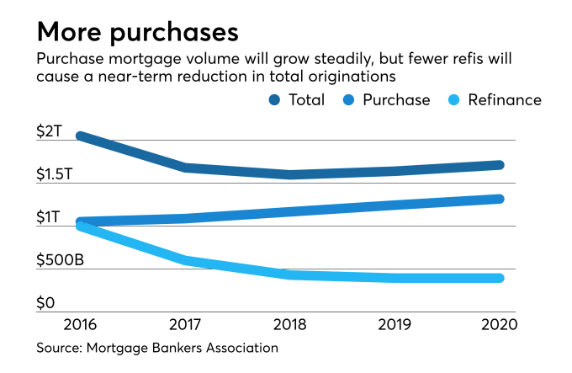
Notes:
35
As mortgage interest rates have risen since 2016, the effect has been a reduction in the number of refinance transactions by property owners. In November of 2018, the average contract interest rate for 30-year fixed-rate mortgage loans within conforming loan limits ($453,100 or less), was 5.16 percent. Thus, with rates at their highest level in eight years, refinance levels have continued to fall, down 40 percent from the previous year.

Slide 36
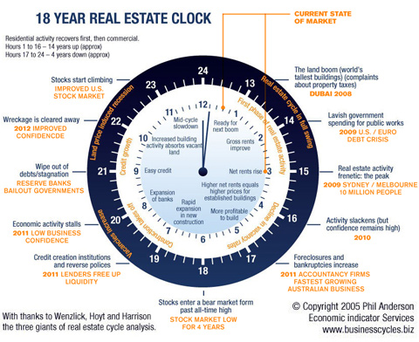

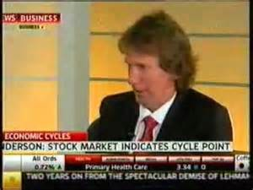
Notes:
36
The resulting stress of rising land prices brings on a property market crash every 18-20 years. Australian analyst Phillip Anderson detailed this cyclical activity in his 2005 book The Secret Life of Real Estate and Banking:

Slide 37
“A study of US history … reveals a very clear (average) 18 year cycle in US real estate prices, measured from trough to trough or peak to peak. The actual cycle has never been shorter than 17 years, never longer than 21.”
Notes:
37
“A study of US history … reveals a very clear (average) 18 year cycle in US real estate prices, measured from trough to trough or peak to peak. The actual cycle has never been shorter than 17 years, never longer than 21.” [from phillipjanderson.com/18-year-real-estate-cycle]

Slide 38
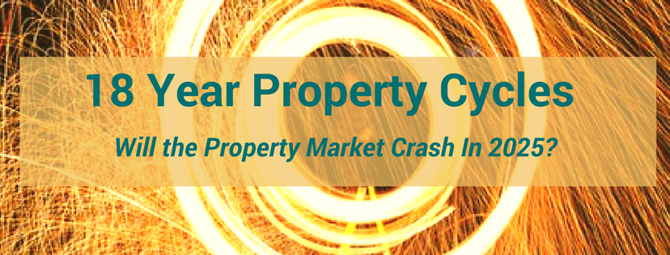
Notes:
Unfortunately, few policy analysts and even fewer of the nation’s elected representatives have come to terms with the nation’s counter-productive tax structure that is at the heart of our boom-to-bust economic system.

Slide 39
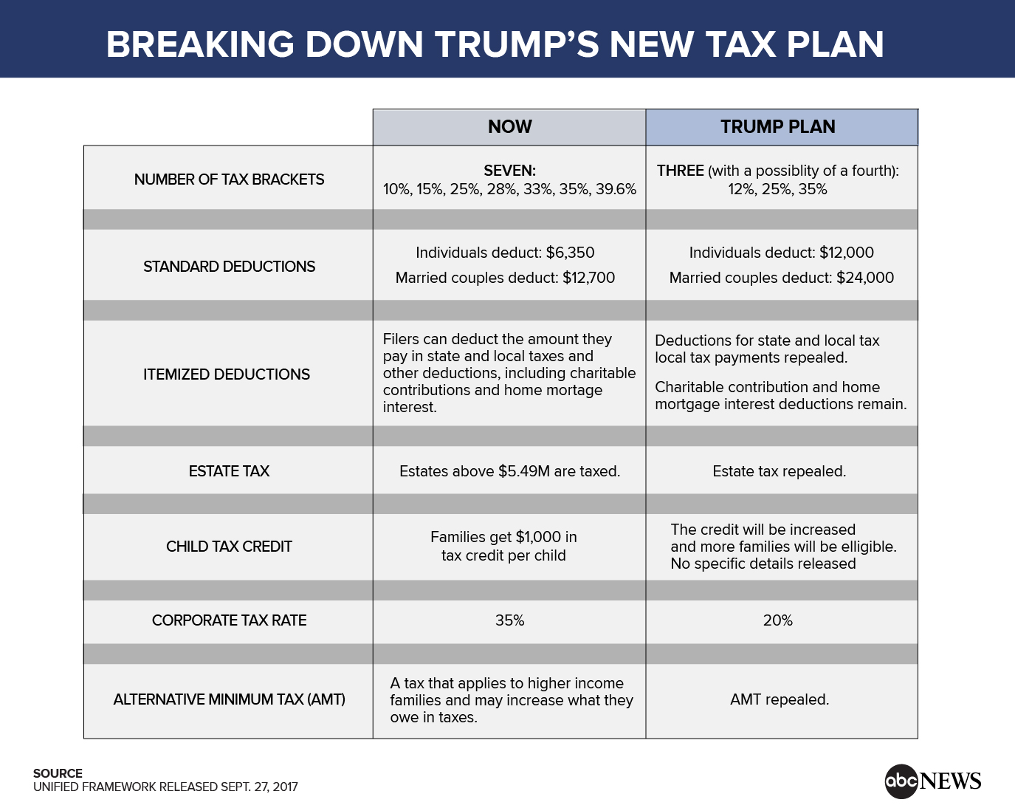
Notes:
Fairness is one issue. Economic efficiency is the other. On these matters there are widely diverse opinions and very powerful vested interests doing all they can to preserve the subsidies by which they benefit. The 2017 tax bill signed by President Trump does not, in my opinion, address any of these fundamental problems for the simple reason that there is no distinction made between income that is rent-derived (and, therefore, unearned) and income earned producing goods or delivering services. In fact, unearned income receives even more advantageous tax treatment.

Slide 40

Notes:
40
The editors of the Bloomberg Report reached the following conclusion in 2013:

Slide 41
“The federal government directly spends between $75 billion and $100 billion a year on everything from farm subsidies to research grants. Include indirect benefits from things like tariffs and corporate tax exclusions, and the favors granted by local and state governments, and the total is much higher – probably more than $1 trillion.”
Notes:
41
“The federal government directly spends between $75 billion and $100 billion a year on everything from farm subsidies to research grants. Include indirect benefits from things like tariffs and corporate tax exclusions, and the favors granted by local and state governments, and the total is much higher – probably more than $1 trillion.” [Source: “Ending Corporate Welfare One Program at a Time,” BloombergView, 4 February, 2013]

Slide 42


Notes:
42
With this as an introduction, let’s look in some detail at the most important segments of our economy and at the benchmarks of who owns what and how income is distributed in our society.

Slide 43
End of Part 1
Notes:
End of Part 1

