Slide 1
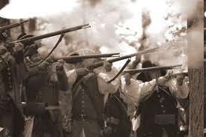
William Johnson:
A Remarkable Life on the Early American Frontier

Slide 2
Written by
Edward J. Dodson, M.L.A.

Slide 3
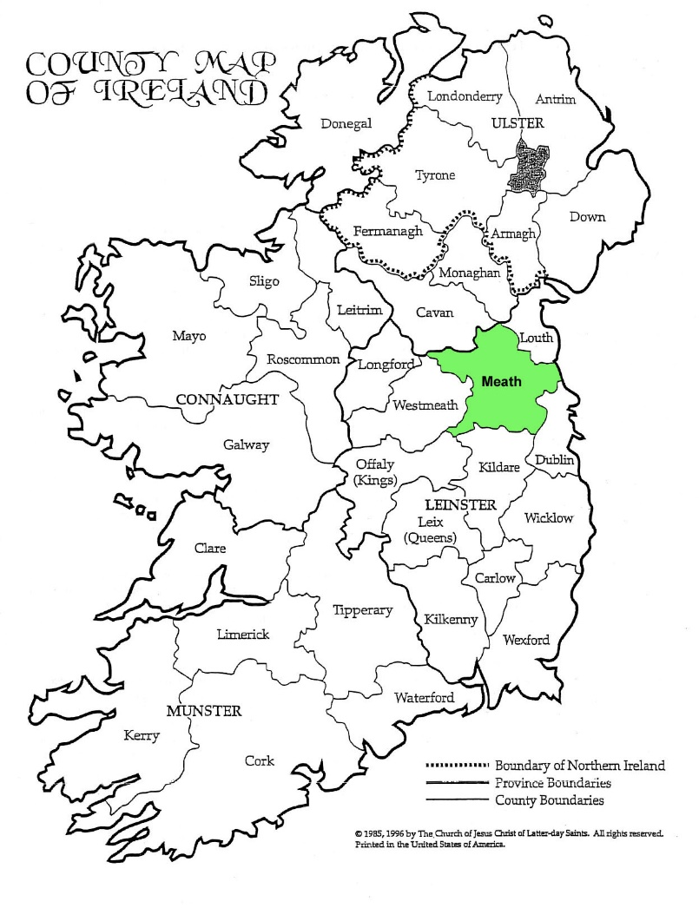
Notes:
William Johnson was born in 1715 at Warrenstown, County Meath, Ireland. His father, Christopher, was a tenant miller of the Earl of Fingal. His mother, Ann Warren Johnson, was the daughter of the owner of a fine stone manor. Christopher had managed to marry above his station.

Slide 4
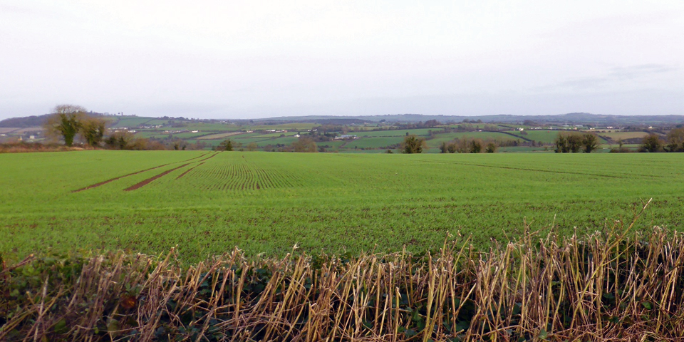
Notes:
William’s father was a Catholic. As such he was forbidden under English law to purchase land. He was fortunate to be able to lease enough land from the Earl of Fingal to provide for his family.

Slide 5
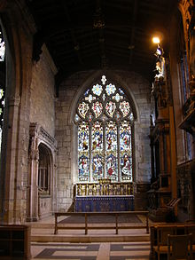
Notes:
Young William Johnson realized at an early age that the only people who could stay in British-held Ireland and remain Catholics were peasants, priests, and martyrs. So, he abandoned the Catholic religion and outwardly adopted the faith of the Church of England.

Slide 6
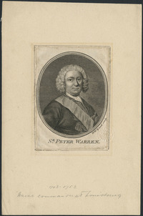
Notes:
On the 29th of April, 1737, William received a letter from his uncle, Peter Warren, a captain in the British navy. The letter read:

Slide 7
“…I have heard from my beloved sister Anne … that you have grown to be a fine, strong, intelligent young man with great imagination and distinct qualities of leadership. …”
Notes:
“…I have heard from my beloved sister Anne … that you have grown to be a fine, strong, intelligent young man with great imagination and distinct qualities of leadership. …”

Slide 8
“I am pleased to learn this, for it has become my lot to seek the services of just such an individual, to manage for me a bountiful section of land I have become possessor of in the valley of the River Mohawk here in America. This title encompasses an area of 14,000 acres of fine ground.”
Notes:
“I am pleased to learn this, for it has become my lot to seek the services of just such an individual, to manage for me a bountiful section of land I have become possessor of in the valley of the River Mohawk here in America. This title encompasses an area of 14,000 acres of fine ground.”

Slide 9
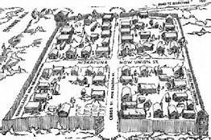
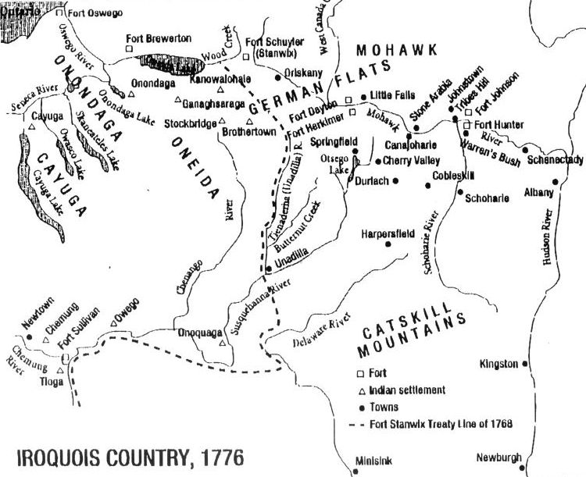
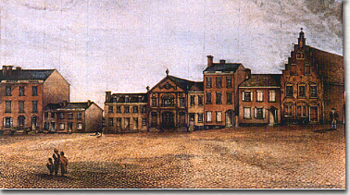
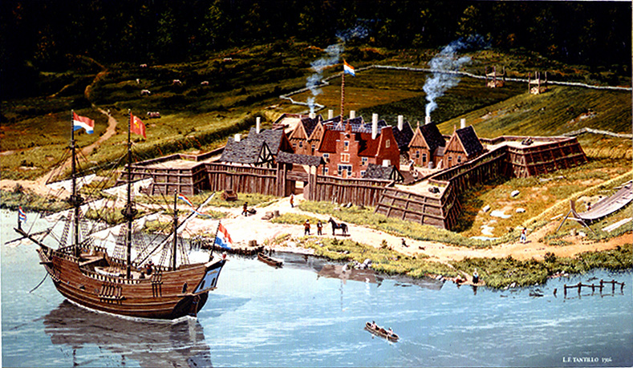
Schenectady
Albany
Notes:
What neither Peter Warren nor William Johnson appreciated was the wildness of this land, thinly occupied by Dutch settlers and the people of the Mohawk tribe, the most eastern member of the Iroquois League.

Slide 10
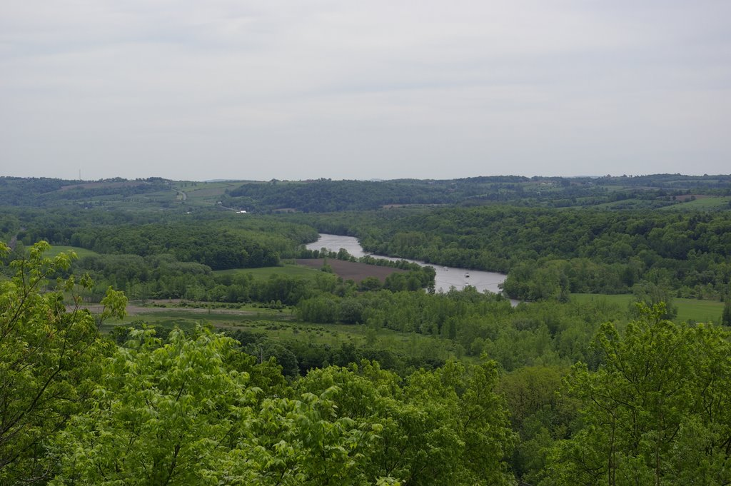
Notes:
William arrived in North America early in 1738 and made his way up the Hudson and Mohawk Rivers. In Albany he purchased a horse and continued to Schenectady, still a small village surrounded by farms . As he approached his uncle’s land, he found steep hills and the travelling difficult. Rough cabins replaced farm houses as he continued riding on.

Slide 11
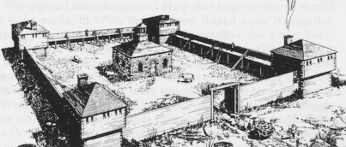
Notes:
He finally came upon Fort Hunter, built by English colonists in 1712 at the request of the Mohawks in exchange for permitting Palatine Germans to settle in Mohawk territory and to provide a location to exchange furs for European goods.

Slide 12
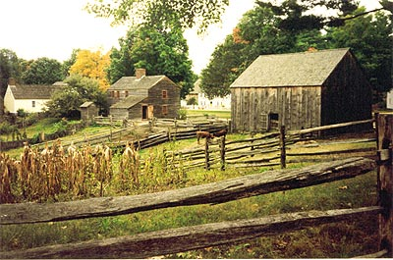
Notes:
William set to work building a farmhouse, barn, stables and barracks for servants and slaves. Soon a store was built on the winding road leading from Fort Hunter to the east.

Slide 13
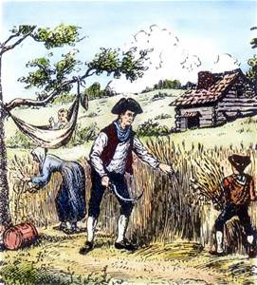
Notes:
His next task was to find settlers willing to lease land in two-hundred-acre plots, as directed by his uncle.

Slide 14
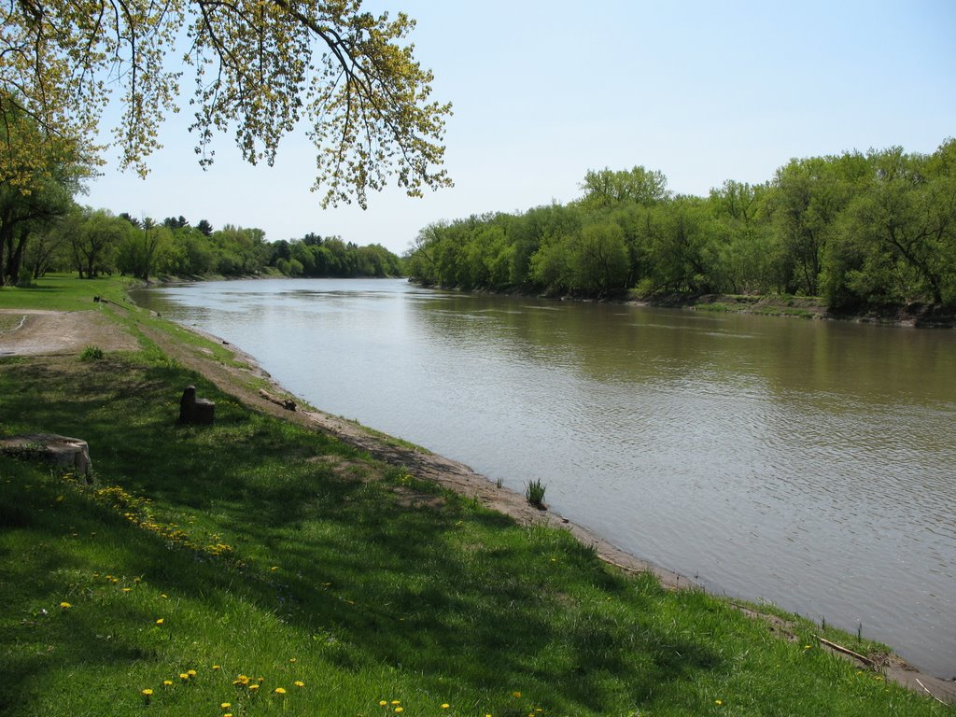
Notes:
William soon demonstrated a keen understanding of the trade goods needed on the frontier. He also saw that the main route being travelled was across the Mohawk River on land with a much easier terrain. With his share of the store’s profits for the year, he went to Albany and bought the land, running a quarter mile along the river’s edge and one mile in depth to the north. Here, he constructed a new store that soon attracted a huge amount of trade.

Slide 15
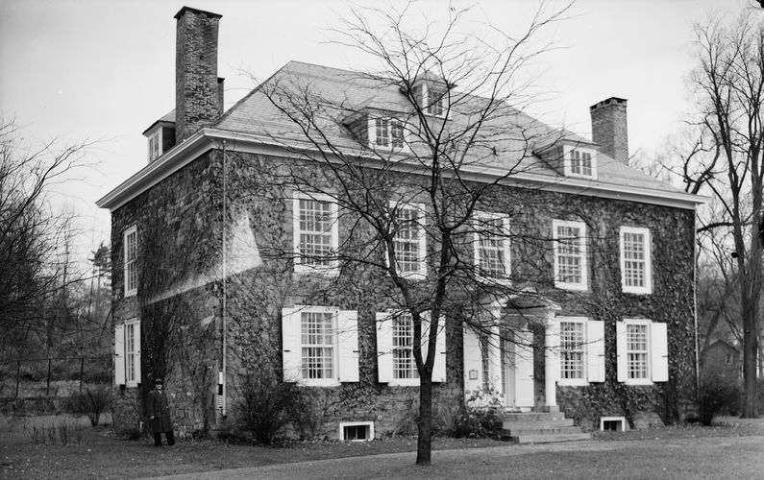
Notes:
His business profits increasing, William then constructed this stone mansion, completed in February of 1740 and named Mount Johnson.

Slide 16
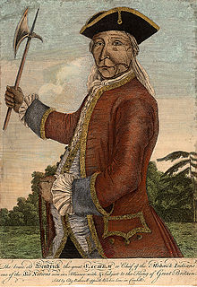
Notes:
William’s commitment to fair trading practices with everyone brought him to the attention of the powerful Mohawk chief, sometimes called Tianyoga or Theyanoquin, now past sixty years of age. Tianoga was one of four Iroquois leaders who had made the trip to London in 1710 for an audience with Queen Anne. Historian Allan Eckert explains:

Slide 17
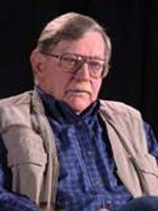
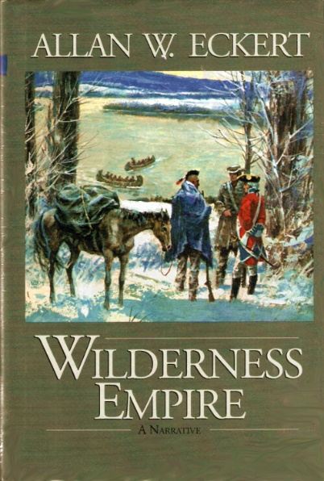
“The young man [William Johnson], Tiyanoga knew from personal observation, went out of his way to trade with them and to treat them fairly in every respect. This in itself was so unusual for a white man to do that when he heard of it, Tiyanoga had begun his surveillance in earnest.”
Notes:
“The young man [William Johnson], Tiyanoga knew from personal observation, went out of his way to trade with them and to treat them fairly in every respect. This in itself was so unusual for a white man to do that when he heard of it, Tiyanoga had begun his surveillance in earnest.” [Allan W. Eckert. Wilderness Empire (Boston: Little, Brown and Company, 1969), p.49]

Slide 18
“The Indians could scarcely believe what happened when William dealt with them. ...[W]hen they came groggily erect the next morning, they found that the rum they had drunk was not charged against them, that their pelt bundles were intact, and that an excellent deal awaited them in the trade.”
Notes:
“The Indians could scarcely believe what happened when William dealt with them. ...[W]hen they came groggily erect the next morning, they found that the rum they had drunk was not charged against them, that their pelt bundles were intact, and that an excellent deal awaited them in the trade.” [Allan W. Eckert. Wilderness Empire (Boston: Little, Brown and Company, 1969), p.50]

Slide 19
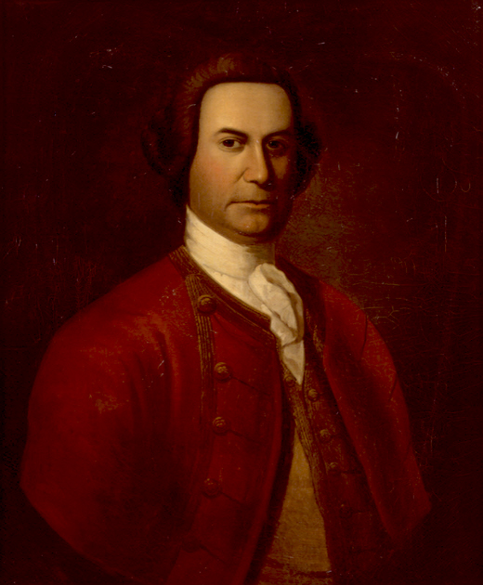
Notes:
William learned to speak the Mohawk tongue and gained the trust of Tiyanoga. The Mohawk needed a white champion for their interests, and they decided to adopt William Johnson into the tribe and into the Iroquois League. Johnson was given the name Warraghiyagey – The Man Who Undertakes Great Things.

Slide 20
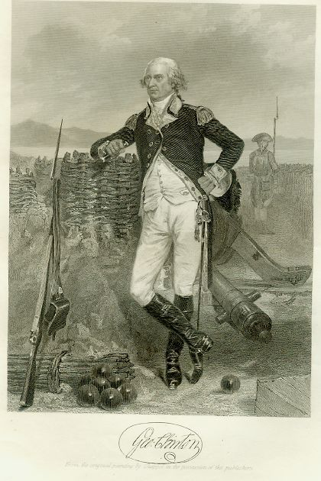
Notes:
George Clinton, Governor of New York Colony, also saw the advantage of having a reliable liaison with the Mohawk and other Iroquois tribes. Taking office in 1743 he appointed William to the post of Superintendent of Affairs of the Six Nations. He also appointed him a justice of the peace.

Slide 21
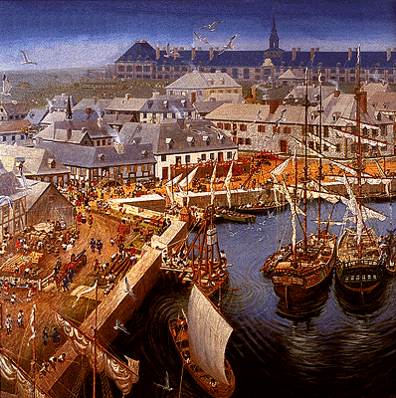
Notes:
In May of 1744, the French dispatched a strong naval force from Fort Louisbourg in Canada against British positions in the Grand Banks area, where fishing rights were in dispute. Yet another war between France and Great Britain was underway.

Slide 22
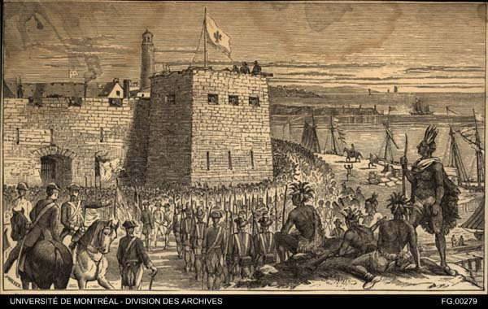
Notes:
In 1746 New York’s Governor Clinton gave William the job of supplying the vital English garrison at Fort Oswego, constructed on Lake Ontario in 1727. In the same year he was also appointed Commissary for Indian Affairs. He was given the rank of colonel, in command of the Iroquois warriors he was able to call upon to fight the French. From Tiyanoga, William Johnson learned how the Iroquois viewed the manner in which white generals fought wars:

Slide 23
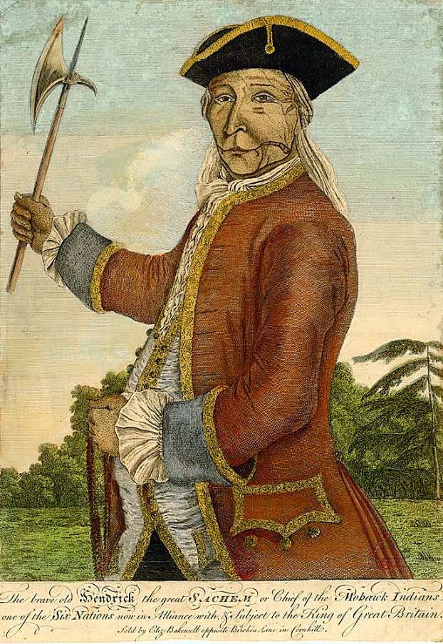
“The white general, no matter whether he is English or French, thinks little of sacrificing his men to win his goal, but to an Iroquois chief, no warrior of his is worth any other life in trade. It is our aim to take scalps without losing our own as part of the bargain. Such is the type of war we make.”
Notes:
“The white general, no matter whether he is English or French, thinks little of sacrificing his men to win his goal, but to an Iroquois chief, no warrior of his is worth any other life in trade. It is our aim to take scalps without losing our own as part of the bargain. Such is the type of war we make.” [Allan W. Eckert. Wilderness Empire (Boston: Little, Brown and Company, 1969), pp.83-84]

Slide 24
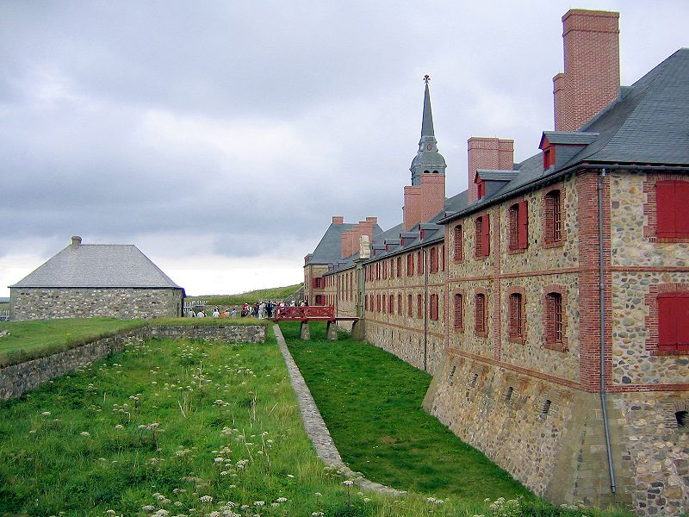
Notes:
A tense peace returned in 1748 with the signing of the Treaty of Aix-la-Chapelle. Britain returned the Fortress of Louisbourg to France, over the objections of colonial officials.

Slide 25
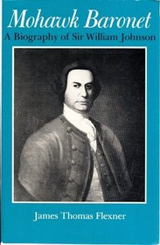
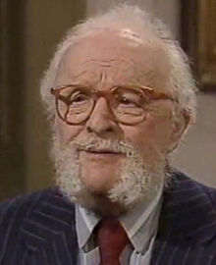
Notes:
In his biography of William Johnson, James Thomas Flexner describes what everyone on the frontier felt was about to occur:

Slide 26
“Since the whites as a group were more concerned with money than glory, the return of peace would bring speculators crowding over Indian lands from which the soldiers had shuddered.”
Notes:
“Since the whites as a group were more concerned with money than glory, the return of peace would bring speculators crowding over Indian lands from which the soldiers had shuddered.”

Slide 27
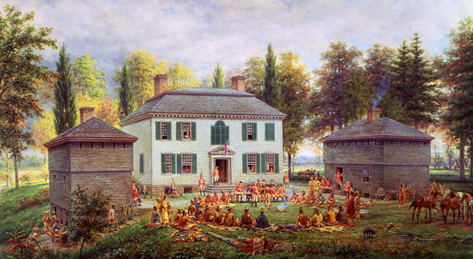
Notes:
William’s attentions were now concentrated on construction of a new home, about a mile from his existing residence.

Slide 28
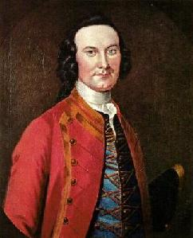
Notes:
He sat for this portrait in 1750, painted by a well-known artist named John Wollaston.

Slide 29
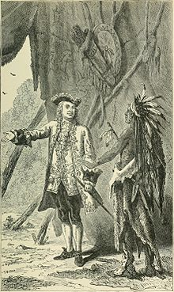
Notes:
Out of his own financial resources, William supplied both the militia and the Iroquois warriors during the war with the French. Despite repeated petitions, the New York Assembly denied his petitions for reimbursement, and in 1751 he resigned his position. In his absence, relations between the Iroquois and the New York colonials darkened.

Slide 30
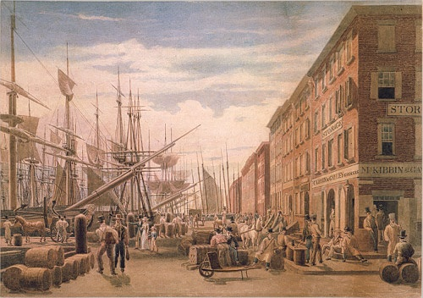
Notes:
However, in November of 1751, William decided to take his seat in the Provincial Council at New York City. Viewed as rough and crude by the refined New Yorkers, William was unable to gain support for his proposals to assist the Iroquois and fund repairs at Fort Oswego.

Slide 31
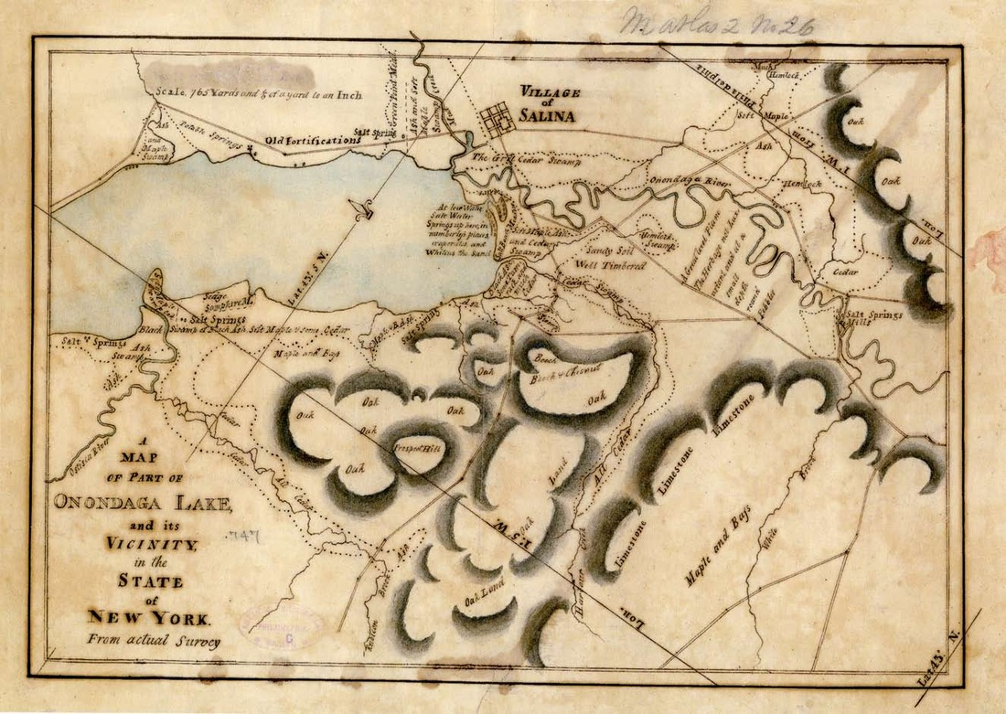
Notes:
However, he was finally able to settle his financial dispute with the New York Colony. As payment of all the debts the colony owed him, he was granted a tract of land on Onondaga Lake. He also purchased land on a tributary of the Susquehanna River from the Mohawks. And, on another purchase he began the construction of a town to be named Johnstown.

Slide 32
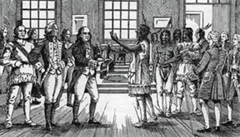
Notes:
As tensions between the French and English intensified, the Board of Trade in London ordered the colonies to meet with the Iroquois representatives and work out a unified Indian policy. They met in Albany in 1754. William Johnson attended as a member of the New York Council.

Slide 33
Notes:
With the renewal of war, the Governor of New York petitioned William to come back, promising to pay him all that was still owed to him by the colony. At the end of 1754 he wrote the Governor that he would abandon his business in the fur trade and devote the rest of his life to the public service.

Slide 34
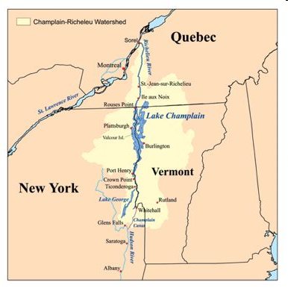
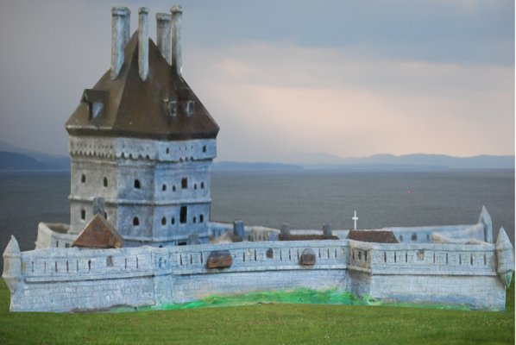
Fort St. Frederic at Crown Point
Notes:
At the same time, the Baron Dieskau was leading a force of three thousand five hundred French soldiers and Indian warriors down Lake Champlain from Fort St. Frederic at Crown Point.

Slide 35
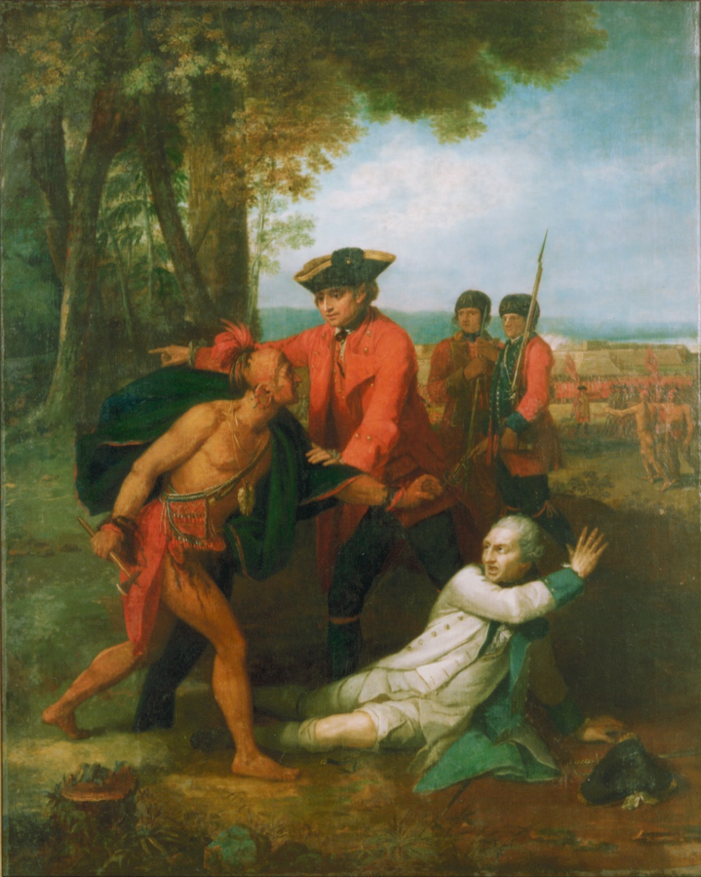
Notes:
William led a force that fought off the French, capturing the French commander and preventing his execution by Iroquois warriors according to their practice. Afterward, William received a baronetcy from the King and a significant cash award.

Slide 36
Marquis Louis Montcalm.
Notes:
After the news of the defeat of the French force reached the French Minister of War, a new commander was selected to take over all military affairs in New France, the Marquis Louis Montcalm.

Slide 37
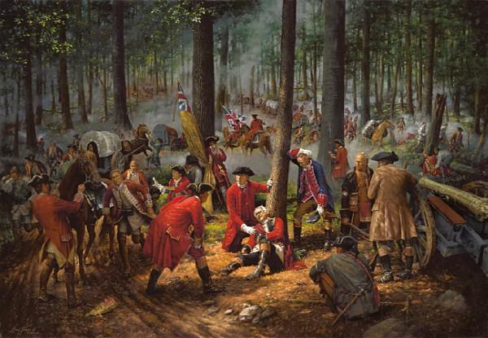
Notes:
Britain’s fortunes looked dire. General Braddock’s force marching on Ft. Duquesne was destroyed, and the support or even neutrality of the tribal peoples toward British interests was on the verge of disappearing.

Slide 38
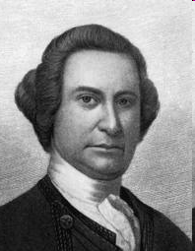
Notes:
In February 1756 William was appointed Sole Agent and Superintendent of Indians and their Affairs – independent of any responsibility to answer to colonial governors.

Slide 39
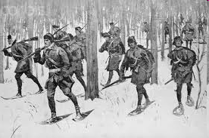
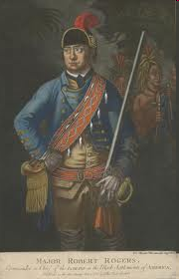
Notes:
As winter arrived, William Johnson assigned Robert Rogers to lead his Rangers on scouting expeditions north to Crown Point and Ticonderoga. Rogers reported that the French were constructing a strong fortress at Ticonderoga.

Slide 40
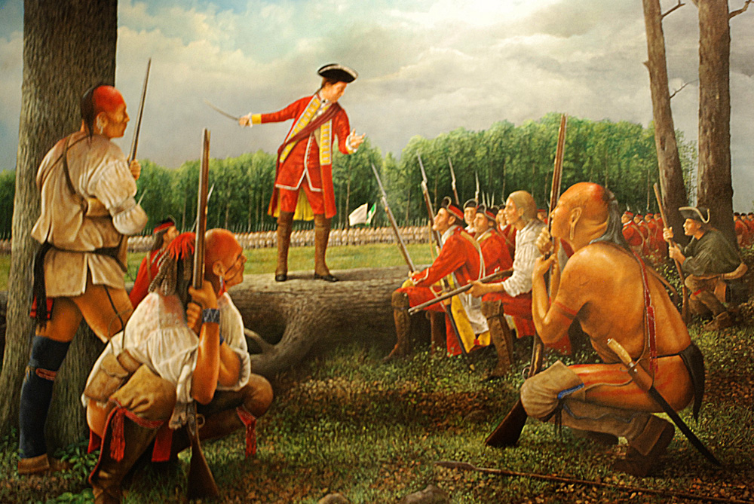
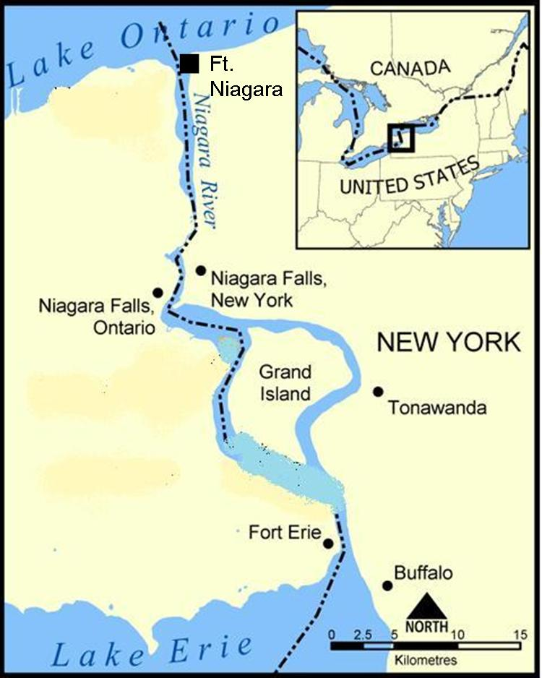
Notes:
Britain’s fortunes on the frontier finally began to change in 1759, with the siege of Fort Niagara. William Johnson was appointed second in command, leading a force of around 600 Indians. When the British commander was killed, William assumed command of the entire force and won an important victory. James Thomas Flexner describes the change of circumstances that resulted from Johnson’s efforts:

Slide 41
“The conquest of Niagara was the greatest English military victory so far achieved on the American mainland during the French and Indian War, and its effects were incalculable. …In New York City, the favorite toast was ‘Johnson forever!’”
Notes:
“The conquest of Niagara was the greatest English military victory so far achieved on the American mainland during the French and Indian War, and its effects were incalculable. …In New York City, the favorite toast was ‘Johnson forever!’” [James Thomas Flexner. Mohawk Baronet, A Biograph of Sir William Johnson (Syracuse University Press, 1959,1979), p.201]

Slide 42

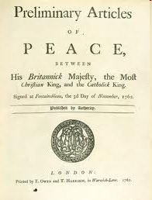
Notes:
In 1763, the Treaty of Paris was signed officially ending the Seven Years’ War. France ceded to Britain all claims to territory in North America east of the Mississippi River.

Slide 43
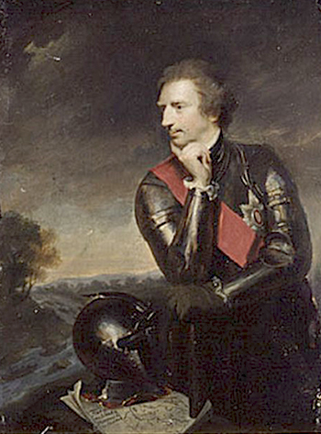
Sir Jeffery Amherst
Notes:
William Johnson now turned his energies to bringing more settlers from Ireland onto his land and into the region. At the same time he battled against new Indian policies of the British commander, Sir Jeffery Amherst, that dramatically reduced “gifts” the Indians were accustomed to receiving in return for their support of British interests. William sent grave warnings to England that war with the Indians was on the horizon.

Slide 44
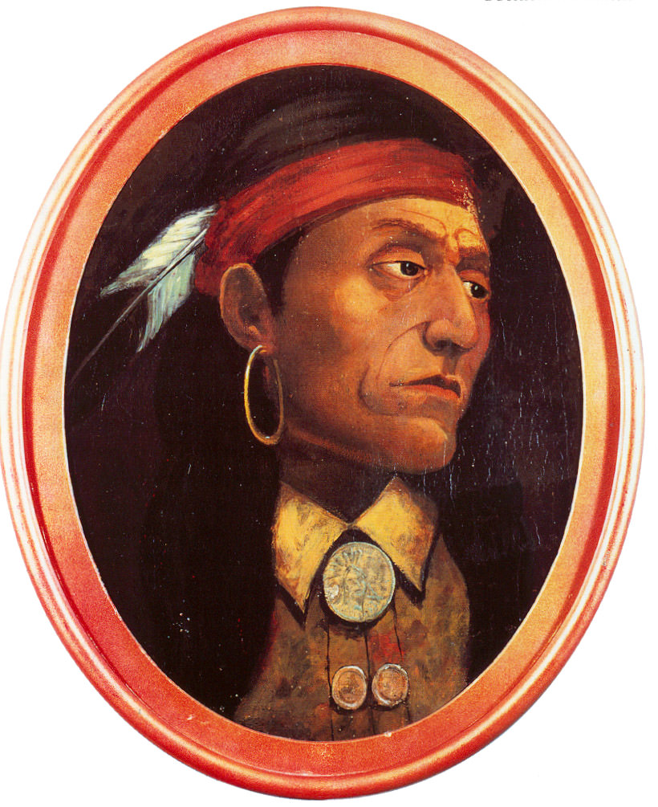
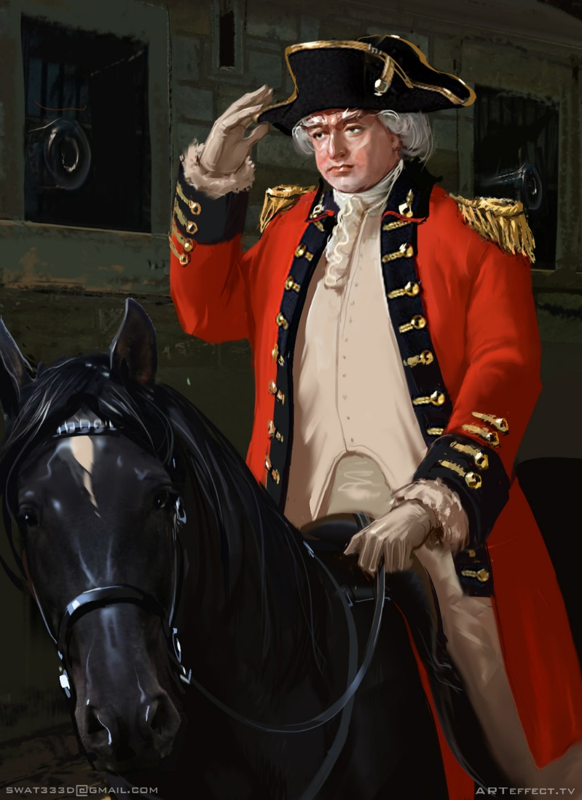
Notes:
Fortunately, Amherst was recalled and command transferred to General Thomas Gage, who sought advice from William Johnson in response to the uprising of Indian forces led by the Ottowa chief, Pontiac. At William’s suggestion a comprehensive plan for Indian policy was prepared by the Lords of Trade and sent to him in July 1764 for comment. The result is described by James Thomas Flexner:

Slide 45
“The Two Indian superintendents, Sir William and the southerner John Stuart, were to be responsible directly to the Crown and, to enhance their local power, were to sit as ex-officio members on the provincial councils of all colonies abutting on the frontiers they ruled. …The superintendents alone would be able to call Indian congresses, deal politically, determine war and peace. …”
Notes:
“The Two Indian superintendents, Sir William and the southerner John Stuart, were to be responsible directly to the Crown and, to enhance their local power, were to sit as ex-officio members on the provincial councils of all colonies abutting on the frontiers they ruled. …The superintendents alone would be able to call Indian congresses, deal politically, determine war and peace. ...” [James Thomas Flexner. Mohawk Baronet, A Biograph of Sir William Johnson (Syracuse University Press, 1959,1979), p.274]

Slide 46
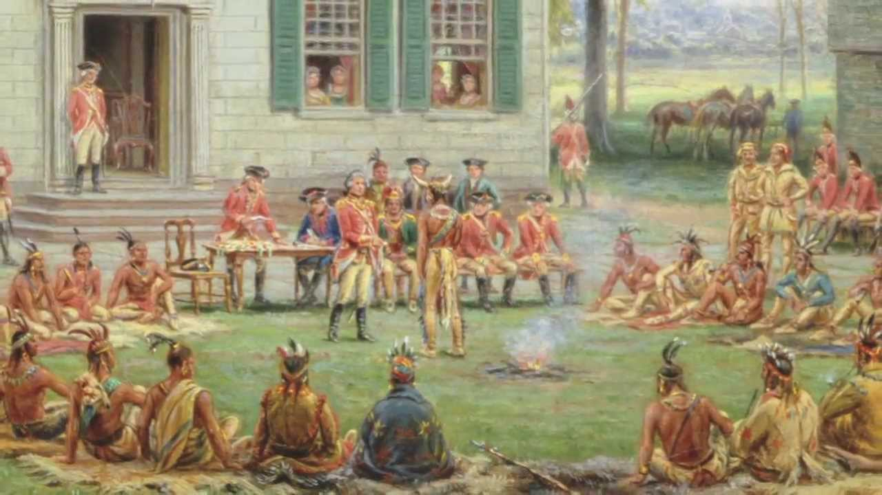
Notes:
Reporting directly to the British Crown, Johnson now held a position of very real power in influence events on the frontier.

Slide 47
“Sir William was certainly in his own generation and probably in the whole history of western expansion the most able frontiersman. He was no land speculator or merchant or soldier or territorial governor who made forays into the forest and then returned to bases in the civilized centers. He practiced all these callings and more; ...”
Notes:
“Sir William was certainly in his own generation and probably in the whole history of western expansion the most able frontiersman. He was no land speculator or merchant or soldier or territorial governor who made forays into the forest and then returned to bases in the civilized centers. He practiced all these callings and more; ...”
[James Thomas Flexner. Mohawk Baronet, A Biograph of Sir William Johnson (Syracuse University Press, 1959,1979), p.287]

Slide 48
“… he determined imperial policy and shaped the continent, yet he lived his whole effective life in the wilderness and saw the world in forest terms.”
Notes:
“… he determined imperial policy and shaped the continent, yet he lived his whole effective life in the wilderness and saw the world in forest terms.” [James Thomas Flexner. Mohawk Baronet, A Biograph of Sir William Johnson (Syracuse University Press, 1959,1979), p.287]

Slide 49
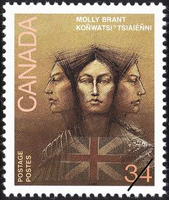
Notes:
Although devoted to his Mohawk brethren (he took as a wife the daughter of the sachem Aroghyiadecker, who the English called Nichus Brant, whose English name was Molly), he hoped to carry the British version of civilization and its laws into the territory occupied by the Indian tribes.

Slide 50
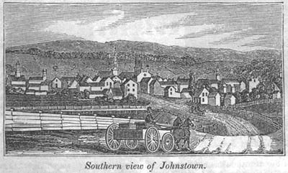
Notes:
Settlers to William Johnson’s expanding domain found peaceful relations with the Mohawk, land already cleared for use as communal fields as they readied their own farms, seed and even horses supplied on easy terms, roads connecting them with the outside world and several free schools. He also established an experimental farm to test new methods of production and different crops to determine whether they could be profitably cultivated.

Slide 51
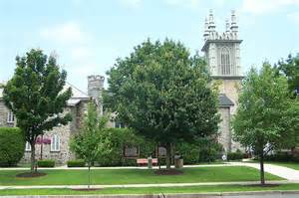
Notes:
During 1765 and 1766 he built -- at Johnstown -- St. John’s Episcopal Church and a residence for clergy. Five years later the population had increased to such an extent that a new church had to be built, large enough to accommodate 1,000 members.

Slide 52
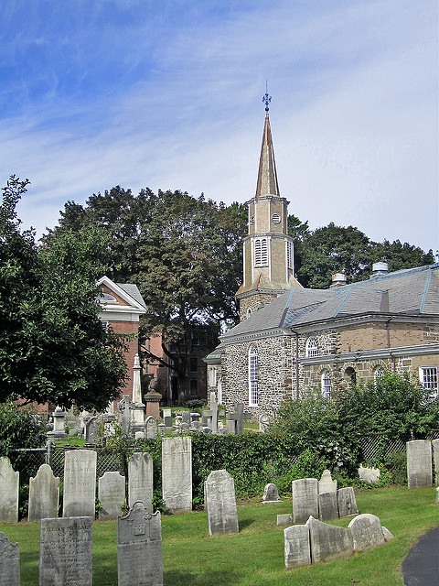
Notes:
He also provided the funds to construct St. George’s Anglican Church at Schenectady in 1769.

Slide 53




Notes:
His new manor home, Johnson Hall, was simply appointed, designed to convey calm, light and cheerfulness. However, his enlightened views had limits. Little is written about the fifteen or so people enslaved by William who worked 500 acres surrounding Johnson Hall and attended the family home.

Slide 54


Notes:
On another aspect of his character, James Thomas Flexner and other biographers describe in detail William’s sexual exploits with many women during his life. How many children he fathered is undocumented but could be in the hundreds. Molly Brant gave him three sons and six daughters.

Slide 55

Notes:
In 1766 he became a freemason, founding his own lodge at Johnstown. A year later he was appointed brigadier then major general of all of the new York militia above the Highlands.

Slide 56

Notes:
His last great accomplishment on behalf of the British empire was to negotiate in 1768 with the Iroquois and other tribes the purchase of territory for settlement that is today a corner of northern Alabama, most of West Virginia, much of Tennessee, and all of Kentucky.

Slide 57

Notes:
As the discontent increased throughout Britain’s American colonies, William’s region remained calm and contented.

Slide 58

John Johnson
Notes:
In January, 1774, he drew up his final will, in which he referred to Molly Brant as his housekeeper and to the mother of his son John, Catherine Weisenberg, as his “beloved wife.” He left contiguous tracts of land to each of his children, whether white or half-Indian. He died before the new conflict between Britain and its American subjects erupted. His last moments are described by James Thomas Flexner:

Slide 59
“As, scorning an interpreter, he addressed the sachems on July 11, 1774, in the arbor behind his house under the hot summer sun, he became ‘apprehensive of the fit coming on from a sense of compression and tightness across the stomach’. However, he continued to speak … ‘with all the spirit, activity and energy’ of an Indian. …’”
Notes:
“As, scorning an interpreter, he addressed the sachems on July 11, 1774, in the arbor behind his house under the hot summer sun, he became ‘apprehensive of the fit coming on from a sense of compression and tightness across the stomach’. However, he continued to speak … ‘with all the spirit, activity and energy’ of an Indian. …’”

Slide 60
“He ordered ‘pipes, tobacco, and some liquor for the Indians,’ and was then ‘obliged to call for assistance to get to his room.’ he ‘drank some wine and water, sat himself down in an elbow chair, reclined his head against the back of it, and expired without a groan.’”
Notes:
“He ordered ‘pipes, tobacco, and some liquor for the Indians,’ and was then ‘obliged to call for assistance to get to his room.’ he ‘drank some wine and water, sat himself down in an elbow chair, reclined his head against the back of it, and expired without a groan.’” [James Thomas Flexner. Mohawk Baronet, A Biograph of Sir William Johnson (Syracuse University Press, 1959,1979), p.347]

Slide 61

Notes:
John Johnson inherited his father’s lands but moved to Canada after the break-out of war. In Canada, he led the King’s Royal Regiment of New York and was appointed a brigadier general in 1782. Sir John was also appointed as Superintendent General and inspector General of Indian affairs of First Nations in Canada, including the four Iroquois nations that had relocated there. This is a photograph of Sir John’s Canadian home in Williamstown on the banks of the Raisin River.

Slide 62
The End

