Slide 1
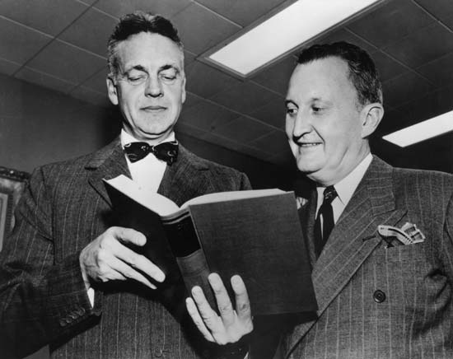
Running Against the Wind The Education of Robert Maynard Hutchins

Slide 2
Written by
Edward J. Dodson
Notes:
Throughout history there have always been those who emerge out of relative obscurity to take center stage, at least for awhile. Within the halls of academe, Robert Maynard Hutchins was such a person.

Slide 3
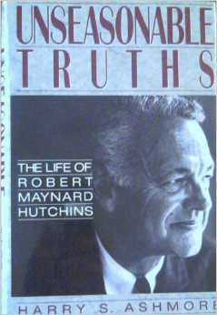
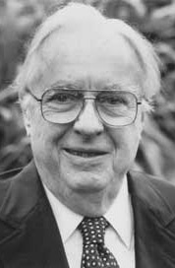
Notes:
Hutchins has been the subject of several biographies, the most comprehensive of which is by his long-time associate, Harry Ashmore.

Slide 4
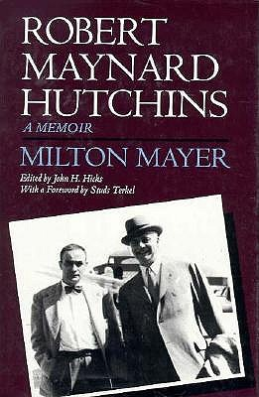
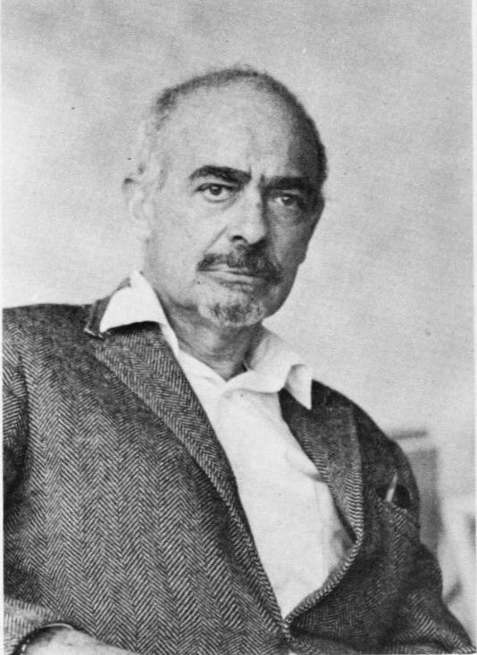
Notes:
A second biography comes from Milton Mayer, which appeared in 1993.

Slide 5
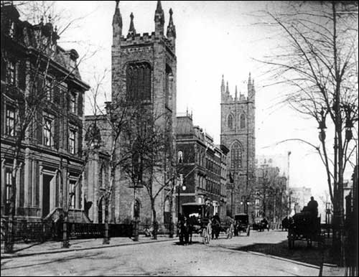
Notes:
Robert Maynard Hutchins was born in the last year of the 19th century, into a Presbyterian family the head of which served as pastor of the neighborhood church in the Bedford section of Brooklyn, New York.

Slide 6
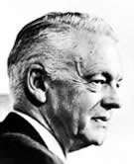
Notes:
Years later, he recalled of his childhood:

Slide 7
“I was born in the dying century, before the open gas flame was superseded by the Welsbach burner, before the horsecars had disappeared, before the telephone was commonplace, and when the iceman was one of the mainstays of our lives. Although everybody went to school, almost nobody went to college. But everybody went to church.”
Notes:
“I was born in the dying century, before the open gas flame was superseded by the Welsbach burner, before the horsecars had disappeared, before the telephone was commonplace, and when the iceman was one of the mainstays of our lives. Although everybody went to school, almost nobody went to college. But everybody went to church.” [Ashmore, pp.3-4]

Slide 8
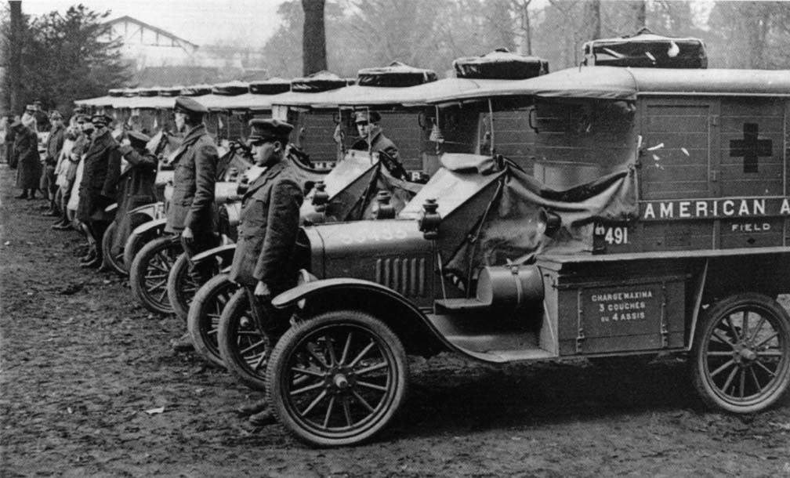
Notes:
When the United States entered the First World War, eighteen year old Robert M. Hutchins left Oberlin College to enter the U.S. Army Ambulance Corps, living up to his obligation as a citizen and patriot, as well as his moral aversion to the possibility of taking the life of another person.

Slide 9
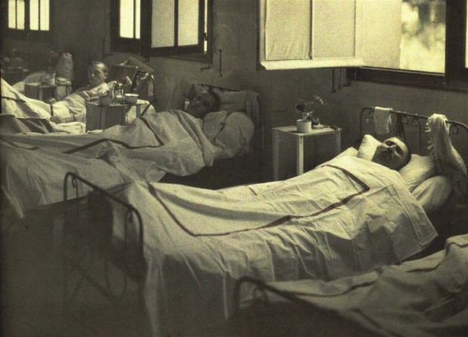
Notes:
Stationed in Italy he did his job removing injured soldiers from the front, at times under heavy artillery fire by Austrians. Recovering in hospital from an illness, he came to form a rather negative opinion of Italian allies:

Slide 10
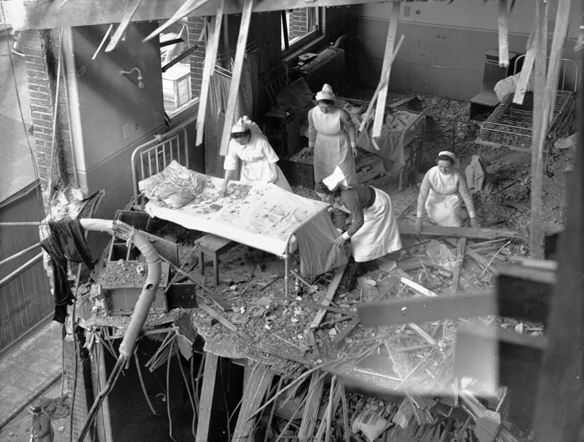
“They filled up our half-empty ward with Italians in the recovering stage. …Individually, the Italians are the people I shall avoid most after the war. You have to admire their collective bravery when things are going their way, but as persons they are rotten, that’s all. They have no sense of decency and they will steal your gold teeth in your sleep.”
Notes:
Slide 9
“They filled up our half-empty ward with Italians in the recovering stage. …Individually, the Italians are the people I shall avoid most after the war. You have to admire their collective bravery when things are going their way, but as persons they are rotten, that’s all. They have no sense of decency and they will steal your gold teeth in your sleep.” [Ashmore, p.22]

Slide 11
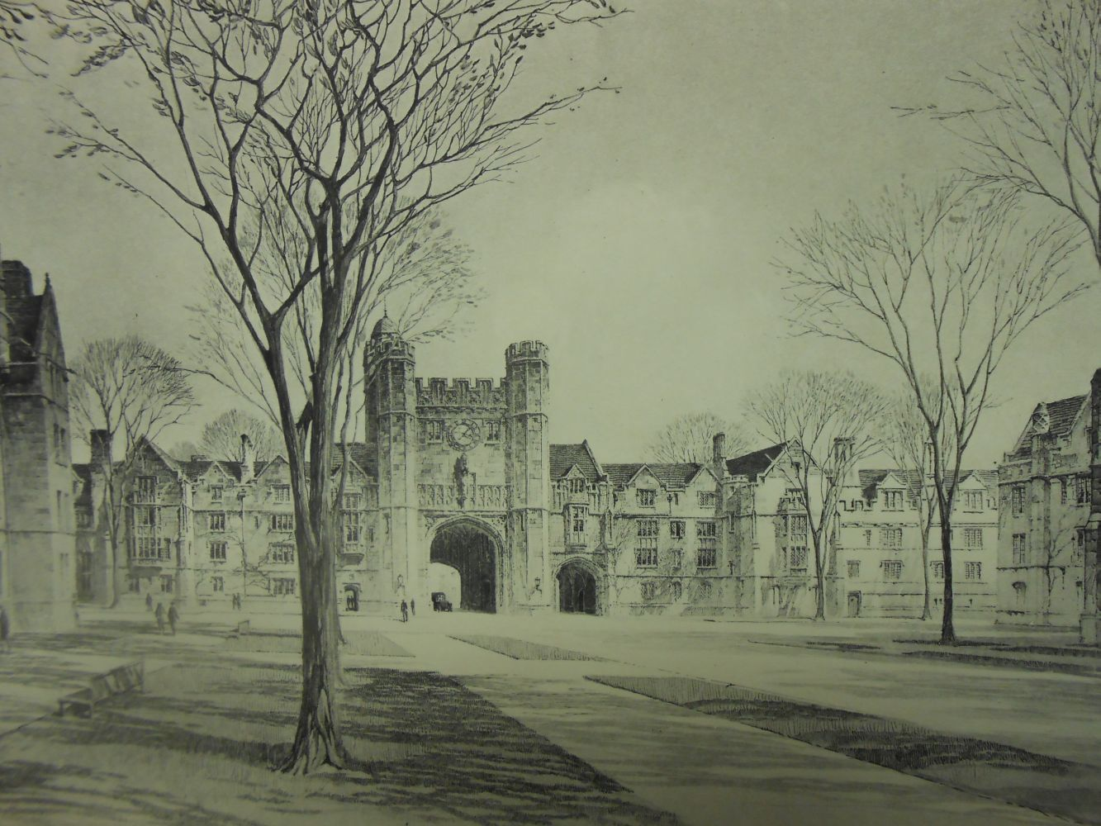
Notes:
Back from the war, Hutchins enrolled at Yale University in 1919, where he thrived, earning needed money by establishing a cooperative tutoring service for students who sought academic help. For him, the great value of attending Yale was the contacts he made with men destined to become prominent in some capacity:

Slide 12
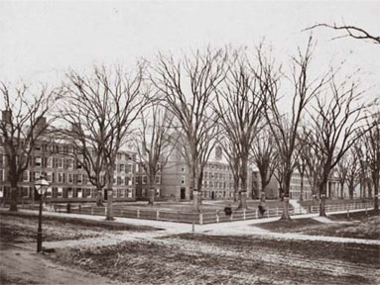
“We went to Yale to become Yale men. Yale men could pass through portals and scale heights which others could not attain. They could do so not because of what they knew, but simply because of where they had been. …The benefits flowing to me from my acquisition of this title have been considerable, and I do not underrate them. My point is that these benefits had nothing to do with my intellectual development.”
Notes:
Slide 11
“We went to Yale to become Yale men. Yale men could pass through portals and scale heights which others could not attain. They could do so not because of what they knew, but simply because of where they had been. …The benefits flowing to me from my acquisition of this title have been considerable, and I do not underrate them. My point is that these benefits had nothing to do with my intellectual development.” [Ashmore, p.31]

Slide 13
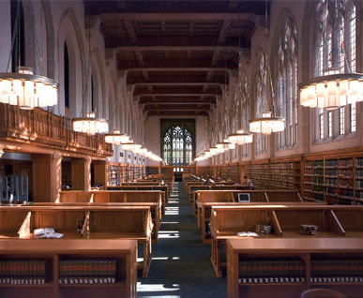
Notes:
After his junior year, Hutchins enrolled in the Law School, out of boredom more than any desire for a career in the law. Yet, it was here, he later said, his real education began:

Slide 14
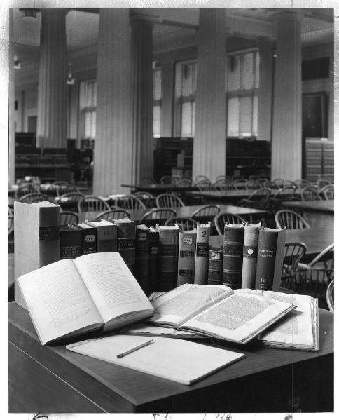
“I do not mean to say that I knew then I was getting an education. I am sure the professors did not know they were giving me one. They would have been shocked at such an insinuation. They thought they were teaching me law. They did not teach me any law. But they did something far more important: they introduced me to the liberal arts.”
Notes:
Slide 13
“I do not mean to say that I knew then I was getting an education. I am sure the professors did not know they were giving me one. They would have been shocked at such an insinuation. They thought they were teaching me law. They did not teach me any law. But they did something far more important: they introduced me to the liberal arts.” [Ashmore, p.32]

Slide 15
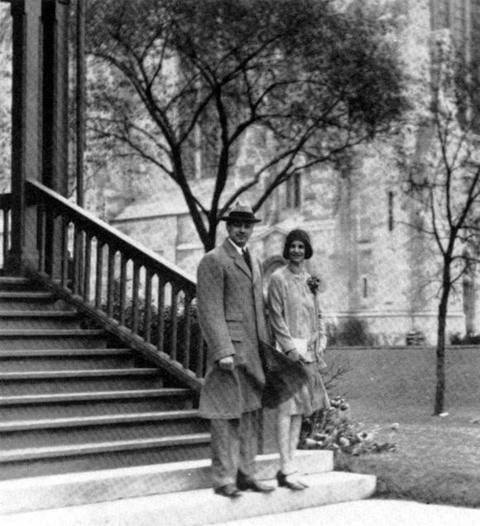
Notes:
Still in his junior year, he met and soon was engaged to marry the 19-year old Maude Phelps McVeigh. They married in September of 1921.

Slide 16
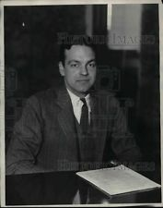
Notes:
Already, he was forming the ideas that would dominate his thinking for decades to come. Selected to deliver the class oration, he titled his talk “Should Institutions of Learning Be Abolished?” What had he learned from being a student at Yale?

Slide 17
“If at college we have never tasted what may be called the sweetness and glory of being rational animals, it is because America does not know or highly esteem that sweetness and that glory. …Where shall our country find its leaders if not among that two percent of her population who have been favored by four years of college?”
Notes:
Sllide 16
“If at college we have never tasted what may be called the sweetness and glory of being rational animals, it is because America does not know or highly esteem that sweetness and that glory. …Where shall our country find its leaders if not among that two percent of her population who have been favored by four years of college?” [Ashmore, p.37]

Slide 18
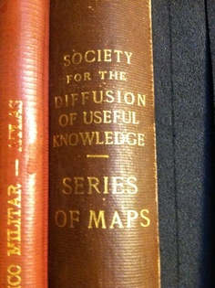
Notes:
Education in the land of his birth had been of the practical and useful sort going back to the colonial period of self-reliance, with the establishment of societies for the diffusion of useful knowledge as championed by Benjamin Franklin.

Slide 19
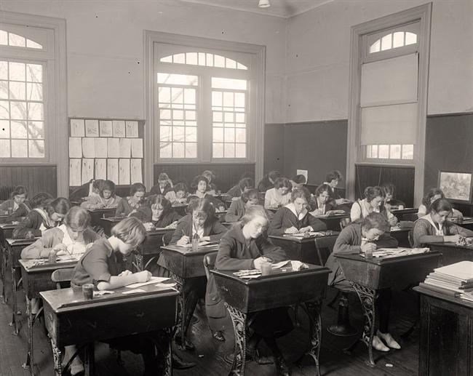
Notes:
Now married, he left law school and found employment teaching English and history at a private college preparatory school in upstate New York. What he did had little if anything to do with education, he concluded:

Slide 20
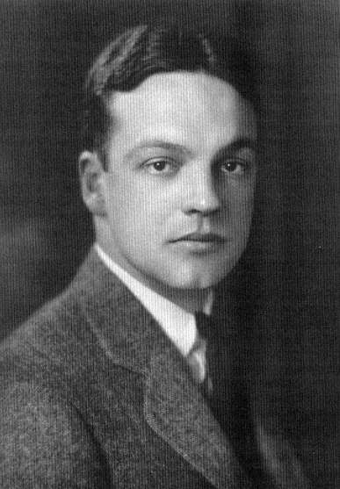
“In the school I taught in, I did not dare try to educate my charges. It would have confused their minds.”
Notes:
Slide 19
“In the school I taught in, I did not dare try to educate my charges. It would have confused their minds.” [Ashmore, p.38]

Slide 21
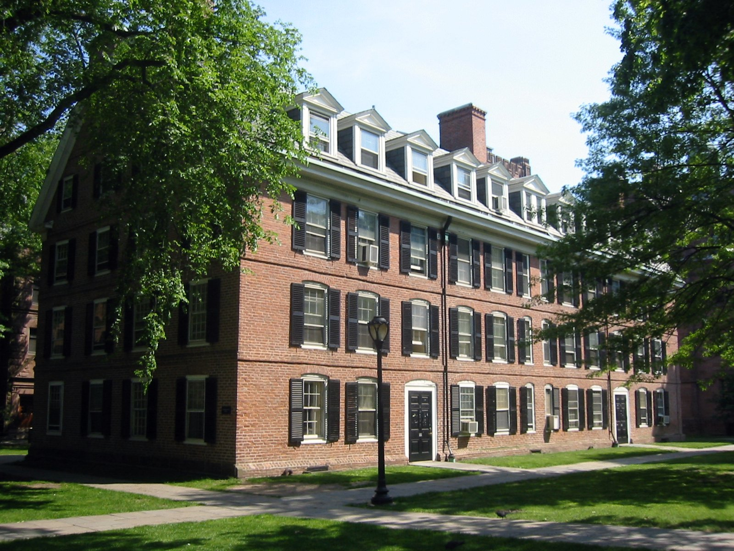
Connecticut Hall
Yale University
Notes:
Not long thereafter, he received an offer from Yale University to become Secretary of the corporation, responsible for public relations and fund-raising. From this point on in his career fund-raising activities would consume the greater part of his time. He began work at Yale on the 1st of January 1923.

Slide 22
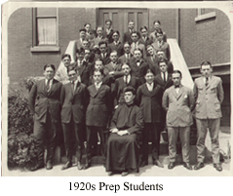
Notes:
He now renewed his pursuit of a degree in the law, balancing work responsibilities that included extensive travel to speak to alumni groups, with his studies and classroom attendance. Working for the university did not prevent him from expressing dissatisfaction with the type of education undergraduate students received, as this brief excerpt from a talk given to prep-school students reveals:

Slide 23
“Those who grow apprehensive about atheism and bolshevism in the colleges merely betray their ignorance, for the most conservative places in America today, as faculty members know, are the universities.”
Notes:
“Those who grow apprehensive about atheism and bolshevism in the colleges merely betray their ignorance, for the most conservative places in America today, as faculty members know, are the universities.” [Ashmore, p.42]

Slide 24

Notes:
What he found attractive in his study of the law was the Socratic method of instruction. What he rebelled against was the law as a trade and the emphasis on technical knowledge – drawing up of wills, writing contracts or the methods of examining witnesses at trial.

Slide 25
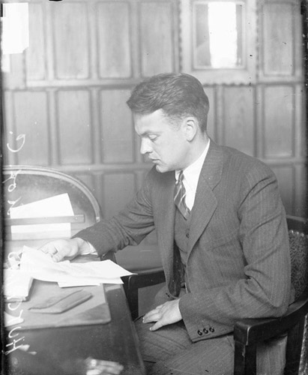
Notes:
Hutchins received his law degree in 1925 and became a member of the Yale Law School faculty, assigned to teach criminal law in a manner in which he found little merit:

Slide 26
“It seemed to me that the only way you could sensibly go after criminal law was to go into the whole system, to go into criminology, go into corrections, and for these purposes try to draw on what I assumed to be the vast knowledge of psychologists and psychiatrists, who were then a budding profession in this country, and anybody else who could shed light on what the actual role of the criminal law was, and how it could be made to work to reduce crime and to do justice, rather than to increase crime and increase injustice.”
Notes:
“It seemed to me that the only way you could sensibly go after criminal law was to go into the whole system, to go into criminology, go into corrections, and for these purposes try to draw on what I assumed to be the vast knowledge of psychologists and psychiatrists, who were then a budding profession in this country, and anybody else who could shed light on what the actual role of the criminal law was, and how it could be made to work to reduce crime and to do justice, rather than to increase crime and increase injustice.” [Ashmore, p.45]

Slide 27
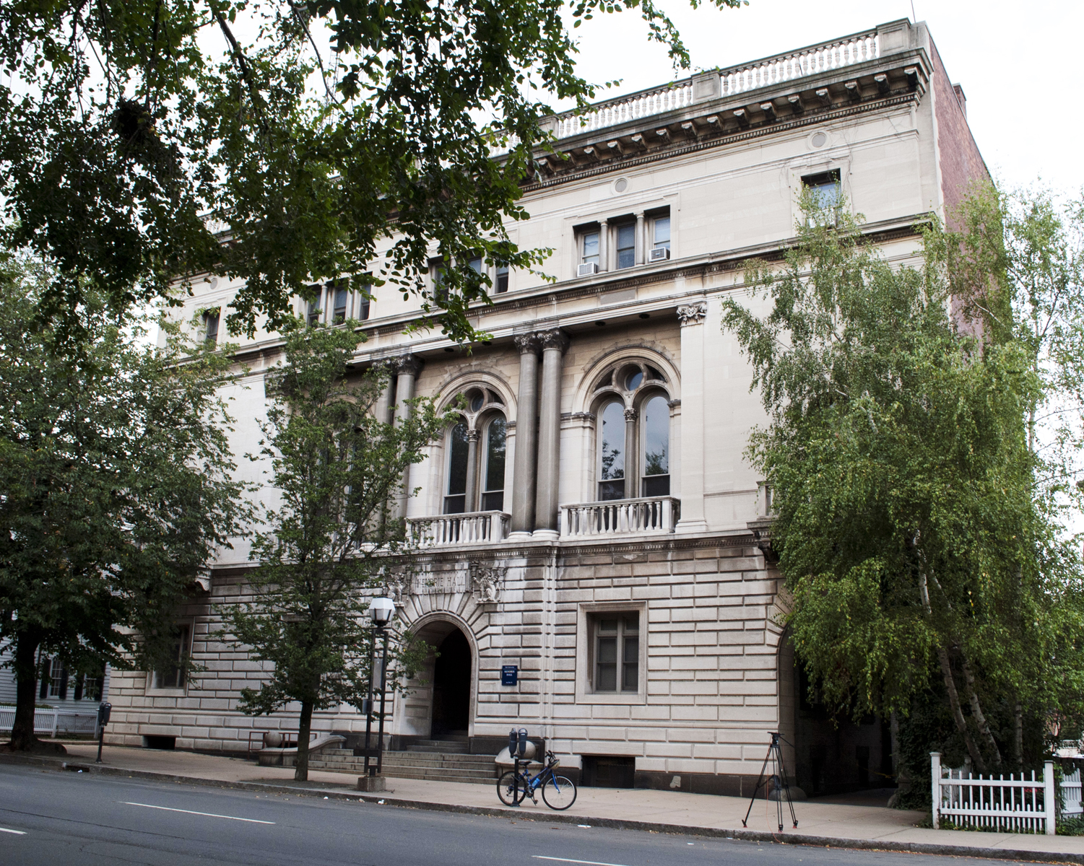
Yale Law School
Notes:
Already, at age 27, he was outspokenly critical of how the law was being taught and practiced. And then, he was appointed dean of the Law School.

Slide 28


New Curriculum:
The Law and The Social Sciences
Notes:
The President of Yale University encouraged Hutchins’ idea of incorporating the social sciences into the study of law. However, as would be the case throughout the rest of his professional life, his efforts were opposed by nearly everyone potentially affected.

Slide 29
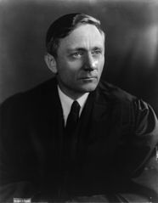
Notes:
One of his first acts was to bring in William O. Douglas from Harvard to join the faculty.

Slide 30
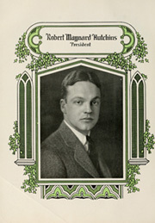
Notes:
And, then, at the end of the 1929 academic year, Hutchins left Yale, appointed the new President of the University of Chicago, the Midwest’s grand educational institution endowed by none other than John D. Rockefeller.

Slide 31
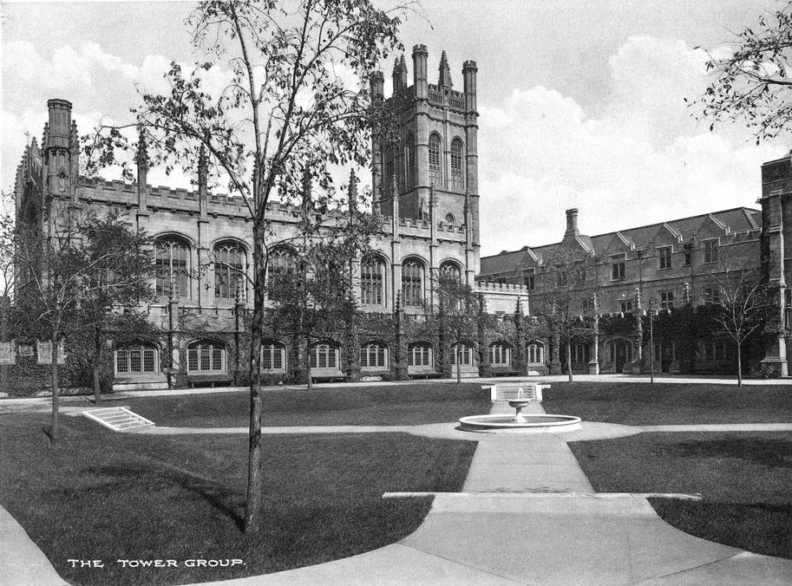
Notes:
What Hutchins found upon taking office at Chicago was not what he considered to be a university. Rather, there were departments operating independently of one another, focused on graduate level education and research. What Hutchins immediately called for was cooperation between departments. More threatening to the senior members of the faculty, he questioned the value of tenure.

Slide 32
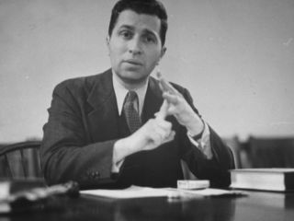
Notes:
One of his first recruits, brought aboard to advance his reform agenda, was Mortimer J. Adler, who had just been awarded his doctorate at Columbia University. The faculty did not react with great enthusiasm, particularly because Adler was to be paid more than any other member of the Philosophy Department faculty.

Slide 33
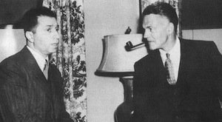
Notes:
With Adler safely onboard, Hutchins next set about to reorganize undergraduate education. From their perspective, very few members of the faculty met their definition of an educated person. As Adler reported to Hutchins:

Slide 34
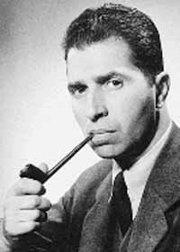
“You have huge mountains of convention, prejudice, laziness, stupidity, vested interest and economic fear against you. …It comes from all quarters. The science people are prejudiced because of their conventional notions of how science must be taught; the humanities are trying to save their language courses; they are all greedily protecting their private diggings and what gets me sorest is that they are doing so under the false banner of educational theory.”
Notes:
“You have huge mountains of convention, prejudice, laziness, stupidity, vested interest and economic fear against you. …It comes from all quarters. The science people are prejudiced because of their conventional notions of how science must be taught; the humanities are trying to save their language courses; they are all greedily protecting their private diggings and what gets me sorest is that they are doing so under the false banner of educational theory.” [Ashmore, pp.95-96]

Slide 35
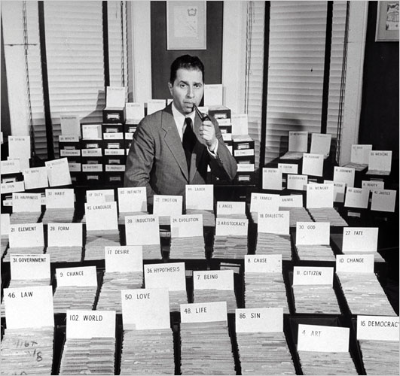
Notes:
Hutchins included himself in this group of uneducated educators. And so, with Mortimer Adler as teacher, Hutchins joined twenty entering freshmen in the first course based on the classic works of Western Civilization. There were no written exams. The students were subjected to an oral examination upon completion.

Slide 36
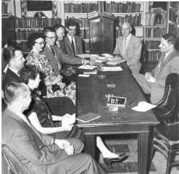
Notes:
Adler and Hutchins then took their program off-campus into the community, involving many of the university trustees and civic leaders as participants.

Slide 37

Notes:
Back on campus, the Dean of the Philosophy Department declined to renew Mortimer Adler’s contract. Hutchins used his influence to secure for Adler a position on the Law School faculty. Adler’s critics began to refer to him as “professor of the blue sky.”

Slide 38
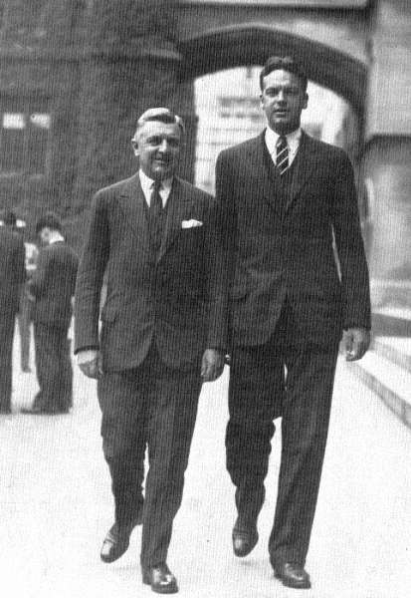
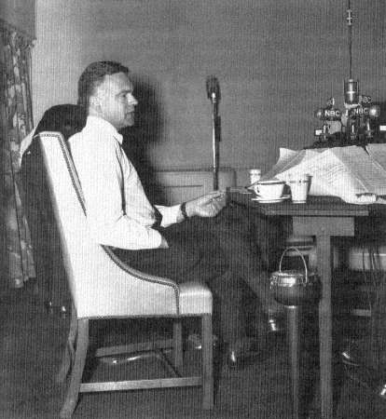
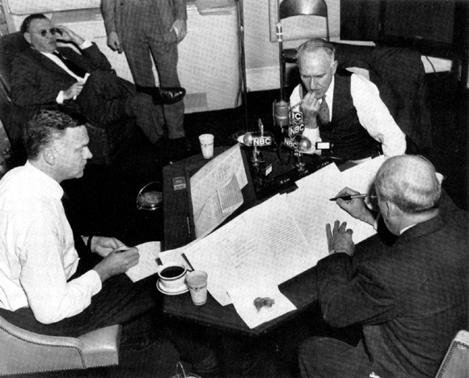
Notes:
Although what was being taught and how it was being taught remained a consistent concern of the President, his responsibilities as the top administrator of the university were more than enough for most normal human beings. A sign on his desk read: “Don’t tell the president what he already knows.” As he observed:

Slide 39
“The problem of time … is insoluble. The administrator should never do anything he does not have to do, because the things he will have to do are so numerous he cannot possibly have time to do them all. …A university administrator has at least five constituencies: the faculty, the trustees, the students, the alumni, and the public. He could profitably spend all his time with any one of the five. What he actually does, of course, is to spend just enough with each of the five to irritate the other four.”
Notes:
Slide 37
“The problem of time … is insoluble. The administrator should never do anything he does not have to do, because the things he will have to do are so numerous he cannot possibly have time to do them all. …A university administrator has at least five constituencies: the faculty, the trustees, the students, the alumni, and the public. He could profitably spend all his time with any one of the five. What he actually does, of course, is to spend just enough with each of the five to irritate the other four.” [Ashmore, pp.111-112]

Slide 40
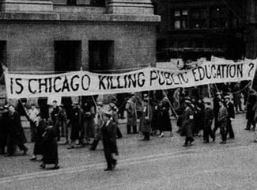
Notes:
One of the most immediate of his concerns was the financial strength of the university. This was the early 1930s, and many of the fortunes sustaining this and other universities were significantly diminished by the Depression. Then, as today, fewer and fewer students could afford the cost of a university education.

Slide 41
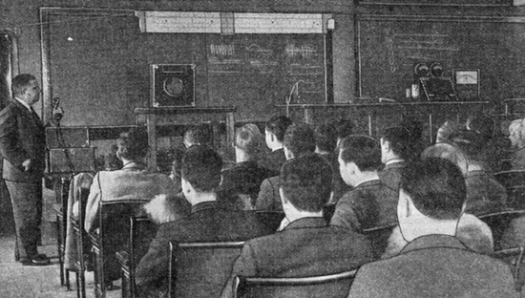
Notes:
Hutchins responded by eliminating some 350 course offerings, capping faculty salaries while increasing their responsibilities to include classroom instruction, reducing administrative salaries, and adopting other cost-cutting measures. However, in 1935, Hutchins reported to the trustees:

Slide 42
“The most serious element in the University’s situation, and the only disturbing one, is its financial position. We have been able to preserve all the essential characteristics of a great University – academic freedom, excellent research, and competent teaching – in the face of unprecedented hardships.”
Notes:
“The most serious element in the University’s situation, and the only disturbing one, is its financial position. We have been able to preserve all the essential characteristics of a great University – academic freedom, excellent research, and competent teaching – in the face of unprecedented hardships.” [Ashmore, p.113]

Slide 43
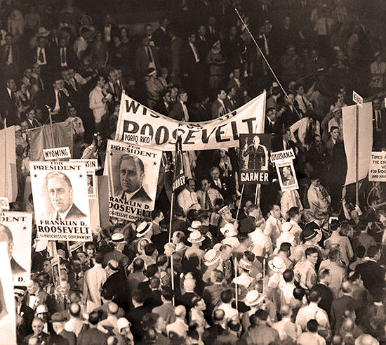
Notes:
Already, the young university president was attracting attention in political circles. In 1932 he was invited to address the Democrats at their national convention. He expressed what he believed were the widely-shared concerns of his generation:

Slide 44
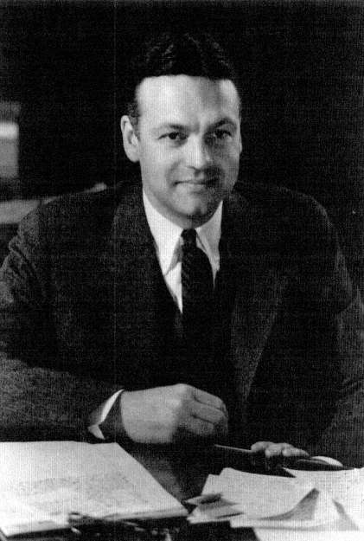
“Upon what terms may a political party claim our allegiance? …We demand an honest party. …We demand a party of the people. …We demand a progressive party. …We demand intelligent leadership.”
Notes:
“Upon what terms may a political party claim our allegiance? …We demand an honest party. …We demand a party of the people. …We demand a progressive party. …We demand intelligent leadership.” [Ashmore, p.122]

Slide 45
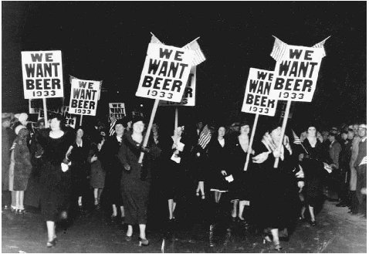
Notes:
Some of his fellow citizens had other priorities for the newly-elected administration.

Slide 46
Notes:
Hutchins also acknowledged that Prohibition had failed and called for repeal of the Eighteenth Amendment. He went on to call for a pledge by the Democrats that they would do all that was required to promote world peace, including unilateral disarmament if other nations chose not to join the United States. Neither military nor economic power was, he argued, a legitimate instrument of power against other nations.

Slide 47
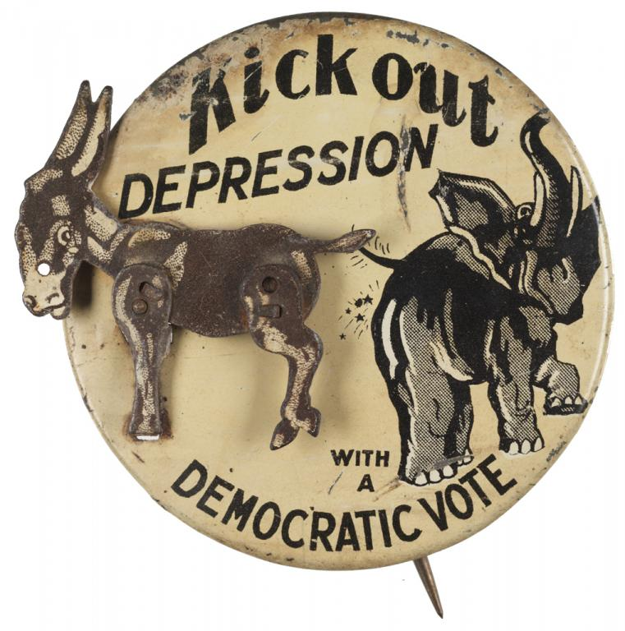
Notes:
Hutchins endorsed the progressive taxation of incomes and of inheritances and argued for the reduction of public debt in times of prosperity but endorsed deficit spending by government during periods of recession or depression. He urged elimination of tariffs that benefited manufacturers at the expense of consumers. And, he called for an end to the private monopoly of natural resources.

Slide 48
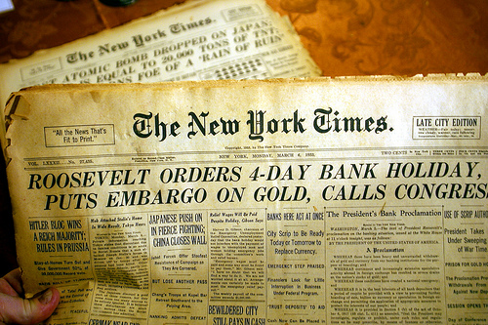
Notes:
He was prompted by the periodic collapse of banks to suggest that, perhaps, banks should be nationalized. Anticipating the charge that what he was proposing was an attack on the American System, Hutchins declared:

Slide 49
“[These measures are] the minimum program demanded by the present emergency. In that sense it is truly conservative, for the true conservative is not interested in conserving chaos. If the Democratic party will issue a clear and decisive challenge in such terms as these, it may command the allegiance of the rising generation.”
Notes:
“[These measures are] the minimum program demanded by the present emergency. In that sense it is truly conservative, for the true conservative is not interested in conserving chaos. If the Democratic party will issue a clear and decisive challenge in such terms as these, it may command the allegiance of the rising generation.” [Ashmore, p.124]

Slide 50
Notes:
It is worth repeating the comment made by Harry Ashmore regarding this speech:

Slide 51
“In that brief compass he managed to gore most of the sacred cows in the nation’s political pasture, and he brought the Young Democrats to their feet, cheering.”
Notes:
“In that brief compass he managed to gore most of the sacred cows in the nation’s political pasture, and he brought the Young Democrats to their feet, cheering.” [Ashmore, p.124]

Slide 52
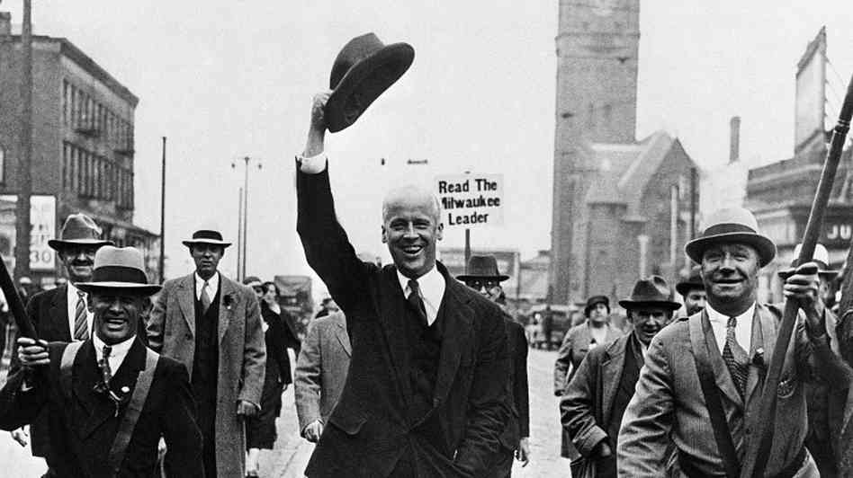
Notes:
Perhaps only some will be surprised that he ended up disappointed in Franklin Roosevelt’s promises and voted for the Socialist candidate, Norman Thomas.

Slide 53
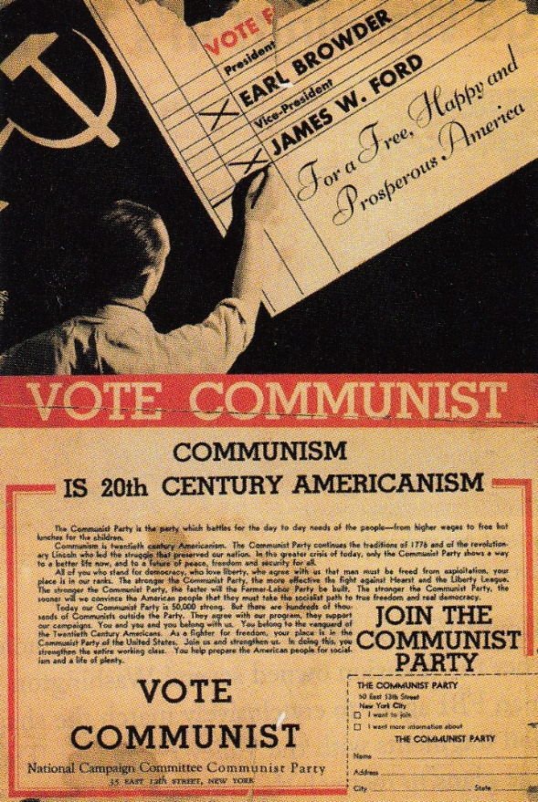
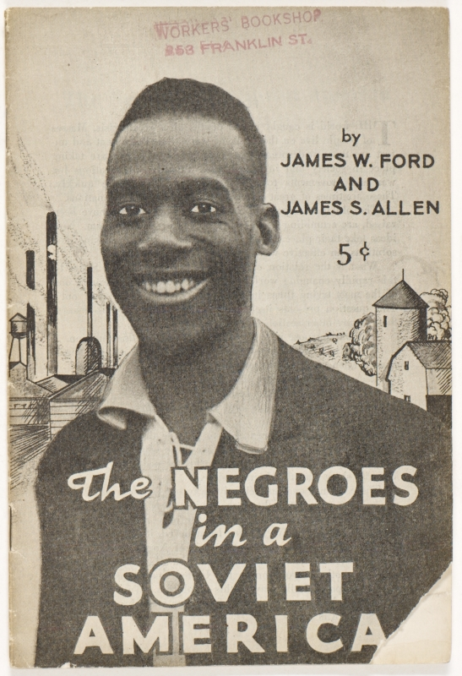
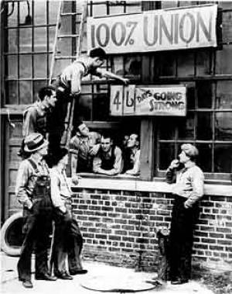
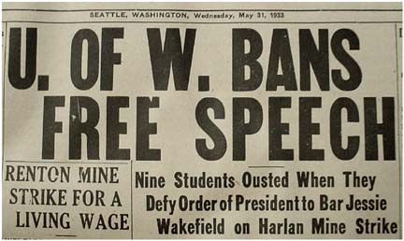
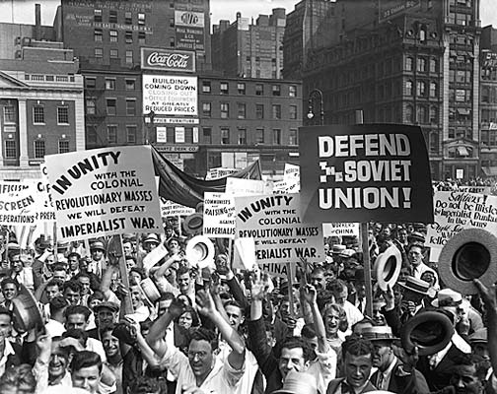
Notes:
Norman Thomas stood for democratic-socialism. Others, less patient for changes to what they believed was a system bankrupt of fundamental justice, thought they saw in Soviet-style state-socialism the solution to a better future. Reactionaries focused on the universities as centers of anti-Americanism. Academic freedom was under attack. Speaking to the American Association of University Professors in 1931, Hutchins took a firm stand:

Slide 54
“We have got to make ourselves clear. The only question that can properly be raised about a professor with the institution to which he belongs is his competence in his field. His private life, his political views, his social attitudes, his economic doctrine – these are not the concern of his university.”
Notes:
“We have got to make ourselves clear. The only question that can properly be raised about a professor with the institution to which he belongs is his competence in his field. His private life, his political views, his social attitudes, his economic doctrine – these are not the concern of his university.” [Ashmore, pp.128-129]

Slide 55
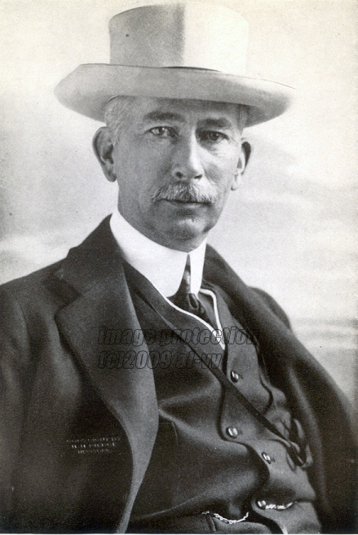
(Colonel) Edward House
Notes:
Despite his continued disappointment with Roosevelt in office, some party leaders thought to bring him into the government. A meeting was arranged with Edward House, the former adviser to Woodrow Wilson, brought aboard to find talented but accommodating individuals for Roosevelt’s administration. Harry Ashmore provides Hutchins’ recollection of the meeting:

Slide 56
“[H]e said he had told Colonel House that the only position he would consider was that of secretary of war, which he expected to occupy only long enough to fire all the officers he had served under in World War I.”
Notes:
“[H]e said he had told Colonel House that the only position he would consider was that of secretary of war, which he expected to occupy only long enough to fire all the officers he had served under in World War I.” [Ashmore, p.126]

Slide 57
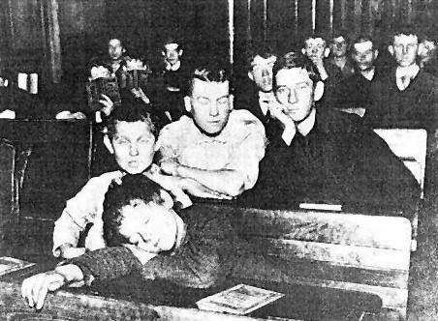
Notes:
Neither the pressures of the Great Depression nor the chaos in world affairs diverted his attention from his advocacy for educational reforms. Although a larger and larger percentage of young people were completing primary and secondary schooling, Hutchins challenged those who believed the system was working. In a speech before the National Education Association he charged:

Slide 58
“The elementary schools are eight years for no better reason than that Horace Mann when he went to Germany to find a school to imitate imitated the wrong one, and imposed upon this country as a preparatory unit a school that was terminal in its native land. …”
Notes:
“The elementary schools are eight years for no better reason than that Horace Mann when he went to Germany to find a school to imitate imitated the wrong one, and imposed upon this country as a preparatory unit a school that was terminal in its native land. …”

Slide 59
“The high schools are largely dominated by collegiate requirements that have no application to a majority of their students. The junior colleges are frequently two years more of high school or pale imitations of the first two years at the state university. The colleges of liberal arts sometimes seem to duplicate the high school at one end and the university at the other. …”
Notes:
“The high schools are largely dominated by collegiate requirements that have no application to a majority of their students. The junior colleges are frequently two years more of high school or pale imitations of the first two years at the state university. The colleges of liberal arts sometimes seem to duplicate the high school at one end and the university at the other. …”

Slide 60
“The universities are weird mixtures of general education, specialized study, professional training, and college life. If we are ever to alter the public attitude toward education, we must clarify the functions of all these organizations and their relationships to each other.”
Notes:
“The universities are weird mixtures of general education, specialized study, professional training, and college life. If we are ever to alter the public attitude toward education, we must clarify the functions of all these organizations and their relationships to each other.” [Ashmore, p.135]

Slide 61
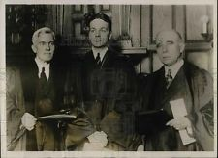
Notes:
What Hutchins had in mind was combining the last two years of high school and the first two years of college as requirements for an undergraduate degree. An additional three years of study would earn a master’s degree and eligibility for teaching positions. The Ph.D. would be reserved for those who had become teachers. A Doctor of Science degree would be awarded to individuals committed to research. In short, he hoped to totally restructure how education services were delivered in the United States.

Slide 62

Notes:
As he should have anticipated, the University of Chicago was not going to become the center of his new experiment. The faculty, the trustees and many alumni were more than content with the status quo. Instead, Hutchins, Adler, Stringfellow Barr and Scott Buchanan took over Saint John’s College in Annapolis, Maryland and remolded it into an interdisciplinary, Socratic academy of learning.

Slide 63

Notes:
Throughout the 1930s Hutchins continued to deliver his message that the nation’s schools, colleges and universities were delivering far less than promised. On one occasion he stated:

Slide 64
“In the preparation of teachers we are involved in a vicious circle. …The teachers are badly educated. They educate their students badly. Some of the badly educated students become badly educated teachers who educate their students badly.”
(1935)
Notes:
“In the preparation of teachers we are involved in a vicious circle. …The teachers are badly educated. They educate their students badly. Some of the badly educated students become badly educated teachers who educate their students badly.” [Ashmore, p.144]

Slide 65

Notes:
Where had it all gone wrong?

Slide 66

“New England invented the horrid machinery composed of course grades, course credits, course examinations, and required residence through which we determined by addition, subtraction, multiplication, division, and a logarithm table the intellectual progress of the young. Of course this machinery has nothing to do with education and constitutes, in fact, one of the prime obstacles in its path.”
Notes:
“New England invented the horrid machinery composed of course grades, course credits, course examinations, and required residence through which we determined by addition, subtraction, multiplication, division, and a logarithm table the intellectual progress of the young. Of course this machinery has nothing to do with education and constitutes, in fact, one of the prime obstacles in its path.” [Ashmore, pp.144-145]

Slide 67
Notes:
Of course, others shared many of the views voiced by Hutchins. What distinguished Robert M. Hutchins was his activism. As Harry Ashmore explains:

Slide 68
“Hutchins was unique in advocating a complete scheme for the reorganization of the nation’s educational structure, including a formulation not only of the ends it should be seeking but of the means for achieving them. He was attempting, moreover, with some success, to put his theories into practice at his own institution.”
Notes:
“Hutchins was unique in advocating a complete scheme for the reorganization of the nation’s educational structure, including a formulation not only of the ends it should be seeking but of the means for achieving them. He was attempting, moreover, with some success, to put his theories into practice at his own institution.” [Ashmore, p.147]

Slide 69

Notes:
With every speech at every conference, Hutchins kept up his attack on conventional wisdom. The nation’s universities had lost their way, abandoning deductive reasoning and thereby abandoning the path to new knowledge. He quoted leading scholars who concurred that the experimental method could not produce abstract ideas, but could only be directed by them. One of his most important observations was this:

Slide 70
“An anti-intellectual attitude toward education reduces the curriculum to the exposition of detail. There are no principles. The world is flux of events. We cannot hope to understand it. All we can do is watch it. …A curriculum of current events, without reference to the intellectual and artistic tradition that has come down to us from antiquity, is the only possible course of study which anti-intellectualism affords.”
Notes:
“An anti-intellectual attitude toward education reduces the curriculum to the exposition of detail. There are no principles. The world is flux of events. We cannot hope to understand it. All we can do is watch it. …A curriculum of current events, without reference to the intellectual and artistic tradition that has come down to us from antiquity, is the only possible course of study which anti-intellectualism affords.” [Ashmore, p.157]

Slide 71



Notes:
From the perspective of most of his older contemporaries, what Hutchins proposed meant abandoning what they embraced as the scientific method. To Hutchins, values were central, first principles the source of philosophical knowledge. Aristotle was the source of the fundamental philosophical concepts, Thomas Aquinas the source of the system of values.

Slide 72

Metaphysics
Logic
Reason
Notes:
This was not a resort to divine inspiration or faith, he argued, but, as Harry Ashmore tells us:

Slide 73
“… of natural law, which demonstrated by rational means that a civilized society depended upon acceptance of values rooted in respect for the sanctity of human life and the understanding of nature.”
Metaphysics
Logic
Reason
Notes:
This was not a resort to divine inspiration or faith, he argued, but, as Harry Ashmore tells us, “of natural law, which demonstrated by rational means that a civilized society depended upon acceptance of values rooted in respect for the sanctity of human life and the understanding of nature.” A belief in God was, Hutchins felt, irrelevant to an acceptance of natural law.

Slide 74

Notes:
Yale University Press published four of his addresses in 1936, prompting responses by a growing number of critics, including John Dewey. Dewey charged Hutchins with opening the door to authoritarian intervention:

Slide 75

“Doubtless much may be said for selecting Aristotle and Saint Thomas as competent promulgators of first truths. But it took the authority of a powerful ecclesiastical organization to secure their wide recognition. …As far as I can see President Hutchins has completely evaded the problem of who is to determine the definite truths that constitute the hierarchy.”
Notes:
“Doubtless much may be said for selecting Aristotle and Saint Thomas as competent promulgators of first truths. But it took the authority of a powerful ecclesiastical organization to secure their wide recognition. …As far as I can see President Hutchins has completely evaded the problem of who is to determine the definite truths that constitute the hierarchy.” [Ashmore, p.163]

Slide 76
Notes:
Robert Hutchins provided a detailed response, indicating that Dewey had both misunderstood and misrepresented his views:

Slide 77
“Mr. Dewey’s dexterous intimation that I am a fascist in result if not intention … suggests the desirability of the education I have proposed. A graduate of my hypothetical university writing for his fellow alumni would know that such observations were rhetoric and would be received as such. As a matter of fact fascism is a consequence of the absence of philosophy. It is possible only in the context of the disorganization of analysis and the disruption of the intellectual tradition through the pressure of immediate practical concerns. …”
Notes:
Slide 74
“Mr. Dewey’s dexterous intimation that I am a fascist in result if not intention … suggests the desirability of the education I have proposed. A graduate of my hypothetical university writing for his fellow alumni would know that such observations were rhetoric and would be received as such. As a matter of fact fascism is a consequence of the absence of philosophy. It is possible only in the context of the disorganization of analysis and the disruption of the intellectual tradition through the pressure of immediate practical concerns. …”

Slide 78
“Mr. Dewey has suggested that only a defective education can account for some of my views. I am moved to inquire whether the explanation of some of his may not be that he thinks he is still fighting nineteenth-century German philosophy.”
Notes:
“Mr. Dewey has suggested that only a defective education can account for some of my views. I am moved to inquire whether the explanation of some of his may not be that he thinks he is still fighting nineteenth-century German philosophy.”

Slide 79

Notes:
His one significant success at the University of Chicago was the restructuring of undergraduate education to provide a unified basic program that permitted but few electives. Courses were taught using original works rather than textbooks. Mortimer Adler, frustrated at Chicago, urged Hutchins to come with him to Saint Johns. Hutchins told him he could think of no where else to go and advised Adler to consider the degree of freedom he enjoyed at Chicago to do exactly as he desired.

Slide 80

Notes:
As the probability increased that the United States would be drawn into a Second World War, Hutchins was far more concerned for the moral, intellectual and spiritual preparedness of the nation than for its military preparedness. Would a better world emerge with defeat of the Axis powers? He wondered. Early in 1941 he delivered a radio address to a national audience:

Slide 81

“I speak tonight because I believe that the American people are about to commit suicide. We are not planning to. We are drifting into suicide. …We are going to try to produce the victory by supplying our friends with the materials of war. But what if this is not enough? …We must guarantee the victory. …The conclusion is inescapable that the President is reconciled to active military intervention if such intervention is needed to defeat the Axis in this war.”
Notes:
“I speak tonight because I believe that the American people are about to commit suicide. We are not planning to. We are drifting into suicide. …We are going to try to produce the victory by supplying our friends with the materials of war. But what if this is not enough? …We must guarantee the victory. …The conclusion is inescapable that the President is reconciled to active military intervention if such intervention is needed to defeat the Axis in this war.” [Ashmore, p.216]

Slide 82

Notes:
The Japanese attack on U.S. forces in Hawaii changed everything. Hutchins advised the faculty what role the university must play:

Slide 83
“… long-run activities must be sacrificed to the short-run activity of winning the war. Education and research … are long-run activities. We have stood for liberal education and pure research. What the country must have now is vocational training and applied research. …This war will be won in the laboratories.”
Notes:
“… long-run activities must be sacrificed to the short-run activity of winning the war. Education and research … are long-run activities. We have stood for liberal education and pure research. What the country must have now is vocational training and applied research. What the country must have we must try to supply.” [Ashmore, p.221]

Slide 84





Leo Szilard
Enrico Fermi
Arthur Compton
Notes:
Beginning in the middle of 1942, the University became home to a group of the world’s most accomplished physicists. The Italian Enrico Fermi and his Hungarian colleague Leo Szilard came in from Columbia University. Under the direction of physicist Arthur Compton they began to build history’s first atomic pile.

Slide 85

Notes:
Remarkably, Hutchins was able to allocate resources to develop an interdisciplinary graduate Social Science program bringing together economic historian John Nef, economist Frank Knight, anthropologist Robert Redfield, dean of the law school Wilbur Katz and chair of the department of education Ralph Tyler. After the war, they were joined by a group including Yves Simon, Friedrich von Hayek, Daniel Boorstin, Saul Bellow and Hannah Arendt

Slide 86

Notes:
By 1943 Hutchins went on the road to express his concerns over the changes the nation was set to experience in the post-war period. These lectures were delivered at Louisiana State University, titled “Education for Freedom.” What worried him greatly was rising materialism. Through education, the nation must experience a spiritual revolution or there would be a political revolution, he warned. War had raised technical training to a dominant position because of government support. This, he feared, would continue.

Slide 87

Notes:
Hutchins spent the next seven years in a failed effort to reorganize the university in a manner that would minimize the threat he saw to the intellectual pursuit of knowledge and to academic freedom. This became a crusade after the first atom bomb was dropped on Hiroshima.

Slide 88


Notes:
His first action was to organize and chair an Atomic Energy Control Conference only six weeks after the war ended. Leo Szilard informed the attendees that the engineering had already made it possible to produce bombs ten times more destructive than those already used. Moreover, he believed the Russians would have the bomb in less than three years.

Slide 89

Notes:
To Hutchins and others the only solution was world government. He became president of a Committee to Frame a World Constitution, the members of which included prominent professors at Chicago, Harvard and Columbia. The document they developed was published and distributed in July of 1947. Not surprisingly, their effort served only to provide ammunition against Hutchins from political conservatives. Reinhold Niebuhr, one of the original committee members withdrew in protest of what he called “the myth of world government.” Even the chairman of the group, Richard McKeon, declared that he was unwilling to sign the final draft. Elsewhere, interest in the document simply never materialized.

Slide 90

Notes:
Already underway since 1944 and a $200,000 grant from Henry Luce of Time, Hutchins established a Commission on Freedom of the Press. The report issued in 1947 ignited yet another round of controversy.

Slide 91

Notes:
Also in 1947, with financial support from a university trustee, Hutchins became chairman of the new Great Books Foundation, intent on expanding the adult discussion program nationwide, train discussion leaders and publish low-cost editions of the great books. Already there were over ten thousand participants. Eventually the program would reach a peak of fifty thousand annual participants.

Slide 92
William Benton
Notes:
Another of his commitments was to the Encyclopaedia Britannia, which had moved its principal operations to the United States in 1929, and then to Chicago in the mid-1930s. In 1943 William Benton, a founder of the advertising agency Benton and Bowles and later a U.S. senator, became chairman of the board and publisher. One of his first acts was to appoint Hutchins to the editorial board.

Slide 93

Paul Hoffman
Notes:
In 1949, Benton was asked by Henry Ford II to intervene with Paul Hoffman (administrator of the Marshall Plan) to become head of the Ford Foundation. Hoffman wanted Hutchins to come with him. A year later Hutchins informed the University Council that he was resigning as chancellor.

Slide 94

Lawrence A. Kimpton, succeeds Hutchins as chancellor - 1951
Notes:
Within just a few years most of the innovations Hutchins brought to the University of Chicago structure and curriculum were reversed. In his farewell address to the trustees and faculty, he seemed to expect this would be the case:

Slide 95

“The most dangerous aspect of public-relations work is its reflex action: we find that the public does not like something about the University; our temptation is to change this so the public will like us. Our duty is to change public opinion so that the public will like what the University does, and if this cannot be immediately accomplished, to hold out against the public until it can be.”
Notes:
“The most dangerous aspect of public-relations work is its reflex action: we find that the public does not like something about the University; our temptation is to change this so the public will like us. Our duty is to change public opinion so that the public will like what the University does, and if this cannot be immediately accomplished, to hold out against the public until it can be.” [Ashmore, p.310]

Slide 96

Notes:
Sometime later, assessing his twenty years at Chicago, he concluded:

Slide 97
“My mistake was that I thought I was a successful evangelist, while I was actually the stopper in the bath tub. I thought I had convinced everybody, when all I had done was block a return to ‘normalcy’.”
Notes:
“My mistake was that I thought I was a successful evangelist, while I was actually the stopper in the bath tub. I thought I had convinced everybody, when all I had done was block a return to ‘normalcy’.” [Ashmore, p.310]

Slide 98

Notes:
Along with Paul Hoffman, Hutchins now picked up and moved to California to take over the Ford Foundation. Instead of the constant pressure to raise funds, they were now in a position to distribute grants into areas of society where they would have significant impact: first, the establishment of peace; second, the strengthening of democracy; third, the strengthening of the economy; fourth, education in a democratic society; and, fifth, individual behavior and human relations.

Slide 99








Notes:
Over the next four years they distributed $186 million in these areas, including $640,000 to Mortimer Adler’s Institute for Philosophical Research established in San Francisco. Their activities attracted critical attention from the House Un-American Activities Committee. And, in 1952, Henry Ford II, Paul Hoffman and Robert M. Hutchins were called to explain the rationale for the foundation’s activities, which some asserted were subversive.

Slide 100

Eugene Cox
Notes:
The three men met with committee chair Eugene Cox of Georgia, the result of which was a clean bill of health, for the moment. Cox was not made aware of the initiative underway at the foundation to support activities of groups committed to elimination of restrictions on freedom of thought, inquiry and expression.

Slide 101

Notes:
With Henry Ford II’s support, the foundation board approved a $1 million grant for establishment of a new corporation to be called the Fund for the Republic. Hutchins described what the fund would do:

Slide 102
“The Fund should feel free to attack the problem of the freedom of the press; of migrant workers; of the immigration laws and the McCarran Act; of loyalty investigations; [of] the House Un-American Activities Committee; of conscientious objectors; of academic freedom and teachers’ oaths; of racial and religious discrimination in all its manifestations, from lynching to inequality of educational opportunity; of disfranchisement; of dishonesty in government; of the liberties guaranteed by the First and Fourteenth amendments; of the administration of justice, etc.”
Notes:
“The Fund should feel free to attack the problem of the freedom of the press; of migrant workers; of the immigration laws and the McCarran Act; of loyalty investigations; [of] the House Un-American Activities Committee; of conscientious objectors; of academic freedom and teachers’ oaths; of racial and religious discrimination in all its manifestations, from lynching to inequality of educational opportunity; of disfranchisement; of dishonesty in government; of the liberties guaranteed by the First and Fourteenth amendments; of the administration of justice, etc.” [Ashmore, p.331]

Slide 103

Notes:
Hutchins then convinced the foundation board to increase the grant to the Fund for the Republic to $10 million, conditioned on the veto of any person put forward to serve on the board of the Fund. And, then the board of the Ford Foundation decided to bring the executive offices back to New York. Paul Hoffman resigned as president. Hutchins remained behind, becoming, as he said, “an associate director with no one to direct, and with whom no one would associate.”

Slide 104

Earl Browder
Notes:
That would not last long. Hutchins became president of the Fund for the Republic. The right-wing came after the Fund and Hutchins when they learned that Earl Browder, head of the Communist Party in the United States was being paid as a consultant for the Fund-sponsored study of Communist infiltration into U.S. institutions.

Slide 105

Sidney Hook
Notes:
Early in 1956, the House Un-American Activities Committee decided to investigate the Fund for the Republic. Henry Ford II publicly announced his own concerns with how the assets of the Fund were being used. Even former Communists such as the philosopher Sidney Hook joined in the attacks, accusing Hutchins of “total political innocence” and suggesting he was the “prince of soapy-minded ritualistic liberals.”

Slide 106


Notes:
The Fund then released a devastating study of the House Un-American Activities Committee’s role in the blacklisting of individuals in the film and television industries.

Slide 107

John Cogley
Notes:
The author, John Cogley, was called to testify before the House Un-American Activities Committee. Harry Ashmore describes Cogley as a very challenging witness:

Slide 108
“[A]s executive editor of the weekly Commonweal, he had earned a solid reputation among Catholic intellectuals, and there was nothing in his record to indicate that he had ever been guilty of Communism or any other heresy.”
Notes:
“[A]s executive editor of the weekly Commonweal, he had earned a solid reputation among Catholic intellectuals, and there was nothing in his record to indicate that he had ever been guilty of Communism or any other heresy.” [Ashmore, p.370]

Slide 109


Notes:
The reputation of the Fund for the Republic emerged strengthened, with widespread acknowledgment of its important contributions to the defense of individual liberty. In his book Freedom and the Foundation, Thomas Reeves states:

Slide 110
“No corporate body during the years of the Fund’s first phase even approached its efforts in what Hutchins accurately called ‘uncharted and dangerous territory’. Fear was the great preventative. The most opulent foundations chose to ignore what were, in many ways, the most serious domestic problems of the fifties. …”
Notes:
“No corporate body during the years of the Fund’s first phase even approached its efforts in what Hutchins accurately called ‘uncharted and dangerous territory’. Fear was the great preventative. The most opulent foundations chose to ignore what were, in many ways, the most serious domestic problems of the fifties. ….”

Slide 111
“No organization went beyond its [professed] belief in equal opportunities to pour hundreds of thousands of dollars into channels promoting racial equality. None tried as hard as the Fund to keep serious conversation alive.”
Notes:
“No organization went beyond its [professed] belief in equal opportunities to pour hundreds of thousands of dollars into channels promoting racial equality. None tried as hard as the Fund to keep serious conversation alive.” [Ashmore, pp.376-377]

Slide 112

Notes:
Even so, Hutchins still had in mind the resurrection of the sort of academy that produced the works of Plato, Socrates and Aristotle. In 1959 he was able to take a major step forward toward realization of his vision. His board approved purchase of a large estate outside of Santa Barbara, California. Now, all he had to do was attract some of the great minds of the world to this oasis of interdisciplinary discourse in the pursuit of knowledge.

Slide 113



Notes:
Hutchins was never able to bring to Santa Barbara as full-time fellows the people he hoped for. Moreover, the roundtable dialogues he desired failed to generate the discovery of the great truths and first principles he imagined would result. What the Center for the Study of Democratic Institutions achieved was still considerable: conferences on vital issues of the day, audiotapes distributed to radio stations, publication of numerous books and papers, and, beginning in 1967 the Center Magazine, which came to have a circulation of 100,000.

Slide 114

Notes:
First to arrive at the office and last to leave throughout his working life, by 1969 health problems hit Robert Hutchins quickly and hard. In May of 1971 he had open heart surgery. He also was diagnosed with cancer, and two months later his bladder and prostate were removed. Hutchins urged the Center’s board to find a successor to relieve him.

Slide 115

Malcolm Moos
Notes:
After a long search, the board announced that Malcolm Moos, president of the University of Minnesota would succeed Robert M. Hutchins on July 1, 1974. Almost immediately, the appointment resulted in a series of conflicts with the board and staff members. In December, the now departed Hutchins wrote to his long-time friend Thorton Wilder:

Slide 116

“I am very depressed about the Center. I do not interfere and speak only when I am spoken to. But the alienation of staff and supporters proceeds apace. Unfortunately the supporters are not replaced. I’m afraid the place will soon run out of money. Well, it was a great idea.”
Notes:
“I am very depressed about the Center. I do not interfere and speak only when I am spoken to. But the alienation of staff and supporters proceeds apace. Unfortunately the supporters are not replaced. I’m afraid the place will soon run out of money. Well, it was a great idea.” [Ashmore, p.512]

Slide 117

Notes:
Less than a year later, the board negotiated a severance package for Moos, and terminated all officers and fellows. Hutchins returned as president, to a Center greatly down-sized and nearly bankrupt. Hutchins was back in the role of fund-raiser to save the Center, if he could. He continued to hope others would embrace the mission to save us from ourselves:

Slide 118
“I have proposed to solve the problems of public education by means of education. Give us educated citizens and the public school will become what it ought to be. …Immediate steps have to be taken to make the schools more adequate to their task. These steps must be taken within the boundaries set by the Constitution and, unfortunately, … we cannot always be sure what those boundaries are.”
Notes:
“I have proposed to solve the problems of public education by means of education. Give us educated citizens and the public school will become what it ought to be. …Immediate steps have to be taken to make the schools more adequate to their task. These steps must be taken within the boundaries set by the Constitution and, unfortunately, … we cannot always be sure what those boundaries are.” [Ashmore, p.523]

Slide 119
Notes:
His final illness began in April of 1977. Kidney failure took him to the hospital where he fell into a coma lasting nearly a month. He died on the 14th of May 1977. Of his life, Harry Ashmore leaves the reader with this:

Slide 120
“He never expected to be honored as a prophet; it was enough that he managed to be heard. …He was the modern embodiment of those Founding Fathers who were democratic enough to open the way for universal suffrage and ‘aristocratic enough to believe that men less educated than themselves might misuse their right’. …His unblinking realism never degenerated into cynicism.”
Notes:
“He never expected to be honored as a prophet; it was enough that he managed to be heard. …He was the modern embodiment of those Founding Fathers who were democratic enough to open the way for universal suffrage and ‘aristocratic enough to believe that men less educated than themselves might misuse their right’. …His unblinking realism never degenerated into cynicism.” [Ashmore, p.540]

Slide 121

Milton Mayer
Notes:
And, from Milton Mayer:

Slide 122
“Bob Hutchins was not the very best man I have known, not by a long shot (nor yet the very worst, by a longer shot still). But he was the only great man I knew both well and long. I knew him well enough and long enough to know that he was a great man who wanted to do good – and got greater. But not as great as he would have got had such goodness as he had had permitted him … to stroke the right people.”
Notes:
“Bob Hutchins was not the very best man I have known, not by a long shot (nor yet the very worst, by a longer shot still). But he was the only great man I knew both well and long. I knew him well enough and long enough to know that he was a great man who wanted to do good – and got greater. But not as great as he would have got had such goodness as he had had permitted him … to stroke the right people. …”

Slide 123

The End
Notes:
Over forty years have come and gone since the death of Robert M. Hutchins. The issues he raised, the perspectives he championed, the problems he recognized but could not resolve remain with us today.

