Slide 1


BUILDING MOMENTUM TO A GLOBAL ECONOMIC COLLAPSE The Untold Story of the Inevitable Consequences of Centuries of Entrenched Privilege
EPISODE 2

Slide 2
Money Market Funds Started the Dominoes Falling; Reagan did the Rest

Slide 3
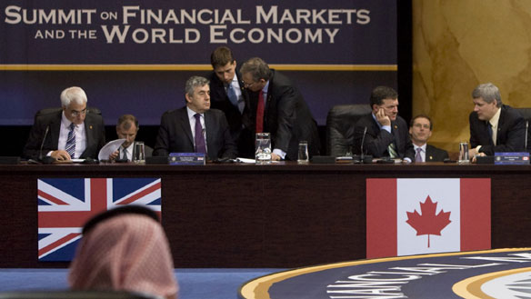
Written by
Edward J. Dodson, M.L.A.

Slide 4
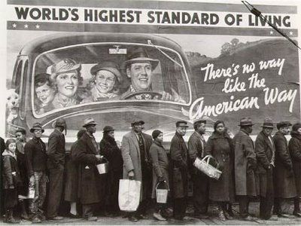
Notes:
There are still quite a few people alive today who experienced the hardships of the Great Depression in the 1930s, which ended only when the world’s nations began to prepare for war.

Slide 5

Notes:
One might conclude that our ongoing, escalating expenditures on the military would have had a similar impact on economic growth today; however, the costs of maintaining a modern, global military presence must be paid for, and the economies of no nations are vibrant enough or strong enough to carry such a heavy expense indefinitely.

Slide 6

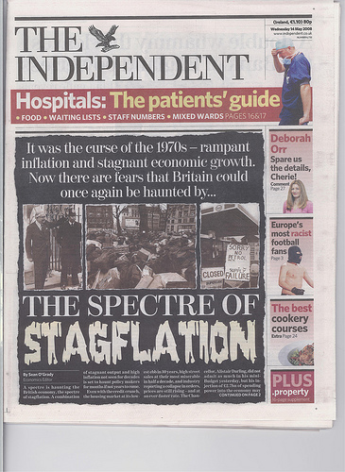
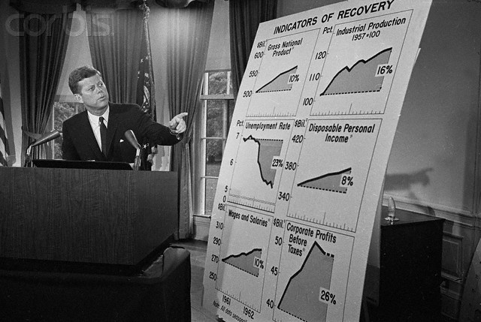
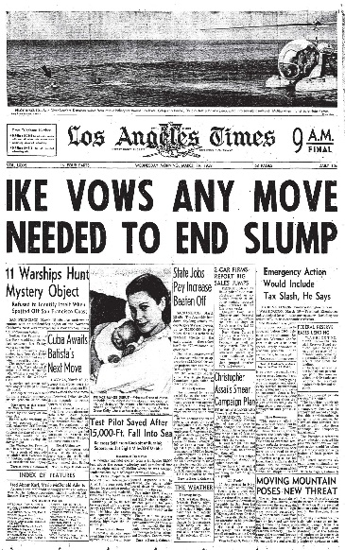
Notes:
Recessionary downturns – some reasonably mild, others severe – have plagued the global economy almost continuously since the end of the Second World War. The new economic tools applied and the new institutions established to deal with these problems not only failed but actually exacerbated the pain experienced during the most recent collapse.

Slide 7
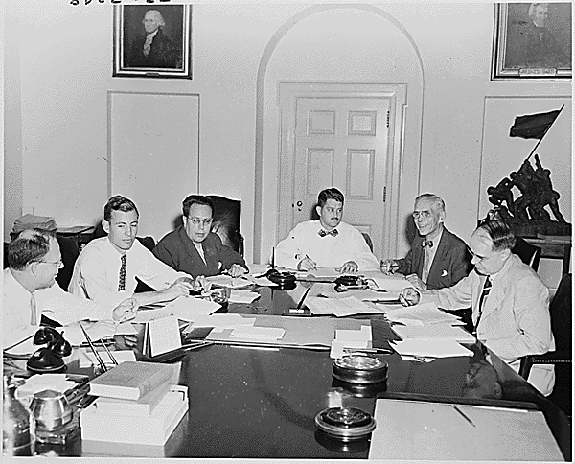
Present at the creation …
Truman’s Council of Economic Advisors (1949)
Notes:
The art of fine-tuning economies by minor adjustments in fiscal and monetary policies has proven to be elusive.

Slide 8
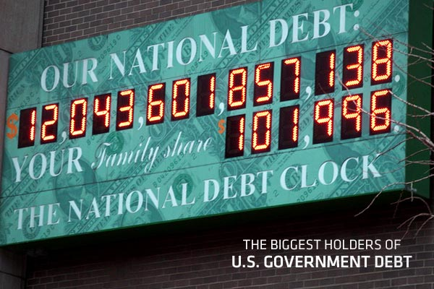
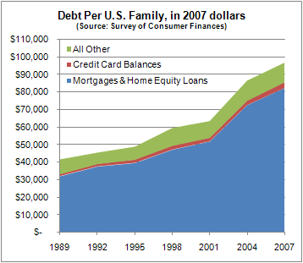
Notes:
For the first time since the Great Depression of the 1930s, an overwhelming majority of households in the United States had no liquid savings. As a nation, we were and are still drowning in debt, with foreclosures and bankruptcies at record levels. A real question is how the U.S. government will manage to service a national debt now well above $20 trillion.

Slide 9

Notes:
This episode presents some of the key reasons – the “triggers” – that have brought us to this precarious position. We begin by looking back to the 1970s, when rising energy costs triggered global “stagflation” and a dramatic shift in purchasing power to those nations with fossil fuel resources still in the ground.

Slide 10

Money Market Funds
Notes:
As inflation eroded the purchasing power of the U.S. Dollar, those who had savings to invest sought to protect themselves from the effects of inflation. The financial markets responded with the creation of money market funds.

Slide 11
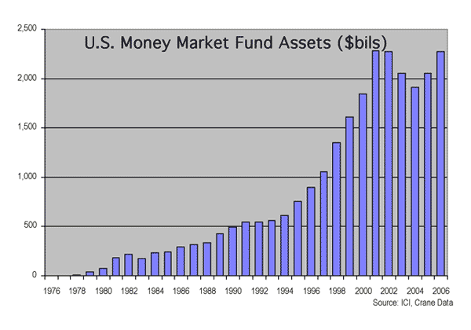
Notes:
From assets of $300,000 in 1972 these funds grew to $390 million in just three years. By 1981 the assets of all money market mutual funds had grown to approximately $80 billion. At the peak of the cycle just ended, the funds controlled over $2.2 trillion.

Slide 12


Notes:
Unfortunately for one major part of the financial sector – the nation’s savings institutions – the regulatory environment did not establish a level playing field. Interest rate ceilings on their lending prevented them from paying competitive interest rates on deposits. Every time market interest rates increased, more and more deposits were withdrawn by consumers and put into the new funds.

Slide 13

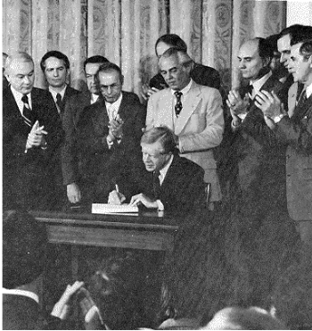
Notes:
Trapped by restrictions on the type of loans they could make, within a few short years many of the nation’s Thrifts faced insolvency. Only in 1980, with passage of the Depository Institutions Deregulation and Monetary Control Act were the Thrifts able to compete with commercial banks and the money market funds. Despite a more level playing field, by 2008, the total amount invested in money market funds reached $1 trillion.

Slide 14

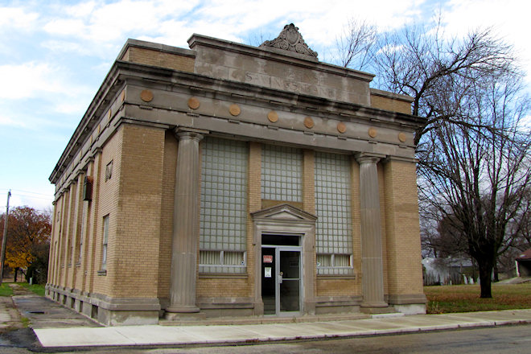


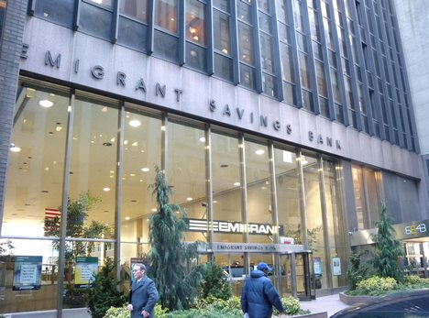
Notes:
Even with deregulation, the Thrifts and all lending institutions faced the problem of losses incurred because of negative spreads between their cost of funds and the yields they experienced on portfolios of fixed rate mortgage loans .

Slide 15



Notes:
Survival depended on their ability to sell their low-yielding mortgage portfolios in the secondary market. Although low rates of interest meant the portfolios would be priced below par value, accounting rules allowed those losses to be amortized over the remaining life of those loans.

Slide 16

Notes:
Another innovation was the creation of mortgage loans with interest rates that could rise or fall based on an, such as one, three or five-year U.S. Treasury notes.

Slide 17

Notes:
Some Thrifts moved recklessly into other areas of lending where they had no expertise, such as making loans to small businesses or investing in syndications financing infrastructure development in countries like Mexico, Chile or Poland. The yields were high, but so was the risk of default, as events would prove.

Slide 18

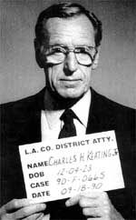
Notes:
And, quite frankly, some of the senior executives of these institutions – Charles Keating becoming one of the most notorious -- milked them for their own benefit until they collapsed.

Slide 19
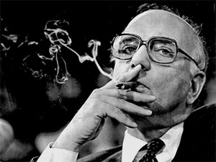
Notes:
With his Presidency plagued by stagflation – that is, by recession, increasing unemployment and inflation together -- Jimmy Carter – reluctantly -- appointed Paul Volcker chairman of the Federal Reserve Board in 1979. Volcker was committed to using the Fed’s powers to bring down inflation, even as unemployment continued to rise.

Slide 20
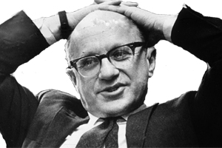
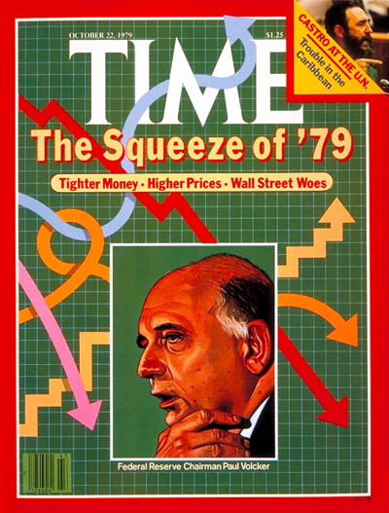
Notes:
The Fed’s board was convinced by economist Milton Friedman that steady, predicable growth in the money supply would be the key to stable and minimally-inflationary economic growth. So, the Fed abandoned its efforts to control interest rates. Rapidly rising interest rates created disposable income for savers, but dramatically curtailed access to credit.

Slide 21

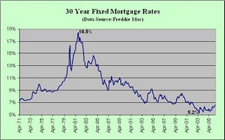

Notes:
By December 1980 the prime rate of interest hit 21.5 percent. Home sales continued to plunge in the face of stagnant household incomes, a disappearance of savings and the problem of high interest rates.

Slide 22

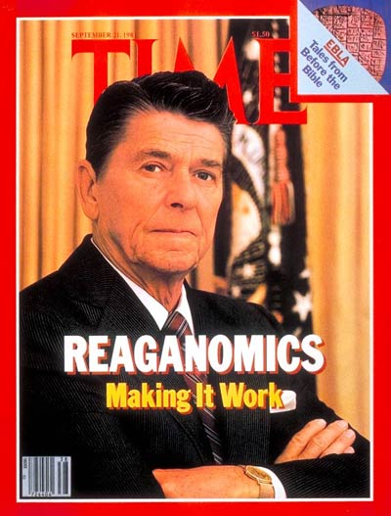
Notes:
The political stage was set for a returned faith in what some view as conservative economic policies. Ronald Reagan’s election in 1980 ushered in the removal of many regulations on business, as well as a significant lowering of tax rates on capital gains and on high marginal incomes. The results were not quite as conservatives promised.

Slide 23
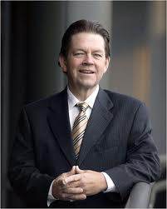
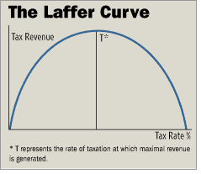
Notes:
The language used to describe the Reagan program referred to “supply-side economics,” ideas attributed to a little known economist named Arthur Laffer, who argued that lower tax rates on higher ranges of income would stimulate economic growth and actually yield increased revenue to the Federal government.

Slide 24
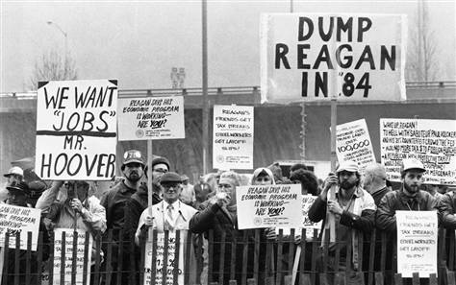
Notes:
Unfortunately, Arthur Laffer’s arguments for changes in tax policies ignored any distinction between earned and unearned income flows. He said nothing about the incentives for investors to engage in speculation rather than production of goods or useful services. The lowering of tax rates failed to stimulate job-creation or building of new factories.

Slide 25

Notes:
Most of the increased disposable income flowing back to the highest income recipients went into highly speculative investments – in the stock market, in commodity futures, in gold, and in the property markets (generally) and in land. Thanks to an ideological commitment to deregulation and a flawed understanding of tax economics, the stage was set for a series of mild economic earthquakes leading to the one that eventually shook the entire globe.

Slide 26

Notes:
We must also remember that Ronald Reagan was committed to whatever military spending was required to bring down the Soviet Union.

Slide 27
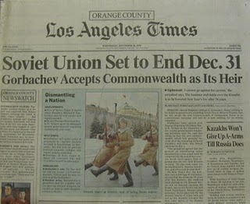
Economic hardship finally brings down the Soviet state …
Notes:
Russia’s command economy could not keep pace, and fewer and fewer members of its younger generation were willing to wait for things to get better. The disparity in living conditions between those in the West and most Russian people was obvious and the source of widespread unrest.

Slide 28
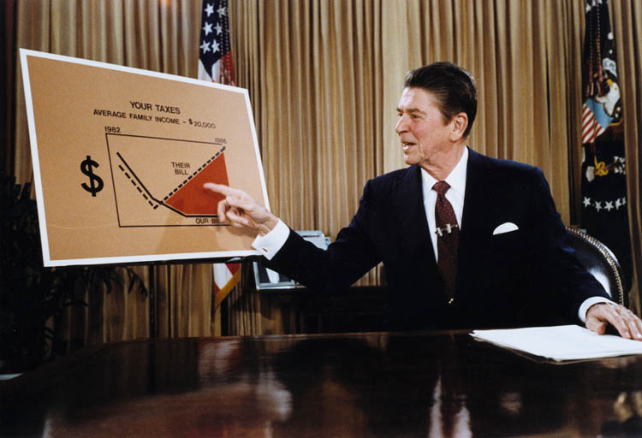
Notes:
In the United States, one result of Reagan’s policies was a $41 billion Federal deficit in 1981, rising to $64 billion in 1982. The U.S. economy slid deeper into recession, with official unemployment climbing to 10.7 percent in 1982 (but real unemployment was considerably higher).

Slide 29
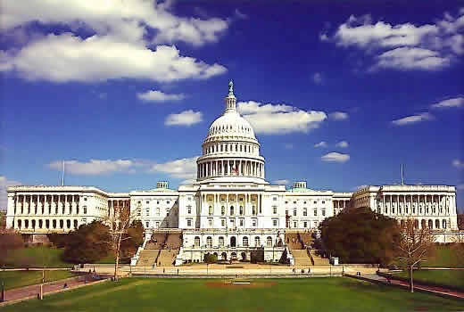
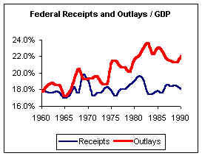
Notes:
At the same time as both Federal spending and deficits were escalating, the Republicans voted to reduce the top marginal tax rate on individual incomes from 70 percent to 28 percent. The corporate income tax rate was reduced from 48 percent to 34 percent. To help make the middle income workers feel they were not being excluded, individual tax brackets were indexed for inflation; and, to be fair, most of the poor were exempting from the income tax altogether.

Slide 30
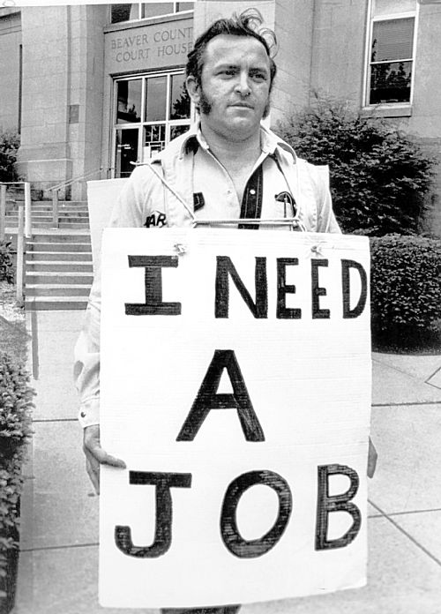

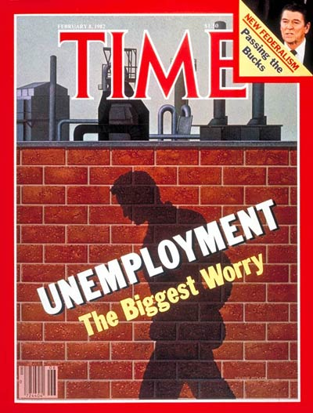
Notes:
By November 1982 well over nine million people were unemployed, the highest number since the Great Depression.

Slide 31

Notes:
Homelessness escalated, estimated in a 1984 study by the U.S. Department of Housing and Urban Affairs to be between 250,000–350,000 persons. More and more low-income families became homeless because of declines in the availability of publicly-subsidized and other low-rent housing options.

Slide 32


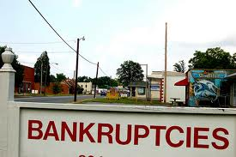


Notes:
Some 17,000 businesses failed, the second highest number since 1933. Countless farmers defaulted on mortgage loans, went into bankruptcy and lost their land.

Slide 33
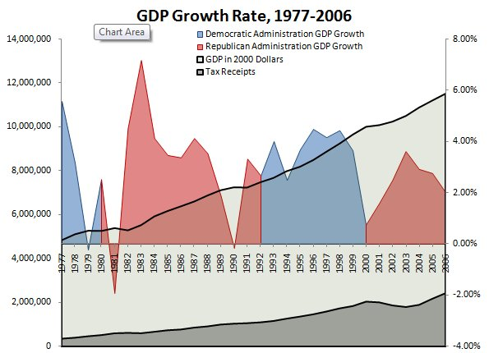
Notes:
Then, at least on the surface, things began to improve, at least that was what we were supposed to believe by reports issued by government economists. Government’s measure of economic growth – Gross Domestic Product – is constantly used to indicate whether or not things are getting better. Yet, rarely does anyone bother to ask what GDP measures.

Slide 34

Gross Domestic Product
Notes:
Most people would be astonished to learn that GDP merely refers to the dollar value of all expenditures on virtually anything.
GDP is determined by calculating the monetary value of all the finished goods and services produced within a country's borders in a specific time period. It includes all of private and public consumption, government outlays, investments and exports net of imports.

Slide 35
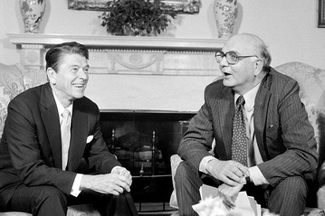
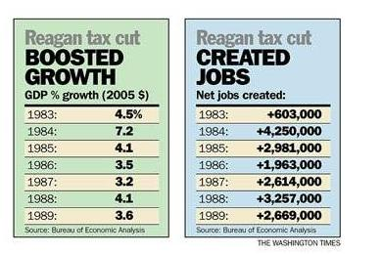
Notes:
By the mid-1980s, the recession accomplished what recessions accomplish. The collapse of demand brings down prices, including property prices. A brief window opened for those who remained employed to purchase homes and other types of property, accessing credit at rates also coming down.

Slide 36
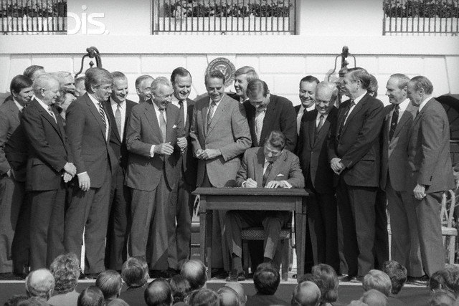
Notes:
Tax reform adopted in 1986 created an additional incentive to take on mortgage debt by eliminating the tax deductibility of interest paid on unsecured forms of loans.

Slide 37

Notes:
Banks and mortgage companies began to enter the traditional markets of the finance companies, making loans and taking second or third lien positions behind first mortgage lenders. Also, as the 1980s came to a close, millions of property owners began to refinance out of high rate or adjustable rate mortgage loans, often consolidating all their debt obligations into one loan.

Slide 38



Notes:
The secondary mortgage market exploded, as lending institutions and mortgage companies passed on the credit and interest rate risks to Fannie Mae, Freddie Mac, Ginnie Mae and a rapidly growing population of investors all around the globe.

Slide 39
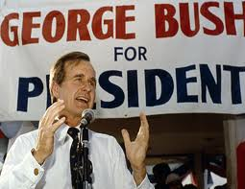
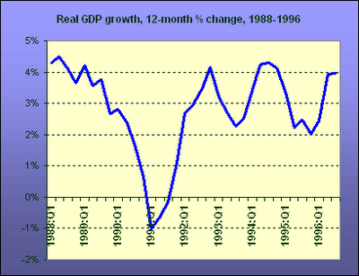
Notes:
In Episode 3, I will examine how the Reagan-era deregulation of financial markets, the dramatic change in how and where government revenue was raised, and the inherently dysfunctional nature of property markets combined to bring the U.S. to the brink of yet another recession under the first President George Bush.

Slide 40
End of Episode 2

