Slide 1
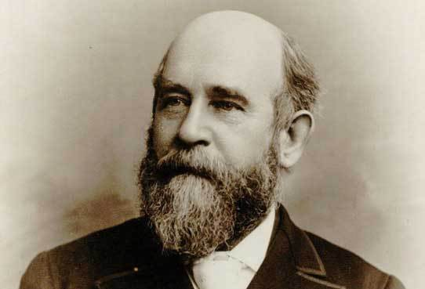
The Life and Legacy of the Nineteenth Century’s Foremost Political Economist: Henry George (1839-1897)

Slide 2
Written By
Edward J. Dodson, M.L.A.

Slide 3
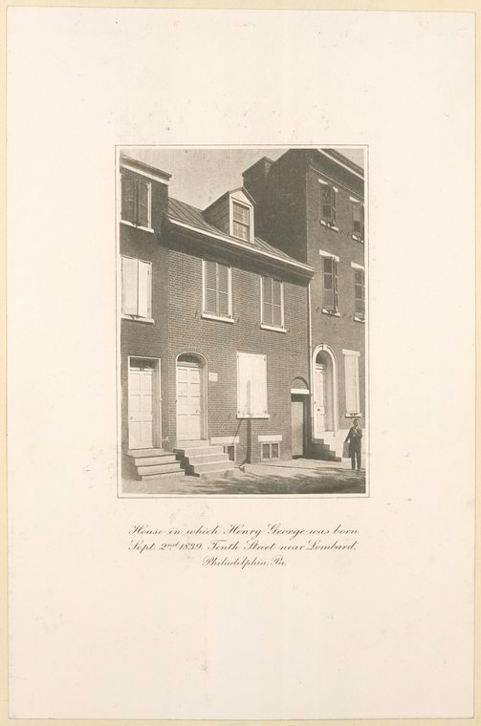
Notes:
Henry George was born on the 2nd of Septmeber, 1839 , in Philadelphia . His family rented this building at 413 South 10th Street, which from the 1950s until 2013 served as the Philadelphia extension of the Henry George School of Social Science.

Slide 4
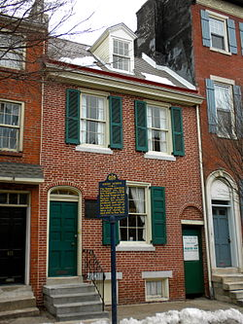
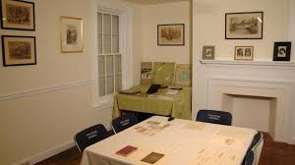
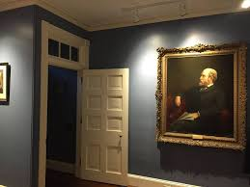
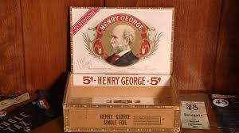
Notes:
The building was temporarily converted into a museum and archive center in 2014 but closed in 2017.

Slide 5
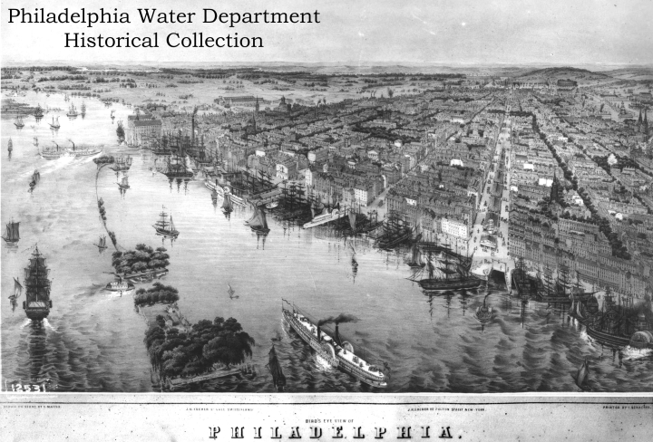
Notes:
As a youth Henry attended lectures at the Franklin Institute and spent a good deal of his time at the piers along the Delaware River, learning about the ships and the trade carried into and out of Philadelphia. In 1855 he went to sea as a “foremast boy” on the merchant ship Hindoo – bound for Melboune, Australia and Calcutta, India.

Slide 6
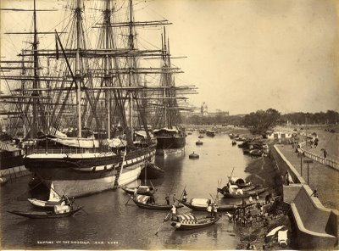
Notes:
Upon arrival in Calcutta, he wrote in his journal:

Slide 7
“One feature which is peculiar to Calcutta was the number of dead bodies floating down in all stages of decomposition, covered by crows who were actively engaged in picking them to pieces. The first one I saw filled me with horror and disgust, but like the natives, you soon cease to pay any attention to them.”
Calcutta
Notes:
“One feature which is peculiar to Calcutta was the number of dead bodies floating down in all stages of decomposition, covered by crows who were actively engaged in picking them to pieces. The first one I saw filled me with horror and disgust, but like the natives, you soon cease to pay any attention to them.”

Slide 8
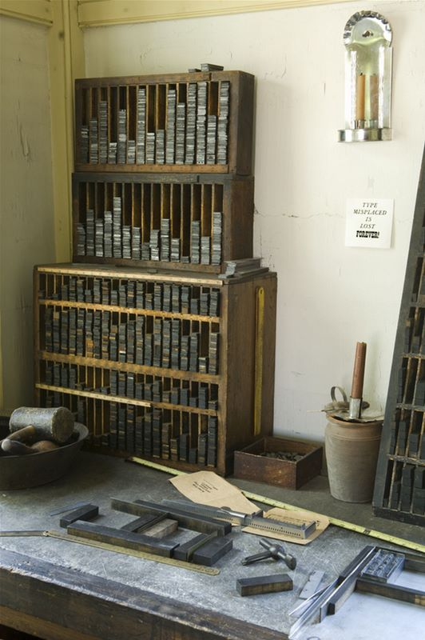
Notes:
Upon his return to Philadelphia in 1856, Henry’s father obtained a position for him with a printing firm, where he learned how to set type.

Slide 9
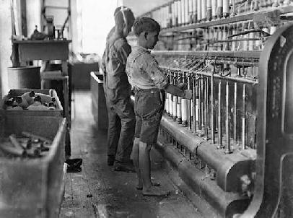
Notes:
Henry in later years recalled his first real discussion on a serious question of political economy:

Slide 10
“An old printer observed to him that while in old countries wages are low, in new countries, they are always high.”
Notes:
“An old printer observed to him that while in old countries wages are low, in new countries, they are always high.” Neither the printer nor Henry at the time could explain why this was so.

Slide 11
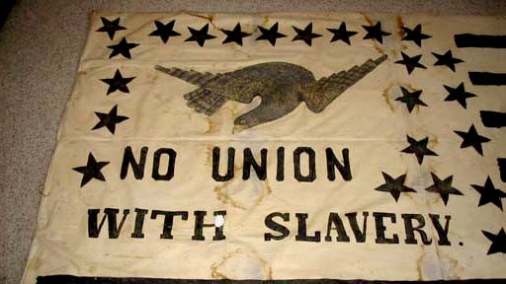
Notes:
He took an interest in political questions and argued strongly against slavery with family members and friends. He later wrote:

Slide 12
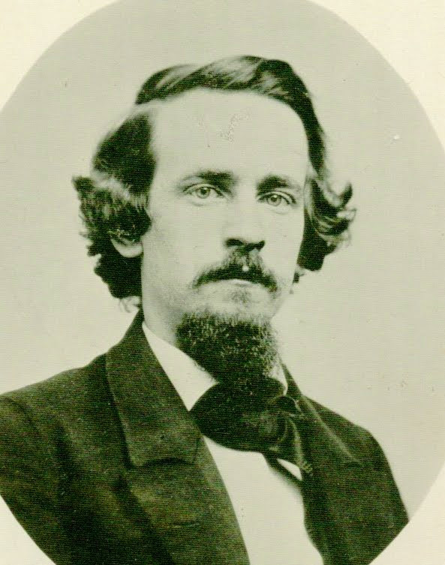
“…over and over again I have heard all questionings of slavery silenced by the declaration that the negroes were the property of their masters, and that to take away a man’s slave without payment was as much a crime as to take away his horse without payment.”
Notes:
“…over and over again I heave heard all questionings of slavery silenced by the declaration that the negroes were the property of their masters, and that to take away a man’s slave without payment was as much a crime as to take away his horse without payment.”

Slide 13
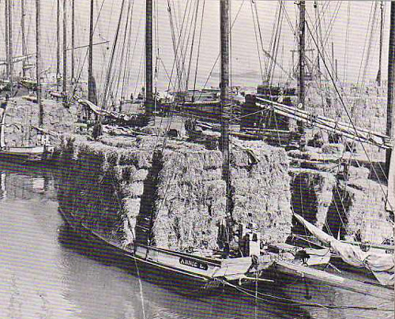
Notes:
Just a year later he left his job setting type and signed on to a schooner taking a load of coal from Philadelphia to Boston. Upon his return to Philadelphia he wrote to a friend:

Slide 14
“The times here are very hard and are getting worse and worse every day, factory after factory suspending and discharging its hands. There are thousands of hard-working mechanics now out of employment in this city.”
Notes:
“The times here are very hard and are getting worse and worse every day, factory after factory suspending and discharging its hands. There are thousands of hard-working mechanics now out of employment in this city.”

Slide 15
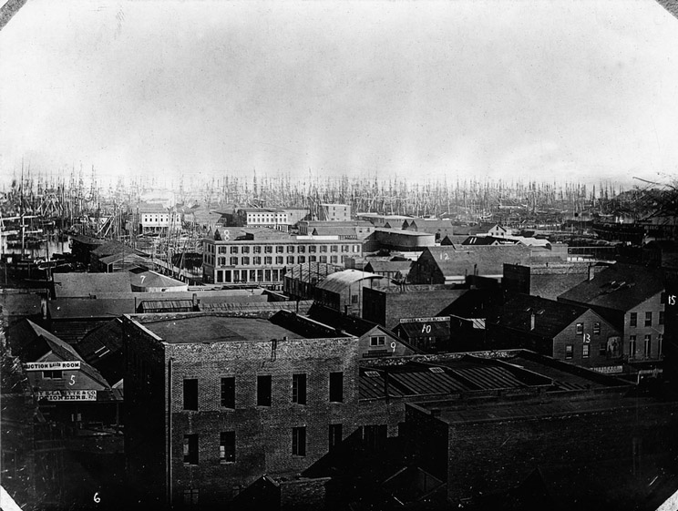
San Francisco - 1855
Notes:
This next year Henry signed on as a ship’s steward aboard a steamship bound for San Francisco. As do many others, Henry leaves the ship before his term of enlistment expires. He is intent on joining the thousands of others headed into the gold fields along the Frazer River.

Slide 16
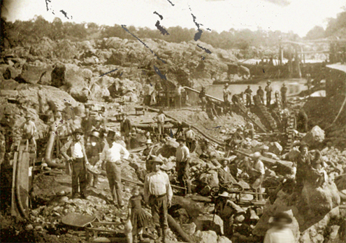
Notes:
Henry worked his way to Victoria, Vancouver Island, on a schooner, then began working in a store managed by his cousin that served the needs of the miners. He considered going to the gold fields but news from returning miners dissuaded him from doing so. He soon returned to San Francisco where he found employment setting type. In a letter to his sister Jennie, he wrote:

Slide 17
“After being deprived of reading for such a time, it is quite delightful to be able to read as much as I wish. In the house in which I am stopping there is a good library, which to me is one of its prominent attractions.”
Notes:
“After being deprived of reading for such a time, it is quite delightful to be able to read as much as I wish. In the house in which I am stopping there is a good library, which to me is one of its prominent attractions.”

Slide 18
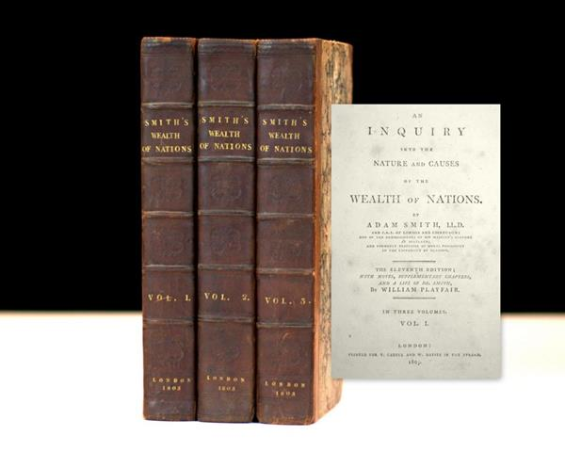
Notes:
He now began his informal study of political economy, reading selections from a small library in the hotel where he was living. Although one of the books available was Adam Smith’s The Wealth of Nations, Henry recalled later that he did not read it at the time.

Slide 19
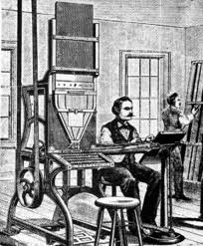
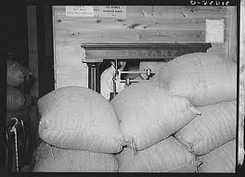
Notes:
For awhile during 1858 he found work type-setting. Laid off, he took a job weighing rice. Then, when the rice mill closed, Henry headed for the California gold fields. He later recalled:

Slide 20
“Having no other ways of reaching them, I started out to walk. I was, in fact, what would now be called a tramp.”
Notes:
“Having no other ways of reaching them, I started out to walk. I was, in fact, what would now be called a tramp.”
He did farm work and manual labor to make enough money to live but did not reach the gold fields and was forced to return to San Francisco.

Slide 21
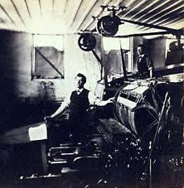
Notes:
Later in 1858, Henry returned to work in printing trade, for the weekly Home Journal. He lost this position after the paper was sold by its owner. After this, he went into partnership with other printers to start a new newspaper, the Evening Journal.

Slide 22
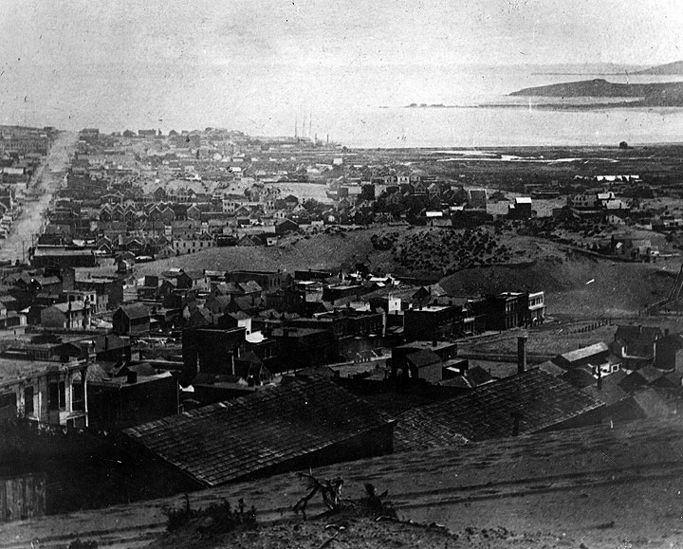
Notes:
By 1860, Henry began to seriously think about the changes to life in California brought on by population growth.

Slide 23
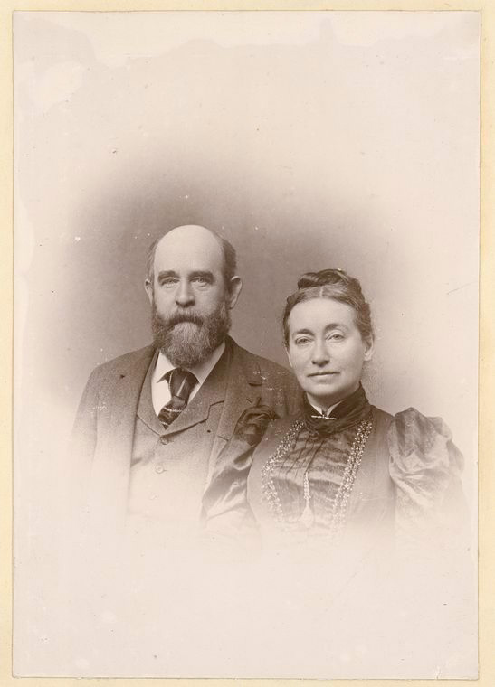
Notes:
In this year he also is introduced to his future wife, Annie Corsina Fox. Her father, an officer in the British army, married Elizabeth McCloskey, whose family had immigrated to Australia from Ireland. When Elizabeth’s family left Australia for California, the couple separated. Elizabeth took their two daughters to California but died not long after in San Francisco. Annie Fox ended up living with her grandmother and aunt.

Slide 24
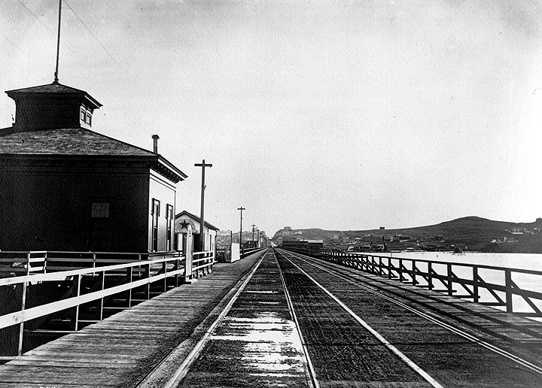
Notes:
Henry’s first newspaper, The Evening Journal survives, but just barely, until mid-November, when the partnership dissolved. The reason for the paper’s financial problems was the completion of the trans-continental telegraph, controlled by a press association monopoly.

Slide 25
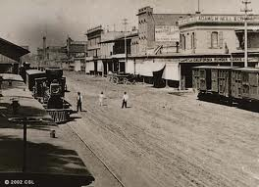
Sacramento – 1860s
Notes:
Henry and Annie Fox married in 1861. Their first son, Henry, Jr. was born in November of 1862. Henry was now working for a newspaper in Sacramento.

Slide 26
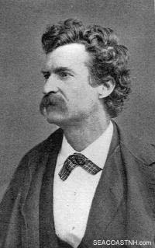
Samuel Clemens
Notes:
In 1862 Samuel Clemens was working as a newspaperman with a growing reputation as a humorist. He came to Sacramento to lecture. Henry George was hired to take tickets at the door.

Slide 27
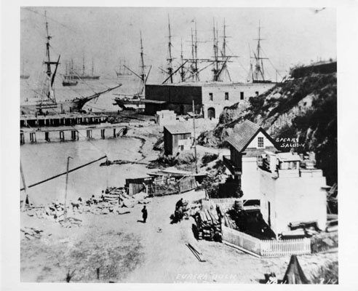
Notes:
In January of 1864, Henry got into an argument with the newspaper’s foreman, and was discharged. He returned to San Francisco and to his former newspaper, the Evening Bulletin, as a typesetter. A few months later he entered into partnership with several others in a printing business. This business venture generated little revenue and put Henry George deeper into debt. During these days he often did not eat breakfast for lack of money. George wrote in his diary:

Slide 28
“I came near starving to death, and at one time I was so close to it that I think I should have done so but for the job of printing a few cards which enabled us to buy a little corn meal.”
Notes:
“I came near starving to death, and at one time I was so close to it that I think I should have done so but for the job of printing a few cards which enabled us to buy a little corn meal.”

Slide 29
Notes:
His second child, Richard, was born on 27 January, 1865. They had no food in the house. Henry went out intent on getting money from someone. He stopped a man, told him his situation, and the man gave him $5. George later wrote:

Slide 30
“If he had not, I think I was desperate enough to have killed him.”
Notes:
“If he had not, I think I was desperate enough to have killed him.”

Slide 31
Notes:
In 1865, Henry began his first serious writing, including a signed letter to the editor urging working men to think about political and social questions. He wrote:

Slide 32
“I hope to see fearless opinions of men and measures ably maintained, and the intelligence of our class brought to the solution of questions of political and social economy which deeply affect us; …”
Notes:
“I hope to see fearless opinions of men and measures ably maintained, and the intelligence of our class brought to the solution of questions of political and social economy which deeply affect us; …”

Slide 33
“… that we may bring our united efforts to the advancement of those great principles upon which our republican institutions rest, and upon which we must depend to secure for us and our children our proper place and rights, and for our country her proud and foremost rank among the nations.”
Notes:
“that we may bring our united efforts to the advancement of those great principles upon which our republican institutions rest, and upon which we must depend to secure for us and our children our proper place and rights, and for our country her proud and foremost rank among the nations.”

Slide 34
Notes:
Following the assassination of Abraham Lincoln, Henry George wrote a remembrance of Lincoln – written as a letter to the editor but printed by the editor as an article. George was then given assignments as a reporter for the paper and his submissions printed as editorials.

Slide 35
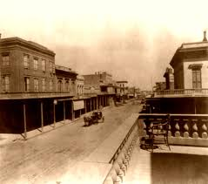
Notes:
The year 1866 found Henry working at his printing trade back in Sacramento, doing work for the state government. At this time he believed in the protection of local industry from external competition as the only way to keep employment and wages high. However, after listening to a speech by a leading protectionist, Henry discarded these ideas in favor of free trade.

Slide 36
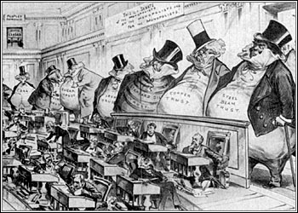
Notes:
He later recalled that when asked what he thought, in response to the protectionist speech by the Land Agent of the Central Pacific Railroad, he said:

Slide 37

“If what he said was true, it seemed to me that the country that was hardest to get at must be the best country to live in; and that, instead of merely putting duties on things brought from abroad, we ought to put them on things brought from anywhere, and that fires and wars and impediments to trade and navigation were the very best things to levy on commerce.”
Notes:
“If what he said was true, it seemed to me that the country that was hardest to get at must be the best country to live in; and that, instead of merely putting duties on things brought from abroad, we ought to put them on things brought from anywhere, and that fires and wars and impediments to trade and navigation were the very best things to levy on commerce.”

Slide 38
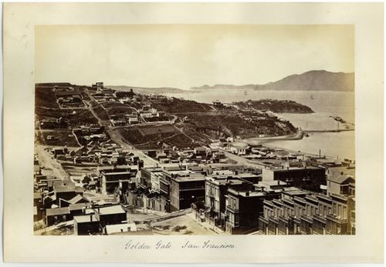
Notes:
His professional life now took a major turn for the better. In June of 1867 he was appointed managing editor of the San Francisco Times. Then, in 1868 he was engaged by owners of another paper, the San Francisco Herald, to travel to New York to try to get the paper admitted to the Associated Press or establish a news service for the paper.

Slide 39
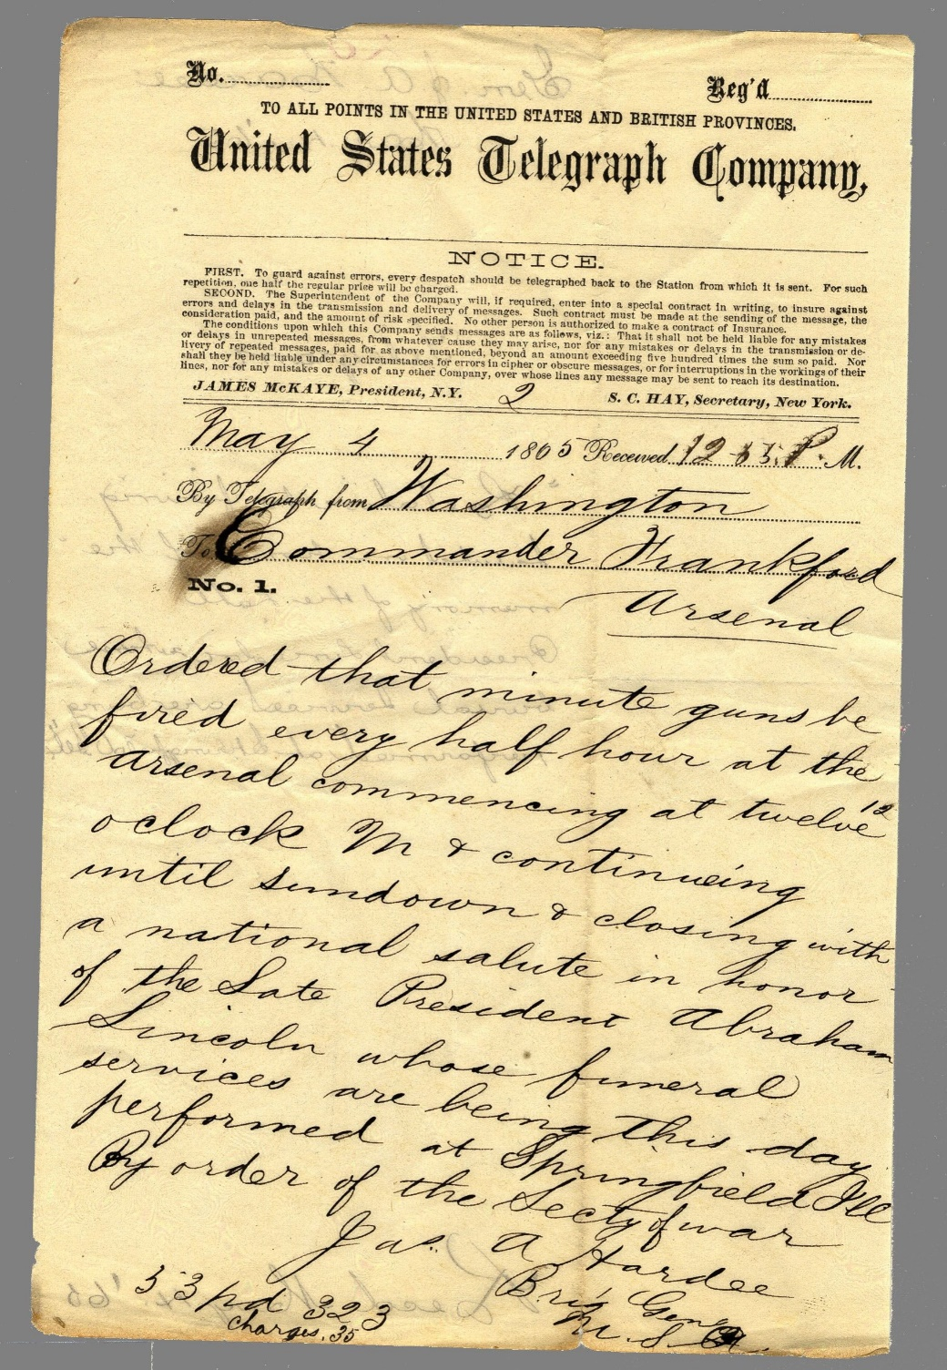
Notes:
The effort failed because of opposition from the Associated Press, whose owners pressured Western Union to dramatically increase the rates charged to Henry George’s newly-created news service.

Slide 40
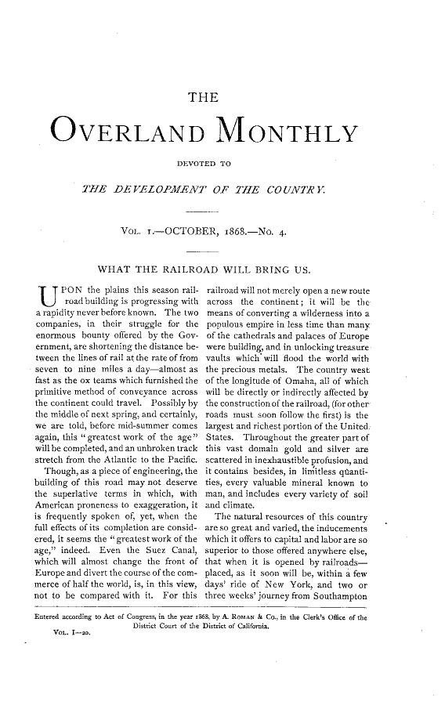
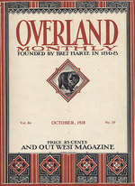
Notes:
Henry’s first major serious writing, “What the Railroad Will Bring Us,” was published in 1868 in the Overland Monthly. He concluded:

Slide 41
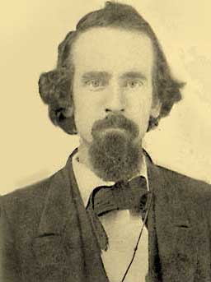
“For years the high rate of interest and the high rate of wages prevailing in California have been special subjects for the lamentations of a certain school of local political economists, who could not see that high wages and high interest were indications that the natural wealth of the country was not yet monopolised, ...”
Notes:
“For years the high rate of interest and the high rate of wages prevailing in California have been special subjects for the lamentations of a certain school of local political economists, who could not see that high wages and high interest were indications that the natural wealth of the country was not yet monopolised, ...”

Slide 42
“… that great opportunities were open to all – who did not know that these were evidences of social health, and that it were as wise to lament them as for the maiden to wish to exchange the natural bloom on her cheek for the interesting pallor of the invalid.”
Notes:
“that great opportunities were open to all – who did not know that these were evidences of social health, and that it were as wise to lament them as for the maiden to wish to exchange the natural bloom on her cheek for the interesting pallor of the invalid.”

Slide 43
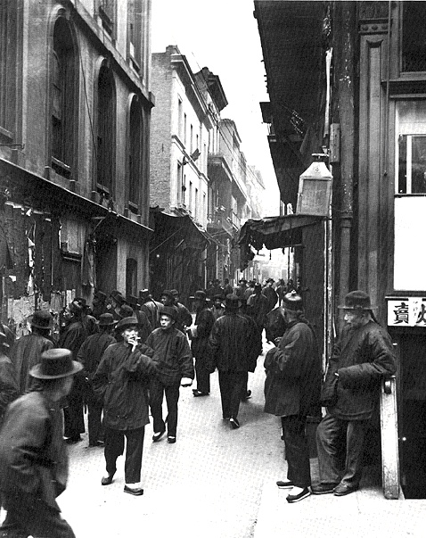
Notes:
Early in 1869, he wrote an article published in the New York Tribune on “The Chinese on the Pacific Coast.” In this article, he opposed unrestricted immigration, and Chinese immigration particularly, for reasons of cultural and racial differences. Years later, he recalled this article as “crude” in its presentation of economic ideas.

Slide 44
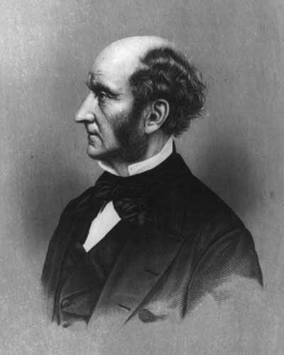
John Stuart Mill
Notes:
Even so, in November of 1869, Henry George received a letter from the British political economist John Stuart Mill responding to Henry George’s article on the assimilation of immigrants. Mill wrote:

Slide 45
“Concerning the purely economic view of the subject, I entirely agree with you; and it could be hardly better stated and argued than it is in your article in the New York Tribune. ...”
Notes:
“Concerning the purely economic view of the subject, I entirely agree with you; and it could be hardly better stated and argued than it is in your article in the New York Tribune. ....”

Slide 46
“That the Chinese immigration, if it attains great dimensions, must be economically injurious to the mass of the present population; that it must diminish their wages, and reduce them to a lower stage of physical comfort and well-being, I have no manner of doubt.”
Notes:
“That the Chinese immigration, if it attains great dimensions, must be economically injurious to the mass of the present population; that it must diminish their wages, and reduce them to a lower stage of physical comfort and well-being, I have no manner of doubt.”

Slide 47
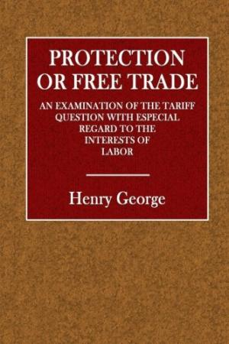
Notes:
In 1886, his own book defending free trade was published. He came to see that certain changes in law and taxation were essential before eliminating tariffs or even restrictions on immigration would lead to widespread benefits.

Slide 48
Notes:
In 1869 Henry campaigned unsuccessfully to become the Democratic Party’s nominee for the California Assembly. Getting the party’s support required a payment to the party’s managers that Henry George refused to make.

Slide 49
Notes:
In an address Henry delivered on the 26th of March, 1878 in San Francisco -- “Why Work is Scarce, Wages Low, and Labour Restless” – Henry revealed the truth he had come to, the reason why workers feared new immigrants:

Slide 50
“To abolish land monopoly will be to make short work of the Chinese question. …Root the white race in the soil, and all the millions of Asia cannot dispossess it.”
Notes:
“To abolish land monopoly will be to make short work of the Chinese question. …Root the white race in the soil, and all the millions of Asia cannot dispossess it.”

Slide 51
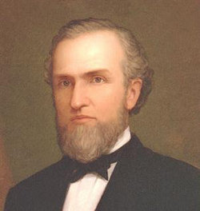
Henry H. Haight
Notes:
Henry then met Henry Haight, Governor of California, an avowed Jeffersonian Democrat. He also befriended a member of the Governor’s staff, John Scott. Both were by now members of the American Free Trade League.

Slide 52
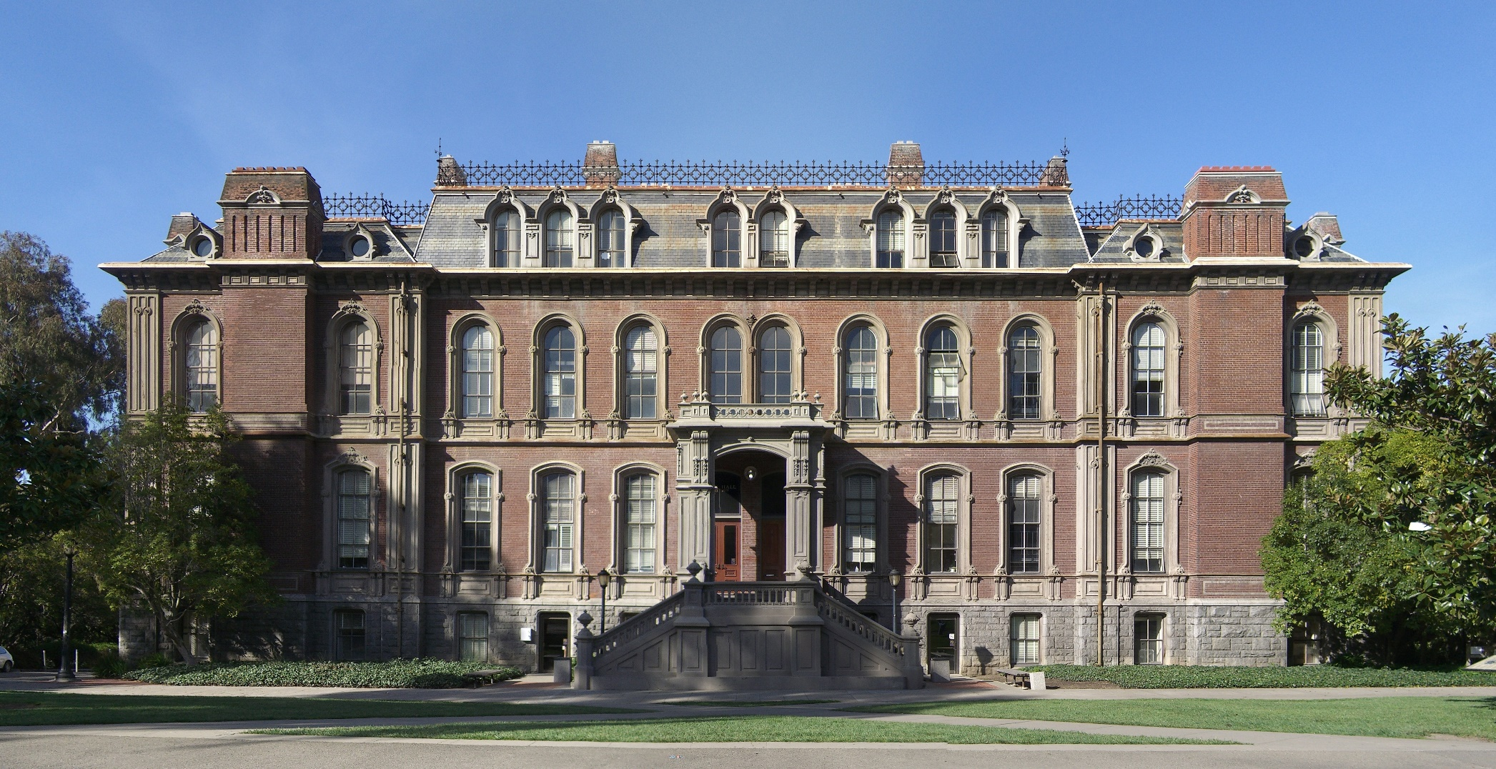
Notes:
As a result of his new associations, Henry was appointed editor of the Democratic party paper, the Transcript. While in this position, he met William Swinton (brother of a well-known New York radical), a lecturer on literature and history at the newly-established University of California at Oakland, who encouraged Henry to broaden his self-education.

Slide 53
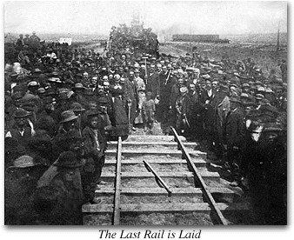
Notes:
Henry had become focused on the coming of railroads to California. He concluded that one of the things the railroad would bring was accelerating speculation in land, driving up prices and the cost of living for working people.

Slide 54
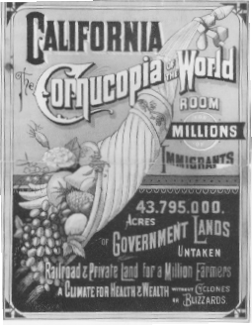
Notes:
While taking a ride in the country one day, he asked a passing teamster what land in the area was worth. He was told that one land owner might sell him some land nearby for a thousand dollars an acre. George later wrote:

Slide 55
“Like a flash it came upon me that there was the reason of advancing poverty with advancing wealth. With the growth of population, land grows in value, and the men who work it must pay more for the privilege.”
Notes:
“Like a flash it came upon me that there was the reason of advancing poverty with advancing wealth. With the growth of population, land grows in value, and the men who work it must pay more for the privilege.”

Slide 56
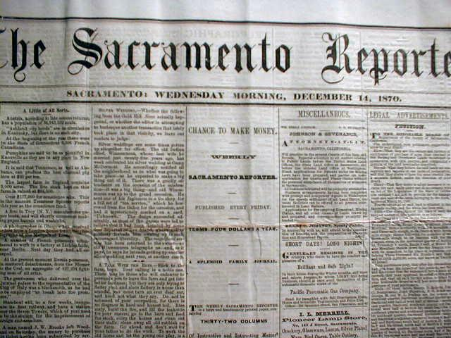
Notes:
In February of 1870, Henry accepted an offer by Governor Haight to become managing editor of the state’s main Democratic party paper, the Sacramento Reporter.

Slide 57
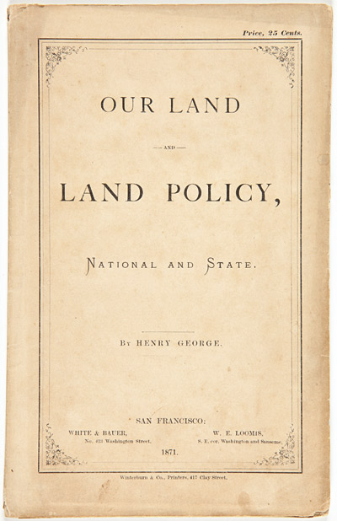
Notes:
Several years of research and thinking about what political economists had referred to as “the land question,” resulted in his first book, Our Land and Land Policy, published in 1871. Henry was just 32 years old. George found it absolutely unbelievable that so much of the nation’s land area had already come under the control of just a small number of people and business entities. On California, he wrote:

Slide 58
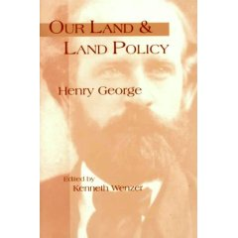
“… with but 600,000 inhabitants, free land should be plentiful; yet the notorious fact is that so reckless has been the land policy that the immigrant in 1871, has, as a general thing, to pay a charge to middlemen before he can begin to cultivate the soil. Already individuals hold thousands and hundreds of thousands of acres apiece.”
Notes:
“… with but 600,000 inhabitants, free land should be plentiful; yet the notorious fact is that so reckless has been the land policy that the immigrant in 1871, has, as a general thing, to pay a charge to middlemen before he can begin to cultivate the soil. Already individuals hold thousands and hundreds of thousands of acres apiece.”

Slide 59
Notes:
Henry George’s understanding of political economy is by this time already well-developed. He makes the penetrating observation that the:

Slide 60
“… value of land is not an element in the wealth of a community. It indicates the distribution of wealth. The value of land and the value of labour must bear to each other an inverse ratio.”
Notes:
“… value of land is not an element in the wealth of a community. It indicates the distribution of wealth. The value of land and the value of labour must bear to each other an inverse ratio.”

Slide 61
Notes:
Henry George in this work provides his views on what the nation’s land policy should be: the taxation of the full annual rental value of land:

Slide 62
“Why should we not go back to the old system, and charge the expense of government upon our lands? …”
Notes:
“Why should we not go back to the old system, and charge the expense of government upon our lands? …” This had been the practice for much of history around the world, until the ownership of land had become privatized.

Slide 63
“Land taxation does not bear at all upon production; it adds nothing to prices, and does not affect the cost of living. As it does not add to prices, it costs the people nothing in addition to what it yields the Government; while as land cannot be hid or moved, this tax can be collected with more ease and certainty, and with less expense than any other tax; and the land-owner cannot shift it to any one else. …”
Notes:
“Land taxation does not bear at all upon production; it adds nothing to prices, and does not affect the cost of living. As it does not add to prices, it costs the people nothing in addition to what it yields the Government; while as land cannot be hid or moved, this tax can be collected with more ease and certainty, and with less expense than any other tax; and the land-owner cannot shift it to any one else. …”

Slide 64
“A tax upon the value of land is the most equal of all taxes, because the value of land is something that belongs to all, and in taxing land values we are merely taking for the use of the community something which belongs to the community.”
Notes:
“A tax upon the value of land is the most equal of all taxes, because the value of land is something that belongs to all, and in taxing land values we are merely taking for the use of the community something which belongs to the community.”

Slide 65
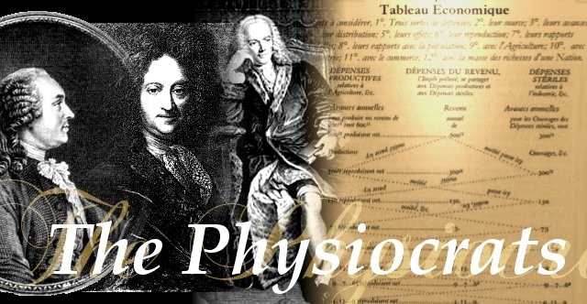
Notes:
A scholarly lawyer he knew in San Francisco informed Henry George that the proposals he advocated were essentially the same as those put forward a century earlier by a French school of political economists known as the Physiocrats. George later wrote of this exchange:

Slide 66
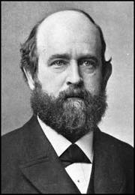
“I forget many things, but the place where I heard this, and the tone and attitude of the man who told me of it, are photographed on my memory. For, when you have seen a truth that those around you do not see, it is one of the deepest of pleasures to hear of others who have seen it.”
Notes:
“I forget many things, but the place where I heard this, and the tone and attitude of the man who told me of it, are photographed on my memory. For, when you have seen a truth that those around you do not see, it is one of the deepest of pleasures to hear of others who have seen it.”

Slide 67
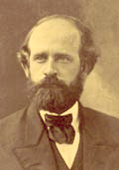
Notes:
In 1871, Henry’s next move was to co-found a new daily newspaper, the San Francisco Evening Post. The paper announced that its editorials would oppose “centralisation and monopolies of all kinds.”

Slide 68
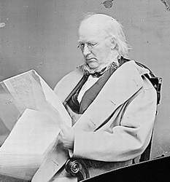
Horace Greeley
Notes:
In 1872, Henry was elected a delegate to the Democratic National Convention; then, returning to California, he campaigned hard for Horace Greeley’s election to the Presidency. Of Greeley, he later wrote:

Slide 69
“We all felt … in this sturdy, benignant old man we had a candidate round whom we could all rally, and who fittingly represented the grandest idea of the time – the idea of reconciliation.”
Notes:
“We all felt … in this sturdy, benignant old man we had a candidate round whom we could all rally, and who fittingly represented the grandest idea of the time – the idea of reconciliation.”

Slide 70

Notes:
An economic downturn beginning in 1875 caused the paper’s financial backer to demand repayment of a large loan only recently extended. The principles were under to raise the cash to make the repayment. Henry George turned over his interest in the paper and departed.

Slide 71
Notes:
Henry decided to leave the Evening Post so that he could devote time to a serious writing project. He wrote to California Governor Irwin to request a position with the state. In seeking this appointment, he asked the Governor:

Slide 72
“… to give me a place where there was little to do and something to get, so that I might devote myself to some important writing.”
Notes:
“… to give me a place where there was little to do and something to get, so that I might devote myself to some important writing.”

Slide 73
Notes:
In January of 1876, Henry was appointed State Inspector of Gas Meters.

Slide 74
Notes:
In March of 1876, Henry makes his first political speech in San Francisco. He declared:

Slide 75
“Fellow-citizens, negro slavery is dead! But cast your eyes over the North to-day and see a worse than negro slavery taking root under the pressure of the policy you are asked … to support by your votes. See seventy thousand men out of work in the Pennsylvania coal-fields; fifty thousand labourers asking for bread in the city of New York; …”
Notes:
“Fellow-citizens, negro slavery is dead! But cast your eyes over the North to-day and see a worse than negro slavery taking root under the pressure of the policy you are asked … to support by your votes. See seventy thousand men out of work in the Pennsylvania coal-fields; fifty thousand labourers asking for bread in the city of New York; …”

Slide 76

Notes:
In 1877, Henry delivered a lecture on “The Study of Political Economy” to students and faculty of the newly-established University of California at Berkeley. He had initially been invited to do a series of lectures. However, he so alarmed some of the university faculty and governing board by his views that he was not invited to return. A few excerpts from his lecture will serve to explain:

Slide 77
“… the very importance of the subjects with which political economy deals raises obstacles in its way. The discoveries of other sciences may challenge pernicious ideas, but the conclusions of political economy involve pecuniary interests, and thus thrill directly the sensitive pocket-nerve. …”
Notes:
“… the very importance of the subjects with which political economy deals raises obstacles in its way. The discoveries of other sciences may challenge pernicious ideas, but the conclusions of political economy involve pecuniary interests, and thus thrill directly the sensitive pocket-nerve. …”

Slide 78
“For the study of political economy you need no special knowledge, no extensive library, no costly laboratory. You do not even need text-books nor teachers, if you will but think for yourselves. All you need is care in reducing complex phenomena to their elements, in distinguishing the essential from the accidental, and in applying the simple laws of human action with which you are familiar.”
Notes:
“For the study of political economy you need no special knowledge, no extensive library, no costly laboratory. You do not even need text-books nor teachers, if you will but think for yourselves. All you need is care in reducing complex phenomena to their elements, in distinguishing the essential from the accidental, and in applying the simple laws of human action with which you are familiar.”

Slide 79
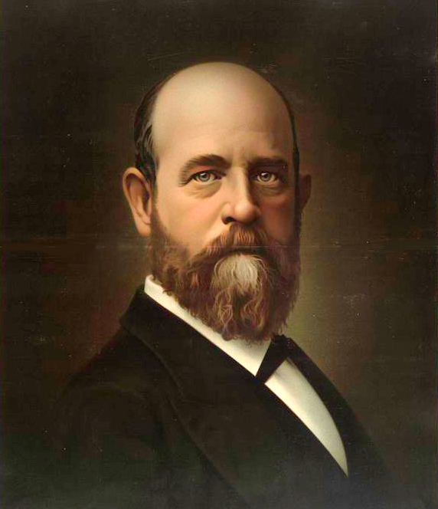
Notes:
On the fourth of July in 1877, Henry delivered a stirring speech on “The American Republic”. He reminded his audience that:

Slide 80
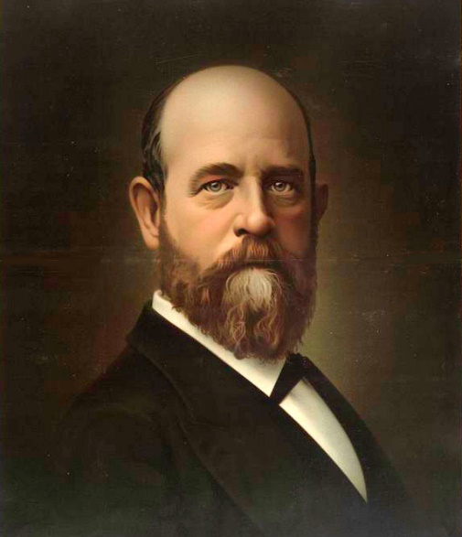
“… republican government is yet but an experiment. They who look upon Liberty as having accomplished her mission, when she has abolished hereditary privileges and given men the ballot, … have not seen her real grandeur… Liberty is the source, the mother, the necessary condition. …”
Notes:
“… republican government is yet but an experiment. They who look upon Liberty as having accomplished her mission, when she has abolished hereditary privileges and given men the ballot, … have not seen her real grandeur… Liberty is the source, the mother, the necessary condition. ...”

Slide 81
“Where Liberty rises, there virtue grows, wealth increases, knowledge expands, invention multiplies human powers, and in strength and spirit the freer nation rises among her neighbours … taller and fairer.”
Notes:
“Where Liberty rises, there virtue grows, wealth increases, knowledge expands, invention multiplies human powers, and in strength and spirit the freer nation rises among her neighbours … taller and fairer.”

Slide 82
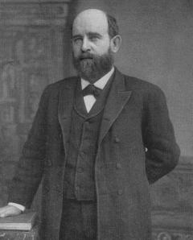
Notes:
By September of 1877 he was ready to begin the writing of his monumental treatise, to which he eventually gave the title Progress and Poverty. He researched the subject and issues thoroughly, as indicated by the fact that his personal library now included some 800 volumes on political economy, history, biography, philosophy and other subjects.

Slide 83
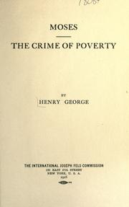
Notes:
In June of 1878, Henry delivered one of his most powerful and oft-repeated addresses, titled “Moses,” at the Young Men’s Hebrew Association of San Francisco. In the Mosaic code, Henry George found a fundamental principle of justice too long ignored:

Slide 84
“It is not the protection of property, but the protection of humanity, that is the aim of the Mosaic code. Its sanctions are not directed to securing the strong in heaping up wealth so much as to preventing the weak from being crowed to the wall. ...”
Notes:
“It is not the protection of property, but the protection of humanity, that is the aim of the Mosaic code. Its sanctions are not directed to securing the strong in heaping up wealth so much as to preventing the weak from being crowed to the wall. ...”

Slide 85
“At every point it interposes its barriers to the selfish greed that, if left unchecked, will sure differentiate men into landlord and serf, capitalist and workman, millionaire and tramp, ruler and ruled.”
Notes:
“At every point it interposes its barriers to the selfish greed that, if left unchecked, will sure differentiate men into landlord and serf, capitalist and workman, millionaire and tramp, ruler and ruled.”

Slide 86

Notes:
Henry completed the manuscript of Progress and Poverty in March of 1879. The book was rejected by a New York publisher, D. Appleton & Co., with the comment:

Slide 87
“There is very little to encourage the publication of any such work at this time and we feel we must decline it.”
Notes:
“There is very little to encourage the publication of any such work at this time and we feel we must decline it.”

Slide 88

Notes:
Henry decided the only way to have the book published was to make his own plates. A former partner, William Hinton, offered his services to set the type and make the plates. As the process started, Henry made numerous revisions to the text. When finished, he dedicated the book …

Slide 89

“… to those who, seeing the vice and misery that spring from the unequal distribution of wealth and privilege, feel the possibility of a higher social state and would strive for its attainment.”
Notes:
“… to those who, seeing the vice and misery that spring from the unequal distribution of wealth and privilege, feel the possibility of a higher social state and would strive for its attainment.”

Slide 90

Notes:
In August of 1879 Henry George published an author’s edition of Progress and Poverty, which he sentto publishers in the U.S. and England.

Slide 91

Notes:
He sent a copy to Sir George Grey in New Zealand, who responded:

Slide 92
“I have already read a large part of the book. I regard it as one of the ablest works on the great questions of the time, …It will be of great use to me.”
Notes:
“I have already read a large part of the book. I regard it as one of the ablest works on the great questions of the time, …It will be of great use to me.”

Slide 93

Notes:
Finally, in October of 1879 D. Appleton agreed to publish Progress and Poverty using the plates provided by Henry George. This edition appeared in January of 1880. Henry George came east to New York to lecture and promote the book. An inexpensive, paper-covered edition followed in April, and this printing sold out quickly. At year end, the book was translated into German and sales of this edition grew steadily.

Slide 94

Notes:
He soon began his next book, the Irish Land Question: What It Involves, and How Alone It can be Settled, which was published early in 1881 with the more general title removing the reference to Ireland.

Slide 95

Notes:
Later in the year, Henry was hired by the New York newspaper Irish World to travel to Ireland and England to report on the rising tension between Irish nationals and absentee English landlords.

Slide 96

Notes:
In his first dispatch to the Irish World , Henry commented on the nature of what passed for government in Ireland:

Slide 97
“It is not merely a despotism; it is a despotism sustained by alien force, and wielded in the interests of a privileged class, who look upon the great masses of the people as intended but to be hewers of their wood and drawers of their water. …”
Notes:
“It is not merely a despotism; it is a despotism sustained by alien force, and wielded in the interests of a privileged class, who look upon the great masses of the people as intended but to be hewers of their wood and drawers of their water. …”

Slide 98

Notes:
In November of 1881, Henry delivered an address on the land question in Dublin, followed by a second address at the beginning of January 1882. He then sailed to England, where he met with the prominent Irish leaders imprisoned in London. He also met with Helen Taylor, the step-daughter of John Stuart Mill, who assured him that Mill would have embraced the truths revealed in Progress and Poverty .

Slide 99

Henry M. Hyndman
Notes:
In January of 1882, Henry received from the socialist leader Henry M. Hyndman, a copy of a 1775 address by Thomas Spence on “The Real Rights of Man,” delivered before the Philosophical Society of Newcastle.

Slide 100

Notes:
Spence is often referred to by historians as a forerunner of Henry George, as they shared many insights. In this address, Spence proclaimed common rights in land and proposed that land values be taken for public purposes, taxing nothing else. George urged Hyndman to publish Spence’s lecture as evidence that this position had a long history of support.

Slide 101

Notes:
George also met Herbert Spencer, author of the book Social Statics, first published in 1851, in which the philosopher expressed views similar to those held by Henry George on the land question. However, by this time Spencer had changed his views, and their meeting left George with “a deep disappointment.”

Slide 102

Notes:
In August of 1882, Henry embarked on an investigative trip through Western Ireland. He and an English companion were arrested by the police “under the Crimes Act as ‘suspicious strangers’.” George later recorded that:

Slide 103
“To come to Ireland only to be mistaken for an emissary of sedition, a would-be assassin of landlords, or maimer of cattle, was something that had not entered into [my companion’s] calculations.”
Notes:
“To come to Ireland only to be mistaken for an emissary of sedition, a would-be assassin of landlords, or maimer of cattle, was something that had not entered into [my companion’s] calculations.”

Slide 104

Notes:
Later the same day, in the town of Athenry, he was again arrested. In both instances, he was released within a few hours. However, he wrote to the President of the United States describing what he observed as the mistreatment of U.S. citizens in Ireland by British authorities.

Slide 105

Notes:
Henry George’s arrests were reported in all of the Irish and British newspapers, which stimulated the demand for his books. A serious review of Progress and Poverty appeared in the London Times. Sales in Australia and New Zealand were also increasing. Back in the United States, the New York Times printed this short poem on Henry George written by Emma Lazarus.

Slide 106

Notes:
In October of 1882, Henry returned from Ireland, his services as a lecturer and writer now in great demand. Among other places, he was invited to speak in St. Louis (Missouri), Terre Haute (Indiana) and Wheeling (West Virginia).

Slide 107

Terence V. Powderly
Notes:
By 1883 some leaders of organized labor in the United States began to champion his proposals. Knights of Labor leader, Terence Powderly, became a strong supporter and saw that George’s writings were distributed widely to members.

Slide 108

Notes:
Later that year, Henry George joined with others to form the “Free Soil Society” with the stated purpose to “free the soil from land speculation”. Founding members included Louis F. Post, former editor of Truth and members of the Irish World editorial staff.

Slide 109

Louis F. Post
Notes:
Louis F. Post had been an assistant U.S. Attorney in New York City, but he had turned to journalism and begun to edit The Public, a weekly journal devoted to the single tax politics of Henry George. Later in life, he served as Undersecretary of the U.S. Department of Labor in 1913.

Slide 110

Notes:
Henry’s financial condition was temporarily improved by receipt of a $1,000 bequest left by a supporter named Francis Shaw. He now set aside time to begin his book attacking tariffs and other restraints on trade.

Slide 111

Notes:
Still in 1883, he writes a series of articles for Frank Leslie’s Illustrated Newspaper under the title “Problems of the Time.” In the fifth article, George provided evidence of the increasing concentration of land holdings and a fall in the number of farms. These articles were published together in book form, with eight additional chapters, under the title Social Problems. Introducing the work, he wrote:

Slide 112

“My endeavor has been to present the momentous social problems of our time, unencumbered by technicalities and without the abstract reasoning which some of the principles of political economy require for thorough explanation.”
Notes:
“My endeavor has been to present the momentous social problems of our time, unencumbered by technicalities and without the abstract reasoning which some of the principles of political economy require for thorough explanation.”

Slide 113

Notes:
From Prof. William Swinton came a suggestion that George produce an abridged and annotated edition of Adam Smith’s Wealth of Nations. George began the work but was soon diverted and never returned to the project.

Slide 114

Notes:
Henry George spends remarkably few pages in his book, Progress and Poverty, analyzing the positions taken by Adam Smith. In the end, he is dismayed that Smith’s thinking does not meet a true test of scientific investigation. In George’s chapter on “the law of wages” he recognizes Adam Smith for also rightly concluding that high wages existed “where land was yet open to settlement.” Yet, in reviewing Smith’s writing on the subject George concludes that:

Slide 115
“Smith failed to appreciate the true laws of the distribution of wealth only because he turned away from the more primitive forms of society to look for first principles amid complex social manifestations, where he was blinded by a preaccepted theory of the functions of capital, and … a vague acceptance of the doctrine which, two years after his death, was formulated by Malthus.”
Progress and Poverty, pp. 215-216
Notes:
“Smith failed to appreciate the true laws of the distribution of wealth only because he turned away from the more primitive forms of society to look for first principles amid complex social manifestations, where he was blinded by a preaccepted theory of the functions of capital, and … a vague acceptance of the doctrine which, two years after his death, was formulated by Malthus.”

Slide 116


Notes:
Supporters in Britain arranged a lecture tour for Henry George throughout England and Scotland. At Oxford University, a young professor, Arnold Toynbee, developed two lectures responding to Progress and Poverty. Unfortunately, Toynbee died suddenly a short time afterward, so that George did not have the opportunity to debate him on the issues.

Slide 117

Joseph Chamberlain
Notes:
Joseph Chamberlain, leader of the so-called Radicals in Parliament, fearful of the growing influence of Henry George’s ideas, wrote:

Slide 118
“If something is not done quickly to meet the growing necessities of the case, we may live to see theories as wild and methods as unjust as those suggested by the American economist adopted as the creed of no inconsiderable portion of the electorate.”
Notes:
“If something is not done quickly to meet the growing necessities of the case, we may live to see theories as wild and methods as unjust as those suggested by the American economist adopted as the creed of no inconsiderable portion of the electorate.”

Slide 119

Notes:
In December of 1883, Henry George arrived in Liverpool, England. His first lecture occurred on 9 January 1884, in St. James’ Hall, London. In this and subsequent lectures in Plymouth, Birmingham and Liverpool, he argued against confiscation of land for redistribution but also argued against compensation to landlords for any land that might be taken. What he wanted was to stop confiscation, the confiscation by those who called themselves landlords, of rent, which belonged not to them but to the entire community.

Slide 120

Alfred Marshall
Notes:
In March of 1884, Henry lectured at Oxford University before an essentially hostile audience, representative of the privileged classes of Britain. Here, the political economist Alfred Marshall challenged George on a number of fronts. Marshall declared that not a single economic doctrine advanced in Progress and Poverty was:

Slide 121
“… both new and true, since what was new was not true, and what was true was not new.”
Notes:
“… both new and true, since what was new was not true, and what was true was not new.”
Marshall also accused George of not understanding any of the authors George had criticized. George responded that the book was based upon the truth; and the truth could not be a new thing; it always had existed and it must be everlasting. Marshall remained unconvinced, and their exchange ended with what amounted to an agreement to disagree. George then went on to lecture at Cambridge, where his reception was far more cordial, even from his many opponents.

Slide 122

Michael Davitt
Notes:
In April of 1884, Henry travelled to Dublin at the invitation of the Irish nationalist and land reformer Michael Davitt, to address a large audience in Dublin, after which he returned to New York.

Slide 123



Notes:
Over the next several months, he wrote several articles, including a response to an attack on Progress and Poverty made by the Duke of Argyll. This was published in pamphlet form.

Slide 124





Notes:
In October of 1884, Henry once again journeys to Britain, this time at the request of the Scottish Land Restoration League. He delivers a major address in London, with the Irish land reformer Michael Davitt – now fully committed to his solution to the land question – among the other speakers. After delivering several speeches to growing audiences, he finally returned to the United States. Remarkably, in Britain now even Joseph Chamberlain was now calling for the taxation of land values in his own speeches.

Slide 125

Notes:
His next book, Protection or Free Trade, appeared in 1886. Several chapters from the book appeared in serial form in various newspapers.

Slide 126

Tom L. Johnson
Notes:
Henry George now made the acquaintance of a wealthy businessman, Tom L. Johnson, who gained his fortune by acquiring street railroad franchises. After reading both Social Problems and Progress and Poverty, Johnson called on Henry George in Brooklyn. Although Johnson’s fortune was based on monopoly privileges he secured from government, he saw the truth in Henry George’s writings. He later recalled:

Slide 127

“I went to talk to Mr. George about his cause; and I wanted in some way to call it my cause, too. But he stretched out on a lounge and I sat in a chair and I found myself telling him the story of my life.”
Notes:
“I went to talk to Mr. George about his cause; and I wanted in some way to call it my cause, too. But he stretched out on a lounge and I sat in a chair and I found myself telling him the story of my life.”

Slide 128


Abram Hewitt
Theodore Roosevelt
Notes:
With his fame growing, Henry George was drafted in 1886 by the New York labor unions to run for the Office of Mayor of New York City. The Tammany political machine nominated Abram S. Hewitt. The Republicans nominated Theodore Roosevelt. A Tammany official approached George, telling him that if he refused the nomination they would run him for Congress. George responded:

Slide 129
“You tell me I cannot possibly get the office. Why, if I cannot possibly get the office, do you want me to withdraw?”
Notes:
“You tell me I cannot possibly get the office. Why, if I cannot possibly get the office, do you want me to withdraw?

Slide 130
His reply:
“You cannot be elected, but your running will raise hell!”
Notes:
His reply: ‘You cannot be elected, but your running will raise hell!’

Slide 131
George responded:
“You have relieved me of embarrassment. I do not want the responsibility and the work of the office of the Mayor of New York, but I do want to raise hell! I am decided and will run.”
Notes:
“You have relieved me of embarrassment. I do not want the responsibility and the work of the office of the Mayor of New York, but I do want to raise hell! I am decided and will run.” George finished second behind Abram Hewitt. He received over 68,000 official votes. More were said to be floating down the Hudson River.

Slide 132

Notes:
In January of 1887, Henry George started a newspaper, The Standard, in New York City. Louis F. Post joined the paper as editorial and special writer, and Henry George’s eldest son came aboard as correspondence editor. The paper defended the Rev. Dr. Edward McGlynn, who in supporting George’s campaign was suspended for holding views contrary to Catholic doctrine. In The Standard, George wrote:

Slide 133
“What Dr. McGlynn is punished for is for taking the side of the working men against the system of injustice and spoliation and the rotten rings which have made the government in New York a by-word of corruption.”
Notes:
“What Dr. McGlynn is punished for is for taking the side of the working men against the system of injustice and spoliation and the rotten rings which have made the government in New York a by-word of corruption.”

Slide 134

Notes:
Henry George and Dr. McGlynn joined forces to form the Anti-Poverty Society.

Slide 135

Notes:
The solution to the land question as Henry George proposed came to be described as “the Single Tax”. The term is said to have been originated with Henry George’s collaborator, Thomas Sherman.

Slide 136

William Lloyd Garrison, Jr.
Notes:
In 1888, William Lloyd Garrison, Jr., son of the anti-slavery crusader, joined the Single Tax campaign. Of Henry George, he wrote in 1898, following George’s death:

Slide 137
“I may be mistaken, but I place him among the great benefactors of the race. It was a privilege to know and love him and a satisfaction to feel that I cast my lot with him in this day of small things, when such tribute as the nations paid him at the last was beyond the most extravagant dream. ...”
Notes:
“I may be mistaken, but I place him among the great benefactors of the race. It was a privilege to know and love him and a satisfaction to feel that I cast my lot with him in this day of small things, when such tribute as the nations paid him at the last was beyond the most extravagant dream. ...”

Slide 138
“Without the right of all men to the use of the earth, men must be in subjection to their brothers and the extremes of wealth and poverty alarm civilization.”
Notes:
“Without the right of all men to the use of the earth, men must be in subjection to their Brothers and the extremes of wealth and poverty alarm civilization.”

Slide 139


Notes:
From Russia, Leo Tolstoy added his own voice to that of Henry George’s. Tolstoy became an ardent supporter of Henry George’s proposals as a solution to Russia’s social problems. In his novel, Resurrection, he presented George’s solution to the land question.

Slide 140
Notes:
Henry George planned to visit Tolstoy during the 1890s but health problems prevented him from doing so before his death in 1897. However, they exchanged correspondence, and in a letter Tolstoy wrote dated 8 April 1896, he conveyed his thanks to Henry George:

Slide 141
“There is nothing that widens so much the horizon, that gives such firm support or such a clear view of things as the consciousness that although it is but in this life that we have the possibility and the duty to act, nevertheless this is not the whole of life but that bit of it only which is open to our understanding. …The reading of every one of your books makes clear to me more and more the truth and practicality of your system.”
Notes:
“There is nothing that widens so much the horizon, that gives such firm support or such a clear view of things as the consciousness that although it is but in this life that we have the possibility and the duty to act, nevertheless this is not the whole of life but that bit of it only which is open to our understanding. …The reading of every one of your books makes clear to me more and more the truth and practicality of your system.”

Slide 142
Notes:
In an 1888 interview, Tolstoy predicted that Henry George’s vision would soon be realized:

Slide 143
“In thirty years private property in land will be as much a thing of the past as now is serfdom. …Henry George had formulated the next article in the programme of the progressivist Liberals of the world.”
Notes:
“In thirty years private property in land will be as much a thing of the past as now is serfdom. …Henry George had formulated the next article in the programme of the progressivist Liberals of the world.”

Slide 144

Notes:
What Tolstoy failed to foresee was that the elimination of private property in land occurred in Russia and elsewhere under circumstances very different from those proposed by Henry George.

Slide 145

Notes:
Early in 1889, Henry George made two more trips to Britain and Ireland in response to requests by supporters, including Ireland’s Michael Davitt. He took time to briefly visit Paris.

Slide 146

Notes:
A new textbook on political economy, consistent with the system developed by Henry George, was now published in Britain, written by Professor J.E. Symes of University College, Nottingham.

Slide 147

Sir George Grey
Notes:
In the Spring of 1890, Henry George sailed for Australia, stopping first in Hawaii, then New Zealand. In New Zealand, he is welcomed by Sir George Grey, one of the first prominent statesmen to read Progress and Poverty and champion its message. From the time he landed in Sydney, in Australia, he spoke and lectured almost without pause. The Editor of the Australian paper, The Standard, described Henry George in this way:

Slide 148
“Of the great reformer himself, all must admit that as a speaker and as a man he more than justifies all our preconceived admiration. His genial manner and outspoken democracy take the hearts of all true Australians by storm; and his infinite variety of illustration, his incisive logic, and at times passionate eloquence, stir his audience to laughter, to deep thought, or to tear almost at his will…”
Notes:
“Of the great reformer himself, all must admit that as a speaker and as a man he more than justifies all our preconceived admiration. His genial manner and outspoken democracy take the hearts of all true Australians by storm; and his infinite variety of illustration, his incisive logic, and at times passionate eloquence, stir his audience to laughter, to deep thought, or to tear almost at his will…”

Slide 149

Notes:
Henry George was back in New York by September of 1890, where he took part in the first national conference in support of the Single Tax. The conference was held for two days at Cooper Union in New York. At the conference, George spoke somewhat prophetically:

Slide 150
“Life, long life is not the best thing to wish for those you love. Not too long; but that in my day, whether it be long or short, I may do my duty, and do my best.”
Notes:
“Life, long life is not the best thing to wish for those you love. Not too long; but that in my day, whether it be long or short, I may do my duty, and do my best.”

Slide 151
Notes:
In December of 1890, Henry was stricken with what was a mild stroke that affected his language skills, causing him to use inappropriate or manufactured words. He quickly began to recover and did not suffer any paralysis, but this was a sign that his health would not hold up if he continued at the pace of recent years.

Slide 152

Notes:
In April of 1891 he decided to write a complete treatise on political economy, tracing its development as a science and explaining the errors of earlier and contemporary writers. The book, his last, was eventually ublished posthumously with the title The Science of Political Economy. His son, Henry George, Jr. completed editing of the manuscript in 1897.

Slide 153


Notes:
He interrupted his research to respond to “The Condition of Labor,” an encyclical letter issued by Pope Leo XIII. The encyclical was interpreted by Henry George and his supporters as a direct response to their teachings. His response was finished in September, translated into Italian and presented to Pope Leo XIII personally. The Vatican issued no reply.

Slide 154


Notes:
From England, the noted philosopher Herbert Spencer succumbed to the pressure of being described as a forerunner to Henry George and recanted positions taken in the early editions of his book Social Statics.

Slide 155

Notes:
Henry George’s response, “A Perplexed Philosopher,” appeared in 1892. The book sold well and was widely read, but Herbert Spencer did not engage George or respond to his charges that Spencer had abandoned his earlier principles. The 1892 edition of Social Statics eliminated the earlier passages containing his argument against private ownership of land. George set the tone of his rebuttal, stating:

Slide 156
“Since philosophy is the search for truth, the philosopher who in his teachings is swerved by favor or by fear forfeits all esteem as a philosopher. …A man of special learning may be a fool as to common relations. And that he who passes for an intellectual prince may be a moral pauper there are examples enough to show.”
Notes:
“Since philosophy is the search for truth, the philosopher who in his teachings is swerved by favor or by fear forfeits all esteem as a philosopher. …A man of special learning may be a fool as to common relations. And that he who passes for an intellectual prince may be a moral pauper there are examples enough to show.”

Slide 157
Notes:
George sided with those who argued that societal law must conform to moral law in order to secure justice. He writes:

Slide 158
“Those who contend that the state is the source of all rights may indeed object to any proposed state action that it would be inexpedient, but they cannot object that it would be wrong.”
Notes:
“Those who contend that the state is the source of all rights may indeed object to any proposed state action that it would be inexpedient, but they cannot object that it would be wrong.”

Slide 159


William McKinley
William Jennings Bryan
Notes:
Faced with rising costs and a falling readership, The Standard ceased publication in August of 1892. Henry George’s supporters split over who to support in the U.S. Presidential election – William McKinley or William Jennings Bryan. Henry supported Bryan, despite Bryan’s position on the reliance on silver to back paper money. George argued the best system of money was that of paper currency issued by the government – that is, paper based on the public credit.

Slide 160

Notes:
In 1890 Tom L. Johnson was elected to the U.S. House of Representatives. Johnson and several other admirers of Henry George in the House of Representatives succeeded in having the entire text of Protection or Free Trade read into the Congressional Record. Their “franking” (i.e., mailing without charge) privileges allowed them to send copies to their constituents – 1.2 million in total.

Slide 161


Tom L. Johnson
James G. Maguire
Notes:
In 1894 U.S. Representatives Tom L. Johnson and James G. Maguire (of California) introduced a “Single Tax amendment” to an income tax bill. The amendment received six votes in favor but, strangely, applause from the floor of the House when the six stood.

Slide 162

Notes:
In 1896, Single Tax supporters in Delaware embarked on a campaign to get legislation passed requiring that all revenue be raised from the taxation of land values. The effort failed. One reason was that Delaware voters reacted negatively to the arrival of so many outsiders calling for changes in Delaware’s laws.

Slide 163

Notes:
A large number of the group were arrested for violating the law against public speaking on the Sabbath. In prison, they formed the Dover Jail Single Tax Club.

Slide 164

Notes:
Henry neared completion of the manuscript of The Science of Political Economy in the Spring of 1897. He mailed a copy to his long-time friend in San Francisco, Dr. Edward R. Taylor, for comment. Between then and October he continued to write and rewrite sections of the book, including a somewhat autobiographic chapter.

Slide 165

Notes:
In October he was drafted to run for the Office of Mayor of the City of New York as an independent candidate. Accepting the nomination in a speech delivered at Cooper Union on 5 October, he declared:

Slide 166

“I have not sought this nomination directly or indirectly. It has been repugnant to me. My line lay in a different path, and I hoped to tread it; but I hope with Thomas Jefferson that while a citizen who can afford to should not seek office, no man can ignore the will of those with whom he stands when they have asked him to come to the front and represent a principle.”
Notes:
“I have not sought this nomination directly or indirectly. It has been repugnant to me. My line lay in a different path, and I hoped to tread it; but I hope with Thomas Jefferson that while a citizen who can afford to should not seek office, no man can ignore the will of those with whom he stands when they have asked him to come to the front and represent a principle.”

Slide 167
Notes:
On the 22nd of October, 1897, he delivered a campaign speech at Turner Hall, in College Point. He was introduced as “the great friend of labour and Democracy.” He told his supporters:

Slide 168
“I have never claimed to be a special friend of labour. Let us have done with this call for special privileges for labour. Labour does not want special privileges. I have never advocated nor asked for special privileges or special sympathy for working men! What I stand for is the equal rights of all men!”
Notes:
“I have never claimed to be a special friend of labour. Let us have done with this call for special privileges for labour. Labour does not want special privileges. I have never advocated nor asked for special privileges or special sympathy for working men! What I stand for is the equal rights of all men!”

Slide 169
Notes:
He spoke twice more that evening, the second time at the Central Opera House in Manhattan, which was described by those attending as disconnected and rambling.

Slide 170

Notes:
In the early morning hours of the 23rd of October his wife found him standing, repeating the word “yes” again and again. Within a few hours he drifted into unconsciousness and died. Over 100,000 people passed by his coffin gain a final glimpse at a man deserved of their respect. His son wrote later:

Slide 171

“He died a hero’s death. He died as he would have wished to die – on the battlefield, spending his last strength in a blow at the enemies of the people.”
Notes:
“He died a hero’s death. He died as he would have wished to die – on the battlefield, spending his last strength in a blow at the enemies of the people.”

Slide 172

Notes:
He died believing his purpose was fulfilled:

Slide 173

“The truth that I have tried to make clear will not find easy acceptance. If that could be, it would have been accepted long ago. If that could be, it would never have been obscured. But it will find friends – those who will toil for it; suffer for it; if need be, die for it. This is the power of Truth.”
Notes:
“The truth that I have tried to make clear will not find easy acceptance. If that could be, it would have been accepted long ago. If that could be, it would never have been obscured. But it will find friends – those who will toil for it; suffer for it; if need be, die for it. This is the power of Truth.”

Slide 174

Notes:
In the United States, Tom L. Johnson became the movement’s most important leader. Johnson was elected Mayor of Cleveland, Ohio in 1901 and remained active until his death in 1911. A statue of Johnson occupies a place of honor in Cleveland. The book he holds is Henry George’s Progress and Poverty.

Slide 175

Notes:
Louis F. Post took over as editor of The Public, a weekly newspaper based in Chicago. Post contributed his own major work, Ethics of Democracy, in 1903, which he dedicated to Henry George. In 1913, Post was appointed by Woodrow Wilson to his cabinet as Undersecretary of Labor. He died at the beginning of 1928.

Slide 176

Lawson Purdy
Notes:
In New York, a developer named Lawson Purdy campaigned for separate land assessments and the taxation of land values. He came to head the New York City Tax Department around 1911. In 1936, he was elected to the board of the Robert Schalkenbach Foundation, established ten years earlier to ensure that Henry George’s books were kept in print.

Slide 177

Notes:
Joseph Fels, whose family had built a sizeable fortune manufacturing soaps, first became interested in the Single Tax movement in 1891, in Philadelphia. He would spend a major portion of his share of this fortune trying to make the Single Tax a reality.

Slide 178




Notes:
In 1899, Fels contributed funds for the construction of a library and other projects in the colony of Fairhope, Alabama, founded in part on the principles espoused by Henry George. Beginning in 1901, he spent most of his time in Britain, working on various land projects. He also provided matching grants to the London-based United Committee for the Taxation of Land Values; and, in 1909, he was instrumental in gaining the support for a land tax bill from Lloyd George.

Slide 179

Notes:
Early in 1909, he launched the Joseph Fels Fund in an effort to jump start what he recognized was a failing campaign in the United States. He pledged $25,000 a year for five years. Yet, he was overspending and fast depleting his own financial reserves. He died on 22 February, 1914. The Joseph Fels Fund was dissolved in 1916.

Slide 180

Notes:
In 1910 the Joseph Fels Fund Commission organized its first Single Tax conference in New York.

Slide 181

Notes:
In 1914, Pennsylvania amended its state constitution to permit large cities to apply a separate rate of taxation to assessed land values than to property improvements. Pittsburgh and Scranton now had a local option to adopt this system.

Slide 182

Robert C. Maccauley
Notes:
In 1920, the Single Tax Party held its first convention in New York City. The party’s Presidential candidate was Robert C. Macauley, Richard C. Barnum ran for Vice President.

Slide 183

Carrie Chapman Catt
Notes:
Carrie Chapman Catt, one of the nation’s leading suffragists was nominated to run as Vice President but did not gain a sufficient number of delegates.

Slide 184

John C. Lincoln
Notes:
In 1924,. a second convention was held, the party changing its name to the Commonwealth Land Party. William J. Wallace was chosen to run for President, and John C. Lincoln, an industrialist, was the party’s candidate for Vice President.

Slide 185

Robert Schalkenbach
Notes:
In 1925 the Robert Schalkenbach Foundation established in New York to ensure Henry George’s books remain available.

Slide 186


Notes:
In 1926, the Henry George Foundation of America was established in Pittsburgh, Pennsylvania. The Foundation brought “Georgists” (as those who are followers of Henry George began to be referred to) together each year until the mid-1970s. Recently, the foundation was merged with another organization here in Philadelphia to form the Henry George Center for the Study of Economics.

Slide 187

Notes:
In 1932, the Henry George School of Social Science was established in New York City. The philosopher John Dewey agreed to serve as the school’s first honorary president. During the 1930s, extensions were opened all across the United States and Canada. Affiliated schools operated in Britain, Australia and New Zealand.

Slide 188

Winston Churchill
Notes:
In 1909, while still in the Liberal camp, Churchill delivered a series of hard-hitting campaign speeches against land monopoly and calling for the taxation of land values. In one speech, Churchill declared:

Slide 189
“It is quite true that the land monopoly is not the only monopoly which exists, but it is by far the greatest of monopolies -- is a perpetual monopoly, and it is the mother of all other forms of monopoly. It is quite true that unearned increments in land are not the only form of unearned or undeserved profit which individuals are able to secure; ...”
Notes:
“It is quite true that the land monopoly is not the only monopoly which exists, but it is by far the greatest of monopolies -- is a perpetual monopoly, and it is the mother of all other forms of monopoly. It is quite true that unearned increments in land are not the only form of unearned or undeserved profit which individuals are able to secure; ...”

Slide 190
“but it is the principal form of unearned increment which is derived from processes which are not merely not beneficial, but which are positively detrimental to the general public. Land, which is a necessity of human existence, which is the original source of all wealth, which is strictly limited in extent, which is fixed in geographical position -- land, I say, differs from all other forms of property in these primary and fundamental conditions.”
Notes:
“but it is the principal form of unearned increment which is derived from processes which are not merely not beneficial, but which are positively detrimental to the general public. Land, which is a necessity of human existence, which is the original source of all wealth, which is strictly limited in extent, which is fixed in geographical position -- land, I say, differs from all other forms of property in these primary and fundamental conditions.”

Slide 191


Notes:
Sun Yat-sen, leader of the Chinese nationalists, read Progress and Poverty around 1897. George’s influence on his thinking is found in an essay written that year. In this essay, he argued that "China's agrarian problems were not the consequence of overpopulation or of the insufficiency of arable land," but rather of inadequate transport, internal trade barriers, and unfair import competition. By 1899 Sun was calling attention to the heavy burdens of land rents upon the farmers:

Slide 192
"We propose that the government shall levy a tax proportionate to the price of the land, and if necessary buy back the land according to its price."
Notes:
"We propose that the government shall levy a tax proportionate to the price of the land, and if necessary buy back the land according to its price."

Slide 193

Albert Einstein
Notes:
From Berlin in 1931, Albert Einstein -- responding to a letter regarding Henry George from a woman in Pennsylvania – wrote:

Slide 194
“I have read for most parts Henry George's book with extraordinary interest and I believe, that its main outline represents an indisputable point of view, particularly with regard to the cause of the poverty.”
Notes:
“I have read for most parts Henry George's book with extraordinary interest and I believe, that its main outline represents an indisputable point of view, particularly with regard to the cause of the poverty.”

Slide 195


Frederick C. Howe
Notes:
Frederick Howe studied at Johns Hopkins University under Woodrow Wilson and economist Richard Ely. He later served in the city administration of Tom L. Johnson in Cleveland. He was eventually appointed commissioner of Ellis Island by President Wilson. Sounding very much like Henry George, Howe wrote:

Slide 196
“Men who worked the hardest and who had often the greatest ability received the smallest returns. Those who contributed most to the community by building up industry, producing useful things, for some reason or other did not rise. But year after year the other group grew richer and acquired social and political power.”
Notes:
“Men who worked the hardest and who had often the greatest ability received the smallest returns. Those who contributed most to the community by building up industry, producing useful things, for some reason or other did not rise. But year after year the other group grew richer and acquired social and political power.”

Slide 197


Notes:
Francis Neilson, author of the great anti-war book published at the outbreak of the First World War, “How Diplomats Make War,” and Member of the British Parliament, arrived in the United States in 1915. In 1920, Neilson founded The Freeman, one purpose of which was to keep the perspectives of Henry George in the public dialogue.

Slide 198


Albert Jay Nock
Notes:
The individualist writer Albert Jay Nock came aboard as editor of The Freeman, which continued publication for four years under Nock.

Slide 199

Notes:
Then, in 1937 a group of Henry George’s supporters resurrected The Freeman, with Henry George’s daughter, Anna George De Mille, as President. This new version of The Freeman survived until the middle of the Second World War.

Slide 200


Notes:
Today, a number of publications continue to be produced and distributed by various organizations devoted to Henry George’s cause. In the United States, the most important is the Georgist Journal, published by the Henry George Institute.

Slide 201

Notes:
In the United Kingdom, the Henry George Foundation of Great Britainpublishes Land & Liberty.

Slide 202

Notes:
Prosper Australia publishes Progress.

Slide 203


Notes:
A Council of Georgist Organizations holds an annual conference at different locations throughout North America.

Slide 204

Notes:
The International Union for land Value Taxation, based in London, has NGO status at the United Nations, publishes books, other materials and holds an international conference every few years.

Slide 205


Notes:
The Robert Schalkenbach Foundation continues its work and has recently funded the documentary film, “The End of Poverty…Think Again?”

Slide 206

The End
Notes:
For the cause initiated nearly 140 years ago by Henry George, these words by Winston Churchill seem quite appropriate as a fitting end.

