Slide 1
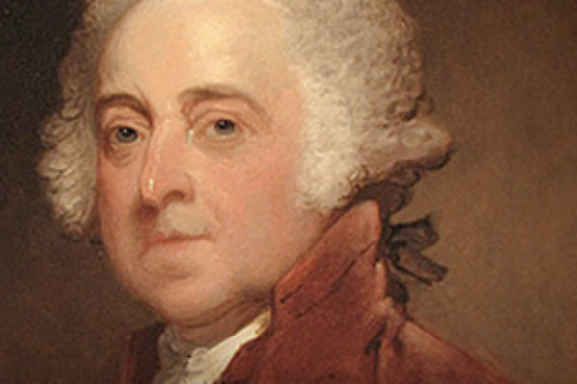
John Adams:
Republican Federalist

Slide 2
Written by
Edward J. Dodson, M.L.A.
Notes:
New England farmer and attorney-at-law, reluctant proponent of independence from Great Britain, holder of high office and defender of the rule of law. This describes John Adams, but only scratches the surface of his character, his ideals and his legacy.

Slide 3
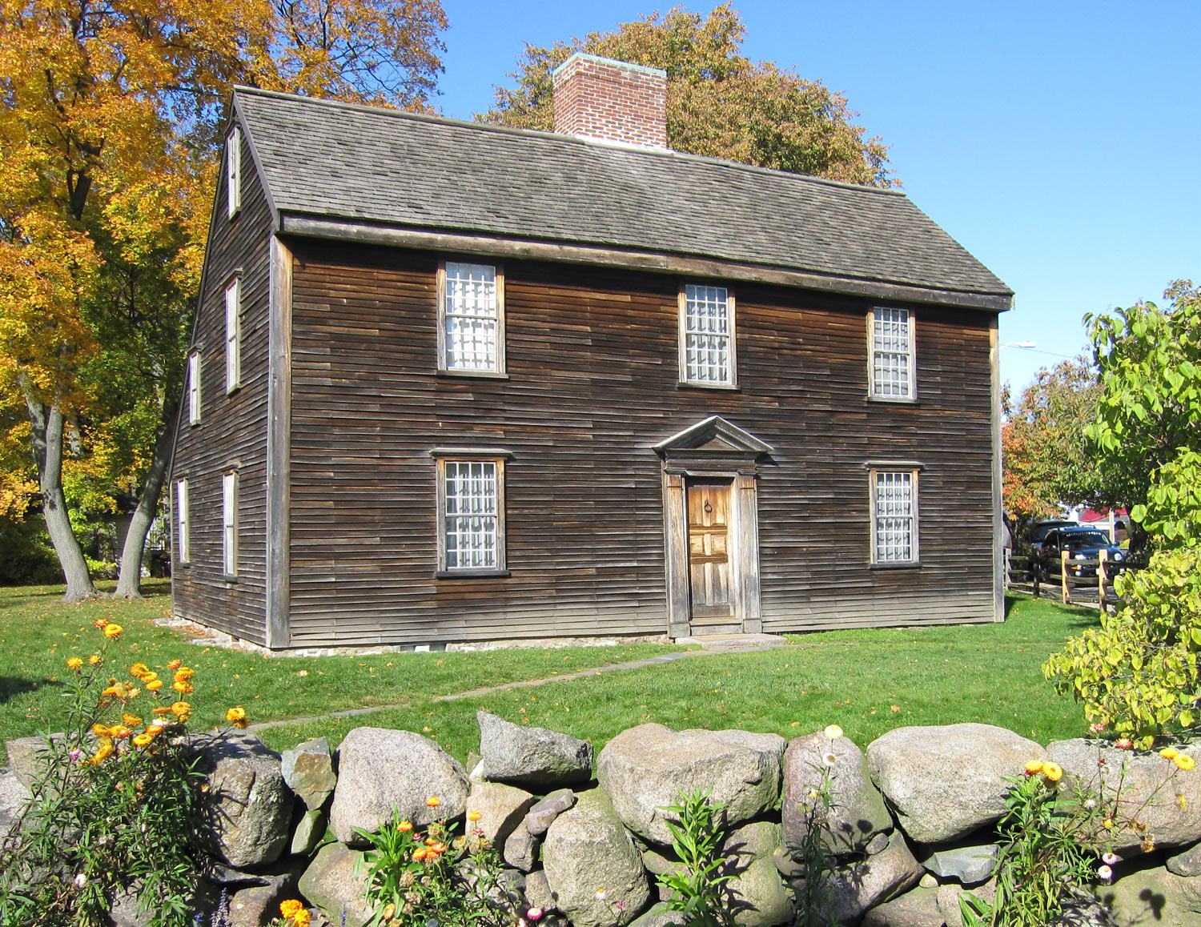
Notes:
John Adams was born in 1735 in Braintree – modern Quincy – Massachusetts, some 10 miles southeast of Boston.

Slide 4
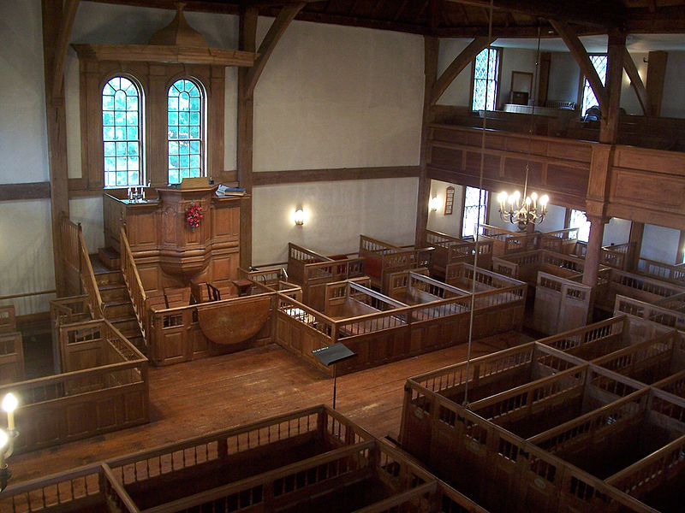
Notes:
His parents were descended from Puritans, and the Adams family were prominent members, their pew located immediately left of the pulpit.

Slide 5
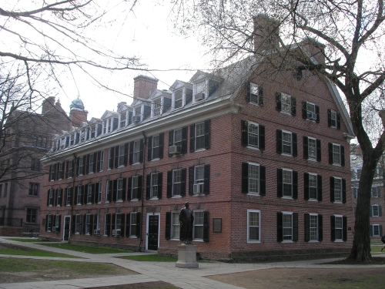
Notes:
At age sixteen, John entered Harvard College, earning his degree in 1755.

Slide 6
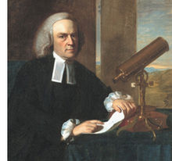
John Winthrop
Notes:
Among his professors at Harvard was the mathematician and scientist, John Winthrop. One indication of the respect shown for Winthrop’s scientific accomplishments is that his paper on the movement of Halley’s comet was read by Benjamin Franklin before the Royal Society in London.

Slide 7
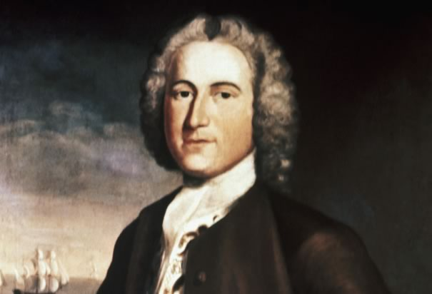
Notes:
Following graduation from Harvard, John accepted a teaching position in Worcester, Massachusetts, some fifty miles west and south of Boston.

Slide 8
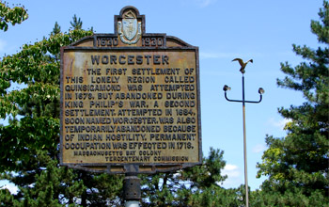
Notes:
In Worcester he was introduced to the doctrines of Voltaire and the French Deists but also to the doctrines of what he referred to as the “frigid John Calvin.” As a teacher, he did his best to offer his pupils an enlightened educational experience. His time with young students brought him to conclude:

Slide 9
“Human nature is more easily wrought upon and governed by promises and encouragement and praise than by punishment, and threatening and blame.”
Notes:
“Human nature is more easily wrought upon and governed by promises and encouragement and praise than by punishment, and threatening and blame.”

Slide 10
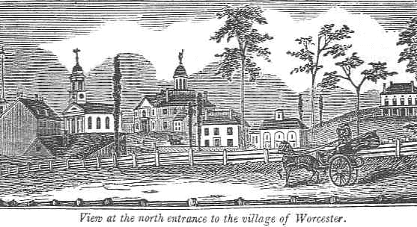
Notes:
From the library of his landlord, Dr. Nahum Willard, he studied works on theology. He became a member of the small circle of intellectuals in Worchester and found with delight that he could hold his own with older, learned men on matters of the practical world.

Slide 11
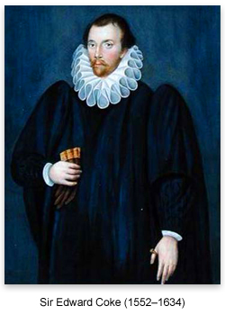
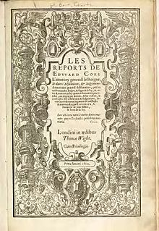
Notes:
He soon made a decision to study for the law and secured an apprenticeship with Worchester attorney James Putnam in 1756. When not in front of his pupils, John now absorbed the works of Edward Coke and other legal scholars.

Slide 12
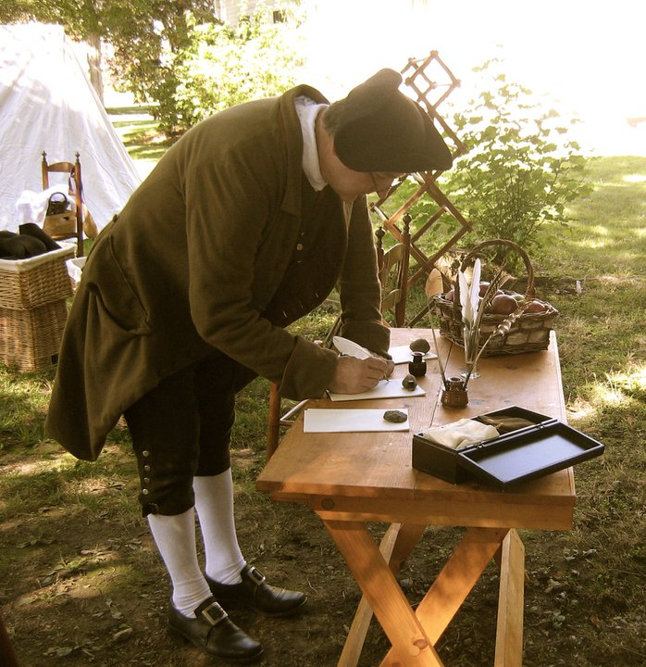
Notes:
In the fall of 1758, John completed his apprenticeship with James Putnam and returned home, to Braintree, and a fierce competition among lawyers for available legal business.

Slide 13
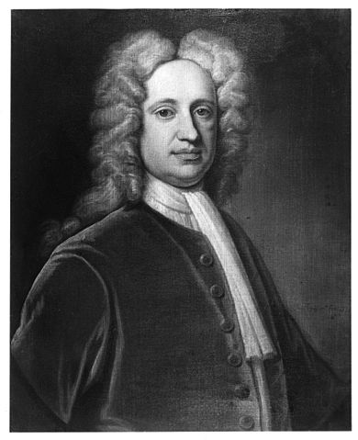
Jeremiah Gridley
Notes:
He sought the guidance and patronage of Boston lawyer Jeremiah Gridley, who was not only the most respected member of the bar but also Grand Master of the Free Masons and a colonel in the Massachusetts militia. Gridley offered the young man good advice:

Slide 14
“One is to pursue the study of the law, rather than the gain of it. Pursue the gain of it enough to keep out of the biers, but give your main attention to the study of it. The next is not to marry early. For an early marriage will obstruct your improvement, and in the next place, it will involve you in expense.”
Notes:
“I have a few pieces of advice to give you. One is to pursue the study of the law, rather than the gain of it. Pursue the gain of it enough to keep out of the biers, but give your main attention to the study of it. The next is not to marry early. For an early marriage will obstruct your improvement, and in the next place, it will involve you in expense.”

Slide 15
Notes:
With the support of Gridley, John was soon admitted to the Massachusetts Bar. Slowly he built a law practice. Yet, he admitted to distractions, writing in his journal:

Slide 16
“Laziness, languor, inattention, are my bane. I am too lazy to rise early and make a fire; and when my fire is made at ten o’clock, my passion for knowledge, fame, fortune or any good is too languid to make me apply with spirit to my book, and … my mind is liable to be called off from law by a girl, a pipe, a poem, a love-letter, a spectator, a play …”
Notes:
“Laziness, languor, inattention, are my bane. I am too lazy to rise early and make a fire; and when my fire is made at ten o’clock, my passion for knowledge, fame, fortune or any good is too languid to make me apply with spirit to my book, and … my mind is liable to be called off from law by a girl, a pipe, a poem, a love-letter, a spectator, a play …”

Slide 17
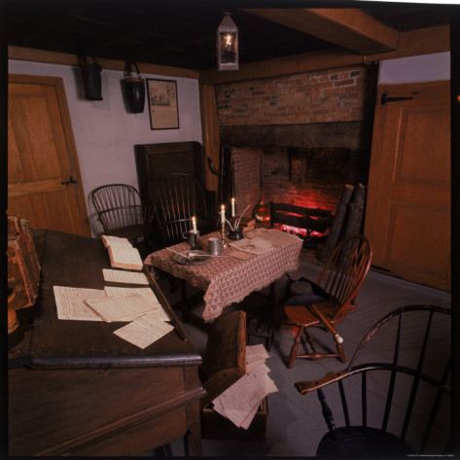
Notes:
When his father died of influenza in May of 1761, John inherited the family’s farm in Braintree. Now owning property, he acquired the greater political rights attached to being a freeholder of land. His first election to public office came shortly thereafter as surveyor of highways, a responsibility for which he had no training to that point.

Slide 18
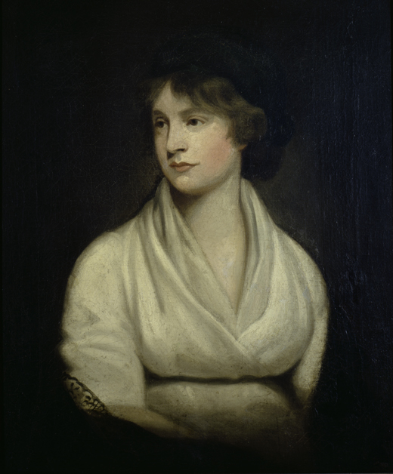
Abigail Smith
Notes:
He soon met and courted Abigail Smith of Weymouth, interrupted prior to their marriage by John’s decision to be inoculated against smallpox, which in that time meant deliberately contracting the disease hoping for eventual immunity. Abigail’s own health was never good, leading historian Page Smith to observe:

Slide 19
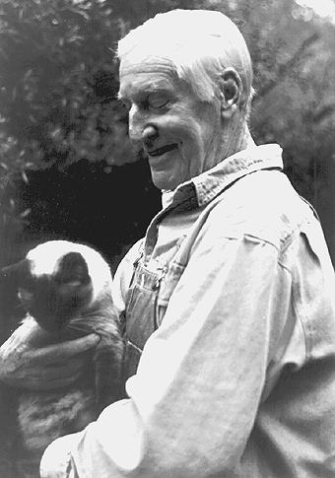
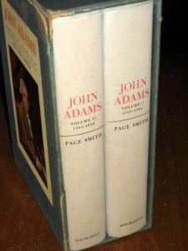
“Simply considering the health of the bride and groom, it was not a promising match. Abigail was almost a chronic invalid, racked by migraine headaches, unaccountable fevers and persistent insomnia. John, a food faddist and seldom free of some nagging complaint, had already resigned himself to an early death.”
Page Smith
Notes:
“Simply considering the health of the bride and groom, it was not a promising match. Abigail was almost a chronic invalid, racked by migraine headaches, unaccountable fevers and persistent insomnia. John, a food faddist and seldom free of some nagging complaint, had already resigned himself to an early death.” [Page Smith. John Adams, Vol.I (Garden City, NY: Doubleday & Company, 1962), p.70.]

Slide 20
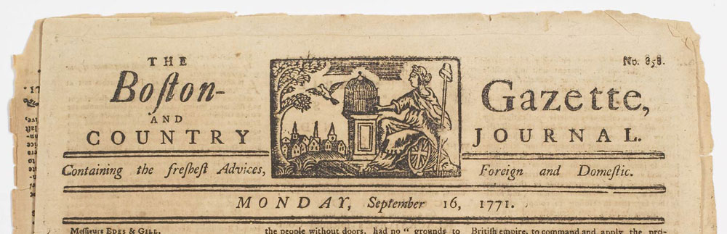
Notes:
John’s desire for public acclaim took a step forward in August 1765, with the publication of four articles submitted anonymously to the Boston Gazette and later reprinted in The London Chronicle with the title “True Sentiments of America.” He succinctly described what he and others embraced as the principles upon which the British colonies in North America were founded:

Slide 21
“With toil and fatigue, perhaps not to be conceived by their brethren and fellow-subjects at home, and with the constant peril of their lives, from a numerous, savage, and warlike race of men, they began their settlement, and God prospered them. …”
Notes:
“With toil and fatigue, perhaps not to be conceived by their brethren and fellow-subjects at home, and with the constant peril of their lives, from a numerous, savage, and warlike race of men, they began their settlement, and God prospered them. ..”

Slide 22
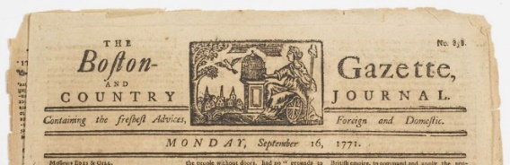
“They obtained a charter from King Charles the first; wherein his Majesty was pleased to grant them and their heirs and assigns for ever, all the lands therein described, to hold of him and his royal successors in free and common soccage; which we humbly conceive is as absolute an estate as the subject can hold under the crown. …”
Notes:
“They obtained a charter from King Charles the first; wherein his Majesty was pleased to grant them and their heirs and assigns for ever, all the lands therein described, to hold of him and his royal successors in free and common soccage; which we humbly conceive is as absolute an estate as the subject can hold under the crown. …”

Slide 23
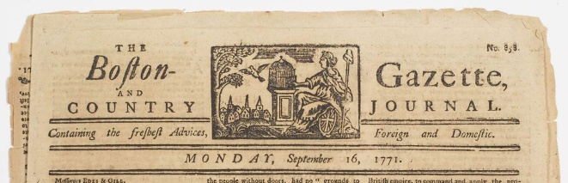
“And in the same charter were granted to them, and their posterity, all the rights, liberties, privileges, and immunities of natural subjects, born within the realm. …”
Notes:
“And in the same charter were granted to them, and their posterity, all the rights, liberties, privileges, and immunities of natural subjects, born within the realm. …”

Slide 24
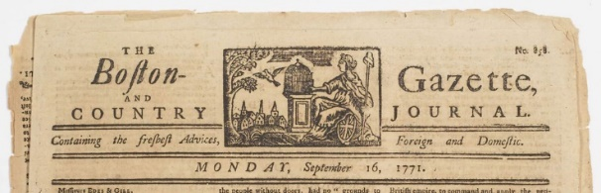
“This charter they enjoyed, having, as we most humbly conceive, punctually complied with all the conditions of it, till in an unhappy time it was vacated–But after the revolution, when King William and Queen Mary, of glorious and blessed memory, were established on the throne: …”
Notes:
“This charter they enjoyed, having, as we most humbly conceive, punctually complied with all the conditions of it, till in an unhappy time it was vacated–But after the revolution, when King William and Queen Mary, of glorious and blessed memory, were established on the throne: ...”

Slide 25

“In that happy reign, when, to the joy of the nation and its dependencies, the crown was settled in your Majesty’s illustrious family, the inhabitants of this province shared in the common blessing.”
Notes:
“In that happy reign, when, to the joy of the nation and its dependencies, the crown was settled in your Majesty’s illustrious family, the inhabitants of this province shared in the common blessing.”

Slide 26
Notes:
And, then, Adams reached what he believed was the logical conclusion of this trust:

Slide 27
“Then they were indulged with another charter; in which their Majesties were pleased for themselves, their heirs and successors, to grant and confirm to them as ample estate in the lands or territories as was granted by the former charter, together with other the most essential rights and liberties contained therein: ...”
Notes:
“Then they were indulged with another charter; in which their Majesties were pleased for themselves, their heirs and successors, to grant and confirm to them as ample estate in the lands or territories as was granted by the former charter, together with other the most essential rights and liberties contained therein: ...”

Slide 28
“The principal of which, is that which your Majesty’s subjects within the realm have ever held a most sacred right, of being taxed only by representatives of their own free election.”
Notes:
“The principal of which, is that which your Majesty’s subjects within the realm have ever held a most sacred right, of being taxed only by representatives of their own free election.”

Slide 29
Notes:
Adams expressed his belief that the power of those who govern is limited by “equity and reason.”

Slide 30
“I say RIGHTS, for such they have, undoubtedly, antecedent to all earthly government – Rights that cannot be repealed or retrained by human law – Rights derived from the great Legislator of the universe.”
Notes:
“I say RIGHTS, for such they have, undoubtedly, antecedent to all earthly government – Rights that cannot be repealed or retrained by human law – Rights derived from the great Legislator of the universe.”

Slide 31
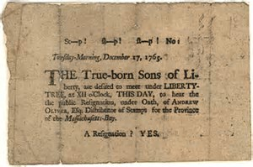
Notes:
Before long, John Adams was drawn into the thick of the protests by Boston’s Sons of Liberty and other citizens against new taxes imposed by Britain.

Slide 32
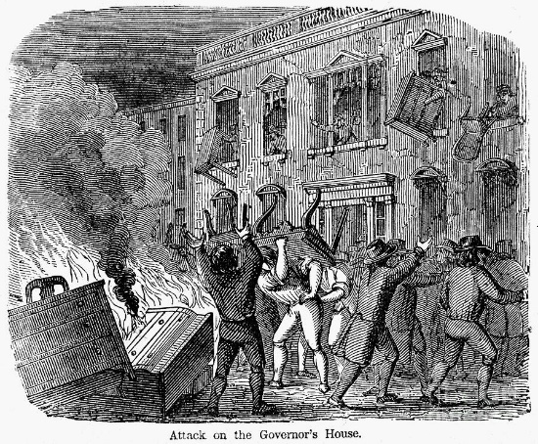
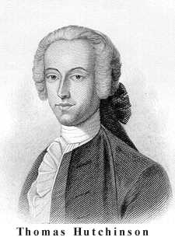
Notes:
On the 26th of August, 1765, a mob surrounded and virtually destroyed the home and possessions of the Lieutenant Governor, Thomas Hutchinson.

Slide 33
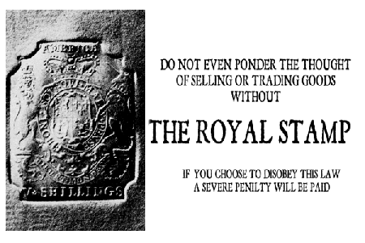
Notes:
In the fall of 1765, John prepared his town’s response to The Stamp Act. What he wrote was soon reprinted in periodicals throughout Massachusetts. Unwilling to comply with The Stamp Act, the people of Massachusetts brought the colony to an administrative and economic standstill.

Slide 34
Notes:
As the new year of 1766 began, John wrote in his journal:

Slide 35
“We are now upon the beginning of a year of greater expectation than any that has passed before it. This year brings ruin or salvation to the British Colonies. The eyes of all America are fixed on the British Parliament. In short, Britain and America are staring at each other – and they will probably stare more and more for some time.”
Notes:
“We are now upon the beginning of a year of greater expectation than any that has passed before it. This year brings ruin or salvation to the British Colonies. The eyes of all America are fixed on the British Parliament. In short, Britain and America are staring at each other – and they will probably stare more and more for some time.”

Slide 36
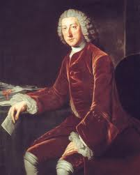
William Pitt
Notes:
Championed by William Pitt, the Stamp Act was repealed by Parliament, but the colonies were warned:

Slide 37
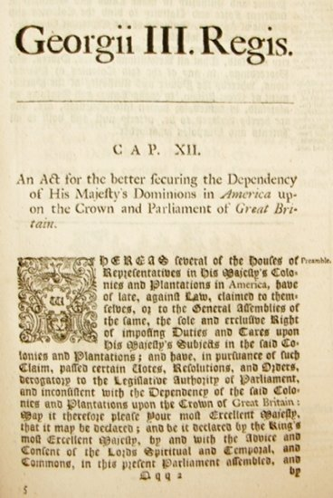
“…that King, lord, and Commons have an undoubted right to make laws for the colonies in all cases whatsoever.”
Notes:
“…that King, lord, and Commons have an undoubted right to make laws for the colonies in all cases whatsoever.” The principle was one of virtual representation.

Slide 38
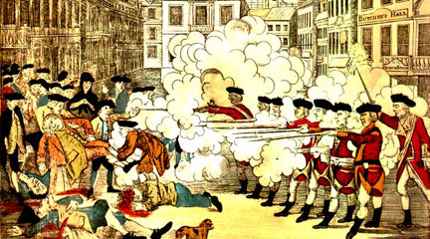
Notes:
In 1770 came John’s defense of the British Captain and his soldiers indicted for murder of colonials killed at the so-called Boston Massacre. To his surprise in the aftermath of the trial and acquittal of the British soldiers, John was elected a delegate to the General Court from Boston.

Slide 39
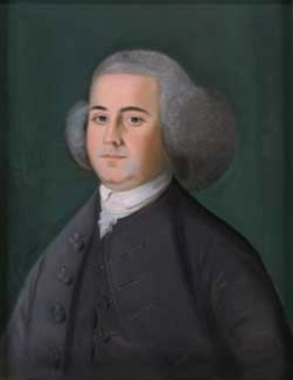
Notes:
As is the case with so many of the literate and thoughtful people of his time, John Adams revealed much in his correspondence. To Isaac Smith, he wrote:

Slide 40
“I see that my countrymen, the Americans, have not the virtue, the fortitude, the magnanimity, to resist these encroachments … to a decisive effect.”
Notes:
“I see that my countrymen, the Americans, have not the virtue, the fortitude, the magnanimity, to resist these encroachments … to a decisive effect.”

Slide 41
Notes:
And, a bit later, as the tensions increased, he added:

Slide 42
“I said there was no more justice left in Britain than there was in hell – that I wished for war, and that the whole Bourbon family was upon the back of Great Britain – avowed a thorough disaffection to that country – wished that anything might happen to them … that they might be brought to reason or to ruin.”
Notes:
“I said there was no more justice left in Britain than there was in hell – that I wished for war, and that the whole Bourbon family was upon the back of Great Britain – avowed a thorough disaffection to that country – wished that anything might happen to them … that they might be brought to reason or to ruin.”

Slide 43
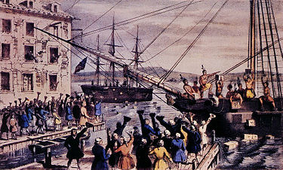
Notes:
During the night of 3 November, 1773, Bostonians boarded the ship “The Dartmouth” and dumped its cargo of tea into the bay. John Adams recorded his excitement at the turn of events:

Slide 44
“This is the most magnificent movement of all! There is a dignity, a majesty, a sublimity, in this last effort of the patriots that I greatly admire. The people should never rise without doing something to be remembered – something notable and striking. This destruction of the tea is so bold, so daring, so firm, intrepid and inflexible, and it must have so important consequences, and so lasting, that I can’t but consider it as an epoch in history.”
Notes:
“This is the most magnificent movement of all! There is a dignity, a majesty, a sublimity, in this last effort of the patriots that I greatly admire. The people should never rise without doing something to be remembered – something notable and striking. This destruction of the tea is so bold, so daring, so firm, intrepid and inflexible, and it must have so important consequences, and so lasting, that I can’t but consider it as an epoch in history.”

Slide 45
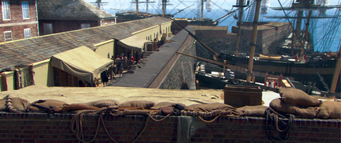
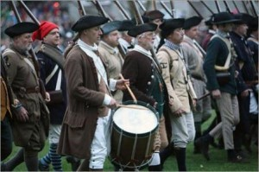
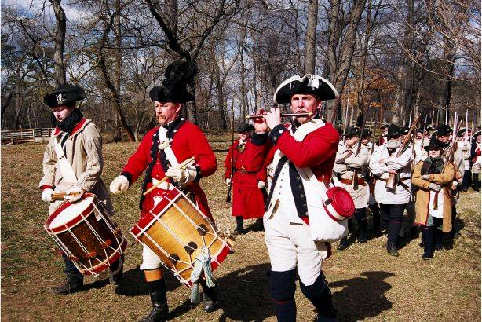
Notes:
In response, King George III ordered a heavy hand. Lord North signed a bill closing the harbor of Boston to all trade. Town meetings were prohibited, and the Royal Governor given what amounted to dictatorial powers, if they could be enforced.

Slide 46
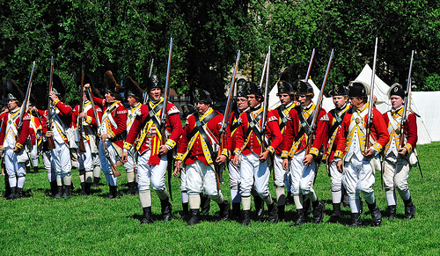
Notes:
Four regiments of British infantry and three of artillery arrived and set up camp on the Boston Commons. The newly-appointed Governor, General Thomas Gage, now had the means to re-establish British authority.

Slide 47
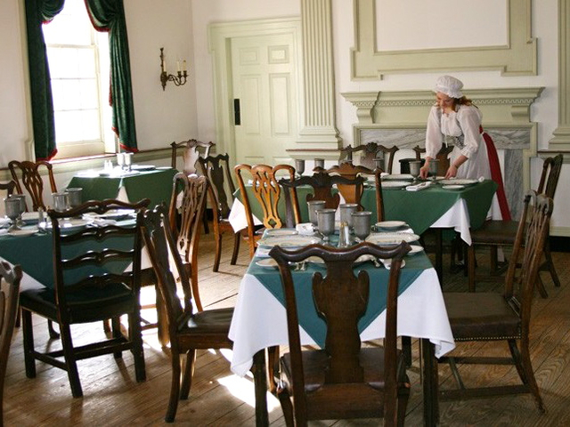
Notes:
The Massachusetts assembly, moved from Boston to Salem, resolved to call a Continental Congress in September at Philadelphia. Adams was elected as one of five delegates. On the 2nd of September Adams and the other delegates who had thus far arrived met at City Tavern. Writing to Abigail, John took time to compare Philadelphia and its citizens with Boston and its citizens:

Slide 48
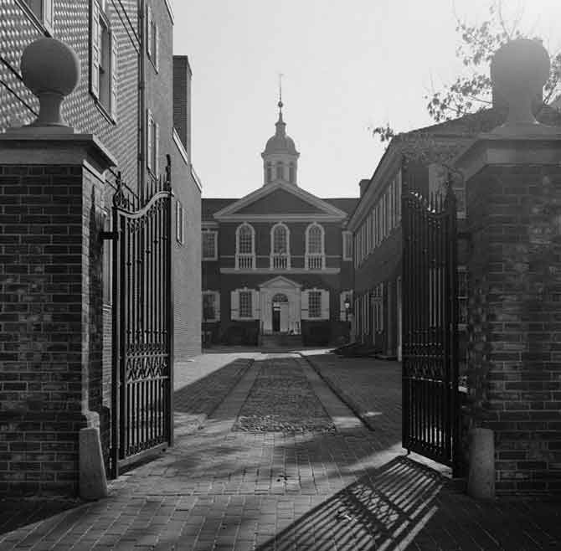
“The morals of our people are much better. Their manners are more polite and agreeable – they are purer English. Our language is better, our persons are handsomer, our spirit is greater, our laws are wiser, our religion is superior, our education is better. We exceed them in everything but in a market, and in charitable public foundations.”
Notes:
“The morals of our people are much better. Their manners are more polite and agreeable – they are purer English. Our language is better, our persons are handsomer, our spirit is greater, our laws are wiser, our religion is superior, our education is better. We exceed them in everything but in a market, and in charitable public foundations.”

Slide 49
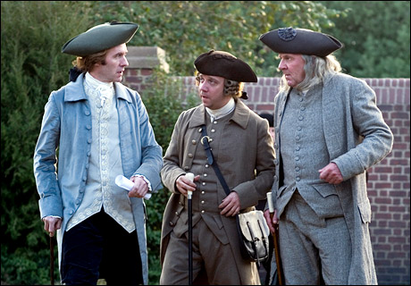
Notes:
At the end of September, John Adams put forward a resolution that, if adopted, would unite the colonies with Massachusetts:

Slide 50
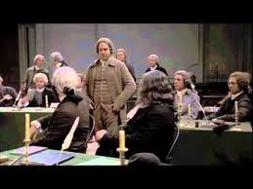
“Resolved, that Massachusetts and the town of Boston are now struggling in the common cause of American freedom, and, therefore, that it is the indispensible duty of all the colonies to support them by every necessary means, and to the last extremity.”
Notes:
“Resolved, that Massachusetts and the town of Boston are now struggling in the common cause of American freedom, and, therefore, that it is the indispensible duty of all the colonies to support them by every necessary means, and to the last extremity.”

Slide 51
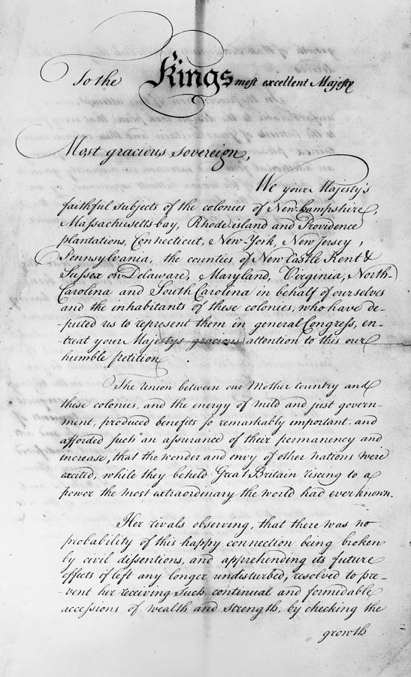
Notes:
The main accomplishment of this first Continental Congress was the so-called Olive Branch Petition addressed to the King. The petition represented a final attempt by the moderates in the colonies to avoid a war of independence against Great Britain.

Slide 52
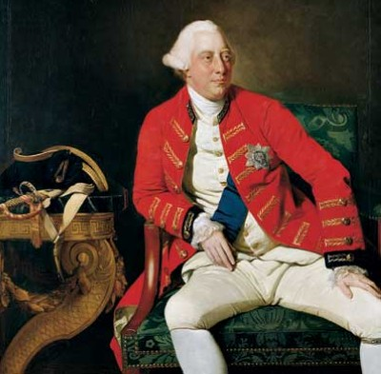
Notes:
As John Adams knew would occur, King George III discarded the petition and determined to use force to subdue his rebellious subjects.

Slide 53
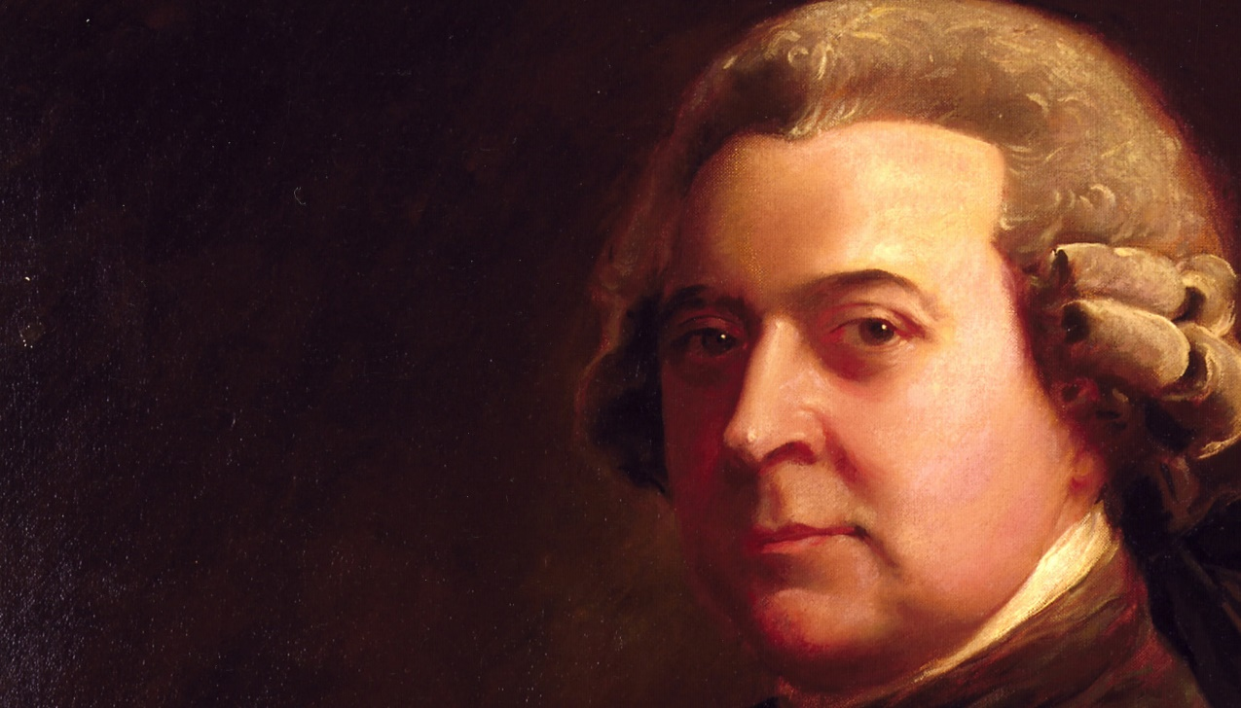
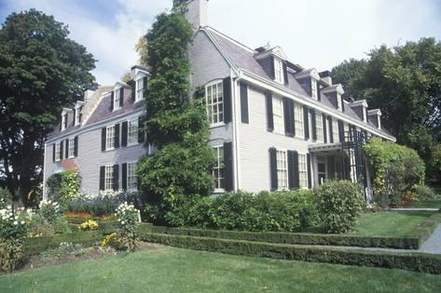
Notes:
John Adams soon thereafter left Philadelphia for his home in Braintree, Massachusetts.

Slide 54
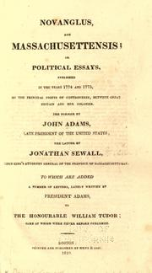
Notes:
He now began to write an explanation of events leading to the first Continental Congress and the basis for colonial resistance to Parliamentary authority. These essays were published under the pen name Novanglus in the Boston Gazette.

Slide 55
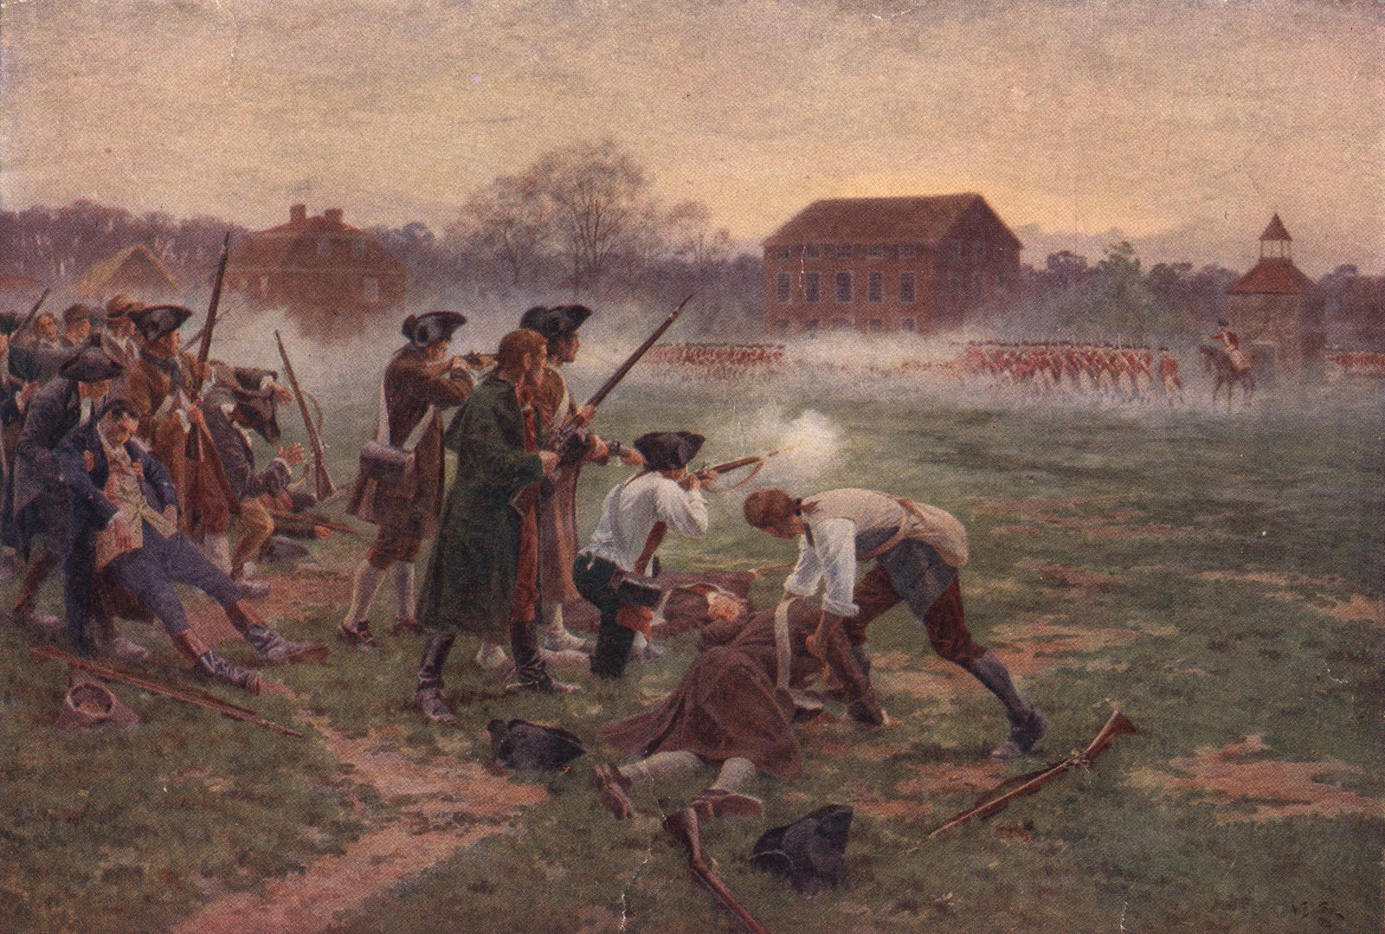
Notes:
The events of one day, the 19th of April, 1775, removed any realistic hope of a negotiated settlement of the disputes. Blood on both sides was spilled at Lexington and Concord in Massachusetts.

Slide 56
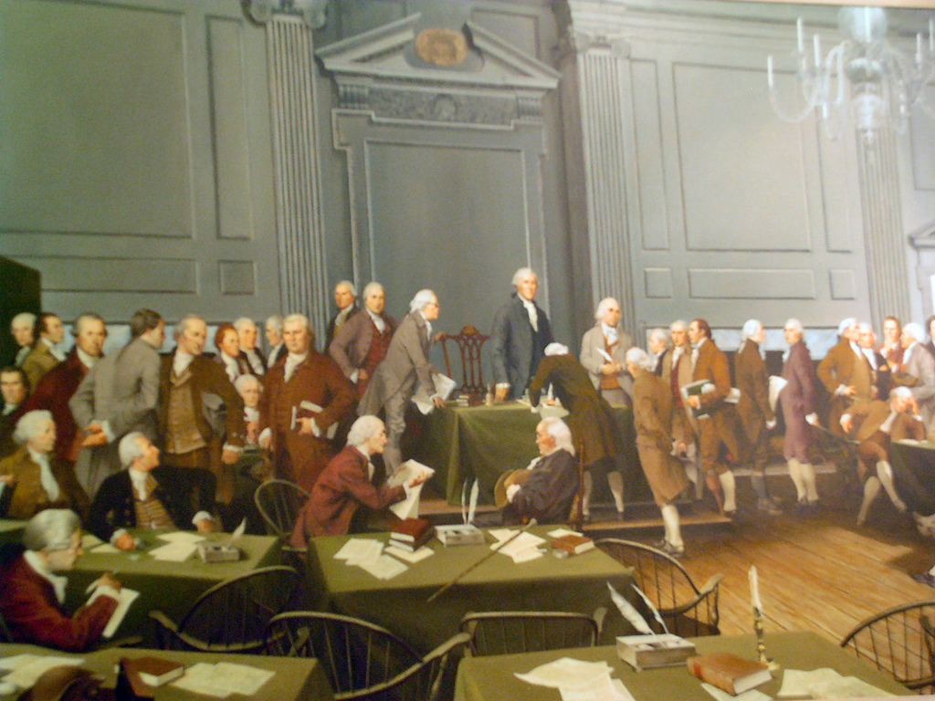
Notes:
News of the fighting at Lexington and Concord spread throughout the colonies, and a second Continental Congress was called, again in Philadelphia. John Adams was returned as a delegate. In preparation, he had undertaken a study of the history of confederated governments.

Slide 57
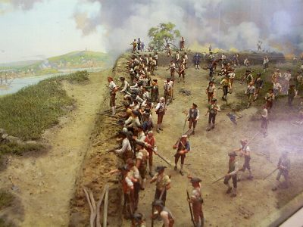
Notes:
What Adams realized was that at least for the time being, the rebellious colonials were on their own in the fight against the powerful British empire.

Slide 58
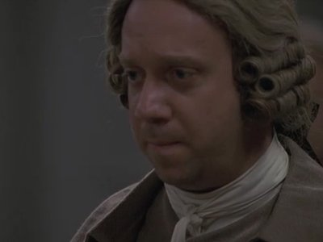
“God helps those who help themselves, and it has ever appeared to me since this unhappy dispute began that we had no friend upon the earth to depend on but the resources of our own country, and the good sense and great virtues of our people. We shall finally be obliged to depend upon ourselves.”
Notes:
“God helps those who help themselves, and it has ever appeared to me since this unhappy dispute began that we had no friend upon the earth to depend on but the resources of our own country, and the good sense and great virtues of our people. We shall finally be obliged to depend upon ourselves.”

Slide 59
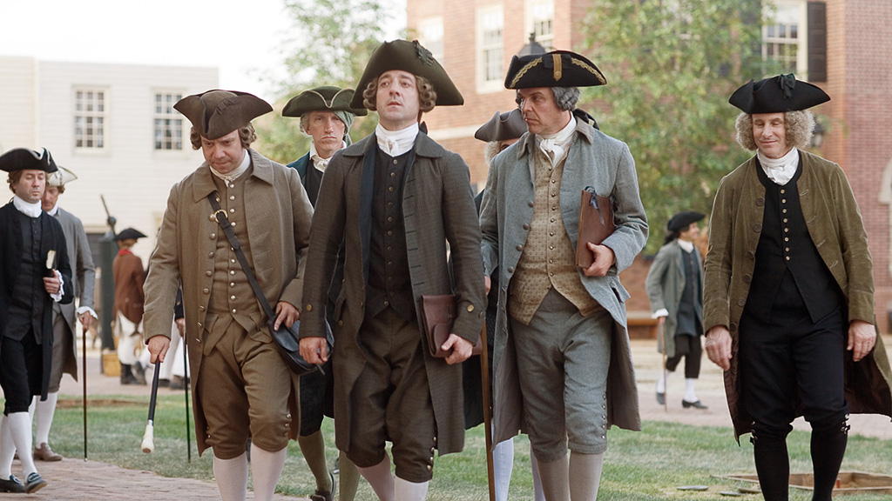
Notes:
High on his list of priorities for the colonies was for each to establish its own system of government. In Congress he moved that every state be instructed to begin work on a written constitution. As historian Page Smith observed:

Slide 60
“The opportunity was irresistible to a philosopher-politician, and Adams, his head full of Harrington, Sidney, Hobbes and Locke, as well as a dozen continental theorists, set to work to put his own views of government in order.”
Notes:
“The opportunity was irresistible to a philosopher-politician, and Adams, his head full of Harrington, Sidney, Hobbes and Locke, as well as a dozen continental theorists, set to work to put his own views of government in order.”

Slide 61
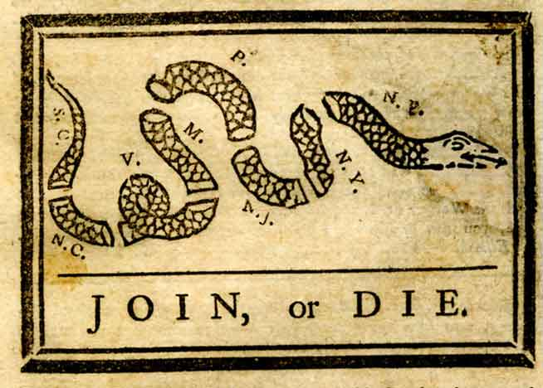
Notes:
Adams embraced the opportunity history was providing to the people of North America, but he was far from certain they would make the most of it. He wrote:

Slide 62
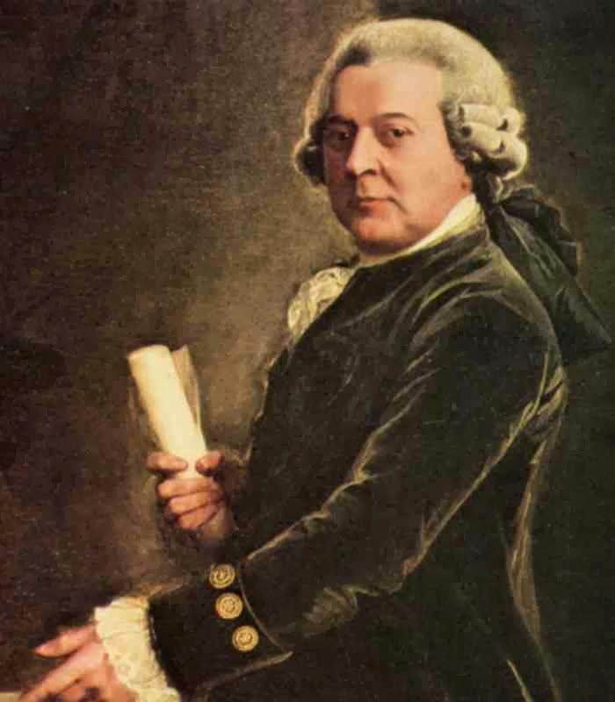
“I have seen all my life such selfishness and littleness even in New England, that I sometimes tremble to think that, although we are engaged in the best cause that ever employed the human heart, yet the prospect of success is doubtful not for want of power or of wisdom but of virtue.”
“I have seen all my life such selfishness and littleness even in New England, that I sometimes tremble to think that, although we are engaged in the best cause that ever employed the human heart, yet the prospect of success is doubtful not for want of power or of wisdom but of virtue.”
Notes:
“I have seen all my life such selfishness and littleness even in New England, that I sometimes tremble to think that, although we are engaged in the best cause that ever employed the human heart, yet the prospect of success is doubtful not for want of power or of wisdom but of virtue.”

Slide 63
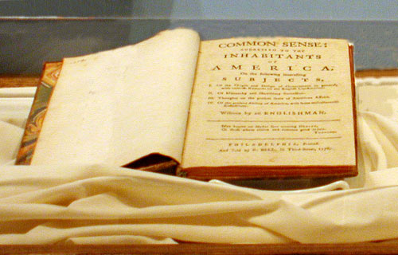
Notes:
When Thomas Paine’s pamphlet, “Common Sense,” appeared in January of 1776 and captured the public’s imagination, John applauded its appeal but was not convinced by its arguments. To one correspondent, he wrote:

Slide 64
“The Old Testament reasoning against monarchy would have never come from me. The attempt to frame a continental constitution is feeble indeed – it is poor and despicable. Yet this is a very meritorious production. In point of argument there is nothing new.”
Notes:
“The Old Testament reasoning against monarchy would have never come from me. The attempt to frame a continental constitution is feeble indeed – it is poor and despicable. Yet this is a very meritorious production. In point of argument there is nothing new.”

Slide 65

Notes:
Adams feared that the call for independence was as yet premature, that a general commitment to a proper form of governance had not yet arisen.

Slide 66
“There must be a decency, and respect and veneration introduced for persons in authority, of every rank, or we are undone. In a popular government, this is the only way to supporting order, and in our circumstances, as our people have been so long without any government at all, it is more necessary than in any other.”
Notes:
“There must be a decency, and respect and veneration introduced for persons in authority, of every rank, or we are undone. In a popular government, this is the only way to supporting order, and in our circumstances, as our people have been so long without any government at all, it is more necessary than in any other.”

Slide 67

Notes:
In this time of uncertainty, Adams feared the rise of men of modest ability and, worse, an opportunistic attitude regarding public office.

Slide 68

Notes:
Adams was asked by two of the delegates from North Carolina for his recommendations on the form government ought to take. Eventually, this manuscript was published with the title, Thoughts on Government. In this document, Adams declared:

Slide 69
“Nothing is more certain, from the history of nations and the nature of man, than that some forms of government are better fitted for being well administered than others.”
Notes:
“Nothing is more certain, from the history of nations and the nature of man, than that some forms of government are better fitted for being well administered than others.”

Slide 70

Notes:
For Adams, this required a republican form of government – a government directed by clear and just law – with representatives elected to serve in an assembly, from which a council would be chosen and a governor elected to counter their natural inclinations…

Slide 71
“… to all the vices, follies, and frailties of an individual; subject to fits of humor, starts of passion, fights of enthusiasm, partialities, or prejudice, and consequently productive of hasty results and absurd judgments.”
Notes:
“… to all the vices, follies, and frailties of an individual; subject to fits of humor, starts of passion, fights of enthusiasm, partialities, or prejudice, and consequently productive of hasty results and absurd judgments.”

Slide 72
Notes:
If, at some point, the states determined to adopt a Continental constitution, he argued for a representative body only, with powers over war, trade, disputes between state and state, the post office and the distribution of unsettled lands.

Slide 73

Notes:
To make this system work, however, required an educated citizenry.

Slide 74
“Education [produces] a greater difference between man and man than nature has made between man and brute. The virtues and powers to which men may be trained, by early education and constant discipline, are truly sublime and astonishing.”
Notes:
“Education [produces] a greater difference between man and man than nature has made between man and brute. The virtues and powers to which men may be trained, by early education and constant discipline, are truly sublime and astonishing.”

Slide 75

Notes:
Yet, education alone was not sufficient in his mind to justify full and equal rights to all:

Slide 76
“It is certain, in theory, that the only moral foundation of government is the consent of the people. To what an extent shall we carry this principle? Shall we say that every individual of the community, old and young, male and female, as well as rich and poor, must consent, expressly, to every act of legislation? This is manifestly impossible. …”
Notes:
“It is certain, in theory, that the only moral foundation of government is the consent of the people. To what an extent shall we carry this principle? Shall we say that every individual of the community, old and young, male and female, as well as rich and poor, must consent, expressly, to every act of legislation? This is manifestly impossible. ...”

Slide 77
“From whence, then, arises the right of the majority to bind the minority? Power always follows property. Men in general, who are wholly destitute of property, are also too little acquainted with public affairs to form a right judgment, and too dependent upon other men to have a will of their own.”
Notes:
“From whence, then, arises the right of the majority to bind the minority? Power always follows property. Men in general, who are wholly destitute of property, are also too little acquainted with public affairs to form a right judgment, and too dependent upon other men to have a will of their own.”

Slide 78

Notes:
In response to the resolves adopted by Virginia’s convention, …

Slide 79
“that the Congress should declare that these United Colonies are, and of right ought to be, free and independent states,” …
Notes:
“that the Congress should declare that these United Colonies are, and of right ought to be, free and independent states,” Adams urged action but others were reticent and resolved to postpone a vote on independence until the 1st of July.

Slide 80

Notes:
Adams joined Thomas Jefferson, Benjamin Franklin, Roger Sherman and Robert Livingston on a five-man committee to draft the declaration of independence. Even as the colonies were in the process of becoming independent states Adams remained worried about the ability of the new governments to govern:

Slide 81
“I fear we shall find that popular elections are not oftener determined upon pure principles of merit, virtue and public spirit than the nominations of a court, if we do not take care. I fear there is an infinity of corruption in our elections already crept in. …A popular government is the worst curse to which human nature can be devoted when it is thoroughly corrupted. Despotism is better.”
Notes:
“I fear we shall find that popular elections are not oftener determined upon pure principles of merit, virtue and public spirit than the nominations of a court, if we do not take care. I fear there is an infinity of corruption in our elections already crept in. …A popular government is the worst curse to which human nature can be devoted when it is thoroughly corrupted. Despotism is better.”

Slide 82

Notes:
Representatives of the thirteen states were attempting to conduct war and perform the functions of government without formal authority. Articles of Confederation were drafted by a committee established on the 12th of July, 1776, and an approved version was sent to the states in November of 1777 but not fully ratified by the states until March of 1781.

Slide 83

Notes:
John Adams was coming to the conclusion that the nation required a strong national government, with appropriate powers granted to the legislative, executive and judicial branches – but with checks and balances on those powers.

Slide 84

Notes:
The Congress sent John to France to assist Benjamin Franklin with the task of cementing relations and obtaining greater assistance. Here, in France, he had no reputation to precede him. The French knew of Samuel Adams and Thomas Paine, but not John Adams. He wrote (probably to Abigail):

Slide 85

“I am inclined to think that all parties, both in France and England – Whigs and Tories in England, the friends of Franklin, [Silas] Deane, and [Arthur] Lee, in France, differing in many other things, agreed in this – that I was not the famous Adams … that I was a man of whom nobody had ever heard before, a perfect cipher, a man who did not understand a word of French; awkward in his figure – awkward in his dress – no abilities – perfect bigot – and fanatic.”
Notes:
“I am inclined to think that all parties, both in France and England – Whigs and Tories in England, the friends of Franklin, Deane, and Lee, in France, differing in many other things, agreed in this – that I was not the famous Adams … that I was a man of whom nobody had ever heard before, a perfect cipher, a man who did not understand a word of French; awkward in his figure – awkward in his dress – no abilities – perfect bigot – and fanatic.”

Slide 86

Notes:
Of France, he observed:

Slide 87
“The fields of grain, the vineyards, the castles, the cities, the parks, the gardens, everything is beautiful, yet every place swarms with beggars.”
Notes:
“The fields of grain, the vineyards, the castles, the cities, the parks, the gardens, everything is beautiful, yet every place swarms with beggars.”

Slide 88

Notes:
And yet, he found considerable pleasure in the company of some of the world’s great thinkers – the Abbe Raynal (who would write a history of the American Revolution without access to any source documents in North America), …

Slide 89

Notes:
as well as the French minister of finance and leader of the physiocratic school, Anne Robert Jacques Turgot, and others.

Slide 90

Notes:
Relieved of his assignment in France, John returned to North America and Massachusetts in time to learn of the defeat of a proposed state constitution. His fellow citizens wanted to remain free of government, which they were convinced was the only way to secure their newfound liberties. Conservative, propertied men –John Adams among them -- saw only anarchy and chaos as the inevitable result.

Slide 91

Notes:
John joined with others determined to create a constitutional government for Massachusetts. At the state convention in September of 1779, he set about the task of drafting A Declaration of Rights and a Frame of Government. Debate began late in October and continued until March of 1780. With stronger language added concerning religious freedom, the Constitution became law. In the preamble, John drew on the heritage of the great political philosophers:

Slide 92
“The end of the institution, maintenance and administration of government is to secure the existence of the body politic; to protect it, and to furnish the individuals who compose it with the power of enjoying, in safety and tranquility, their natural rights and the blessing of life; ....”
Notes:
“The end of the institution, maintenance and administration of government is to secure the existence of the body politic; to protect it, and to furnish the individuals who compose it with the power of enjoying, in safety and tranquility, their natural rights and the blessing of life; ...”

Slide 93
“and whenever these great objects are not obtained, the people have a right to alter the government and to take measures necessary for their safety, happiness and prosperity.”
Notes:
“and whenever these great objects are not obtained, the people have a right to alter the government and to take measures necessary for their safety, happiness and prosperity.”

Slide 94

Notes:
Massachusetts would have, as John Adams urged, a two-house legislature, a strong chief executive and an independent judiciary. There would be property requirements to exercise the franchise, but this was sufficiently low to allow most males over age twenty-one to qualify. Only a man of the Christian faith and considerable wealth could stand for election to the office of Governor. He completed his draft near the end of October 1779. A month later he left Massachusetts to assume the office of minister plenipotentiary in Europe.

Slide 95

Notes:
The Commonwealth of Massachusetts formally adopted the state constitution in 1780, which excluded African-Americans and Native Americans from voting. After the state judiciary ruled slavery to be unconstitutional, all enslaved persons were freed in 1783. However, although free blacks ostensibly were eligible to vote, they were effectively prevented from doing so.

Slide 96

Notes:
This form of government he hoped would be adopted to govern the nation, although he feared:

Slide 97
“… division of the Republic into two great parties, each arranged under its leader and concerting measures in opposition to each other.”
Notes:
“… division of the Republic into two great parties, each arranged under its leader and concerting measures in opposition to each other.”

Slide 98

Notes:
The end of war with Britain solved one set of problems but opened new ones, in particular how to find the revenue to service the huge amount of debt now owed by governments, business men and farmers. Facing high prices and heavy taxes, the farmers of Massachusetts, led by Daniel Shays, rose up against their government. Responding to this threat to order and to the general rise in dissent, John Adams wrote:

Slide 99
“The just complaints of the people of real grievances ought never to be discouraged and even their imaginary grievances may be treated with too great severity. But when a cry is set up for the abolition of debts, equal division of property, and the abolition of senates and governors, it is time for every honest man to consider his situation.”
Notes:
“The just complaints of the people of real grievances ought never to be discouraged and even their imaginary grievances may be treated with too great severity. But when a cry is set up for the abolition of debts, equal division of property, and the abolition of senates and governors, it is time for every honest man to consider his situation.”

Slide 100

Notes:
And, now, only months before his countrymen would first meet to debate whether to revise the Articles of Confederation or create an entirely different form of national government, John Adams was writing a book on republican government, Defence of the Constitutions of Government.

Slide 101

Notes:
John believed the book was not his best work, but it was widely read and his positions debated extensively. Page Smith expands on the book’s influence:

Slide 102
“Because of the prestige of the author and the awesome array of authorities quoted, the Defence attained at once the stature of a kind of reference work, a source book on government.”
Notes:
“Because of the prestige of the author and the awesome array of authorities quoted, the Defence attained at once the stature of a kind of reference work, a source book on government.” [Page Smith. John Adams, Vol. II, p.701]

Slide 103

Notes:
Perhaps the ideas presented in this book would find their way into the debates getting underway at the Constitutional Convention in Philadelphia. He had completed a second volume and was now working on a third. Upon receipt of a copy of the new federal constitution and the reactions of Thomas Jefferson, he responded:

Slide 104
“We agree perfectly that the many should have a full, fair, and perfect representation. You are apprehensive of monarchy, I of aristocracy. I would therefore have given more power to the president and less to the Senate.”
Notes:
“We agree perfectly that the many should have a full, fair, and perfect representation. You are apprehensive of monarchy, I of aristocracy. I would therefore have given more power to the president and less to the Senate.”

Slide 105
Notes:
His concerns aside, he supported its adoption:

Slide 106
“It appears to be admirably calculated to cement all America in affection and interest, as one great nation. A result of accommodation and compromise cannot be supposed perfectly to coincide with everyone’s ideas of perfection. ...”
Notes:
“It appears to be admirably calculated to cement all America in affection and interest, as one great nation. A result of accommodation and compromise cannot be supposed perfectly to coincide with everyone’s ideas of perfection. ...”

Slide 107
“But, as all the great principles necessary to order, liberty, and safety are respected in it, and provision is made for corrections and amendments as they may be found necessary, I confess I hope to hear of its adoption by all the states.”
Notes:
“But, as all the great principles necessary to order, liberty, and safety are respected in it, and provision is made for corrections and amendments as they may be found necessary, I confess I hope to hear of its adoption by all the states.”

Slide 108

Notes:
With the new Constitution finally ratified, George Washington was unanimously elected as the first President of the new United States of America by electors from 10 of the 13 original states. He took the oath of office on April 30, 1789. John Adams received the second highest number of votes and became Vice President. Adams already had come to identify serious cracks in the constitution:

Slide 109

“Is not my election to this office, in the scurvy manner in which it was done, a curse rather than a blessing? Is this justice? Is there common sense or decency in this business? Is it not an indelible stain on our country, countrymen, and constitution? I assure you I think so.”
Notes:
“Is not my election to this office, in the scurvy manner in which it was done, a curse rather than a blessing? Is this justice? Is there common sense or decency in this business? Is it not an indelible stain on our country, countrymen, and constitution? I assure you I think so.”

Slide 110

Notes:
The form of Democracy emerging in which men of lesser talents and principles, as he saw them, found their way into high governmental positions pulled John Adams further in support of Presidential authority on a level with that enjoyed under monarchy:

Slide 111

“I am as much a republican as I was in 1775. I do not consider hereditary monarchy or aristocracy as ‘rebellion against nature.’’ On the contrary. I esteem them both institutions of admirable wisdom and exemplary virtue in a certain stage of society in a great nation, the only institutions that can possibly preserve the laws and liberties of the people ...”
Notes:
“I am as much a republican as I was in 1775. I do not consider hereditary monarchy or aristocracy as ‘rebellion against nature.’’ On the contrary. I esteem them both institutions of admirable wisdom and exemplary virtue in a certain stage of society in a great nation, the only institutions that can possibly preserve the laws and liberties of the people...”

Slide 112
“…and I am clear that America must resort to them as an asylum against discord, seditions, and civil war, and that at no very distant period of time – I shall not live to see it but you may.”
Notes:
“…and I am clear that America must resort to them as an asylum against discord, seditions, and civil war, and that at no very distant period of time – I shall not live to see it but you may.”

Slide 113

Notes:
What he believed in deeply was meritocracy, but a meritocracy that came from education, self-discipline, high moral character and a respect for the wisdom of those who had come before:

Slide 114

“A society can no more subsist without gentlemen than an army without officers. So says Harrington; so says history; so says experience; so says reason. …This was the group that put service to their country above gain, and every society needed such a group.”
Notes:
“A society can no more subsist without gentlemen than an army without officers. So says Harrington; so says history; so says experience; so says reason. …This was the group that put service to their country above gain, and every society needed such a group.”

Slide 115

Notes:
George Washington retired after serving eight years as President. Adams and Thomas Pinckney of South Carolina ran against Thomas Jefferson and Aaron Burr of New York. The election results revealed a fundamental flaw in the new nation’s election system. Jefferson received more votes than Pinckney and thus became Vice President.

Slide 116

Notes:
The French Revolution, which began in 1789, had triggered the renewal tensions between Britain and France. After Robespierre and the Jacobins rose to power in 1793, the French mobilized an army of nearly 1.2 million men. War broke out between France and Britain, and the United States under George Washington issued a Proclamation of Neutrality. John Adams inherited an extremely tense situation with the nation’s foreign relations. Fearful of war with France, legislation was passed creating the U.S. Navy.

Slide 117


Notes:
Adams sent a mission to France in 1797 to try to reduce tensions with the French. When the French demanded a monetary bribe in order to meet with Tallyrand, the French foreign minister, relations quickly deteriorated into undeclared war. The French began seizing American ships engaged in trade with Britain.

Slide 118

Notes:
By 1798, Adams and the Federalist majority Congress passed The Alien and Sedition Acts, which made it more difficult for an immigrant to become a citizen and allowed the government to imprison and deport non-citizens who were deemed dangerous. The Acts also made criminal making false statements critical of the federal government.

Slide 119

Notes:
In response, the legislatures of Kentucky and Virginia passed resolutions declaring the Alien and Sedition Acts were unconstitutional. They argued on behalf of a strong states’ rights and strict constructionist interpretation of the federal Constitution. The authors of these resolutions were none other than Thomas Jefferson and James Madison.

Slide 120

Notes:
Then, in 1799 Napoleon Bonaparte overthrew the French Directory and established himself as first consul of France. Napoleon forced Spain to relinquish its claims to the territory in North American generally described as Louisiana. The American response to the threat of a powerful French presence would await a new president.

Slide 121

Notes:
All of the domestic and foreign policy issues made the election of 1800 extremely bitter. Jefferson and Burr each received the same number of electoral votes, defeating Adams and Pinckney. It then took 36 votes in the House of Representatives before Thomas Jefferson became President.

Slide 122

Notes:
From his retirement at the family home in Quincy, he eventually began to write his autobiography and reflect on all that had occurred during his years of public service:

Slide 123


John Taylor
Notes:
Between 1814 and 1815 he issued thirty-two letters defending his positions taken in the Defence, responding to an attack by John Taylor of Virginia. His most serious concern was over the rise of extremism. To Benjamin Rush we wrote:

Slide 124

“When men are given up to the rule of their passions, they murder like weasels for the pleasure of murdering, like bulldogs and bloodhounds in a fold of sheep.”
Notes:
“When men are given up to the rule of their passions, they murder like weasels for the pleasure of murdering, like bulldogs and bloodhounds in a fold of sheep.”

Slide 125

Notes:
Then began the well-known years of renewed friendship and correspondence between Adams and Jefferson, with Adams almost always looking to Jefferson to agree in hindsight that the course pursued by Adams in office, if followed, would have better prepared the nation for the challenges to come. To Federalists who wondered how such a friendship was possible, Adams wrote:

Slide 126

“I do not believe that Mr. Jefferson ever hated me. On the contrary I believed that he always liked me, but he detested Hamilton and my whole administration. Then, he wished to be President of the United States, and I stood in his way. So he did everything he could to pull me down. …”
Notes:
“I do not believe that Mr. Jefferson ever hated me. On the contrary I believed that he always liked me, but he detested Hamilton and my whole administration. Then, he wished to be President of the United States, and I stood in his way. So he did everything he could to pull me down. ...”

Slide 127
“But if I should quarrel with him for that, I might quarrel with every man I have had anything to do with in life. This is human nature. …I forgive all my enemies and hope they may find mercy in heaven. Mr. Jefferson and I have grown old and retired from public life. So we are upon our ancient terms of good will.”
Notes:
“But if I should quarrel with him for that, I might quarrel with every man I have had anything to do with in life. This is human nature. …I forgive all my enemies and hope they may find mercy in heaven. Mr. Jefferson and I have grown old and retired from public life. So we are upon our ancient terms of good will.”

Slide 128

Notes:
Near the end of 1818 Abigail suffered a stroke and died soon thereafter. John lived to see his son, John Quincy, elected President in 1824 and to once again see the Marquis de Lafayette during the Frenchman’s visit to the United States. He and Thomas Jefferson survived to the same day, the 4th of July, 1826.

Slide 129
The End
Notes:
The End

