Slide 1
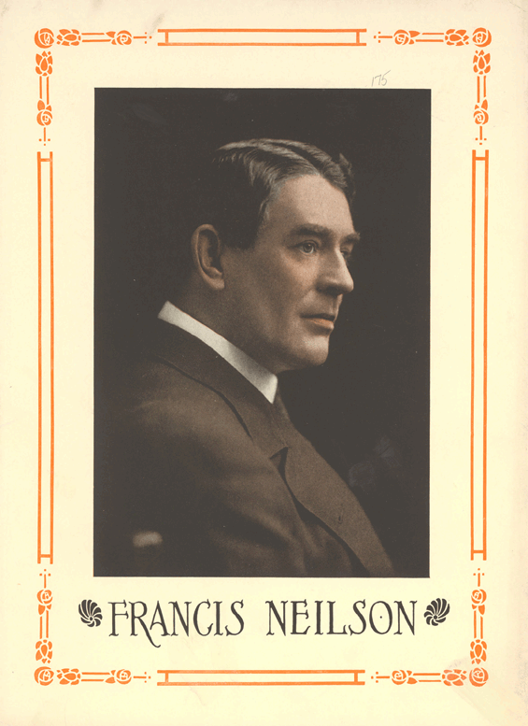
Francis Neilson: Pacifist, Georgist and Churchill Revisionist

Slide 2
Written by
Edward J. Dodson, M.L.A.
Notes:
Beginning in the mid-1990s I began to gather information on the thousands of men and women who came to embrace the principles embraced by the American political economist, journalist and newspaper editor Henry George. This project grew into an online record of the Biographical History of the Georgist Movement. This is the life story of one of the leading figures of the Georgist movement, Francis Neilson.

Slide 3
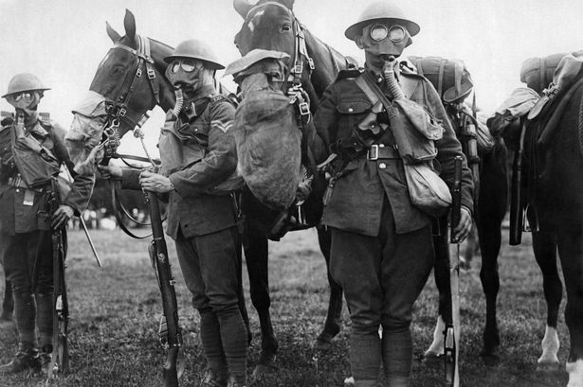
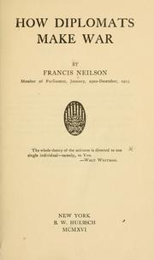
Notes:
If Francis Neilson had written nothing else, historians of the First World War would recognize him for his 1915 book, How Diplomats Make War.

Slide 4
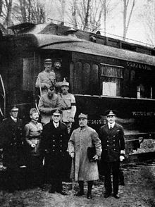
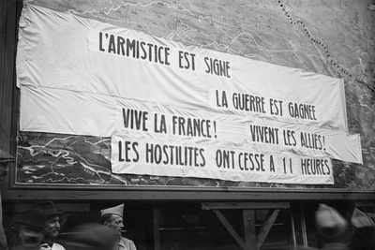
Notes:
Even as the fighting was underway on the battlefields of Europe and the seas surrounding Britain, Neilson warned that the outcome would change nothing. The intrigues and manipulations that had pulled country after country into the war were certain to be repeated. As Neilson explained:

Slide 5
"Governments will look after their own interests; but with people it is different, for no Government will do anything really worth while for them unless they keep clearly in view all those factors which have caused so much suffering and death, and firmly decide to rid themselves of pernicious systems which ferment wars.”
Notes:
"Governments will look after their own interests; but with people it is different, for no Government will do anything really worth while for them unless they keep clearly in view all those factors which have caused so much suffering and death, and firmly decide to rid themselves of pernicious systems which ferment wars.“ (Neilson, 1915, pp.366-367)

Slide 6

Notes:
How did Francis Neilson come to know what he knew about the workings of diplomats and governments?

Slide 7
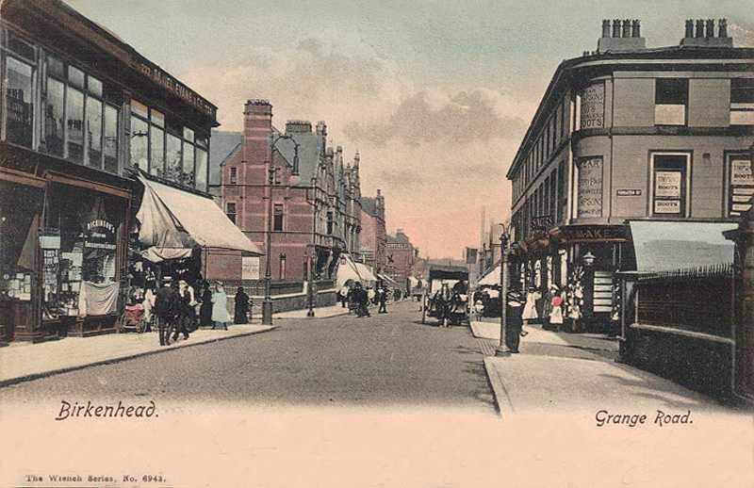
Notes:
Already by 1915 he had come a long way from his quite humble beginnings in the town of Birkenhead, across the River Mersey from the city of Liverpool.

Slide 8
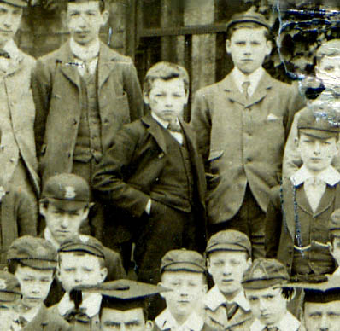
Notes:
For someone who developed into a writer of significant talent and energy, he was a poor student and felt confined by formal schooling. He left school in 1881 at age 14 to spend five years apprenticed to an engineering firm. During this time he developed a love of reading and the theatre.

Slide 9
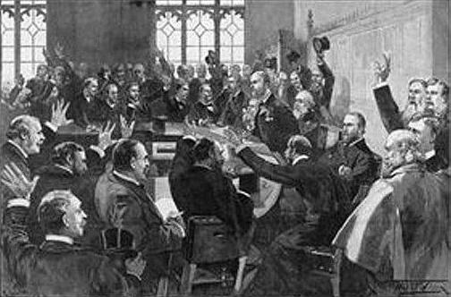
Notes:
His interest in the political realm was nurtured by his father.

Slide 10
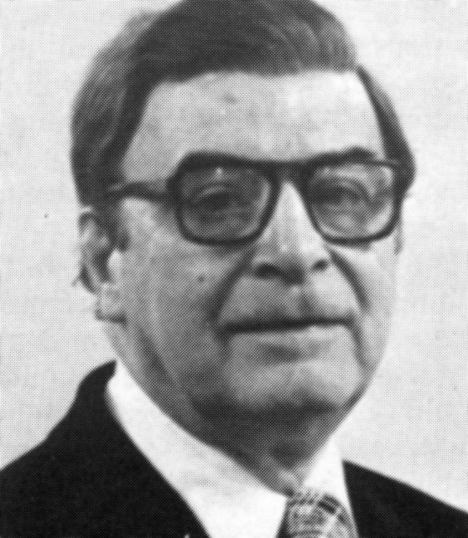
Notes:
An American who came to know him well was Will Lissner, an economics reporter for The New York Times from 1926 until his retirement in 1976. Lissner then became editor of the American Journal of Economics and Sociology, to which Neilson became a frequent contributing writer. Lissner offers this insight into Neilson’s Liberal political ideals:

Slide 11
"Uneducated though he had been, the father was a cultured man, a Liberal of the old school. His library had practically all the speeches and pamphlets of Cobden and Bright that were the product of the campaigns for the repeal of the corn laws, the campaigns that helped to end the 'Hungry Forties'."
Notes:
"Uneducated though he had been, the father was a cultured man, a Liberal of the old school. His library had practically all the speeches and pamphlets of Cobden and Bright that were the product of the campaigns for the repeal of the corn laws, the campaigns that helped to end the 'Hungry Forties'.“ (Lissner, 1947, p.144)

Slide 12
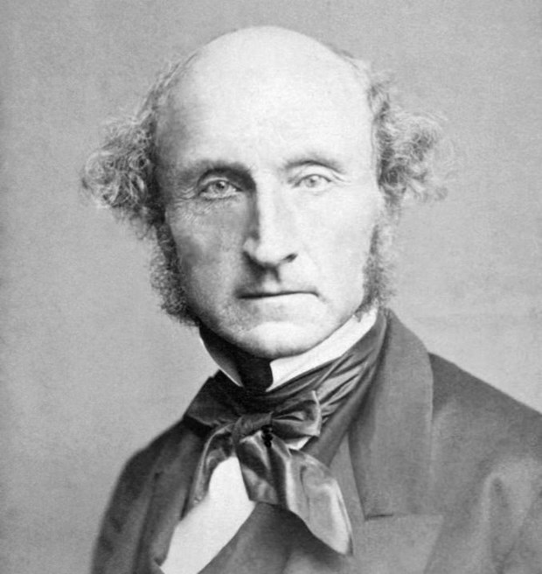
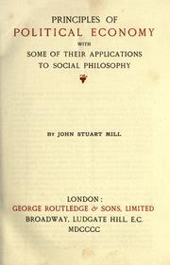
Notes:
Another important influence on Francis was an uncle, who read to Francis and his siblings from the works of John Stuart Mill and other major contributors to English literature.

Slide 13
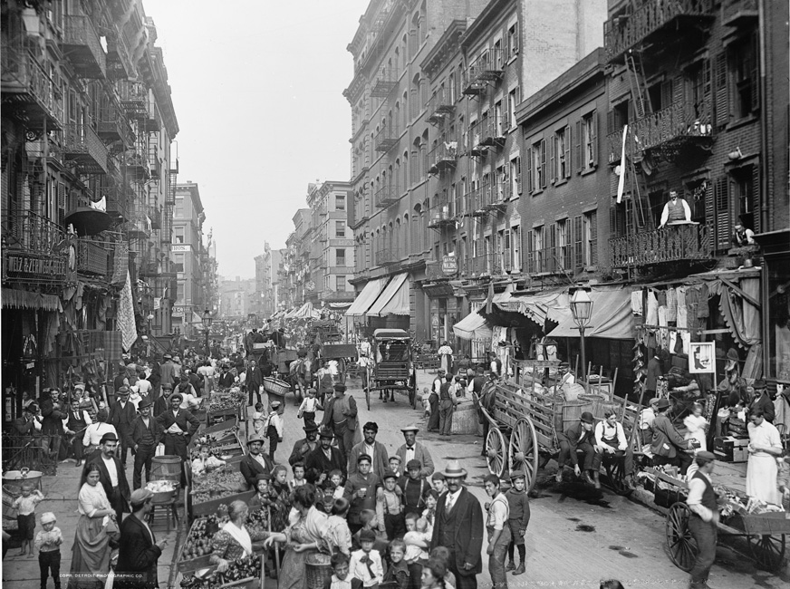
Notes:
By the time he reached age 18 Francis was hungry for new experiences. And so, he left for the United States and New York City where, among other things, he learned a good deal about the racism that prevented people of color from achieving their true potential living in the United States.

Slide 14
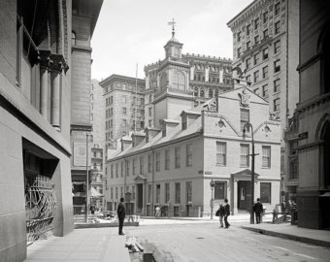
Notes:
His own economic circumstances were not much better, and a year later he moved to Boston.

Slide 15
"… spent the free time that unemployment afforded him in the Boylston Street Library, reading every work it contained on socialism."
Notes:
As Will Lissner relates to us, he: "… spent the free time that unemployment afforded him in the Boylston Street Library, reading every work it contained on socialism.“ (Lissner, 1947, p.144)

Slide 16
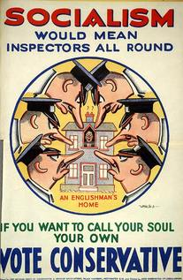
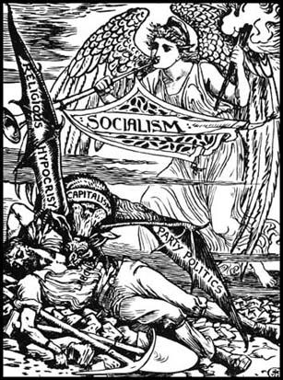
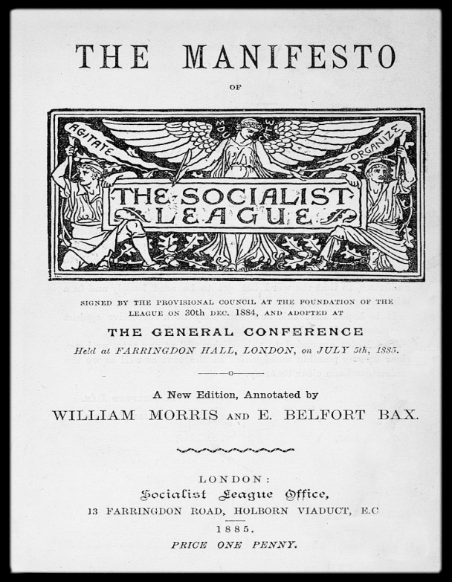
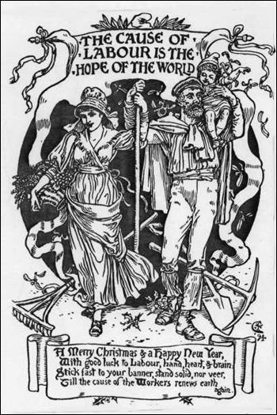
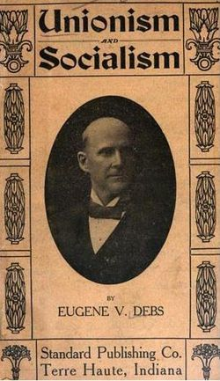
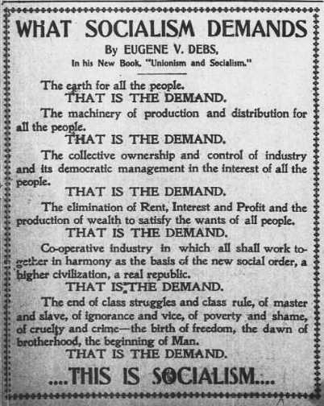
Notes:
However, the writings of socialists failed to satisfy him either intellectually or morally.

Slide 17
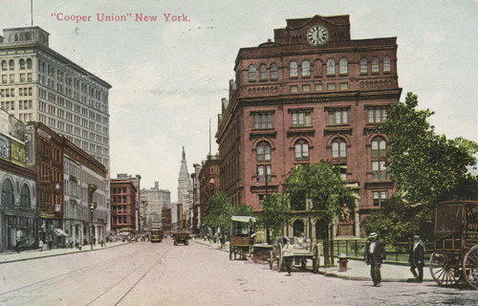
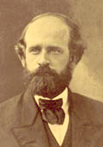
Notes:
Returning to New York City, he continued to study and attend lectures. One day at Cooper Union he heard Henry George speak.

Slide 18
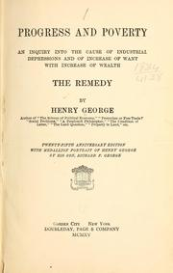
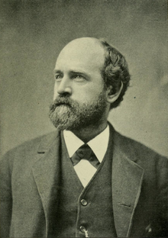
Notes:
After that lecture, Henry George gifted him a copy of his book, Progress and Poverty, which pulled Francis into the growing number of Henry George supporters.

Slide 19
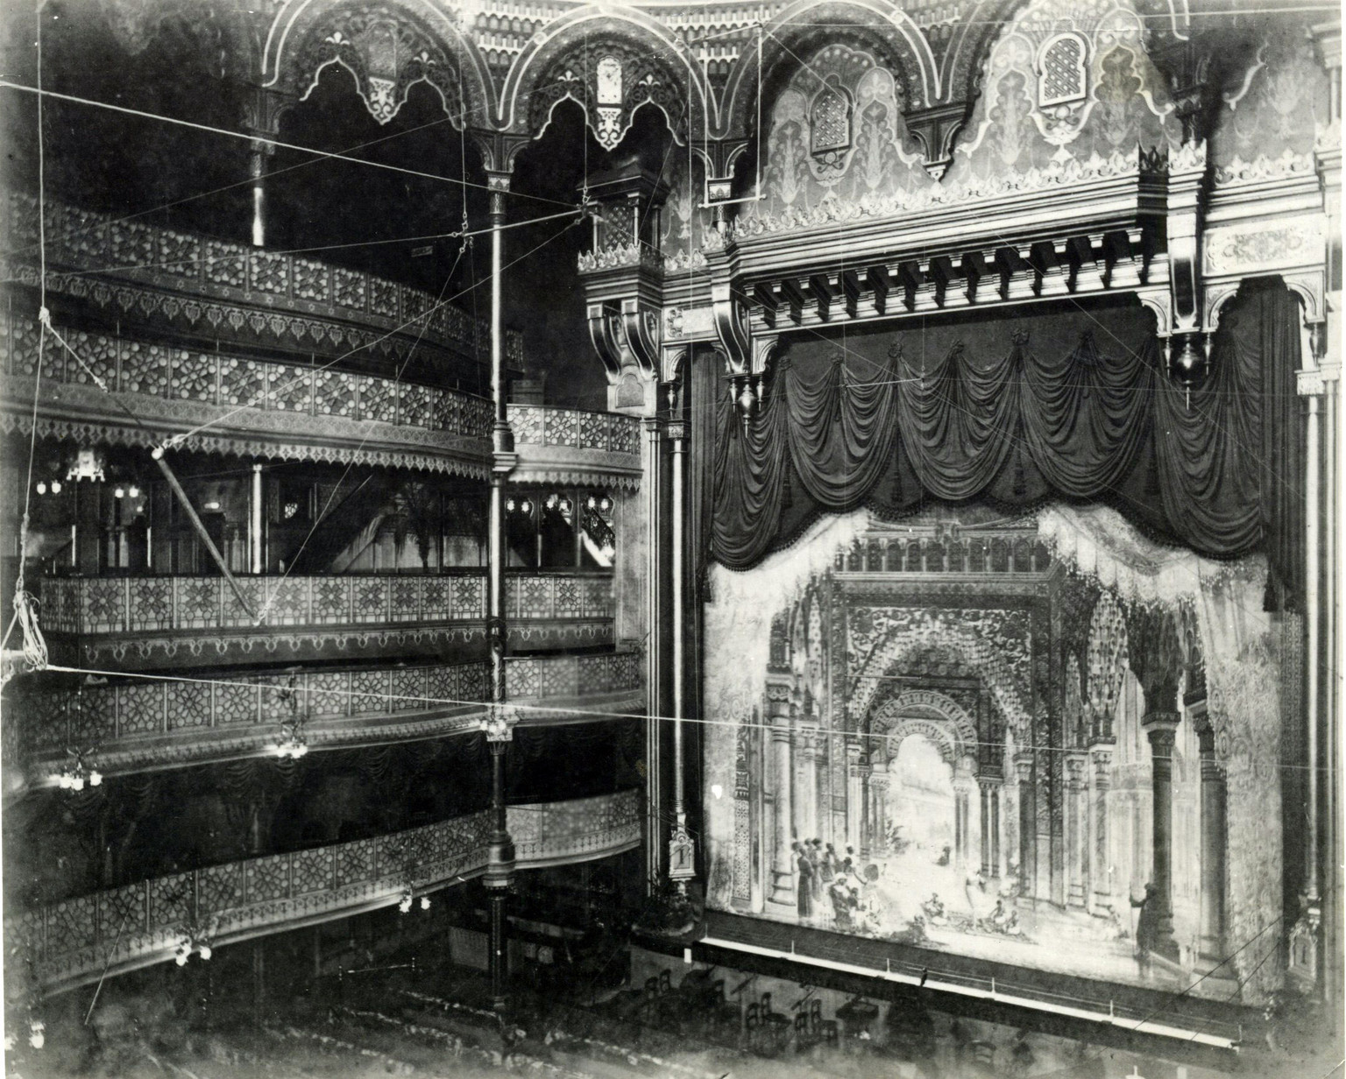
Notes:
Yet, his immediate interests had become the theatre and writing. The second play he wrote was enormously successful, taken by a road company on a tour in 1895. Hired as stage manager to take another play to London, Francis returned to England in 1897. His career in the theatre now took off.

Slide 20
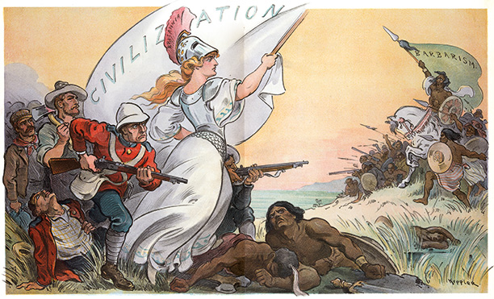
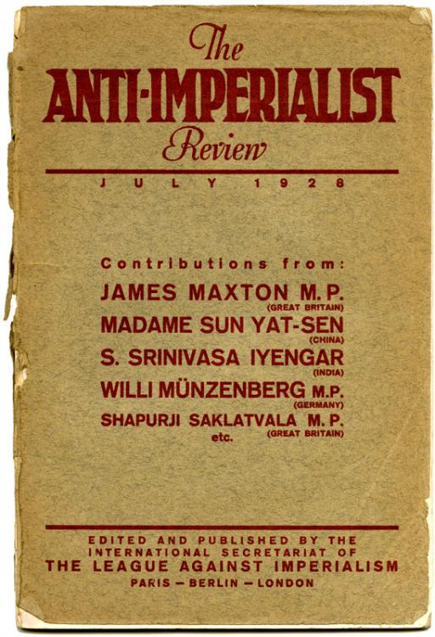
Notes:
In London he soon joined forces with others who were voicing opposition to what they saw as British imperialism.

Slide 21
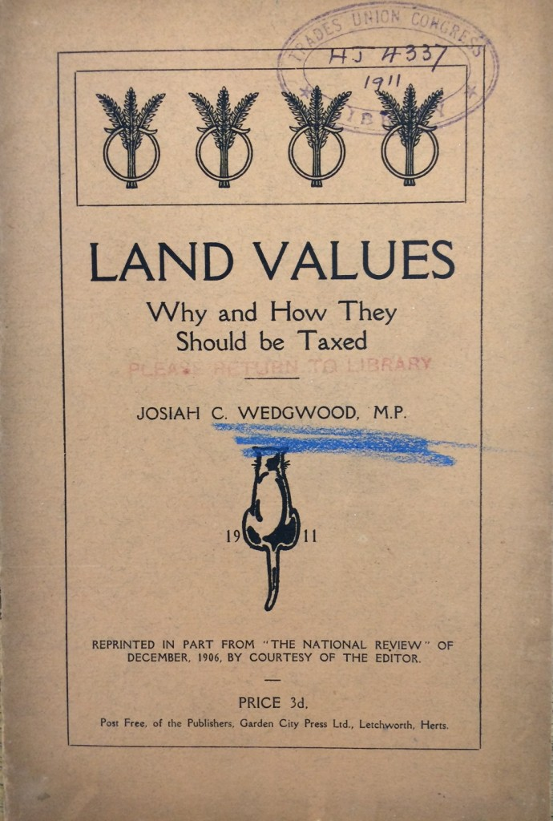
Notes:
Then, by 1902 he had become a vocal supporter of Henry George's arguments in favor of the public collection of the rent of land, described by fellow Liberals, such as Josiah Wedgwood, as land value taxation.

Slide 22
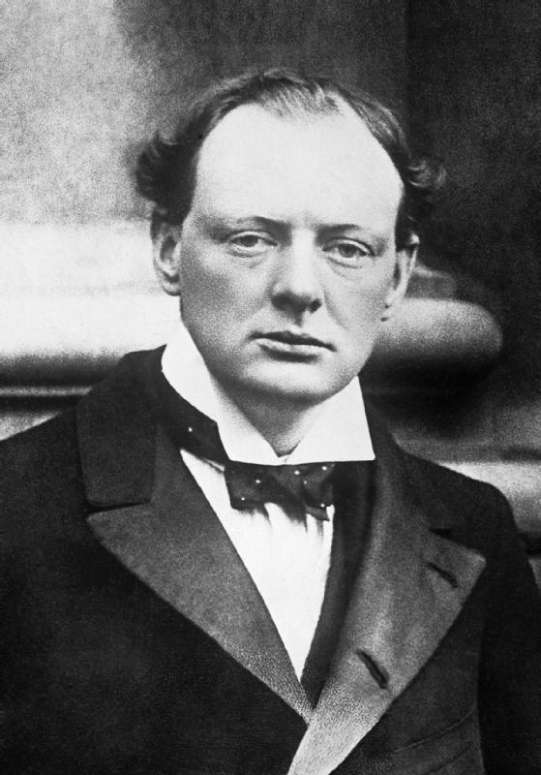
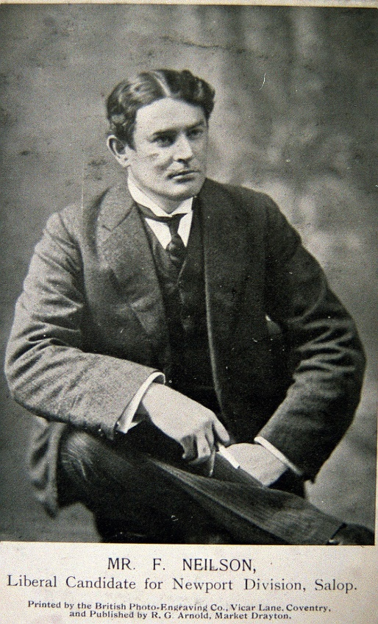
Notes:
Francis was now at the center of the "great Liberal revival" and, along with Winston Churchill, was elected to the House of Commons in 1909, where he headed the group of Liberals championing the taxation of land values.

Slide 23
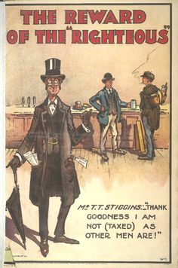
Notes:
Their efforts were undermined by powerful landed interests and failed to gain widespread public support for reasons still debated by historians and those in Britain who continue to work for this reform.

Slide 24
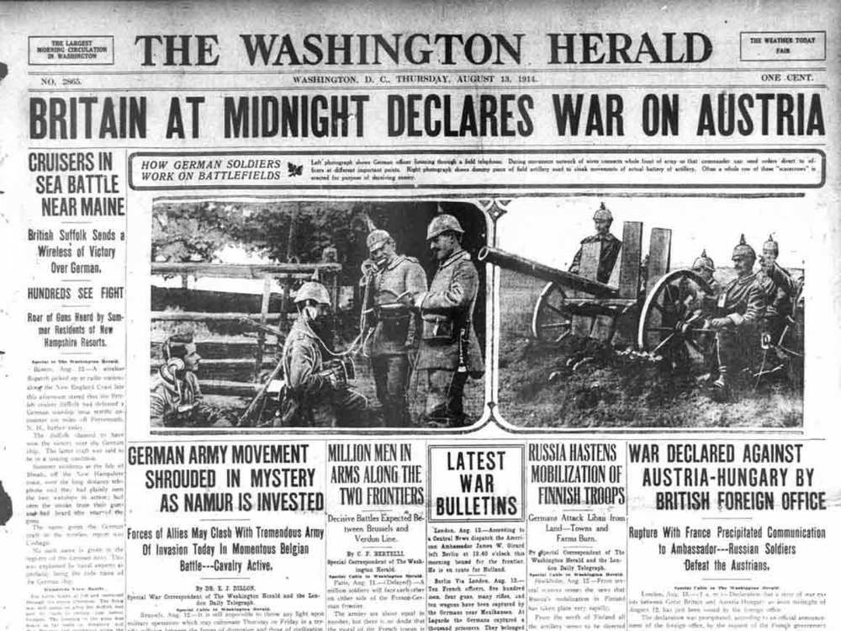
Notes:
In any event, efforts on behalf of societal reforms were about to take a back seat to the war effort. Disgusted with the political situation, Neilson felt compelled to take action to demonstrate his deep opposition to Britain’s entrance into yet another war.

Slide 25
"… resigned his seat in Parliament, retired from his position in his party, and quitted England for the United States, where he foreswore his allegiance to the Crown and became an American citizen. He was through with politics."
Notes:
Will Lissner writes that he "… resigned his seat in Parliament, retired from his position in his party, and quitted England for the United States, where he foreswore his allegiance to the Crown and became an American citizen. He was through with politics.“ (Lissner, 1947, p.154)

Slide 26
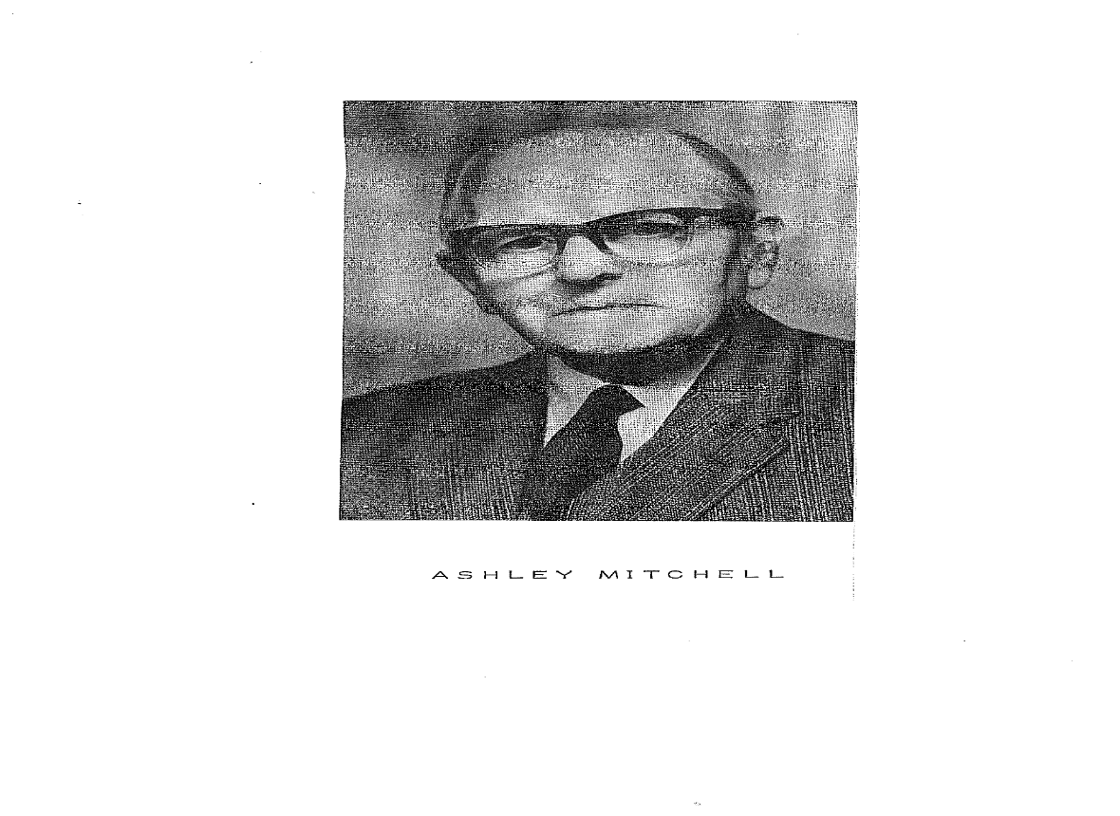
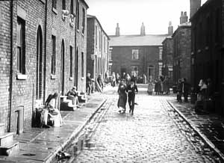
Notes:
Neilson's long-time friend back in Britain, Ashley Mitchell, a leading figure in the United Committee for the Taxation of Land Values, years later lamented over what they had concluded was the abandonment by Britain's political leaders of any serious effort to solve the real problems of their society:

Slide 27
"Up to 1914, up to the outbreak of the first world war, British politics were based on something like principle. At any rate, the issues were plain and the ordinary man could understand them. The conflict was between reform and privilege. The progressive party stood for reform and the other party stood in defense of privilege, and even worse, in favor of reaction."
Notes:
"Up to 1914, up to the outbreak of the first world war, British politics were based on something like principle. At any rate, the issues were plain and the ordinary man could understand them. The conflict was between reform and privilege. The progressive party stood for reform and the other party stood in defense of privilege, and even worse, in favor of reaction."

Slide 28
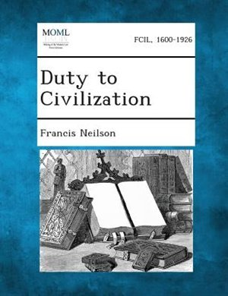
Notes:
Although Neilson turned away from politics, he was far from through with the struggles for social justice. In an essay written in 1921 titled "Duty to Civilization," he took the opportunity to explain why he had left Britain:

Slide 29
"I know not any statesman monarchial or republican, in Europe who has my sympathy; and, for the past twenty-five years, I have been remarkably consistent in my impartiality in this matter. …”
Notes:
"I know not any statesman monarchial or republican, in Europe who has my sympathy; and, for the past twenty-five years, I have been remarkably consistent in my impartiality in this matter. …”

Slide 30
“ I have found but one, Sir Henry Campbell-Bannerman, who was worth saying a good word for.”
Notes:
“ I have found but one, Sir Henry Campbell-Bannerman, who was worth saying a good word for.“ (Neilson, 1921, p.2)

Slide 31
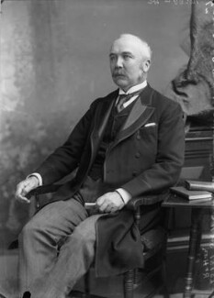
Notes:
Henry Campbell-Bannerman served as Britain’s Liberal Prime Minister from 1905-1908. He had become quite ill in the fall of 1907 and stepped down a few weeks before his death on the 22nd of April, 1908.

Slide 32
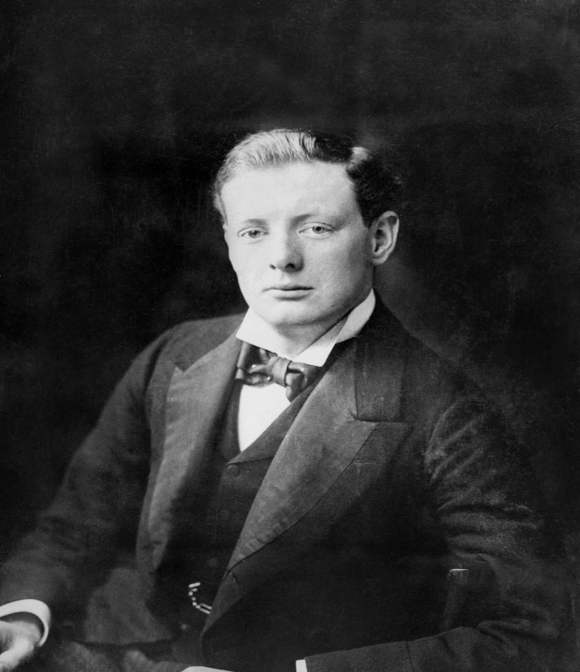
Notes:
As a rising figure within Liberal circles, Francis soon came into frequent contact with Winston Churchill. Keeping the above expressed sentiments regarding political figures in mind, he later recalled his first introduction to Winston Churchill:

Slide 33
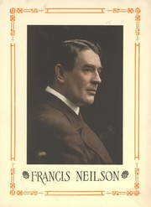
"Shortly after the Boer War, he was pointed out to me in a Manchester hotel; I think it must have been after he crossed the floor of the House -- about the time he deserted the Tories and joined the Liberal party."
Notes:
"Shortly after the Boer War, he was pointed out to me in a Manchester hotel; I think it must have been after he crossed the floor of the House -- about the time he deserted the Tories and joined the Liberal party.“ (Neilson, 1953, p.252)

Slide 34
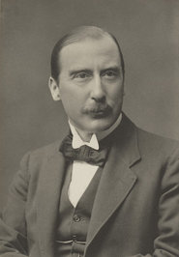
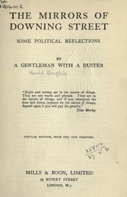
Notes:
In his autobiography, Francis reprinted the assessment of Churchill he attributes to F.S. Oliver in The Mirrors of Downing Street. However, my limited research finds the author of this volume is one Harold Begbie an assessment with which he obviously concurred:

Slide 35
"From his youth up Mr. Churchill has loved with all his heart, with all his mind, with all his soul, and will all his strength, three things -- war, politics, and himself. …”
Notes:
"From his youth up Mr. Churchill has loved with all his heart, with all his mind, with all his soul, and will all his strength, three things -- war, politics, and himself. …”

Slide 36
“He loved war for its dangers, he loves politics for the same reason, and himself he has always loved for the knowledge that his mind is dangerous - dangerous to his enemies, dangerous to his friends, dangerous to himself. …”
Notes:
“He loved war for its dangers, he loves politics for the same reason, and himself he has always loved for the knowledge that his mind is dangerous - dangerous to his enemies, dangerous to his friends, dangerous to himself. …”

Slide 37
“I can think of no man I have ever met who would so quickly and so bitterly eat his heart out in Paradise."
Notes:
“I can think of no man I have ever met who would so quickly and so bitterly eat his heart out in Paradise.“ (Neilson, 1953, p.254)

Slide 38
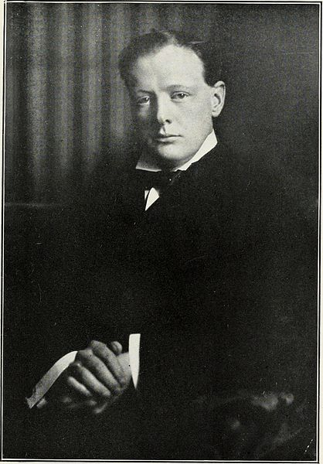
Notes:
Winston Churchill provided plenty of ammunition for those, such as Neilson, who challenged Churchill's description of world events and the roles he played in those events.

Slide 39
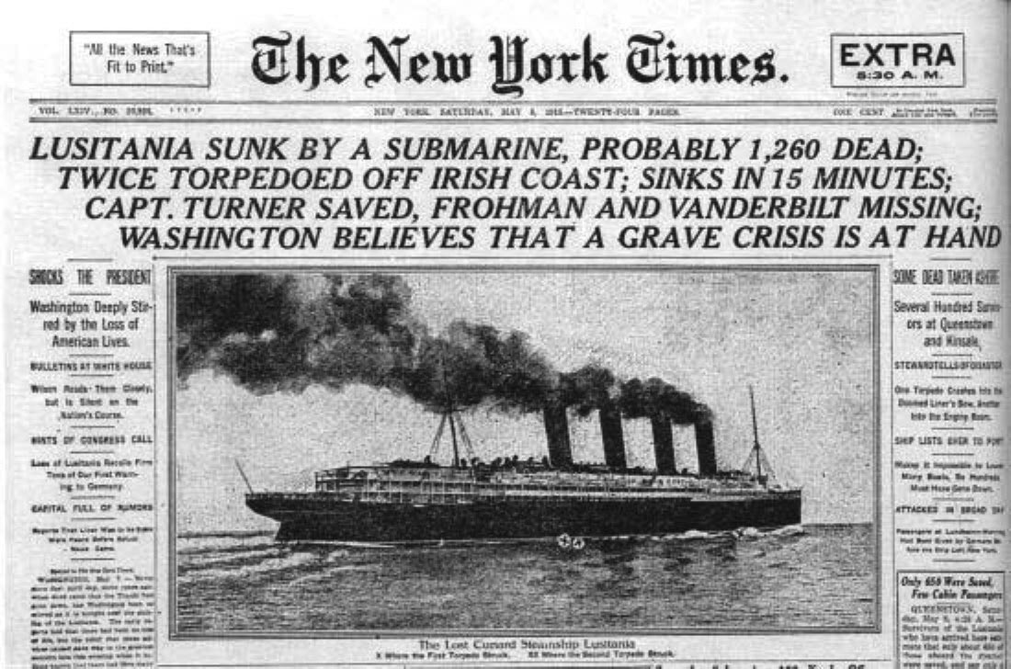
Notes:
For Francis Neilson, an important personal loss may have triggered his quest to get to the truth. One of his sisters was a passenger on the Lusitania, torpedoed by a German submarine in 1917 under the strangest of circumstances.

Slide 40
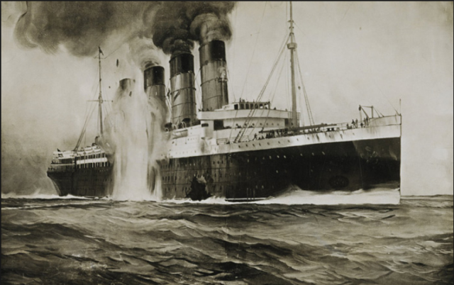
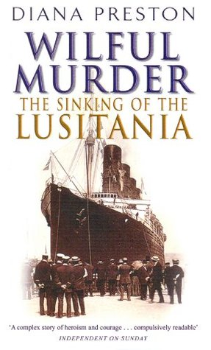
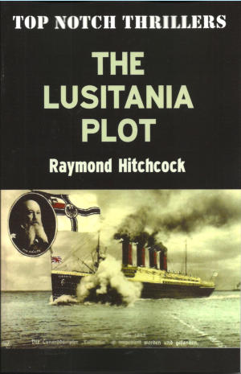
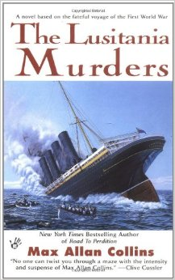
Notes:
Much has been written about this sinking and the roles of those in charge at the Admiralty, Churchill included.

Slide 41
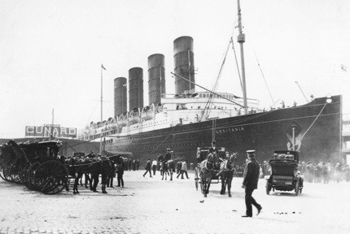
Notes:
The Lusitania carried not only passengers but a huge shipment of arms and ammunition. And yet, when the ship entered British-controlled waters no destroyer escort was provided, even though British naval intelligence knew that at least one German submarine was patrolling in the immediate area.

Slide 42
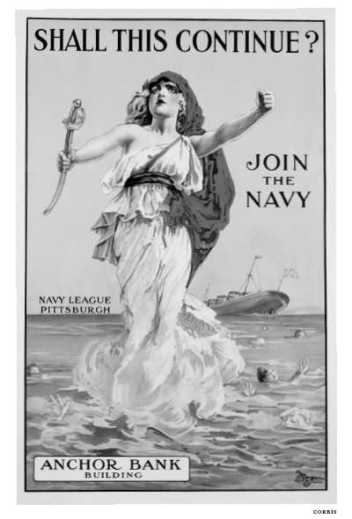
Notes:
Thus was raised the question of whether the Lusitania was sacrificed because the death of its American passengers would sufficiently anger the Americans to bring them into the war on the side of Britain.

Slide 43
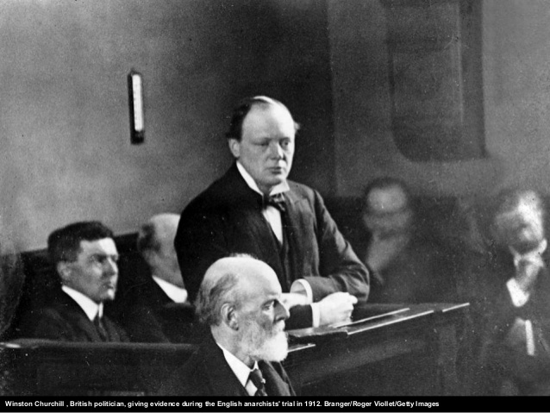
Notes:
Two days before the sinking, Churchill left for France to participate in a Naval conference.

Slide 44
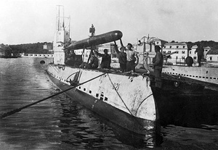
Notes:
At the Admiralty, the intelligence group was closely tracking a German submarine. Records for this submarine, U20, confirm that the British Admiralty had intercepted and decoded every message sent from U20, right up to the sinking of the Lusitania.

Slide 45
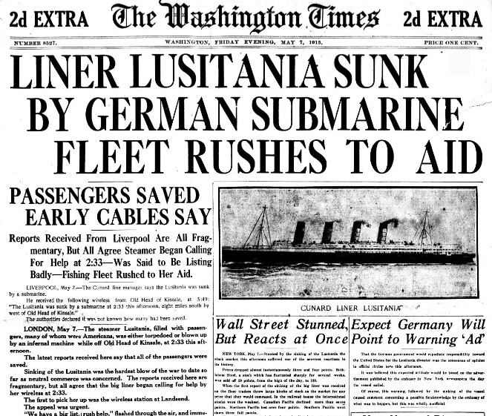
Notes:
Prior to his departure, Churchill and other Admiralty officials decided to recall the escort vessel because the ship was older and therefore a potential victim of submarine attack. However, no warning was sent to the captain of Lusitania that he would have no escort.

Slide 46

Notes:
Left behind at the Admiralty and in charge was a 75-year old First Sea Lord named Jacky Fisher, described in several accounts as showing signs of senility. Reports had continued to arrive of attacks and sinkings made by U20 but still nothing was done to alert Lusitania of the danger.

Slide 47

Notes:
Years later, in 1935, historian Thomas A. Bailey at the University of Nebraska examined all of the evidence and interviewed both survivors and key officials.

Slide 48
"There was great confidence in the remarkable speed of the vessel, and a general feeling approaching boastfulness among the ship's officers, Cunard officials and others that the Lusitania could run away from any possible assailant."
Notes:
Professor Bailey concluded: "There was great confidence in the remarkable speed of the vessel, and a general feeling approaching boastfulness among the ship's officers, Cunard officials and others that the Lusitania could run away from any possible assailant.“ (Bailey, 1935, pp.65-66)

Slide 49

Notes:
Some naval experts also thought the ship was unsinkable. This was probably true of the ship if its hull had not been filled with ammunition.

Slide 50

Notes:
Bailey also writes that the Lusitania's captain stated in testimony that he had slowed his ship in order to time his arrival in Liverpool with the tide.

Slide 51






Notes:
From what has been written, it seems that errors in judgment rather than a decision to sacrifice Lusitania for the greater need of American support resulted in the sinking. Yet, the stage was set for future charges of conspiracy.

Slide 52

Notes:
At the time, Neilson offered no published criticism of Churchill or the Admiralty. That would come from other quarters. Decades later, Neilson described Churchill's reaction to criticism this way:

Slide 53

"His dolor when the shafts of criticism are aimed at him is really pathetic. For one who never had any mercy upon a political opponent, he reveals a tenderness that quails at reproach. …"
Notes:
"His dolor when the shafts of criticism are aimed at him is really pathetic. For one who never had any mercy upon a political opponent, he reveals a tenderness that quails at reproach."(Neilson, 1955, p.347)

Slide 54
"What a champion of the tactics of recrimination he was when he was out of office; but what a sensitive, tender skin he has when shafts of recrimination are aimed at him."
Notes:
"What a champion of the tactics of recrimination he was when he was out of office; but what a sensitive, tender skin he has when shafts of recrimination are aimed at him."(Neilson, 1955, p.351)

Slide 55

Notes:
This was made quite clear as Winston's war memoirs were published and reviewed. What troubled Neilson most, it seemed, was what he saw as Winston's opportunistic shifts in that which he championed or attacked.

Slide 56

Notes:
As one who never abandoned the struggle to solve "the land question," Neilson could not be faulted for looking upon Churchill as a man with no strong convictions or principles. As Neilson observes:

Slide 57

"Not even Gladstone excelled Churchill in delivering homilies upon naughty politicians and their nations. But students of the past wars in this century should be able to conclude by now that moral sentiments expressed by politicians are slippery things. ..."
Notes:
"Not even Gladstone excelled Churchill in delivering homilies upon naughty politicians and their nations. But students of the past wars in this century should be able to conclude by now that moral sentiments expressed by politicians are slippery things. …”

Slide 58
"Still, it is possible to form a judgment as to why they change so frequently and adapt their morals to fit the circumstances that arise from time to time."
Notes:
"Still, it is possible to form a judgment as to why they change so frequently and adapt their morals to fit the circumstances that arise from time to time.“ (Neilson, 1949, p.201)

Slide 59
Notes:
Churchill, Francis believed, was getting ahead of the historians by presenting his rationale for decisions he took that were certain to attract criticism in the cooler post-war atmosphere. Neilson felt compelled to respond:

Slide 60

"There are so many passages in this work to which the industrious and well-informed student will take exception that it is difficult to know which one or two should be considered in a critique. But it is essential for the reader to remember that Churchill is not only a protagonist, but one who shows in his work that it was necessary for him to defend his actions. …”
Notes:
"There are so many passages in this work to which the industrious and well-informed student will take exception that it is difficult to know which one or two should be considered in a critique. But it is essential for the reader to remember that Churchill is not only a protagonist, but one who shows in his work that it was necessary for him to defend his actions. …”

Slide 61

“Therefore, many of his recordings should not be accepted as history but as the opinions of a man who has a personal case to present."
Notes:
“Therefore, many of his recordings should not be accepted as history but as the opinions of a man who has a personal case to present." (Neilson, 1949, p.202)

Slide 62

Notes:
Neilson continued his challenge in a review of the third of Churchill's volumes.

Slide 63
"As autobiography, the volumes are of great value, for they reveal a unique personality who is not afraid to expose many of his defects, and seems to glory in his Jesuitical career."
Notes:
"As autobiography, the volumes are of great value, for they reveal a unique personality who is not afraid to expose many of his defects, and seems to glory in his Jesuitical career.“ (Neilson, 1950, pp.96-97)

Slide 64

Notes:
At bottom, concludes Neilson, Winston Churchill exhibits all of the traits of the politician and few of the statesman:

Slide 65
"Foresight, consistency, and logic are not political attributes, and if any one should doubt this statement, all he has to do to confirm it is to read Churchill's book, 'While England Slept', and 'Step by Step'."
Notes:
"Foresight, consistency, and logic are not political attributes, and if any one should doubt this statement, all he has to do to confirm it is to read Churchill's book, 'While England Slept', and 'Step by Step'.“ (Neilson, 1950, p.108)

Slide 66








Notes:
Francis Neilson may have revealed to his close friends why he felt compelled to respond so extensively and for so many years to Churchill's autobiographical memoirs. He surely understood that future historians would closely examine the record and provide dispassionate analysis.

Slide 67

Notes:
In 1954, Neilson produced a stern portrait of the British leader, The Churchill Legend, a portrait which remains worth repeating despite the passage of years:

Slide 68
"Churchill had but one aim; only one desire. In The Grand Alliance he states, 'I have only one purpose, the destruction of Hitler, and my life is much simplified thereby'. It is his life that is to be satisfied. England? Europe? Are they merely the arenas that provide the accessories of the conflict? …”
Notes:
"Churchill had but one aim; only one desire. In The Grand Alliance he states, 'I have only one purpose, the destruction of Hitler, and my life is much simplified thereby'. It is his life that is to be satisfied. England? Europe? Are they merely the arenas that provide the accessories of the conflict? …”

Slide 69
“His life is to be 'simplified' by throwing the world into chaos again. His purpose is the destruction of one man; and the last chance to maintain the culture of a thousand years must be abandoned because a politician's life is to be 'simplified'."
Notes:
“His life is to be 'simplified' by throwing the world into chaos again. His purpose is the destruction of one man; and the last chance to maintain the culture of a thousand years must be abandoned because a politician's life is to be 'simplified'.“ (Neilson, 1954, p.444)

Slide 70

Notes:
Neilson took the long view of history. He saw the rise of fascism and the Hitler regime as the inevitable consequence of vengeance rather than shared responsibility for the First World War. He never came to terms with the making of war against noncombatants, to the wholesale destruction of great cities and the physical, artistic and cultural accomplishments of earlier generations. War destroyed much that was, to Neilson, the inheritance of the generations.

Slide 71


Notes:
When the second global conflict erupted, Neilson committed himself to a daily recording of the events as reported and as his remaining sources in Britain conveyed to him. The first volume of this epic journal was published in 1940, with an introduction by University of Chicago President, Robert M. Hutchins.

Slide 72
Notes:
One reviewer, a Professor of History at the University of Nebraska, offered this assessment of Neilson's effort:

Slide 73
"Mr. Neilson's diary from September 1, 1939, to October 31, 1940, gives the reader no new information on the events of the last two years. The book's importance, if any, lies, therefore, in the reflections of the author on these events. …”
Notes:
"Mr. Neilson's diary from September 1, 1939, to October 31, 1940, gives the reader no new information on the events of the last two years. The book's importance, if any, lies, therefore, in the reflections of the author on these events. …”

Slide 74
“The reflections are those of a disillusioned pacifist who sees nothing but the utter futility of war. They are those of a revisionist publicist (How Diplomats make War, 1915) who holds Churchill, France, and Russia responsible for the last war and who is eager to start a revisionist movement for the War of 1939. …”
Notes:
"The reflections are those of a disillusioned pacifist who sees nothing but the utter futility of war. They are those of a revisionist publicist (How Diplomats make War, 1915) who holds Churchill, France, and Russia responsible for the last war and who is eager to start a revisionist movement for the War of 1939. …”

Slide 75
“They seem to be those of a crusader who loves to utter unpopular opinions, but who leaves the reader with the feeling that he would argue with the same fervor on the other side if only it were unpopular."
Notes:
“They seem to be those of a crusader who loves to utter unpopular opinions, but who leaves the reader with the feeling that he would argue with the same fervor on the other side if only it were unpopular.“ (Winnaker, 1942, pp.340-341)

Slide 76

Notes:
The world Francis Neilson hoped would emerge following the end of the Second World War was not to be. He put a good deal of the blame on Winston Churchill for making a deal with the devil Joseph Stalin in a desperate effort to save the British empire. Churchill, he knew, could not plead ignorance:

Slide 77
"He not only knew of the secret treaty made during the First World War with Russia, in which her aims to the west of the Vistula were set down in clear sentences but, as Minister of War, after the Revolution of 1917, he had aided and abetted the counter-revolution…”
Notes:
"He not only knew of the secret treaty made during the First World War with Russia, in which her aims to the west of the Vistula were set down in clear sentences but, as Minister of War, after the Revolution of 1917, he had aided and abetted the counter-revolution…”

Slide 78
“If there were one man outside the borders of Russia during World War II, who knew what Russia desired and intended to obtain, if Germany was conquered, it was Churchill."
Notes:
“If there were one man outside the borders of Russia during World War II, who knew what Russia desired and intended to obtain, if Germany was conquered, it was Churchill.“ (Neilson, 1955, p.348)

Slide 79

Notes:
Could Russia's westward advance into the heart of Europe have been prevented by mere diplomacy? Neilson in a later passage from the same writing is pragmatic:

Slide 80

"It was a trick of fate, and she -- the merciless jade -- made it impossible for him to play other than an ignominious part in every transaction that was to ensue. For our modern historians and editors to labor under the delusion that, at any time after the retreat of the German armies from Russia, he could have changed the course of events is a notion that vanishes after a moment's consideration."
Notes:
"It was a trick of fate, and she -- the merciless jade -- made it impossible for him to play other than an ignominious part in every transaction that was to ensue. For our modern historians and editors to labor under the delusion that, at any time after the retreat of the German armies from Russia, he could have changed the course of events is a notion that vanishes after a moment's consideration.“ (Neilson, 1955, p.353)

Slide 81

Notes:
Nevertheless, Neilson joined with those who felt for the people whose expectation of liberation was betrayed.

Slide 82

Notes:
The French and Dutch were liberated with much destruction of their cities.

Slide 83

Notes:
The Italians were purged of their fascist aspirations and then liberated from German occupation, but the potential for democracy to find a home in Italy was severely threatened by the country’s communists.

Slide 84

Notes:
And, what about the future of the people of Poland, of Czechoslovakia, Austria, Hungary, Rumania, Albania, Bulgaria, or the Baltic states? The future looked bleak to Neilson:

Slide 85
"The Europe of twenty years ago no longer exists; even the Europe of Clemenceau, Lloyd George, and Woodrow Wilson is gone. And instead of peace and disarmament, we have crushing burdens of taxation, and a foreboding future with the prospect of the hydrogen bomb. …”
Notes:
"The Europe of twenty years ago no longer exists; even the Europe of Clemenceau, Lloyd George, and Woodrow Wilson is gone. And instead of peace and disarmament, we have crushing burdens of taxation, and a foreboding future with the prospect of the hydrogen bomb. …”

Slide 86
“Is it any wonder that some of the experts are now devising plans for us to live like rats in cellars and underground shelters?"
Notes:
“Is it any wonder that some of the experts are now devising plans for us to live like rats in cellars and underground shelters?“ (Neilson, 1955, p.354)

Slide 87

Notes:
Winston Churchill outlived Francis Neilson by four years. His life and the times in which he lived have been the subject of countless books, conferences, documentaries, and feature films.

Slide 88








Notes:
Neilson continued to write, producing a long list of thoughtful, provocative books. As Neilson's contemporaries died off, the memory of his challenging intellect and his passion for justice disappeared from public awareness.

Slide 89

Notes:
There is irony in the fact that the positions taken on "the land question" by a young Winston Churchill are reprinted and quoted far more often today than the extensive writings on the subject produced by Francis Neilson. Neilson would not be surprised by this. He understood the fleeting nature of fame and notoriety.

Slide 90

Notes:
However, thanks to funds bequeathed by Francis Neilson in his will, the American Journal of Economics and Sociology has remained as an important source of academic treatment of important social, political and economic issues.

Slide 91

The End
Notes:
The End

