Slide 1
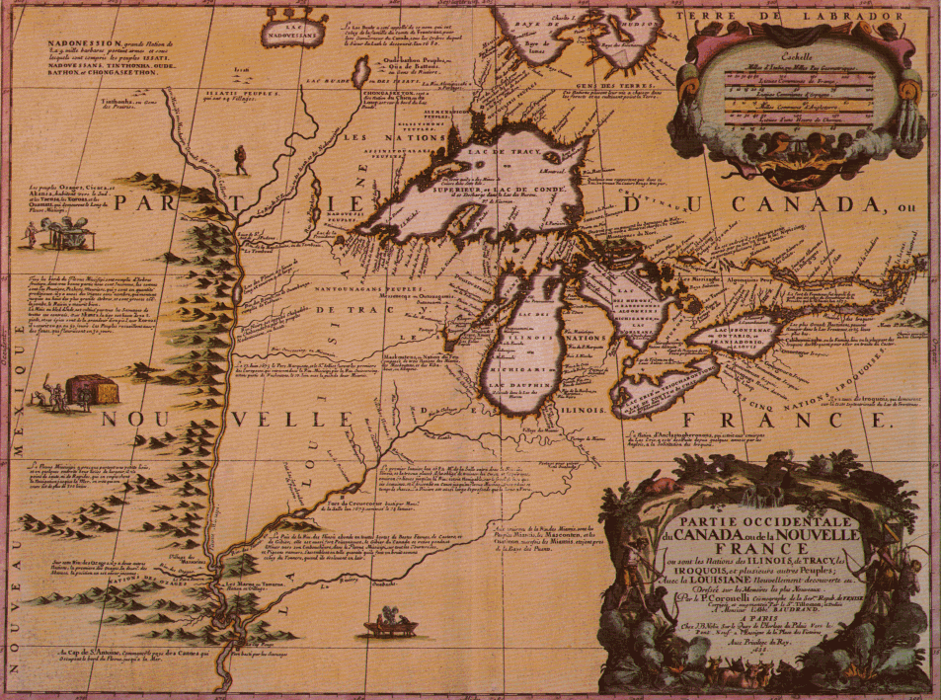
Discovery and Settlement of the Region the French Named Detroit

Slide 2
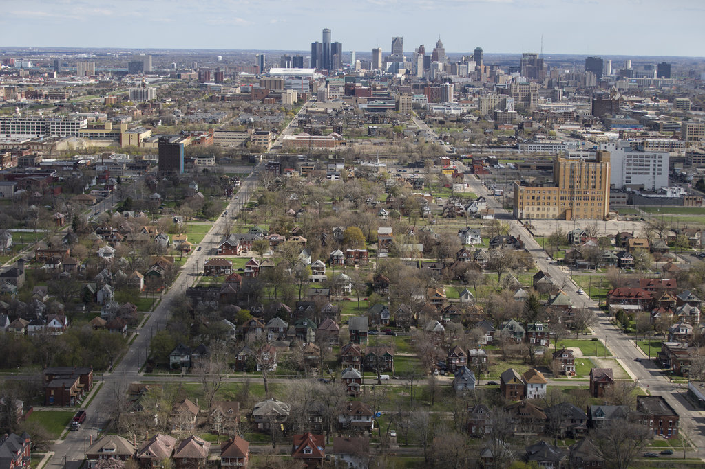
Written by
Edward J. Dodson

Slide 3
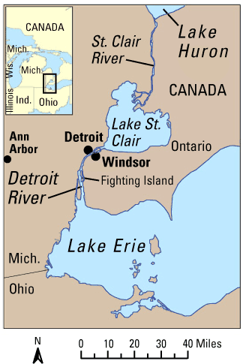
Notes:
Two of the Great Lakes – Huron and Erie – are connected by a water route of great value to whoever controlled the strategic point of land where the City of Detroit arose. Centuries of settlement and territorial conflict between several tribal societies occupying the region set the stage for new alliances and greater conflict when the first European explorers arrived at the dawn of the seventeenth century.

Slide 4
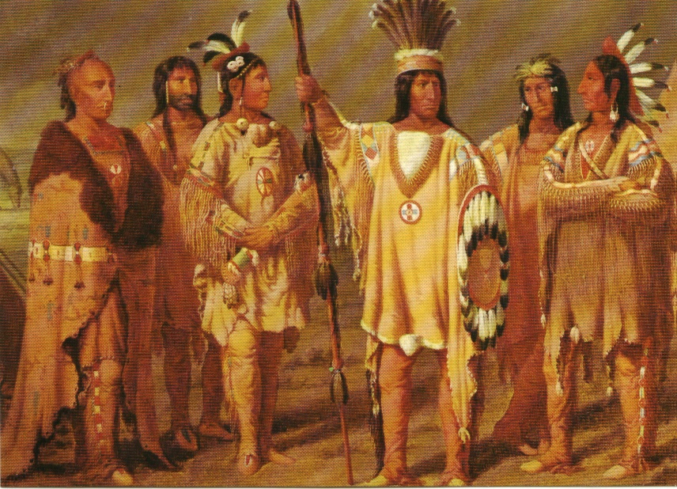
Notes:
At the end of the sixteen century there were an estimated 100,000 people occupying the region. They were members of five tribal groups: Potawatomi, Ottawa, Ojibwa/Chippewa, Miami, and Huron. The Potawatomi, Ottawa and Ojibwa speak similar Algonquin languages and are known as the “People of the Three Fires”.

Slide 5
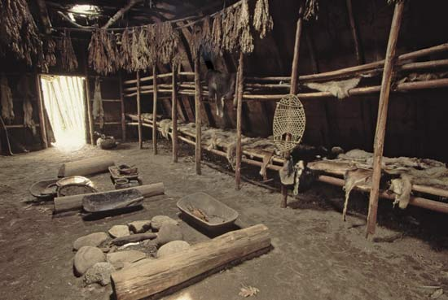
Notes:
However, warfare and exposure to European diseases killed off half of the people of these tribes by the end of the seventeen century.

Slide 6
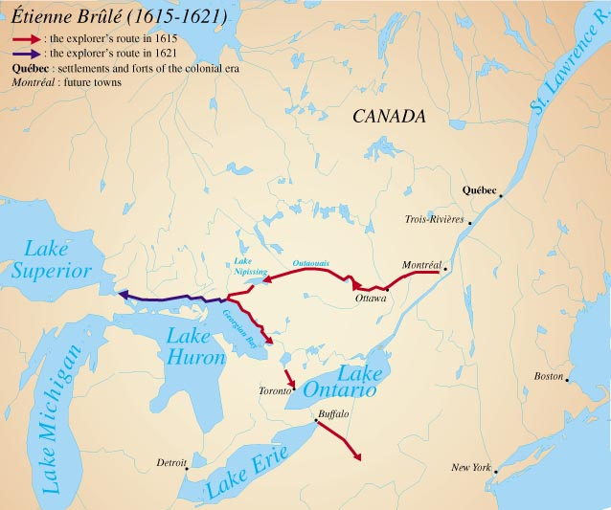
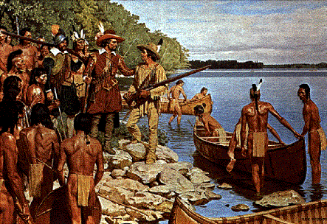
Notes:
As the French established a presence along the St. Lawrence River, they began to explore the Great Lakes region. In 1615, Samuel de Champlain sent Etienne Brule on the first mission of exploration deep into the interior. Brule was a perfect choice for this expedition. He had arrived in Canada in 1608 and lived with the Hurons, learning their language and culture. However, Brule apparently did not travel to the Detroit region.

Slide 7
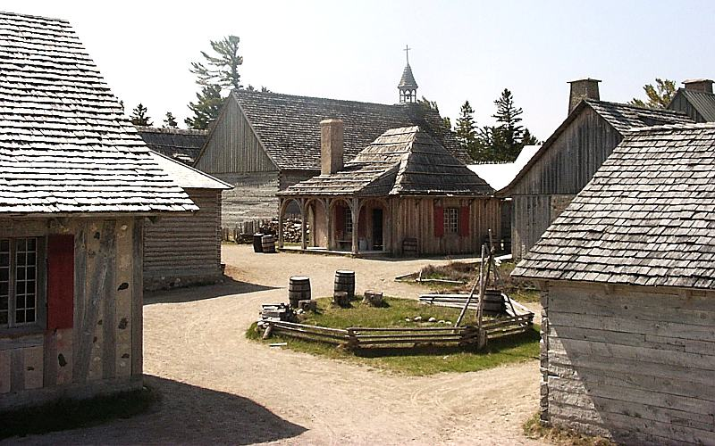
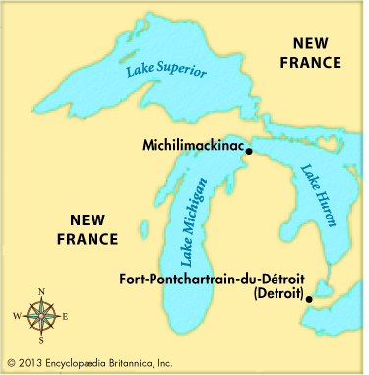
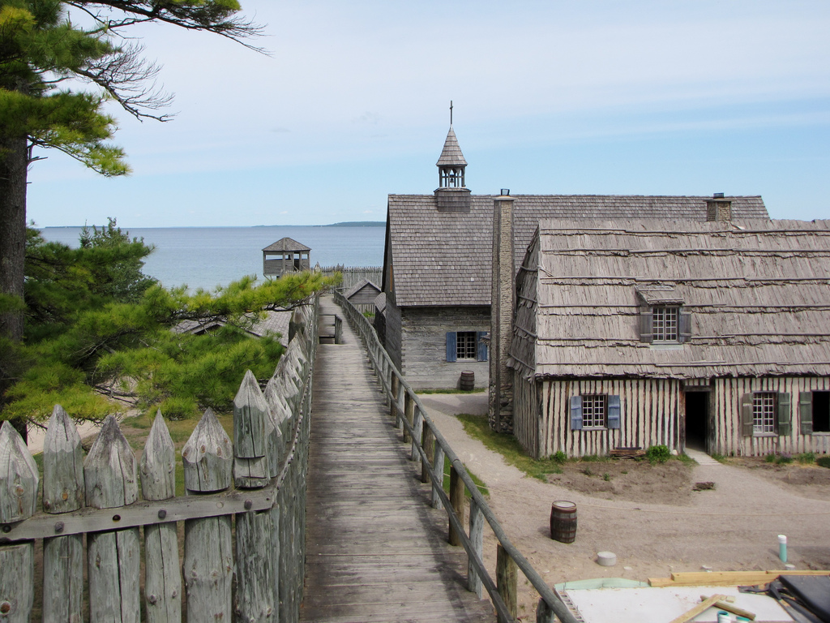
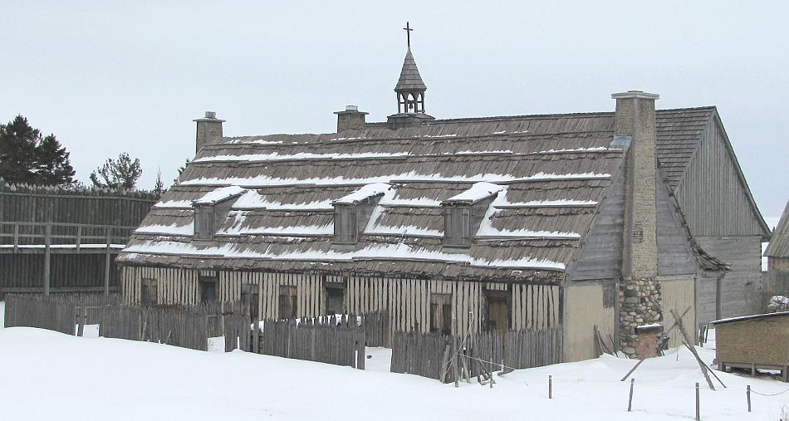
Notes:
In 1694 a new French captain arrived to take command of the post at Michilimackinac at the northern tip of the lower Michigan peninsula.

Slide 8
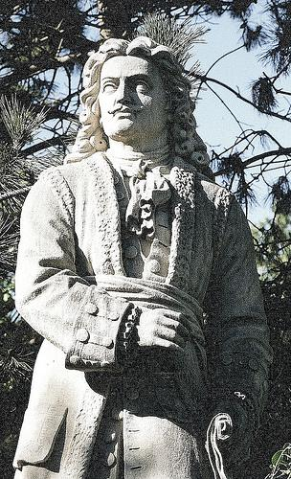
Notes:
He was Antoine de la Mothe-Cadillac.

Slide 9
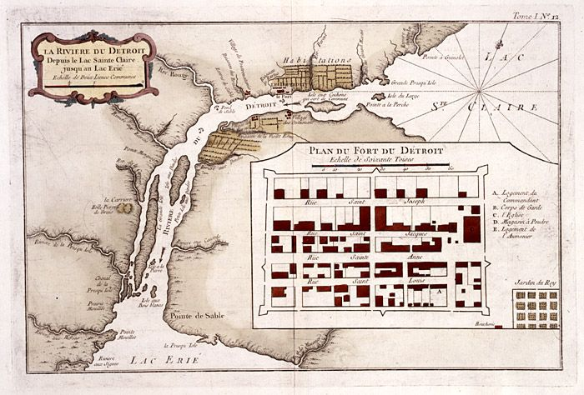
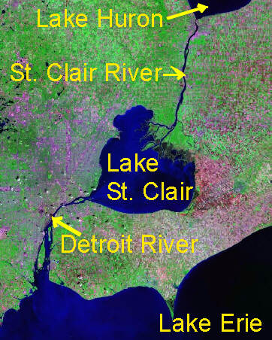
Notes:
Soon, Cadillac proposed to his superiors the erection of a new fort he believed would be far more strategically placed. The location was the strait – or de troit – which separated Lake Huron from Lake Erie. Cadillac explained the region’s importance:

Slide 10
“It is the most important of all the Western passes and the key to the upper great lakes, with the vast countries watered by their tributaries, and it gives Canada her readiest access to the valley of the Mississippi. …”
Notes:
“It is the most important of all the Western passes and the key to the upper great lakes, with the vast countries watered by their tributaries, and it gives Canada her readiest access to the valley of the Mississippi. …”

Slide 11
“If we hold it, the English will be shut out from the Northwest and if, as seems likely, the English should seize it, the Canadian fur trade will be ruined. …”
Notes:
“If we hold it, the English will be shut out from the Northwest and if, as seems likely, the English should seize it, the Canadian fur trade will be ruined. …”

Slide 12
“In addition, possession of it will be a constant curb and menace to the Five Nations [the Iroquois], as well as a barrier between those formidable tribes and the Western Indians, our allies.”
Notes:
“In addition, possession of it will be a constant curb and menace to the Five Nations [the Iroquois], as well as a barrier between those formidable tribes and the Western Indians, our allies.”

Slide 13
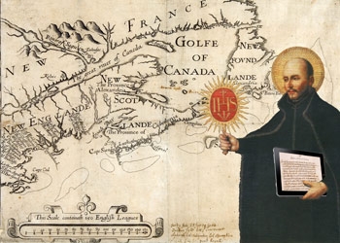
Notes:
Opening this new territory to trade and settlement also presented Cadillac with an opportunity for personal gain. Most of French Canada was owned by the Jesuits. Cadillac knew the new fort would attract settlers and make him a rich landowner.

Slide 14
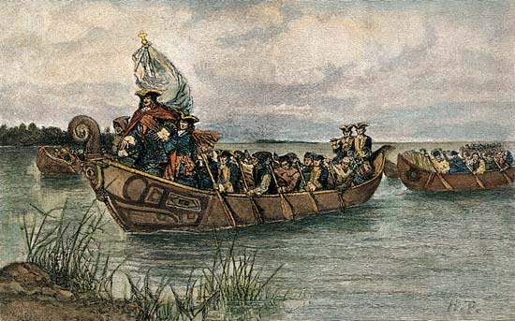
Notes:
In 1698, Cadillac proposed that the de troit region be established as a shelter for displaced Indian allies. The government in Paris approved, and in 1701 Cadillac led a party of 100 Frenchmen to establish a post called Fort Pontchartrain du Détroit, naming it after his sponsor, the Colonial Minister under Louis XIV.

Slide 15
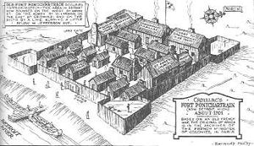
Notes:
The palisade or stockade was constructed of logs vertically driven into the earth about 3 feet, and rising 12 feet into the sky. Two or three gates were built in the palisades. Each corner of the palisade contained a blockhouse for look-out and defense purposes.

Slide 16
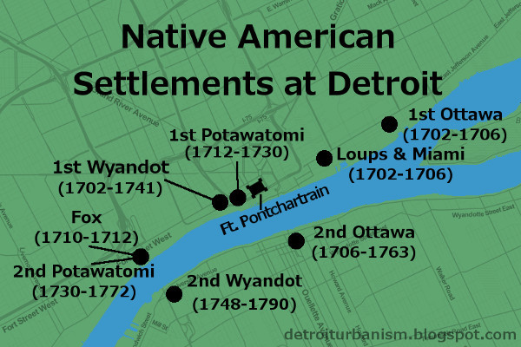
Notes:
Very quickly, the area attracted increasing numbers of Hurons, Ottawas, Chippewas, Miami, Potawatomi, Foxes, Sacs and Mascoutens and small groups from other tribes.

Slide 17
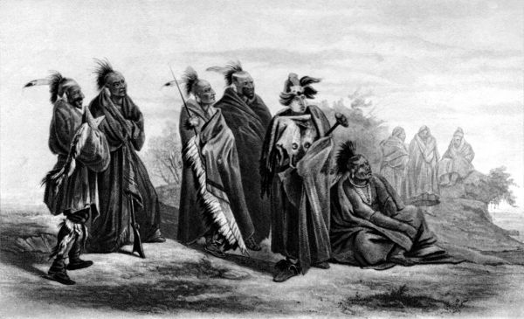
Notes:
Tensions between some tribes escalated, leading to an Ottawa attack on the Hurons and Miamis. When several Frenchmen were killed by the Miamis, Cadillac led a force against them. The Miamis withdrew south to the Ohio River, where they invited English traders to their villages.

Slide 18
Notes:
In 1704 Cadillac was granted ownership of the settlement. Subsequently, an investigation revealed he had used his position to accumulate a sizeable fortune by controlling the supply and price of goods brought in. He was removed and ordered south, to take over as governor of Louisiana.

Slide 19
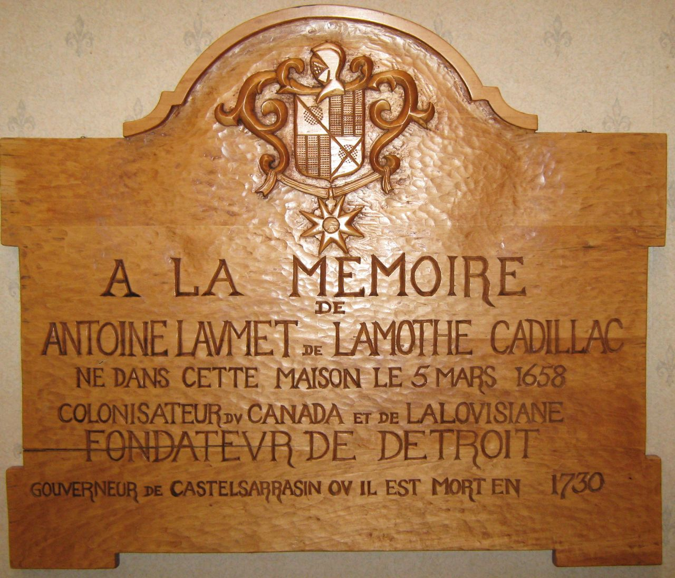
Notes:
However, Cadillac did not proceed directly to Louisiana. In fact, after a brief stop in Quebec — where he submitted desperate (and ultimately rejected) claims to property in Detroit that stretched from Lake Erie to Lake Huron and west from the river for some 700 miles — he returned to France. A few years later he was back in North America exploring along the Mississippi River. He sailed for France in 1717 where he remained until his death in 1730.

Slide 20
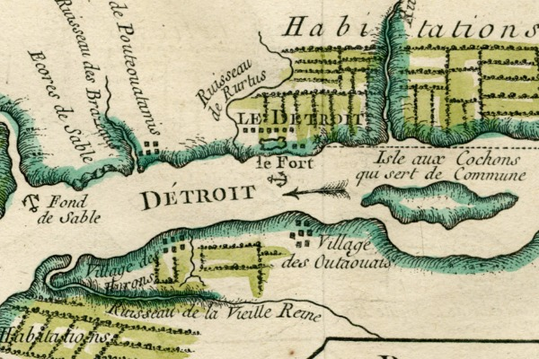
Notes:
French settlement at Detroit was largely confined to the northern bank of the river until much later.

Slide 21
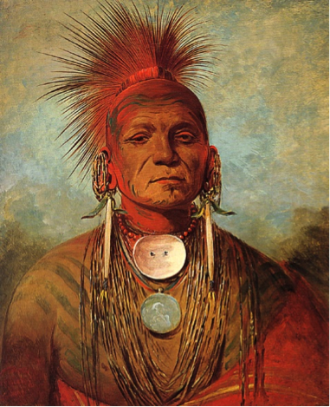
Obwan Diyag
Notes:
The Ottawas established a village on the same side of the river as Detroit, less than a mile upstream. In this village in 1720 a Chippewa woman, married to an Ottawa brave, gave birth to a son who would later come to unite many of the tribes against the encroaching English. He was named Obwan Diyag – the warrior the English called Pontiac.

Slide 22
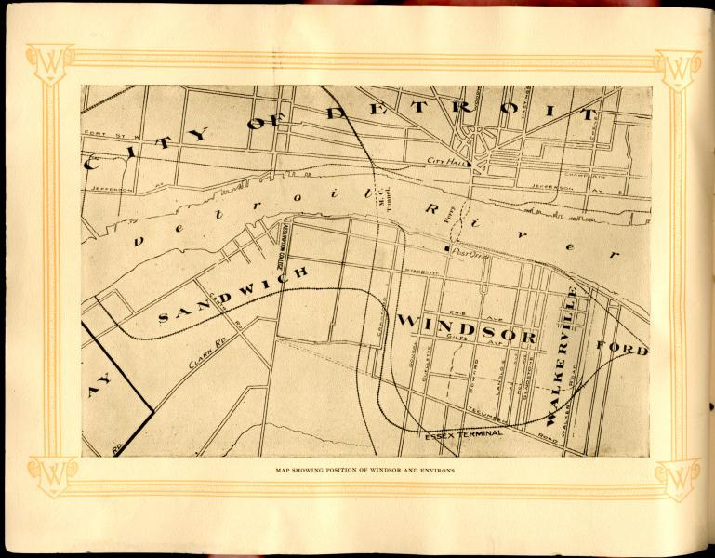
Notes:
In 1748 a Jesuit mission to the Huron Indians was established on the southern bank. Then, from 1748 to 1760, a French agricultural settlement developed along the Windsor side of the river, paralleling a similar settlement on the Detroit side.

Slide 23
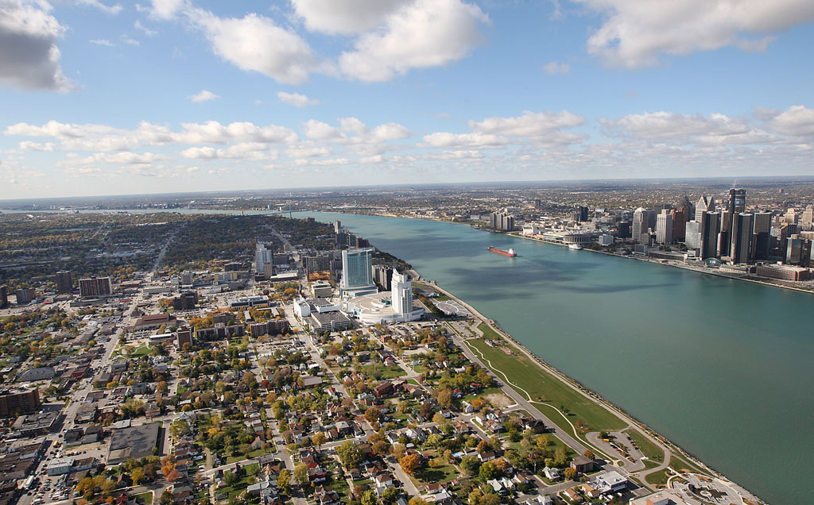
Notes:
Windsor, growing on the southern bank of the Detroit River, is the oldest continually inhabited European settlement in Canada west of Montreal. The area was referred to as "Poverty Coast" because of the sandy soils.

Slide 24
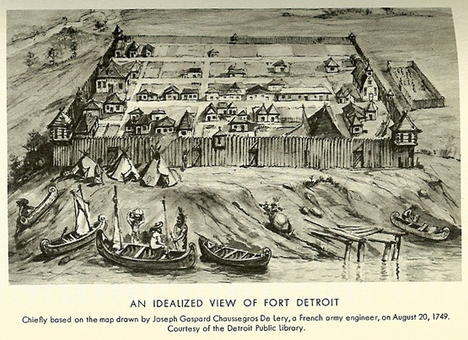
Notes:
Within the fort at Detroit, residential lots were marked out at roughly 25 feet x 25 feet. Houses were only tall enough to just permit standing inside. Roofs consisted of bark or straw, sometimes covered with skins. Most doors were simply propped against the houses as hinges were not available. Most floors consisted of hard-packed earth. A few structures had floors made of logs that were cut flat on one side.

Slide 25
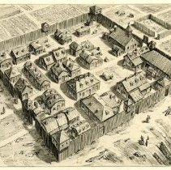
Notes:
There was no glass in the village for a long time, so windows were square open holes covered in thinly scraped skins. Later, windows had wooden shutters, and "Dutch Doors" were added, as were crude chimneys. Gradually, lofts were added with dormer windows. Still later, white-washed clapboard covered the outside and the doors were painted apple green.

Slide 26
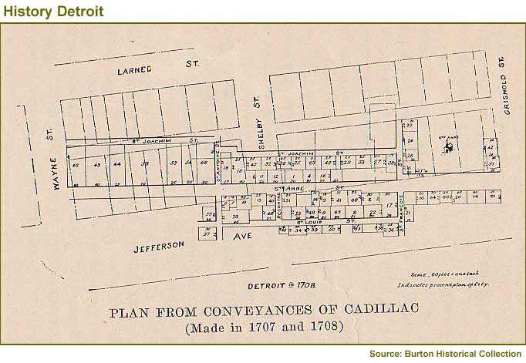
Notes:
In some land conveyances, Cadillac had imposed a condition that the purchaser must join others in setting up a May pole before the house of the Commandant on the first of May in each year to celebrate the end to winter and the arrival of warm weather. Exemption from this condition could be purchased each year upon payment of three livres in money or skins.

Slide 27
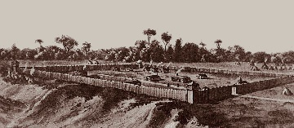
Notes:
Following Cadillac’s departure, conditions deteriorated quickly, and many of the original settlers left, exposing the settlement to attack by hostile tribes.

Slide 28
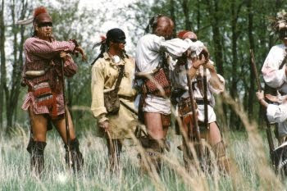
Notes:
In May of 1712, the fort was attacked by a large number of Sacs, Foxes, and Mascoutens. The fort was defended by fewer than forty soldiers. Wyandots and Ottawas allied to the French were away at the time, fighting other tribes in the Mississippi Valley. Runners were dispatched to bring the warriors home, and upon their return a long battle ensued. Eventually, the attackers fled after suffering heavy losses.

Slide 29
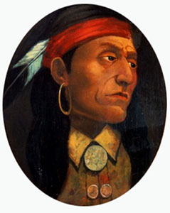
Notes:
Despite the fact that France declared war on Britain in March of 1744, the war did not reach the de troit area until two years later. A force of Chippewas under Chief Mackinac, supported by some Wyandots and Iroquois, came north to attack the fort. Pontiac led the Ottawas against this force and drove them off.

Slide 30
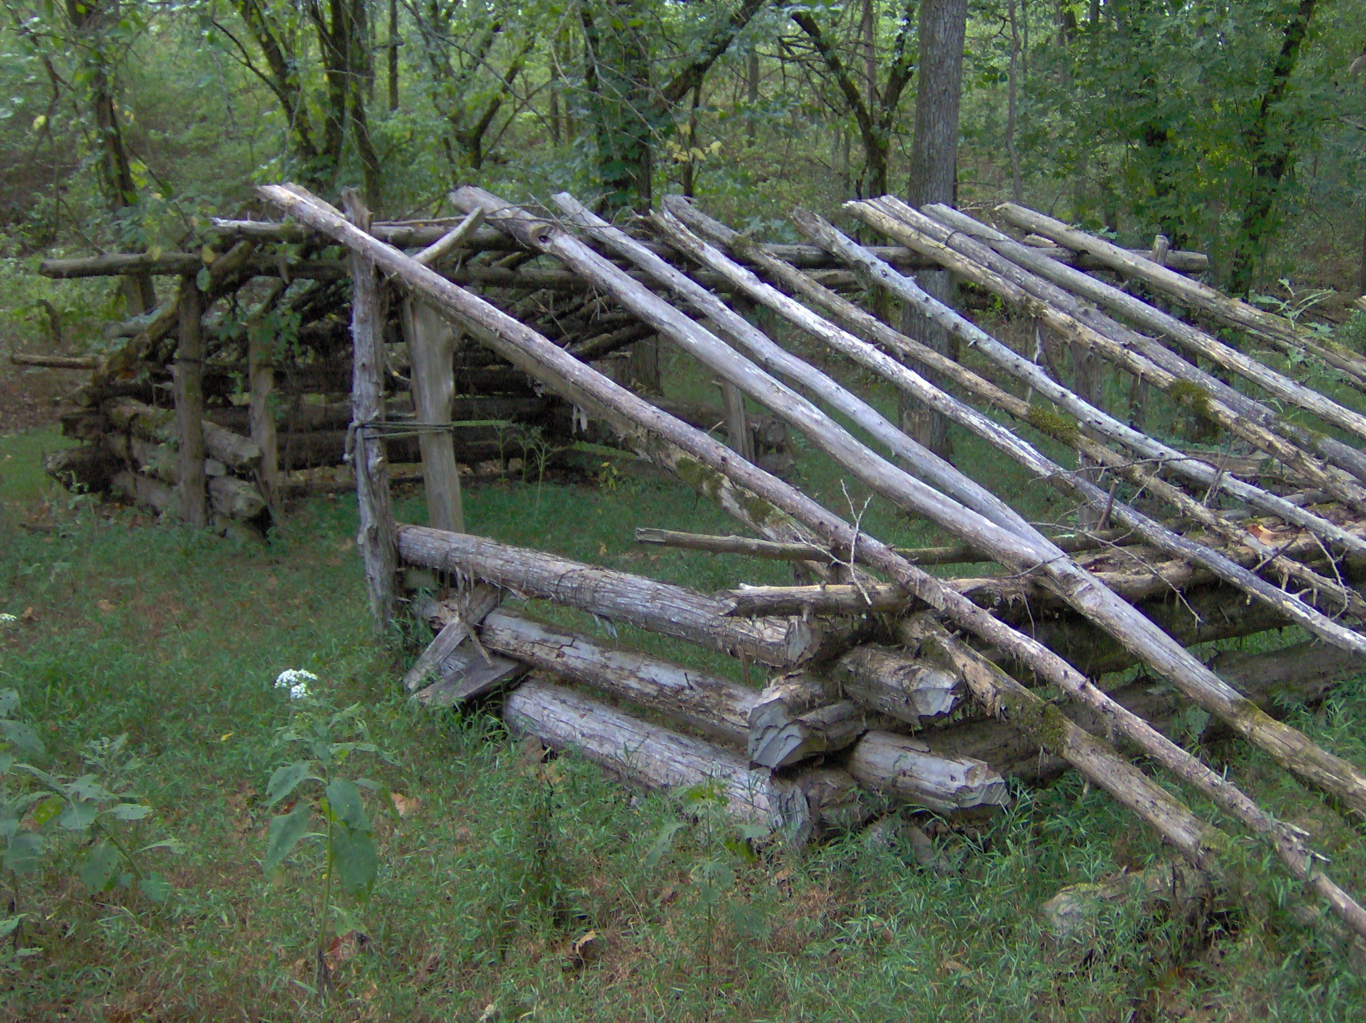
Notes:
In 1750, Pierre Joseph Celoron became commandant of the fort. During this period, the governor of Canada offered incentives to people to settle at the post. Each family was promised a farm, supplies from the military stores, tools, and agricultural supplies. Around 55 individuals responded. However, they had been deceived. The tools were not gifts, but loans that were to be returned once the family was settled.

Slide 31
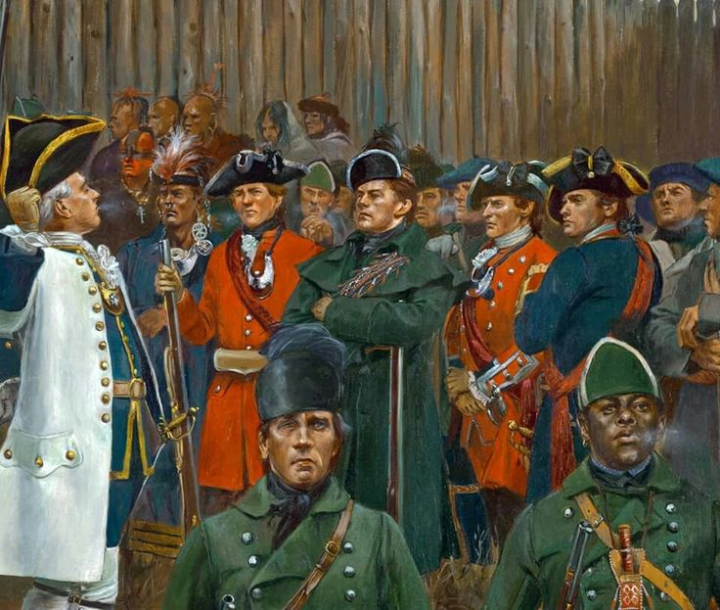
Notes:
During the French and Indian War, the British attacked and took Quebec and Montreal. On November 29, 1760, in pursuance with the articles of capitulation, the British took control of the fort, ending French rule in the region forever. The British shortened the name of the settlement to Detroit.

Slide 32
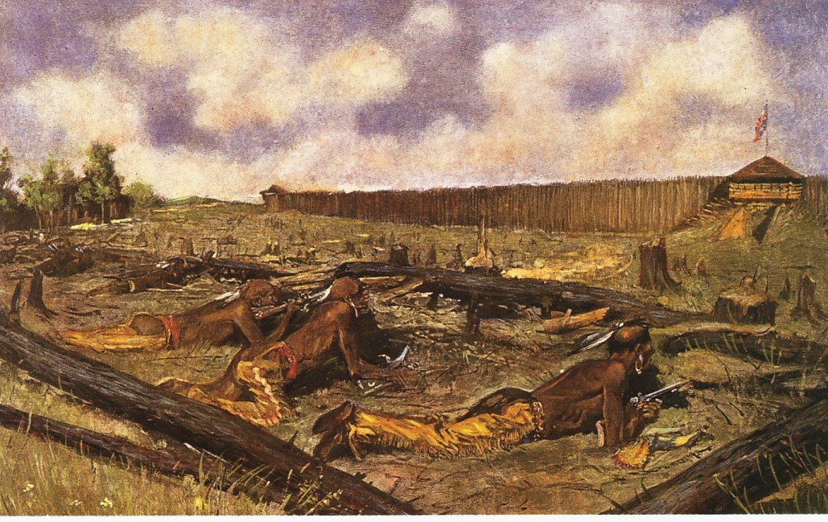
Notes:
Early in May of 1763, Pontiac attempted to take Fort Detroit by surprise, as a main part of his effort to unite the tribes to drive the British military and settlers from lands long claimed by the tribes. Pontiac’s siege of the fort continued until the end of October, ending as warriors returned to their villages for their winter hunts.

Slide 33
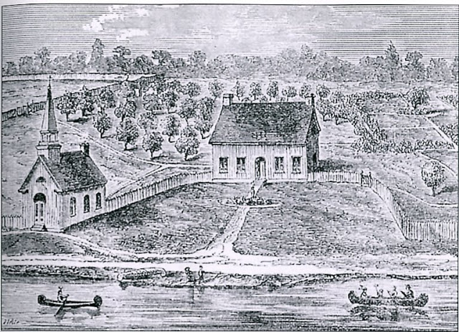
Notes:
Grants of free land attracted families to Detroit, which grew to 800 people in 1765. The main business was trading furs with the Indians, using goods supplied from Montreal. Detroit was now the largest settlement between Montreal and New Orleans.

Slide 34
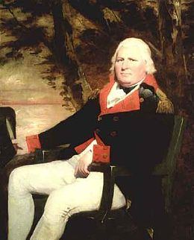
Notes:
In 1775 Henry Hamilton arrived at Fort Detroit to assume his role as Lieutenant Governor and Superintendent of Indian Affairs. Detroit was located in the newly-established Province of Quebec. Hamilton provided arms and ammunition to the northern Huron and Ottawa tribes, encouraging them to conduct raids on American settlements.

Slide 35
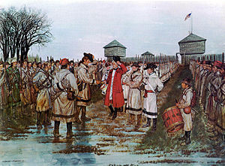
Notes:
In response, George Rogers Clark led his rangers against British posts at Kaskaskia, Cahokia and Vincennes. Hamilton raised a force of 500 British regulars, French militia and tribal warriors to retake Vincennes. Vincennes fell to his force on the 18th of December, 1778. Rogers returned the following February to take Vincennes once more. Hamilton was taken prisoner and escorted to Williamsburg as a prisoner.

Slide 36
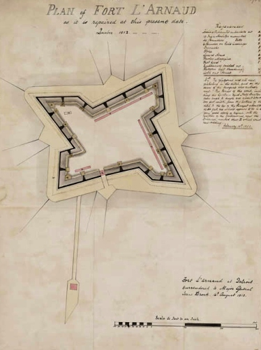
Notes:
To improve the defenses at Detroit, British Major Richard Lernoult ordered his troops to construct a new fort on a hill outside the city. Construction began in November 1778 and was completed by spring. The new fort was a 400 square foot structure ringed by a palisade fence with earth walls between 12 and 26 feet thick. Though hastily constructed, the fort was a formidable defensive structure. It housed close to 400 men and was armed with several dozen cannons .

Slide 37
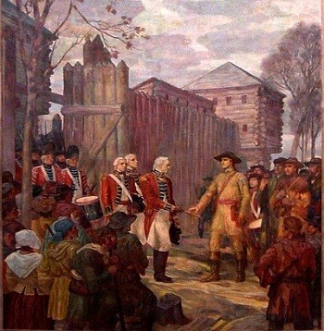
Notes:
The expected attack on Detroit never came, and with the Treaty of Paris in 1783, Detroit passed into the hands of the Americans. The British were slow to surrender the fort and several other outposts in the Northwest Territories. They claimed the fort as compensation for colonial debts. It wasn’t until the Jay Treaty of 1796 that the British agreed to depart.

Slide 38
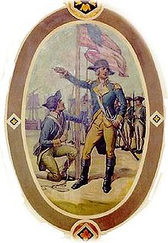
Notes:
On July 10th 1796, the British abandoned the fort and moved their troops to Canada. The following day, American troops arrived at the fort. Finally under American control, the fort was renamed Fort Detroit. The Americans constructed new buildings and made other improvements to the fort.

Slide 39
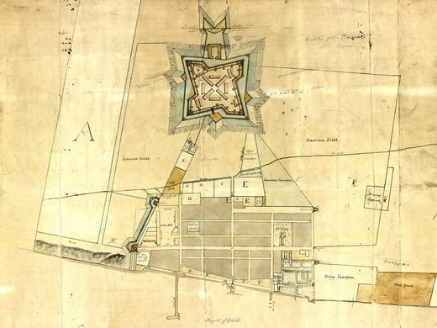
Notes:
During this period, the settlement continued to grow but remained predominantly French in population, and until 1791 French civil law remained in effect.

Slide 40
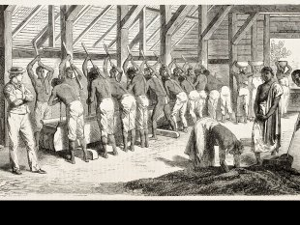
Notes:
Slavery of people of color was also prevalent among the region’s European settlers. William Macomb, described as the wealthiest person in Detroit, held 26 people as slaves. Slavery was as much a part of early Detroit as the fur trade. Most residents who could afford slaves owned them during Detroit’s French, British and early American periods. In 1750, for example, toward the end of the French regime, more than 25 percent of Detroit residents held slaves.

Slide 41
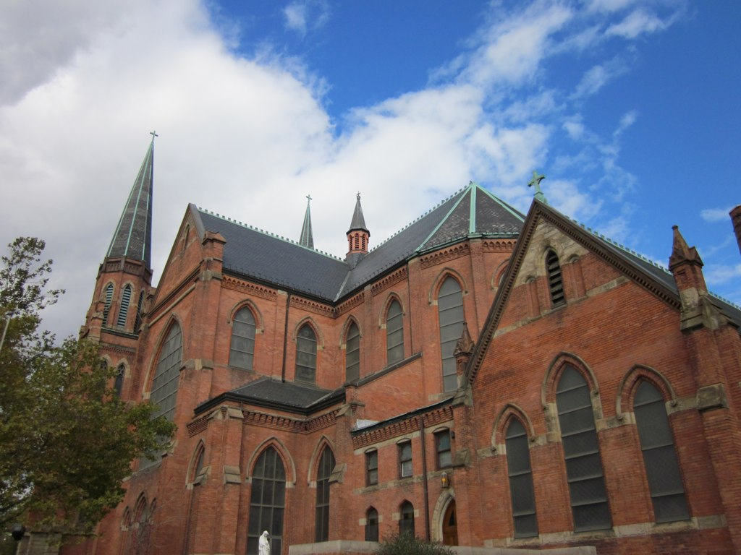
Notes:
The Catholic Church in Detroit was heavily involved in slavery – priests owned slaves and baptized them, and at least one slave worked on the construction of Saint Anne’s Church around 1800. The men who funded the Free Press when it was established in 1831 were ex-slave owners, and the paper supported slavery during the national debate before the Civil War.

Slide 42
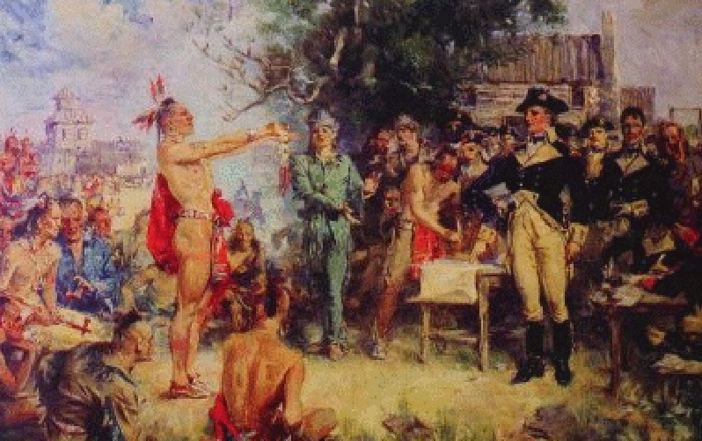
Notes:
Relations between the newly-arrived Americans and the tribes still living in the region broke down in the face of ongoing encroachment of territory the tribes considered theirs. The tribes were defeated in 1794 by an American force commanded by Anthony Wayne.

Slide 43
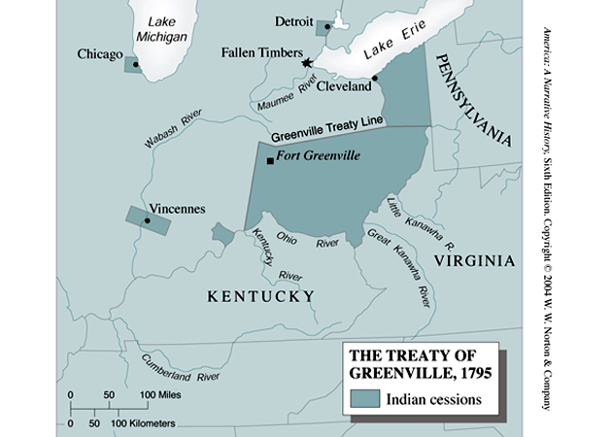
Notes:
The area round Fort Detroit was included in the territory ceded by the tribes signing the Treaty of Greenville.

Slide 44
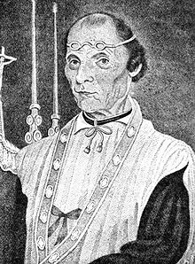
Notes:
A Father Gabriel Richard arrived in 1796, helping to start the school that eventually grew into the University of Michigan. Appointed a territorial representative to the U.S. Congress, Father Richard helped to secure funding for a road-building project that connected Detroit and Chicago.

Slide 45
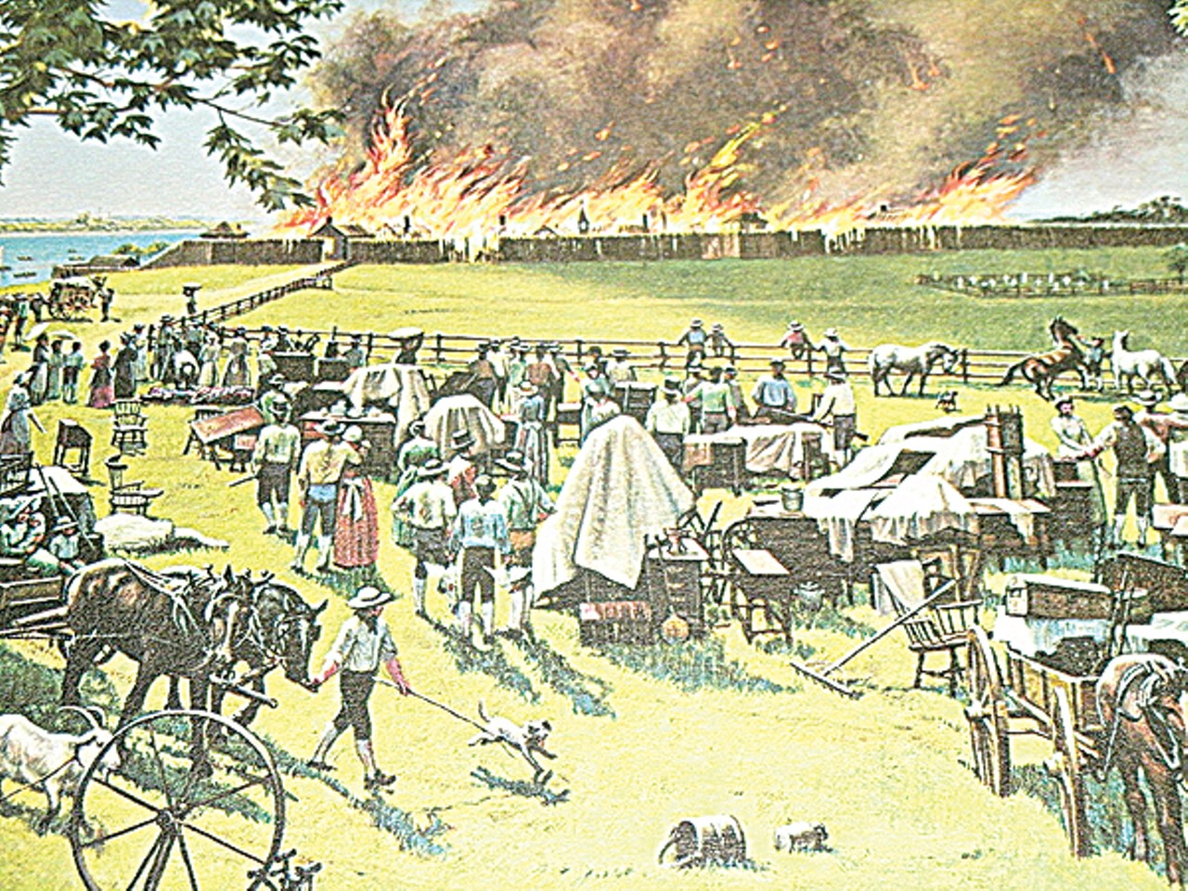
Notes:
On the morning of June 11, 1805, Baker John Harvey accidentally started a fire in his barn. The fire spread quickly, and by the end of the day the entire settlement of Detroit had burned to the ground.

Slide 46
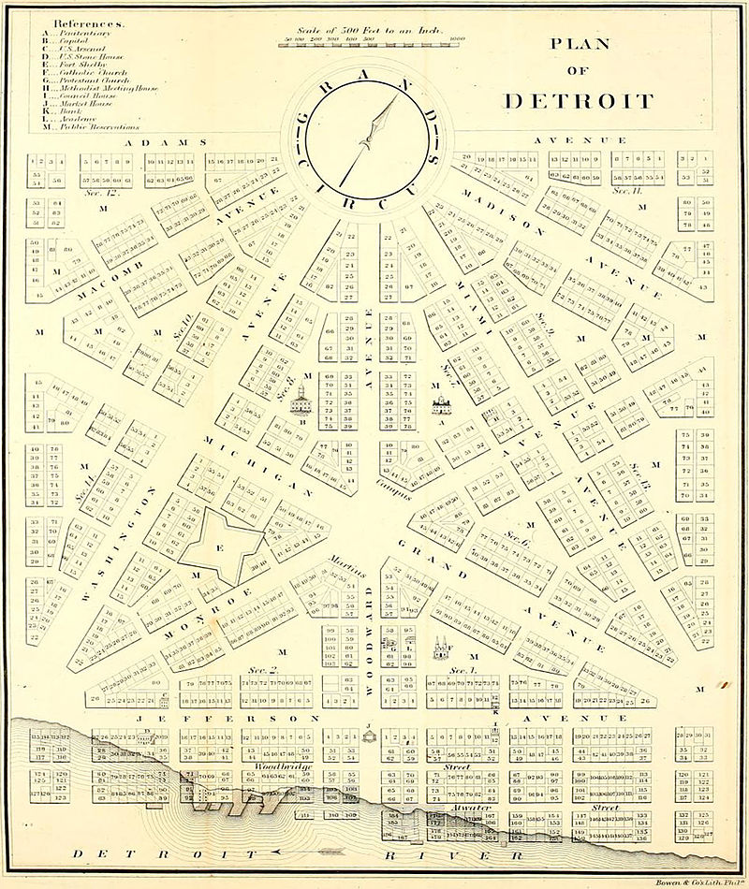
Notes:
After the fire, Augustus Woodward devised a street plan similar to the design for Washington, D.C. The new town included an additional 10,000 acres awarded to residents whose houses had burned in the fire.

Slide 47
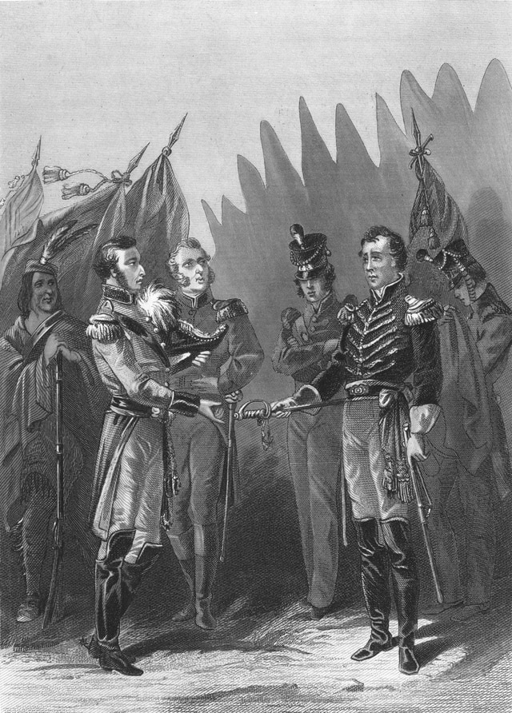
Notes:
Early during the War of 1812, Detroit was surrendered without a fight by U.S. General Hull, who greatly feared the tribal warriors allied with the British. Hull was later convicted of cowardice and sentenced to death by a court martial, but received a presidential pardon.

Slide 48
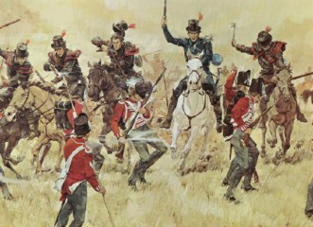
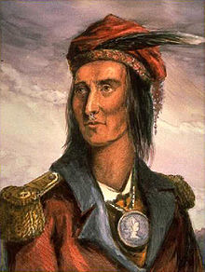
Notes:
The U.S. Army reoccupied the fort in 1813 after the British abandoned it. The Americans then used the fort as a base to invade Canada and permanently end the threat of Indian raids on American settlements. American forces caught up to the escaping British and warriors led by the Shawnee warrior Tecumseh, who was killed during the battle.

Slide 49

Notes:
With the British removed and the threat of tribal attacks ended, Detroit was rebuilt in the early 19th century. A thriving community soon sprang up.

Slide 50

Notes:
By 1860 over 45,000 people were living in the city, primarily spread along Jefferson Avenue to the east and Fort Street to the west.

Slide 51

Charles Trowbridge House (1826)
Notes:
As in many major U.S. cities, subsequent redevelopment of the central city over the next 150 years eliminated all but a handful of the early structures in Detroit. One of the few early residential buildings that survived is the Charles Trowbridge House, constructed in 1826.

Slide 52

Charles Trowbridge
Notes:
Charles Trowbridge moved to Detroit from New York State in 1819, serving first as Deputy United States Marshall and Deputy Clerk of the Court. He studied law, assisted in negotiation of a treaty with the Winnebago and Menominee tribes and was appointed as an interpreter with the Indian department. In 1825 he went to work for the new Bank of Michigan. Then, in 1833 he became an alterman of the city of Detroit. A year later he served as mayor during a cholera epidemic. Until his death in 1883 he was involved in banking and other business and charitable interests.

Slide 53

Notes:
In 1840, planning began for the construction a new fort at the point on the Detroit River closest to Canada. The new fort was named in honor of General Anthony Wayne, whose force defeated the British at the Battle of Fallen Timbers in 1794.

Slide 54

Woodward Avenue Shopping District, 1865
Notes:
The Great Lakes provided a ready-made avenue for international commerce and trade, and Detroit emerged as one of the major industrial and transportation centers. The primary shopping district emerged along Woodward Avenue.

Slide 55

Notes:
In 1889, Detroit’s civic leaders decided it was time to show the rest of the country what their city had to offer. The area west of Historic Fort Wayne, along the Detroit River, became home to the Detroit International Exposition and Fair. The promotional brochure highlighted the city’s locational advantages – its access to rail and water, its public gas and electricity services as well as its growing industrial strength.

Slide 56

Notes:
Population growth pushed development north of the downtown area. This is Woodward Avenue in the 1890s.

Slide 57

Notes:
The late 1800s ushered in the Progressive era in many parts of the United States. In 1889, Hazen Pingree -- strongly influenced in his views on how government ought to raise revenue for public goods and services by Henry George – was elected Mayor of Detroit.

Slide 58

Notes:
Detroit and much of the nation experienced a serious economic crash in 1893. Mayor Pingree organized a program to put the unemployed to work growing vegetables on the city’s vacant lots. Following the advice given in Henry George’s writings, Pingree got the city’s assessors to increase the assessed valuation of land, effectively shifting the source of revenue to those who owned vacant or underdeveloped parcels.

Slide 59

Notes:
Progressives in the Pingree government supported the use of property tax revenue to fund the city’s trolley system, public schools, health care, parks, water and sanitation systems and other services that made Detroit a very livable city. Small businesses flourished, and the city imposed no sales taxes, business profits taxes or individual income taxes.

Slide 60

Notes:
Nearly nine out of ten residents in 1900 lived in single-family homes. German, Polish, and Irish immigrant families came together to assist one another to construct their homes.

Slide 61

Notes:
Then, in 1910, Henry Ford constructed his first automobile assembly plant in Detroit, at Highland Park. Other automobile manufacturers followed, and the Detroit region became the center for not only automobile assembly but the production of automobile parts.

Slide 62

Notes:
Detroit’s industrial prowess was further established in 1919, with the construction of the headquarters for General Motors Corporation.

Slide 63

Notes:
Between 1900 and 1930, the city's population increased nearly five-fold, to over 1.5 million. The city expanded outward, even as developers added new apartment buildings throughout the city to meet the demand for housing by automobile workers.

Slide 64

Notes:
City planners now had to address the problem of traffic congestion, one cause of which was the railway lines that interfered with traffic flow. In 1929, the city constructed this railroad bridge above Chestnut Street to partially solve the problem. Other above-grade bridges were constructed elsewhere in the city.

Slide 65

Notes:
A bridge constructed in 1922 over the Rouge River gave shipping access to the Ford Motor Company River Rouge complex.

Slide 66

Notes:
The success of the automobile industry also created opportunities for immigrants to establish businesses – such as this grocery store established in 1922 at 31st and Herbert Streets – serving immigrant residents living in the area.

Slide 67

Notes:
A growing number of African-Americans were arriving in Detroit as well, seeking opportunity in the expanding factories.

Slide 68

Notes:
In 1919 an African-American team -- The Detroit Stars – began playing in the Negro National League. As the depression deepened, the team was forced to disband in 1931. Two years later a team from Indianapolis was moved to Detroit and played one year before the Depression brought an end to this new team.

Slide 69

Notes:
In just ten years between 1910 and 1920 the population of Detroit doubled, to over 900,000. One result was that ethnic and racial tensions mounted.

Slide 70

Notes:
During the summer of 1921, an African-American physician named Ossian Sweet moved to Detroit to set up a medical practice. His race prevented him from finding employment in a hospital. Yet, Dr. Sweet persevered. He found office space in a pharmacy and began to serve the poor residents of his community. By 1924, Sweet became affiliated with Dunbar Hospital, Detroit’s only hospital treating African-Americans.

Slide 71

Notes:
In 1925, he purchased a property in a neighborhood where no other African-American families lived, and a mob of Whites surrounded his home and began throwing rocks through the windows. Dr. Sweet and others in the home were armed and fired into the crowd, killing one man.

Slide 72


The All-White Jury
Clarence Darrow
Notes:
With support provided by the NAACP, Clarence Darrow agreed to serve as defense counsel. Eventually, the cases against most of the defendants was dismissed. Dr. Sweet and his brother were acquitted.
.

Slide 73

Notes:
The nation’s economic collapse during the 1930s hit Detroit particularly hard, as automobile sales disappeared and large numbers of workers lost employment. The Mayor established an Unemployment Committee and set up relief soup kitchens and potato gardens. By 1933 the city experienced a severe financial crisis and defaulted on its bond payments.

Slide 74


Notes:
In 1931, the Mayor, Frank Murphy, initiated a number of public works projects to help provide jobs and generate economic activity.

Slide 75

Notes:
However, with nothing left in the city’s treasury, Detroit issued its own currency with which to pay the salaries of public employees.

Slide 76

Notes:
Federal assistance finally came through to help city officials fund job-creating public works projects, such as new street-lighting and an expanded sewage system.

Slide 77

Notes:
Yet, even with the Depression, Detroit managed to purchase a new fleet of cars from Chevrolet for its police force.

Slide 78

Notes:
Some minor automobile companies managed to linger on until the late 1930s when their factories were converted to produce military arms.

Slide 79

Detroit -- 1942
Notes:
From 1942 to 1945, production of commercial automobiles in the city ceased entirely, as factories were converted to the assembly of tanks, planes, jeeps, trucks and other military craft.

Slide 80


Notes:
As occurred in other cities, after the end of the Second World War, Detroit’s public transit system – consisting of 30 electric streetcar lines and nearly 550 miles of track – was quickly supplanted by new highways, buses and the automobile. Between the end of the war and 1949, the city discontinued half of its 20 streetcar lines. More closings followed until in 1955, Mayor Albert Cobo pressed City Council to sell the city's recently purchased fleet of modern streetcars to Mexico City.

Slide 81

Notes:
The needs of industry were beginning to change, and by the late 1940s, the City of Detroit was running out of vacant land for new factories.

Slide 82

Notes:
One of the first automobile industry giants to collapse was the Packard Motor Company. By 1957 the company’s Detroit plant was closed. Packard’s designs and tooling were sold to foreign buyers, and Packards continued to be manufactured in Russia for several decades.

Slide 83

Notes:
Designed by Albert Kahn and opened in 1903, Packard’s factory was world-class in its day, consisting of 3.5 million square feet of interior space across 47 buildings. It employed over 40,000 skilled workers on a campus that spanned 35 acres.

Slide 84

Notes:
Detroit’s residents resisted efforts to remove the cities aging housing stock to make room for new factories. And, as there was still a large supply of affordable land at the city’s suburban edge, this is where the new factories and jobs went – and still go, as evidenced by the decision by Chrysler to move it headquarters out of Detroit to the distant suburb of Auburn Hills.

Slide 85




Notes:
Decisions by the United Auto Workers contributed to the exodus. UAW members opposed urban renewal projects and voted for conservative mayoral candidates in order to protect their white neighborhoods from residential integration.

Slide 86

Notes:
Racism and poverty combined in 1967 in what has been described as the most destructive and deadliest riot in the United States.

Slide 87

Notes:
Governor George Romney ordered the Michigan Army National Guard into Detroit. At the end of five days, 2,000 buildings were destroyed and 43 people were dead.

Slide 88

Notes:
After the riot, the Kerner Commission reported that their survey of African-Americans in Detroit found universal dissatisfaction with discrimination they experienced in policing, housing, employment, spatial segregation within the city, mistreatment by merchants, shortage of recreational facilities, poor quality of public education, limited access to medical services, and how Federal funds were used under “war on poverty” programs.

Slide 89

1900
1950
2000
Notes:
A 2014 study published by the Brookings Institute found that Detroit experienced the most serious loss of employment to the surrounding region of all major metropolitan areas in the United States. Even so, the population of the Detroit metropolitan region has declined by 1.2 percent since 1970.

Slide 90

Notes:
The departure occurred even as the city’s planner, Charles Blessing, attempted to reshape the city’s physical appearance.

Slide 91

Notes:
Lafayette Park, located in Detroit’s lower east side just north of downtown, was the first urban renewal project in the United States. The 78-acre housing development, which includes two residential high rises, town homes, a shopping center and a park, was built on the land cleared when the Black Bottom neighborhood was razed in the 1960s.

Slide 92

Notes:
Today, there is renewed demand for these properties. Town homes with three bedrooms and 1,400 square feet of space are are now selling for over $300,000.

Slide 93

Notes:
A major reason Lafayette Park continued to thrive even as much of Detroit did not was its land use plan. City streets were not allowed to pass through, which allowed the creation of a large central park and a network of walking paths.

Slide 94

Notes:
Elsewhere, residential properties in the neighborhoods of Detroit were gradually, then rapidly, abandoned. Retail and other businesses left as the prospect of profit disappeared. And, of course, revenue from the taxation of real estate evaporated.

Slide 95

Notes:
Publicly-funded freeway construction facilitated the out-migration of people to the suburbs. Young adults were lured by new housing and public schools.

Slide 96

Notes:
One of the suburban communities to which people and businesses moved to is the City of Southfield.

Slide 97

Notes:
Southfield Township is adjacent to the City of Detroit’s north side. Most of what was left of the township was formally incorporated as a city in 1958, as civic leaders sought to protect the area from annexation attempts by the city of Detroit.

Slide 98

Notes:
A key figure in the growth of Southfield was S. James Clarkson, who served four terms as mayor. In a speech he delivered in 2001, he recalled one of the most important steps he took to stimulate the city’s economic growth:

Slide 99
“When I became Mayor of Southfield, I discharged the assessor and appointed an assessor by the name of Ted Gwartney who favored land value taxation. ...After a complete reappraisal of all of the land in Southfield that had been appraised lower than the improvements, the result for most residential taxpayers was that taxes went down.”
Notes:
“When I became Mayor of Southfield, I discharged the assessor and appointed an assessor by the name of Ted Gwartney who favored land value taxation. ...After a complete reappraisal of all of the land in Southfield that had been appraised lower than the improvements, the result for most residential taxpayers was that taxes went down.”

Slide 100

Notes:
The very simple process of assessing the land in Southfield at its actual market value, even though the city imposed the same rate of taxation on the assessed value of land as on buildings, was enough to bring more of Southfield’s land to its highest, best use.

Slide 101

Notes:
And yet, with Southfield as a strong example of a better way to raise revenue for public goods and services, the civic leaders of Detroit failed to see the connection and use changes in tax policy to stem the outflow of people, of businesses or of financial resources.

Slide 102

Notes:
Today, roughly one-fourth of Detroit’s 139 square miles is vacant..

Slide 103

Notes:
An estimated 200,000 parcels of land in the city and surrounding region were vacant in 2012. A year later, the City Council passed a zoning ordinance allowing agriculture within the city limits.

Slide 104




Notes:
Today, in 2018, as a result, urban agriculture has become the highest, best use of a large portion of the land of Detroit.

Slide 105

Notes:
In recent years, urban farming has coalesced into a more organized movement. The Garden Resources Program supports some 1,400 farms and gardens in Detroit.

Slide 106

Notes:
Civic leaders in Detroit are trying to plan for a very different future. Detroit still draws fans downtown to its new baseball park to watch the Detroit Tigers.

Slide 107

Notes:
Land was cleared to construct Ford Field, home of the Detroit Lions National Football League team. Opened in 2002, the stadium cost an estimated $430 million to build, financed largely through private money, public money, and the sale of the naming rights.

Slide 108

Notes:
Detroit is rebuilding and changing direction. Eric Larson, is principal of a large real estate group and CEO of the Downtown Detroit Partnership, which broke ground in 2015 on city-owned land for a $650-million arena and entertainment district. He described the hoped-for impact:

Slide 109

"It is more critical mass of activity and development than the city has seen in a very very long time. In a lot of ways, quite frankly, we're building the equivalent of a small city within the downtown. So it is very significant.“
Notes:
"It is more critical mass of activity and development than the city has seen in a very very long time. In a lot of ways, quite frankly, we're building the equivalent of a small city within the downtown. So it is very significant.”

Slide 110





Slide 111

Notes:
Another major construction project planned is a new International Trade Crossing bridge between Detroit and Windsor.

Slide 112

Notes:
So, for the people of Detroit, their story is still being written. Will its leaders finally come to an understanding of how to attract people and businesses back to the city? Will they take a page out of former Mayor Pingree’s book and look once again to the ideas of Henry George to rebuild their city?

Slide 113

Notes:
Or, will land owners and speculators end up as the primary beneficiaries of the huge public and private investment undertaken.

Slide 114

Notes:
Or, will much of the city revert permanently to agriculture or even wilderness?

Slide 115

The End

