Slide 1


BUILDING MOMENTUM TO A GLOBAL ECONOMIC COLLAPSE The Untold Story of the Inevitable Consequences of Centuries of Entrenched Privilege
EPISODE 5

Slide 2
Coming Unglued – The Bush Legacy

Slide 3
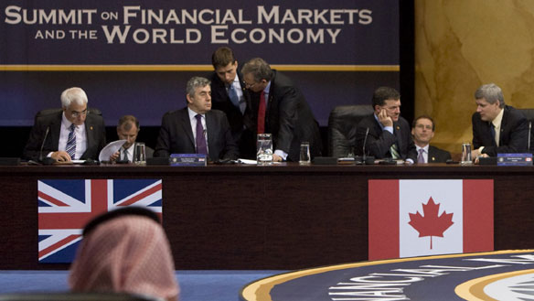
Written by
Edward J. Dodson, M.L.A.

Slide 4
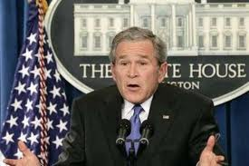
Notes:
4
As George Bush entered the final months of his Presidency, the financial markets of the United States collapsed. The President addressed the nation on the 19th of September:

Slide 5

“There will be ample opportunity to debate the origins of this problem. Now is the time to solve it. Our system of free enterprise rests on the conviction that the federal government should interfere in the marketplace only when necessary. …”
Notes:
5
“There will be ample opportunity to debate the origins of this problem. Now is the time to solve it. Our system of free enterprise rests on the conviction that the federal government should interfere in the marketplace only when necessary. …”

Slide 6
“Given the precarious state of today's financial markets -- and their vital importance to the daily lives of the American people -- government intervention is not only warranted, it is essential.”
Notes:
6
“Given the precarious state of today's financial markets -- and their vital importance to the daily lives of the American people -- government intervention is not only warranted, it is essential.”

Slide 7
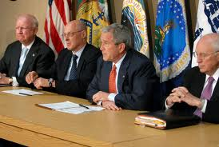
Notes:
7
For six years, the President, his economic advisers, the regulators and the U.S. Congress all missed or ignored the building signals of the crisis that now enveloped the nation.

Slide 8
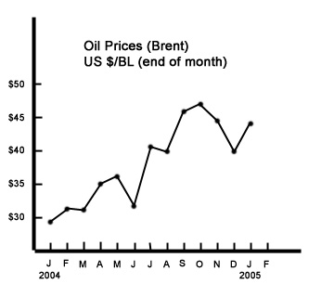
Notes:
8
By the end of 2004, government reports were declaring the U.S. economy robust, with a rate of growth at nearly 4 percent. The Commerce Department indicated businesses were spending more on capital investment and were building up inventories. These signs convinced most economists the U.S. would not be pulled into another recession by the rise in oil prices that occurred earlier in 2004.

Slide 9
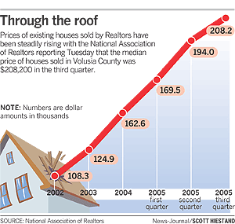

Notes:
9
Just a year later growth stalled. A growing number of economists were new warning of a property market bubble, and the national median price of new homes actually declined for the first time in years. Also during 2005 the automobile industry experienced a decline in sales after eliminating general incentive programs.

Slide 10

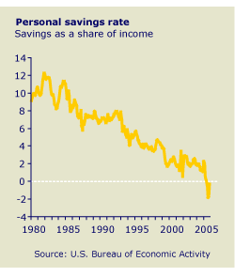
Notes:
In 2006, as the first boomers turned 60, personal savings was reported to be negative for the first time since the great depression.

Slide 11



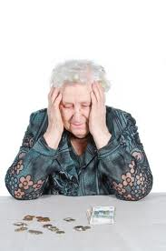
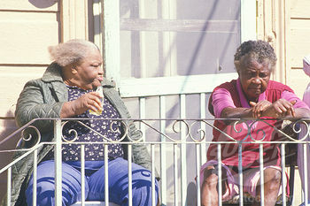
Notes:
11
As interest rates fell so did the interest income received by the nation’s households with savings and money market fund accounts. Many retirees experienced significant declines in investment-derived income, causing for some sufficient financial stress they were forced to sell their residence – downsizing or relocating to a lower cost region of the country.

Slide 12

Notes:
12
Roughly a half million American retirees have left the United States altogether to live in Mexico, Costa Rica or other countries where American enclaves were being established.

Slide 13
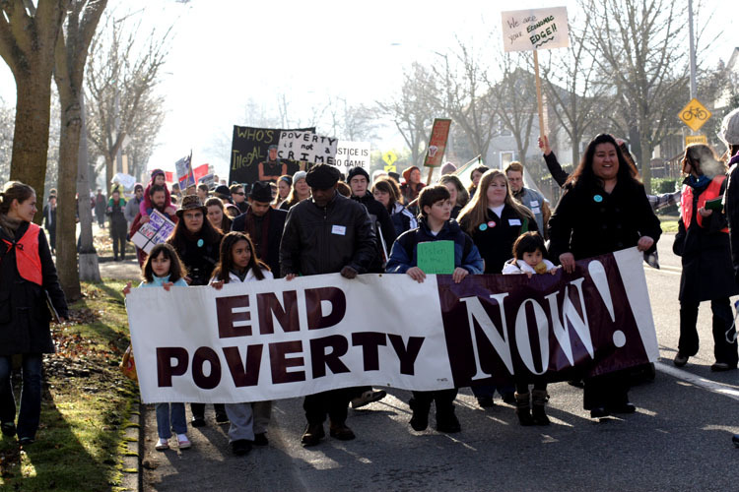
Notes:
13
Most vulnerable to even minor financial setbacks were an estimated 35 million people categorized as poor by the U.S. government.

Slide 14
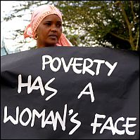
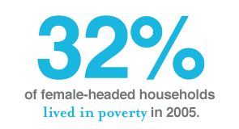
Notes:
14
The primary reasons why some children are poor is that they are part of families where the adults are not employed full-time or not regularly employed or reside in single-parent homes; some 1.3 million children are born out of wedlock each year. And, the most important variable determining child poverty is living in a female headed household.

Slide 15

Notes:
To supplement declining income, a growing number of seniors were trading property equity for a reverse mortgage.

Slide 16
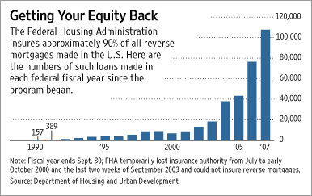
Notes:
Reverse mortgage volume increased steadily, from 37,000 loans in 2004 to 107,000 in 2007. Despite the credit crisis and tightening credit requirements in the mortgage market, the Department of Housing and Urban Development reported that over 115,000 HECMs closed during 2008.

Slide 17


Notes:
17
This indicates that despite falling property values, many seniors continued to have sufficient equity positions to trade that equity for income. Miami, Los Angeles and Tampa were the top 3 markets for reverse mortgages.

Slide 18
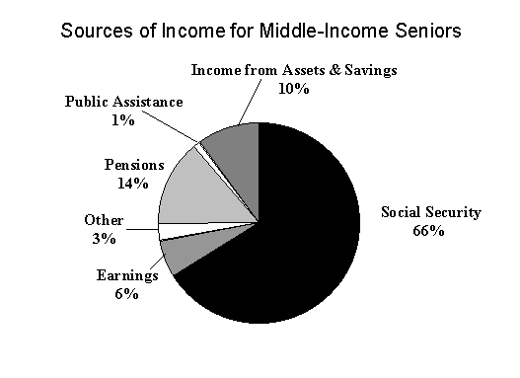
Notes:
Low income homeowners and renters faced rising costs of living but stagnant or falling incomes. The great majority of seniors received relatively little income from pensions or investments. Rather than a safety net, Social Security benefits represented two-thirds or more of the household income of seniors.

Slide 19





Notes:
Then, in the midst of these mounting stresses on the U.S. population, financial institutions and Wall Street investment firms created an entirely new market for private placement mortgage-backed securities, collateralized by a class of mortgage loans yielding high nominal returns but originated with minimal or nonexistent criteria for creditworthiness. Misrepresentation and fraud were commonplace.

Slide 20
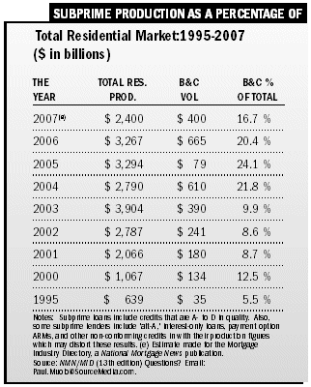
Notes:
Aggressive telemarketing, television and radio advertising, and internet marketing generated an explosion in the subprime mortgage market -- from a 5.5% share in 1995 to 16.7% in 2007.

Slide 21
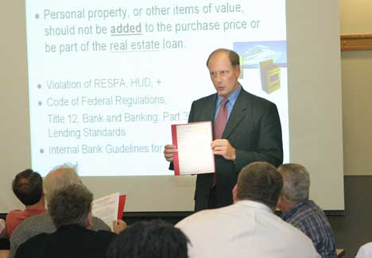
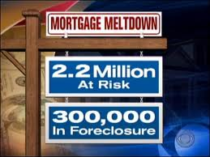
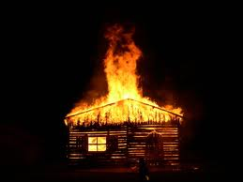
Notes:
One concern of regulators was the high number of borrowers qualified for prime loan terms who were processed as subprime borrowers because of mortgage broker fees tied to higher interest rates and loan volume objectives. Millions of other borrowers were at risk for default from the outset.

Slide 22
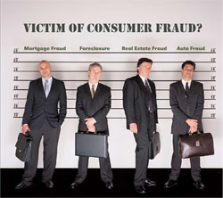
Notes:
22
Yet, state banking commissioners and other regulators were slow to intervene on behalf of consumers.

Slide 23
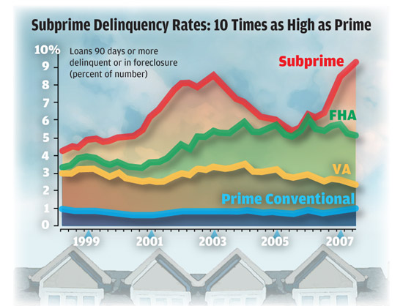
Notes:
With property values continuing to climb, investors and the bond rating agencies ignored rising delinquency rates.

Slide 24

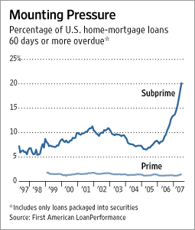
24
Notes:
24
High and growing unemployment caused many subprime loans to become delinquent in Ohio, Michigan and other distressed regions of the country.

Slide 25

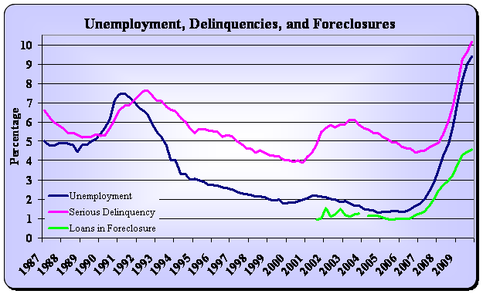
Notes:
25
Once the U.S. economy was pulled into a downward spiral and unemployment rose, the number of foreclosures against homeowners who obtained conventional mortgage financing escalated, increasing by more than 20 percent between 2007 and 2008.

Slide 26
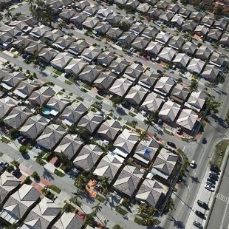
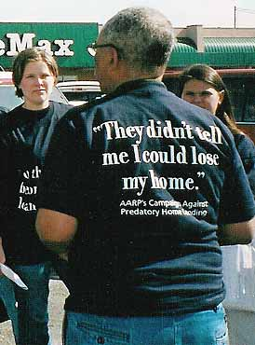
Notes:
26
California, Nevada, Florida, Arizona and Washington were the states with the highest incidence of predatory lending practices.

Slide 27
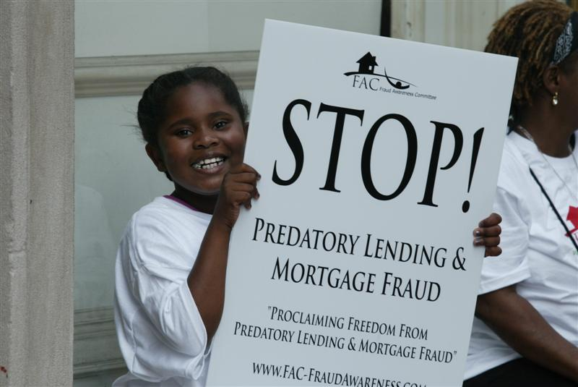
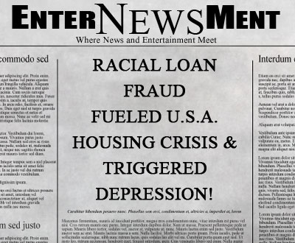


Notes:
One recent study, reviewing the accuracy of income and employment information provided by borrowers, found that one in four mortgage loans involved serious misrepresentation. The worst states, including California, Nevada, Arizona, New York, Illinois, Ohio and Michigan, averaged an incredible one in three cases.

Slide 28

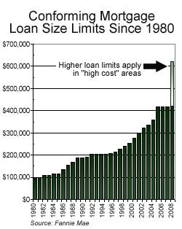

Notes:
Fannie Mae and Freddie Mac were essentially forced by competitive pressures to annually increase maximum loan limits, exposing the two GSEs to higher and higher risks when borrowers defaulted and properties were later sold. As property prices climbed, reflecting the skyrocketing increase in land prices, mortgage investors were financing more and more land and less and less housing.

Slide 29

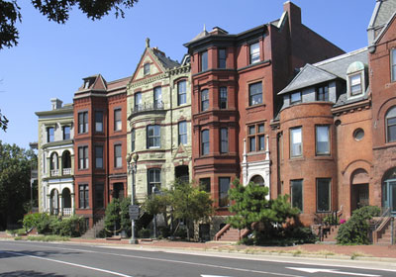


Notes:
29
Land-to-total value ratios in many markets consistently exceeded 50 percent. Existing residential properties in the most highly speculative markets (e.g., Manhattan, San Francisco, Boston, or Washington, D.C.) frequently involved land valued as high as 80-85% of the total price.

Slide 30
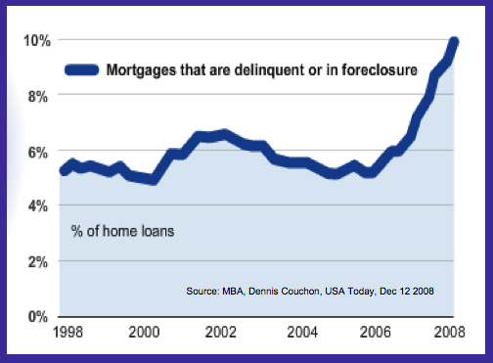
Notes:
30
As the collapse of the financial markets made its way through the economy and unemployment increased, so did conventional mortgage loan delinquencies.

Slide 31
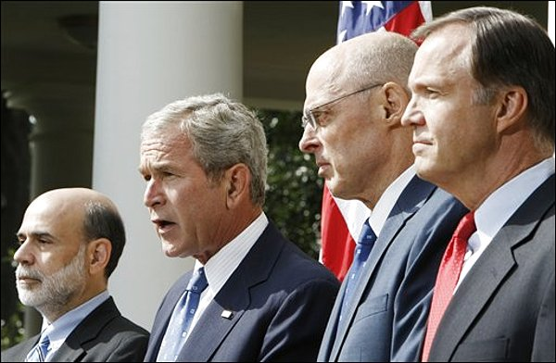
Notes:
31
As George Bush prepared to leave office, the United States economy threatened to implode. Late in September, the President urged the Congress to approve a $700 billion bailout plan, admitting:

Slide 32
“We’re in the midst of a serious financial crisis, and the federal government is responding with decisive actions.”
Notes:
32
"We're in the midst of a serious financial crisis, and the federal government is responding with decisive actions.”

Slide 33
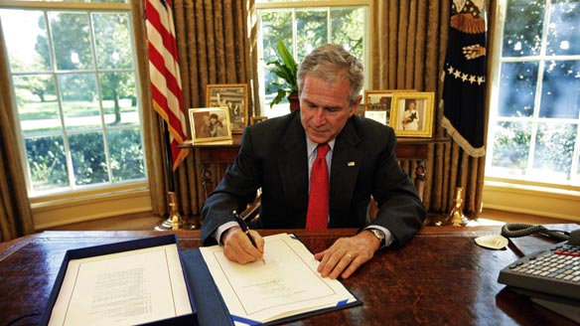
$700 BILLION FOR THE FIRE SECTOR
(finance, insurance and real estate)
Notes:
The trouble was, the decisive actions put forward by the Bush administration addressed symptoms only. The underlying systemic causes of the crisis were neither acknowledged nor understood. These problems would have to wait for the return of a Democratic Party majority in the Congress and Barach Obama in the Office of the President – if, in fact, they actually went in search of solutions rather than mitigations. Episode 6, the final episode in this series, takes us into the Obama Presidency and the escalating expenditures made to stabilize and restart the nation’s economic engine.

Slide 34
End of Episode 5

