Slide 1


BUILDING MOMENTUM TO A GLOBAL ECONOMIC COLLAPSE The Untold Story of the Inevitable Consequences of Centuries of Entrenched Privilege
EPISODE 4

Slide 2
Clinton’s Third Way

Slide 3
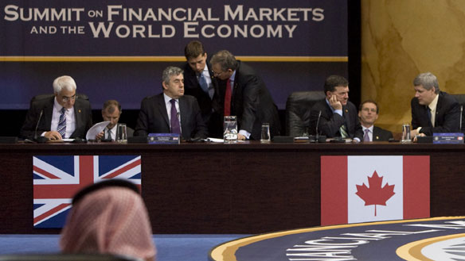

Written by
Edward J. Dodson, M.L.A.

Slide 4
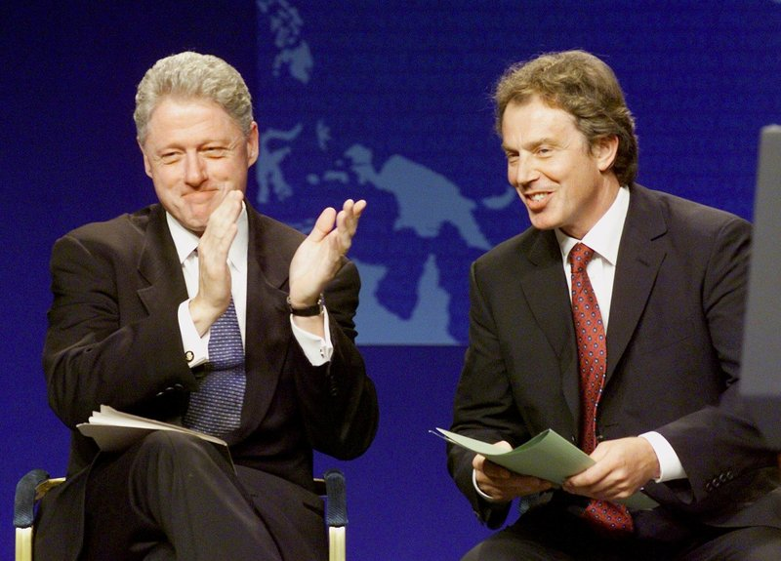
Notes:
The combined impact of the 1987 stock market crash, the subsequent property market downturns and the closing of hundreds of financial institutions set the stage for a change in leadership of the U.S. Presidency. Similar conditions brought Tony Blair into power as Prime Minister of Britain.

Slide 5

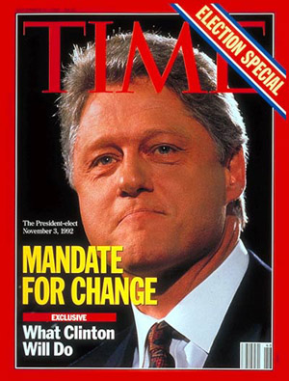
Notes:
Campaigning for the Presidency, Bill Clinton told an audience at the Wharton School at the University of Pennsylvania that the economy hadn't really been working since the early 1970s, that the recession had simply aggravated problems that existed long before George H. W. Bush took office.

Slide 6
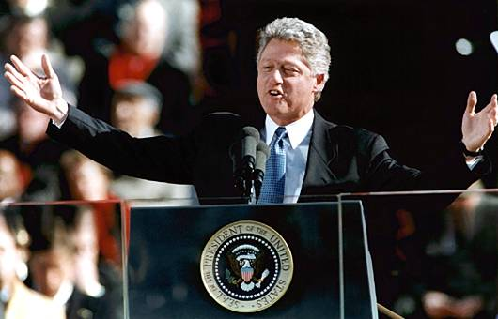
“Even when the Bush recession ends, most Americans will find themselves worse off.”
Notes:
"Even when the Bush recession ends," Mr. Clinton said, "most Americans will find themselves worse off.“

Slide 7
“We’re Eisenhower Republicans here. We stand for lower deficits, free trade, and the bond market.”
Notes:
Yet, not long after the election, Clinton declared: "We're Eisenhower Republicans here. We stand for lower deficits, free trade, and the bond market." Campaign promises aside, Bill Clinton immediately adopted the economic policies of a fiscal conservative.

Slide 8

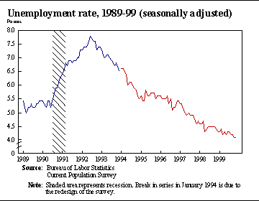
Notes:
The official statistics stated that between 1993 and 2000, the unemployment rate fell steadily from 7.5 -- 4.0 percent. Yet, many workers were, in fact, underemployed and experiencing declining incomes and benefit packages.

Slide 9

Notes:
The official inflation rate, reported to be 1.6 percent for 1998, ignored what was happening to land prices and the effect on property prices, which were escalating at a much higher rate. Production of goods of high quality now came out of countries with lower wage and lower land costs, establishing global prices U.S.-based firms had to meet or lose market share.

Slide 10

Notes:
The U.S. was absorbing large numbers of unskilled immigrant laborers who could not command high wages for their services, allowing some businesses to at least maintain profit margins in the face of rising land costs.

Slide 11

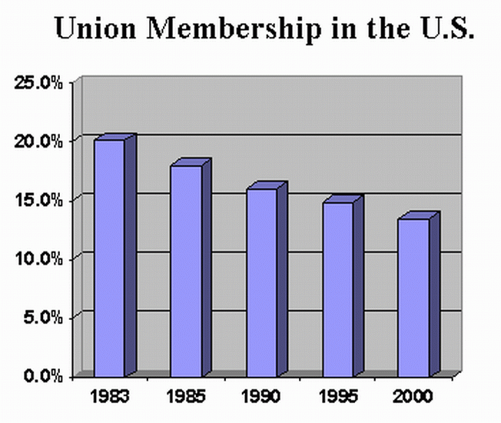
Notes:
Global competition also weakened the negotiating strength of labor unions, as heavy industry and manufacturing firms faced with high labor costs and high land costs threatened to move to other regions or other countries unless concessions were made.

Slide 12

Notes:
Borrowing against rising home equity stimulated a resurgence in consumer spending. Simultaneously, however, the nation entered a period of frenzied property speculation that, when the current land market cycle peaked, resulted in a collapse that too many analysts believe has been averted. The problem is that the need for systemic reforms have not been addressed.

Slide 13

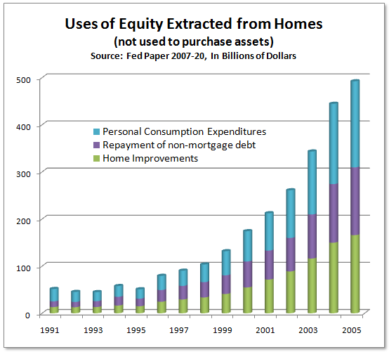
Notes:
A sustained period of low interest rates triggered an explosion in the volume of home equity mortgage loans – for purposes of debt consolidation, home improvements, college tuition for children or to cover uninsured medical expenses.

Slide 14

Notes:
Credit card debt also exploded for those who did not own a home or owned a home already heavily mortgaged.

Slide 15
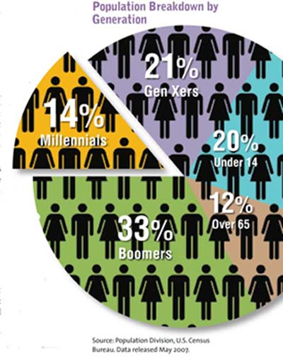
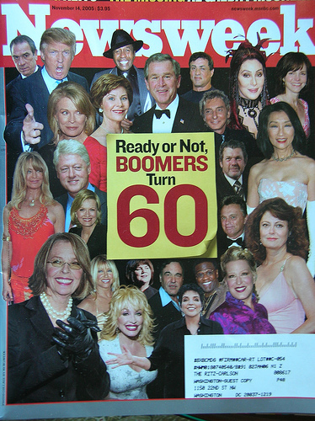
Notes:
A number of demographic patterns were also having a significant impact on the U.S. economy.

Slide 16

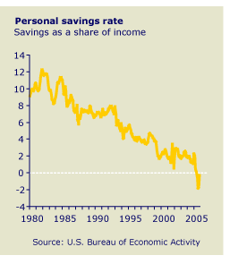
Notes:
Household savings was in a continuous downward slide throughout the 1980s that continued during the Clinton Presidency and after.

Slide 17

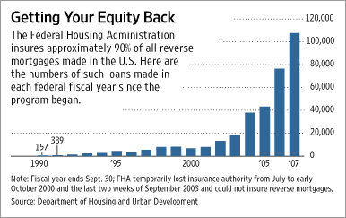
Notes:
The need for income by seniors created a growing market for reverse mortgages, most of which were made under the government-insured Home Equity Conversion Mortgage program, developed by the Federal Housing Administration. Volumes remained low during the Clinton years, as seniors only gradually became more comfortable with giving up equity in their property in return for income.

Slide 18
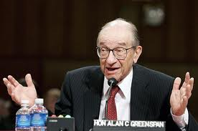
Notes:
In 2004, Alan Greenspan, still serving as Chairman of the Federal Reserve Board, looked back on the decade of low interest rates:

Slide 19
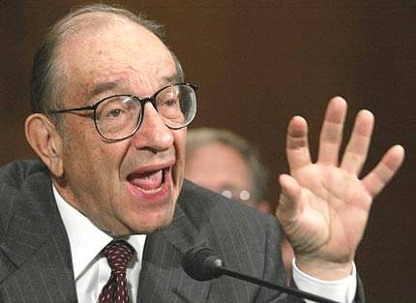
“Indeed, the surge in mortgage refinancing likely improved rather than worsened the financial condition of the average homeowner…”
Notes:
“Indeed, the surge in mortgage refinancings likely improved rather than worsened the financial condition of the average homeowner. ...”

Slide 20
“Some of the equity extracted through mortgage refinancing was used to pay down more expensive, non-tax-deductible consumer debt or used to make purchases that would otherwise have been financed by more expensive and less tax-favored credit.”
Notes:
“Some of the equity extracted through mortgage refinancing was used to pay down more expensive, non-tax-deductible consumer debt or used to make purchases that would otherwise have been financed by more expensive and less tax-favored credit.”

Slide 21
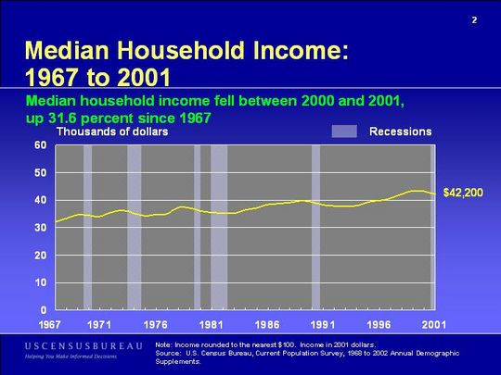
Notes:
Refinancing to lower mortgage payments certainly improved – at least temporarily – the financial well-being of millions of homeowners. However, too many individuals were relying heavily on new debt to maintain their lifestyles in the face of rising costs – because income was not keeping pace.

Slide 22

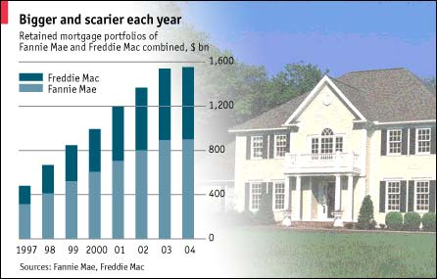
Notes:
Throughout the 1990s the purchase of mortgage loans and the issuance of mortgage-backed securities by the Fannie Mae and Freddie Mac skyrocketed as refinancings and new home sales rebounded.

Slide 23
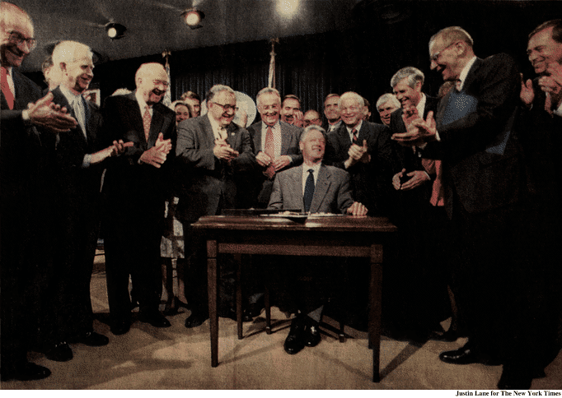

President Clinton signs the repeal of the Glass-Steagall Act
Notes:
A major factor in the growth of the securitization market was repeal of the Glass-Steagall Act of 1933, permitting commercial and investment banks to consolidate. Banks also went on a spending spree purchasing finance companies that specialized in second mortgage lending.

Slide 24

Notes:
Banks also went to a spending spree purchasing finance companies that specialized in second mortgage lending. Another minor trigger occurred in late 1999, when stock analysts begin to pull investors out of the high tech stocks, particularly those of start-up internet businesses, in favor of bank stocks and indexed bond funds.

Slide 25

Notes:
In early 2000 the NASDAQ fell from 5,000 to 2,000 and by 2002 stabilized at around 800. Investors rapidly moved their financial reserves from the stock market and into income-producing property, real estate investment trusts and land. High income investors were acquiring farms, driving up the price of agricultural land in many of the best farming regions of the United States.

Slide 26

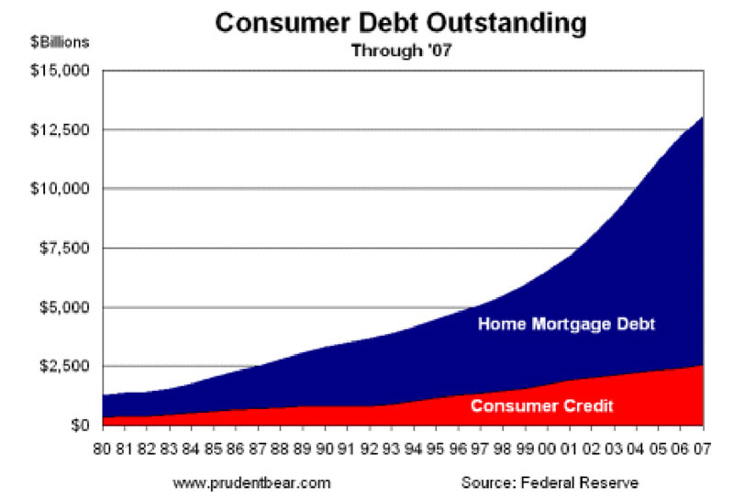
Notes:
At the other end of the population, household debt as a percentage of household income climbed to dangerous levels. Total debt reached $5 trillion in 1997 and continued to climb to record levels.

Slide 27
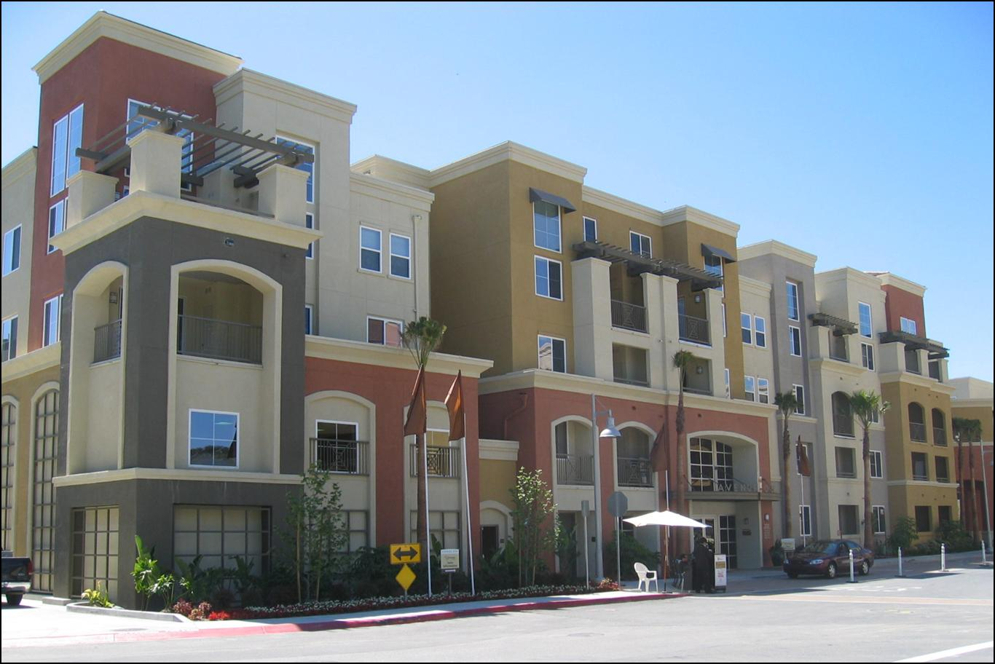
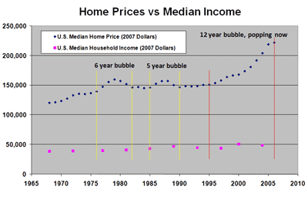
Notes:
Residential property prices began to skyrocket by the mid-1990s. National median property prices increased by more than 45 percent in the decade ending 2007.

Slide 28

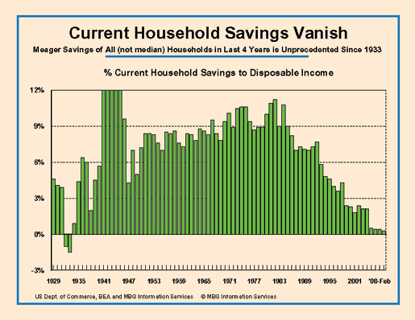
Notes:
Median wages increased by only 10 percent in the same period, and household savings particularly for potential first-time homebuyers was often insufficient to meet minimum requirements for a cash down payment and to cover closing costs.

Slide 29

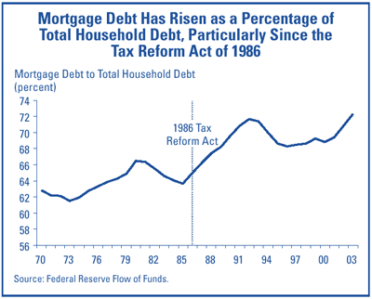
Notes:
Homeowners borrowing for their childrens’ educations, to pay medical bills or to consolidate debt took on 2nd or even 3rd mortgage liens on their primary residence. Some lenders providing financing resulting a combined loan-to-value ratio well above 100%, gambling that property values would continue to climb.

Slide 30

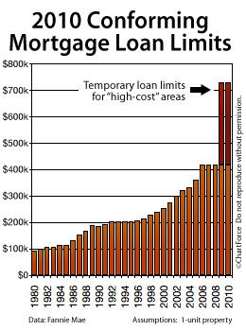
Notes:
As property prices climbed, reflecting the skyrocketing increase in land prices, mortgage investors were financing more and more land and less and less housing. Land-to-total value ratios in many markets consistently exceeded 50 percent.

Slide 31
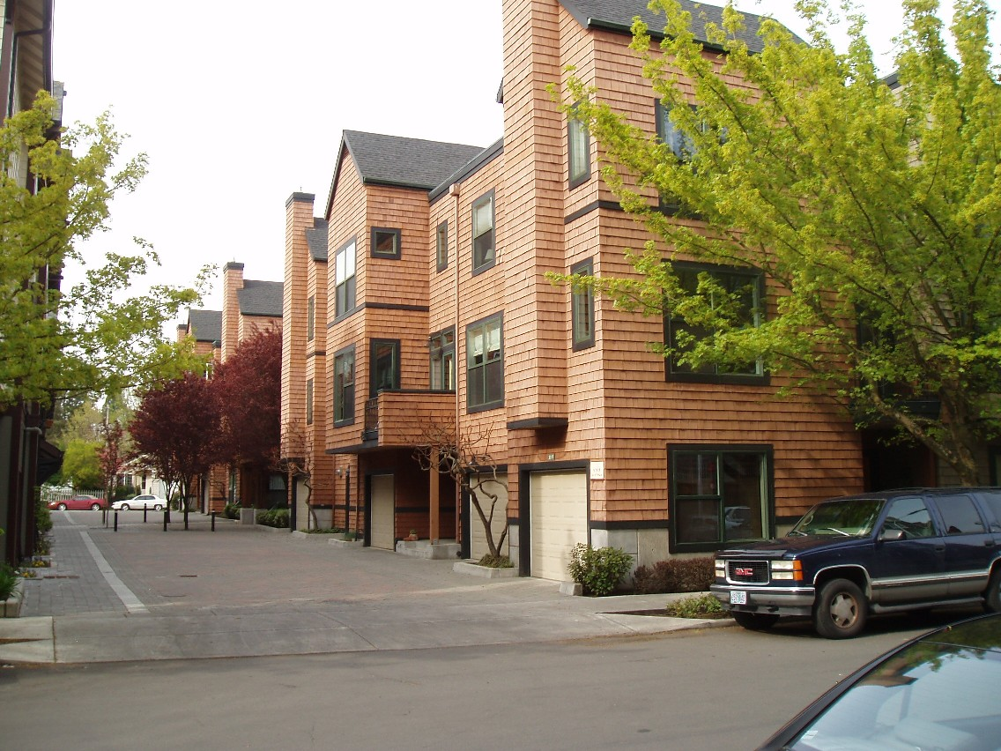
Notes:
Existing residential properties in the most highly speculative markets (e.g., Manhattan, Boston, or Washington, D.C.) frequently involved land valued as high as 80-85% of the total price.

Slide 32
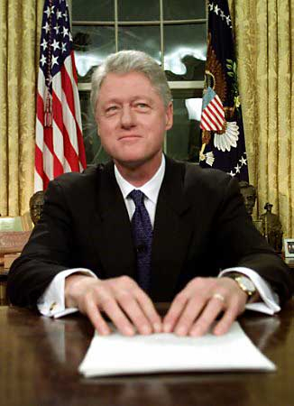
Notes:
As William Jefferson Clinton looked back over his eight years in the Presidency, he provided his own assessment of what was accomplished:

Slide 33

“Working together, America has done well. Our economy is breaking records with more than 22 million new jobs, the lowest unemployment in 30 years, the highest homeownership ever, the longest expansion in history. …More than 3 million children have health insurance now, and more than 7 million Americans have been lifted out of poverty. Incomes are rising across the board.”
Notes:
“Working together, America has done well. Our economy is breaking records with more than 22 million new jobs, the lowest unemployment in 30 years, the highest homeownership ever, the longest expansion in history. …More than 3 million children have health insurance now, and more than 7 million Americans have been lifted out of poverty. Incomes are rising across the board.”

Slide 34
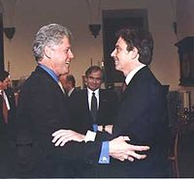
Notes:
34
As I have shown, Clinton’s ‘Third Way’ yielded far less impressive results than he promised, or claimed to have delivered.

Slide 35
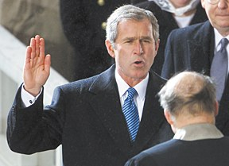
Notes:
Episode 5 takes us through the second Bush presidency and his legacy of stimulating a prolonged and deepening depression, a skyrocketing national debt, and a nation at risk of societal breakdown.

Slide 36
End of Episode 4

